Slide 1


RoboSub Competition
（International Autonomous Underwater Vehicle Competition）
(IAUVC)
Lantao Xie
Zhejiang University
3090101519@zju.edu.cn
2011.12.26

Slide 2
RoboSub Competition
一、赛事简介
二、2011年赛事详解
三、历年参赛队伍统计
四、获奖队简介
五、2012参赛须知

Slide 3
RoboSub Competition
一、赛事简介
国际水下机器人竞赛(IAUVC)是由国际无人系统联合会AUVSI和美国海军装备研究中心ONR共同主办的国际水下机器人最高级别赛事。迄今已成功举办十四届（1998-2011），历届参赛队伍均为世界各国顶级高校，如麻省理工学院、哥伦比亚大学、康奈尔大学、日本东京大学、多伦多大学等。竞赛主要项目包括水下自主机器人完成过门，巡线、撞球、射门、抓取目标物，以及水声定位等。

Slide 4
RoboSub Competition
一、赛事简介
The goals of the AUVSI student competitions are to provide opportunities for students to experience the
challenges of system engineering, to develop skill in accomplishing realistic missions with autonomous vehicles and to foster relationships between young engineers and the organizations developing and producing
autonomous vehicle technologies.

Slide 5

RoboSub Competition
二、2011年赛事详解

Slide 6
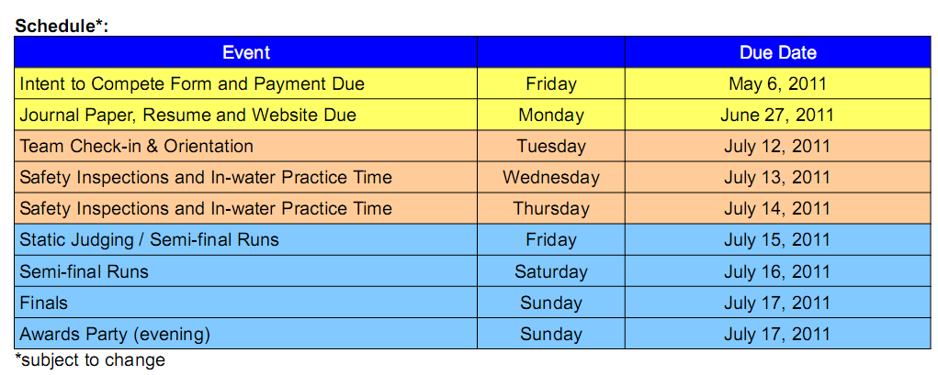
RoboSub Competition
二、2011年赛事详解

Slide 7
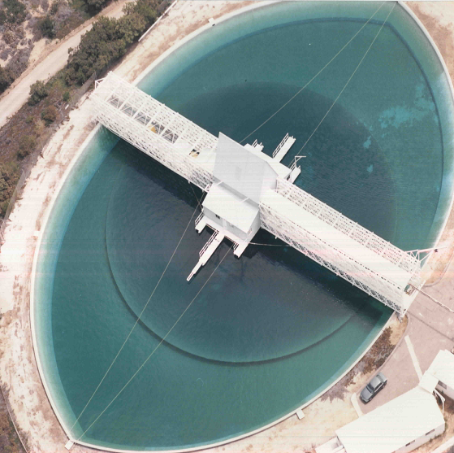
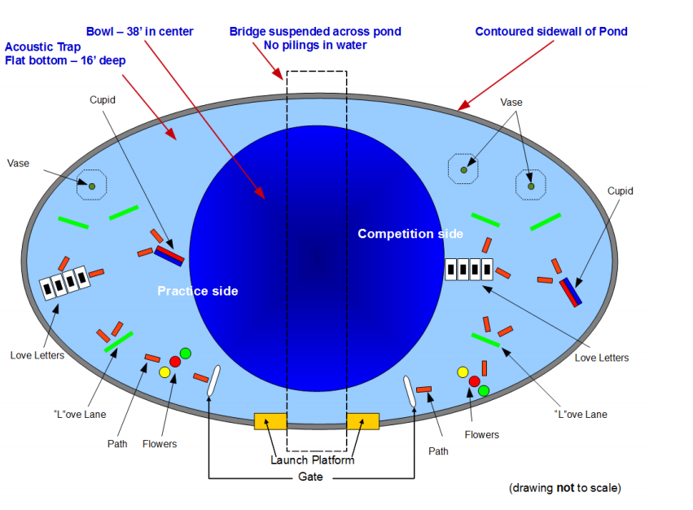
RoboSub Competition
二、2011年赛事详解

Slide 8
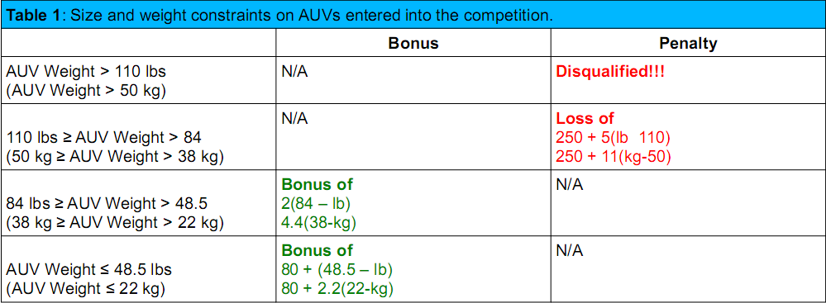

RoboSub Competition
二、2011年赛事详解

Slide 9
RoboSub Competition
二、2011年赛事详解

Slide 10
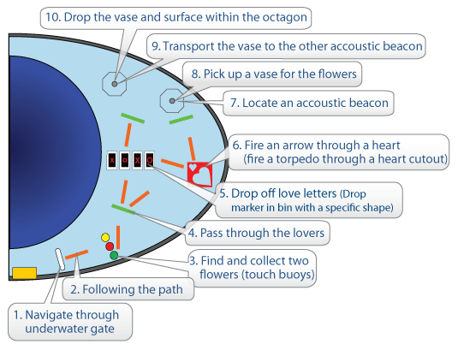
RoboSub Competition
二、2011年赛事详解

Slide 11
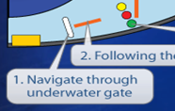
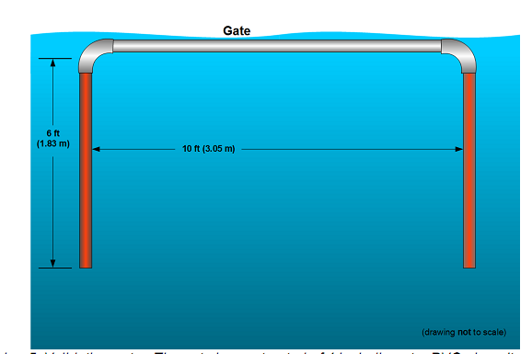
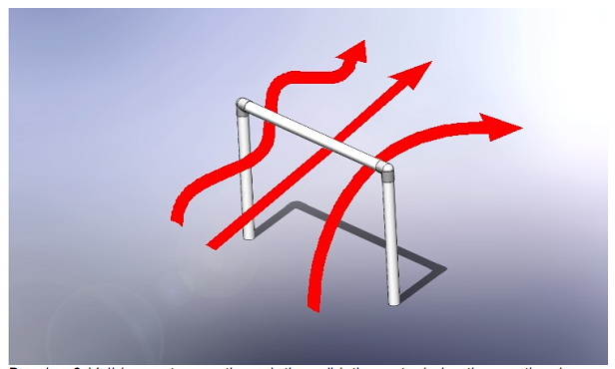
RoboSub Competition
二、2011年赛事详解

Slide 12
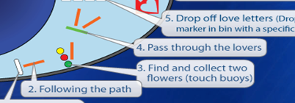
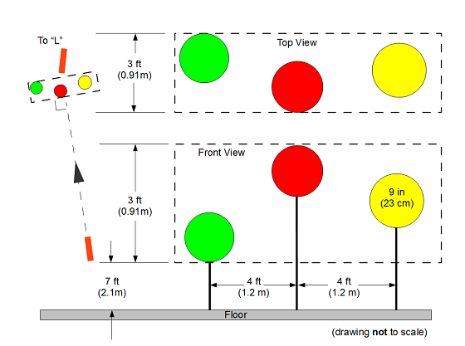
RoboSub Competition
二、2011年赛事详解

Slide 13

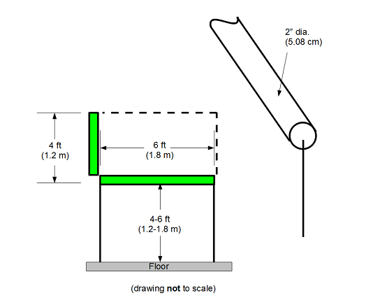
RoboSub Competition
二、2011年赛事详解

Slide 14
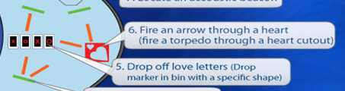
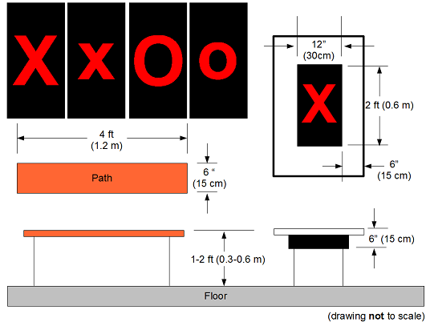
RoboSub Competition
二、2011年赛事详解
Marker:

Slide 15
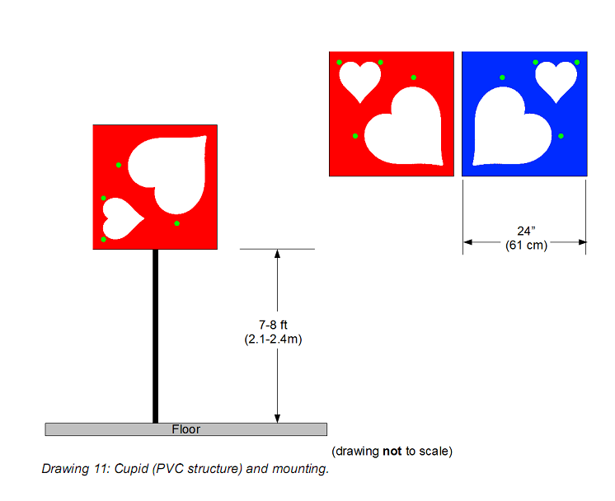
RoboSub Competition
二、2011年赛事详解
Torpedo:

Slide 16

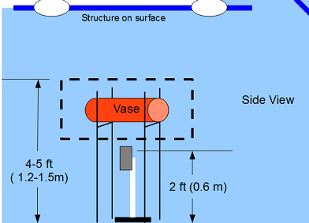
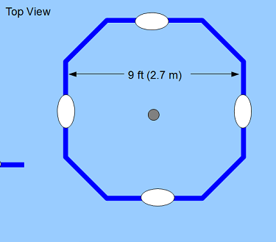
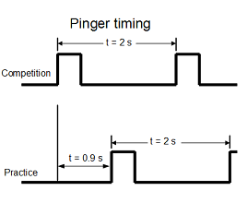
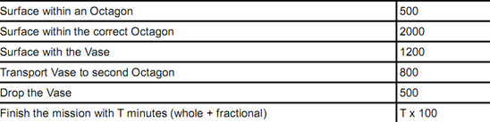
RoboSub Competition
二、2011年赛事详解

Slide 17
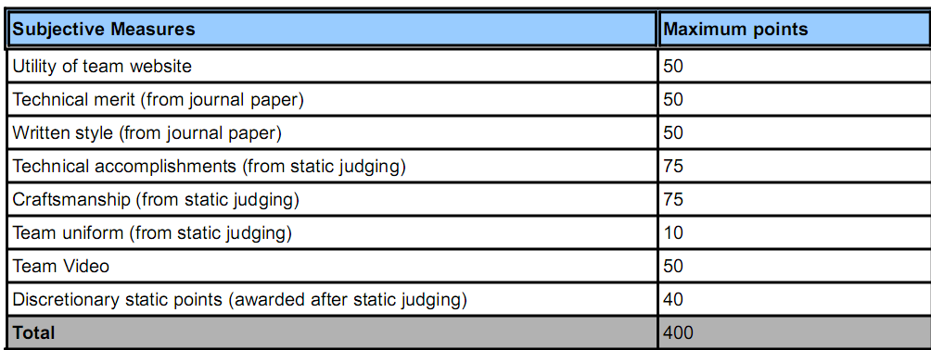
RoboSub Competition
二、2011年赛事详解

Slide 18
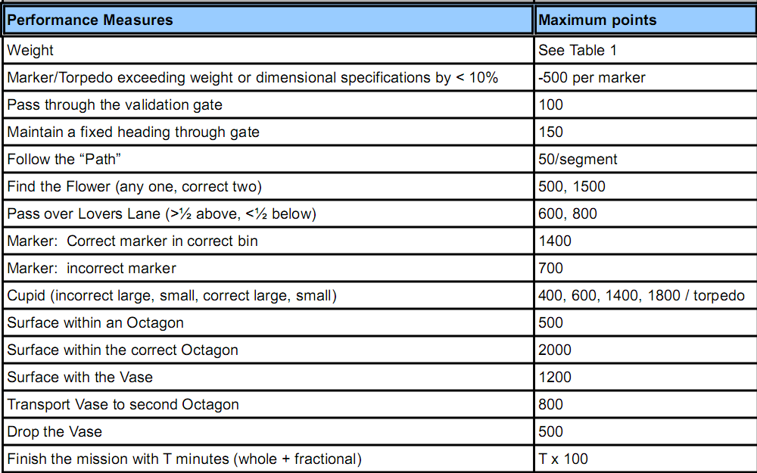
RoboSub Competition

Slide 19
RoboSub Competition
二、2011年赛事详解
几点重要规则：
1.比赛过程中，vehicle必须完全自主,且不能浮出水面，否则失去比赛资格。
2.参赛队可由undergraduate和graduate学生组成，但full-time student要
占至少75%。
3.3-5队能参加决赛
4.20min比赛时间，其中5分钟时间准备。
5.不交Journal Paper的取消资格
对于vehicle，Jornal Paper还有更细致的要求

Slide 20
RoboSub Competition
二、2011年赛事详解
1st Place: ETS Team SONIA (awarded $7,000)
2nd Place : Cornell University (awarded $4000)
3rd Place: University of Florida (awarded $3,000)
4th Place : Reykjavik University (awarded $2,000)
5th Place: University of Maryland (awarded $500)
6th Place: University of Rhode Island ($500)
7th Place: United States Naval Academy
8th Place: NC State

Slide 21
RoboSub Competition
三、历年参赛队伍统计
2008 | 2009 | 2010 | 2011
University of Maryland | Cornell University | Cornell | ETS Team SONIA
University of Texas at Dallas | University of Victoria | U.S. Naval Academy | Cornell University
école de technologie supérieure | University of Rhode Island | University of Maryland | University of Florida
University of Florida | UCF | ETS | Reykjavik University
United States Naval Academy | U Texas @ Dallas | Amador Valley High School | University of Maryland
University of Victoria | USC | University of Texas at Dallas | University of Rhode Island
Cornell University | FAU | Kyushu Institute of Technology | United States Naval Academy
Florida Atlantic University | U Maryland |  | NC State
Delhi College of Engineering | Kyushu Institute of Tech
San Diego City College | ETS

Slide 22
University of Florida
RoboSub Competition
四、获奖队简介
1.ETS Team SONIA
2.Cornell University

Slide 23
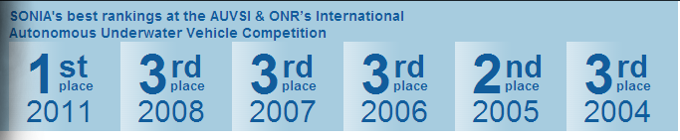
RoboSub Competition
四、获奖队简介-ETS Team SONIA
The SONIA AUV project from the École de technologie supérieure, entirely composed of volunteer, undergraduate engineering students, is devoted to the development of an Autonomous Underwater Vehicle (AUV).

Slide 24
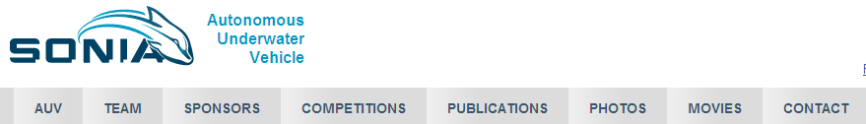
RoboSub Competition
四、获奖队简介-ETS Team SONIA
Since our beginning in 1999, we have developed 7 AUV prototypes with the goal of competing at the AUVSI and ONR's International Autonomous Underwater Vehicle Competition. Recent years have seen us consistently ranking in the top 3 positions with our award winning designs.

Slide 25
RoboSub Competition
四、获奖队简介-ETS Team SONIA
team有2000-2011各届人员配置及联系方式
publications可下载2000-2011各届SONIA的参赛潜艇设计FTP（已下载）
competitions有2003-2011各届赛事概况（已下载整理）
网站还有各种照片视频等信息

Slide 26
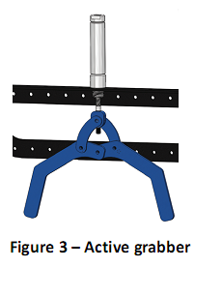
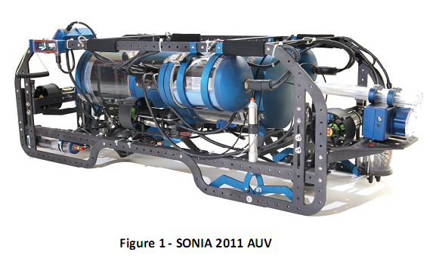
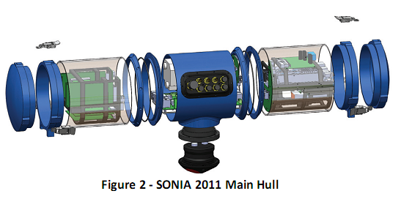
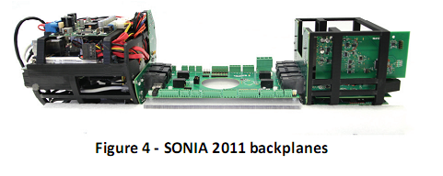
RoboSub Competition
四、获奖队简介-ETS Team SONIA

Slide 27

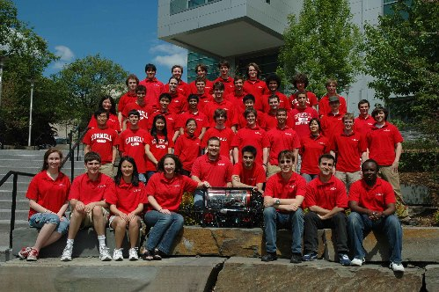
RoboSub Competition
四、获奖队简介-Cornell University
网站内容无太大区别
关于该工程组制作的参赛潜艇有更多的技术细节（详见见CUAUV文件夹）

Slide 28
RoboSub Competition
四、获奖队简介-Cornell University
One of our team's objectives is the AUVSI/ONR Underwater Vehicle competition, held each year in San Diego, California. We are a long time competitor and have a tradition of excellence. Our 2010 competition vehicle, Tachyon, took first place out of 27 international teams at the competition this past summer. While our team has placed in the top ten every year, this past year was the third time that we've won the overall competition. The team has also placed 1st in technical design for the last nine years.

Slide 29
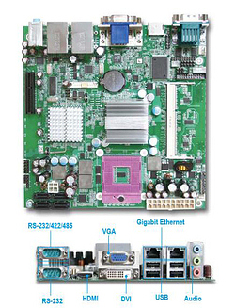
RoboSub Competition
四、获奖队简介-Cornell University
Tachyon's onboard computer is comprised of a Portwell WADE-8067 low power embedded Mini-ITX motherboard, an Intel Core 2 Extreme QX9300 quad core processor, 4GB of RAM, and an Intel X25-E Extreme 32GB solid state drive. This provides more than enough computing power for all mission, machine vision, and control processing tasks. A PCI Express expansion card is used to provide 3 IEEE1394 ports for the vehicle's cameras. The computer runs a minimalist installation of Debian GNU/Linux. Communication with all external sensor and actuator boards is routed through a custom serial interface board.

Slide 30
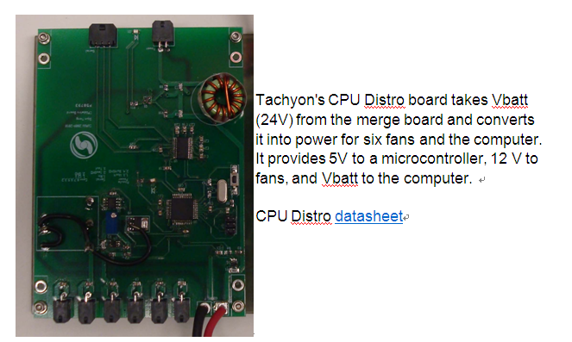
RoboSub Competition
四、获奖队简介-Cornell University

Slide 31
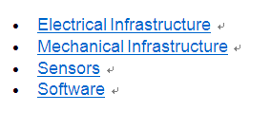
RoboSub Competition
四、获奖队简介-Cornell University

Slide 32
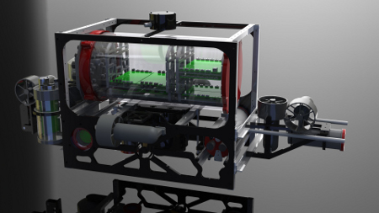
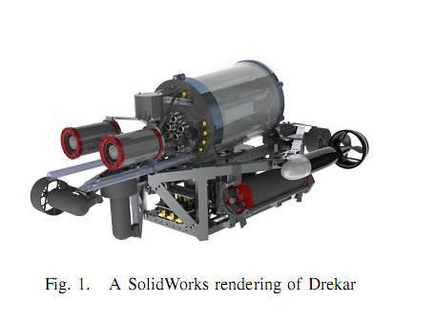
RoboSub Competition
四、获奖队简介-Cornell University

Slide 33
RoboSub Competition
六、2012参赛须知
AUVSI Foundation and ONR's 15th International RoboSub Competition July 17-22, 2012 SSC Pacific TRANSDEC, San Diego, CA
Submission Deadline: April 1, 2012
Resumes, Websites, Papers, Static Judging Materials and Team Rosters

