Slide 1

Agile – SCRUM
NOT A Methodology, But A new Way Of Thinking

Slide 2












SCRUM OVERVIEW
Requirements
Product Backlog
Sprint Planning
Sprint
Sprint Review
Sprint Retrospective

Slide 3
Requirements For The Product Backlog
Feature
Epic
User Story
User Story
Epic
User Story
User Story
Task
Task
Task
Task
Task
Task
Task
Task

Slide 4
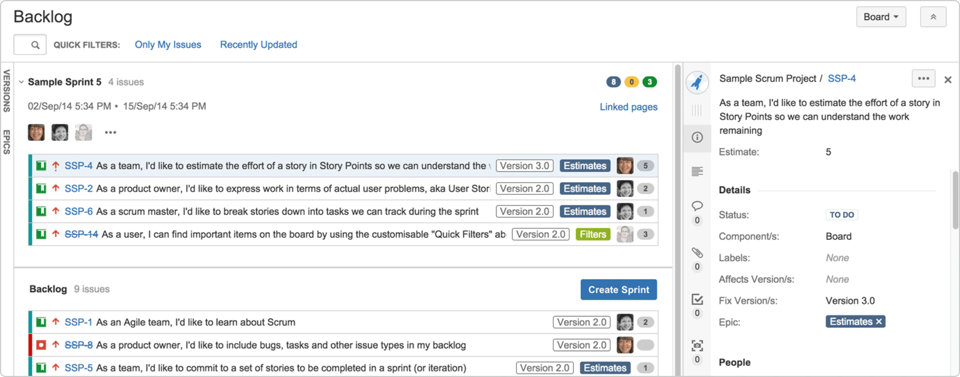
Product Backlog

Slide 5

Sprint Planning
SPRINT BACKLOG
BACKLOG
Discuss Goal(s) For Sprint & Strategize

Slide 6
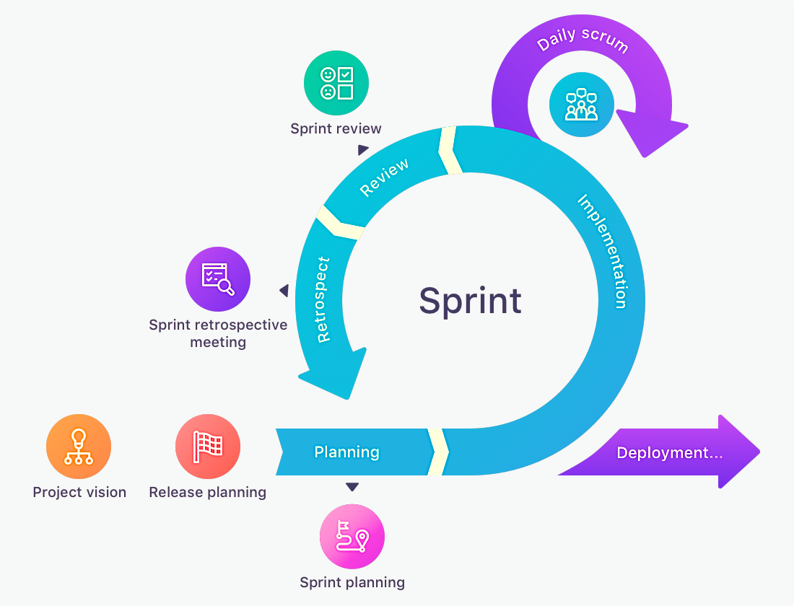
Sprint

Slide 7



Sprint Review

Slide 8

Sprint Retrospective
Burndown Chart
What Went Well
What Did Not Go So Well
Improvements

Slide 9








Requirements For The Product Backlog
MONTHS
Feature
Epic
User Story
User Story
Epic
User Story
User Story
WEEKS
DAYS
Task
Task
Task
Task
Task
HOURS
Task
Task
Task

Slide 10
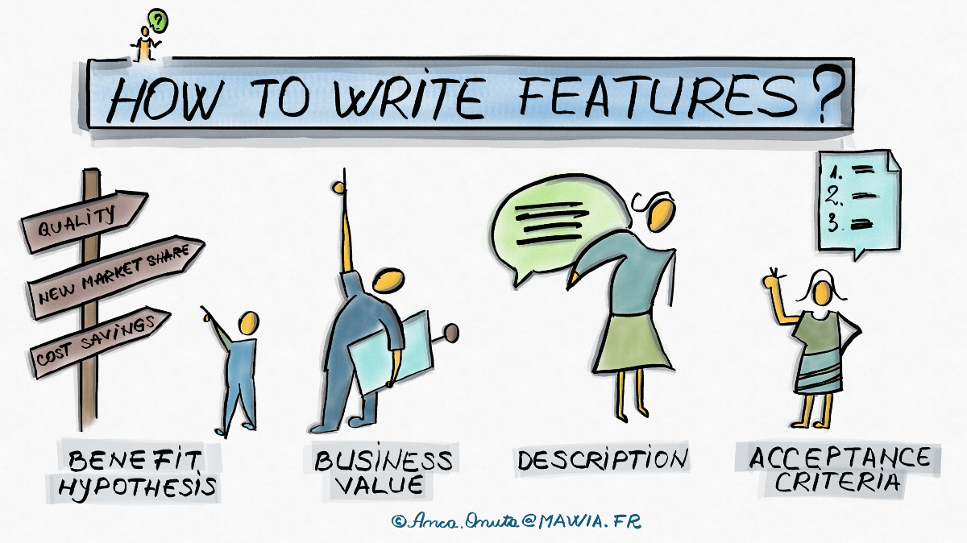
Feature
Define The Benefit Hypothesis
The “Why” Component
The Parts Of The Product That Bring Significant Value To Its Users
Capabilities That The Customers / Stakeholders Will Have That They Did Not Have Before
Service That Fulfills The Customers / Stakeholders Need

Slide 11
Epics
Epic
Epics refer to the large user stories that can be broken down into two or more stories of smaller size
Epics refer to high level business requirements used to track large ideas in a product backlog
Epics are too big and complex to be delivered in a single sprint
Series Of Actions Related To The Feature
The Next Stage In Breaking Features Into Actionable Requirements
An Epic Is Smaller Than The Feature But Bigger Than The Integrations

Slide 12
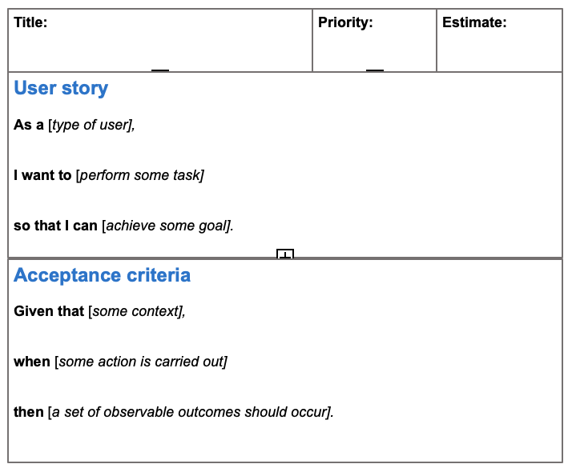
User Stories
The Smallest Forms Of Requirements That Can Stand On Their Own
Consists Of One Action Of Value Or One Integration Of Value
User Stories Are Small Enough To Add To Sprints And Begin Developing.

Slide 13
Task
The Steps Needed To Implement The User Story
Break The User Story Down Into Tasks
X
Y
Z

Slide 14
Physics
I am going to introduce how physics has a relation to our success as a TEAM!
First, we need to understand that although we may consider the velocity at which we can accomplish our goals in a sprint, this is not our focus.
Our focus needs to be surrounded around the magnitude of the work we are producing during the sprint. For example, a person driving a street bike at 65mph and a Semi doing the same. The street-bike can only produce so much work due to its Force being substantially lower than that of the semi.
We recognize that our team’s output is our work and the ability to produce our work during a sprint is our power.
This is how we gain power as a team. Instead of focusing on the speed that we can achieve our goal. We need to focus on the magnitude of our work.
Acceleration ‘a’ = ∆v/∆t
Velocity ‘v’ = V1 + ( ‘a’ * ‘t’ ) = ∆x/∆t
Mass ‘m’ = weight * ’a’
Force ‘F’ = ‘m’ * ‘a’
Work ‘J’ = ‘F’ * distance
Power ‘W’ = ‘F’ * ‘v’
Magnitude ‘P’ = ’m’ * ‘v’

Slide 15

Thank You
Jonathan C. Sanchez
GitHub: Link To 70 of My Repositories
Email:
jcsanchez@lanl.gov

