Slide 1
Solution Uplift Measurement

Slide 2
Estimator Variance Reduction in Random Experiments
Is customer matching a good idea for this?
Stratified sampling (NetFlix)
Inverse Probability Weighting by Propensity Score
CUPED (Microsoft)
Weight by customer variance estimate (FaceBook)
Include customer features in regression uplift model (TripAdvisor)
CUPAC (Control Using Predictions As Covariates) (DoorDash)

Slide 3
Potential Uplift Models
Separately for each solution: uplift = change in mean response between test (target) and holdout (control). Groups could be matched or unmatched. Note that this is a specific case of model 2 (below), with only features the intercept and a single binary treatment indicator (see appendix I for more info.).
Simultaneous estimation of solution effects (all solutions in 1 model) using linear model (could include customer features in model to reduce noise due to mismatched customers). Test/holdout groups can be matched or unmatched. This is a natural extension of model 1 (above).

Slide 4

Uplift Model: Simultaneous estimation of solution effects
$$y=β_{0}+{γ_{1}X}_{solution1}+{γ_{2}X}_{solution2}+…+{β_{1}X}_{1}+{β_{2}X}_{2}+…$$
solution effects
customer feature effects
Inclusion of customer feature effects accounts for any imbalances between the groups

Slide 5
References
Title | URL
Unbiased variance reduction in randomized experiments | 1904.03817.pdf (arxiv.org)
Variance reduction in randomised trials by inverse probability weighting using the propensity score | https://onlinelibrary.wiley.com/doi/full/10.1002/sim.5991
MATCHIT: Nonparametric Preprocessing for Parametric Causal Inference | https://r.iq.harvard.edu/docs/matchit/2.4-20/
(FaceBook) Increasing the sensitivity of A/B tests by utilizing the variance estimates of experimental units | https://research.fb.com/blog/2020/10/increasing-the-sensitivity-of-a-b-tests-by-utilizing-the-variance-estimates-of-experimental-units/
Reducing A/B test measurement variance by 30%+ | https://www.tripadvisor.com/engineering/reducing-a-b-test-measurement-variance-by-30/
Genetic Matching for Estimating Causal Effects: A General Multivariate Matching Method for Achieving Balance in Observational Studies | http://sekhon.berkeley.edu/papers/GenMatch.pdf
Reducing the Variance of A/B Tests Using Prior Information | http://www.degeneratestate.org/posts/2018/Jan/04/reducing-the-variance-of-ab-test-using-prior-information/
Having issues with under-powered A/B tests? Try controlling your variability | https://towardsdatascience.com/having-issues-with-under-powered-a-b-tests-try-controlling-your-variability-903748f0aefd
Modern Algorithms for Matching in Observational Studies | https://www.annualreviews.org/doi/pdf/10.1146/annurev-statistics-031219-041058
Improving Experimental Power through Control Using Predictions as Covariate (CUPAC) | https://doordash.engineering/2020/06/08/improving-experimental-power-through-control-using-predictions-as-covariate-cupac/
Improving the Sensitivity of Online Controlled Experiments by Utilizing Pre-Experiment Data (CUPED) | https://exp-platform.com/Documents/2013-02-CUPED-ImprovingSensitivityOfControlledExperiments.pdf

Slide 6
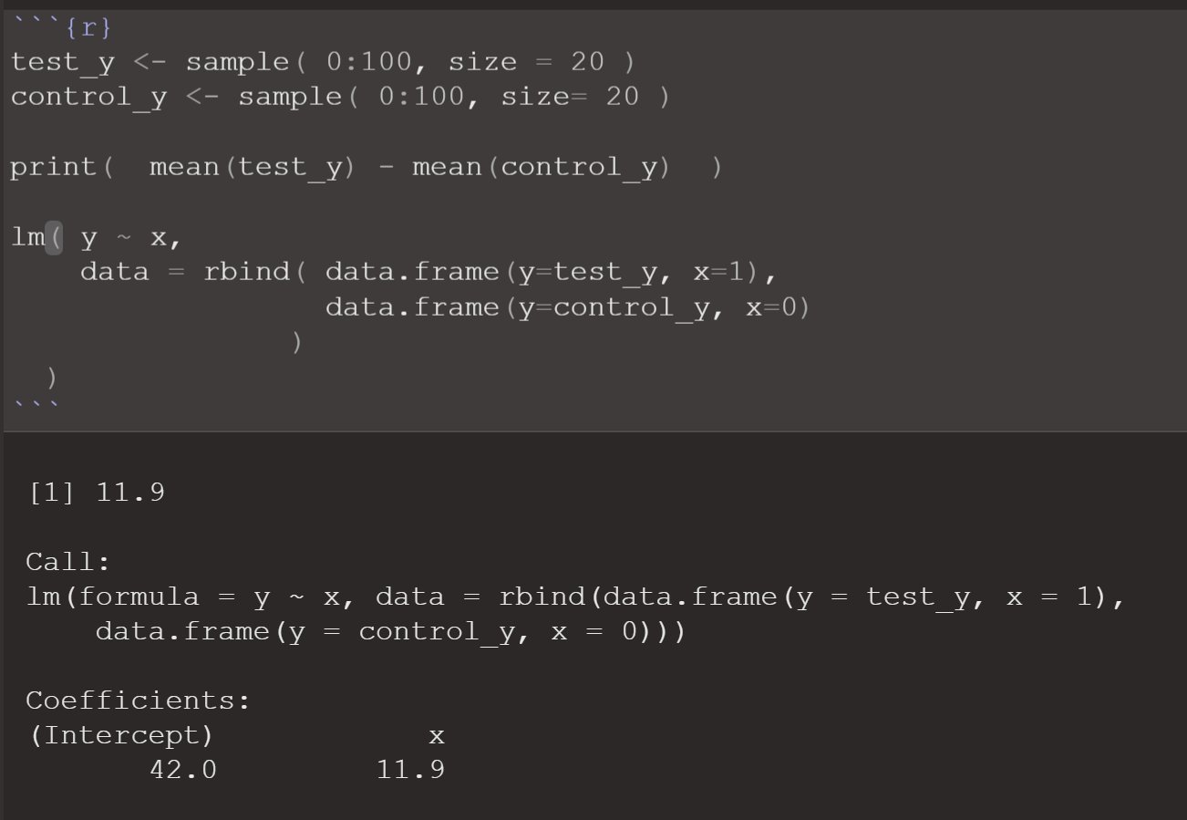
Appendix I

