Slide 2
Example Ratings Matrices
Implicit Ratings
(observed user behaviour:
click, view, buy etc.)
Explicit Ratings
(direct feedback from user
e.g. movie rating)
 |  |  |  |  |  | ITEM
 |  | 1 | 2 | 3 | 4 | 5 | 6 | 7 | 8 | 9 | 10
 | 1 | 1 |  |  |  | 1 | 1 | 1 |  | 1
 | 2 |  | 1
 | 3 |  |  | 1 | 1
USER | 4 |  |  |  |  | 1 | 1 | 1 |  |  | 1
 | 5 |  | 1 |  | 1
 | 6
 | 7 | 1 |  |  |  |  |  |  |  |  | 1
 | 8 |  |  | 1 |  |  |  |  | 1
 |  |  |  |  |  | ITEM
 |  | 1 | 2 | 3 | 4 | 5 | 6 | 7 | 8 | 9 | 10
 | 1 | 5 |  |  |  | 1 | 5 | 2 |  | 1
 | 2 |  | 2
 | 3 |  |  | 3 | 1
USER | 4 |  |  |  |  | 4 | 1 | 5 |  |  | 1
 | 5 |  | 1 |  | 5
 | 6
 | 7 | 5 |  |  |  |  |  |  |  |  | 1
 | 8 |  |  | 3 |  |  |  |  | 5

Slide 3
Title

Slide 4
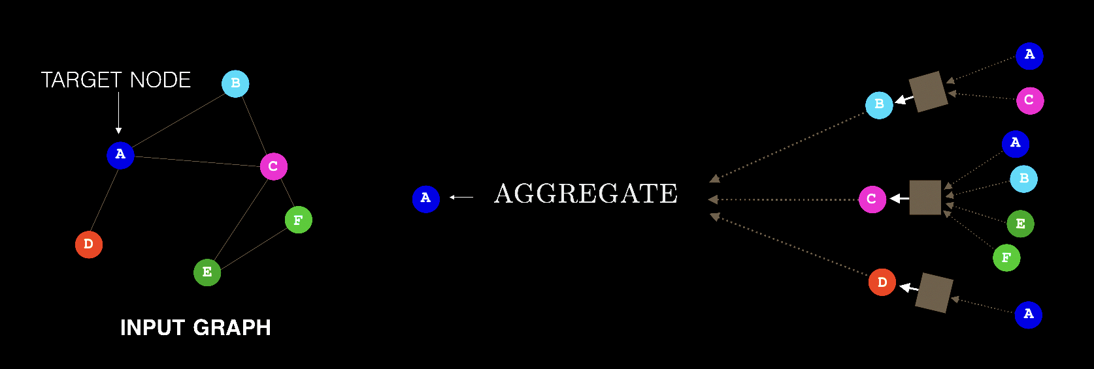
GNN message passing
AGGREGATE

Slide 5
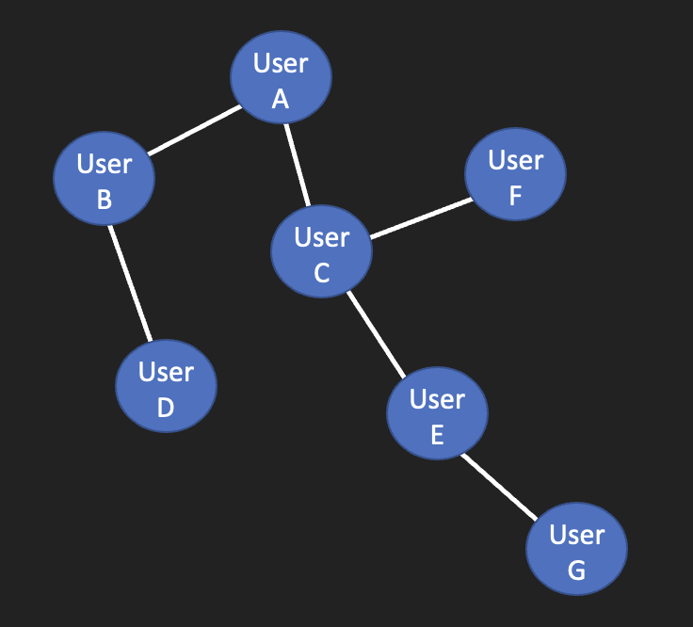
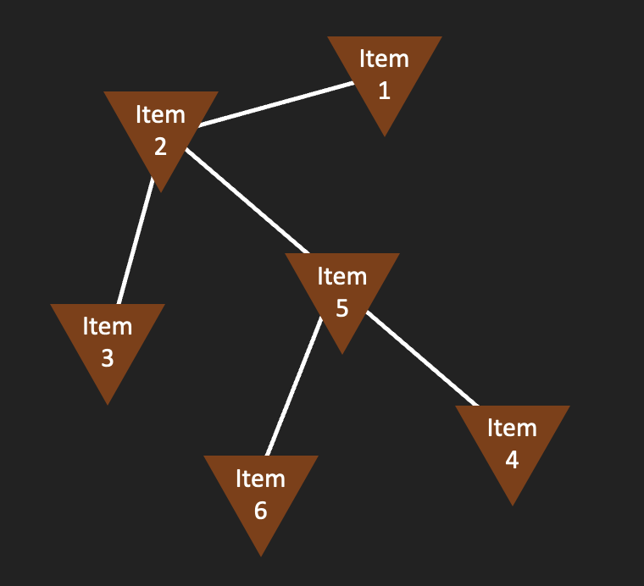
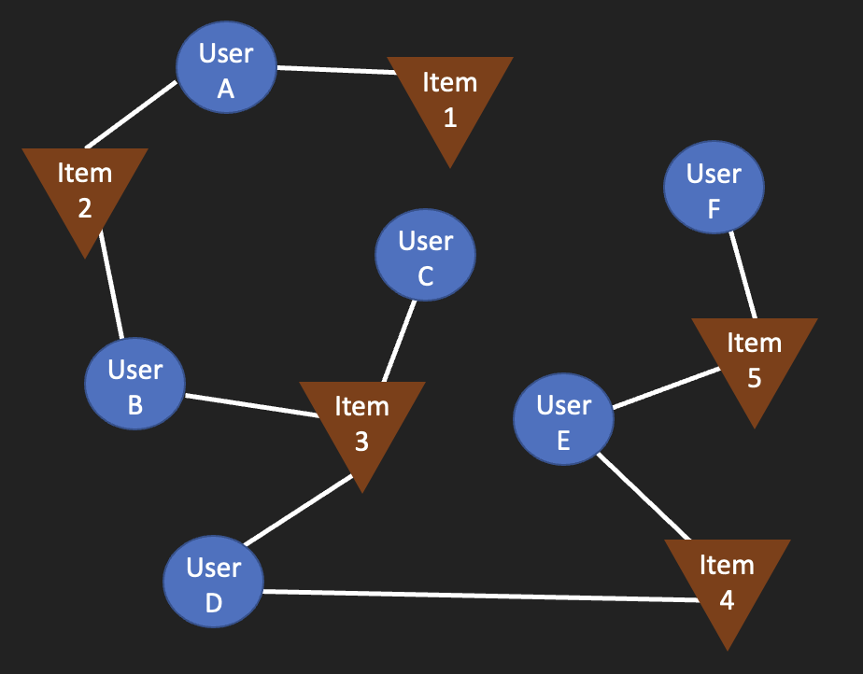
Different kinds of graph representations
User/Item Graph User/User Graph Item/Item Graph

Slide 6
Multi Armed Bandit Example
Decision
A
B
C
D
Higher value decision
Lower value decision
Iteration Number

Slide 7



Matrix Factorization example
user latent factors
item latent factors
(matrix transposed)
low-rank (rank=3) approximation of observed true ratings matrix
 |  |  |  |  |  | ITEM
 |  | 1 | 2 | 3 | 4 | 5 | 6 | 7 | 8 | 9 | 10
 | 1 | 1.7 | 4 | 5.2 | 2 | 3.5 | 3.4 | 1.3 | 1 | 2.2 | 2.7
 | 2 | 0.9 | 3.9 | 4.4 | 3.6 | 3.2 | 3 | 1.8 | 3 | 4.3 | 3.8
 | 3 | 0.5 | 2.7 | 2.4 | 1.2 | 2.2 | 1.6 | 0.8 | 1.1 | 2.2 | 2.2
USER | 4 | 0.6 | 3.3 | 2.5 | 0.8 | 2.7 | 1.7 | 0.7 | 0.8 | 2.3 | 2.5
 | 5 | 0.6 | 2.4 | 3.4 | 3.6 | 2 | 2.3 | 1.6 | 2.9 | 3.5 | 2.8
 | 6 | 1.4 | 4.6 | 5 | 2.5 | 3.9 | 3.3 | 1.5 | 1.8 | 3.5 | 3.6
LATENT USER FACTOR
 |  | 1 | 2 | 3
 | 1 | 1.1 | 0.3 | 1.9
 | 2 | 1.5 | 1.6 | 0.5
 | 3 | 1.3 | 0.3 | 0.4
USER | 4 | 1.7 | 0 | 0.5
 | 5 | 0.7 | 1.8 | 0.2
 | 6 | 1.7 | 0.7 | 1.3
LATENT ITEM FACTOR | ITEM
 |  | 1 | 2 | 3 | 4 | 5 | 6 | 7 | 8 | 9 | 10
 | 1 | 0.1 | 1.6 | 0.9 | 0.3 | 1.3 | 0.6 | 0.3 | 0.5 | 1.3 | 1.3
 | 2 | 0.2 | 0.6 | 1.3 | 1.8 | 0.5 | 0.9 | 0.7 | 1.4 | 1.4 | 1
 | 3 | 0.8 | 1.1 | 2 | 0.6 | 1 | 1.3 | 0.4 | 0 | 0.2 | 0.5
$$×$$
$$=$$
 |  |  |  |  |  | ITEM
 |  | 1 | 2 | 3 | 4 | 5 | 6 | 7 | 8 | 9 | 10
 | 1 | 2 |  | 5 |  |  | 3 | 1
 | 2 |  | 4 | 4 | 4 |  |  |  | 3
 | 3 |  |  |  |  |  | 2 | 1 | 1 | 2
USER | 4 |  | 3 |  | 1 |  | 2 | 1 |  | 2 | 2
 | 5 |  |  |  |  | 2 |  | 2 |  | 3
 | 6 |  |  | 5 | 3 |  |  | 2 | 2
$$≈$$
(partially) observed true ratings matrix

Slide 8
Novelty vs. Serendipity
Novel
Serendipitous
Items never seen before, but are obvious/ unsurprising
Items never seen before that are surprising/unexpected
Items seen before, but are surprising/unexpected

Slide 9
User-User Collaborative Filtering
 |  |  |  |  |  | ITEM
 |  | 1 | 2 | 3 | 4 | 5 | 6 | 7 | 8 | 9 | 10
 | 1 | 5 |  |  |  | 4 | 2 | 5 |  | 1
 | 2 |  | 2
 | 3 |  |  | 3 | 1
USER | 4 | 4 |  |  |  | 4 | ? | 5 |  |  | 1
 | 5 |  | 1 |  | 5
 | 6
 | 7 | ? |  |  |  | 5 | 2 | 4 |  |  | 1
 | 8 |  |  | 3 |  |  |  |  | 5
 |  |  |  |  |  | ITEM
 |  | 1 | 2 | 3 | 4 | 5 | 6 | 7 | 8 | 9 | 10
 | 1 | 5 |  |  |  | 4 | 2 | 5 |  | 1
 | 2 |  | 2
 | 3 |  |  | 3 | 1
USER | 4 | 4 |  |  |  | 4 | 2 | 5 |  |  | 1
 | 5 |  | 1 |  | 5
 | 6
 | 7 | 4.5 |  |  |  | 5 | 2 | 4 |  |  | 1
 | 8 |  |  | 3 |  |  |  |  | 5

Slide 10
Item-Item Collaborative Filtering
 |  |  |  |  |  | ITEM
 |  | 1 | 2 | 3 | 4 | 5 | 6 | 7 | 8 | 9 | 10
 | 1 | 5 |  | 2 |  | 4 | 5 | 1 |  | 2
 | 2 |  | 2 | 1 |  | 5 |  | 2 |  | 2
 | 3 |  |  | 3 | 1 | 1 |  | ? |  | 3
USER | 4 |  |  | ? |  | 4 | 1 | 4 |  | 4 | 1
 | 5 |  | 1 |  | 5
 | 6
 | 7 | 5 |  | 5 |  | 1 |  | 5 |  | 5 | 1
 | 8 |  |  | 3 |  | 1 |  | ? |  | 4
 |  |  |  |  |  | ITEM
 |  | 1 | 2 | 3 | 4 | 5 | 6 | 7 | 8 | 9 | 10
 | 1 | 5 |  | 2 |  | 4 | 5 | 1 |  | 2
 | 2 |  | 2 | 1 |  | 5 |  | 2 |  | 2
 | 3 |  |  | 3 | 1 | 1 |  | 3 |  | 3
USER | 4 |  |  | 4 |  | 4 | 1 | 4 |  | 4 | 1
 | 5 |  | 1 |  | 5
 | 6
 | 7 | 5 |  | 5 |  | 1 |  | 5 |  | 5 | 1
 | 8 |  |  | 3 |  | 1 |  | 3.5 |  | 4

Slide 11
User-Item Graph
User
A
Item
1
- Edges are only present between a user and an item (no user-user or item-item edges)
- Edges represent user interaction with an item (click, view, buy, rate etc.)
Item
2
User
F
User
C
Item
5
User
B
Item
3
User
E
User
D
Item
4

Slide 12
Item-Item Graph
Item
1
- Graph contains only items (no users)
- Edges represent similarity between items
Item
2
Item
5
Item
3
Item
4
Item
6

Slide 13
User-User Graph
User
A
- Graph contains only users (no items)
- Edges represent similarity between users
User
B
User
F
User
C
User
D
User
E
User
G

Slide 14

Wide & Deep
$$\hat{y}=f\left({w_{deep}^{T}a^{(l)}+ w}_{wide}^{T}\left[x,ϕ\left(x\right)\right]+b\right)$$
Neural Network
∪
Concatenate
φ
Feature Crossing
learn embeddings
continuous features
categorical features

Slide 15
2 Tower Model
Score (output)
o
x
dot product
User Embedding
Item Embedding
Neural Network
Neural Network
User Features
Item Features

