Slide 1

A Guideline-Informed AI Agent
for Empiric Antibiotic Decision Support in the ICU
[Team 5] Minso Kim, Soyoung Park, Taewon Jung, Jisu Ha, Seungmin Lee, Woojin Kim
Notes:
안녕하세요, 5팀입니다. 저희는 중환자실에서 경험적 항생제 처방을 가이드라인에 근거해 지원하는 AI 에이전트를 주제로 발표하겠습니다.

Slide 2

Contents
Members
Background
Method
Result
Limitation
Discussion
Conclusion
02
Notes:
발표는 팀 소개와 연구 배경, 방법, 결과, 그리고 한계와 결론 순서로 진행하겠습니다.

Slide 3





Members
3 Technicians ∩ 3 Clinicians
“It runs fine
on my GPU.”
“…but at 3 a.m.
in the ICU?”
Technicians
Clinicians
Minso Kim
Seungmin Lee
Neurologist
Team 5
Soyoung Park
Jisu Ha
ICU nurse, > 10 yrs
Taewon Jung
Woojin Kim
ICU nurse
sepsis · antibiotics · guidelines · bedside
Code × Care = an antibiotic AI agent clinicians may trust
03
Notes:
저희 팀은 데이터와 모델을 다루는 기술팀 세 명과, ICU 간호사 두 분, 신경과 의사 한 분으로 이루어진 임상팀 세 명이 함께했습니다. 기술 쪽 시각과 임상 쪽 질문 사이의 간극을 줄이는 것이 이번 프로젝트의 출발점이었습니다.

Slide 4
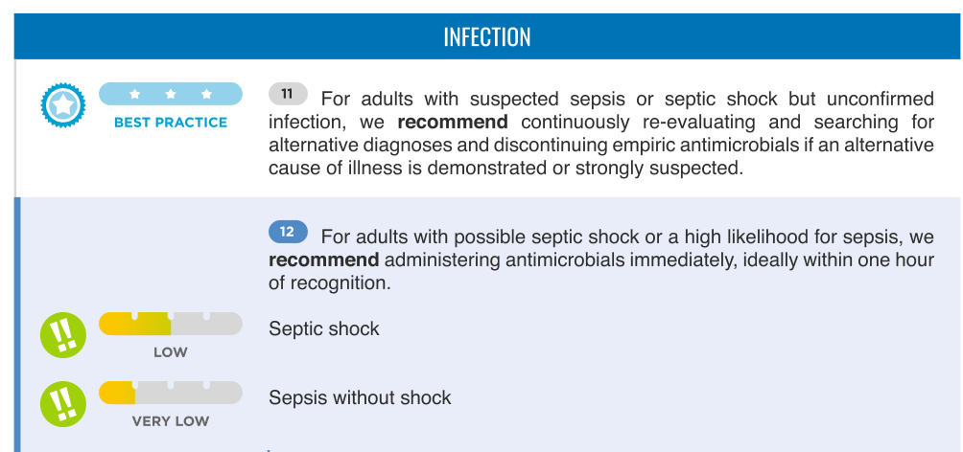
Background
Empirical Antibiotic Therapy
Definition [1]
Why it matters [2, 3]
Antibiotics started before the pathogen is identified
≤ 1 h
antimicrobials for possible septic shock / high likelihood of sepsis
pathogen unknown
pathogen identified
Suspected infection
Empiric antibiotics
Culture results
Targeted / de-escalation
Surviving Sepsis Campaign 2021 [2]
Timely
early treatment in severe infection
Appropriate
source · pathogen · severity
1
2
Not excessive
adverse events · resistance
Reassessed
de-escalate with cultures
3
4
High-stakes decision under uncertainty
→ guideline-concordant choice matters
Table 1 (excerpt), Evans et al., Intensive Care Med 2021 [2]
04
[1] Rhodes A, Evans LE, Alhazzani W, Levy MM, Antonelli M, Ferrer R, et al. Surviving Sepsis Campaign: international guidelines for management of sepsis and septic shock: 2016. Intensive Care Med. 2017;43(3):304-77. doi:10.1007/s00134-017-4683-6.
[2] Evans L, Rhodes A, Alhazzani W, Antonelli M, Coopersmith CM, French C, et al. Surviving Sepsis Campaign: international guidelines for management of sepsis and septic shock 2021. Intensive Care Med. 2021;47(11):1181-247. doi:10.1007/s00134-021-06506-y. Table 1 (excerpt), CC BY-NC 4.0.
[3] Tamma PD, Bonomo RA, Heil EL, Justo JA, Satlin MJ, Mathers AJ. Infectious Diseases Society of America 2026 guidance on the treatment of antimicrobial-resistant gram-negative infections. Clin Infect Dis. 2026. doi:10.1093/cid/ciag481.
Notes:
먼저 배경입니다. 경험적 항생제는 원인균이 확인되기 전, 감염이 의심되는 시점에 시작하는 항생제입니다. 특히 패혈증에서는 시간이 중요해서, Surviving Sepsis Campaign 2021은 패혈성 쇼크가 의심되면 1시간 이내 투여를 권고합니다. 동시에 불필요한 광범위 항생제는 부작용과 내성을 늘리기 때문에, 정보가 부족한 상황에서 가이드라인에 맞는 선택을 하는 것이 핵심입니다.

Slide 5
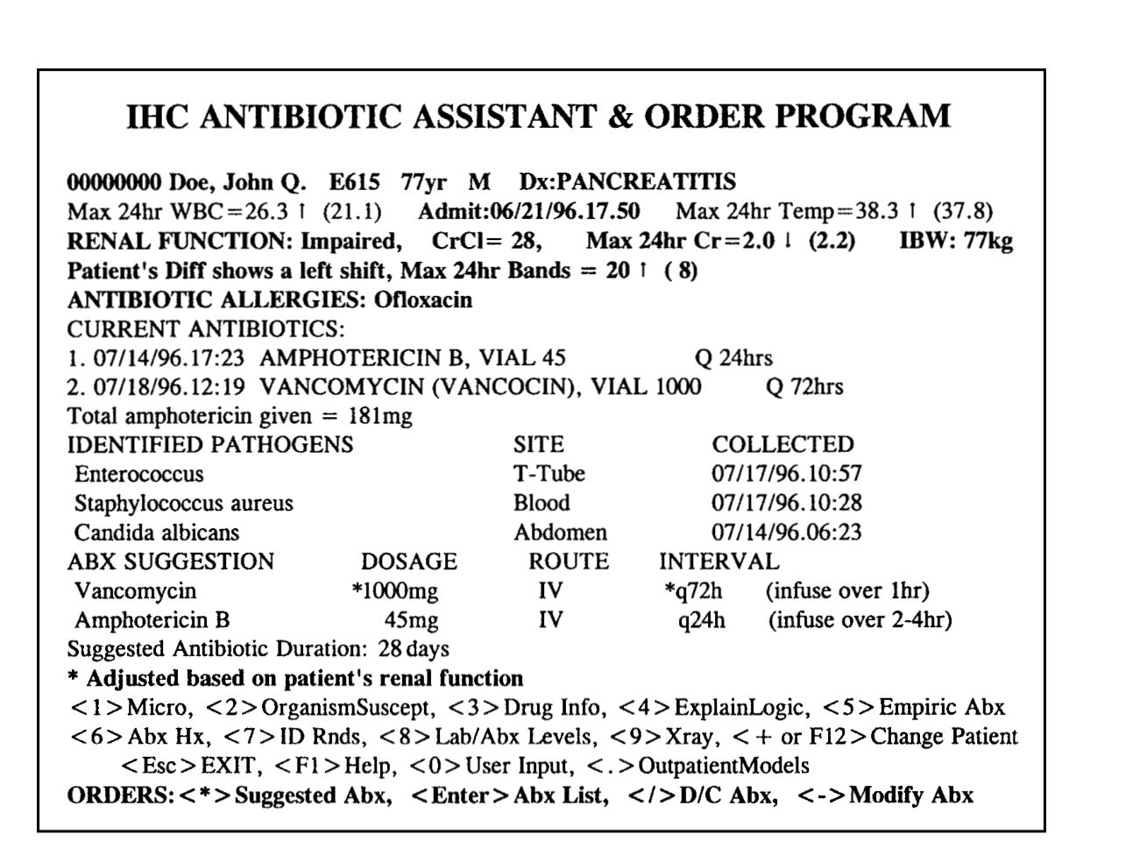
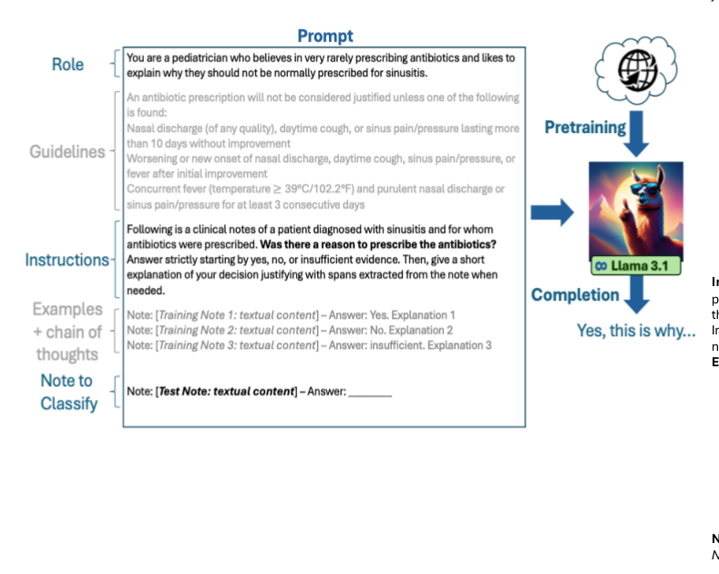
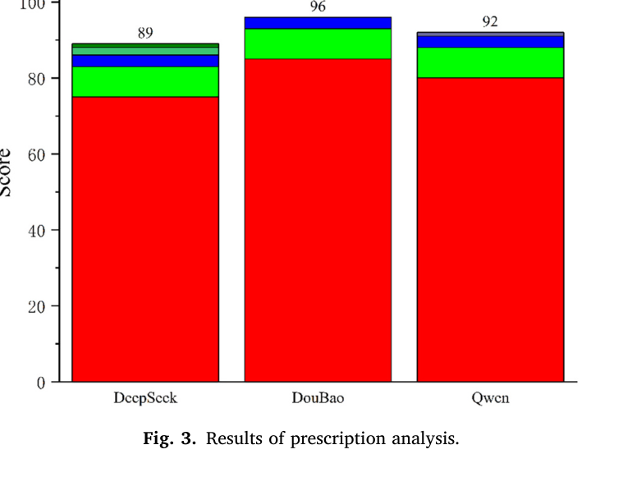
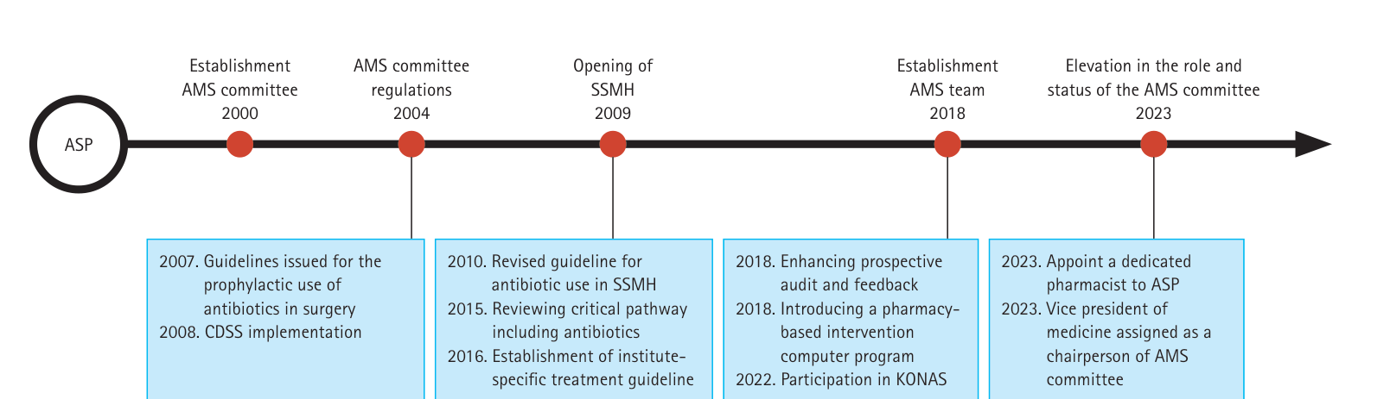
Background
Previous Studies
Roles of CDSS [4]
Prescribing support
Guideline implementation
Dose optimization
Use monitoring
Rule-based CDSS 1998 – 2024
Generative AI / LLM 2025 – 2026
Evans et al. (USA, 1998) [5]
Weissenbacher et al. (2025) [7]
28 → 4
94.7% / 66.2%
anti-infective adverse events with a computerized ICU program
appropriate / inappropriate prescriptions identified (pediatric sinusitis)
Lee et al. (Korea, 2024) [6]
Zhang et al. (2026) [8]
CDSS since 2008
3 LLMs · 20 cases
stepwise stewardship in a Korean tertiary hospital
real-world outpatient prescriptions with problems
Gap: single condition or small, preselected samples
05
[4] Barlam TF, Cosgrove SE, Abbo LM, MacDougall C, Schuetz AN, Septimus EJ, et al. Implementing an antibiotic stewardship program: guidelines by the Infectious Diseases Society of America and the Society for Healthcare Epidemiology of America. Clin Infect Dis. 2016;62(10):e51-77. doi:10.1093/cid/ciw118.
[5] Evans RS, Pestotnik SL, Classen DC, Clemmer TP, Weaver LK, Orme JF Jr, et al. A computer-assisted management program for antibiotics and other antiinfective agents. N Engl J Med. 1998;338(4):232-8. doi:10.1056/NEJM199801223380406. Figure 1.
[6] Lee SJ, Lee R, Cho SY, Nho D, Ahn HL, Lee DG. Implementing antimicrobial stewardship: lessons and perspectives from a university-affiliated tertiary hospital in Korea. Korean J Intern Med. 2024;39(3):399-412. doi:10.3904/kjim.2023.504. Figure 1, CC BY-NC 4.0.
[7] Weissenbacher D, Dutcher L, Boustany M, Cressman L, O'Connor K, Hamilton KW, et al. Automated evaluation of antibiotic prescribing guideline concordance in pediatric sinusitis clinical notes. Pac Symp Biocomput. 2025;30:138-53. doi:10.1142/9789819807024_0011. Fig. 1 (left).
[8] Zhang W, Xu J, Dong T, Hao X, Yang Q, Zhang J, et al. Exploring large language models as a prescription decision support tool for rational antibiotic use: a dual-framework analysis using standardized examinations and real-world clinical cases. Explor Res Clin Soc Pharm. 2026;23:100821. doi:10.1016/j.rcsop.2026.100821. Fig. 3.
Notes:
이런 결정을 돕기 위해 임상 의사결정지원시스템, CDSS가 오랫동안 연구되어 왔습니다. 1998년 Evans 등은 컴퓨터 기반 항생제 관리 프로그램으로 항생제 관련 부작용을 28건에서 4건으로 줄였고, 국내에서도 서울성모병원이 2008년부터 CDSS를 항생제 관리에 도입했습니다. 최근에는 LLM으로 처방의 가이드라인 부합도를 판단하는 연구도 나왔지만, 소아 부비동염 같은 단일 질환이거나 20건 정도의 작은 표본에 머물렀습니다.

Slide 6
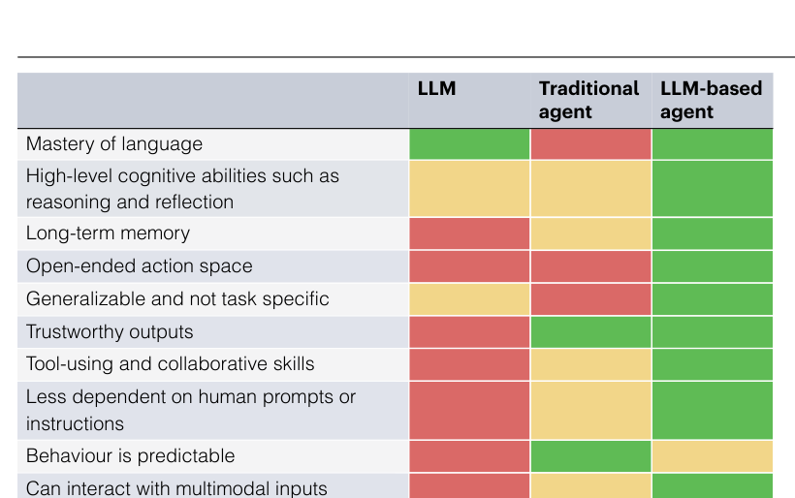
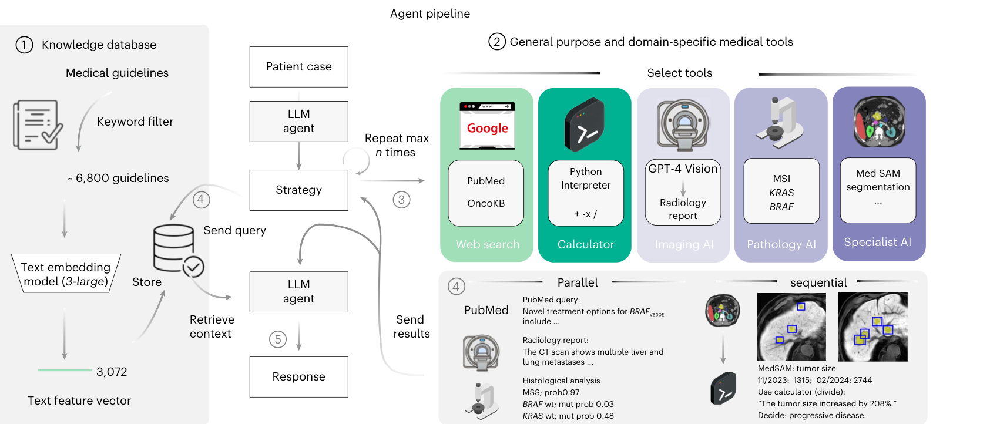
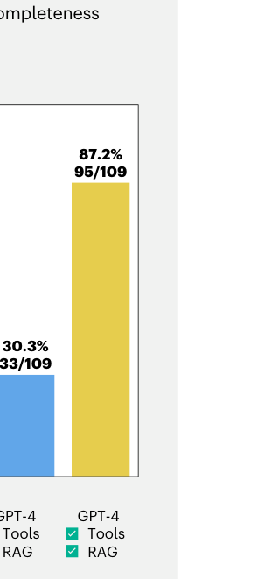
Background
Why AI agents? — Our Approach (novelty)
AI agent = LLM + tools · retrieval · memory [9]
LLM-based agents
memory
tool use
open-ended actions
multimodal input
Fig. 1, Qiu et al., Nat Mach Intell 2024 [9]
Gap: one condition · small samples · one guideline set
This study (novelty)
Fig. 1, Ferber et al., Nat Cancer 2025 [10]
Pneumonia & UTI (± sepsis)
MIMIC-IV (US) + K-MIMIC (Korea)
30.3% → 87.2%
GPT-4 alone → agent with tools + RAG
[10]
up to +18%
accuracy with medical RAG
6 LLMs · 7,663 questions [11]
National + WHO guidelines
3-function agent · clinician-evaluated
06
[9] Qiu J, Lam K, Li G, Acharya A, Wong TY, Darzi A, et al. LLM-based agentic systems in medicine and healthcare. Nat Mach Intell. 2024;6(12):1418-20. doi:10.1038/s42256-024-00944-1. Fig. 1.
[10] Ferber D, El Nahhas OSM, Wölflein G, Wiest IC, Clusmann J, Leßmann ME, et al. Development and validation of an autonomous artificial intelligence agent for clinical decision-making in oncology. Nat Cancer. 2025;6(8):1337-49. doi:10.1038/s43018-025-00991-6. Fig. 1, Fig. 2b, CC BY 4.0.
[11] Xiong G, Jin Q, Lu Z, Zhang A. Benchmarking retrieval-augmented generation for medicine. In: Findings of the Association for Computational Linguistics: ACL 2024. Bangkok: ACL; 2024. p. 6233-51. doi:10.18653/v1/2024.findings-acl.372.
Notes:
그래서 저희는 단순한 LLM이 아니라 AI 에이전트에 주목했습니다. 에이전트는 LLM이 검색, 도구, 기억을 활용해 스스로 계획하고 행동하는 시스템으로, Ferber 등의 연구에서는 GPT-4 단독으로 30.3%였던 정확도가 도구와 RAG를 갖춘 에이전트에서 87.2%까지 올라갔습니다. 저희 연구는 폐렴과 요로감염을 대상으로 미국과 한국 두 나라의 ICU 데이터에 국가별 가이드라인과 WHO 가이드라인을 함께 적용하고, 그 결과를 임상가가 직접 평가했다는 점에서 새롭습니다.

Slide 7

Data
MIMIC-IV & K-MIMIC
MIMIC-IV
K-MIMIC
▼ narrowed down to
▼ narrowed down to
Pneumonia
Urinary Track Infection
Urinary Track Infection
Pneumonia
with sepsis
with sepsis
07
Notes:
데이터는 미국 단일기관 중환자 데이터인 MIMIC-IV와 국내 다기관 중환자 데이터인 K-MIMIC을 사용했습니다. MIMIC-IV에서는 폐렴과 요로감염을 각각 패혈증 동반 여부까지 나눠 네 그룹으로 좁혔고, K-MIMIC에서는 폐렴과 요로감염 두 그룹까지 구분했습니다. K-MIMIC은 패혈증 판정에 필요한 정보가 충분하지 않아 패혈증 여부는 분석하지 못했습니다.

Slide 8
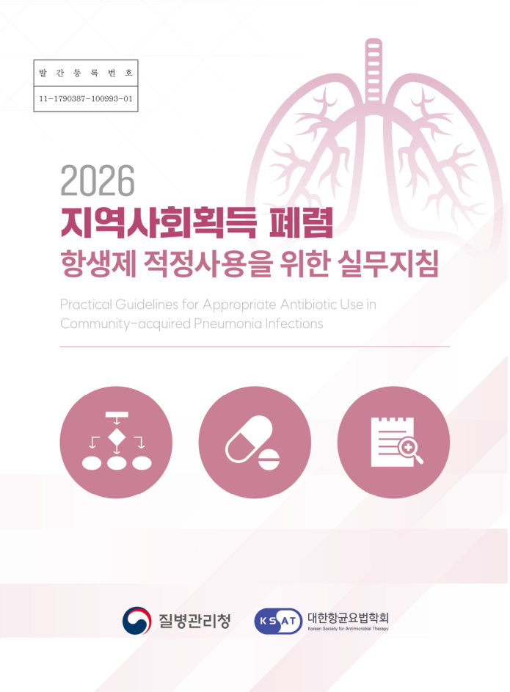
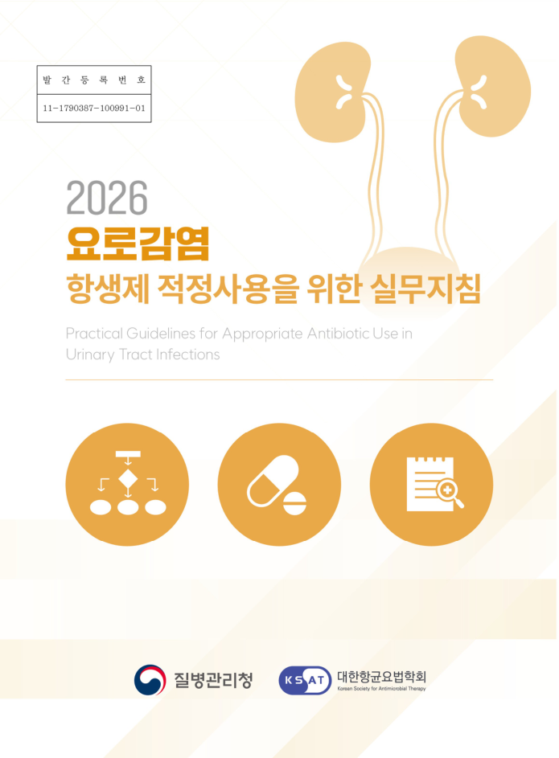
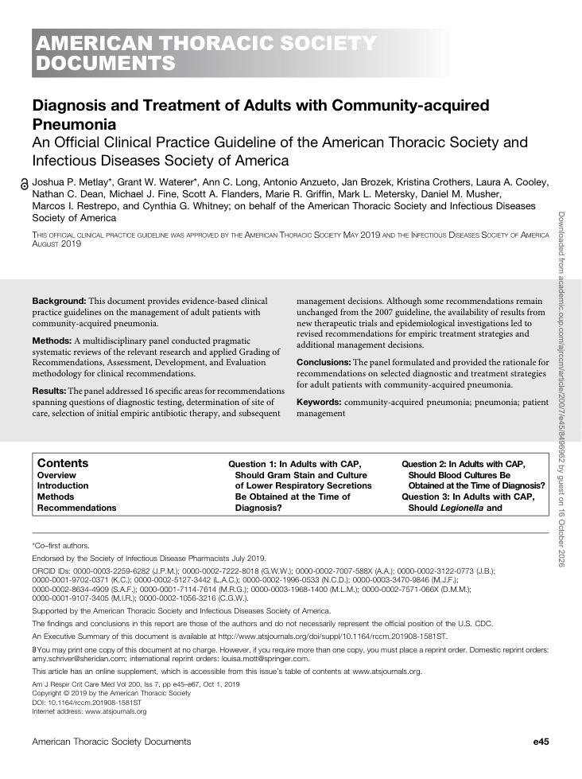
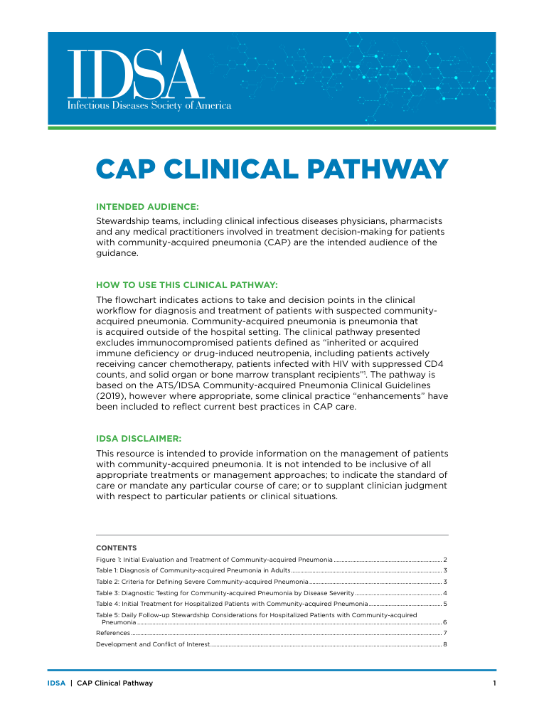
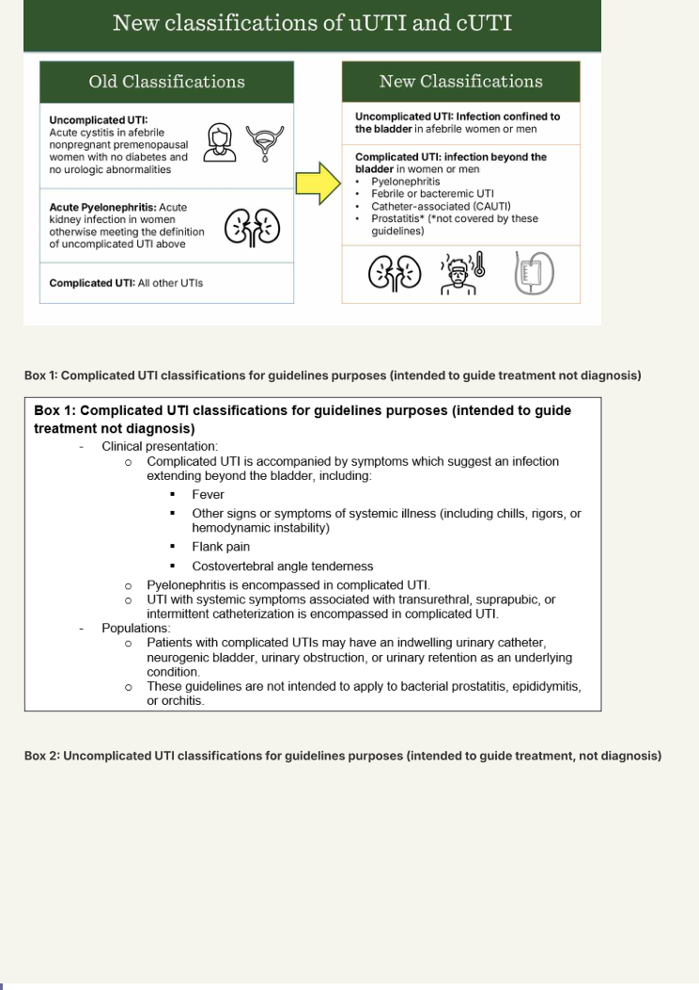

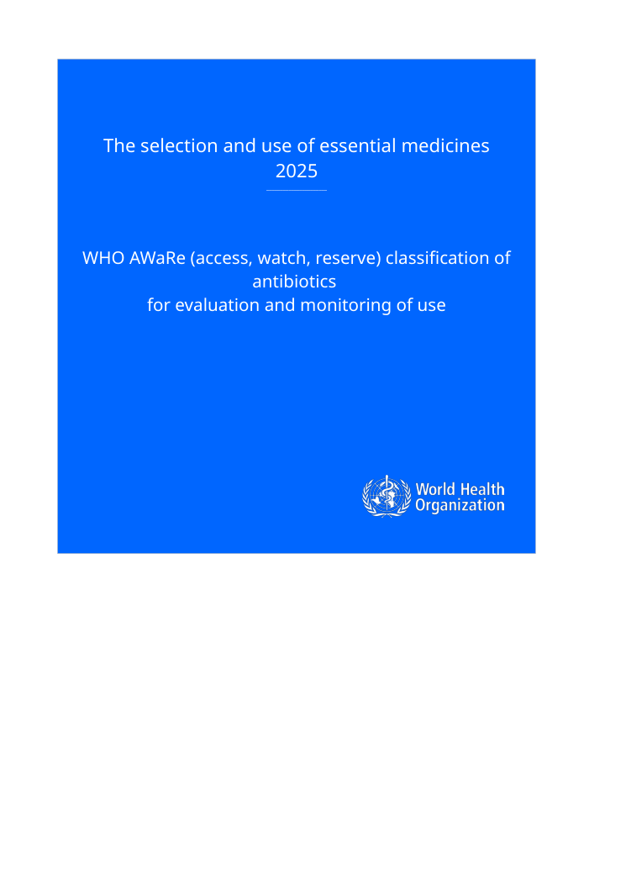
Data
Guidelines
Korean guidelines → K-MIMIC
USA guidelines → MIMIC-IV
International (WHO) → both
K02
K04
M03
M04
M07
W01
W02
 | Guideline | Issuer, year | Infection | K-MIMIC | MIMIC-IV
K02 | Practical guidelines for appropriate antibiotic use in community-acquired pneumonia [12] | KDCA · KSAT, 2025 | Pneumonia | ● | –
K04 | Practical guidelines for appropriate antibiotic use in urinary tract infection [13] | KDCA · KSAT, 2025 | UTI | ● | –
M03 | Diagnosis and treatment of adults with community-acquired pneumonia [14] | ATS / IDSA, 2019 | Pneumonia | – | ●
M04 | CAP clinical pathway (antimicrobial stewardship) [15] | IDSA | Pneumonia | – | ●
M07 | Guideline on the management of complicated urinary tract infections [16] | IDSA, 2025 | UTI | – | ●
W01 | The WHO AWaRe (Access, Watch, Reserve) antibiotic book [17] | WHO, 2022 | Pneumonia · UTI | ● | ●
W02 | WHO AWaRe classification of antibiotics for evaluation and monitoring of use [18] | WHO, 2025 | All antibiotics | ● | ●
[12] Korea Disease Control and Prevention Agency, Korean Society for Antimicrobial Therapy. Practical guidelines for appropriate antibiotic use in community-acquired pneumonia (2025 ed.). Cheongju: KDCA; 2026. Available from: https://www.kdca.go.kr/bbs/kdca/55/310916/artclView.do
[13] Korea Disease Control and Prevention Agency, Korean Society for Antimicrobial Therapy. Practical guidelines for appropriate antibiotic use in urinary tract infection (2025 ed.). Cheongju: KDCA; 2026. Available from: https://www.kdca.go.kr/bbs/kdca/55/310916/artclView.do
[14] Metlay JP, Waterer GW, Long AC, Anzueto A, Brozek J, Crothers K, et al. Diagnosis and treatment of adults with community-acquired pneumonia: an official clinical practice guideline of the ATS and IDSA. Am J Respir Crit Care Med. 2019;200(7):e45-e67. doi:10.1164/rccm.201908-1581ST.
[15] Infectious Diseases Society of America. Community-acquired pneumonia (CAP) clinical pathway. Arlington (VA): IDSA; 2023. Available from: https://www.idsociety.org/practice-guideline/community-acquired-pneumonia-cap-in-adults/
[16] Trautner BW, Cortés-Penfield NW, Gupta K, Hirsch EB, Horstman M, Moran GJ, et al. IDSA 2025 guideline on management and treatment of complicated urinary tract infections: selection of antibiotic therapy. Clin Infect Dis. 2026;82(Suppl 3):i36-i67. doi:10.1093/cid/ciaf460.
[17] World Health Organization. The WHO AWaRe (Access, Watch, Reserve) antibiotic book. Geneva: WHO; 2022. ISBN 978-92-4-006238-2. Available from: https://www.who.int/publications/i/item/9789240062382
[18] World Health Organization. The selection and use of essential medicines, 2025: WHO AWaRe (Access, Watch, Reserve) classification of antibiotics for evaluation and monitoring of use. Geneva: WHO; 2025. doi:10.2471/B09489.
08
Notes:
적용한 가이드라인은 모두 일곱 개입니다. K-MIMIC에는 질병관리청의 폐렴과 요로감염 실무지침을, MIMIC-IV에는 ATS/IDSA 폐렴 지침, IDSA 폐렴 임상경로, 그리고 2025년 IDSA 복잡성 요로감염 지침을 적용했습니다. 여기에 WHO AWaRe 항생제 북과 2025년 AWaRe 분류를 두 데이터의 공통 국제 기준으로 더했습니다.

Slide 9








Method
Study Population Filtration (1/3)
A. Cohort construction (MIMIC-IV v3.1; counts = admissions)
MIMIC-IV v3.1 (hosp + icu modules)
364,627 patients · 546,028 admissions · 94,458 ICU stays
Definitions
Sepsis-3: suspected infection + acute organ dysfunction (SOFA ≥ 2) [19]
Suspected infection: culture & antibiotic within 72 h / 24 h of each other [20]
First ICU stay per patient · adults ≥ 18 years
65,366 patients, one admission each (readmissions excluded)
Diagnosis codes, primary + secondary (ICD-9 / ICD-10)
Sepsis classification
three labels (pneumonia · UTI)
Pneumonia 8,234
ICD-10: J13–J16, J18.0/.1/.8/.9
ICD-9: 481–483, 485, 486
UTI 7,793
ICD-10: N10, N12, N39.0
ICD-9: 590.1/.80/.9, 599.0
PNA · UTI
×
Excluded
Aspiration 815 · VAP 419 (pneumonia)
Catheter-associated 330 (UTI)
Both pneumonia & UTI codes 1,029
Sepsis-3
(mimic-code official; primary label) [21]
3,666 · 3,180
After exclusion
Pneumonia 6,056 · UTI 6,434
Simplified SOFA ≥ 2
(shared code, also applied to K-MIMIC)
3,858 · 3,496
Suspected-infection time = culture ↔ antibiotic pairing
culture_first (culture → antibiotic ≤ 72 h): 4,752 · 5,464
antibiotic_first (antibiotic → culture ≤ 24 h): 1,009 · 628
Suspicion time assigned: 5,761 · 6,092
ICD sepsis codes
1,721 · 1,526
Agreement with Sepsis-3: SOFA 85% · 82% / codes 50% · 54%
18% had no ICU record within the SOFA window → flagged, not excluded
No culture–antibiotic pair: 295 · 342
Hospital-acquired (> 48 h): 886 · 1,569
Community-acquired: suspicion ≤ 48 h after hospital arrival
Pneumonia 4,875 · UTI 4,523 (final cohort)
09
[19] Singer M, Deutschman CS, Seymour CW, Shankar-Hari M, Annane D, Bauer M, et al. The third international consensus definitions for sepsis and septic shock (Sepsis-3). JAMA. 2016;315(8):801-10. doi:10.1001/jama.2016.0287.
[20] Seymour CW, Liu VX, Iwashyna TJ, Brunkhorst FM, Rea TD, Scherag A, et al. Assessment of clinical criteria for sepsis: for the Third International Consensus Definitions for Sepsis and Septic Shock (Sepsis-3). JAMA. 2016;315(8):762-74. doi:10.1001/jama.2016.0288.
[21] Johnson AE, Stone DJ, Celi LA, Pollard TJ. The MIMIC Code Repository: enabling reproducibility in critical care research. J Am Med Inform Assoc. 2018;25(1):32-9. doi:10.1093/jamia/ocx084.
Notes:
다음은 MIMIC-IV의 환자군 선정 과정입니다. 약 36만 명 중 18세 이상, 첫 ICU 입실 환자 6만 5천여 명을 뽑고, 진단코드로 폐렴과 요로감염을 찾은 뒤 흡인성 폐렴, 인공호흡기 관련 폐렴, 카테터 관련 요로감염은 제외했습니다. 그리고 병원 도착 48시간 이내에 감염이 의심된 지역사회 획득 감염만 남겨 폐렴 4,875명, 요로감염 4,523명을 얻었고, Sepsis-3 기준으로 각각 3,666명과 3,180명이 패혈증에 해당했습니다.

Slide 10




Method
Study Population Filtration (2/3)
B. One patient's timeline and rule windows (hours from hospital arrival, t0 = 0)
Rule 1 · culture_first
Culture
≤ 72 h
Antibiotic
⇒ Suspicion time = culture time
Rule 2 · antibiotic_first
Antibiotic
≤ 24 h
Culture
⇒ Suspicion time = antibiotic time
Culture drawn (+3 h) → suspected-infection time
48 h cut-off
suspicion after 48 h = hospital-acquired → excluded
First antibiotic order (+8 h) = t_first_antibiotic
Hospital arrival (t0 = 0)
First administration (+9.5 h; median eMAR delay 1.1 h)
ICU admission (+14 h)
-12
0
+12
+24
+36
+60
◂ Sepsis-3 window: suspicion time −48 h … +24 h (SOFA ≥ 2 within → sepsis)
Hours after hospital arrival (h)
Initial (empiric) regimen
all systemic antibiotics started ≤ 24 h after the first antibiotic
Vitals · SOFA components exist only after ICU admission
(emergency-department vitals are not in this dataset)
10
[19] Singer M, Deutschman CS, Seymour CW, Shankar-Hari M, Annane D, Bauer M, et al. The third international consensus definitions for sepsis and septic shock (Sepsis-3). JAMA. 2016;315(8):801-10. doi:10.1001/jama.2016.0287.
[20] Seymour CW, Liu VX, Iwashyna TJ, Brunkhorst FM, Rea TD, Scherag A, et al. Assessment of clinical criteria for sepsis: for the Third International Consensus Definitions for Sepsis and Septic Shock (Sepsis-3). JAMA. 2016;315(8):762-74. doi:10.1001/jama.2016.0288.
Notes:
이 과정을 한 환자의 타임라인으로 보면 이렇습니다. 배양이 먼저면 72시간 안의 항생제와, 항생제가 먼저면 24시간 안의 배양과 짝을 지어 감염 의심 시각을 정합니다. 그 시각 48시간 전부터 24시간 후 사이에 SOFA 점수가 2점 이상 오르면 패혈증으로 보고, 첫 항생제부터 24시간 안에 시작된 항생제를 초기 경험적 요법으로 정의했습니다.

Slide 11










Method
Study Population Filtration (3/3)
C. Leakage-free case card given to the agent (hashed ID; all times relative to first antibiotic = T+0)
Case-card availability rule
only values whose result was reported (storetime) before the first antibiotic
case.json
Not in the card
Age · sex · weight · ED pathway · ICU type
Discharge diagnosis codes
First antibiotic (+8 h)
Test A: drawn +1.0 h, reported +1.8 h
→ included in card
In-hospital death
Test B: drawn +6.5 h, reported +9.0 h
reported after first antibiotic → excluded
Vitals · labs: last value reported before T+0
Culture results after T+0
SOFA score / sepsis label
Cultures before T+0: specimen type & time only, no results
+0h
+2h
+4h
+6h
+8h
+10h
+12h
Selecting by draw time would leak results the physician had not yet seen into 13% of 'last values' and 21% of patients
Judgement
Empiric regimen: agent · class · AWaRe · route · dose · start T+h
Case cards → LLM agent
hashed ID · relative time
A1 syndrome · severity → A4 domestic / international guideline
Adherence judgement → A5 evidence verification
Clinician review: 5 cases × 4 groups (1–5 score, 4-level verdict)
History: admission / IV antibiotics ≤ 90 d · MRSA / Pseudomonas ≤ 1 y
20
evaluation cases
(5 × 4 groups)
20
reserve cases
Comorbidities (codes): diabetes, CKD, COPD, immunosuppression, etc.
11
Notes:
에이전트에는 이 정보를 사례 카드 형태로 전달하는데, 가장 신경 쓴 부분은 정보 누출을 막는 것이었습니다. 첫 항생제 이전에 결과가 보고된 값만 카드에 넣었는데, 채취 시각을 기준으로 고르면 환자의 21%에서 의사가 아직 보지 못한 결과가 섞였기 때문입니다. 퇴원 진단, 사망 여부, 패혈증 라벨도 카드에서 제외했습니다.

Slide 12




Method
Embedding Vector Construction & RAG LLM Model Comparison
2
Embedding
Indexing
FAISS
1
Text extraction & Chunking
BGE-M3
3
4
Question
Korean clinical question
Query translation
LLM → English query
Retrieval
top-3
Prompt
Context chunks + fixed system rules
Generator LLM
Qwen3.5-9B
or HARI-q3-8B
Output (JSON)
Answer + citations: file · page · section · quote · chunk_id
Qwen3.5-9B
Alibaba Cloud · Qwen team [22]
HARI-q3-8B
Seoul National University Hospital [23]
TYPE
General-purpose multilingual LLM
TYPE
Korean medical LLM built on Qwen3-8B-Base
Identical for both LLMs: same embedding & FAISS index · same 9 retrieved chunks · same prompt · temperature 0.2, seed 42, context 8,192 · local inference
14
[22] Qwen Team. Qwen3.5: towards native multimodal agents [Internet]. Alibaba Cloud; 2026. Available from: https://qwen.ai/blog?id=qwen3.5 ; Yang A, Li A, Yang B, Zhang B, Hui B, Zheng B, et al. Qwen3 technical report. arXiv:2505.09388. 2025.
[23] Healthcare AI Research Institute, Seoul National University Hospital. hari-q3-8b [model card]. Hugging Face; 2025. Available from: https://huggingface.co/snuh/hari-q3-8b
Notes:
다음은 가이드라인 임베딩과 RAG 구조입니다. 일곱 개 PDF를 페이지 단위로 1,000자씩, 200자 겹치게 나누고, 한국어와 영어를 함께 다루는 BGE-M3로 임베딩해 FAISS에 저장했습니다. 질문이 들어오면 영어로 번역한 질의와 함께 검색해 근거 문단 9개를 가져오고, 생성 모델로 범용 모델인 Qwen3.5-9B와 서울대병원의 한국어 의료 특화 모델 HARI-q3-8B를 비교했습니다. 나머지 설정은 모두 같게 두어 생성 모델만 달라지도록 했습니다.

Slide 13
Method
RAG Evaluation
① Automatic metrics vs. reference answer
② Clinician evaluation 5 criteria × 5-point Likert [29, 30, 31]
Embedding cosine similarity [24]
ICU nurse
junior
ICU nurse
> 10 years
Neurologist
physician
independent
scoring
Criterion | What is assessed | 1 point | 5 points
Accuracy | agreement with guideline content, dose, conditions | key recommendation wrong / no answer | numbers, conditions & exceptions all correct
Relevance | directly answers the question | unrelated to the question | direct and concise for the whole question
Completeness | essential elements of the reference answer | almost no essential element | all elements, conditions & exceptions
Groundedness | citation location is correct and supports the claim | no / non-existent / unsupportive citation | file, page & location exact; all claims supported
Clinical usefulness | helps interpretation and decision making | dangerous misunderstanding / unusable | clear; conditions and limits made explicit
BERTScore F1 [25]
ROUGE-L F1 [26, 27]
Token F1 [28]
[24] Chen J, Xiao S, Zhang P, Luo K, Lian D, Liu Z. M3-Embedding: multi-linguality, multi-functionality, multi-granularity text embeddings through self-knowledge distillation. In: Findings of ACL 2024. Bangkok: ACL; 2024. p. 2318-35. doi:10.18653/v1/2024.findings-acl.137.
[25] Zhang T, Kishore V, Wu F, Weinberger KQ, Artzi Y. BERTScore: evaluating text generation with BERT. In: International Conference on Learning Representations (ICLR); 2020. arXiv:1904.09675.
[26] Lin CY. ROUGE: a package for automatic evaluation of summaries. In: Text Summarization Branches Out. Barcelona: ACL; 2004. p. 74-81.
[27] Lee M. Kiwi: developing a Korean morphological analyzer based on statistical language models and skip-bigram. Korean J Digit Humanit. 2024;1(1):109-36. doi:10.23287/KJDH.2024.1.1.6.
[28] Rajpurkar P, Zhang J, Lopyrev K, Liang P. SQuAD: 100,000+ questions for machine comprehension of text. In: Proceedings of EMNLP 2016. Austin (TX): ACL; 2016. p. 2383-92. doi:10.18653/v1/D16-1264.
[29] Tam TYC, Sivarajkumar S, Kapoor S, Stolyar AV, Polanska K, McCarthy KR, et al. A framework for human evaluation of large language models in healthcare derived from literature review. NPJ Digit Med. 2024;7(1):258. doi:10.1038/s41746-024-01258-7.
[30] Singhal K, Azizi S, Tu T, Mahdavi SS, Wei J, Chung HW, et al. Large language models encode clinical knowledge. Nature. 2023;620(7972):172-80. doi:10.1038/s41586-023-06291-2.
[31] Es S, James J, Espinosa Anke L, Schockaert S. RAGAs: automated evaluation of retrieval augmented generation. In: Proceedings of EACL 2024: System Demonstrations. St. Julians: ACL; 2024. p. 150-8. doi:10.18653/v1/2024.eacl-demo.16.
15
Notes:
RAG 평가는 두 축으로 진행했습니다. 가이드라인마다 세 문항씩 21개의 질문과 기준 답안을 만들어, 먼저 임베딩 유사도, BERTScore, ROUGE-L, Token F1 같은 정량 지표로 비교했습니다. 하지만 이런 지표는 표현의 유사도일 뿐 사실 정확성을 보장하지 않기 때문에, 임상가 세 분이 정확성, 관련성, 완전성, 근거 충실성, 임상적 유용성을 1점에서 5점으로 각자 평가했습니다.

Slide 14
Method
Agent System Configuration
Input: patient clinical information
AI agent
1
Guideline adherence report
2
Guideline-based prescription recommendation
3
Similar-case prescription
INPUT
Current prescription + clinical information
INPUT
Clinical information only
INPUT
Clinical information only
OUTPUT
How closely the prescription follows each guideline
OUTPUT
Recommended empiric regimen with citations
OUTPUT
Prescriptions given to the most similar past patients
K-MIMIC Korean (K02, K04) + WHO
K-MIMIC Korean | WHO
Routing by race / ethnicity → K-MIMIC or MIMIC-IV cases
MIMIC-IV US (M03, M04, M07) + WHO
MIMIC-IV US | WHO
Data-driven reference, independent of guidelines
16
Notes:
에이전트는 임상팀과의 논의를 바탕으로 세 가지 기능으로 구성했습니다. 첫째는 현재 처방이 가이드라인과 얼마나 맞는지 분석하는 규칙 기반 리포트로, 중증 환자에 해당하는 권고만 발췌해 규칙으로 만들었습니다. 둘째는 임상 정보만으로 국가별 가이드라인과 WHO 가이드라인 각각에 따른 처방을 RAG로 추천하고, 셋째는 가이드라인과 별개로 인종에 따라 K-MIMIC 또는 MIMIC-IV에서 비슷한 과거 환자의 실제 처방을 보여줍니다.

Slide 15
Result
MIMIC-IV Antibiotics Prescription Tendency
Antibiotics Prescription
Top 5
Antibiotics Prescription
Top 5
Pneumonia
vancomycin 50.4 (%)
azithromycin 37.6
ceftriaxone 37.1
cefepime 28.5
levofloxacin 25.5
Urinary Track Infection
ceftriaxone 38.6
ciprofloxacin 24.0
vancomycin 23.9
cefepime 10.3
cefazolin 10.2
4,875
patients
4,523
patients
with sepsis
3,666
75.2% · Sepsis-3
vancomycin 67.2
cefepime 38.6
azithromycin 30.7
ceftriaxone 29.2
piperacillin/tazobactam 22.2
with sepsis
3,180
70.3% · Sepsis-3
vancomycin 47.1
ceftriaxone 35.8
cefepime 21.7 piperacillin/tazobactam 19.0
ciprofloxacin 17.1
17
Notes:
이제 결과입니다. 먼저 MIMIC-IV의 실제 경험적 항생제 처방을 질환과 패혈증 여부별 상위 5개로 보면, 폐렴에서는 vancomycin이 50.4%로 가장 많았고 패혈증이 동반되면 67.2%까지 올라갔습니다. 요로감염에서는 ceftriaxone이 1위였지만, 패혈증이 있으면 vancomycin이 47.1%로 1위가 되고 piperacillin/tazobactam이 새로 상위권에 들어왔습니다. 즉 중증일수록 광범위 항생제 사용이 뚜렷하게 늘었습니다.

Slide 16
Result
MIMIC-IV Antibiotics USA Guidelines Adherence Rate
Pneumonia
4,875
patients
USA guidelines (M03, M04, M07)
Adherence rate
12.5%
Urinary Track Infection
4,523
patients
USA guidelines (M03, M04, M07)
Adherence rate
39.4%
adherent 12.5%
non-adherent 87.5%
adherent 39.4%
non-adherent 60.6%
Guideline not complying prescription Top 1 and 2
Guideline not complying prescription Top 1 and 2
1
cefepime + vancomycin
1
pip/tazo + vancomycin
2
pip/tazo + vancomycin
2
cefepime + vancomycin
17
Notes:
그렇다면 이 처방들이 가이드라인에 얼마나 맞았을까요? 에이전트의 첫 번째 기능인 규칙 기반 부합도 분석을 MIMIC-IV의 실제 처방에 적용해 보았습니다. 미국 가이드라인 기준 부합률은 폐렴에서 12.5%, 요로감염에서 39.4%로 낮았습니다. 가이드라인에 맞지 않는 처방 1, 2위는 두 질환 모두 cefepime과 vancomycin, 그리고 piperacillin/tazobactam과 vancomycin 병합이었습니다. 즉 실제 ICU에서는 가이드라인이 권하는 범위보다 넓은 병합요법이 경험적으로 많이 쓰이고 있었습니다.

Slide 17
Result
K-MIMIC Antibiotics Prescription Tendency
Antibiotics Prescription
Top 10
Pneumonia
piperacillin and beta-lactamase inhibitor 19.96 (%)
meropenem 12.81
levofloxacin 9.39
sulfamethoxazole and trimethoprim 6.74
ceftriaxone 4.85
vancomycin 4.52
teicoplanin 4.21
ciprofloxacin 3.61
colistin 2.78
amikacin 2.37
12,062
patients
Urinary Track Infection
2,895
patients
17
Notes:
K-MIMIC에서는 폐렴 12,062명, 요로감염 2,895명을 대상으로, 두 질환을 합친 상위 10개 항생제를 뽑았습니다. piperacillin과 베타락탐분해효소 억제제 복합제가 19.96%로 가장 많았고, meropenem이 12.81%, levofloxacin이 9.39%로 뒤를 이었습니다. 반면 MIMIC-IV에서 가장 많았던 vancomycin은 4.52%에 그쳐, 두 나라의 처방 양상이 꽤 다르다는 것을 볼 수 있었고, 이는 국가별 가이드라인을 따로 적용한 이유이기도 합니다.

Slide 18

Result
RAG Performance
Metric (mean of 21 questions) | Qwen3.5-9B | HARI-q3-8B | HARI better questions
Embedding cosine similarity | 0.711 | 0.747 | 16 / 21
BERTScore F1 | 0.879 | 0.884 | 14 / 21
ROUGE-L F1 | 0.230 | 0.253 | 12 / 21
Token F1 | 0.332 | 0.351 | 12 / 21
'Not found'-type answers | 6 / 21 | 0 / 21 | —
Same embedding (BGE-M3), same 9 retrieved chunks, same prompt — only the generator LLM differs.
Korean medical LLM HARI-q3-8B > general LLM Qwen3.5-9B on every automatic metric
19
Notes:
RAG의 정량 평가에서는 HARI가 네 개 지표 모두에서 Qwen보다 높았습니다. 특히 Qwen은 21문항 중 6문항에서 근거를 찾을 수 없다는 식으로 답했지만, HARI에서는 그런 응답이 한 번도 없었습니다.

Slide 19
Result
RAG Performance Evaluation By Clinicians
Mean score by criterion (1–5; 3 raters pooled)
Rater | Role | Qwen3.5-9B | HARI-q3-8B
Seungmin Lee | Neurologist | 3.55 | 4.03
Jisu Ha | ICU nurse | 3.42 | 3.40
Woojin Kim | ICU nurse, junior | 3.03 | 3.41
Question group | K-MIMIC (Korean guidelines) |  |  |  |  |  | MIMIC (US guidelines) |  |  |  |  |  |  |  |  | WHO (AWaRe)
 | Q01 | Q02 | Q03 | Q04 | Q05 | Q06 | Q07 | Q08 | Q09 | Q10 | Q11 | Q12 | Q13 | Q14 | Q15 | Q16 | Q17 | Q18 | Q19 | Q20 | Q21
Qwen3.5-9B | 4.7 | 1.1 | 4.4 | 4.4 | 4.5 | 4.5 | 4.9 | 4.2 | 2.5 | 2.9 | 2.9 | 4.2 | 2.9 | 4.8 | 1.1 | 4.4 | 2.8 | 1.1 | 3.0 | 3.5 | 1.1
HARI-q3-8B | 4.3 | 2.7 | 4.1 | 3.7 | 4.7 | 4.2 | 4.9 | 3.9 | 3.6 | 2.8 | 2.7 | 3.5 | 3.4 | 4.1 | 3.8 | 4.6 | 3.2 | 3.4 | 2.4 | 2.7 | 3.2
Per-question mean of 5 criteria × 3 raters · colour: < 2 2–3 3–4 ≥ 4
20
Notes:
임상가 평가에서도 세 분 평균 HARI 3.61점, Qwen 3.33점으로 다섯 기준 모두 HARI가 높았습니다. 다만 문항별로 보면 Qwen은 대부분 좋은 답을 했지만 근거가 있는데도 답을 거부한 네 문항에서 1.1점을 받았고, HARI는 모든 문항에 답했지만 WHO AWaRe 분류 문항에서 오류가 있었습니다. 두 모델은 서로 다른 방식으로 실패한 셈입니다.

Slide 20
Result
Agent System Scheme
21
Notes:
이렇게 구성한 에이전트의 전체 흐름입니다. 환자 정보가 들어오면 세 기능이 각각 가이드라인 부합도 리포트, 가이드라인 기반 추천, 유사 환자 처방을 내놓고, 임상가는 이를 함께 비교하면서 최종 판단을 내릴 수 있습니다.

Slide 21

Limitation
1
Real-time agent deployment was not feasible
The agent was evaluated on retrospective case cards; integrating it with live ICU data streams in real time was difficult to implement
2
Few target diseases, few guidelines
3
Temporal changes in diagnostic criteria
Only pneumonia and UTI (± sepsis) were targeted
→ the number of applicable guidelines was also small (7)
Changes in diagnostic criteria during the study period could not be fully accounted for, potentially affecting the consistency of patient classification
→ past data were judged against recent guidelines
23
Notes:
이 연구에는 몇 가지 한계가 있습니다. 첫째, 실시간으로 동작하는 에이전트를 구현하기는 쉽지 않아 후향적 사례로 평가했습니다. 둘째, 대상 질환이 폐렴과 요로감염으로 적어 적용한 가이드라인 수도 적었습니다. 셋째, 과거 데이터를 최신 가이드라인 기준으로 보았기 때문에, 연구 기간 동안의 진단 기준 변화를 완전히 반영하지는 못했습니다.

Slide 22
Conclusion
Key results
1
Guideline RAG in two LLM versions
2
AI agent built around clinicians’ needs
3
Antibiotic tendency in MIMIC-IV & K-MIMIC
Qwen3.5-9B vs HARI-q3-8B, assessed with automatic metrics and by 3 clinicians
adherence report · guideline-based recommendation · similar-case prescription
MIMIC-IV: top-5 by disease & sepsis · K-MIMIC: top-10 (pneumonia + UTI)
Further research
▸ External & prospective validation
other hospitals, real-time ICU workflow
▸ Broader populations
HAP/VAP, intra-abdominal, skin & soft tissue; ED and wards
▸ Better retrieval
source routing, reranker, table-aware chunking
▸ Verification agent
check every claim against cited text to curb hallucination
▸ Outcome linkage
mortality, resistance, C. difficile; local antibiogram
▸ Robust expert evaluation
more blinded raters, κ / ICC, agent vs clinicians
24
Notes:
결론입니다. 저희는 첫째, 가이드라인 RAG를 두 가지 LLM 버전으로 구현해 정량 평가와 의료진 평가를 모두 받았고, 둘째, 실제 의료진의 요구에 맞춘 세 가지 기능의 AI 에이전트를 구성했으며, 셋째, MIMIC-IV와 K-MIMIC 두 데이터에서 실제 경험적 항생제 처방 경향을 뽑아 비교했습니다. 앞으로는 외부 검증과 대상 질환 확대, 검색 성능 개선, 그리고 근거 검증 에이전트를 통해 실제 ICU에서 쓸 수 있는 수준으로 발전시키고자 합니다.

Slide 23

Thank You
25
Notes:
경청해 주셔서 감사합니다. 질문 받겠습니다.

