Slide 1
CSCE 436 – Advanced Embedded Systems Lecture 1 – Intro to Git
Prof Jeffrey Falkinburg Avery Hall 368 472-5120

Slide 2
CSCE 436 – Advanced Embedded Systems Lecture 1 – Intro to Git
Prof Jeffrey Falkinburg Avery Hall 368 472-5120

Slide 3
Lesson Outline
Introduction to Git
BitBucket Repo
Git Demonstration

Slide 4
Introduction to Git

Slide 5
Introduction to Git
Why to we use Git?
Git is a version control system that enables you to track changes to files.
Here is a Git Tutorial for Beginners:
https://www.liquidlight.co.uk/blog/git-for-beginners-an-overview-and-basic-workflow/
Git Cheat Sheet:
https://www.atlassian.com/git/tutorials/atlassian-git-cheatsheet
Example Git Repo
https://github.com/jfalkinburg/CSCE_436_Lab_Ex

Slide 6
Introduction to Git
Before you start
Configure Git with your details
$ git config --global user.name 'Your Name’
$ git config --global user.email you@huskers.unl.edu

Slide 7




Introduction to Git
BitBucket Repo
Push
Pull
Clone
Pull
Add Files
Push
Commit changes
Other computer or collaborator

Slide 8
Introduction to Git
Common Git Commands
Git clone <repo>
Clone repo located at <repo> onto local machine.
Git status
Lists the files that are staged, unstaged, and untracked.
$ git status
Git add
Stage files or directory changes for next commit.
$ git add <directory/file name>
Git commit
Commit the staged snapshot.
$ git commit –m “<message>”

Slide 9
Introduction to Git
Common Git Commands
git push <remote> <branch>
Push the branch to the <remote>, along with necessary commits and objects..
$ git push origin master
git pull <remote>
Fetch the specified remote’s copy of current branch and immediately merge it into the local copy.$ git push origin master
$ git pull origin master

Slide 10
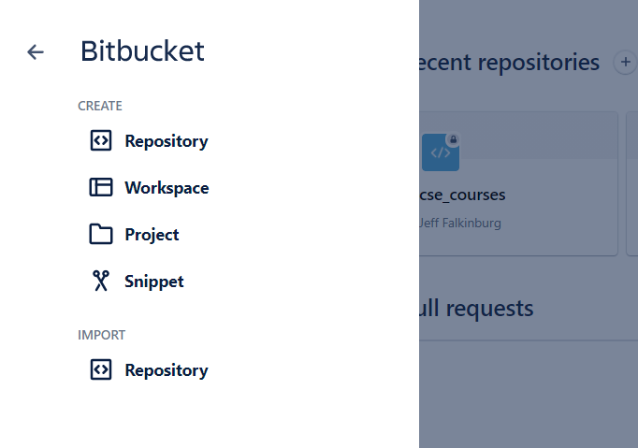
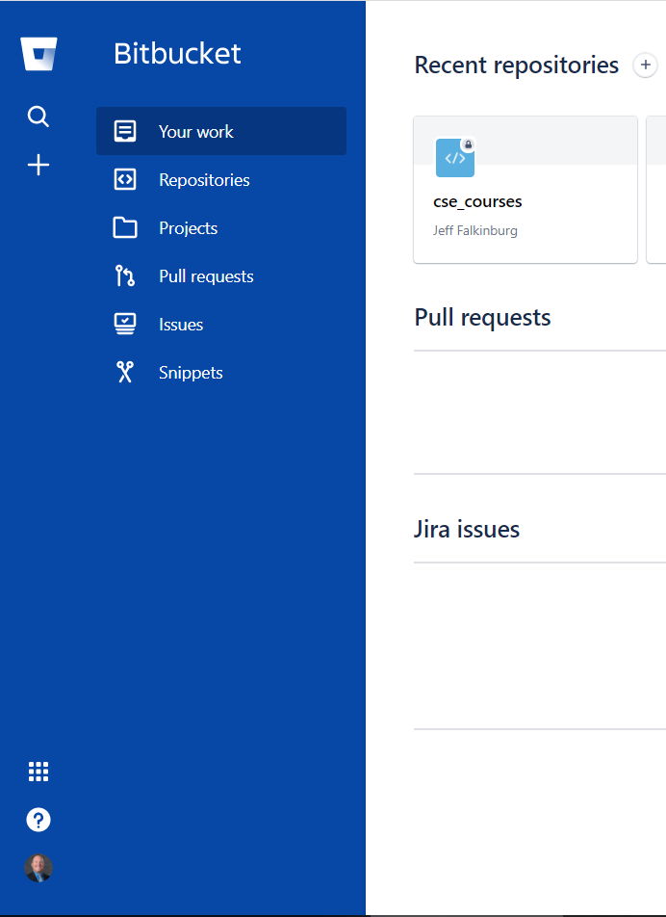
BitBucket Repo
Create a Private BitBucket Repo

Slide 11
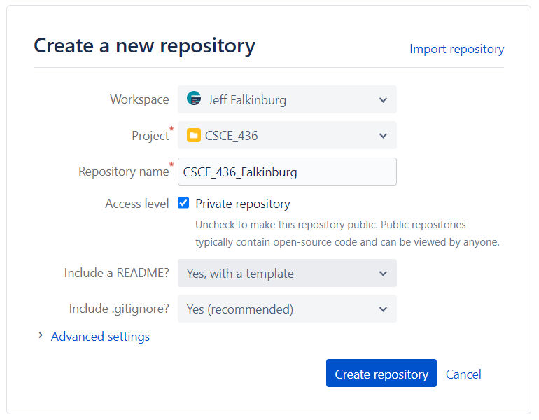
BitBucket Repo

Slide 12
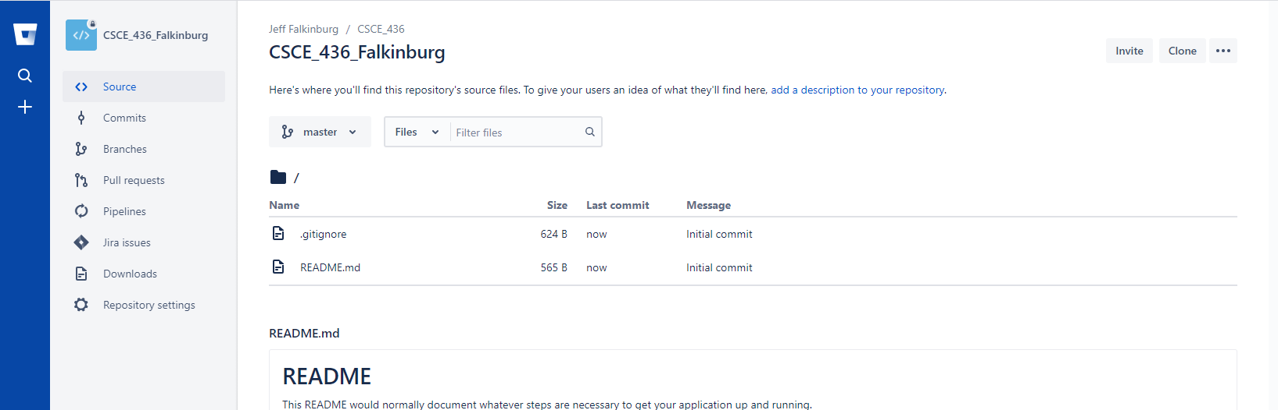
BitBucket Repo

Slide 13
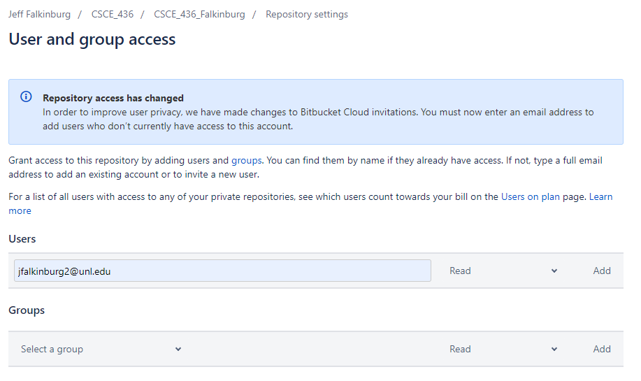
BitBucket Repo

Slide 14
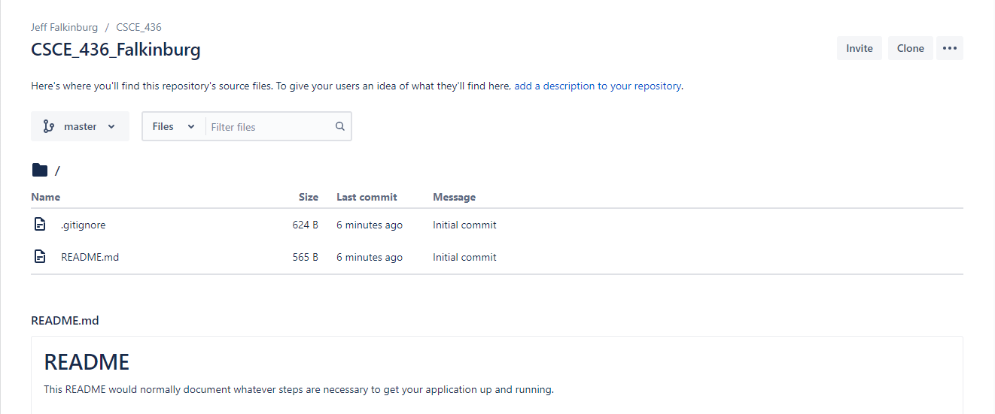
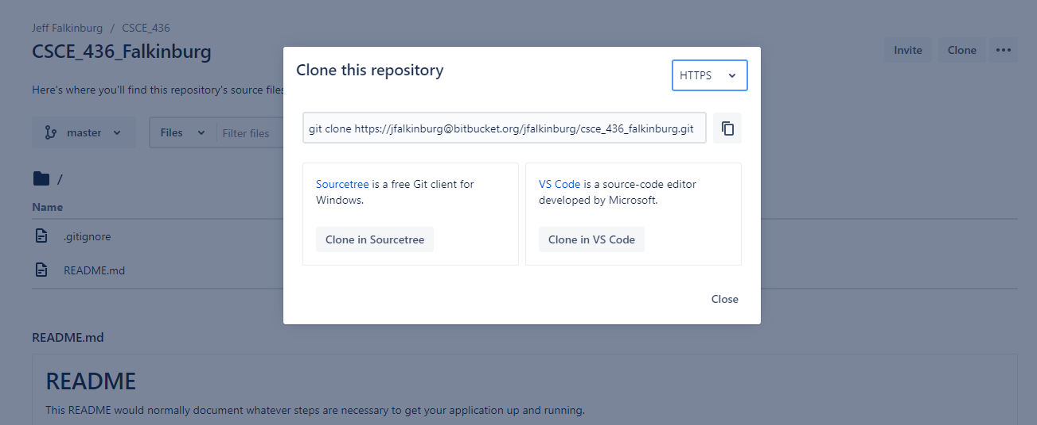
BitBucket Repo

Slide 15
Git Demonstration

Slide 16
Git Demonstration
Linus Torvalds - Linux Git Repo:
https://github.com/torvalds/linux
Example Git Repo
https://github.com/jfalkinburg/CSCE_436_Lab_Ex

Slide 17
Lesson Outline
Introduction to Git
BitBucket Repo
Git Demonstration

