Slide 1
CSCE 436 – Advanced Embedded Systems Lecture 32 – Asynchronous Design FPGA fabric
Prof Jeffrey Falkinburg Avery Hall 368 472-5120

Slide 2
Lesson Outline
Time Logs!
Lab 4 Write-Up Due Today
Asynchronous Design FPGA fabric

Slide 3
Xilinx Artix-7 Architecture

Slide 4
Xilinx Artix-7 Architecture
The Artix-7 FPGA consists of Logic Blocks, Block RAM, DSP blocks, and a global routing network.
We will spend most of our time discussing the Logic Blocks.
Before we do, realize that modern reconfigurable logic exists because logic designs can easily be expressed in terms of medium scale logic building blocks such as registers, shift registers, multiplexers, counters, adders, subtractors, and comparators.

Slide 5
Xilinx Artix-7 Architecture
Consider the following output from the Xilinx ISE during the synthesis of Lab 4 on the Spartan-6 FPGA.
=================================================================
HDL Synthesis Report Macro Statistics
# Multipliers : 1
16x16-bit multiplier : 1
# Adders/Subtractors : 9
13-bit adder : 1
16-bit adder : 1
16-bit addsub : 2
16-bit subtractor : 1
5-bit subtractor : 3
8-bit adder : 1

Slide 6
Xilinx Artix-7 Architecture
# Registers : 21
1-bit register : 6
13-bit register : 1
16-bit register : 6
20-bit register : 6
32-bit register : 1
8-bit register : 1
# Comparators : 14
8-bit comparator greater : 2
8-bit comparator lessequal : 12
# Multiplexers : 13
1-bit 2-to-1 multiplexer : 4
1-bit 20-to-1 multiplexer : 3
16-bit 2-to-1 multiplexer : 2
20-bit 2-to-1 multiplexer : 4
# FSMs : 2
=================================================================

Slide 7
Xilinx Artix-7 Architecture
What does this show?
Xilinx Software decomposed my VHDL design into basic building blocks.

Slide 8
Xilinx Artix-7 Architecture
Consider the following output from the Xilinx Vivado during the synthesis of Lab 4 on the Artix-7 FPGA.
Copyright 1986-2019 Xilinx, Inc. All Rights Reserved.
-----------------------------------------------------------------------------------------------------
| Tool Version : Vivado v.2019.1 (win64) Build 2552052 Fri May 24 14:49:42 MDT 2019
| Date : Fri Mar 20 11:29:54 2020
| Host : cse-falk-01 running 64-bit major release (build 9200)
| Command : report_utilization -file lab4_utilization_placed.rpt -pb lab4_utilization_placed.pb
| Design : lab4
| Device : 7a200tsbg484-1
| Design State : Fully Placed
-----------------------------------------------------------------------------------------------------
Utilization Design Information
Table of Contents
-----------------
1. Slice Logic
1.1 Summary of Registers by Type
2. Slice Logic Distribution
3. Memory
4. DSP
5. IO and GT Specific
6. Clocking
7. Specific Feature
8. Primitives
9. Black Boxes
10. Instantiated Netlists
1. Slice Logic
--------------
+-------------------------+------+-------+-----------+-------+
| Site Type | Used | Fixed | Available | Util% |
+-------------------------+------+-------+-----------+-------+
| Slice LUTs | 309 | 0 | 133800 | 0.23 |
| LUT as Logic | 309 | 0 | 133800 | 0.23 |
| LUT as Memory | 0 | 0 | 46200 | 0.00 |
| Slice Registers | 271 | 0 | 267600 | 0.10 |
| Register as Flip Flop | 271 | 0 | 267600 | 0.10 |
| Register as Latch | 0 | 0 | 267600 | 0.00 |
| F7 Muxes | 0 | 0 | 66900 | 0.00 |
| F8 Muxes | 0 | 0 | 33450 | 0.00 |
+-------------------------+------+-------+-----------+-------+
1.1 Summary of Registers by Type
--------------------------------
+-------+--------------+-------------+--------------+
| Total | Clock Enable | Synchronous | Asynchronous |
+-------+--------------+-------------+--------------+
| 0 | _ | - | - |
| 0 | _ | - | Set |
| 0 | _ | - | Reset |
| 0 | _ | Set | - |
| 0 | _ | Reset | - |
| 0 | Yes | - | - |
| 0 | Yes | - | Set |
| 3 | Yes | - | Reset |
| 36 | Yes | Set | - |
| 232 | Yes | Reset | - |
+-------+--------------+-------------+--------------+
2. Slice Logic Distribution
---------------------------
+--------------------------------------------+------+-------+-----------+-------+
| Site Type | Used | Fixed | Available | Util% |
+--------------------------------------------+------+-------+-----------+-------+
| Slice | 103 | 0 | 33450 | 0.31 |
| SLICEL | 66 | 0 | | |
| SLICEM | 37 | 0 | | |
| LUT as Logic | 309 | 0 | 133800 | 0.23 |
| using O5 output only | 0 | | | |
| using O6 output only | 240 | | | |
| using O5 and O6 | 69 | | | |
| LUT as Memory | 0 | 0 | 46200 | 0.00 |
| LUT as Distributed RAM | 0 | 0 | | |
| LUT as Shift Register | 0 | 0 | | |
| Slice Registers | 271 | 0 | 267600 | 0.10 |
| Register driven from within the Slice | 235 | | | |
| Register driven from outside the Slice | 36 | | | |
| LUT in front of the register is unused | 15 | | | |
| LUT in front of the register is used | 21 | | | |
| Unique Control Sets | 18 | | 33450 | 0.05 |
+--------------------------------------------+------+-------+-----------+-------+
* Note: Available Control Sets calculated as Slice Registers / 8, Review the Control Sets Report for more information regarding control sets.
3. Memory
---------
+-------------------+------+-------+-----------+-------+
| Site Type | Used | Fixed | Available | Util% |
+-------------------+------+-------+-----------+-------+
| Block RAM Tile | 1 | 0 | 365 | 0.27 |
| RAMB36/FIFO* | 0 | 0 | 365 | 0.00 |
| RAMB18 | 2 | 0 | 730 | 0.27 |
| RAMB18E1 only | 2 | | | |
+-------------------+------+-------+-----------+-------+
* Note: Each Block RAM Tile only has one FIFO logic available and therefore can accommodate only one FIFO36E1 or one FIFO18E1. However, if a FIFO18E1 occupies a Block RAM Tile, that tile can still accommodate a RAMB18E1
4. DSP
------
+----------------+------+-------+-----------+-------+
| Site Type | Used | Fixed | Available | Util% |
+----------------+------+-------+-----------+-------+
| DSPs | 2 | 0 | 740 | 0.27 |
| DSP48E1 only | 2 | | | |
+----------------+------+-------+-----------+-------+
5. IO and GT Specific
---------------------
+-----------------------------+------+-------+-----------+-------+
| Site Type | Used | Fixed | Available | Util% |
+-----------------------------+------+-------+-----------+-------+
| Bonded IOB | 21 | 21 | 285 | 7.37 |
| IOB Master Pads | 10 | | | |
| IOB Slave Pads | 7 | | | |
| Bonded IPADs | 0 | 0 | 14 | 0.00 |
| Bonded OPADs | 0 | 0 | 8 | 0.00 |
| PHY_CONTROL | 0 | 0 | 10 | 0.00 |
| PHASER_REF | 0 | 0 | 10 | 0.00 |
| OUT_FIFO | 0 | 0 | 40 | 0.00 |
| IN_FIFO | 0 | 0 | 40 | 0.00 |
| IDELAYCTRL | 0 | 0 | 10 | 0.00 |
| IBUFDS | 0 | 0 | 274 | 0.00 |
| GTPE2_CHANNEL | 0 | 0 | 4 | 0.00 |
| PHASER_OUT/PHASER_OUT_PHY | 0 | 0 | 40 | 0.00 |
| PHASER_IN/PHASER_IN_PHY | 0 | 0 | 40 | 0.00 |
| IDELAYE2/IDELAYE2_FINEDELAY | 0 | 0 | 500 | 0.00 |
| IBUFDS_GTE2 | 0 | 0 | 2 | 0.00 |
| ILOGIC | 0 | 0 | 285 | 0.00 |
| OLOGIC | 0 | 0 | 285 | 0.00 |
+-----------------------------+------+-------+-----------+-------+
6. Clocking
-----------
+------------+------+-------+-----------+-------+
| Site Type | Used | Fixed | Available | Util% |
+------------+------+-------+-----------+-------+
| BUFGCTRL | 4 | 0 | 32 | 12.50 |
| BUFIO | 0 | 0 | 40 | 0.00 |
| MMCME2_ADV | 1 | 0 | 10 | 10.00 |
| PLLE2_ADV | 0 | 0 | 10 | 0.00 |
| BUFMRCE | 0 | 0 | 20 | 0.00 |
| BUFHCE | 0 | 0 | 120 | 0.00 |
| BUFR | 0 | 0 | 40 | 0.00 |
+------------+------+-------+-----------+-------+
7. Specific Feature
-------------------
+-------------+------+-------+-----------+-------+
| Site Type | Used | Fixed | Available | Util% |
+-------------+------+-------+-----------+-------+
| BSCANE2 | 0 | 0 | 4 | 0.00 |
| CAPTUREE2 | 0 | 0 | 1 | 0.00 |
| DNA_PORT | 0 | 0 | 1 | 0.00 |
| EFUSE_USR | 0 | 0 | 1 | 0.00 |
| FRAME_ECCE2 | 0 | 0 | 1 | 0.00 |
| ICAPE2 | 0 | 0 | 2 | 0.00 |
| PCIE_2_1 | 0 | 0 | 1 | 0.00 |
| STARTUPE2 | 0 | 0 | 1 | 0.00 |
| XADC | 0 | 0 | 1 | 0.00 |
+-------------+------+-------+-----------+-------+
8. Primitives
-------------
+------------+------+---------------------+
| Ref Name | Used | Functional Category |
+------------+------+---------------------+
| FDRE | 232 | Flop & Latch |
| LUT3 | 98 | LUT |
| LUT6 | 89 | LUT |
| LUT4 | 71 | LUT |
| LUT2 | 56 | LUT |
| LUT1 | 38 | LUT |
| FDSE | 36 | Flop & Latch |
| LUT5 | 26 | LUT |
| CARRY4 | 20 | CarryLogic |
| IBUF | 17 | IO |
| OBUF | 4 | IO |
| BUFG | 4 | Clock |
| FDCE | 3 | Flop & Latch |
| RAMB18E1 | 2 | Block Memory |
| OBUFT | 2 | IO |
| DSP48E1 | 2 | Block Arithmetic |
| MMCME2_ADV | 1 | Clock |
+------------+------+---------------------+
9. Black Boxes
--------------
+----------+------+
| Ref Name | Used |
+----------+------+
10. Instantiated Netlists
-------------------------
+-----------+------+
| Ref Name | Used |
+-----------+------+
| clk_wiz_1 | 1 |
+-----------+------+

Slide 9
Xilinx Artix-7 Architecture
Utilization Design Information
Table of Contents
-----------------
1. Slice Logic
1.1 Summary of Registers by Type
2. Slice Logic Distribution
3. Memory
4. DSP
5. IO and GT Specific
6. Clocking
7. Specific Feature
8. Primitives
9. Black Boxes
10. Instantiated Netlists

Slide 10
Xilinx Artix-7 Architecture
1. Slice Logic
--------------
+-------------------------+------+-------+-----------+-------+
| Site Type | Used | Fixed | Available | Util% |
+-------------------------+------+-------+-----------+-------+
| Slice LUTs | 309 | 0 | 133800 | 0.23 |
| LUT as Logic | 309 | 0 | 133800 | 0.23 |
| LUT as Memory | 0 | 0 | 46200 | 0.00 |
| Slice Registers | 271 | 0 | 267600 | 0.10 |
| Register as Flip Flop | 271 | 0 | 267600 | 0.10 |
| Register as Latch | 0 | 0 | 267600 | 0.00 |
| F7 Muxes | 0 | 0 | 66900 | 0.00 |
| F8 Muxes | 0 | 0 | 33450 | 0.00 |
+-------------------------+------+-------+-----------+-------+

Slide 11
Xilinx Artix-7 Architecture
1.1 Summary of Registers by Type
--------------------------------
+-------+--------------+-------------+--------------+
| Total | Clock Enable | Synchronous | Asynchronous |
+-------+--------------+-------------+--------------+
| 0 | _ | - | - |
| 0 | _ | - | Set |
| 0 | _ | - | Reset |
| 0 | _ | Set | - |
| 0 | _ | Reset | - |
| 0 | Yes | - | - |
| 0 | Yes | - | Set |
| 3 | Yes | - | Reset |
| 36 | Yes | Set | - |
| 232 | Yes | Reset | - |
+-------+--------------+-------------+--------------+

Slide 12
Xilinx Artix-7 Architecture
2. Slice Logic Distribution
---------------------------
+--------------------------------------------+------+-------+-----------+-------+
| Site Type | Used | Fixed | Available | Util% |
+--------------------------------------------+------+-------+-----------+-------+
| Slice | 103 | 0 | 33450 | 0.31 |
| SLICEL | 66 | 0 | | |
| SLICEM | 37 | 0 | | |
| LUT as Logic | 309 | 0 | 133800 | 0.23 |
| using O5 output only | 0 | | | |
| using O6 output only | 240 | | | |
| using O5 and O6 | 69 | | | |
| LUT as Memory | 0 | 0 | 46200 | 0.00 |
| LUT as Distributed RAM | 0 | 0 | | |
| LUT as Shift Register | 0 | 0 | | |
| Slice Registers | 271 | 0 | 267600 | 0.10 |
| Register driven from within the Slice | 235 | | | |
| Register driven from outside the Slice | 36 | | | |
| LUT in front of the register is unused | 15 | | | |
| LUT in front of the register is used | 21 | | | |
| Unique Control Sets | 18 | | 33450 | 0.05 |
+--------------------------------------------+------+-------+-----------+-------+
* Note: Available Control Sets calculated as Slice Registers / 8, Review the Control Sets Report for more information regarding control sets.

Slide 13
Xilinx Artix-7 Architecture
3. Memory
---------
+-------------------+------+-------+-----------+-------+
| Site Type | Used | Fixed | Available | Util% |
+-------------------+------+-------+-----------+-------+
| Block RAM Tile | 1 | 0 | 365 | 0.27 |
| RAMB36/FIFO* | 0 | 0 | 365 | 0.00 |
| RAMB18 | 2 | 0 | 730 | 0.27 |
| RAMB18E1 only | 2 | | | |
+-------------------+------+-------+-----------+-------+
* Note: Each Block RAM Tile only has one FIFO logic available and therefore can accommodate only one FIFO36E1 or one FIFO18E1. However, if a FIFO18E1 occupies a Block RAM Tile, that tile can still accommodate a RAMB18E1

Slide 14
Xilinx Artix-7 Architecture
4. DSP
------
+----------------+------+-------+-----------+-------+
| Site Type | Used | Fixed | Available | Util% |
+----------------+------+-------+-----------+-------+
| DSPs | 2 | 0 | 740 | 0.27 |
| DSP48E1 only | 2 | | | |
+----------------+------+-------+-----------+-------+

Slide 15
Xilinx Artix-7 Architecture
5. IO and GT Specific
---------------------
+-----------------------------+------+-------+-----------+-------+
| Site Type | Used | Fixed | Available | Util% |
+-----------------------------+------+-------+-----------+-------+
| Bonded IOB | 21 | 21 | 285 | 7.37 |
| IOB Master Pads | 10 | | | |
| IOB Slave Pads | 7 | | | |
| Bonded IPADs | 0 | 0 | 14 | 0.00 |
| Bonded OPADs | 0 | 0 | 8 | 0.00 |
| PHY_CONTROL | 0 | 0 | 10 | 0.00 |
| PHASER_REF | 0 | 0 | 10 | 0.00 |
| OUT_FIFO | 0 | 0 | 40 | 0.00 |
| IN_FIFO | 0 | 0 | 40 | 0.00 |
| IDELAYCTRL | 0 | 0 | 10 | 0.00 |
| IBUFDS | 0 | 0 | 274 | 0.00 |
| GTPE2_CHANNEL | 0 | 0 | 4 | 0.00 |
| PHASER_OUT/PHASER_OUT_PHY | 0 | 0 | 40 | 0.00 |
| PHASER_IN/PHASER_IN_PHY | 0 | 0 | 40 | 0.00 |
| IDELAYE2/IDELAYE2_FINEDELAY | 0 | 0 | 500 | 0.00 |
| IBUFDS_GTE2 | 0 | 0 | 2 | 0.00 |
| ILOGIC | 0 | 0 | 285 | 0.00 |
| OLOGIC | 0 | 0 | 285 | 0.00 |
+-----------------------------+------+-------+-----------+-------+

Slide 16
Xilinx Artix-7 Architecture
6. Clocking
-----------
+------------+------+-------+-----------+-------+
| Site Type | Used | Fixed | Available | Util% |
+------------+------+-------+-----------+-------+
| BUFGCTRL | 4 | 0 | 32 | 12.50 |
| BUFIO | 0 | 0 | 40 | 0.00 |
| MMCME2_ADV | 1 | 0 | 10 | 10.00 |
| PLLE2_ADV | 0 | 0 | 10 | 0.00 |
| BUFMRCE | 0 | 0 | 20 | 0.00 |
| BUFHCE | 0 | 0 | 120 | 0.00 |
| BUFR | 0 | 0 | 40 | 0.00 |
+------------+------+-------+-----------+-------+

Slide 17
Xilinx Artix-7 Architecture
7. Specific Feature
-------------------
+-------------+------+-------+-----------+-------+
| Site Type | Used | Fixed | Available | Util% |
+-------------+------+-------+-----------+-------+
| BSCANE2 | 0 | 0 | 4 | 0.00 |
| CAPTUREE2 | 0 | 0 | 1 | 0.00 |
| DNA_PORT | 0 | 0 | 1 | 0.00 |
| EFUSE_USR | 0 | 0 | 1 | 0.00 |
| FRAME_ECCE2 | 0 | 0 | 1 | 0.00 |
| ICAPE2 | 0 | 0 | 2 | 0.00 |
| PCIE_2_1 | 0 | 0 | 1 | 0.00 |
| STARTUPE2 | 0 | 0 | 1 | 0.00 |
| XADC | 0 | 0 | 1 | 0.00 |
+-------------+------+-------+-----------+-------+

Slide 18
Xilinx Artix-7 Architecture
8. Primitives
-------------
+------------+------+---------------------+
| Ref Name | Used | Functional Category |
+------------+------+---------------------+
| FDRE | 232 | Flop & Latch |
| LUT3 | 98 | LUT |
| LUT6 | 89 | LUT |
| LUT4 | 71 | LUT |
| LUT2 | 56 | LUT |
| LUT1 | 38 | LUT |
| FDSE | 36 | Flop & Latch |
| LUT5 | 26 | LUT |
| CARRY4 | 20 | CarryLogic |
| IBUF | 17 | IO |
| OBUF | 4 | IO |
| BUFG | 4 | Clock |
| FDCE | 3 | Flop & Latch |
| RAMB18E1 | 2 | Block Memory |
| OBUFT | 2 | IO |
| DSP48E1 | 2 | Block Arithmetic |
| MMCME2_ADV | 1 | Clock |
+------------+------+---------------------+

Slide 19
Xilinx Artix-7 Architecture
9. Black Boxes
--------------
+----------+------+
| Ref Name | Used |
+----------+------+
10. Instantiated Netlists
-------------------------
+-----------+------+
| Ref Name | Used |
+-----------+------+
| clk_wiz_1 | 1 |
+-----------+------+

Slide 20
Logic Blocks

Slide 21
Logic Blocks
Note: Everything in this section and the following section is derived from the Xilinx 7-Series Configurable Logic Block (CLB) User Guide.

Slide 22
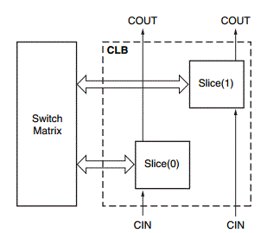
Logic Blocks
A configurable logic block (CLB) is a basic block used to implement the logic behind the VHDL designs we have been working on all semester.

Slide 23
Logic Blocks
In FPGAs, hundreds or thousands of CLBs are laid out in an array (commonly a switch matrix) known as the global routing network.

Slide 24
Logic Blocks
All of the CLBs on the FPGA are connected to each other. On the Artix-7 (and other Xilinx 7-series boards), each CLB contains two Logic Slices
The logical layout of a CLB can be seen in the Figure below.

Slide 25
Logic Slices

Slide 26
Logic Slices
The Artix-7 on our board (Artix-7 7A200T) has a total of 33,650 logic slices (16,825 CLBs).
Each logic slice contains four 6-input LUTs and eight flip-flops. This corresponds to 134,600 total 6-input LUTs.
There are three possible types of logic slices: SLICEM, SLICEL, and SLICEX.
However, in the Artix-7, SLICEX slices are unused; of the 33,650 logic slices, 22,100 are SLICEL and 11,550 are SLICEM.
In the subsequent sections, we will examine the slice with the most features: SLICEM. Lets look at a SLICEM.

Slide 27
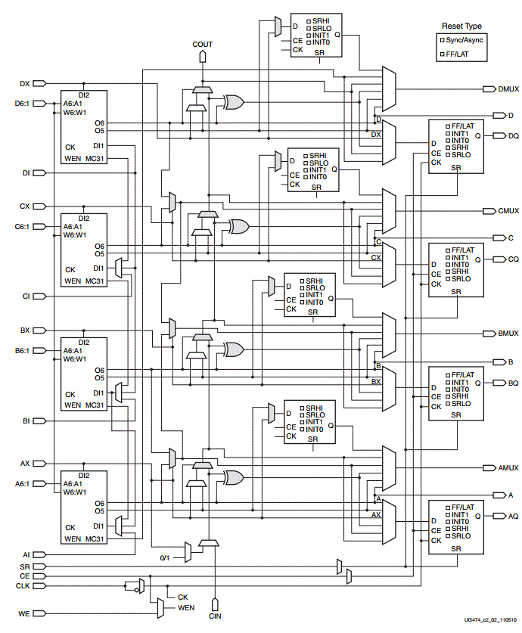
SLICEM
In the diagram, three major SLICEM subystems can be seen:
the four 6-input LUTs,
the eight flip-flops, and
the fast carry logic.
These subsystems will be discussed shortly.

Slide 28
1. Look-up tables
If you need a refresher on how a hardware LUT works, see this link. In a SLICEM, there are four 64x1 RAMs which are used to realize 5 or 6-variable functions; the truth table for the function is stored in the RAM and the inputs are used as the input addresses. As an example, let's try to realize a full adder using RAM. In class, we will derive the truth table for sum and carry and show how they can be inserted into a LUT. It is important for the further development of the lecture to point out that sum = a xor b xor c and that you can represent cout = ((a xor b) and cin) or (a and b) This last form is pretty nutty, but is also very useful, as we will see in a moment.

Slide 29
1. Look-up tables

Slide 30
2. Flip Flops
There are 8 flip flops in each logic slice. Answer the following questions:
Where does the data input come from?
How are the slices clocked?
How are the slices initialized?
Where are the slices' outputs sent?

Slide 31
2. Flip Flops

Slide 32
2. Flip Flops
Figure 7 on Page 14:

Slide 33
3. Fast Carry Logic
The fast carry logic is designed explicitly to realize a variation of a carry look-ahead adder.
Consider the construction of a 4-bit adder with inputs A=a3,a2,a1,a0 , B=b3,b2,b1,b0 , and a carry in c0.
Each slice of the adder can either generate a carry bit or propagate its carry in to the carry out.
Propagate -- pi is equal to 1 when the inputs to a bit slice are such that any carry in will be propagated.
Generate -- gi is equal to 1 when the inputs to a bit slice are such that a carry will be generated.
We can represent the cout of a slice as cout = g + p*cin. This arrangement is effectively what is happening in the carry logic block in the middle of each logic slice.

Slide 34
3. Fast Carry Logic

Slide 35
Interconnect

Slide 36
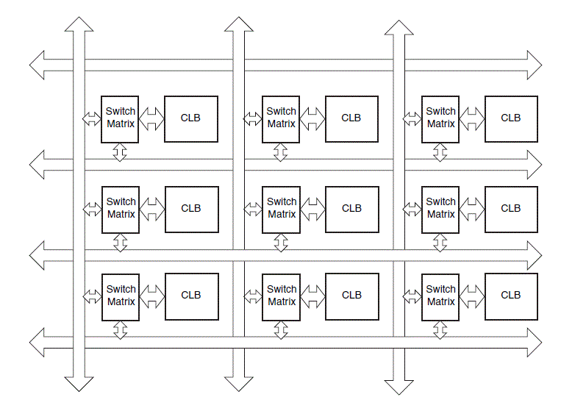
Interconnect
A logical figure of how the CLBs on the Artix-7 are interconnected to each other can be seen in the Figure below (taken from Spartan-6 documentation).
Source: "Spartan-6 FPGA Configurable Logic Block User's Guide", page 37, Figure 29

Slide 37
DSP Slice

Slide 38
DSP Slice
Apart from the slices which make up the CLBs, the Artix-7 also contains DSP slices.
The Artix-7 we are using contains 700 DSP48E1 slices. Each DSP48E1 slice contains a pre-adder, a 25 x 18 multiplier, an adder, and an accumulator.
A picture of a DSP slice can be seen in the Figure below.

Slide 39
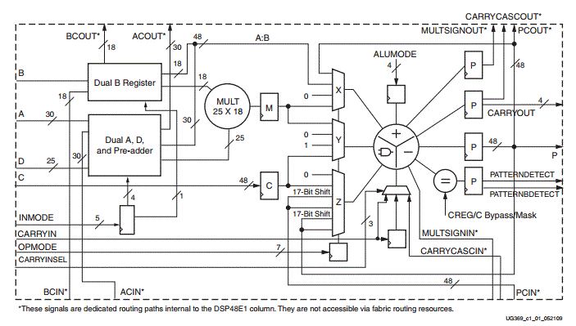
DSP Slice
A picture of a DSP slice can be seen in the Figure below.
Source: Xilinx 7 Series DSP48E1 Slice User Guide

