Slide 1
CSCE 436 – Advanced Embedded Systems Lecture 23 - Direct Digital Synthesis
Prof Jeffrey Falkinburg Avery Hall 368 472-5120

Slide 2
Lesson Outline
Time Logs!
Lab 3 – O’Scope Control
Functionality Due COB Today
Write-up Due COB LSN 26
Project Proposals Due BOC LSN 27
Fixed Point Arithmetic and Multiplication
Direct Digital Synthesis
Phase Increment

Slide 3
Fixed Point

Slide 4
Fixed Point
Binary Coded Number: 10010
How do you (formally) determine what decimal value it represents?
You need the Equation:
Decimal value = sum(b_{i}*2^{i})
Where the sum ranges over all the bit positions i.
Remember that the LSB (the one closest to the binary point) is ALWAYS index 0.
1*2⁴ + 0*2³ + 0*2² + 1*2¹ + 0*2⁰ = 16 + 2 = 18

Slide 5
Fixed Point
Well now generalize this idea to the right of the binary point and take a stab at what 1.11 means?
Important to note is that to represent values less than 1 (to the right of the decimal point), negative indices need to be used
1*2⁰ + 1*2⁻¹ + 1*2⁻² = 1 + 0.5 + 0.25 = 1.75

Slide 6
Fixed Point
Lets now convert 1.53125 into binary.
This is done by using the tried and true technique of finding the largest power of 2 that will fit into the number, subtracting it, and then continuing the conversion with the difference.
This process stops when you get down to zero.
To illustrate:
The largest power of two that fits into 1.53125 is 2⁰ = 1.0
The largest power of two that fits into 0.53125 is 2⁻¹ = 0.5
The largest power of two that fits into 0.03125 is 2⁻⁵ = 0.03125
Thus the binary representation of 1.53125 is 1.10001

Slide 7
Fixed Point Number Systems
Given: 01010.0101 (Designated in Q5.4 Format)
Find Decimal value:
1*2³ + 1*2¹ + 1*2⁻² + 1*2⁻⁴
= 8 + 2 + 0.25 + 0.0625
= 10.3125

Slide 8
Fixed Point Number Systems
Lets now convert -13.3125 into binary (Q8.8 Format)
Forget about the negative for now…
The largest power of two that fits into 13.3125 is 2³ = 8
The largest power of two that fits into 5.3125 is 2² = 4
The largest power of two that fits into 1.3125 is 2¹ = 1
The largest power of two that fits into 0.3125 is 2⁻² = 0.25
The largest power of two that fits into 0.0625 is 2⁻⁴ = 0.0625
Thus the binary representation of 13.3125 is 00001101.01010000
Now how to make it a negative 2’s Complement?
Flip bits and add 1 to LSB
00001101.01010000 ➔ 11110010.10110000 ➔ 0xF2B0 ➔ -13.3125

Slide 9
Fixed Point
Remember 13.3125 in binary (Q8.8 Format) is
00001101.01010000
What if that binary number was in Q16.0 Format what would you get?
All you have to do is shift the binary point right by 8-bits
00001101 01010000.
Converted to decimal is 3408₁₀
You get this by multiplying 13.3125 * 2⁸ = 3408 to shift the binary point right by 8 bits
Works in Reverse as well:
3408 / 2⁸ = 13.3125
Alternatively 3408 * 2⁻⁸ = 13.3125

Slide 10
Fixed Point
As you can imagine, some rational real numbers do not have a rational binary representation.
For example, the decimal number 0.1 cannot be represented as a finite binary string of 0's and 1's - it would repeat endlessly.
You can give the conversion a try if you want to prove this yourself.

Slide 11
Fixed Point Arithmetic

Slide 12
Fixed Point Arithmetic
Fixed point numbers vs floating point?
Can represent numbers with fractions even when hardware resources are limited or you would like to keep complexity to a minimum.

Slide 13
Fixed Point Arithmetic
W7 W6 W5 W4 W3 W2 W1 W0 . F7 F6 F5 F4 F3 F2 F1 F0
The 8 W-bits represent the whole portion
The 8 F-bits represent the fractional portion
The resulting 16-bit number can be manipulated as a whole with some minor book keeping to keep track of the binary point
This is Q8.8 format

Slide 14
Fixed Point Arithmetic
As an exercise determine the representation of:
23.5 and 45.25 in Q8.8 format and then add them.
00010111 10000000 (23.5)
+ 00101101 01000000 (45.25)
---------------------------------------
01000100 11000000 (68.75)
What about the Binary Point?
Doesn’t really exist per se
Line up binary points and add the bits like normal binary addition

Slide 15
Fixed Point Multiplication

Slide 16
Fixed Point Multiplication
Assume that 23 have a 4-bit representation where the binary point resides in the middle of the number (i.e. Q2.2).
We will multiply 3.25 and 1.25.
1111 (3.75) → Multiplicand
x 0101 (1.25) → Multiplier
--------------------
1111
0000
1111
+ 0000
--------------------- -----------
0100.1011 (4.6875) → Product requires (Q4.4)

Slide 17
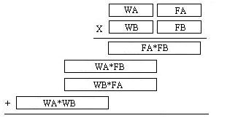
Fixed Point Multiplication
What if the multiplier is the wrong size?
Lets consider the multiplication of two 16-bit fixed point numbers (representing angles) WA:FA and WB:FB.
From our discussion the product requires 32-bits to represent.

Slide 18
Direct Digital Synthesis

Slide 19
Direct Digital Synthesis
Direct Digital Synthesis (DDS) is a technique to create periodic waveforms with very precise frequency control using a system with a fixed clock frequency.
The periodic function is stored in a look-up table like the following for a sin wave.
int8 sin[64] = {128,141,153,165,177,189,200,210,219,227,235,241,246,250,253,255, 255,254,252,248,244,238,231,223,214,205,194,183,171,159,147,134, 122,109, 97, 85, 73, 62, 51, 42, 33, 25, 18, 12, 8, 4, 2, 1, 1, 3, 6, 10, 15, 21, 29, 37, 46, 56, 67, 79, 91,103,115,128};

Slide 20
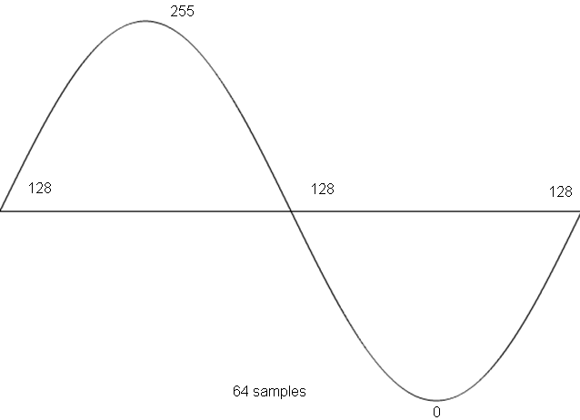
Direct Digital Synthesis
int8 sin[64] = {128,141,153,165,177,189,200,210,219,227,235,241,246,250,253,255, 255,254,252,248,244,238,231,223,214,205,194,183,171,159,147,134, 122,109, 97, 85, 73, 62, 51, 42, 33, 25, 18, 12, 8, 4, 2, 1, 1, 3, 6, 10, 15, 21, 29, 37, 46, 56, 67, 79, 91,103,115,128};
Table Length is a factor of 2^n (i.e. 2^6 = 64 samples).

Slide 21
Phase Increment

Slide 22
Phase Increment
Lets say that you could provide a new sample from the sin table at 48kHz (through an interrupt) to the codec.
If you incremented the pointer in the sin table by 1 on every interrupt. How long to get through the table?
64*21uS = 1.3mS
Generating a sine wave with a frequency of about 750Hz
If you incremented the pointer in the sin table by 2 every interrupt. How long to get through the table?
32*21uS = 0.65mS
Generating one period of the sine wave for a frequency of about 1.5kHz.

Slide 23
Phase Increment
Using integer values for the increment we are limited to very coarse adjustments in the frequency.
For example how could you use this schema to generate a sin wave with frequency of 1.0kHz?
Well you would need to increment the pointer in the sin table by 1.5 every 21uS.
And surprisingly, you can easily accomplish this using a fixed point representation.
This fractional value is called the phase increment.

Slide 24
Phase Increment
Lets look at how the phase increment, update rate, and size of the LUT are related to the output frequency.
1) Given a lookup table with 2^N values corresponding to one wavelength of a function.
2) Given a sampling rate or a play back rate of f_{s} updates/second
3) Given a phase increment x, which every 1/f is added to the index of the LUT.
f_{s} updates x values 1 cycle f*x
-------------- * -------------- * ------------- = ---- hz
1 second update 2^N values 2^N

Slide 25
Questions

Slide 26
Questions
Assuming an update rate of 48kHz, a LUT with 1024 entries, and a phase increment of x, expressed as a 10.6 fixed point number. Answer the following questions.
What is the maximum frequency we could generate?
What is the minimum frequency we can generate?
What is the smallest change in frequency we can make with the phase increment?
What phase increment generates a frequency of 440hz?
How did I arrive at the format of the phase increment?

Slide 27
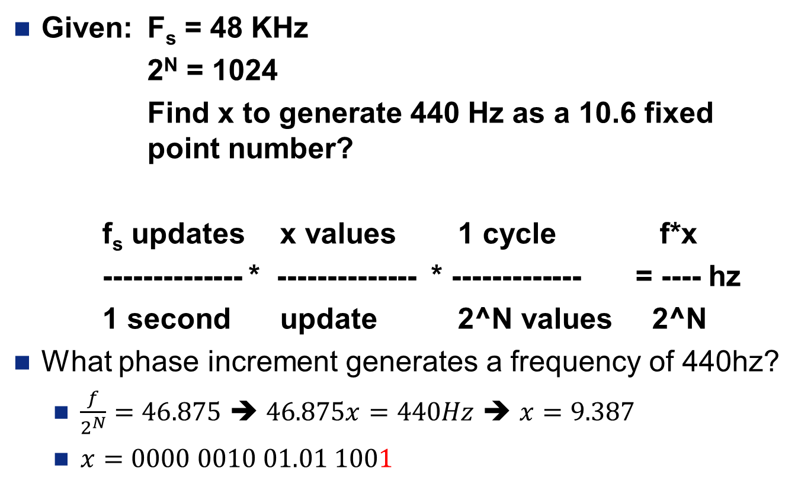
Phase Increment
Given: F_{s} = 48 KHz
2^{N} = 1024
Find x to generate 440 Hz as a 10.6 fixed point number?
f_{s} updates x values 1 cycle f*x
-------------- * -------------- * ------------- = ---- hz
1 second update 2^N values 2^N
What phase increment generates a frequency of 440hz?
$\frac{f}{2^{N}}=46.875$ ➔ $46.875x=440Hz$ ➔ $x=9.387$
$x=0000 0010 01.01 1001$

Slide 28
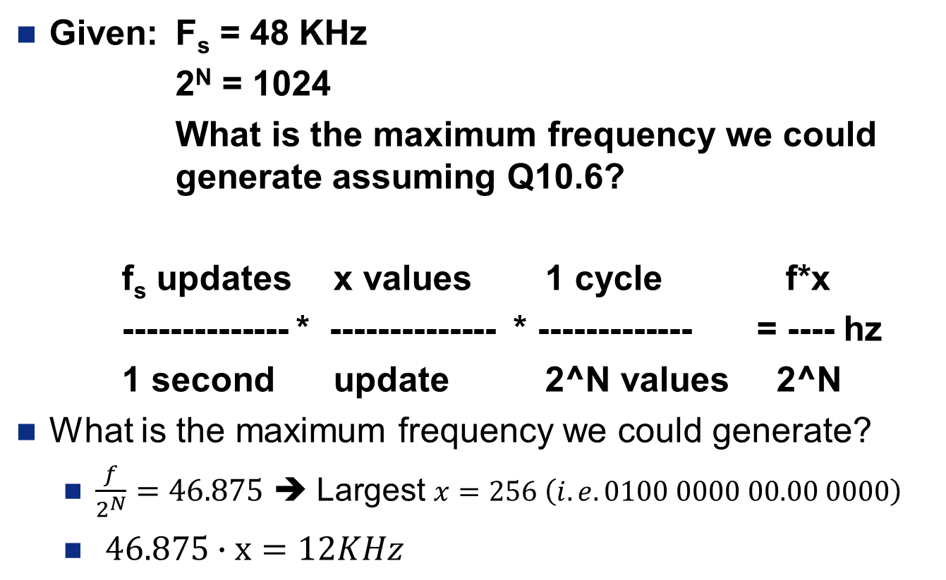
Phase Increment
Given: F_{s} = 48 KHz
2^{N} = 1024
What is the maximum frequency we could generate assuming Q10.6?
f_{s} updates x values 1 cycle f*x
-------------- * -------------- * ------------- = ---- hz
1 second update 2^N values 2^N
What is the maximum frequency we could generate?
$\frac{f}{2^{N}}=46.875$ ➔ Largest $x=256 \left(i.e. 0100 0000 00.00 0000\right)$
$46.875∙x=12KHz$
Why can’t we use $x=512$? Because of Nyquist Theorem
Why can’t we use $x=512$? Because of Nyquist Theorem

Slide 29
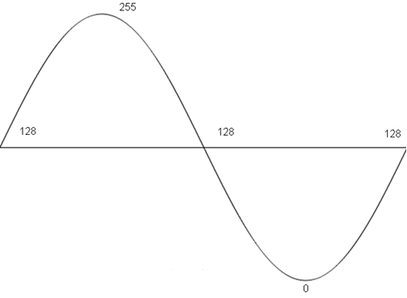

Phase Increment
Nyquist Theorem states that we must sample a signal at twice the highest frequency.
$x=512$ would give us the highest frequency, but the problem is
Why can’t we use $x=512$? Because of Nyquist Theorem
1024 Samples

Slide 30

Phase Increment
Given: F_{s} = 48 KHz
2^{N} = 1024
What is the minimum frequency we could generate assuming Q10.6?
f_{s} updates x values 1 cycle f*x
-------------- * -------------- * ------------- = ---- hz
1 second update 2^N values 2^N
What is the minimum frequency we can generate?
$\frac{f}{2^{N}}=46.875$ ➔ Smallest $x=2^{−6} \left(i.e. 0000 0000 00.00 0001\right)$
$46.875∙0.015625=0.73Hz$

Slide 31
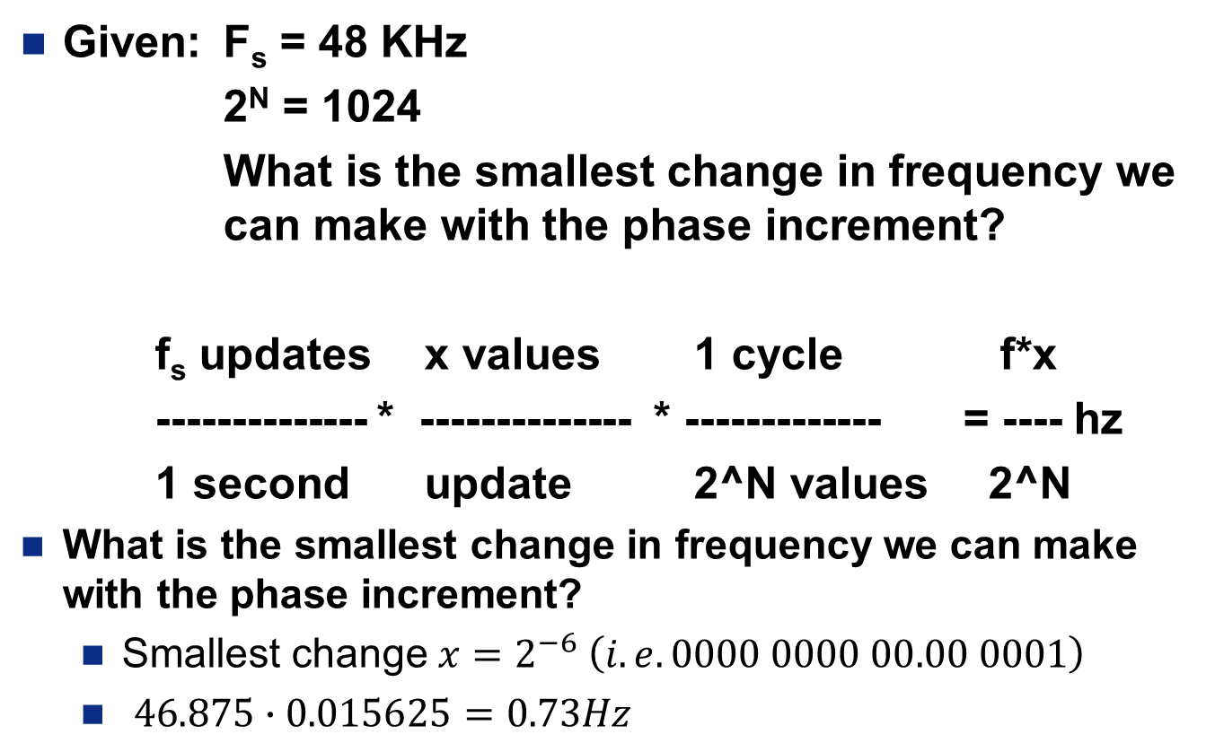
Phase Increment
Given: F_{s} = 48 KHz
2^{N} = 1024
What is the smallest change in frequency we can make with the phase increment?
f_{s} updates x values 1 cycle f*x
-------------- * -------------- * ------------- = ---- hz
1 second update 2^N values 2^N
What is the smallest change in frequency we can make with the phase increment?
Smallest change $x=2^{−6} \left(i.e. 0000 0000 00.00 0001\right)$
$46.875∙0.015625=0.73Hz$

Slide 32
Phase Increment
Given: F_{s} = 48 KHz
2^{N} = 1024
How did I arrive at the format of the phase increment?
f_{s} updates x values 1 cycle f*x
-------------- * -------------- * ------------- = ---- hz
1 second update 2^N values 2^N
How did I arrive at the format of the phase increment?
The RAM needs a 10-bit address. A standard 16-Bit register would have 6 bits left over for the fraction.

