Slide 1
CSCE 436 - Advanced Embedded Systems Lecture 2 – Digital System, Hierarchical Design, and testbench
Prof Jeffrey Falkinburg Avery Hall 368 472-5120

Slide 2
Lesson Outline
Time Logs!
HW #1 Due Now!
Overview of HDLs
Basic VHDL concepts by example
Testbenches

Slide 3
Overview of HDLs

Slide 4
Programming Language
Can we use C or Java as an HDL?
A computer programming language:
Semantics ("meaning")
Syntax ("grammar")
Development of a Language
Study the characteristics of the underlying processes
Develop syntactic constructs and their associated semantics to model and express these characteristics

Slide 5
HDL vs Traditional PL
Traditional PL
Modeled after a sequential process
Operations performed in a sequential order
Help human's thinking process to develop an algorithm step-by-step
Resemble the operation of a basic computer model
HDL
Characteristics of digital hardware
Connections of parts
Concurrent operations
Concept of propagation delay and timing
Characteristics cannot be captured by traditional PLs
Require new languages: HDL

Slide 6
HDL vs Traditional PL
HDL continued
Structural Connections
Timing
Parallel Nature

Slide 7
Modern Use of HDLs
Formal Documentation
Input to a simulator
Input to a synthesizer

Slide 8
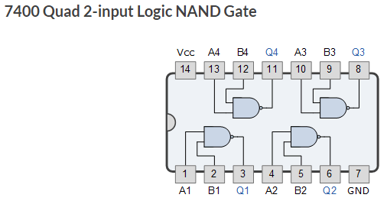
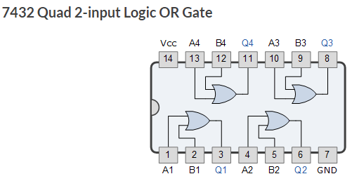
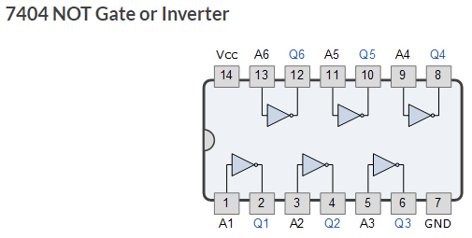
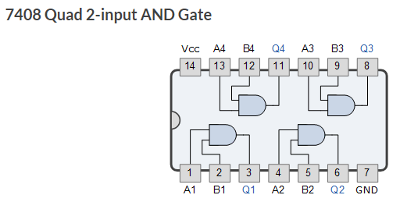
7400-Series Integrated Circuits
7400-Series Integrated Circuits
https://en.wikipedia.org/wiki/List_of_7400-series_integrated_circuits
Images from https://www.electronics-tutorials.ws/logic/logic_2.html

Slide 9
Characteristics of an HDL
Capture characteristics of a digital circuit:
Entity - basic building block (e.g. 7400 chips)
Connectivity - Connection of entities (e.g. wires)
Concurrency - parallel operations
Timing - schedule / order of multiple operations
Must be able to describe a circuit in
Gate level and RT level
Structural view and behavioral view (not physical)

Slide 10
Highlights of Modern HDLs
Encapsulate the concepts of entity, connectivity, concurrency, and timing
Incorporate propagation delay and timing information
Consist of constructs for structural implementation
Incorporate constructs for behavioral description (sequential execution of traditional PL)
Describe the operations and structures in gate level and RT level
Consist of constructs to support hierarchical design process

Slide 11
Industry-Standard HDLs
VHDL
DoD initiative in 1980s
Transferred to IEEE to standardize
First released in 1987
Similar to Ada
Heavily used in FPGA industry
New versions: 1993, 2001, 2008
Verilog
Developed by industry
Released in early 1980s
Similar to C
Heavily used in ASIC industry
New versions: 1995, 2001, 2005, 2009
SystemVerilog is a superset of Verilog 2005 & 2009

Slide 12
Basic VHDL Concepts By Example

Slide 13
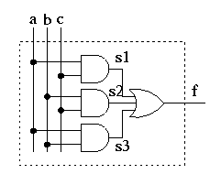
Structural Description
Structural Description from Lesson 1
Entity
Truth Table
a b c | f
-------|--
0 0 0 | 0
0 0 1 | 0
0 1 0 | 0
0 1 1 | 1
1 0 0 | 0
1 0 1 | 1
1 1 0 | 1
1 1 1 | 1
Architecture

Slide 14
Structural Description
Entity declaration
i/o ports (“outline” of the circuit)
Architecture body
Signal declaration
Each concurrent statement
Can be thought of as a circuit part
Contains timing information
Arch body can be thought as a “collection of parts”
What’s the difference between this and a C program

Slide 15
Structural Description
In structural view, a circuit is constructed by smaller parts.
Structural description specifies the types of parts and connections.
Essentially a textual description of a schematic
Done by using “component” in VHDL
First declared (make known)
Then instantiated (used)

Slide 16
Structural Description – Component Declaration
library IEEE; -- These lines are similar to a #include in C
use IEEE.std_logic_1164.all;
library unisim; -- Use these libraries if you are using primitive components
use unisim.vcomponents.all;
entity majority is
port( a, b, c: in std_logic;
f: out std_logic);
end majority;
architecture structure of majority is
component AND2
port ( i0, i1 : in std_logic;
o : out std_logic);
end component;
component OR3
port ( i0, i1, i2 : in std_logic;
o : out std_logic);
end component;
signal s1, s2, s3: std_logic; -- wires which begin and end in the component
Primitive Components Library
Component Declarations before Begin

Slide 17
Structural Description –Component Instantiation
begin
unit1: AND2
port map ( -- s1 <= a and b;
i0 => a,
i1 => b,
o => s1);
unit2: AND2
port map ( -- s2 <= b and c;
i0 => b,
i1 => c,
o => s2);
unit3: AND2
port map ( -- s3 <= a and c;
i0 => a,
i1 => c,
o => s3);
unit4: OR3
port map ( -- f <= s1 or s2 or s3;
i0 => s1,
i1 => s2,
i2 => s3,
o => f);
end structure;
Component Instantiations after Begin

Slide 18
Behavioral
A behavioral description of a component describes what the circuit does rather than how it is done.
library IEEE; -- These lines are similar to a #include in C
use IEEE.std_logic_1164.all;
entity majority is
port( a, b, c: in std_logic;
f: out std_logic);
end majority;
architecture Behavioral of majority is
begin
f <= '0' when a='0' and b='0' and c='0' else
'0' when a='0' and b='0' and c='1' else
'0' when a='0' and b='1' and c='0' else
'1' when a='0' and b='1' and c='1' else
'0' when a='1' and b='0' and c='0' else
'1' when a='1' and b='0' and c='1' else
'1' when a='1' and b='1' and c='0' else
'1';
-- essentially an enumeration of a truth table
end Behavioral;
Truth Table
a b c | f
-------|--
0 0 0 | 0
0 0 1 | 0
0 1 0 | 0
0 1 1 | 1
1 0 0 | 0
1 0 1 | 1
1 1 0 | 1
1 1 1 | 1

Slide 19
Behavioral
Concatenation operator helps make code more readable
Concatenation Operator
library IEEE; -- These lines are similar to a #include in C
use IEEE.std_logic_1164.all;
entity majority is
port( a, b, c: in std_logic;
f: out std_logic);
end majority;
architecture Behavioral of majority2 is
signal temp: std_logic_vector(2 downto 0);
begin
temp <= a & b & c;
f <= '0' when temp = "000" else
'0' when temp = "001" else
'0' when temp = "010" else
'1' when temp = "011" else
'0' when temp = "100" else
'1' when temp = "101" else
'1' when temp = "110" else
'1';
end Behavioral;
Double quotes for std_logic_vectors

Slide 20
Combinational vs Sequential
What is the difference between combinational and sequential?
A clock signal in the entity for the output

Slide 21
Literals
In VHDL they are called literals (not a constant)
hexDigit : std_logic_vector (3 downto 0);
…hexDigit = x“D” else
…hexDigit = “0101” else
…hexDigit = d“12” else
“=” – used to compare
“<=” – used to assign
hexDigit : std_logic_vector (15 downto 0);
…hexDigit <= x“C0_FF_EE”; --can also use separators

Slide 22
Testbenches

Slide 23
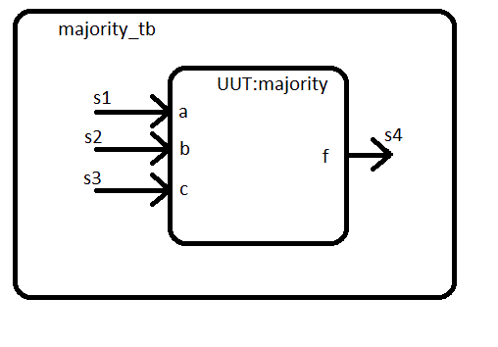
Testbench – Component Declaration and Instantiation
ENTITY majority_tb IS
END majority_tb;
ARCHITECTURE behavior OF majority_tb IS
COMPONENT majority
PORT( a : IN std_logic;
b : IN std_logic;
c : IN std_logic;
f : OUT std_logic);
END COMPONENT;
signal s1, s2, s3, s4: std_logic;
begin
uut: majority PORT MAP (
a => s1,
b => s2,
c => s3,
f => s4);
end

Slide 24
Simple Test Vectors
begin
uut: majority PORT MAP (
a => s1,
b => s2,
c => s3,
f => s4);
end
s1 <= '0', '1' after 40us;
s2 <= '0', '1' after 20us, '0' after 40us, '1' after 60us;
s3 <= '0', '1' after 10us, '0' after 20us, '1' after 30us , '0' after 40us, '1' after 50us , '0' after 60us, '1' after 70us, ;
end behavior;

Slide 25
Testbench – Test Vectors for self checking testbenches
Test Vector Setup (before begin):
Loop to apply the 8 test input vectors to majority circuit (after begin)
1. CONSTANT TEST_ELEMENTS:integer:=8;
2. SUBTYPE INPUT is std_logic_vector(2 downto 0);
3. TYPE TEST_INPUT_VECTOR is array (1 to TEST_ELEMENTS) of INPUT;
4. SIGNAL TEST_INPUT: TEST_INPUT_VECTOR := ("000", "001", "010", "011", "100", "101", "110", "111");
1. for i in 1 to TEST_ELEMENTS loop
2. testVector <= test_input(i);
3. wait for 1 us;
4. assert f = test_output(i)
5. report "Error in majority circuit for input " & integer'image(i)
6. severity failure;
7. end loop;

Slide 26
Testbench – Test Vectors for self checking testbenches
Test Vector Setup:
Loop to apply the 8 test input vectors to majority circuit
1. CONSTANT TEST_ELEMENTS:integer:=8;
2. SUBTYPE INPUT is std_logic_vector(2 downto 0);
3. TYPE TEST_INPUT_VECTOR is array (1 to TEST_ELEMENTS) of INPUT;
4. SIGNAL TEST_INPUT: TEST_INPUT_VECTOR := ("000", "001", "010", "011", "100", "101", "110", "111");
1. for i in 1 to TEST_ELEMENTS loop
2. testVector <= test_input(i);
3. wait for 1 us;
4. assert f = test_output(i)
5. report "Error in majority circuit for input " & integer'image(i)
6. severity failure;
7. end loop;

Slide 27
Simulation Experimentation
How to add and remove waveforms to the waveform view.
How to change the radix of a vector waveform
How to change the colors of the waveforms.
How to transcend the design hierarchy.
How to observe signal values in design hierarchy.
How to observe signals values in the VHDL code.
How to save a load a simulation waveform wcfg file.

Slide 28
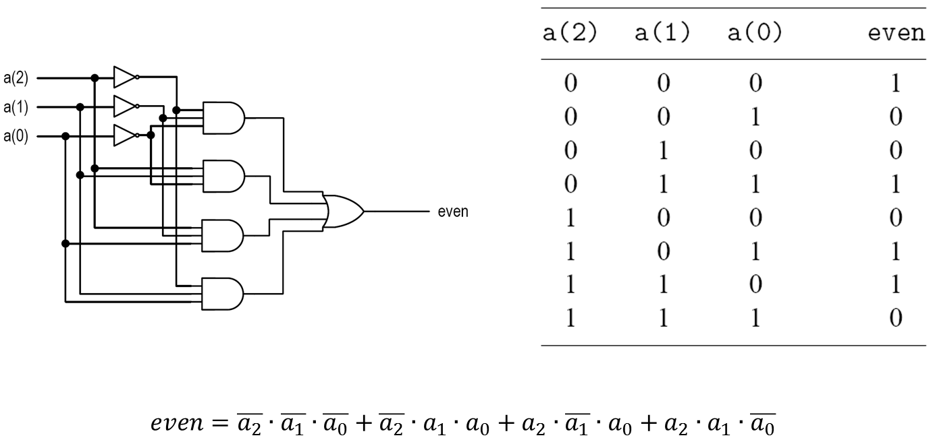
Even Parity Detection Circuit
Inputs: a(2 downto 0)
Output: even

Slide 29
Even Parity Detection Circuit
library ieee;
use ieee.std_logic_1164.all;
entity even_detector is
port(
a : in std_logic_vector(2 downto 0);
even : out std_logic
);
end even_detector;
architecture sop_arch of even_detector is
signal p1, p2, p3, p4 : std_logic;
begin
even <= (p1 or p2) or (p3 or p4) after 20 ns;
p1 <= (not a(2)) and (not a(1)) and (not a(0)) after 15 ns;
p2 <= (not a(2)) and a(1) and a(0) after 12 ns;
p3 <= a(2) and (not a(1)) and a(0) after 12 ns;
p4 <= a(2) and a(1) and (not a(0)) after 12 ns;
end sop_arch;

Slide 30
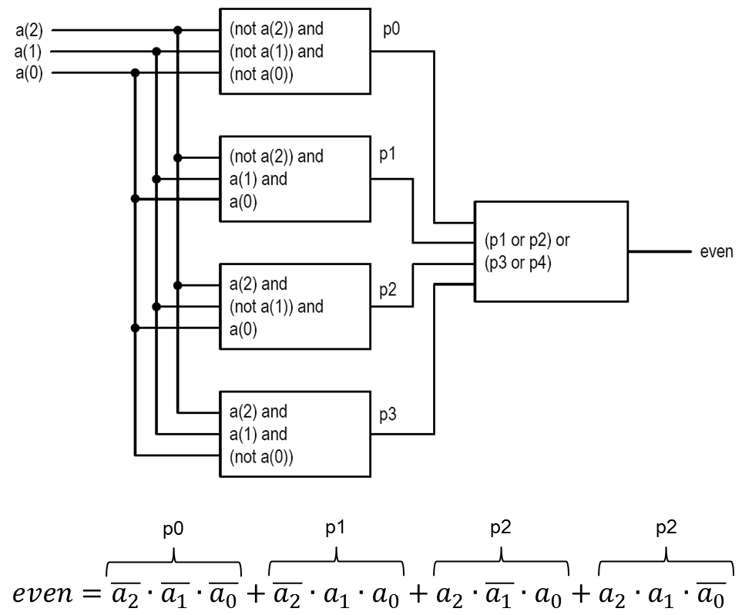
VHDL Conceptual Diagram

Slide 31
Alternative Implementation
Same entity declaration
VHDL now contains two architecture bodies (sop_arch is in the "...")
Implicit delta delay

Slide 32
Lesson Outline
Overview of HDLs
Basic VHDL concepts by example
Testbenches

