Slide 1
CSCE 436 – Advanced Embedded Systems Lecture 4 – Sequential Element
Prof Jeffrey Falkinburg Avery Hall 368 472-5120

Slide 2
Using Unsigned and Decimal Numbers
Convert Decimal number to Unsigned Vector (7 downto 0)
to_unsigned(17, 8)
First argument is the decimal number
Second argument is the number of bits
Conditional with unsigned number
LED_Trigger <= '1' when (Binary_Input = to_unsigned(17, 8) ) else
‘0';

Slide 3
Lesson Outline
Time Logs!
HW #3 Due Now!
Sequential Elements
Mod 10 Counter Example
Truth Table
Timing Diagram
Circuit Diagram
VHDL
General VHDL Rules
Adding Signals to Isim

Slide 4
Sequential Elements

Slide 5
Sequential Elements
Goals:
basic sequential process and sensitivity list
register, counter in VHDL
Combination of sequential and combinational logic (counters)
Translate between schematic, truth table, and VHDL code

Slide 6
Combinational vs Sequential Counter
Combinational Way:
Output = F(inputs)
Sequential Way
Output = F(input, state)
With the state we accumulate memory or a history of inputs

Slide 7
Mod 10 Counter Example

Slide 8
Mod 10 Counter Example
State Table
clk | reset | ctrl | D | Q+
0,1,falling | x | xx | x | Q
rising | 0 | xx | x | 0
rising | 1 | 00 | x | Q
rising | 1 | 01 | x | Q+1 mod 10
rising | 1 | 10 | D | D
rising | 1 | 11 | x | 0

Slide 9
Mod 10 Counter Example
Memory: The first line tells us that only a positive clock edge will result in an increment. Any other condition results in the next state of Q (denoted Q+) being unchanged (equal to Q).
clk | reset | Ctrl | D | Q+
0,1,falling | x | xx | x | Q
rising | 0 | xx | x | 0
rising | 1 | 00 | x | Q
rising | 1 | 01 | x | Q+1 mod 10
rising | 1 | 10 | D | D
rising | 1 | 11 | x | 0

Slide 10
Mod 10 Counter Example
Reset: The second line defines the behavior when the reset is active low (to agree with the active-low reset on the Nexys Video board).
clk | reset | Ctrl | D | Q+
0,1,falling | x | xx | x | Q
rising | 0 | xx | x | 0
rising | 1 | 00 | x | Q
rising | 1 | 01 | x | Q+1 mod 10
rising | 1 | 10 | D | D
rising | 1 | 11 | x | 0

Slide 11
Mod 10 Counter Example
Hold: The third row tells us that the counter will hold when the 2-bit control is equal to 00.
clk | reset | Ctrl | D | Q+
0,1,falling | x | xx | x | Q
rising | 0 | xx | x | 0
rising | 1 | 00 | x | Q
rising | 1 | 01 | x | Q+1 mod 10
rising | 1 | 10 | D | D
rising | 1 | 11 | x | 0

Slide 12
Mod 10 Counter Example
Count Up Mod 10: The fourth row tells us that the counter will count up when the 2-bit control is equal to 01. The "mod 10" means that the counter is supposed to count from 0 to 9 and then, on the next count, roll back to 0.
clk | reset | Ctrl | D | Q+
0,1,falling | x | xx | x | Q
rising | 0 | xx | x | 0
rising | 1 | 00 | x | Q
rising | 1 | 01 | x | Q+1 mod 10
rising | 1 | 10 | D | D
rising | 1 | 11 | x | 0

Slide 13
Mod 10 Counter Example
Load D: The fifth row tells us that the counter will load in the value 'D' when the 2-bit control is equal to 10.
clk | reset | Ctrl | D | Q+
0,1,falling | x | xx | x | Q
rising | 0 | xx | x | 0
rising | 1 | 00 | x | Q
rising | 1 | 01 | x | Q+1 mod 10
rising | 1 | 10 | D | D
rising | 1 | 11 | x | 0

Slide 14
Mod 10 Counter Example
Sync Reset: The sixth row tells us that the counter will synchronously reset when the 2-bit control is equal to 11.
clk | reset | Ctrl | D | Q+
0,1,falling | x | xx | x | Q
rising | 0 | xx | x | 0
rising | 1 | 00 | x | Q
rising | 1 | 01 | x | Q+1 mod 10
rising | 1 | 10 | D | D
rising | 1 | 11 | x | 0

Slide 15
Mod 10 Counter Example
Truth Table Behavior Summary:
clk | reset | Ctrl | D | Q+ | Behavior
0,1,falling | x | xx | x | Q | Memory
rising | 0 | xx | x | 0 | Reset
rising | 1 | 00 | x | Q | Hold
rising | 1 | 01 | x | Q+1 mod 10 | Count Up
rising | 1 | 10 | D | D | Load D
rising | 1 | 11 | x | 0 | Sync Reset

Slide 16
Timing Diagram

Slide 17
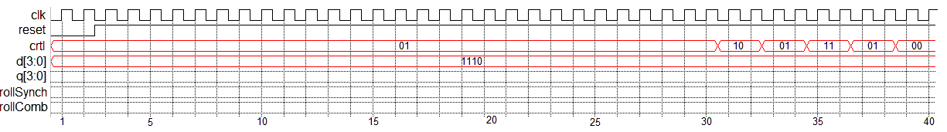
Mod 10 Counter - Timing Diagram
Complete the Q trace in the following timing diagram based on the state table for the mod-10 counter.
clk | reset | Ctrl | D | Q+ | Behavior
0,1,falling | x | xx | x | Q | Memory
rising | 0 | xx | x | 0 | Reset
rising | 1 | 00 | x | Q | Hold
rising | 1 | 01 | x | Q+1 mod 10 | Count Up
rising | 1 | 10 | D | D | Load D
rising | 1 | 11 | x | 0 | Sync Reset

Slide 18
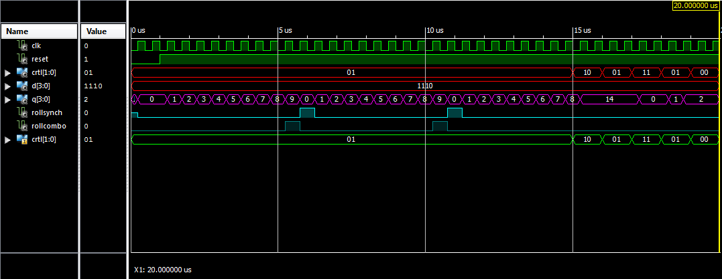
Mod 10 Counter - Timing Diagram

Slide 19
Mod 10 Counter - Timing Diagram

Slide 20
Mod 10 Counter - Timing Diagram

Slide 21
Circuit Diagram

Slide 22
Circuit Diagram
After completing the timing diagram, see if you can figure out how to construct the counter using the arrangement of devices show in the picture below.
You may assume that all these inputs are able to handle 4-bit values - to indicate this, draw a hash through the signal lines with a "4" next to it.
You should not draw additional lines in this picture. Instead, label the wires with names and use these names to create logical connections between signals with the same name.
Draw a border around your circuit. The only signals that should cross the boundary are those which are part of the entity description.

Slide 23
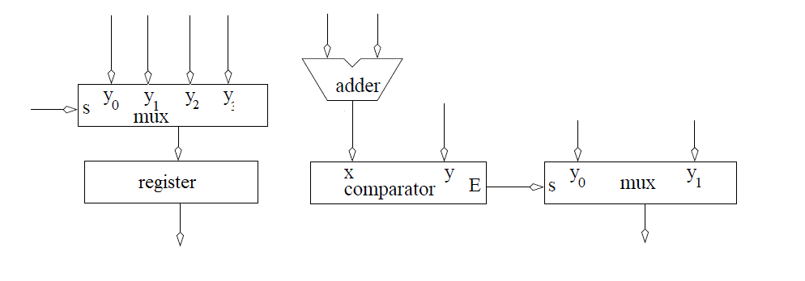
Circuit Diagram
Build the Architecture for the Mod 10 Counter

Slide 24
VHDL

Slide 25
Mod 10 Counter – VHDL Code Entity
entity lec4 is
Port( clk: in STD_LOGIC;
reset : in STD_LOGIC;
ctrl: in std_logic_vector(1 downto 0);
D: in unsigned (3 downto 0);
Q: out unsigned (3 downto 0));
end lec4;
1. architecture behavior of lec4 is
2. signal rollSynch, rollCombo: STD_LOGIC;
3. signal processQ: unsigned (3 downto 0);
4. begin

Slide 26
Mod 10 Counter – VHDL Code Architecture
Sensitivity List
process(clk)
begin
if (rising_edge(clk)) then
if (reset = '0') then
processQ <= (others => '0');
rollSynch <= '0';
elsif ((processQ < 9) and (ctrl = "01")) then
processQ <= processQ + 1;
rollSynch <= '0';
elsif ((processQ = 9) and (ctrl = "01")) then
processQ <= (others => '0');
rollSynch <= '1';
elsif (ctrl = "10") then
processQ <= unsigned(D);
elsif (ctrl = "11") then
processQ <= (others => '0');
end if;
end if;
end process;
Line 1 of State Table
Line 2 of ST: -- Reset
Line 3 of ST: Not Here -- Hold
Line 4
-- Count Up
Line 5 of ST: -- Load D
Line 6 of ST: -- Synch Reset

Slide 27
Mod 10 Counter – VHDL Code Architecture
-- Concurrent Signal Assignments
rollCombo <= '1' when (processQ = 9) else '0';
Q <= processQ;
end behavior;
Can add “and (ctrl = "01")” to confirm it only happens when counting up and count = 9

Slide 28
General VHDL Rules

Slide 29
General VHDL Rules
Introduce the following rules for designing in VHDL in order to write code that can be synthesized.
Never use processes for combinational logic.
Only the clk should appear in the sensitivity list
The outermost structure should be "if (rising_edge(clk)) then"
Inside this structure should be "if (reset = '0') then" to reinitialize the state element used by the process
The else clause of the reset element (the body) should consist of a set of exclusive signal conditions in an if/then case structure.
Any signal on the left-hand side of an assignment statement (in the body) may not be put on the left-hand side of any assignment statement outside the process.

Slide 30
Adding Signals in Xsim

Slide 31
Adding Signals in Xsim
Sometimes it is necessary to examine signals not directly visible in a design. In the Instances and Process subwindow, reveal the instances inside the lec4_tb by clicking on the arrow to the left lec4_tb.
Reveal the signals inside the lec4 instance (called uut) by clicking on the label "uut".
In the Objects subwindow select the signal that you want to observe on the timing diagram. In our case the ctrl signal.
Drag and drop the signal into the timing diagram.
In most cases you will have to restart the simulation to get a complete trace of the newly added signal.
And the rerun it for the needed amount of time.

Slide 32
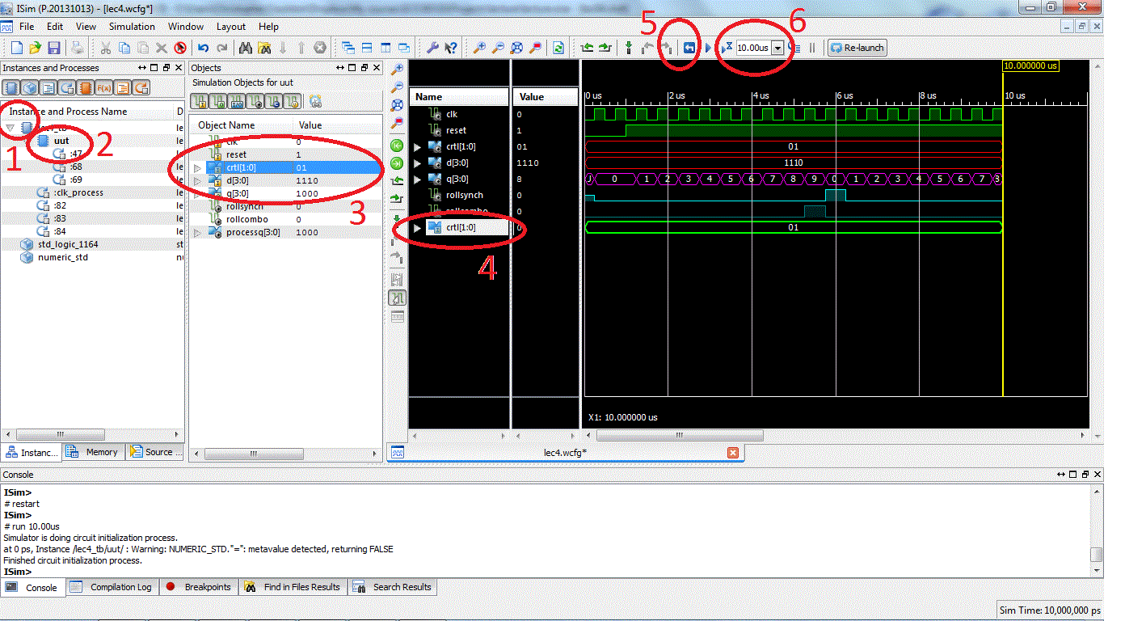
Adding Signals in Xsim Vivado Simulator

Slide 33
Lesson Outline
Sequential Elements
Mod 10 Counter Example
Truth Table
Timing Diagram
Circuit Diagram
VHDL
General VHDL Rules
Adding Signals to Isim

