Slide 1
CSCE 436 – Advanced Embedded Systems Lecture 10 – Finite State Machines
Prof Jeffrey Falkinburg Avery Hall 368 472-5120

Slide 2
Lesson Outline
Time Logs!
Lab 1 Write-up Due COB!
D Flip Flop
Finite State Machine
FSM Timing
The DAISY System

Slide 3
D Flip Flop

Slide 4
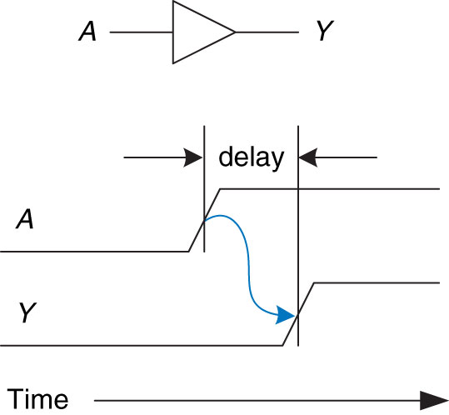
Delay
Figure 2.66 Circuit delay
Copyright © 2013 Elsevier Inc. All rights reserved.

Slide 5
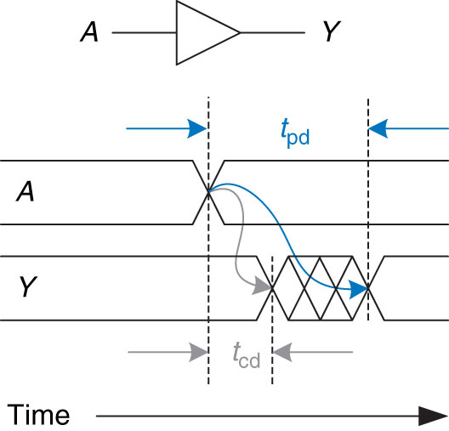
Propagation Delay and Contamination Delay
Figure 2.67 Propagation and contamination delay
Copyright © 2013 Elsevier Inc. All rights reserved.

Slide 6
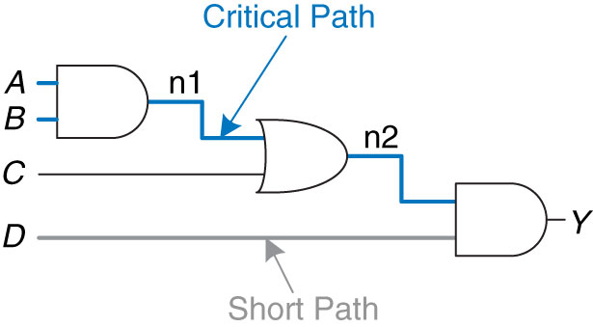
Critical Path and Shortest Path
Figure 2.68 Short path and critical path
Copyright © 2013 Elsevier Inc. All rights reserved.

Slide 7
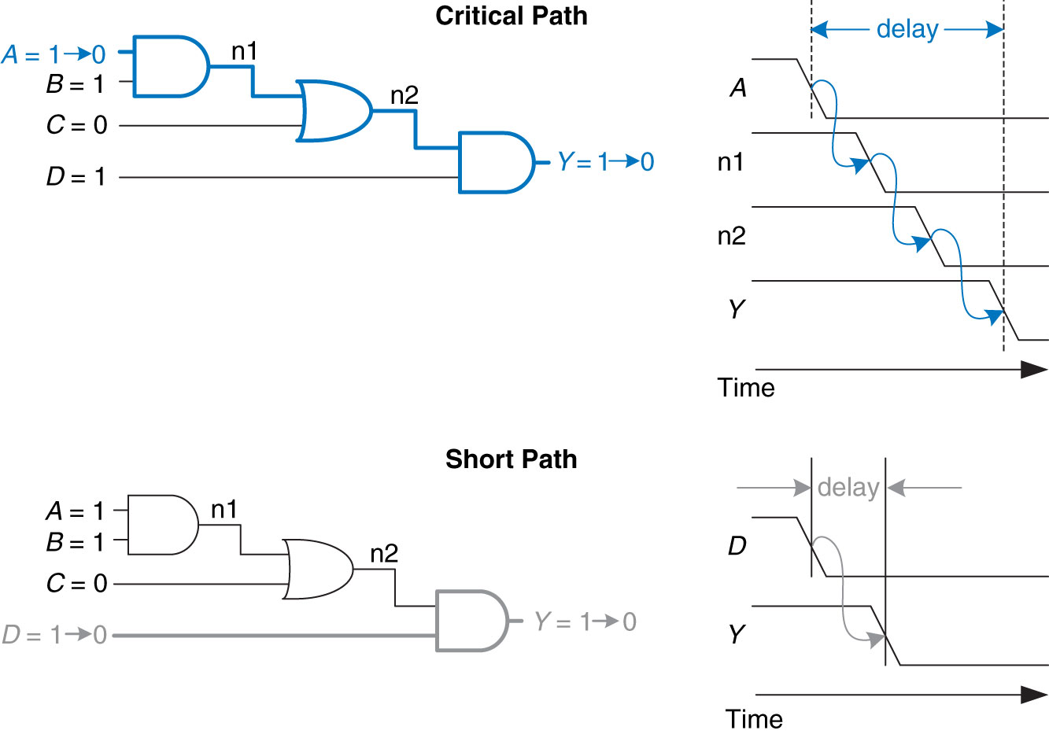
Critical Path and Shortest Path Waveform
Figure 2.69 Critical and short path waveforms
Copyright © 2013 Elsevier Inc. All rights reserved.

Slide 8
D Flip Flop
Setup time(t_{su}) - is the amount of time before the rising edge of the clock in which the data inputs must be stable.
Hold time(t_{h}) is the amount of time after the rising edge of the clock during which the data input must be stable.
Propagation Delay(t_{p}), is the amount of time after the rising edge of the clock required for the new Q value to become valid.
It is also known as t_{CQ}, for "time clock to Q", or t_{FF}. These time values are illustrated in the picture below.

Slide 9
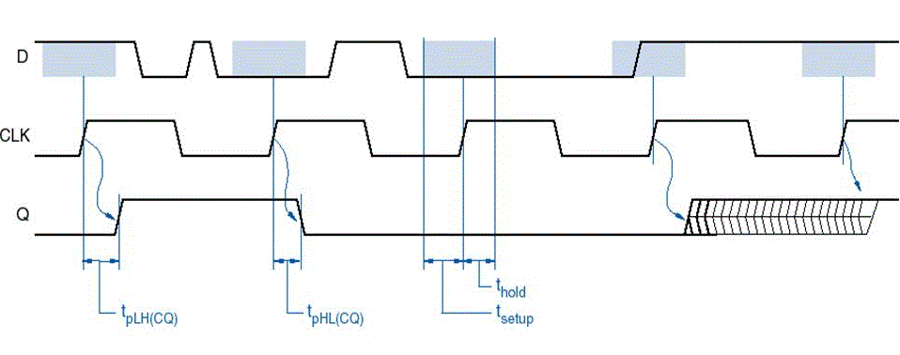
D Flip Flop

Slide 10
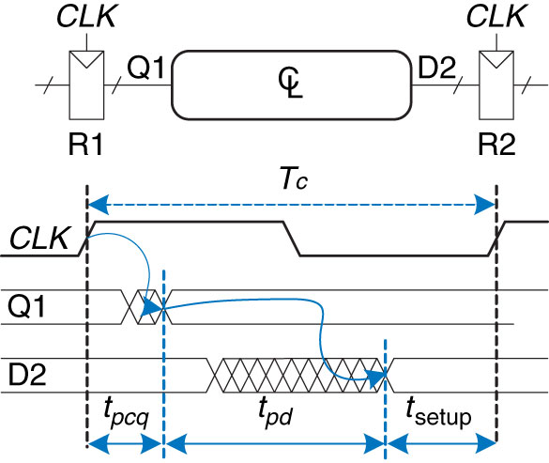
Time Clock to Q
Propagation Delay
Figure 3.39 Maximum delay for setup time constraint
Copyright © 2013 Elsevier Inc. All rights reserved.

Slide 11
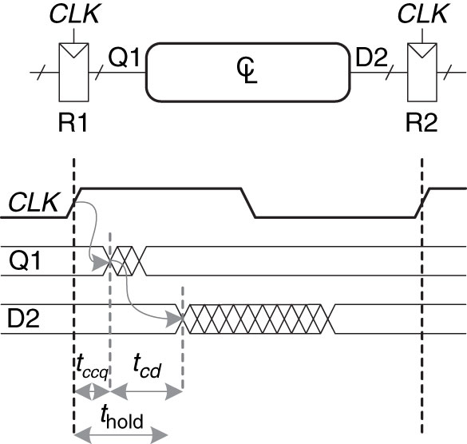
Time Clock to Q
Contamination Delay
Figure 3.40 Minimum delay for hold time constraint
Copyright © 2013 Elsevier Inc. All rights reserved.

Slide 12
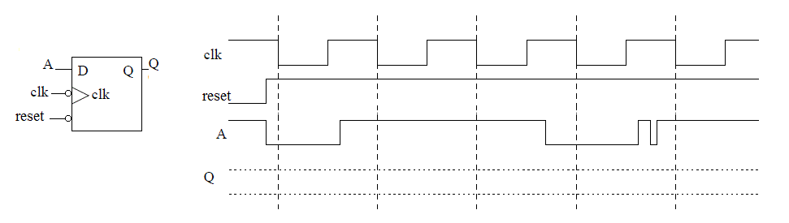
D Flip Flop
What type of D Flip Flop is this?
Fill in waveform!
T_{su}, T_{h}, T_{pd}

Slide 13
Finite State Machine

Slide 14
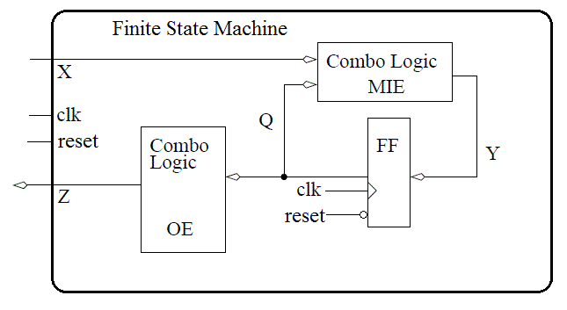
Finite State Machine
Finite State Machine (FSM) – most general form of a sequential circuit, a circuit whose output is a function of input and an internal state
Moore or Mealy?

Slide 15
Finite State Machines
FSM – M- inputs, N – Outputs, and K - bits of state
FSMs have K registers that can be one of a finite number (2^{K}) unique states
Two types of FSMs?
Clock
Next
State
Current
State
Inputs
M
Combinational Logic or
Next State Logic
K
Flip Flops
K
Output Logic
N
Outputs

Slide 16
Finite State Machines - Moore Machine
Moore Machine – outputs depend only on current state of the machine.
Clock
Next
State
Current
State
Inputs
M
Combinational Logic or
Next State Logic
K
Flip Flops
K
Output Logic
N
Outputs

Slide 17
Finite State Machines - Mealy Machine
Mealy Machine – outputs depend on both the current state and current inputs of the machine.
Clock
Next
State
Current
State
Inputs
M
Combinational Logic or
Next State Logic
K
Flip Flops
K
Output Logic
N
Outputs

Slide 18
Finite State Machines - Design
How to Design a State Machine:
0) Description
1) State Transition Diagram
2) State Transition Table & Output Table
3) Next State and Output State Equations
4) Schematic
Copyright © 2013 Elsevier Inc. All rights reserved.

Slide 19
Finite State Machine - Design
Design of a FSM requires three questions answered:
What are the Memory Input Equations (MIEs)?
What are the Output Equations (OEs)?
How many D flip flops are required?

Slide 20
Finite State Machine - Design
Design of a FSM requires three questions answered:
What are the Memory Input Equations (MIEs)?
What are the Output Equations (OEs)?
How many D flip flops are required?
clk
Finite State Machine
reset
clk
X
Combo Logic (MIE)
Y
Flip Flops
Q
Combo Logic
(OE)
Z
Q
reset

Slide 21
Finite State Machines - Moore vs Mealy Machine
Moore Machine – outputs depend only on current state of the machine.
Mealy Machine – outputs depend on both the current state and current inputs of the machine.
Clock
Next
State
Current
State
Inputs
M
Combinational Logic or
Next State Logic
K
Flip Flops
K
Output Logic
N
Outputs
Clock
Next
State
Current
State
Inputs
M
Combinational Logic or
Next State Logic
K
Flip Flops
K
Output Logic
N
Outputs
21

Slide 22
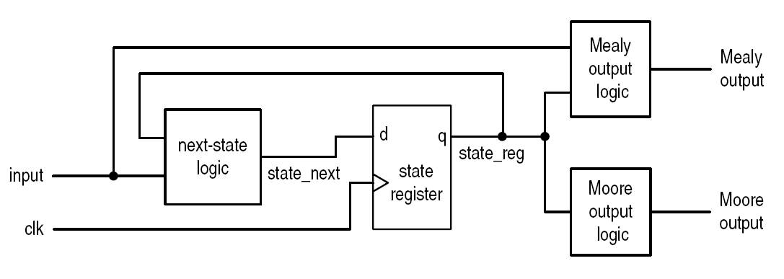
Finite State Machine
Figure 10.1 Block diagram of an FSM.

Slide 23
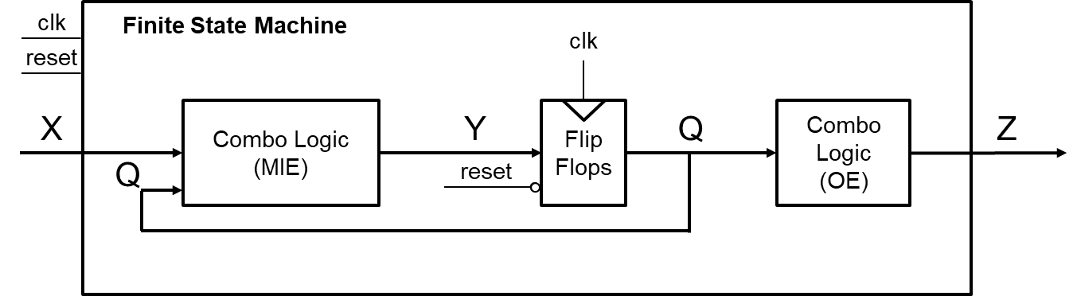
FSM Timing

Slide 24
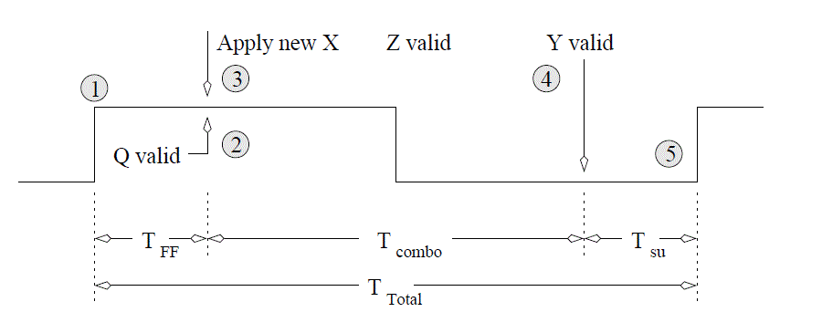
FSM Timing
Event 1- Since flip flops sample their inputs on the positive edge of the clock, this point is the beginning of the timing analysis.`
1

Slide 25
FSM Timing
Event 1- Since flip flops sample their inputs on the positive edge of the clock, this point is the beginning of the timing analysis.
1

Slide 26
FSM Timing
Event 2 - The propagation delay of the flip flops means a small delay occurs between the clock edge and the flip flop outputs, Q, becoming valid. This is the called the propagation delay of the flip flop and denoted T_ff in the diagram below.
2

Slide 27
FSM Timing
Event 3 - In order to maximize the clocking frequency of the FSM, the new inputs, X, to the FSM should be applied at the same moment that the flip flop outputs become valid.
3

Slide 28
FSM Timing
Event 4 - According to Figure above, changing Q and X causes the memory inputs to change (the Y signal above). The delay between the application of the new inputs to the MIE logic and Y becoming valid is the propagation delay of the combination logic, denoted Tcombo.
4

Slide 29
FSM Timing
Event 5 - When the Y values are valid, a small delay occurs while the flip flops register their new inputs, denoted Tsu. After this setup time, the FSM is ready for another clock edge.
5

Slide 30
The DAISY System
Lets bring in the cows.

Slide 31
The DAISY System
Dairy Automated Information System, or DAISY for short
Word Statement Cows have a RFID tag attached to their collars. When the cow passes through the cattle chute on their way into the barn, a RFID reader reads the unique ID stored on the RFID tag and logs the cow into the barn.
The RFID system outputs a single bit: a 1 means the system has read an RFID tag and has successfully checked a cow back into the barn; a 0 means the RFID system is either still processing a tag or is not currently reading a tag.
The RFID system outputs a single bit:
Logic 1 – Cow Checked In
Logic 0 – Cow Not Processed

Slide 32
The DAISY System
In order to ensure each cow is scanned, the flow of cows into the barn is controlled by two gates at either end of the chute. Each gate is controlled by a single bit. To lift a gate, this input must be held at logic 1; to lower a gate, the input must be held at a logic 0. The sequence of raising and lowering the gates in order to control the flow of cows.
Flow of cows is controlled by two gates
Logic 1 – To lift a gate
Logic 0 – To lower a gate

Slide 33
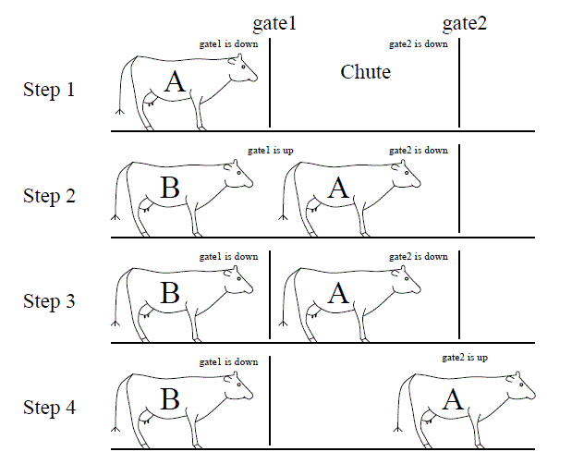
The DAISY System

Slide 34
The DAISY System
Step 1 - Gate1 is lifted allowing cow A to enter the chute.

Slide 35
The DAISY System
Step 2 - The DAISY system has detected cow A is in the chute and closes gate1.

Slide 36
The DAISY System
Step 3 - The cow waits in the closed off chute until the RFID reader signals that it has read the tag and checked in cow A.

Slide 37
The DAISY System
Step 4 - Gate2 is raised allowing cow A to leave. If the cow takes more than 30 seconds to leave, then the cow is "goosed" by a three-second burst of compressed air. An air bust is repeated at 30-second intervals until the cow leaves the chute. At any time when the cow leaves the chute, Gate 2 is closed and the system transitions back to Step 1.

Slide 38
The DAISY System

Slide 39
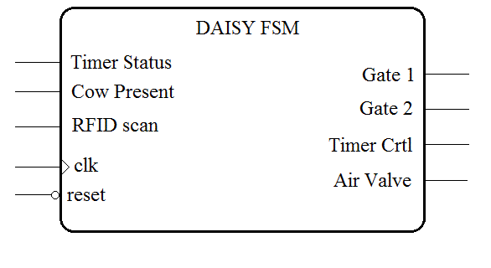
The DAISY System
DAISY FSM Entity

Slide 40
The DAISY System
Inputs to Daisy
Outputs to Daisy
RFID Scanner = r | Cow Present = c | Timer Status = t
1 - Cow checked in | 1 - cow present | 1 - timer up
0 - Cow not processed | 0 - no cow | 0 - timer running
Gate1 | Gate2 | Timer Control | Air Valve
1-gate up | 1-gate up | 00 Stop timer | 0 closed
0-gate down | 0-gate down | 01 Set to 30 secs | 1 open
 |  | 10 Set to 3 secs
 |  | 11 Run timer

Slide 41
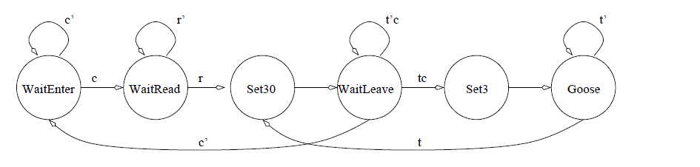
The DAISY System
State Diagram
Open gate1
Wait for cow to enter chute
Close gate1
Wait for RFID to read cow
Open gate2
Wait for cow to leave
If 30 seconds has transpired, then "goose" cow; goto Step 6
Else if the cow has left, then close gate2; goto Step 1

Slide 42
The DAISY System
State Diagram
Open gate1
Wait for cow to enter chute
Close gate1
Wait for RFID to read cow
Open gate2
Wait for cow to leave
If 30 seconds has transpired, then "goose" cow; goto Step 6
Else if the cow has left, then close gate2; goto Step 1
c'
r'
t’c
t'
WaitEnter
c
WaitRead
r
Set30
WaitLeave
tc
Set3
Goose
c'
t

Slide 43
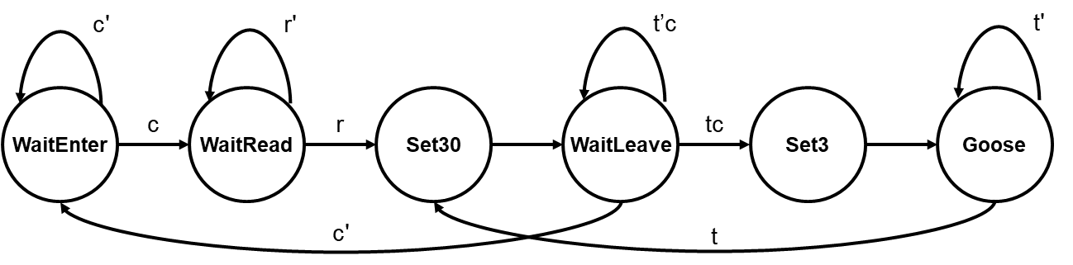
The DAISY System
Memory Input Equations
How many Flip Flops do we need?
State | Code
WaitEnter | 000
WaitRead | 001
Set30 | 010
WaitLeave | 011
Set3 | 100
Goose | 101

Slide 44
The DAISY System
Solve for three (one for each flip flop) 6-input Boolean Expressions
Using espresso

Slide 45
The DAISY System – Expresso input file
.i 6 # .i specifies the number of inputs
.o 3 # .o specifies the number of outputs
.ilb Q2 Q1 Q0 R C T # This line specifies the names of the inputs in order
.ob D2 D1 D0 # This line specifies the names of the outputs in order
# The first six digits (before the space) correspond
# to the inputs, the three after the space correspond
# to the outputs, both in order specified above.
000 -0- 000 # WaitEnter + c' => WaitEnter
000 -1- 001 # WaitEnter + c => WaitRead
001 0-- 001 # WaitRead + r' => WaitRead
001 1-- 010 # WaitRead + r => Set30
010 --- 011 # Set30 => WaitLeave
011 -10 011 # WaitLeave + t’c => WaitLeave
011 -11 100 # WaitLeave + tc => Set3
011 -0- 000 # WaitLeave + c' => WaitEnter
100 --- 101 # Set3 => Goose
101 --0 101 # Goose + t' => Goose
101 --1 010 # Goose + t => Set30 .e # Signifies the end of the file.

Slide 46
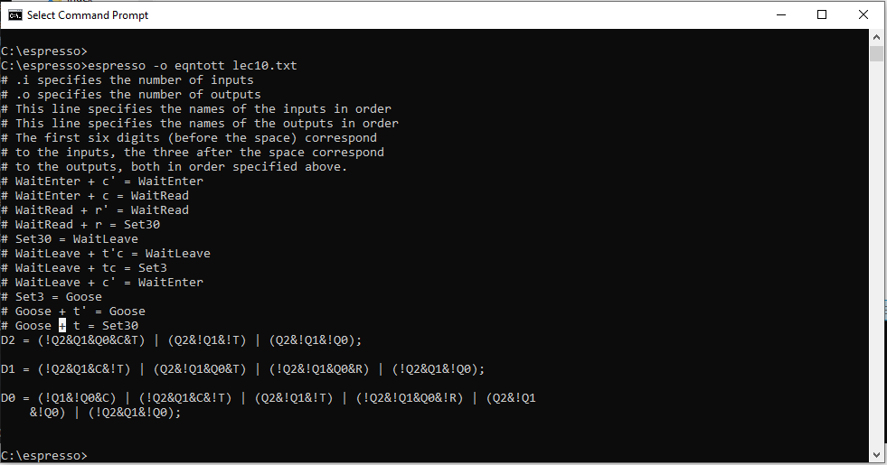
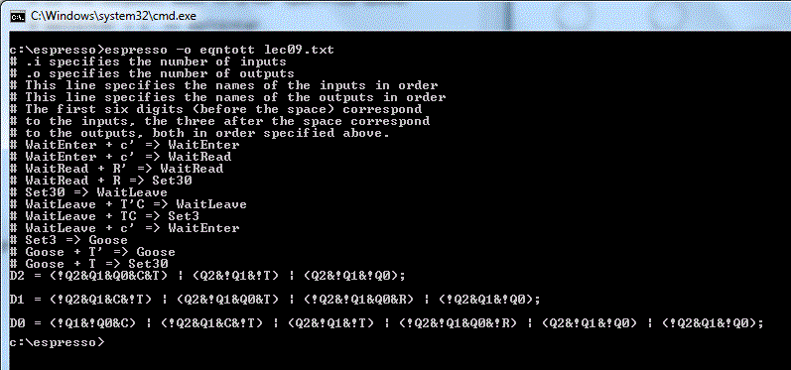
The DAISY System – Expresso Output

Slide 47
The DAISY System – One’s Hot Encoding
D_WaitEnter =
D_WaitRead =
D_Set30 =
D_WaitLeave =
D_Set3 =
D_Goose =
Using a One’s Hot Encoding MIEs:
D_WaitEnter = Q_WaitEnter * c' + Q_WaitLeave * c'
D_WaitRead = Q_WaitRead * r' + Q_WaitEnter * c
D_Set30 = Q_WaitRead * r + Q_Goose * t
D_WaitLeave = Q_Set30 + Q_WaitLeave * t' * c
D_Set3 = Q_WaitLeave * t * c
D_Goose = Q_Goose * t' + Q_Set3
State | Code
WaitEnter | 000001
WaitRead | 000010
Set30 | 000100
WaitLeave | 001000
Set3 | 010000
Goose | 100000

Slide 48
The DAISY System – Output Equations
The first step in generating the output equations is to build a control word table - a table listing, for each state, its output.
State | Gate1 | Gate2 | Timer | Control Air
 | 1-gate up | 1-gate up | 00 Stop timer | 0 - closed
 | 0-gate down | 0-gate down | 01 Set to 30 secs | 1 - open
 |  |  | 10 Set to 3 secs
 |  |  | 11 Run timer
WaitEnter | 1 | 0 | 00 | 0
WaitRead | 0 | 0 | 00 | 0
Set30 | 0 | 1 | 01 | 0
WaitLeave | 0 | 1 | 11 | 0
Set3 | 0 | 1 | 10 | 0
Goose | 0 | 1 | 11 | 1
State | Gate1 | Gate2 | Timer | Control Air
 | 1-gate up | 1-gate up | 00 Stop timer | 0 - closed
 | 0-gate down | 0-gate down | 01 Set to 30 secs | 1 - open
 |  |  | 10 Set to 3 secs
 |  |  | 11 Run timer
WaitEnter
WaitRead
Set30
WaitLeave
Set3
Goose

Slide 49
The DAISY System – Output Equations
State | Gate1 | Gate2 | Timer | Control Air
 | 1-gate up | 1-gate up | 00 Stop timer | 0 - closed
 | 0-gate down | 0-gate down | 01 Set to 30 secs | 1 - open
 |  |  | 10 Set to 3 secs
 |  |  | 11 Run timer
WaitEnter | 1 | 0 | 00 | 0
WaitRead | 0 | 0 | 00 | 0
Set30 | 0 | 1 | 01 | 0
WaitLeave | 0 | 1 | 11 | 0
Set3 | 0 | 1 | 10 | 0
Goose | 0 | 1 | 11 | 1
Z_Gate1 <= Q_WaitEnter;
Z_Gate2 <= Q_Set30 + Q_WaitLeave + Q_Set3 + Q_Goose
Z_Timer_1 <= Q_Set3 + Q_WaitLeave + Q+Goose
Z_Timer_0 <= Q_Set30 + Q_WaitLeave + Q_Goose
Z_Air = Q_Goose
Z_Gate1 <=
Z_Gate2 <=
Z_Timer_1 <=
Z_Timer_0 <=
Z_Air =

Slide 50
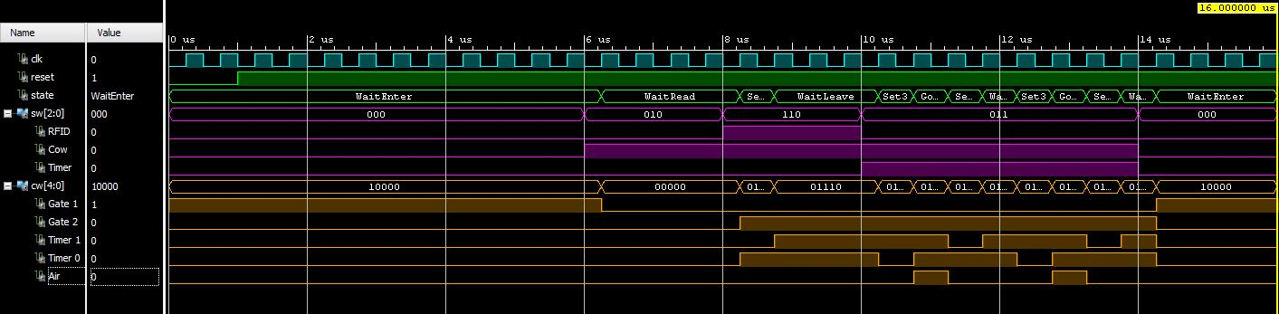
The DAISY System – VHDL

