Slide 1
CSCE 436 – Advanced Embedded Systems Lecture 5 – Combination of Elements and Lab Intro
Prof Jeffrey Falkinburg Avery Hall 368 472-5120

Slide 2
Lesson Outline
Time Logs!
HW #4 Due Now!
HW #5 Due next time!
Comparator Construction
Gated and Non-Gated Circuit
Lab 1 Intro

Slide 3
Comparator Construction

Slide 4
Comparator Construction
You will generate a signal similar to this CSA in Lab 1:
h_synch <= '1' when ((h_count >= 100) and (h_count < 200)) else '0';
This is a Non-Gated output Signal
Non-Gated signals Generate glitches on the output!
How is a comparator constructed?

Slide 5
Gated and Non-Gated Circuit

Slide 6
Gated and Non-Gated Circuit
Take a look at lec05.vhdl
Lec5
clk
counter
reset
clk
R4
clk
reset
G4
btn(4)
reset
btn(4)
processQ
btn(4 downto 0)
B22, D22, C22, D14, F15
clk
gated (Sequential)
ungated (combinational)
reset
clk
reset
clk
process (clk)…
JB <= “0001” when…
JB(7)
JB(6 downto 4)
JB(3 downto 0)
Y7
Y8, Y9, W9
W7,V7-V9
processQ
0
L0=47
L1=95
L2=191
L0
L1
L2
255
0001
0010
0100
1000
JB

Slide 7
Gated and Non-Gated Circuit
Combinational Realization – Non-gated
JB(3 downto 0) <= "0001" when ((processQ >= 0) and (processQ < L0)) else "0010" when ((processQ >= L0) and (processQ < L1)) else "0100" when ((processQ >= L1) and (processQ < L2)) else "1000";
Sequential Realization – Gated
process(clk) begin if (rising_edge(clk)) then if (reset = '0') then JB(6 downto 4) <= "000"; elsif ((processQ >= 0) and (processQ < L0)) then JB(6 downto 4) <= "001"; elsif ((processQ >= L0) and (processQ < L1)) then JB(6 downto 4) <= "010"; elsif ((processQ >= L1) and (processQ < L2)) then JB(6 downto 4) <= "100"; elsif (processQ >= L2) then JB(6 downto 4) <= "111"; end if; end if; end process;

Slide 8
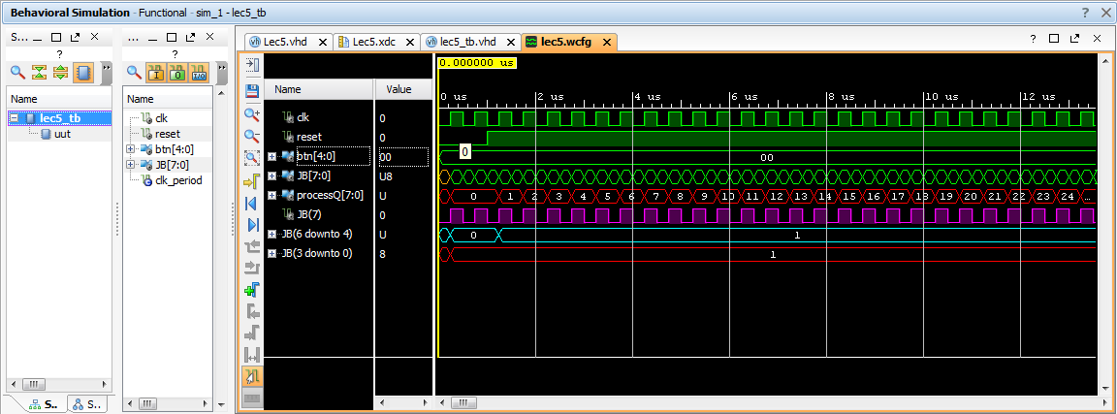

Slide 9
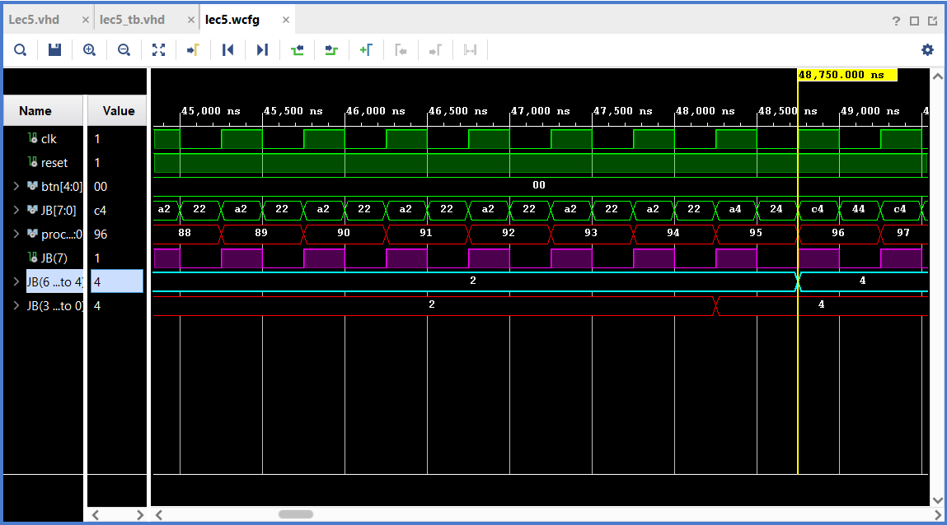

Slide 10
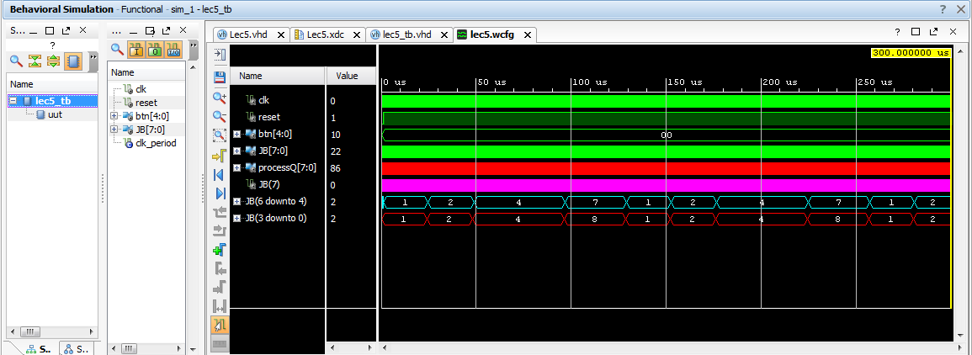

Slide 11
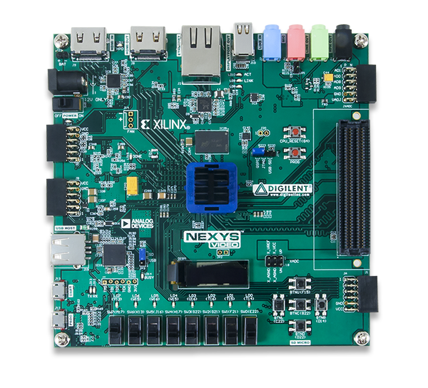
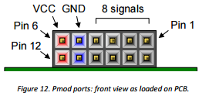
Gated and Non-Gated Circuit – PMOD Connector
JB PMOD
Connector
PMOD connector (see page 20 (Chapter 10) of the Nexys Video Board Reference Manual)

Slide 12
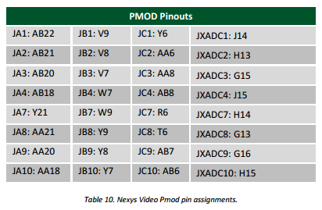
Gated and Non-Gated Circuit – PMOD Connector
JB(3)
JB(2)
JB(2)
JB(3)
PMOD connectors (see page 20 (Chapter 10) of the Nexys Video Board Reference Manual) corresponding to JB(3) and JB(2) (the most 2 significant bits of the non-gated comparator outputs)

Slide 13
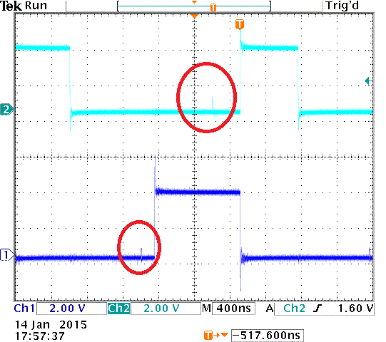
Gated and Non-Gated Circuit
JB(3) and JB(2) (the most 2 significant bits of the non-gated comparator outputs)

Slide 14
Lab 1 – Prelab

Slide 15
HW 5 – Lab 1 Prelab
Draw a detailed diagram of the oscilloscope grid required for Lab1. A detailed diagram must be drawn on green engineering paper and include
(x,y) corners of the monitor.
(x,y) each of the four major corners (already given).
y-coordinates for all the major horizontal grid lines.
(x,y) coordinates for one set of three horizontal of hatch marks. Indicate with an arrow which set of three.
x-coordinates for all the major vertical grid lines.
(x,y) coordinates for one set of four vertical of hatch marks. Indicate with an arrow which set of four.
(x,y) coordinates for the nine pixels of the trigger volt mark in reference to the tr_volt signal.
(x,y) coordinates for the nine pixels of the trigger time mark in reference to the tr_time signal.

Slide 16
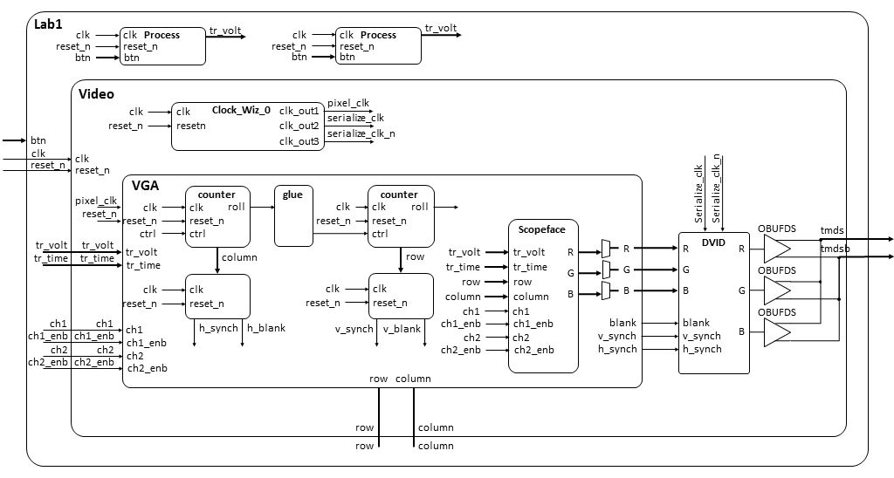
Lab 1 Intro – Architecture

Slide 17
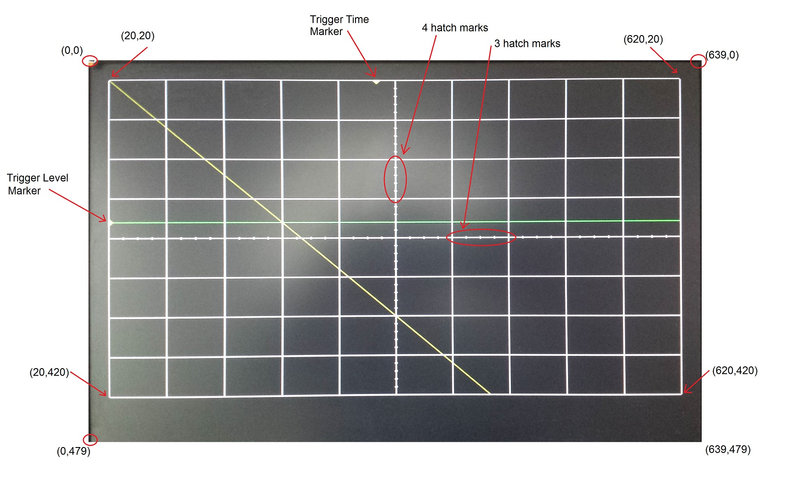
HW 5 – Lab 1 Prelab

Slide 18
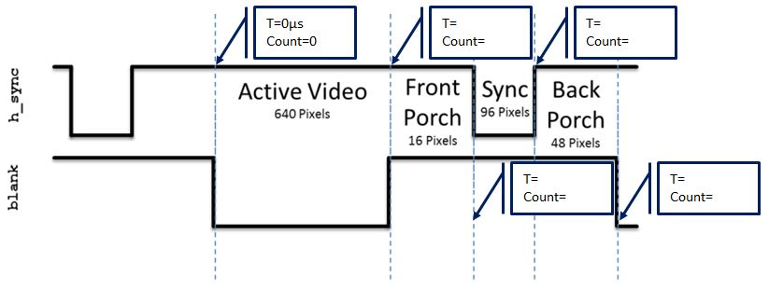
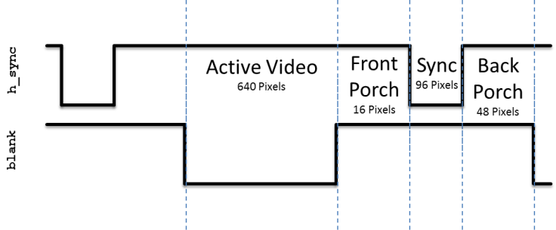
HW 5 – Lab 1 Prelab
Given that the pixel clock is running at 25Mhz, add the durations of the h_synch and v_synch signals show in Lab1. Set time=0 on the blue dashed line on the left side of the region labeled "Active Video".

Slide 19
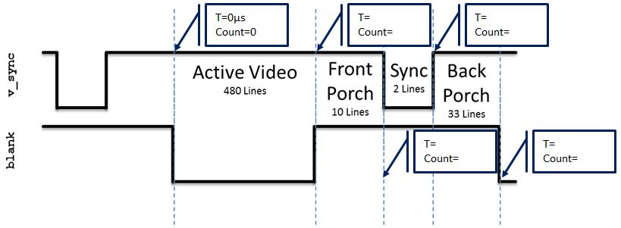
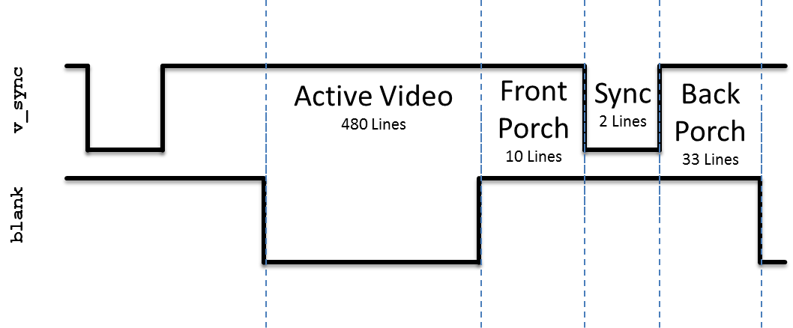
HW 5 – Lab 1 Prelab
Given that the pixel clock is running at 25Mhz, add the durations of the h_synch and v_synch signals show in Lab1. Set time=0 on the blue dashed line on the left side of the region labeled "Active Video".

Slide 20
Lab 1 – VGA Overview

Slide 21
Lab 1 Intro – Architecture
VGA

Slide 22
Lab 1 Intro – VGA Overview
http://www-mtl.mit.edu/Courses/6.111/labkit/vga.shtml

Slide 23
VGA Module
entity vga is
Port( clk: in STD_LOGIC;
reset_n : in STD_LOGIC;
h_sync : out STD_LOGIC;
v_sync : out STD_LOGIC;
blank : out STD_LOGIC;
r: out STD_LOGIC_VECTOR(7 downto 0);
g: out STD_LOGIC_VECTOR(7 downto 0);
b: out STD_LOGIC_VECTOR(7 downto 0);
trigger_time: in unsigned(9 downto 0);
trigger_volt: in unsigned (9 downto 0);
row: out unsigned(9 downto 0);
column: out unsigned(9 downto 0);
ch1: in std_logic;
ch1_enb: in std_logic;
ch2: in std_logic;
ch2_enb: in std_logic);
end vga;

Slide 24
VGA Module
clk | This is the 25Mhz pixel clock generated by the DCM in the video module.
reset_n | This is the same active low reset signal passed into the top level Lab1 module.
tr_volt | This is a 10-bit unsigned value representing the trigger voltage. This value is passed to the scopeFace module so that a yellow arrow (see Trigger Level Marker in the screen show) on the vertical axis.
tr_time | This is a 10-bit unsigned value representing the trigger time. This value is passed to the scopeFace module so that a yellow arrow (see Trigger Time Marker in the screen show) on the horizontal axis.
ch1 | This 1-bit signal signals the VGA module to draw the channel 1 signal on the scope for this row, column pixel. When the value is 1, draw a yellow pixel on the display at the current row,colum position. When 0, do not draw a pixel.
ch1_enb | This 1-bit signal enable the ch1 signal to be drawn.
ch2 | This 1-bit signal signals the VGA module to draw the channel 2 signal on the scope for this row,column pixel. When the value is 1, draw a green pixel on the display at the current row, column position. When 0, do not draw a pixel.
ch2_enb | This 1-bit signal enable the ch2 signal to be drawn.
R | The 8-bit red intensity for this row,column pixel on the screen.
G | The 8-bit green intensity for this row,column pixel on the screen.
B | The 8-bit blue intensity for this row,column pixel on the screen.
Row | The current row being drawn on the display.
Column | The current row being drawn on the display.
blank | The blank signal for the current row,column position. Its the logical OR of the h_blank and v_blank signals.
h_synch | The h_synch signal for the current row,column position.
v_synch | The v_synch signal for the current row,column position.
Behavior | The VGA component contains a pair of cascaded counters which generate the row and column values of the current pixel being displayed. The row and column values are used to generate the blank, h_synch and v_synch signals according to the Figures above. The scopeFace component (more on this below), takes the row and column values (along with some other information) and generates the R,G,B color of that pixel. The three muxes on the output of the R,G,B output of the scopeFace component output the scopeFace R,G,B values for row,column values within the 640x480 displayable region, or 0's for values outside this region.

Slide 25
Lab 1 – Scopeface

Slide 26
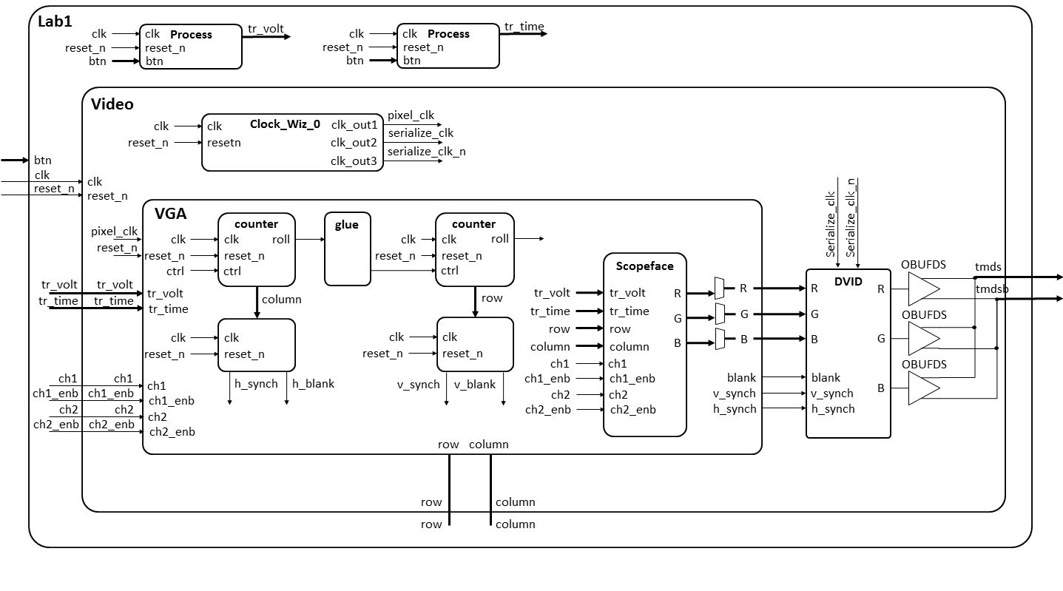
Lab 1 Intro – Architecture
ScopeFace

Slide 27
scopeFace Module
entity scopeFace is
Port ( row : in unsigned(9 downto 0);
column : in unsigned(9 downto 0);
trigger_volt: in unsigned (9 downto 0);
trigger_time: in unsigned (9 downto 0);
r : out std_logic_vector(7 downto 0);
g : out std_logic_vector(7 downto 0);
b : out std_logic_vector(7 downto 0);
ch1: in std_logic;
ch1_enb: in std_logic;
ch2: in std_logic;
ch2_enb: in std_logic);
end scopeFace;

Slide 28
ScopeFace Module
clk | This is the 25Mhz pixel clock generated by the DCM in the video module.
reset_n | This is the same active low reset signal passed into the top level Lab1 module.
tr_volt | This is a 10-bit unsigned value representing the trigger voltage. This value is passed to the scopeFace module so that a yellow arrow (see Trigger Level Marker in the screen show) on the vertical axis.
tr_time | This is a 10-bit unsigned value representing the trigger time. This value is passed to the scopeFace module so that a yellow arrow (see Trigger Time Marker in the screen show) on the horizontal axis.
ch1 | This 1-bit signal signals the VGA module to draw the channel 1 signal on the scope for this row, column pixel. When the value is 1, draw a yellow pixel on the display at the current row,column position. When 0, do not draw a pixel.
ch1_enb | This 1-bit signal enable the ch1 signal to be drawn.
ch2 | This 1-bit signal signals the VGA module to draw the channel 2 signal on the scope for this row,column pixel. When the value is 1, draw a green pixel on the display at the current row, column position. When 0, do not draw a pixel.
ch2_enb | This 1-bit signal enable the ch2 signal to be drawn.
R | The 8-bit red intensity for this row,column pixel on the screen.
G | The 8-bit green intensity for this row,column pixel on the screen.
B | The 8-bit blue intensity for this row,column pixel on the screen.
Row | The current row being drawn on the display.
Column | The current row being drawn on the display.
Behavior | The scopeFace component takes in the current row,column coordinates of the display and generates the R,G,B values at that screen coordinate. For example, if row,column = 20,20 then the R,G,B output should be 0xFF,0xFF,0xFF (white) because the upper left corner of the O'scope grid display is white. Note, you can get the RGB values for common colors at this website or this website.

Slide 29
scopeFace Module
RGB Colors:
http://www.w3schools.com/colors/colors_names.asp

Slide 30
Lab 1 – Connections

Slide 31
Lab 1 Intro – Architecture

Slide 32
Lab 1 Connections
HDMI Out
Power
CPU Reset
Buttons
USB Prog

Slide 33
Lab 1 – Digital Clocking Wizard

Slide 34
Digital Clocking Wizard
Xilinx Clocking Wizard Page:
https://www.xilinx.com/products/intellectual-property/clocking_wizard.html
Clocking Wizard v5.3 - LogiCORE IP Product Guide:
https://www.xilinx.com/support/documentation/ip_documentation/clk_wiz/v5_3/pg065-clk-wiz.pdf

Slide 35
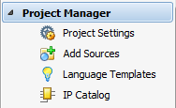
Digital Clocking Wizard
Click on IP Catalog
Search for Clocking Wizard IP

Slide 36
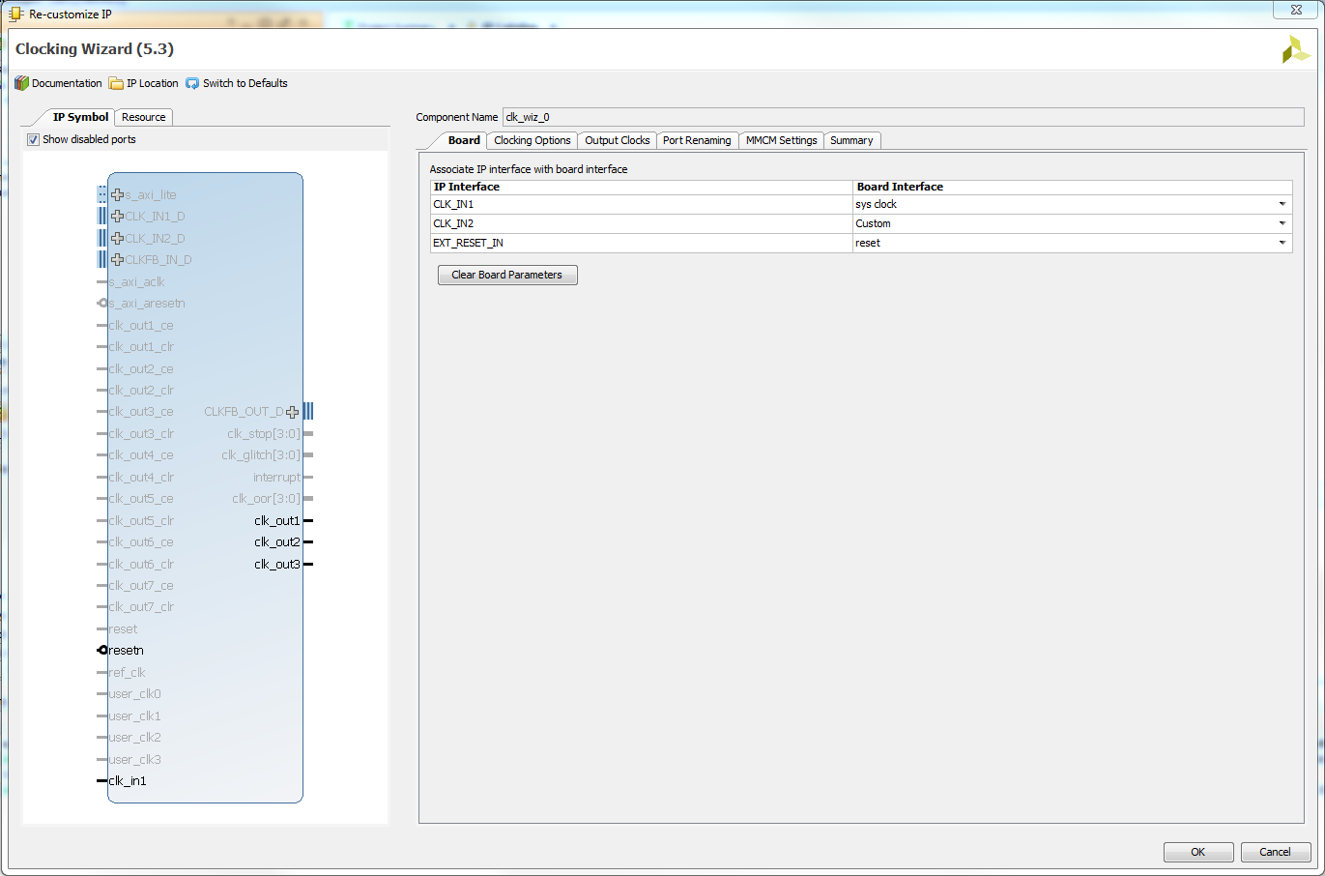
Digital Clocking Wizard

Slide 37
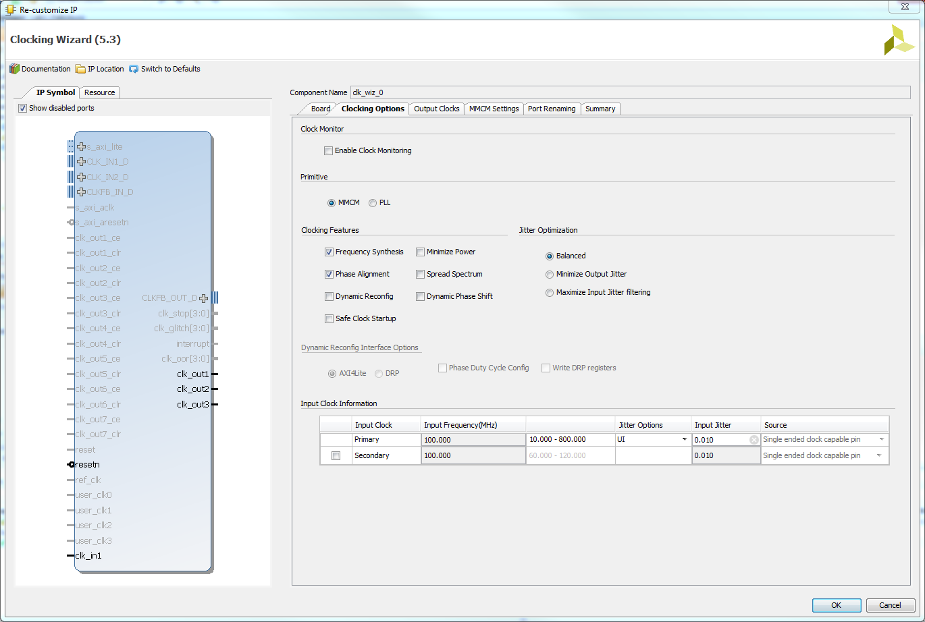
Digital Clocking Wizard

Slide 38
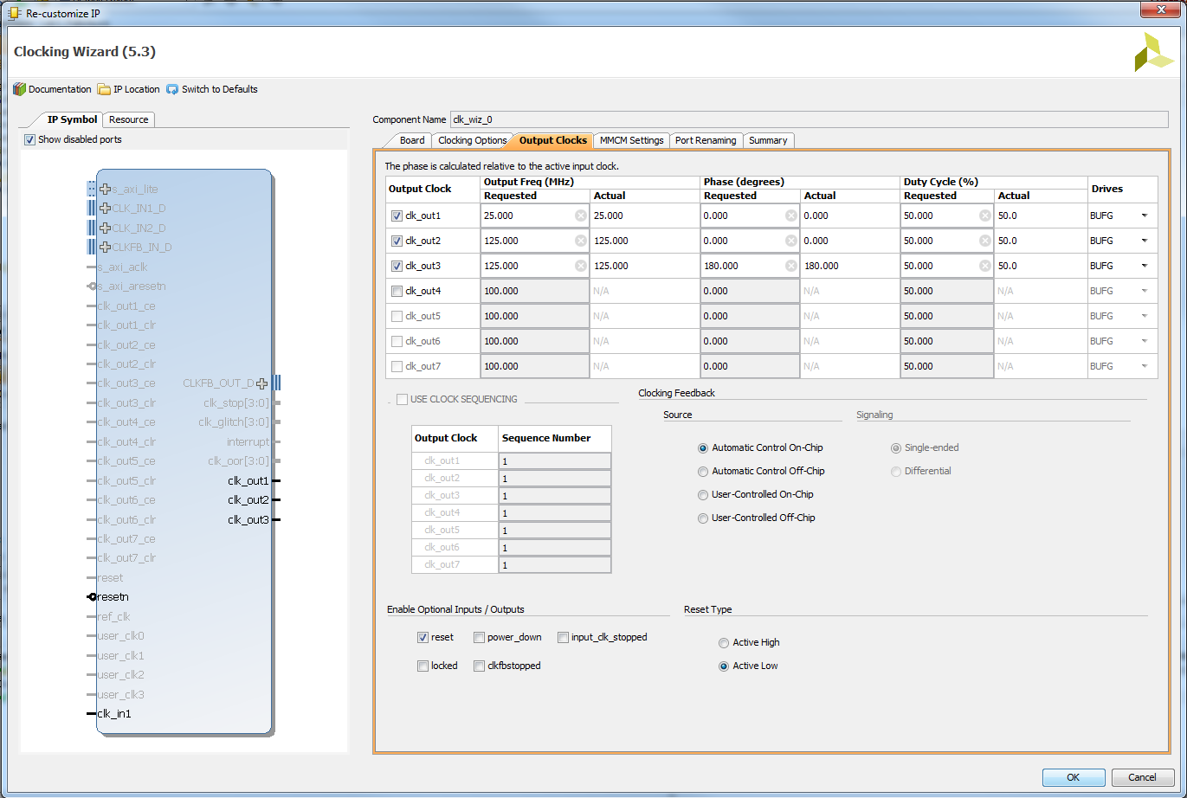
Digital Clocking Wizard

Slide 39
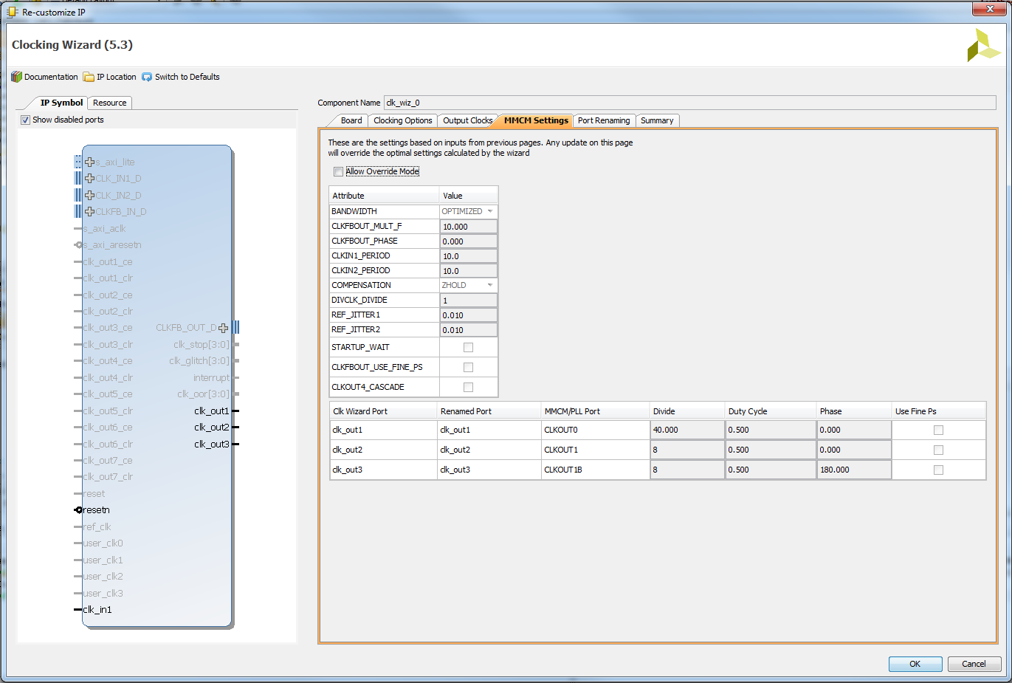
Digital Clocking Wizard

Slide 40
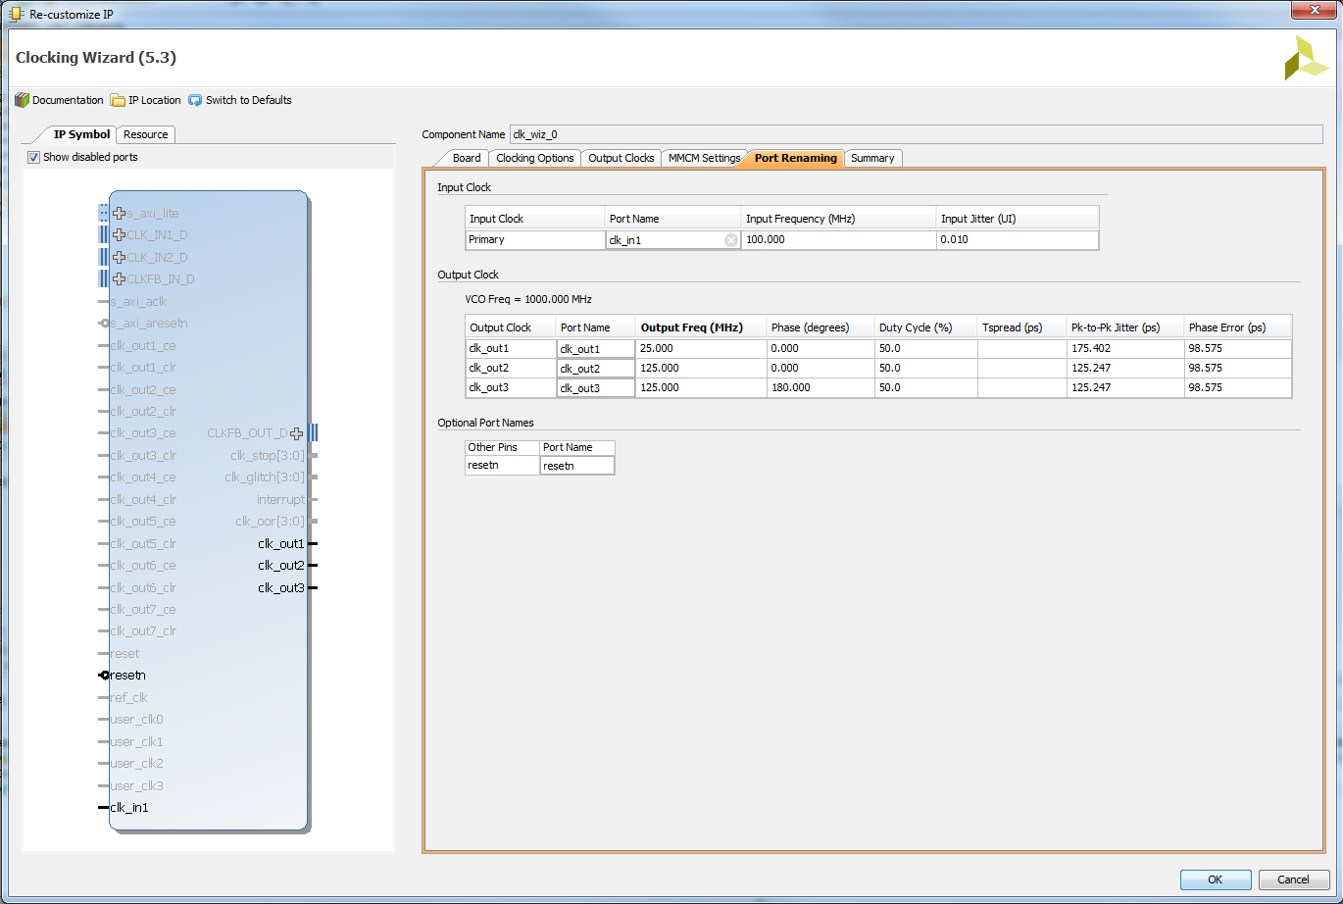
Digital Clocking Wizard

Slide 41
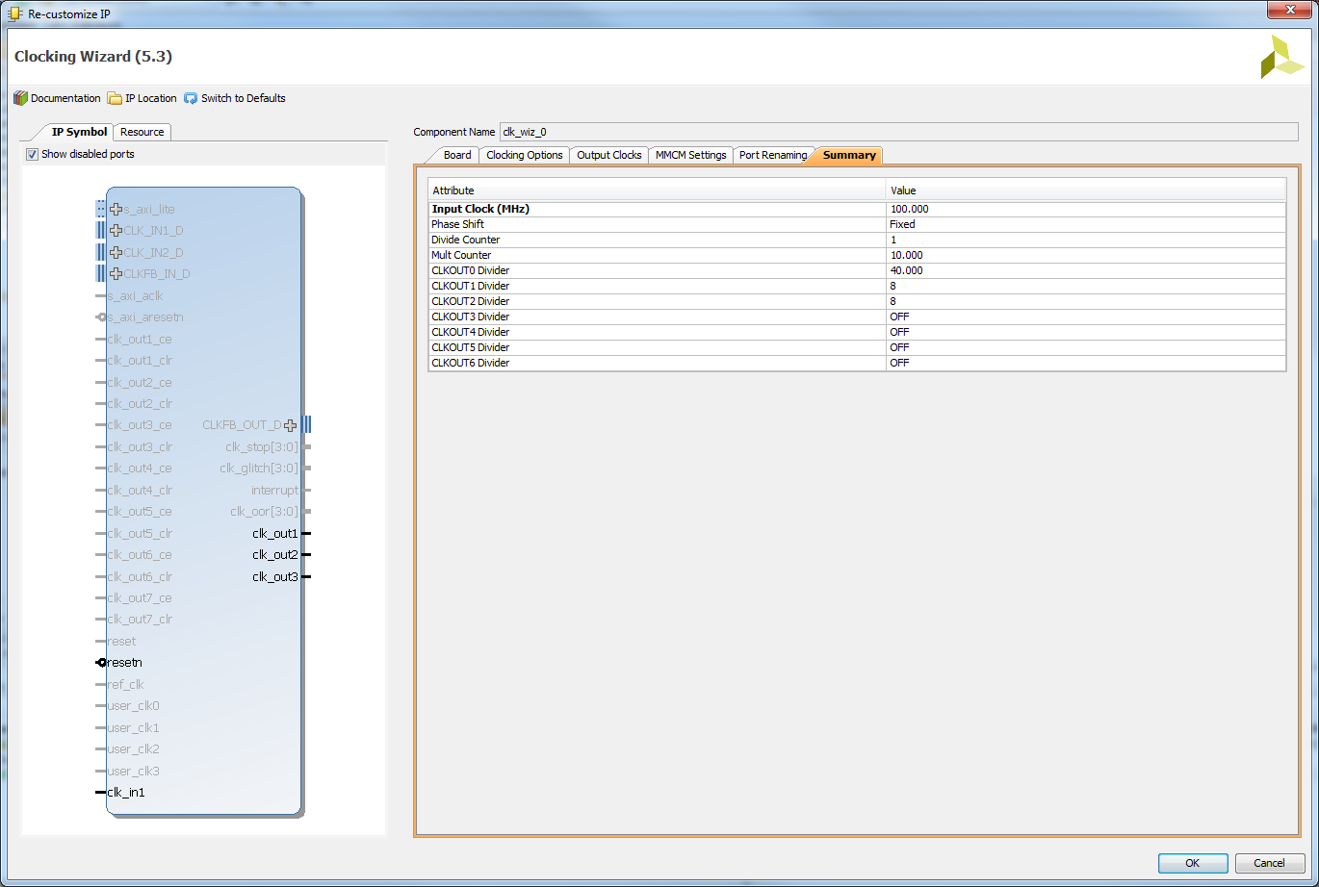
Digital Clocking Wizard

Slide 42
Digital Clocking Wizard
Verify Component Declaration in video.vhd
--------------------------------------------------------------------------
-- Clock Wizard Component Instantiation Using Xilinx Vivado
--------------------------------------------------------------------------
component clk_wiz_0 is
Port (
clk_in1 : in STD_LOGIC;
clk_out1 : out STD_LOGIC;
clk_out2 : out STD_LOGIC;
clk_out3 : out STD_LOGIC;
resetn : in STD_LOGIC);
end component;
Verify Component Instantiation in video.vhd

Slide 43
Digital Clocking Wizard
Verify Component Instantiation in video.vhd
--------------------------------------------------------------------------
-- Digital Clocking Wizard using Xilinx Vivado creates 25Mhz pixel clock and
-- 125MHz HDMI serial output clocks from 100MHz system clock. The Digital
-- Clocking Wizard is in the Vivado IP Catalog.
--------------------------------------------------------------------------
mmcm_adv_inst_display_clocks: clk_wiz_0
Port Map (
clk_in1 => clk,
clk_out1 => pixel_clk, -- 25Mhz pixel clock
clk_out2 => serialize_clk, -- 125Mhz HDMI serial output clock
clk_out3 => serialize_clk_n, -- 125Mhz HDMI serial output clock 180 degrees out of phase
resetn => reset_n); -- active low reset for Nexys Video

Slide 44
Lab 1 - Requirements

Slide 45
Lab 1 – Requirements Gate Check 1
Gate Checks for Required Functionality
There are 2 gate checks associated with this lab, each worth 5 points - see the rubric below.
Gate Check 1
By BOC Lesson 7, you must have finished setting up the VGA counters to generate the proper rows and columns on the waveform. This can be shown with waveform screenshots from the VGA testbench showing the h count rolling over causing the v count to increment. Be sure to also show both max counts.

Slide 46
Lab 1 – Requirements Gate Check 2
Gate Check 2
By BOC Lesson 8, you must have setup the appropriate v_synch, v_blank, h_synch, and h_blank signals on the waveform and created the scopeFace module to draw at least one line on the display. Include picture of the line on the display and associated .bit file for the scopeFace module proof. Additionally, include screenshots of waveforms showing:
Show the h_synch going high, low, and high in relation to h count.
Show the v_synch going high, low, and high in relation to v count.
Show the blank signals going high, low, and high in relation to v count and h count.

Slide 47
Lab 1 – Requirements Required Functionality
Required Functionality
For Required Functionality your code must generate the white oscilloscope grid pattern shown in the Figure above and draw the two channels of traces. To test this draw:
The channel 1 trace (yellow) along a diagonal where (row = column).
The channel 2 trace (green) should be drawn along a diagonal where (row = 440-column).
This test code should be placed in the Lab1 entity.

Slide 48
Lab 1 – Requirements A-Level Functionality
A-level Functionality
A-level functionality is shown in the Figure in the Lab Overview section at the top of the page. In addition to drawing the display, the display must update when one of the buttons is pressed according to the list below.
Pressing the upper directional button (BTNU) once should move the Trigger Level Marker up.
Pressing the lower directional button (BTND) once should move the Trigger Level Marker down.
Pressing the left directional button (BTNL) once should move the Trigger Time Marker left.
Pressing the right directional button (BTNR) once should move the Trigger Time Marker right.

Slide 49
Lab 1 – Requirements A-Level Functionality Cont.
A-level Functionality
In order to achieve this level of functionality, you will need to implement the two Process blocks in the Lab1 entity in the schematic.
You need to draw the channel 1 trace (yellow) along a diagonal where (row = column). The channel 2 trace (green) should be drawn along a diagonal where (row = 440-column). This test code should be placed in the Lab1 entity.

Slide 50
Lab 1 – Requirements Turn In
Turn In Requirements
All your work in this lab is to be submitted using Bitbucket. The main part of the lab is your README, documenting your design. Your README must include the following:
Introduction - Provide a brief overview of the problem.
Implementation - Provide block-diagram of your solution using the signal names in your code. The block diagram given above is somewhat incomplete, make sure to include corrections to this diagram. An editable block diagram PPT is provided at the top of the page. For each module that you built, explain its overall purpose, inputs, outputs, and behavior. Include all your vhdl files (code and testbench), wcfg file, and bit files. Put these in a folder called "code".

Slide 51
Lab 1 – Requirements Turn In Cont.
Test/Debug - Briefly describe the methods used to verify system functionality. Show at least three excerpts from your testbench for the VGA module (as screen shots):
Show the h_synch going high, low, and high in relation to h count.
Show the v_synch going high, low, and high in relation to v count.
Show the blank signals going high, low, and high in relation to v count and h count.
Show the h count rolling over causing the v count to increment and max counts for both counters.
List the major problems …

Slide 52
Lab 1 – Requirements Turn In Cont.
Test/Debug - Cont
List the major problems you encountered and how you fixed them. This should cover all the problems you encountered in the lab and how you fixed them. Break each problem and solution into separate paragraphs.
Conclusion - Explain what your learned from this lab and what changes you would recommend in future years to this lab or the lectures leading up to this lab.

Slide 53
Lesson Outline
Comparator Construction
Gated and Non-Gated Circuit
Lab 1 Intro
Lab 1 – Prelab
Lab 1 – VGA Overview
Lab 1 – Scopeface
Lab 1 – Connections
Lab 1 – Digital Clocking Wizard
Lab 1 – Requirements

