Slide 1
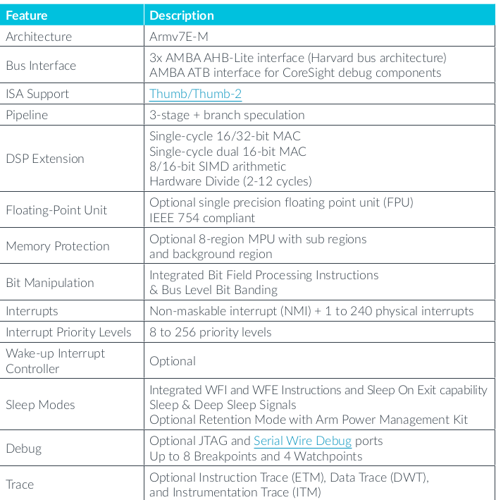
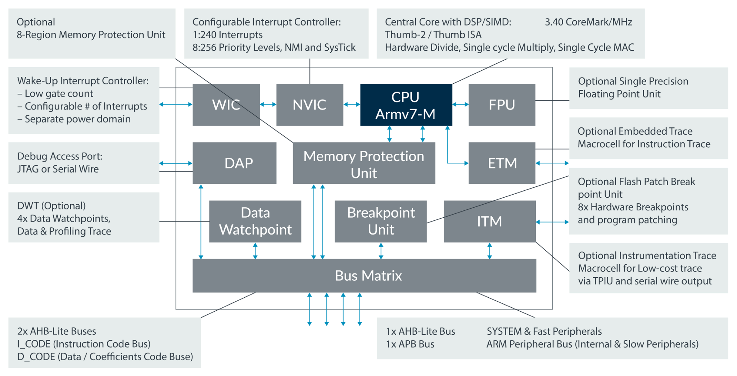
Cortex-m4 for Anti-lock Braking System
Microprocessor Features
Cortex-m4 Block Diagram

Slide 2
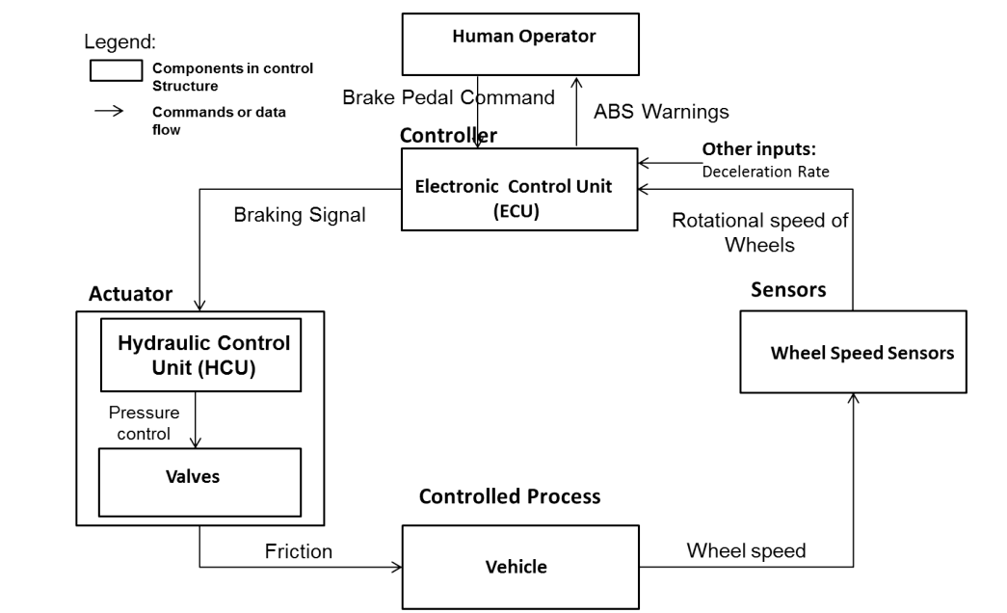
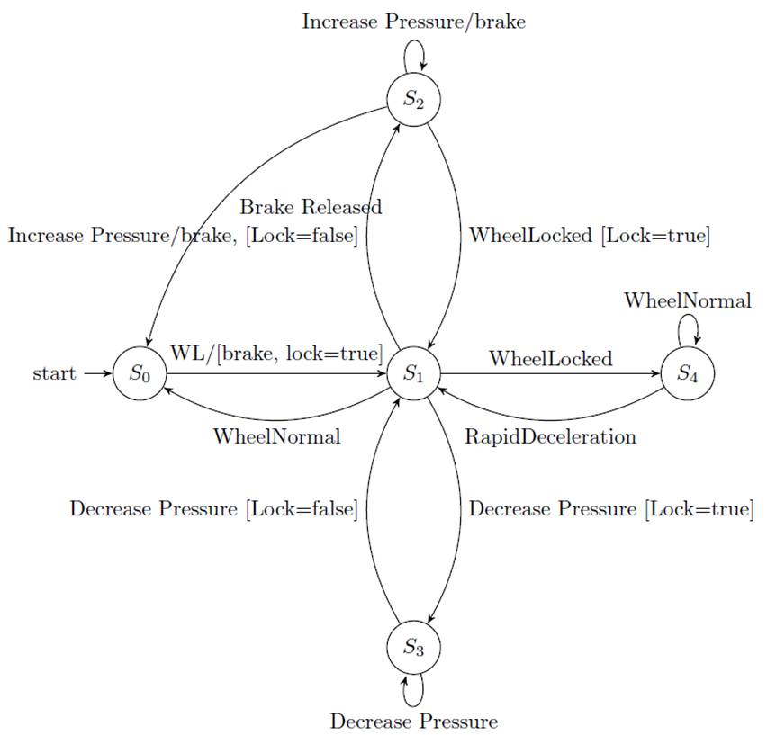
Architecture Rationale
• System Level Goals:
– G.1: Prevent wheel lockup during an emergency stop.
– G.2: Provide controlled stopping by maintaining maximum tire to road friction.
– G.3: Permit the driver to maintain steering while braking.
• Accident: The accident to be considered is the ABS vehicle crashes with a vehicle and the occupants are injured while ABS is involved.
• System Level Hazards:
– H.1: Loss of steering control during braking operation.
– H.2: ABS did not manipulate optimal wheel slip and stop in the shortest distance.
• Safety Constraints:
– ABS must engage automatically when rapid deceleration are detected.
– ABS must sense the motion of each wheel to detect a skid condition and be able to pulse the braking hundreds of times per second.
• Design Constraints:
– ABS must be engaged after brake pedal is pressed.
– ABS must prevent wheel lock-up in hard braking situations (e.g. when the speed of vehicle is over 15 mph) when lockup may occur.
• Design Requirements:
– ABS shall stop the vehicle in the shortest distance.
– ABS shall maintain the safe stop distance on loose road surface (e.g. snow-covered, gravel-roads, etc.).
• Functional Control Structure: Once the hazards to be evaluated have been reviewed, the safety analyst develops a control structure diagram of the system showing the control structure diagram which depicts the interacting control loop between ECU and HCU in ABS system.
Integrating State Machine Analysis with System-Theoretic Process Analysis
Asim Abdulkhaleq, Stefan Wagner
The control structure of ABS (ECU-HCU).
Finite state machine of ECU controller in the ABS system.
Where:
S0 = inactive (brake not pressed),
S1=handellock,
S2= applyBrakePedal,
S3= pressureReduction,
S4= MonitorDeceleration and WL= WheelLocked.

Slide 3
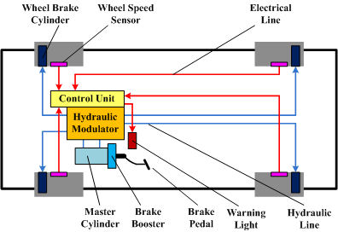
Application Domain Features
Cyclic executive
All tasks driven by one trigger (Braking pedal).
Executed task depends on previous task’s results (deceleration rate, friction, wheel speed).
Busy-wait architecture
No task executed until received triggering signal.
Hardware interrupt (Braking Signal).
ADC (Wheel Speed Sensor).
ADC/DSP (Hydraulic Pressure Sensor).
DAC (Hydraulic Pressure Actuator Signal).
ABS architecture
int main()
{
/* setup the interrupt service routine */
InitTasks();
RegisterTask(0, 30, FSMroutine, 1, 0);
/* enable interrupts */
while (true)
{
EnterLowPowerMode3();
}
return 0;
}
void FSMroutine(void)
{
Switch(FSM)
{
Case S1:
Task1();
break;
Case S2:
Task2();
break;
}
}
void Task1(void)
{
a = ReadRotation();
if (a > ThresholdA)
{
FSM = S1;
}
}
void Task2(void)
{
p = ReadPressure();
if (p > ThresholdP)
{
FSM = S3;
{
}

