Slide 1


Advanced Predictive Modelling on the California Housing Dataset
By Joyal John

Slide 2
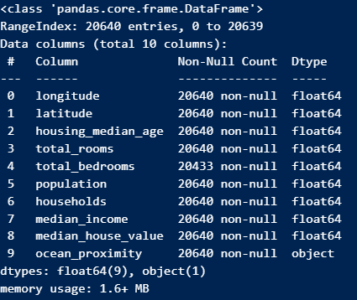

Dataset Exploration
Predictive modelling enables the identification of patterns, trends, and relationships within datasets, which in turn allows the forecast of future outcomes.
Understanding the dataset is crucial to engineer and make the models predictive accuracy better
You will notice that total_bedrooms has missing data
ocean_proximity is categorical, text-based data

Slide 3
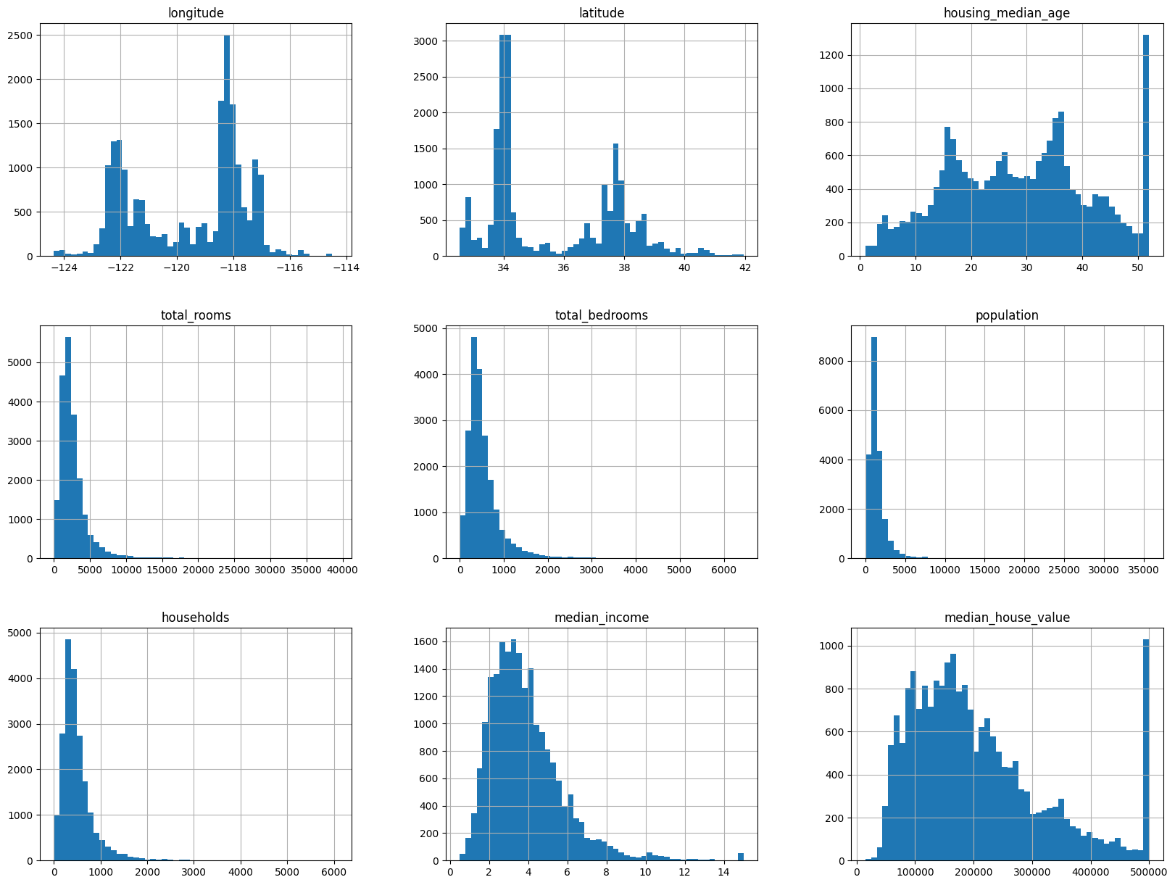
Vast majority of housing is 50+ years old
Total_rooms, total_bedrooms, population, households, all these fields look similar to each other
Median_house_value has a 500k+ houses as a cap

Slide 4
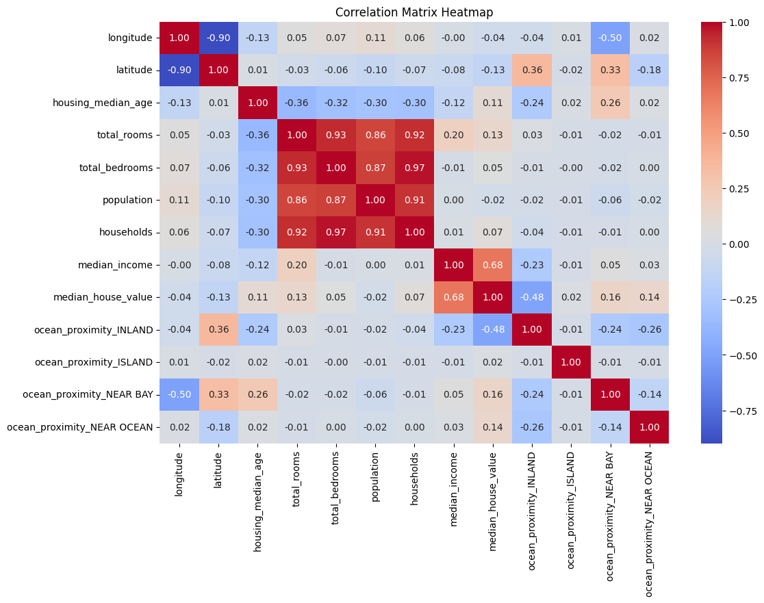

Slide 5
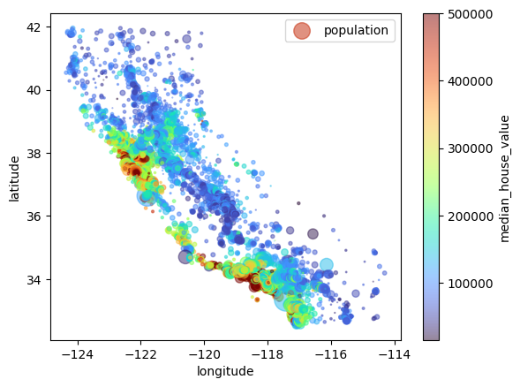

Geospatial Elements
One of the key features of the dataset lies in its geospatial attributes, allowing for geographical insights that play a pivotal role in real estate predictions and trends.
These geographical attributes can include latitude, longitude, and proximity to the ocean, factors that significantly influence housing prices and demand.

Slide 6

Data Cleaning and Preprocessing
1
Handling Missing Values
- Imputed the total_bedrooms feature using the fillna() method available in pandas
2
Outlier Detection and Removal
Interquartile Range (IQR) method
Removes data in lower and upper quartiles
3
One-hot encoding
Converting categorical data into integers

Slide 7
Feature Engineering
1
house_hold_rooms
2
household_population
3
bedroom_ratio

Slide 8
Model Selection
1
Rationale for Selection
Random Forest algorithm is robust to overfitting due to its ensemble nature, which combines multiple decision trees.
It can handle many features and a large dataset effectively.
Random Forest can capture non-linear relationships between features and the target variable.
It performs well with both numerical and categorical data without the need for extensive preprocessing.
Random Forest is less sensitive to outliers compared to linear regression models.
The algorithm provides feature importance scores, which can aid in understanding the significance of different features in predicting the target variable.
It tends to generalise well to unseen data, resulting in better performance on test datasets.

Slide 9

Both Models
1
Baseline model: Linear Regression
Linear regression serves as a fundamental modelling technique, allowing for the analysis of the relationship between dependent and independent variables. It provides a clear framework for understanding the impact of each variable on the predicted outcome.
2
Random Forest Regression
Random Forest Regression, on the other hand, excels in handling complex datasets with multiple input variables. By creating an ensemble of decision trees, it leverages the power of 'forest' to make accurate predictions.

Slide 10
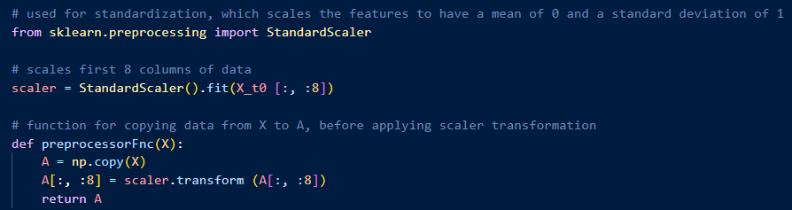
Scaling

Slide 11





Model Implementation & Evaluation: Precision in Action
Implementation Process
Evaluation Metrics
The evaluation process involved the thorough analysis of metrics such as Mean Squared Error (MSE), Mean Absolute Error (MAE), and R-squared

Slide 12
Testing split

Slide 13
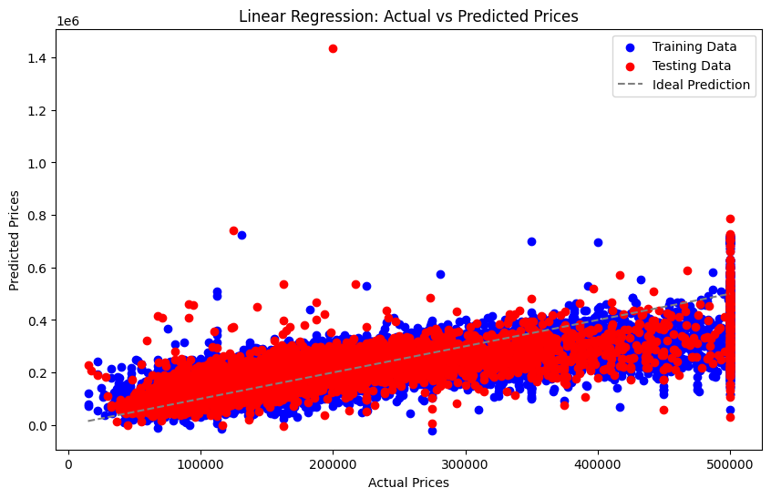
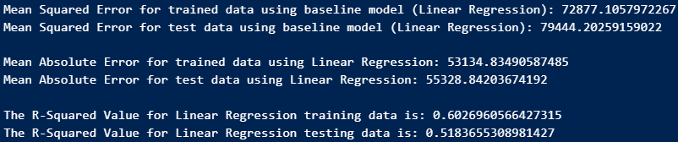

Slide 14
