Slide 1
VPN
(Virtual Private Network)
Team Members:
Kaci Luu
Jia-Yu Joy Ho
Farwah Bakhsh
420-521-VA
ADVANCED NETWORKS
Final Project

Slide 2
01
02
TABLE OF CONTENTS
03
04
05
06
07
INTRODUCTION TO VPN
CORE COMPONENTS & MECHANISMS
ADVANTAGES & DISAVANTAGES
VPN vs. TOR NETWORK
WIREGUARD SETUP
TAILSCALE EXPLORATION
RiseupVPN

Slide 3
Introduction to VPN
What is VPN?
A VPN (Virtual Private Network) is a tool that creates a secure, encrypted connection between a device and the internet
How a VPN Works?
https://surfshark.com/learn/what-is-vpn?srsltid=AYCX9vL3O3G3TH4aa3_9CNbmz1pk7GwY5dTGfZqMGaSkGa7W2nskyzo0

Slide 4
Core Components &
Mechanism

Slide 5
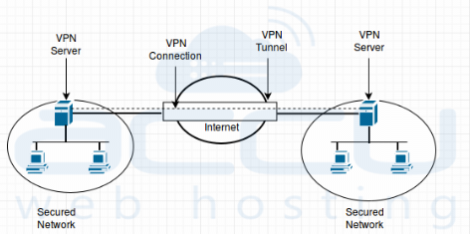
Remote VPN Server
Core Components & Mechanism
A remote VPN server is a secure entry point that allows off-site users or devices to connect safely to a private network over the public internet
https://www.accuwebhosting.com/blog/install-vpn-rras-remote-routing-access/

Slide 6
IP Address Masking
Core Components & Mechanism

Slide 7
NAT Traversal
Core Components & Mechanism

Slide 8
Traffic Routing
Core Components & Mechanism

Slide 9
VPN Tunnelling
Core Components & Mechanism

Slide 10
Encryption Keys & Decryption
Core Components & Mechanism

Slide 11
Advantages & Disadvantages of a VPN
ADVANTAGES
DISADVANTAGES

Slide 12
VPN vs. TOR
VPN | TOR

Slide 13
WIREGUARD SETUP

Slide 14
TAILSCALE Exploration
What is TailScale?
Zero-config, identity-based mesh VPN that is built on-top of WireGuards' open-source protocol
Compared to traditional VPNs, it creates a private, encrypted peer-to-peer connected network called a tailnet, which directly connects all devices to eachother no matter where they are located!
How does it work though..?
Mesh Network – Tailnet
  Every connected device gets its own private IP address and communicated directly with the other connected devices, without needing to go through a middleman, like in traditional VPNs.
Identity-Based Authentication
  Instead of managing complex passwords and ssh keys, you login using your existing identity provider (e.g., Google, Microsoft, GitHub, Apple) with 2FA.

Slide 15
REFERENCES
https://www.forbes.com/advisor/business/software/what-does-vpn-hide/
https://www.kaspersky.com/resource-center/definitions/what-is-a-vpn
https://azure.microsoft.com/en-ca/resources/cloud-computing-dictionary/what-is-vpn
https://www.ibm.com/think/topics/vpn
https://www.paloaltonetworks.com/cyberpedia/what-is-a-vpn-tunnel
https://tailscale.com/docs/concepts/what-is-tailscale
https://tailscale.com/blog/how-tailscale-works
https://tailscale.com/why-tailscale

Slide 16
THANK
YOU!

