Slide 1
FallAndCall
Event-driven fall detection for low-power wearables

Slide 2
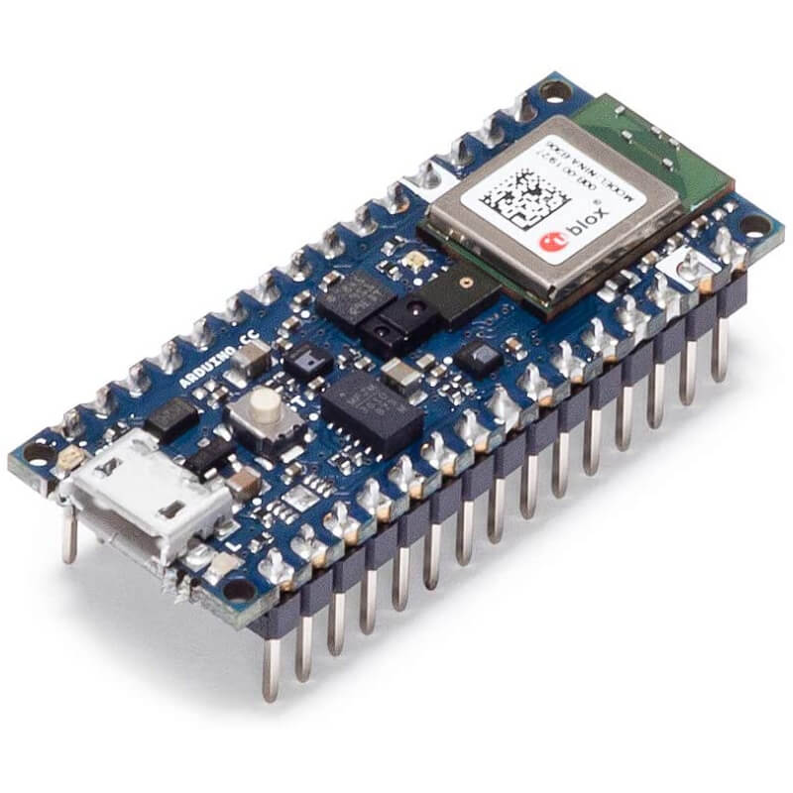
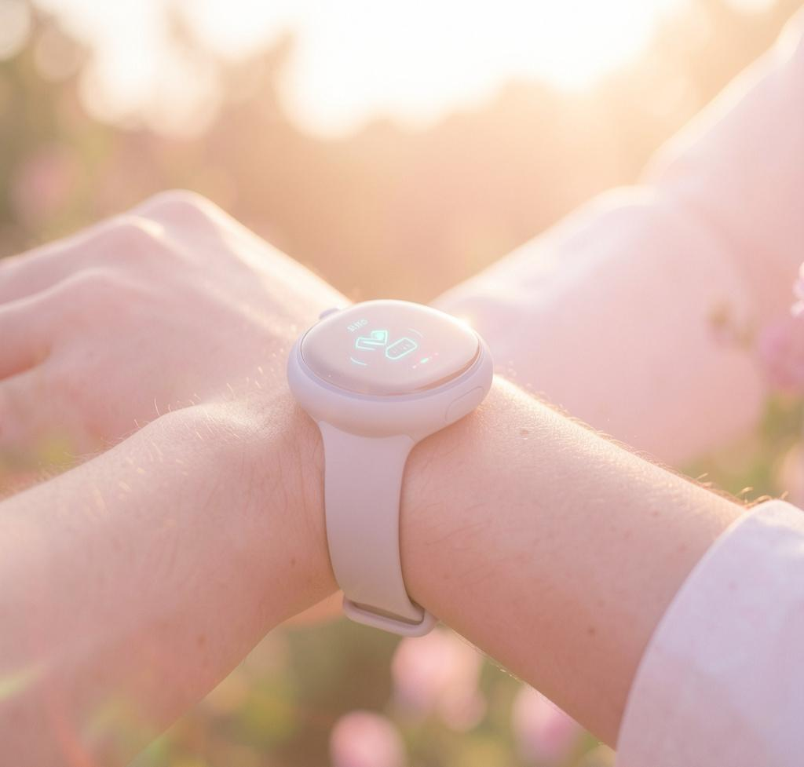
Introduction Multimodal Emergency Detection
An event-driven fall-detection system that minimizes always-on sensing and ML.
Low-power IMU continuously monitors; compact TinyML verifies impacts; microphone activates only after confirmation to confirm HELP/CANCEL, conserving battery while ensuring timely emergency response.
An event-driven system that uses "Sensory Gating" to activate high-power sensors and inferences only when a high-probability event is detected.

Slide 3

01
System Overview

Slide 4
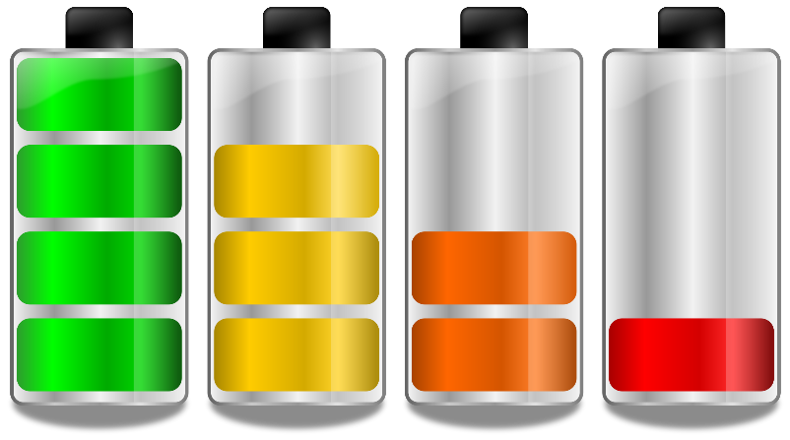
Problem Statement
Traditional "always-on" emergency detectors suffer from high battery drain and significant privacy concerns regarding continuous audio monitoring.
Goal: detect falls with a low-power pipeline that runs high-cost sensing and inference only when an IMU-triggered event suggests a potential emergency.

Slide 5

Sensory Gating Flow
Stage 0: Simple IMU polling for a >4.5G Impact. Zero ML overhead.
Stage 1: IMU CNN verifies true fall using motion signature (Descent → Impact → Stillness). If positive, proceed.
Stage 2: PDM mic activates to detect HELP/CANCEL, preventing unnecessary audio use and reducing false alarms.

Slide 6
Power Efficiency Logic
A three-stage sensory gating pipeline minimizes continuous high-power sensing.
Stage 0: passive IMU watches for 4.5G impacts (no ML).
Only verified events trigger the IMU CNN and then the microphone, keeping audio and heavy compute off most of the time.
Impact trigger
IMU CNN verify
Voice CNN KWS
Emergency Alert

Slide 7

02
TinyML & Implementation

Slide 8
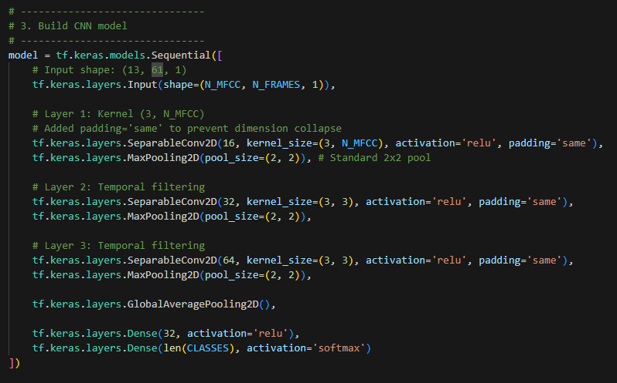
Model Architecture
Mainly used Depthwise separable CNNs as I intended to have 2 models on 1 Arduino Nano
Significantly reduces parameter count (to ∼15,000 parameters per model) by separating spatial and depth-wise filters.
Made use of Max pooling, and globalAveragePooling before going to dense layer to reduce parameters further
Model Size
IMU “Fall” Model: 60KB Arena
Audio “Emergency” Model: 64KB Arena

Slide 9
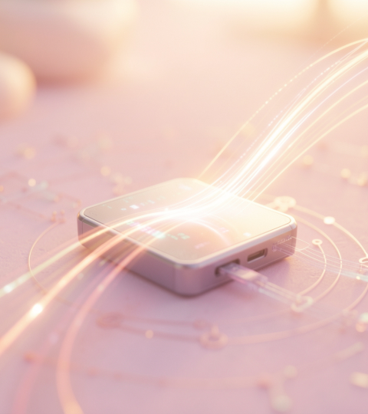
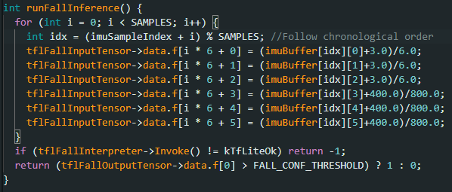
Embedded Optimization
Since both models combined use about half of Nano available SRAM, I decided to have only 1 shared Arena as both inference will never happen at the same time.
The system maintains a rolling 0.33s history pre-impact to capture the "weightless descent" phase required by the CNN
Then I "unwrap" the circular buffer into a linear timeline before inference, ensuring consistency with training data

Slide 10
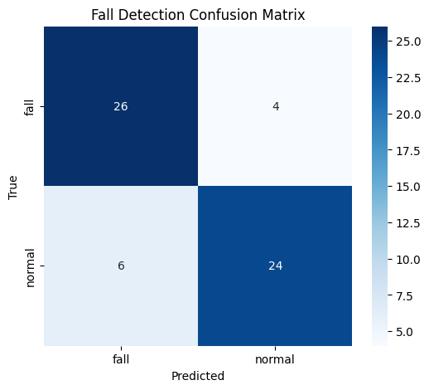
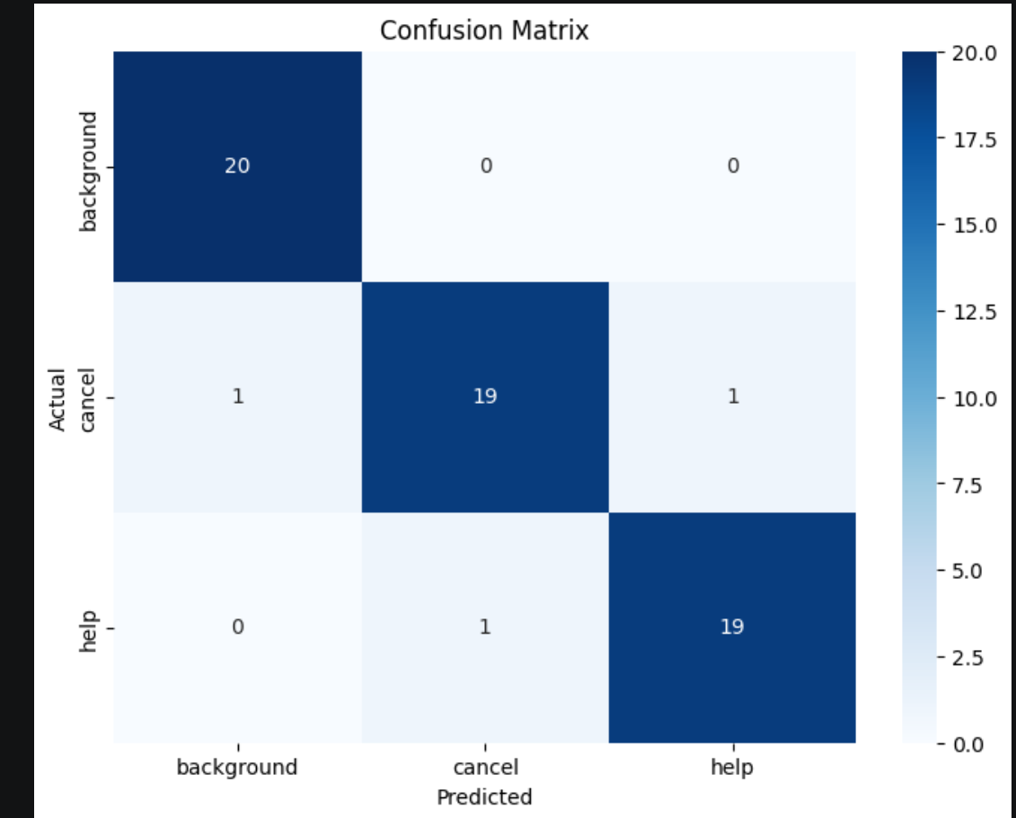
Performance
Stage 1 (IMU): High Sensitivity
Prioritized 86.7% Recall to ensure no fall event is ever ignored.
Accepts a 20% False Positive Rate (FPR) as a safety-first trade-off.
Stage 2 (Audio): High Precision
Provides 95% Precision on "HELP" detection to filter out Stage 1 false alarms.
Eliminates "Alarm Fatigue" by only triggering alerts for confirmed distress.
The Fail-Safe: "CANCEL" keyword allows the user to manually override any remaining system errors.

Slide 11
DEMO

Slide 12
Thanks!
Do you have any questions?

