Slide 1
SC4031 · INTERNET OF THINGS · COMM & NETWORKING
TERM PAPER · PRESENTATION
Smart Home IoT Protocols (PAN)
Literature review
Balancing energy, scalability, and security across the Wireless Personal Area Network landscape — from Wi-Fi and BLE to Zigbee, Z-Wave, Thread, and Matter.
Jonathan Low Seng Kian
5 min · 11 slides
U2321652C · Nanyang Technological University
AY2025/26 · Semester 2

Slide 2
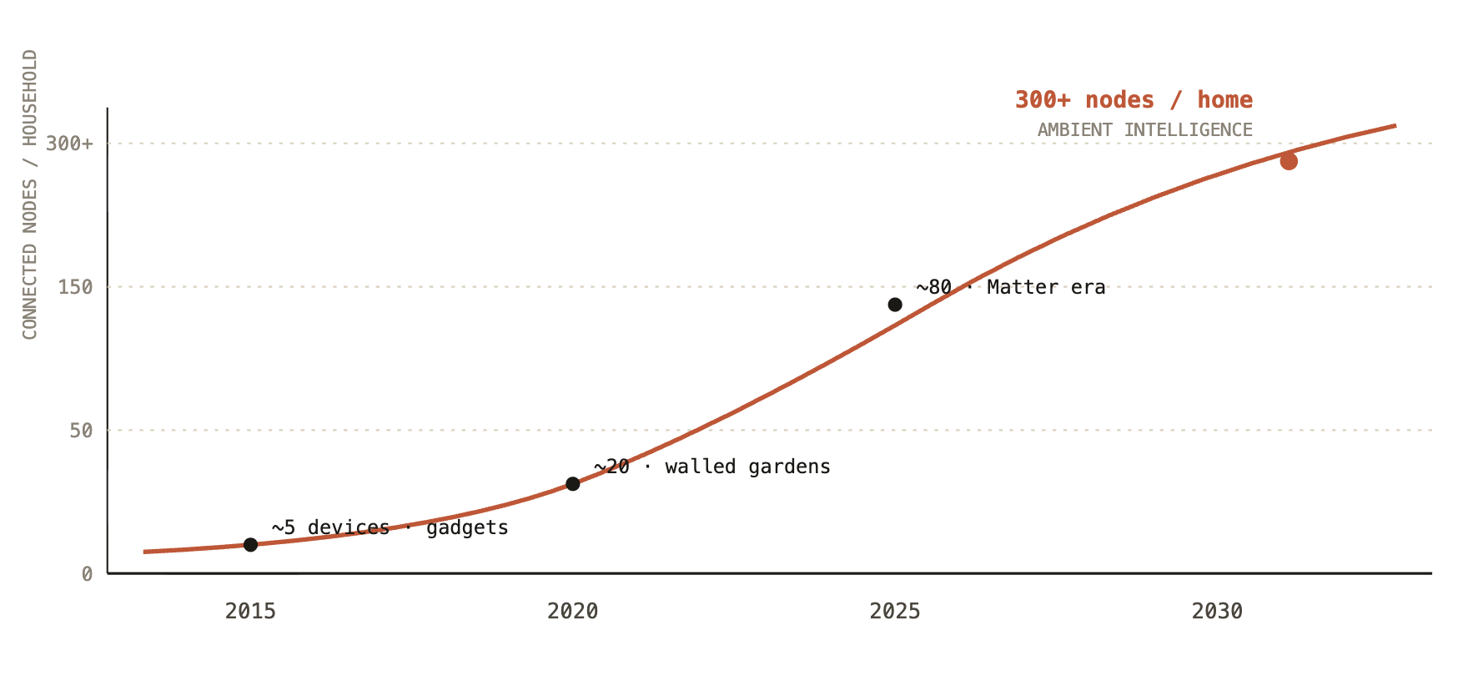
01 · THE PROBLEM
FIG 1 · EVOLUTION OF CONNECTIVITY
THE IRON TRIANGLE
From isolated gadgets to ambient intelligence
RESIDENTIAL IOT · PROJECTION
Smart Home IoT Protocols
02 / 11

Slide 3
02 · ARCHITECTURE
FIG 2 · EDGE–FOG–CLOUD HIERARCHY
THREE-LAYER HIERARCHY
Perception at the edge, coordination at the fog, intelligence in the cloud.
L1
L2
L3
Edge
Fog
Cloud
// PERCEPTION
// LOCAL COORDINATION
// REMOTE INTELLIGENCE
Physical sensors and actuators collect environmental data and execute commands. Strictest power budget — runs on coin-cell batteries for years.
Hubs and border routers bridge WPAN to IP. Guarantees local survivability — a motion sensor still triggers a light even if the internet drops.
Long-term storage, advanced analytics, mobile sync. Increasingly a data-layer resource rather than the real-time controller.
TYPICAL DEVICES
TYPICAL DEVICES
TYPICAL WORKLOADS
PIR, DHT22, smart relays
Thread Border Router
ML / anomaly detection
motorized blinds, door locks
Zigbee coordinator, Hubs
federated state, mobile apps
PROTOCOLS
ROLE
TREND
BLE · Zigbee · Thread · Z-Wave
Translate · cache · enforce logic
Control shifts down to the fog
↑ MQTT / HTTPS
↑ IP · 6LoWPAN
↑ WPAN RADIO
Smart Home IoT Protocols
03 / 11

Slide 4
03 · PROTOCOL A
FIG 3 · IEEE 802.11
01 / 05
IEEE 802.11 · 2.4 & 5 GHZ
Wi-Fi— the connectivity baseline
Native IP support is Wi-Fi's decisive advantage. Smart cameras, speakers, and displays connect directly to the internet — no specialized hub, no translation layer.
Up to 9.6 Gbps (Wi-Fi 6) — orders of magnitude above WPAN peers
THROUGHPUT
But Wi-Fi was engineered for laptops, not leaf nodes. Its high duty cycle and always-on radio make it a non-starter for a sensor expected to survive two years on a CR2032.
TOPOLOGY
Star, via access point / router
POWER DRAW
~200–800 mW active. Incompatible with coin-cell operation
→ Best for: high-bandwidth, mains-powered endpoints (cameras, streaming).
IP STACK
Full TCP/IP natively — no 6LoWPAN translation required
VERDICT
Eyes and ears, not nervous system
Smart Home IoT Protocols
04 / 11

Slide 5
03 · PROTOCOL B
FIG 4 · BLUETOOTH LOW ENERGY
02 / 05
BLUETOOTH SIG · 2.4 GHZ
BLE— the efficiency specialist
99%
BLE spends up to 99% of its life in deep sleep , waking for 1–3 ms bursts to exchange tiny payloads. This is why your temperature sensor lasts two years on a coin cell.
Historically trapped in a room-scale star topology. BLE Mesh and its role as the commissioning fabric for Matter make it indispensable for modern onboarding.
OF OPERATIONAL TIME SPENT IN DEEP SLEEP
DUTY CYCLE · TYPICAL SENSOR
DEEP SLEEP · 99%
RANGE
THROUGHPUT
TOPOLOGY
ROLE
50m
2Mbps
Star / Mesh
Commission
0 ms
ACTIVE · 1–3 ms burst →
line of sight
5.0 LE coded
5.0+ mesh
Matter onboarding
Smart Home IoT Protocols
05 / 11

Slide 6
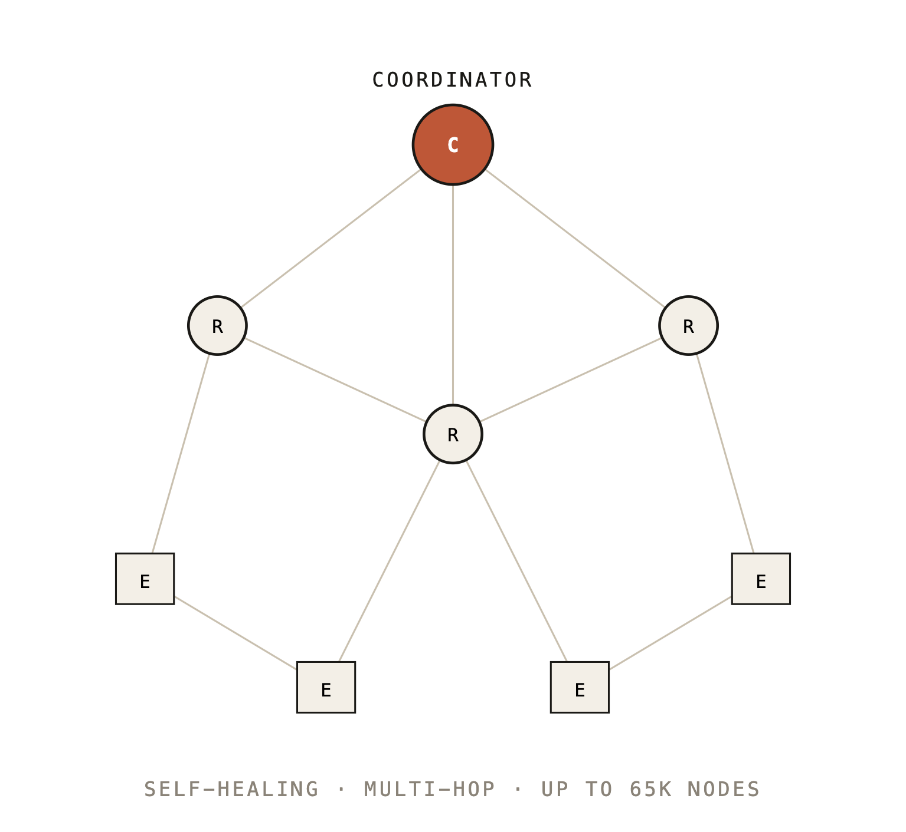
03 · PROTOCOL C
FIG 5 · ZIGBEE · ZCL
03 / 05
IEEE 802.15.4 · 2.4 GHZ · MESH
Zigbee— mesh & the ZCL
MESH TOPOLOGY
ZIGBEE CLUSTER LIBRARY · ZCL
Zigbee's quiet superpower isn't the radio — it's the standardized vocabulary at the application layer .
CLUSTER 0x0006
CLUSTER 0x0008
CLUSTER 0x0300
On / Off
Level Control
Color Control
0x0402
0x0500
0x0702
Temperature
IAS Zone
Metering
A "Turn On" command — cluster 0x0006, command 0x01 — is understood identically by a Philips bulb, an IKEA plug, and a Sonoff switch. Interoperability moves from the radio to the app layer.
Smart Home IoT Protocols
06 / 11

Slide 7
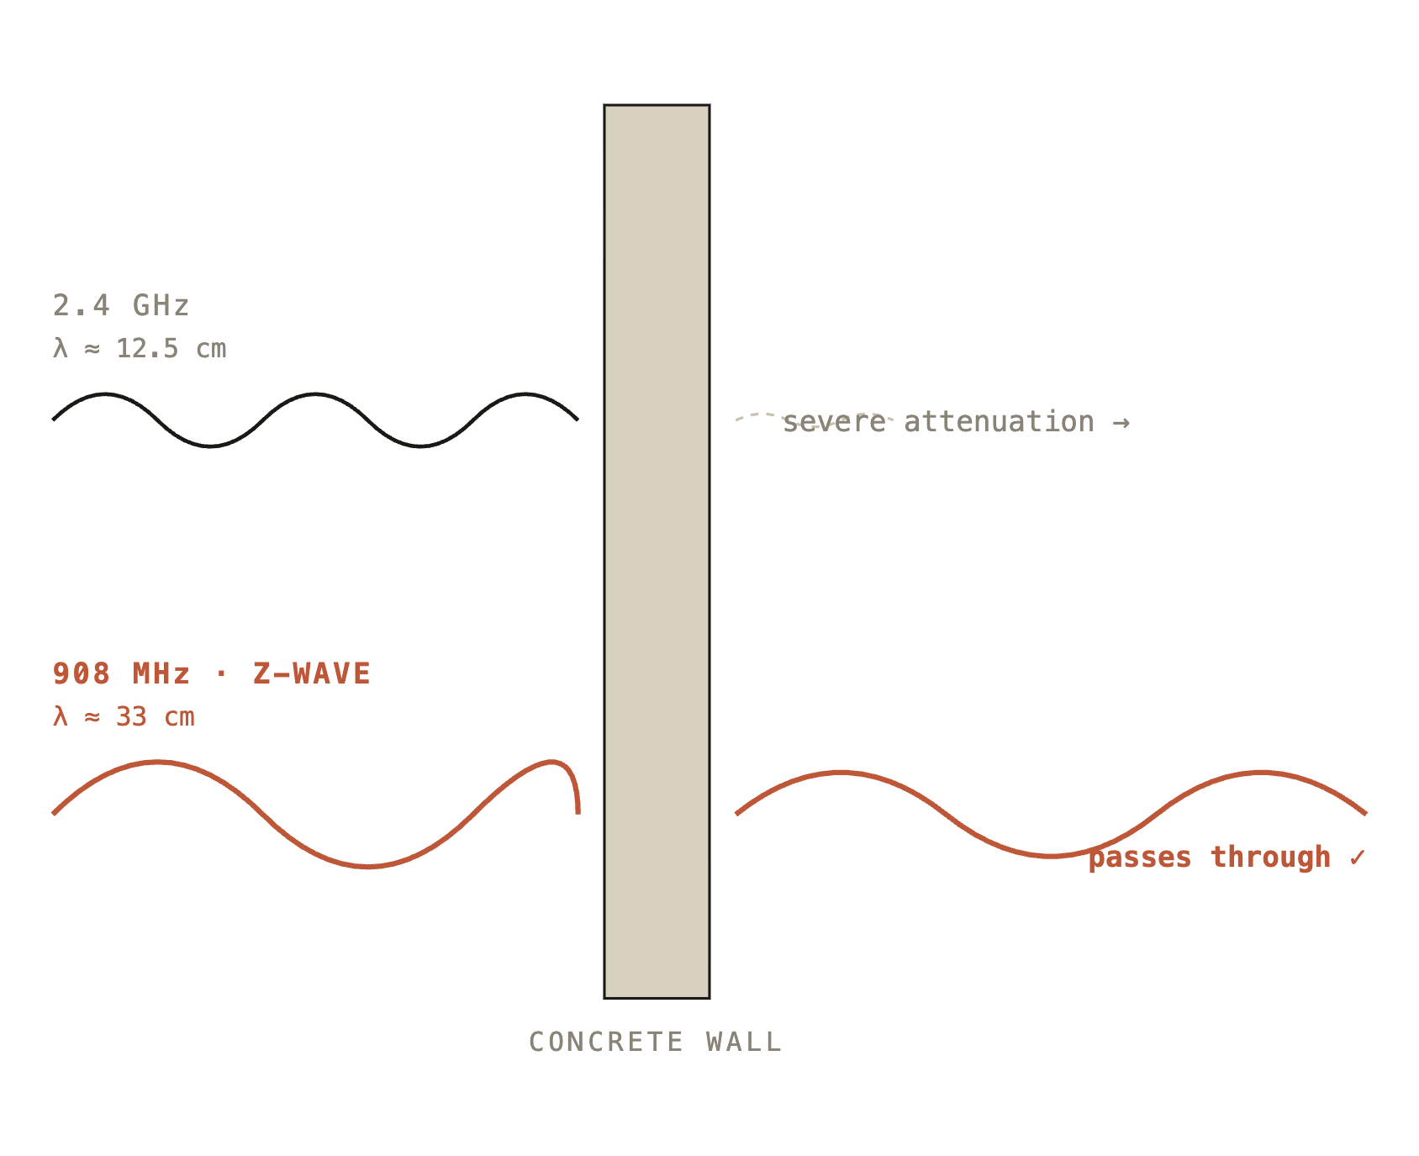
03 · PROTOCOL D
FIG 6 · Z-WAVE · SUB-GHZ
04 / 05
ITU-T G.9959 · 868 / 908 MHZ
Z-Wave— the sub-GHz advantage
WALL PENETRATION · Λ COMPARISON
Lower frequency means longer wavelength — and wavelength decides how much of your signal survives a concrete wall.
Operating at 868/908 MHz gives Z-Wave superior indoor range and near-zero interference from the chaos of the 2.4 GHz band already shared by Wi-Fi, Bluetooth, and Zigbee.
FREQ
RATE
RANGE
NODES
908MHz
100kbps
100m
232
US ISM
peak
open air
per network
Smart Home IoT Protocols
07 / 11

Slide 8
03 · PROTOCOL E
FIG 7 · THREAD · DTLS
05 / 05
IEEE 802.15.4 · IPV6 · 6LOWPAN
Thread— IPv6-native & secure
THREAD PROTOCOL STACK
Every sensor gets its own IPv6 address via 6LoWPAN. A door sensor is reachable end-to-end from the cloud — no hub translation, no proprietary gateway.
APPLICATION
L7
CoAP / Matter
Because Thread runs over UDP, security cannot depend on TCP. DTLS adds its own sequence numbers and retransmission timers to deliver a reliable, bank-grade handshake over an unreliable transport.
SECURITY
DTLS 1.2 · AES-128-CCM
★
TRANSPORT
L4
UDP
DTLS HANDSHAKE
ClientHello → cookie HelloVerifyRequest ← replay-proof ClientHello + Cookie → seq # Certificate, KeyExchange ⇄ AEAD Finished ⇄ secure channel
NETWORK
L3
IPv6 · 6LoWPAN · RPL
MAC / PHY
L1/2
IEEE 802.15.4 · 2.4 GHz
Smart Home IoT Protocols
08 / 11

Slide 9
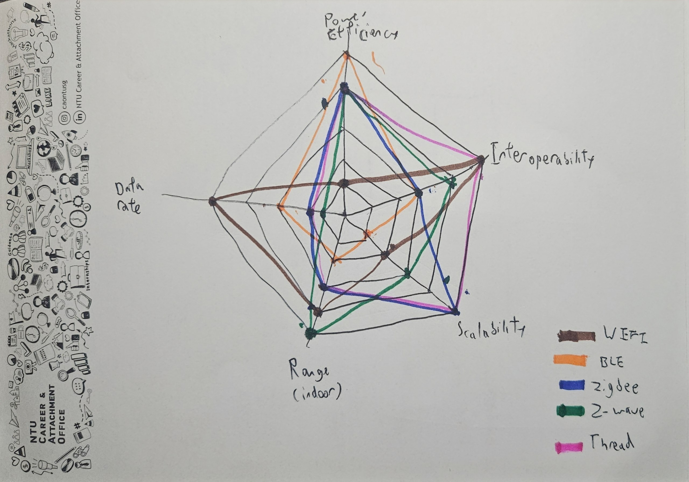
04 · COMPARISON
FIG 8 · TRADE-OFF SURFACE
TRADE-OFF SURFACE
No protocol wins — each dominates different axis.
LEADERS BY AXIS
■ SPEED
Wi-Fi — gigabit throughput, at a cost
■ RANGE
Z-Wave — sub-GHz, penetrates walls
■ POWER
BLE — 99% deep sleep
■ SCALE
Zigbee / Thread — thousands of nodes per mesh
■ INTEROP
Thread — IPv6-native, Matter-ready
The choice is never "which protocol wins" — it is "which constraint matters most for this device?"
Smart Home IoT Protocols
09 / 11

Slide 10

05 · THE FUTURE
FIG 9 & 10 · MATTER · HYBRID
THE HYBRID FUTURE
Matter doesn't replace radios. It unifies them.
APPLICATION LAYER
Matter
common data model · certified interop
EYES & EARS
CENTRAL NERVOUS SYSTEM
ONBOARDING
Wi-Fi
Thread+ Zigbee
BLE
High-bandwidth — cameras, displays, streaming. Mains-powered nodes.
Low-power mesh — sensors, switches, locks. Runs for years on a coin cell.
Commissioning channel — phone-to-device handshake before device joins the mesh.
Smart Home IoT Protocols
10 / 11

Slide 11
06 · CONCLUSION
THANK YOU
IN SUMMARY
The IoT landscape remains fragmented — but convergence on IP-based standards and edge computing is building a more resilient smart home.
01 · UNIFY
02 · DECENTRALIZE
03 · SECURE
Matter harmonizes the application layer across radios.
Fog-layer control ensures local survivability when the cloud is gone.
IPv6 + DTLS bring bank-grade encryption down to the leaf node.
Jonathan Low · U2321652C · SC4031
11 / 11

