Slide 1
WDV341 Intro PHP
Client Server Model
For Website Applications

Slide 2
Client – Server Model
The client–server model of computing is a distributed application structure that partitions tasks or workloads between the providers of a resource or service, called servers, and service requesters, called clients.^{[1]} source: www.wikipedia.org
Client-server describes an application architecture in which the client requests an action or service from the provider of services, the server. Source: http://www.ni.com/white-paper/4431/en/

Slide 3
Client Server Model The Players
Client
Server
A computer on the Internet
Your computer!
The customer’s computer being used to access the company website!
Can be any type of computer
Can be anywhere in the world!
A computer, running a Server Operating System, designed to respond to requests on a network.
All websites on the Internet run on a server.
Your webhost account is a server!

Slide 4
Client Server Model The Operating Systems
Client
Server
Windows
MAC iOS
Linux
Unix
Windows Server
MAC OS Server
Linux - Ubuntu Server Edition
Unix
Apache – Common tool for stand alone Server on a local/client machine

Slide 5
Client Server Model The Software
Client
Server
Operating System
Browser
Internet Explorer
Chrome
Firefox
Safari
Etc…
Operating System
Script Processor
A Server must have a processor for each Server side language used within a Web Application
There could be multiples on the same server
Database
Multiple databases are available
MySQL, Oracle, MS Access, SQLServer

Slide 6
Client Server Model The languages/technologies
Client
Server
HTML, XHTML, HTML5
CSS
Javascript
Image presentation
Audio presentation
Video presentation
‘Server Side Scripting Languages’
PHP
JSP – Java Server Pages
ASP.NET – Active Server Pages
ColdFusion
Database Language
SQL – Structured Query Language

Slide 7
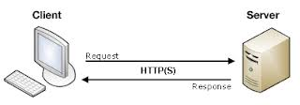
Client Server Model Basic Request-Response

Slide 8
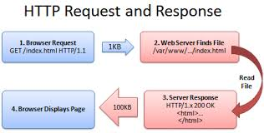
Client – Server Model Website Request - Response

Slide 9
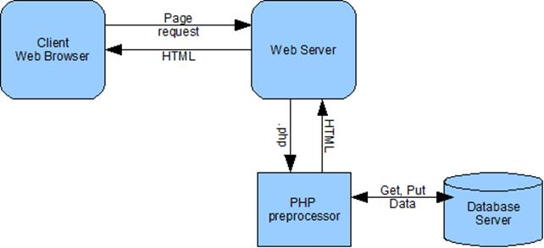
Client Server Model
Request Object
Response Object

Slide 10
Client Server Model Summary
The basis for all Website Application Development
Requires a working knowledge of the client/browser and the server/scripting language
Client is a computer somewhere on the Internet
Client’s role is to display to the user and send information to the server
Server is a computer on the Internet that is called by a Client.
Server processes scripting languages to add content to a web page.

