Slide 1
WDV341 Intro PHP
The Server Side Story

Slide 2
WDV341 Intro PHP Basic Terms
Client:
The browser running on some computer somewhere
Server:
A computer on the Internet setup to process and send web pages or content to a client
Web Server - processes pages
Image Server - send images or videos, etc.
Mail Server - sends and receives emails
Client-Server processing:
A website application that has both client and server side components

Slide 3
WDV341 Intro PHP Basic Terms
Static Pages
Content is already defined by the developer
Includes most html pages
.htm or .html
Developer must make changes and then move the page to the server
Server sends the page, without any processing, to the client
Page is rendered and displayed in the browser

Slide 4
WDV341 Intro PHP Basic Terms
Dynamic Pages
Structure is already defined by the developer
Content comes from a database and can change based upon the customer’s actions
Server processes the Server Side code and puts any results on the requested page
Results must use Client Side code, HTML,CSS,Javascript
Server sends the processed page to the Client
Page is rendered and displayed in the browser

Slide 5
Client Side vs. Server Side
Client – Runs in the Browser
Server - Server Side Scripting
HTML / XHTML
CSS
Javascript
Flash
Generally the Server will ignore code from these languages
PHP
ASP.Net
ASP Active Server Pages
Previous to ASP.Net
JSP Java Server Pages
ColdFusion
Generally the Browser will ignore code from these languages

Slide 6

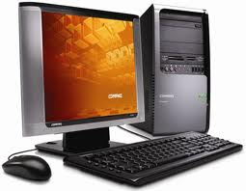
Requesting a Static Page from the Server
Client
Server
www.flowers.com
www.flowers.com/spring.html

Slide 7
Requesting a Static Page from the Server
Client
Request Object
Server
www.flowers.com
www.flowers.com/spring.html

Slide 8
Requesting a Static Page from the Server
Client
Request Object
Server
www.flowers.com
www.flowers.com/spring.html

Slide 9
Requesting a Static Page from the Server
Client
Server
www.flowers.com
www.flowers.com/spring.html
Request Object
Response Object
spring.html

Slide 10
Requesting a Static Page from the Server
Client
Server
www.flowers.com
www.flowers.com/spring.html
Request Object
Response Object
spring.html

Slide 11
Requesting a Static Page from the Server
Client
www.flowers.com/spring.html
Request Object
Server
www.flowers.com
Response Object
Browser renders the HTML and CSS then displays the page.
spring.html

Slide 12
Requesting a PHP page (dynamic) from the Server
Notice .php file name
Server
www.flowers.com
Client
www.flowers.com/season.php
Request Object

Slide 13
Requesting a PHP page (dynamic) from the Server
Server
www.flowers.com
Client
www.flowers.com/season.php
Request Object
season.php

Slide 14
Requesting a PHP page (dynamic) from the Server
Server
www.flowers.com
Client
www.flowers.com/season.php
Request Object
season.php
HTML,CSS Javascript
code
PHP code
PHP
Processor

Slide 15
Requesting a PHP page (dynamic) from the Server
Server
www.flowers.com
Client
www.flowers.com/season.php
Request Object
season.php
HTML,CSS Javascript
code
PHP code
Response Object
PHP
Processor
Results in HTML,CSS Javascript
code

Slide 16
Requesting a PHP page (dynamic) from the Server
Server
www.flowers.com
Client
www.flowers.com/season.php
Request Object
season.php
HTML,CSS Javascript
code
PHP code
Response Object
PHP
Processor
Browser renders the HTML and CSS then displays the page.
Results in HTML,CSS Javascript
code
Contains only HTML, CSS or Javascript

Slide 17
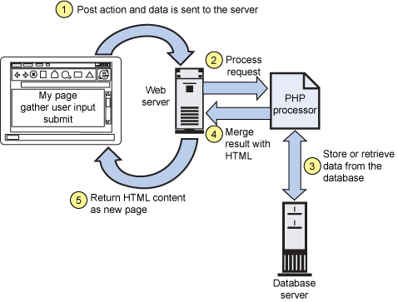
Client Server Model

Slide 18
Client Server Model Summary
Client gathers customer information and sends the Request Object to the Server
Server uses the information from the Client
Server finds the requested file(s)
Server processes any Server Side Scripting and sends any results to the Response Object
Server sends the Response Object back to the Client
Client uses the results from the Response Object and displays the page to the customer.

