Slide 1
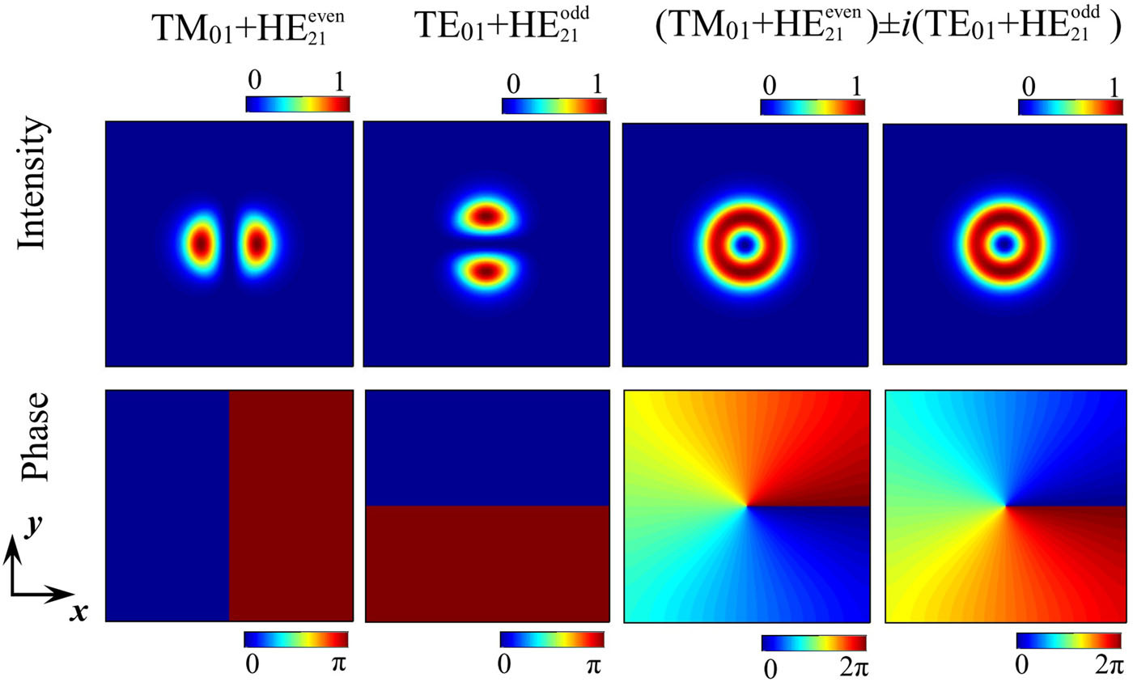
FIG. 1. Relation between vortex modes and four high-order vector modes. The upper and lower figures show the intensity profiles and phase distributions of these modes, respectively.
Published in: Dong Mao; Mingkun Li; Zhiwen He; Xiaoqi Cui; Hua Lu; Wending Zhang; Han Zhang; Jianlin Zhao; APL Photonics 4, 060801 (2019)
DOI: 10.1063/1.5094599
Copyright © 2019 Author(s)

