Slide 1
Lecture 13-2
An Overall Review
Some homework
The total Content

Slide 2

Just for fun
纸上得来终觉浅，恳请老师画重点；
天若有情天亦老，范围一定要画小；
天涯何处无芳草，别说整本书都考；
绝知此事要躬行，老师请念师生情；
春眠不觉晓，挂科得补考；
安能摧眉折腰事权贵，题出难了我不会；
南朝四百八十寺，大题少让写点字；
桃花潭水深千尺，卷子最好一张纸；
谁知盘中餐，代表整个班~

Slide 3
Preface
Time Complexity(时间复杂性)
Elementary Operation
Three Notations:
    O(.) : “Big-Oh” – the most used
    Ω(.) : “Big omega”
    Θ(.) : “Big theta”

Slide 4
Asymptotic Notation (O)
O-notation: asymptotic upper bound
  O(g(n)) = {f(n): there exist positive constants c and n₀ such that 0 ≤ f(n) ≤ cg(n) for all n ≥ n₀}.

Slide 5
Asymptotic Notation (Ω)
Ω-notation: asymptotic lower bound
  Ω(g(n)) = {f(n): there exist positive constants c and n₀ such that 0 ≤ cg(n) ≤ f(n) ) for all n ≥ n₀}.

Slide 6
Asymptotic Notation (Θ)
Θ-notation:
  Θ(g(n)) = {f(n): there exist positive constants c₁, c₂, and n₀ such that 0 ≤ c₁g(n) ≤ f(n) ≤ c₂g(n) for all n ≥ n₀}.

Slide 7
Representations of graphs
Representations of graphs
  Adjacency-list
  Adjacency-matrix

Slide 8
Breadth first search
Breadth first search
  Properties of the Queue
  Correctness
  22.2-7
  Time complexity
  Breadth first tree

Slide 9
Depth first search
Depth first search
  Properties
    Parenthesis theorem
    Nesting of descendants’ intervals
    White-path theorem
    Classification of edges
  22.3-12
  depth first tree

Slide 10
Topological sort
Procedure
Lemma 22.11:Acyclic ⇔ no back edge
Proof of its Correctness
22.4-2
22.4-5

Slide 11
Strongly Connected Component
Procedure
Lemma 22.13: G^{scc} is acyclic.
Lemma 22.14: (u, v) ∈ E, where u ∈ C and v ∈ C’. Then f(C) > f(C’).
Corollary 22.15
Theorem 22.16: Correctness
22.5-7
Problem 22-3

Slide 12
Minimum Spanning Tree
Tree and Its Properties
Idea of the Generic Algorithm
Three Properties of Minimum Spanning Tree
  Use them to prove the correctness of some algorithm
Theorem 23.1 : light edge is safe.
  Use this theorem to prove the correctness of some algorithm
Corollary 23.2: idea for Prim and Kruskal

Slide 13
23.1-5
证：反证。假设G的所有最小生成树都包含边e。任取这样的一棵最小生成树T, 在T上去掉e，将T分为两棵子树T₁和T₂。记T₁上顶点的集合为V₁，T₂上顶点的集合为V₂，则(V₁, V₂)是一个割。
e所在的圈C至少穿越割(V₁, V₂)两次。即，C至少有两条边在(V₁, V₂)中，其中一条边是e。记e’为除e之外的另外任一条边。由题目给定，可知w(e’) ≤ w(e)。
将e’并到T₁和T₂上，将T₁、T₂连接成一棵新的生成树T’。由于T’是在T上去掉e、加入e’形成的，可知w(T’) ≤ w(T)。
因此，T’也是G的一棵最小生成树，且T’中不包含边e，与假设矛盾。命题得证。
© 2004 SDU <number>

Slide 14
Kruskal’ algorithm
Procedure
Note:
  sort the edges into non-increasing order
  do if T-{e} is a connected graph
  then T←T-e

Slide 15
Proof 23-4(a)
证明：用归纳法。假设算法过程中当前的图分别是G₁,G₂,…,G_{k}, 只要证明每个G_{i}中都包含Ｇ的一棵最小支撑树即可。 ｉ＝１时显然成立。假设结论对ｉ－１成立，下面证明结论对ｉ也成立。假设Ｇ_{i}＝Ｇ_{i-1}-ｅ, 边e＝（ｕ，ｖ）．则容易知道e 是G_{i-1}中某个圈C上的最大边。下面只需证明G_{i}中包含 G_{i-1}的一棵最小支撑树即可。
© 2004 SDU <number>

Slide 16
23-4(a)
证明: 设T中的边按照权值非递减顺序依次为e₁, e₂,…, e_{n-1},
即算法依次保留边e₁, e₂,…, e_{n-1}。设边集A_{i} ={ e₁, e₂,…, e_{i}}，1≤i≤n-1则只需要证明每个A_{i} 都是某棵最小生成树的子集。
用归纳法证明。
i=1时，设T’是一棵最小生成树，如果(u, v)=e₁∈T’, 结论自然成立。如果e₁∉T’，则在T’中存在u到v的路径p。因为删除e₁会使图不连通，即删除e₁会使顶点集合V划分为两个子集V₁和V₂，其中u∈V₁，v∈V₂。则路径p中存在1条边(x, y)满足x∈V₁，y∈V₂，并且(x, y)已经被删除了，否则如果p中所有边都没被删除，删除e₁不会使图不连通。既然(x, y)已经被删除了，根据算法是按照权值由大到小的顺序删边的，所以w(x, y)≥ w(u, v)。则T’’=T’ - (x, y)+(u, v)必然是一棵最小生成树。

Slide 17
Continued
设对边集A_{i}时结论成立，现在证明边集A_{i+1}也是某棵最小生成树的子集。
设A_{i} ={ e₁, e₂,…, e_{i}}是最小生成树T’的子集，如果(u, v)=e_{i+1}∈T’, 结论自然成立。如果e_{i+1}∉T’，则在T’中存在u到v的路径p。因为删除e_{i+1}会使图不连通，即删除e_{i+1}会使顶点集合V划分为两个子集V₁和V₂，其中u∈V₁，v∈V₂。则路径p中存在1条边(x, y)满足x∈V₁，y∈V₂，并且(x, y)已经被删除了，否则如果p中所有边都没被删除，删除e₁不会使图不连通。既然(x, y)已经被删除了，根据算法是按照权值由大到小的顺序删边的，所以w(x, y)≥ w(u, v)。则T’’=T’ - (x, y)+(u, v)必然是一棵最小生成树。现在只需要证明T’’包含A_{i} ={ e₁, e₂,…, e_{i+1}}中的所有边，因为T’’与T’只有1条边不同，所以只需要证明(x,y)∉A_{i}，这显然是成立的，因为(x, y)已经被删除了，而{ e₁, e₂,…, e_{i}}是没被删除的。
证明完毕！

Slide 18
23-4(c)
证明：算法实际上是在图G中删除一些圈上权值最重的边，最后得到一棵MST。
设删除的边依次为e₁, e₂…,e_{m-n+1}，剩余的图依次是G₀, G₁,…,G_{m-n+1}，其中G=G₀，G_{m-n+1}=T，m=|E|，n=|V|。
我们证明G_{i+1}的MST同时也是G_{i}的MST即可。
前面23.1-5已经证明了存在G_{i+1}的MST T’同时也是G_{i}的MST，而G_{i+1}的所有MST的大小与T’一样的，所有它们都与G_{i}的MST的大小一样，所以他们都是G_{i}的MST。
从而G_{m-n+1}必然是G_{m-n},…, G_{o}的MST。

Slide 19
Prim’s Algorithm
Procedure
Key idea

Slide 20
Thinking carefully
23-1:Second best minimum spanning tree
  当所有边的权重都互不相同时，MST唯一。
23-3: Bottleneck spanning tree

Slide 21
Bottleneck Spanning Tree
A bottleneck spanning tree T of a connected, weighted and undirected graph G is a spanning tree of G whose largest edge weight is minimum over all spanning trees of G.
  Let T₁, T₂, …, T_{m} are all the spanning trees G, and the largest edge of each tree is e_{t1}, e_{t2}, …, e_{tm.} If w(e_{ti}) ≤ w(e_{tj}) for 1 ≤ j ≤ m and j ≠ i, then T_{i} is a bottleneck spanning tree.
  The value of a BST T is the weight of the maximum-weight edge in T.
  The bottleneck spanning tree may not be unique.

Slide 22
BST vs MST
Every minimum spanning tree is a bottleneck spanning tree.
  Property 3 implies it.
  Another proof: Let T be a MST and T’ be a BST, let the maximum-weight edge in T and T’ be e and e’, respectively. Suppose for the contrary that the MST T is not a BST, then we have w(e)>w(e’), which also indicates that the weight of e is greater than that of any edges in T’. Removing e from T disconnects T into two subtrees T₁ and T₂, there must exist an edge f in T’ connecting T₁ and T₂, otherwise, T’ is not connected. T₁∪T₂ ∪{f} forms a new tree T’’ with w(T’’) = w(T) - w(e) + w(f) < w(T), A contradiction to the fact that T is MST, thus, a MST is also a BST.

Slide 23
The BST Problem
The Problem:
  Input: A weighted, connected and undirected graph G.
  Output: A BST T of G.
A solution:
  Kruskal’s and Prim’s Algorithm works for the BST problem.
More efficient algorithm exist for the problem?

Slide 24
A Verification Problem
A verification problem:
  Input: A graph G = (V, E; W) and an integer b
  Output: TRUE if the value of the bottleneck spanning tree of G is at most b and FALSE otherwise
How to solve this problem in linear time?

Slide 25
CHECKBOTTLENECK(G, b)
for each vertex u ∈ V[G]
do color[u] ←WHITE
u ←randomly chosen vertex in G
DFS(u, b) //O(V+E)
for each vertex u ∈V[G]
do if color[u] = WHITE
then return FALSE
return TRUE
DFS(u, b)
color[u] ←GRAY
for each v ∈Adj[u]
do if color[v] = WHITE and w(u, v)≤b
then DFS(v, b)
color[u] ←BLACK

Slide 26
Solve the BST Problem
BOTTLENECK(G)
sort the weights of edges of G in non-decreasing order: e[1], e[2], …, e[| E |]
start ← 1
end ← | E |
while start < end
do middle ← ⎣(start + end)/2⎦
if CHECKBOTTLENECK(G, e[middle]) = FALSE
then start ←middle
else end ←middle //in the end there is a BST with value =e[end],
u ← randomly chosen a vertex of G
call DFS(u, e[start]) to build a spanning tree

Slide 27
Solve the Problem in Linear Time
Time complexity:
Sorting:O(ElgE)
Finding the value of BST: O((V+E)lgE)=O(ElgE)
Total:O(ElgE)
Can the problem be solved in linear time?
Please think it carefully, anyone who finds the solution will be given an extra bonus.
Will it be unsolved all our lives?

Slide 28
Single-Source Shortest Path
Variants of Shortest-Paths Problems
Properties of Shortest-Paths and Relaxation
  Triangle inequality
  Upper-bound
  No-path property
  Convergence property
  Path-relaxation property
  Predecessor-subgraph property

Slide 29
Bellman-Ford Algorithm
The Bellman-Ford Algorithm
  Correctness proof
  24.1-6
In DAG
  correctness

Slide 30
24.1-6
首先对G进行改造。增加一个新的顶点s，以及s到G中所有顶点的边，边上的权重均为0。记如此得到的图为G’ = (V’, E’)。
将E中的边任意定一个顺序。对E中每一条边e，进行如下测试。将e从G’上去掉。调用BF算法在当前图G’上测试是否有负费用圈。若有，则e永久删除。否则，表明e在剩下的唯一一个负权重圈中，将e重新放回到G’。这样测试完E中所有的边之后，最后留在G’中的（不包括从s出发的那些新加的边）即是一个负权重圈。
© 2004 SDU <number>

Slide 31
Dijkstra’s algorithm
key idea
Correctness
Its similarity to BFS and Prim
24.3-2
24.3-3

Slide 32
All-Pair Shortest Paths
Matrix multiplication
  Idea: l_{ij}^{(m)}
  The recursive formula:
  l_{ij}⁽¹⁾ =w_{ij}
  l_{ij}^{(m)} = min_{1≤k≤n} {l_{ik}^{(m-1)} + w_{kj}}
  Time complexity

Slide 33
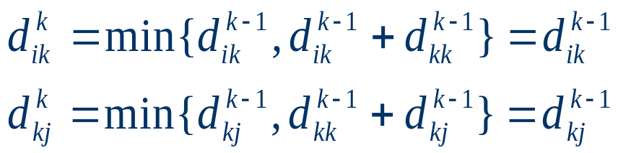
The Floyd-Warshall Algorithm
Idea: d_{ij}^{(m)}
The recursive formula:
  d_{ij}⁽⁰⁾ = w_{ij}
  d_{ij}^{(k)} = min(d_{ij}^{(k-1)}, d_{ik}^{(k-1)} + d_{kj}^{(k-1)})
Time complexity
Run some examples
25.2-5

Slide 34
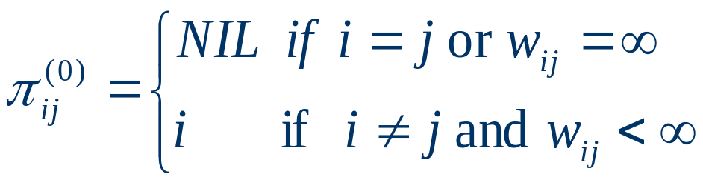
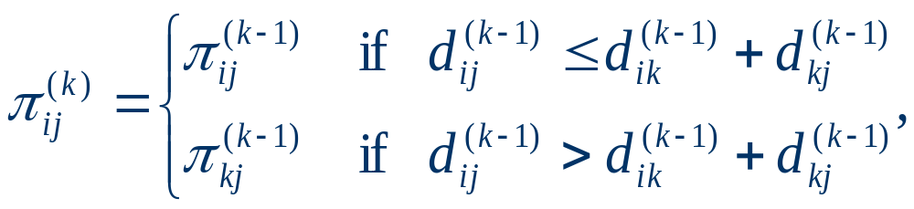
Constructing a shortest path
For k=0
For k>=1

Slide 35
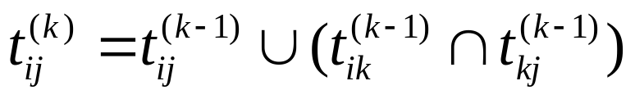
Transitive closure
How to revise the Floyd-Warshall Algorithm?
Time Complexity
25.2-8

Slide 36
Johnson’s Algorithm
Procedure
Time Complexity
Lemma 25.1: reweighting does not change shortest paths.
Rewrite :h(v) = δ(s,v), why?
25.3-4

Slide 37
Maximum Flow
Definitions
There properties of the flow:
  Capacity constraint
  Skew symmetry
  Flow conservation

Slide 38
The Ford-Fulkerson Method
residual networks :Lemma 26.2
augmenting paths: Lemma 26.3, Corollary 26.4
Cuts: Lemma 26.5, Corollary 26.6
Theorem 26.7(Max-flow Min-cut Theorem)
Run some examples
  f(S,T)
  c(S,T)
Edmonds-Karp, Dinic, Time Complexity.
Maximum bipartite matching.

Slide 39
What should I say?
We have burdened our song with so much music that it is slowly sinking and our art has become so ornate that the makeup has corroded her face.

Slide 40
Thank you!

