Slide 1
Discrete Mathematics
Shandong University Qilu Software College

Slide 2
Chapter 7
Boolean Algebra

Slide 3
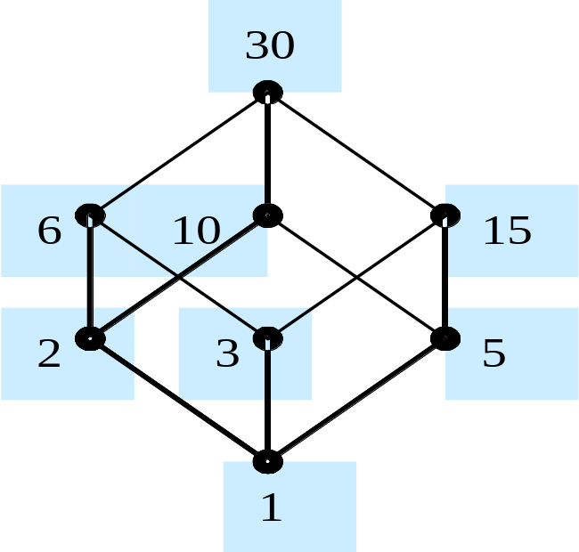
§7.1 Lattices (1)
7.1.1 Posets
Exam 1:S₃₀ = {1,2,3,5,6,10,15,30}
| = {<x,y> | x,y∈S₃₀ and x|y}
S₆={1,2,3,6} ⊆ S₃₀
S₁₅={1,3,5,15} ⊆ S₃₀

Slide 4
§7.1 Lattices (2)
7.1.2 Lattices
(1) The concept of lattices and
their properties
A partially ordered set in which every pair of elements has both a least upper bound(LUB) and a greatest lower bound(GLB) is called a lattices.
a∧b= glb(a,b)，a∨b=lub(a,b)

Slide 5
§7.1 Lattices (1)
7.1.1 Posets
例 集合S的幂集P(S)和定义在其上的包含关系构成偏序集< P(S) ， ⊆ >.对于任意子集A,B S，因为A ⊆ A∪B,B ⊆ A∪B，而且若A ⊆ C,B ⊆ C,则A∪B ⊆ C。因此， {A,B}的最小上界A ∨B=A∪B。同理{A,B}的最大下界A ∧ B=A∩B。于是，< P(S) ， ⊆ >是格(<P(S), ∨, ∧ >)。
由集合S={a,b,c}得到的格<L， ⊆ >的Hass图，如下图所示。

Slide 6
§7.1 Lattices (1)
{a,b,c}
{a,b}
{b,c}
{a,c}
{a}
{b}
{c}
ф

Slide 7
§7.1 Lattices (1)
Example :<S_{30,}|>, <S_{6,}|>,
<S_{20,}|>,
30
6
15
10
2
3
5
1

Slide 8
§7.1 Lattices (1)
例判断图中的哈斯图表示的偏序集是否构成格,说明为什么。
d
e
f
d
e
e
c
d
d
e
c
d
c
c
b
b
c
b
a
a
a
a
b
a
b
(a)
(b)
(c)
(d)
(e)

Slide 9
Lattices: Example
Is the example a lattice?
i
j
f
g
h
No, because the pair {b,c} does not have a LUB-least upper bound
e
b
c
d
a

Slide 10
Lattices: Example
Is this example a lattice?
g
No!
  The lower bound of A={e,f} is {a,b,c}
  However, A has no glb
Similarly, B={b,c} has no ULB
f
e
h
b
c
d
a

Slide 11
Lattices: Example
j
Is the example a lattice?
i
f
g
h
Yes, because for any pair, there is an lub & a glb
e
b
c
d
a

Slide 12
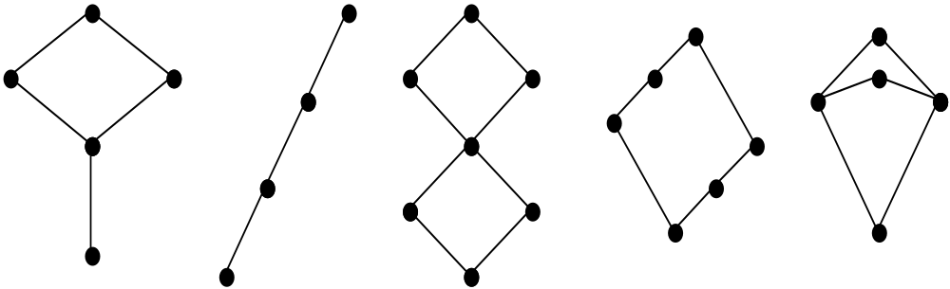
§7.1 Lattices (3)
7.1.2 Lattices
(1) The concept of lattices and
their properties

Slide 13
§7.1 Lattices (1)
例 设I⁺为正整数集合，对于a,b ∈ I⁺，关系“≤”定义为：a≤b当且仅当a整除b。则偏序集< I⁺,≤>构成格，
其中:
a ∧ b是a,b的最大公因数（记作GCD），
a ∨ b是a,b的最小公倍数(记作LCM)，即
a ∧ b=GCD(a,b)， a ∨ b= LCM(a,b)

Slide 14
§7.1 Lattices (4)
7.1.2 Lattices
(1) The concept of lattices and
their properties
For ∀a,b,c∈P
① Idempotent laws :a∨a = a, a∧a = a
② Commutative laws：
a∨b = b∨a, a∧b = b∧a

Slide 15
§7.1 Lattices (5)
7.1.2 Lattices
For ∀a,b,c∈P
③ Associative laws：
a∨(b∨c) = (a∨b)∨c,
(a∧b)∧c = a∧(b∧c)
④ Absorption laws：
a∧(a∨b) = a, a∨(a∧b) = a

Slide 16
§7.1 Lattices (6)
7.1.2 Lattices
(2) The relation between lattices and
algebra system
< P, ≤ > ⇔ <P, ∨, ∧>
命题：
假设< P, ≤ >是一个格，则对∀a,b∈P，
有 a ≤ b ⇔ a∧b=a ⇔ a∨b=b。

Slide 17
§7.1 Lattices (6)
7.1.2 Lattices
(2) The relation between lattices and
algebra system
设<L,∨,∧>是一个代数系统,∨和∧是L上的两个二元运算,如果这两个运算满足交换律、结合律、幂等律和吸收律,则称<L，∧,∨>是一个格(Lattice)。

Slide 18
§7.1 Lattices (7)
命题：设<P, ∨, ∧>是一个代数系统，
如果运算 ∨, ∧ 满足幂等、结合、交换、吸收性，
那么 a ∧ b = a ⇔ a ∨ b = b。
定理：假设<P, ∨, ∧>是一个代数系统，其中的运算 ∨, ∧ 满足幂等、结合、交换、吸收性，定义 P 上的关系为：对∀a,b∈P，a ≤ b ⇔ a ∧ b = a，则 ≤ 是偏序关系，并且对 ∀a,b∈P，a ∧ b 和 a ∨ b 分别表示为 a,b 在<P, ≤>中的最大下界和最小上界，从而，<P, ≤>是一个格。

Slide 19
§7.1 Lattices (7)
定理：<P, ≤ >格，对∀a,b∈P，都有
a ≤ b ⇔ a ∧ b = a ⇔ a ∨ b = b ，

Slide 20
§7.1 Lattices (7)
例 < P(S) ， ⊆ >是格
表示为<P(S), ∨, ∧ >
又可表示为< P(S) ,∪,∩>。

Slide 21
§7.1 Lattices (7)
子格(Sublattice):设<L,∧,∨>是一个格,如果<A ,∨,∧>是<L,∨,∧>的子代数,则称
<A,∨,∧>是<L,∨,∧>的子格Sublattice)。
子格也是一个格,因为当运算∨和∧限制在A上时,交换律、结合律和吸收律也是成立的。

Slide 22
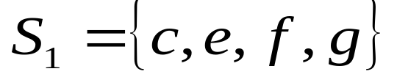

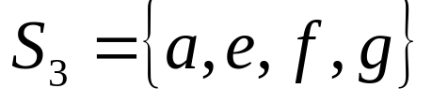

§7.1 Lattices (7)
子格(Sublattice):
例设<L,∨,∧>是一个格,其中 ，如下图
令
则 <S₁, ∨,∧>和<S₂, ∨,∧>是<L,∨,∧>的一个子格,
<S₃, ∨,∧>不是<L,∨,∧>的子格，这是因为
g
e
f
c
b
d
a

Slide 23
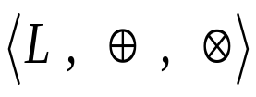



§7.1 Lattices (7)
例题：设 是一个格， a,b∈L ，且 ，令
其中≤ 是格中的偏序关系，
证： 是 的子格。

Slide 24
§7.1 Lattices (7)
定理：在<P, ≤ >格中，对∀a，b，c，d∈P，
a ≤ c, b ≤ d 则
a ∨ b ≤ c ∨ d ,a ∧ b ≤ c ∧ d
例题：在<P, ≤ >格中，对∀a，b，c ∈P，
若b ≤ c 则
a ∨ b ≤ a ∨ c ,a ∧ b ≤ a ∧ c

Slide 25
§7.1 Lattices (8)
7.1.2 Lattices
（3）Several different types of lattices
① Complete lattice 完全格
A complete lattice is a partially ordered set in which all subsets have both a supremum（最大元） and an infimum（最小元）.

Slide 26
§7.1 Lattices (9)
7.1.2 Lattices
② Bounded lattice 有界格
A bounded lattice is a lattice <P,≤> and ∃a,b∈P satisfy the following:
1. for all x∈P , a≤x,that a is called the lower bound(a 全下界,0);
2. for all x∈P , x≤b, that b is called the upper bound (a 全上界,1);.

Slide 27
§7.1 Lattices (9)
7.1.2 Lattices
② Bounded lattice 有界格
同时有全下界0和全上界1的格称为有界格
有界格⟨L ,∨,∧,0,1⟩
也就是0,1分别是L的最小元，最大元。
例如：有限格都是有界格。

Slide 28
§7.1 Lattices (10)
7.1.2 Lattices
③ Complemented lattice 补格
A complemented lattice is a bounded lattice (that is it has a least element 0 and a greatest element 1), in which each element x has a complement.

Slide 29
§7.1 Lattices (10)
7.1.2 Lattices
③ Complemented lattice 补格
有界格⟨L, ∧, ∨,0,1⟩的元素 a 的补元是满足 a∧b=0 and a∨ b=1的元素 b∈L; 每个元素都有补元的有界格称为有补格.
例如:幂集格⟨ρ(S), ∩, ∪,′,∅,S⟩

Slide 30
§7.1 Lattices (7)
1
1
a
c
a
c
b
b
d
0
0

Slide 31
§7.1 Lattices (7)
1
1
b
c
a
c
a
b
d
0
0

Slide 32
§7.1 Lattices (11)
7.1.2 Lattices
④ Distributive lattice 分配格
A lattice is said to be distributive if it satisifes either (and therefore both) of the distributive laws:
a∨(b∧c) =(a∨b)∧ (a∨c)
a∧ (b∨c)=(a∧b)∨(a∧c)

Slide 33
§7.1 Lattices (11)
例题 .在分配格<P,≤>中某一元素的补元存在则必唯一。

Slide 34
Chain: （A, ≤）
If（A, ≤）is a poset and every two elements of A are comparable,（A, ≤）is called a totally ordered or linearly ordered set,and ≤ is called a total order or linear order.A totally ordered set （A, ≤） also called a chain.

Slide 35
§7.1 Lattices (12)
7.1.2 Lattices
⑤ Boolean lattice 布尔格-有补分配格
A Boolean lattice B is a distributive lattice in which for each element x∈B there exists a complement x’∈B .

Slide 36
§7.1 Lattices (12)
7.1.2 Lattices
⑤ Boolean lattice 布尔格-有补分配格
定义:有补分配格中每元的补元唯一,从而可定义一个“取补”的一元运算.因此,此种格是一个有两个二元运算,一个一元运算和常数0,1的代数 ⟨L, *, ⊕,′,0,1⟩,称为布尔代数.(例如,幂集格⟨ρ(S), ∩, ∪,′,∅,S⟩是布尔代数.)

Slide 37
§7.1 Lattices (12)
7.1.2 Lattices
⑤ Boolean lattice 布尔格-有补分配格
定义1: 布尔代数是有补分配格.
定义2(公理化定义): 有两个二元运算的代数⟨B, ⊕, * ⟩ 称为布尔代数,如果对任意元素a,b,c∈B,成立:

Slide 38
§7.1 Lattices (12)
7.1.2 Lattices
⑤ Boolean lattice 布尔格-有补分配格
①(交换律) a*b=b*a,a⊕b=b⊕a;
②(分配律) a*(b⊕c)=(a*b)⊕(a*c),
a⊕(b*c)=(a⊕b)*(a⊕c);
③(有界)存在0,1∈B,使得
a*1=a,a⊕0=a,a∈B;
④(有补) B 的每一元a都有(唯一)a′∈S,使得
a*a′=0 , a⊕a′=1.

Slide 39
§7.1 Lattices (12)
7.1.2 Lattices
⑤ Boolean lattice 布尔格-有补分配格
例如:
1 幂集代数: ⟨ρ(S), ∩, ∪,′,∅,S⟩;
2 命题代数: ⟨B, ∧, ∨,¬,F,T⟩;

Slide 40
§7.2 Boolean expressions and
Boolean functions (1)
7.2.1 Boolean expressions
定义：假设 B 是一个布尔代数，x₁,x₂,…,x_{n}是 B 上的变量，B上由x₁,x₂,…,x_{n}生成的布尔表达式归纳定义如下：
(1) B中的元素是B上由x₁,x₂,…,x_{n}生成的布尔表达式；
(2) B上任意变量x_{i}（i=1,2,…,n）是B上由x₁,x₂,…,x_{n}生成的布尔表达式；
(3)如果α，β是B上由x₁,x₂,…,x_{n}生成的布尔表达式，则α∨β，α∧β，α’（α的补元）是B上由x₁,x₂,…,x_{n}生成的布尔表达式；
(4)只有通过有限次使用(1),(2),(3)得到的符号串是B上由x₁,x₂,…,x_{n}生成的布尔表达式。

Slide 41
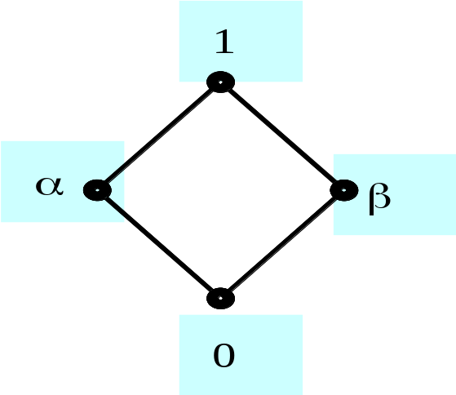
§7.2 Boolean expressions and
Boolean functions (2)
7.2.1 Boolean expressions
例：假设 B={0,1,α,β} 是由图
示确定的一个布尔代数，x,y 是
B 上的变量。若B上的布尔表达
式为：

Slide 42
§7.2 Boolean expressions and
Boolean functions (3)
7.2.2 Boolean functions
Let B={0,1}.Then B^{n}={(x₁,x₂,…,x_{n}) | x_{i}∈B for 1 ≤ i ≤ n} is the set of all possible n-tuples of 0s and 1s.The variable x is called a Boolean variable if it assumes values only from B,that is,if its only possible values are 0 and 1.A function from B^{n} to B is called a Boolean function of degree n.

Slide 43
§7.2 Boolean expressions and
Boolean functions (4)
7.2.2 Boolean functions
例如：计算由下式表示的布尔函数的值。
x | y | x’ | x’ ⋅y | x+y | (x+y)’ | y’ | x⋅y’ | f(x,y)
0 | 0 | 1 | 0 | 0 | 1 | 1 | 0 | 0
0 | 1 | 1 | 1 | 1 | 0 | 0 | 0 | 1
1 | 0 | 0 | 0 | 1 | 0 | 1 | 1 | 1
1 | 1 | 0 | 0 | 1 | 0 | 0 | 0 | 0

Slide 44
§7.2 Boolean expressions and
Boolean functions (5)
7.2.2 Boolean functions
（1）Equivalent
Boolean functions f and g of n variables
are equal if and only if
f(x₁,x₂,…,x_{n}) = g(x₁,x₂,…,x_{n})
whenever x₁,x₂,…,x_{n} belong to B.
Two different Boolean expressions that represent the same function are called equivalent.

Slide 45

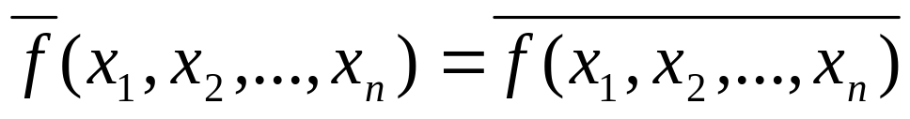
§7.2 Boolean expressions and
Boolean functions (6)
7.2.2 Boolean functions
（2）Complement
The complement of the boolean function
f is the function ,where

Slide 46
§7.2 Boolean expressions and
Boolean functions (7)
7.2.2 Boolean functions
（3）Boolean sum and Boolean product
Let f and g be Boolean functions of degree n.The Boolean sum f+g and the Boolean product fg are defined by
(f+g)(x₁,x₂,…,x_{n}) = f(x₁,x₂,…,x_{n}) + g(x₁,x₂,…,x_{n})
(fg) (x₁,x₂,…,x_{n}) = f(x₁,x₂,…,x_{n}) g(x₁,x₂,…,x_{n})
7.2.3 Identities of Boolean algebra

Slide 47
§7.3 Representing Boolean
functions (1)
7.3.1 Sum-of-products expansions
例：假设函数f(x,y,z)
和函数g(x,y,z)定义
如表所示。
x | y | z | f(x,y,z) | g(x,y,z)
0 | 0 | 0 | 0 | 0
0 | 0 | 1 | 0 | 0
0 | 1 | 0 | 0 | 1
0 | 1 | 1 | 0 | 0
1 | 0 | 0 | 0 | 0
1 | 0 | 1 | 1 | 0
1 | 1 | 0 | 0 | 1
1 | 1 | 1 | 0 | 0

Slide 48
§7.3 Representing Boolean
functions (2)
7.3.1 Sum-of-products expansions
Definition：
A literal is a Boolean variable or its complement.A minterm of the Boolean variable x₁,x₂,…,x_{n} is a Boolean product y₁y₂…y_{n},where y_{i} = x_{i} or y_{i} = x_{i}’.Hence,a minterm is a product of n literals,with one literal for each variable.

Slide 49
§7.3 Representing Boolean
functions (3)
7.3.1 Sum-of-products expansions
Definition：
The sum of minterm that represents the function is called the sum-of-products expansion or the disjunctive normal form of the Boolean function.
7.3.2 Functional completeness

Slide 50
§7.4 Logic Gates (1)
7.4.1 Basic gate circuits
(1) AND gate
The input to this gate are the value of two or more Boolean variables.
The output is the Boolean product of their value.

Slide 51
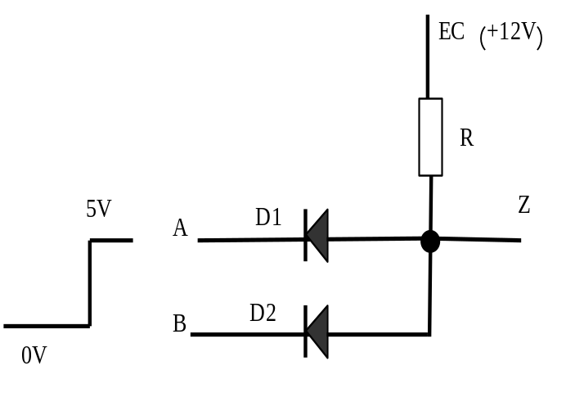
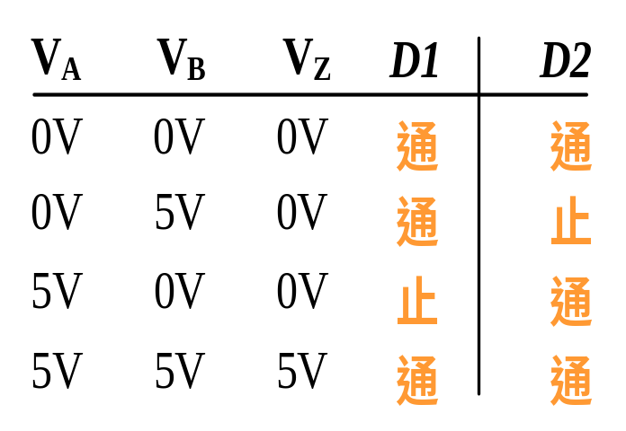
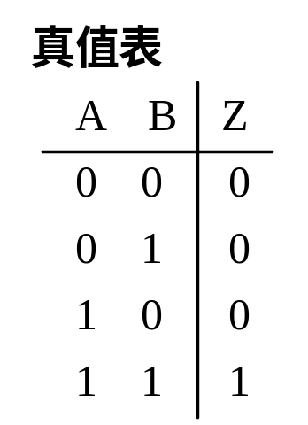
§7.4 Logic Gates (2)
7.4.1 Basic gate circuits
(1) AND gate

Slide 52
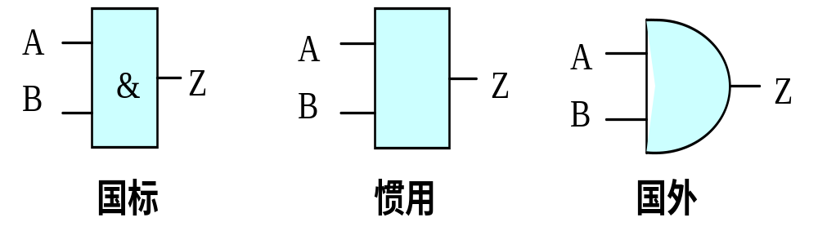
§7.4 Logic Gates (3)
7.4.1 Basic gate circuits
(1) AND gate

Slide 53
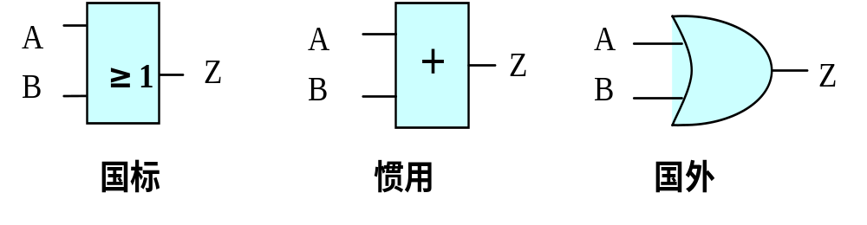
§7.4 Logic Gates (4)
7.4.1 Basic gate circuits
(2) OR gate
The input to this gate are the value of two or more Boolean variables.The output is the Boolean sum of their value.

Slide 54
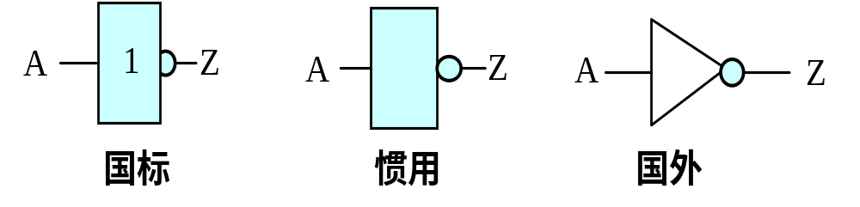
§7.4 Logic Gates (5)
7.4.1 Basic gate circuits
(3) NOT gate
It accepts the value of one Boolean variable as input and produce the complement of this value as its output.

Slide 55
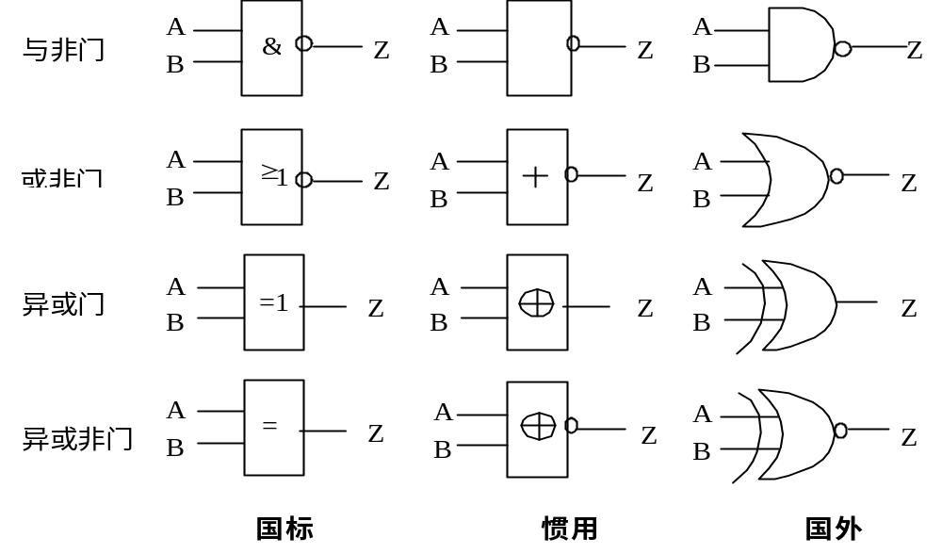
§7.4 Logic Gates (6)
7.4.2 Combinations of gates

Slide 56


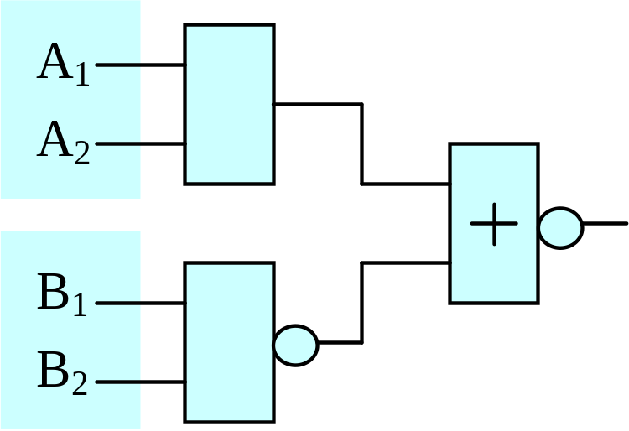
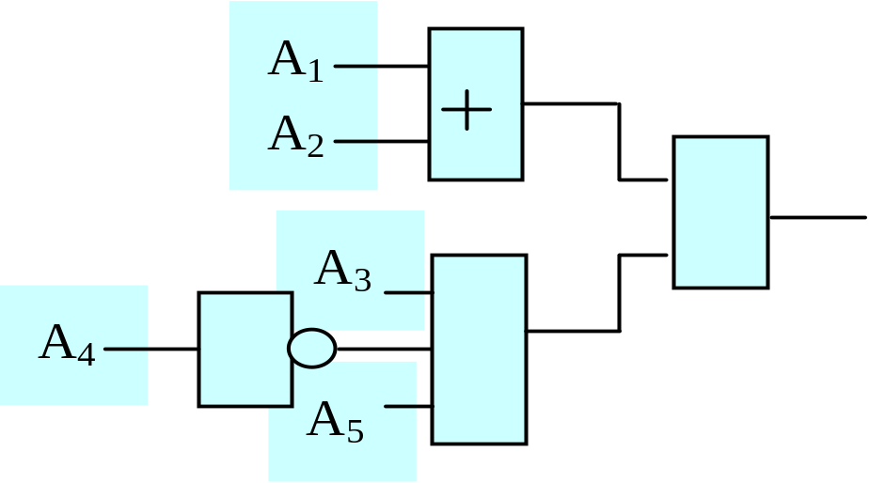
§7.4 Logic Gates (7)
7.4.2 Combinations of gates
Exap1: (1)
(2)

Slide 57
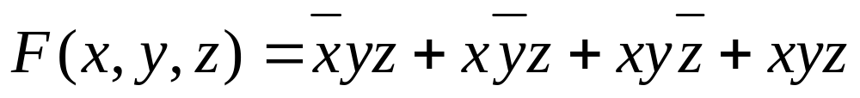

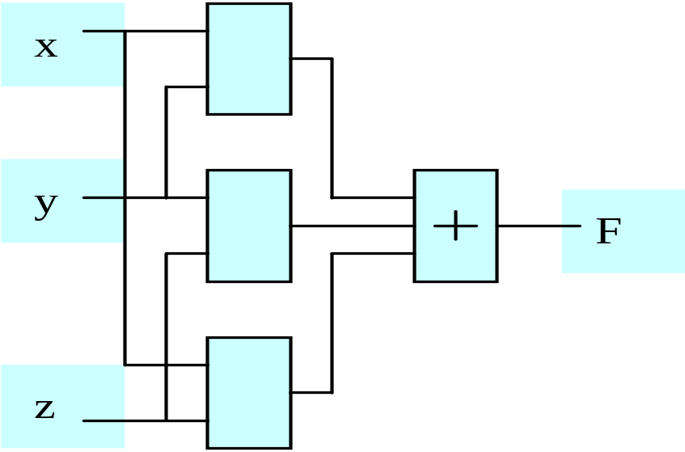
§7.4 Logic Gates (8)
7.4.3 Examples of circuits
Exam 1: (1) Majority Voting
输入变量 x y z | 输出 F
0 0 0 | 0
0 0 1 | 0
0 1 0 | 0
0 1 1 | 1
1 0 0 | 0
1 0 1 | 1
1 1 0 | 1
1 1 1 | 1

Slide 58
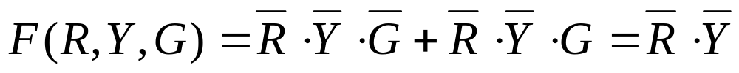
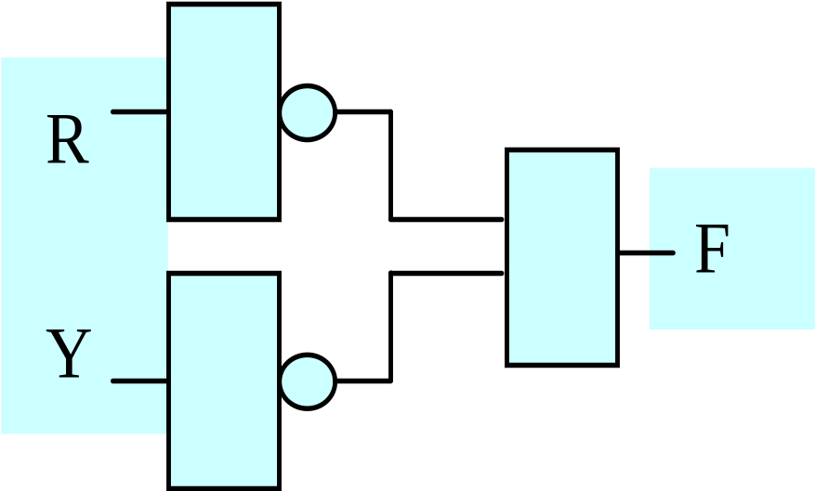
§7.4 Logic Gates (9)
7.4.3 Examples of circuits
Exam 2: Vehicle traffic controller
输入变量 R Y G | 输出 F
0 0 0 | 1
0 0 1 | 1
0 1 0 | 0
0 1 1 | *
1 0 0 | 0
1 0 1 | *
1 1 0 | *
1 1 1 | *

Slide 59
§7.4 Logic Gates (10)
7.4.3 Examples of circuits
Exam 3: Statistics of credit hour
输入变量 A B C D | 总学分 | 输出变量 Y |  | 输入变量 A B C D | 总学分 | 输出变量 Y
0 0 0 0 | 0 | 0 |  | 1 0 0 0 | 5 | 0
0 0 0 1 | 1 | 0 |  | 1 0 0 1 | 6 | 0
0 0 1 0 | 2 | 0 |  | 1 0 1 0 | 7 | 1
0 0 1 1 | 3 | 0 |  | 1 0 1 1 | 8 | 1
0 1 0 0 | 4 | 0 |  | 1 1 0 0 | 9 | 1
0 1 0 1 | 5 | 0 |  | 1 1 0 1 | 10 | 1
0 1 1 0 | 6 | 0 |  | 1 1 1 0 | 11 | 1
0 1 1 1 | 7 | 1 |  | 1 1 1 1 | 12 | 1

Slide 60



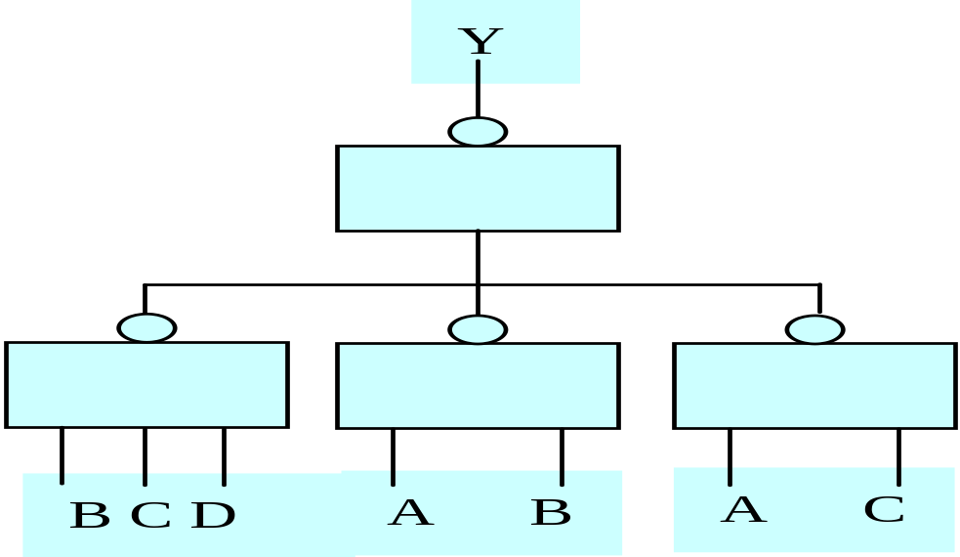
§7.4 Logic Gates (11)
7.4.3 Examples of circuits
Exam 3: Statistics of credit hour

Slide 61


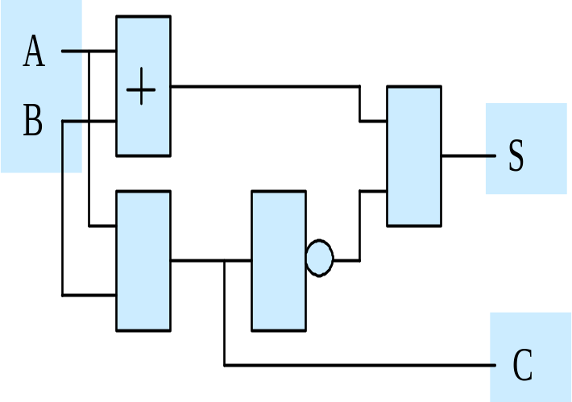
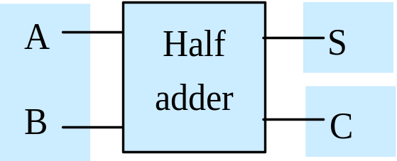
§7.4 Logic Gates (12)
7.4.4 Adders
(1) Half adder
输入 A B | 输出 S C
0 0 | 0 0
0 1 | 1 0
1 0 | 1 0
1 1 | 0 1

Slide 62
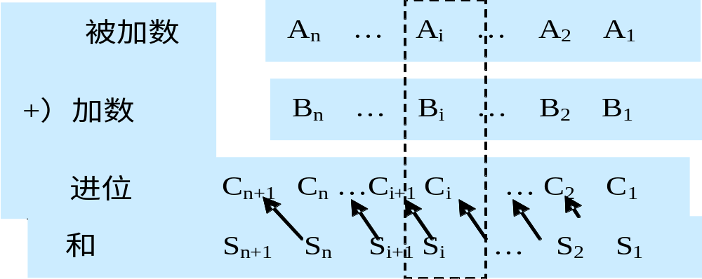
§7.4 Logic Gates (13)
7.4.4 Adders
(2) Full adder

Slide 63
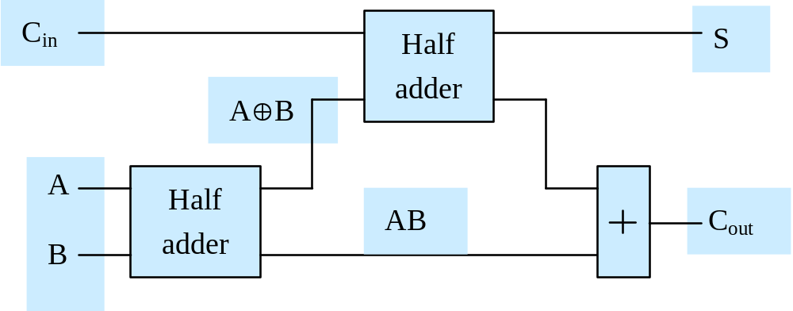
§7.4 Logic Gates (14)
7.4.4 Adders
(2) Full adder
Input A B Cin | Output S Cout
0 0 0 | 0 0
0 0 1 | 1 0
0 1 0 | 1 0
0 1 1 | 0 1
1 0 0 | 1 0
1 0 1 | 0 1
1 1 0 | 0 1
1 1 1 | 1 1

Slide 64
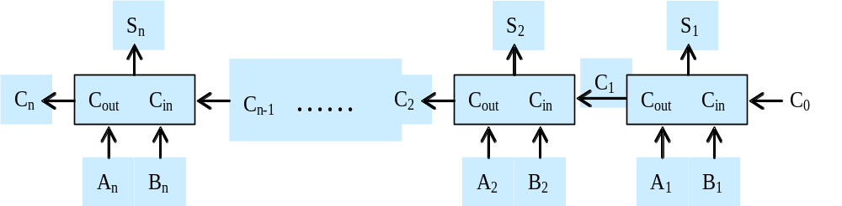
§7.4 Logic Gates (15)
7.4.4 Adders
(3) n-adder

Slide 65
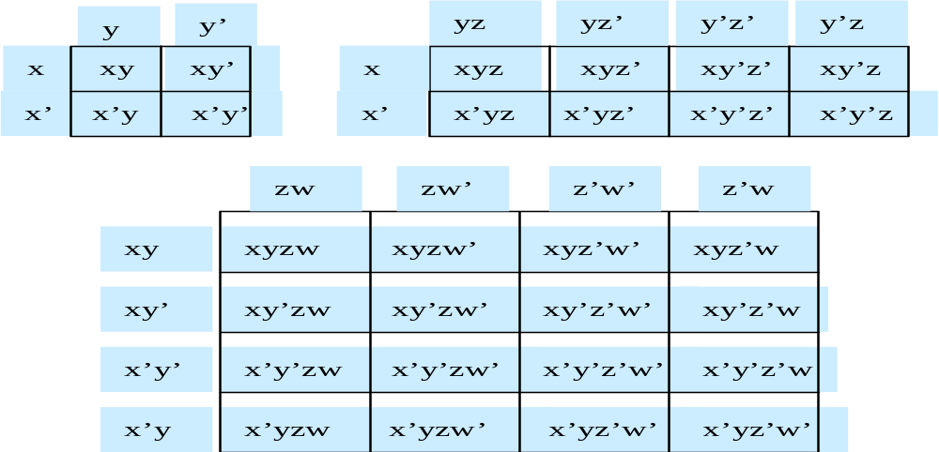
§7.5 Minimization of Circuits (1)
7.5.1 Karnaugh maps
(1) The structure of Karnaugh maps

Slide 66
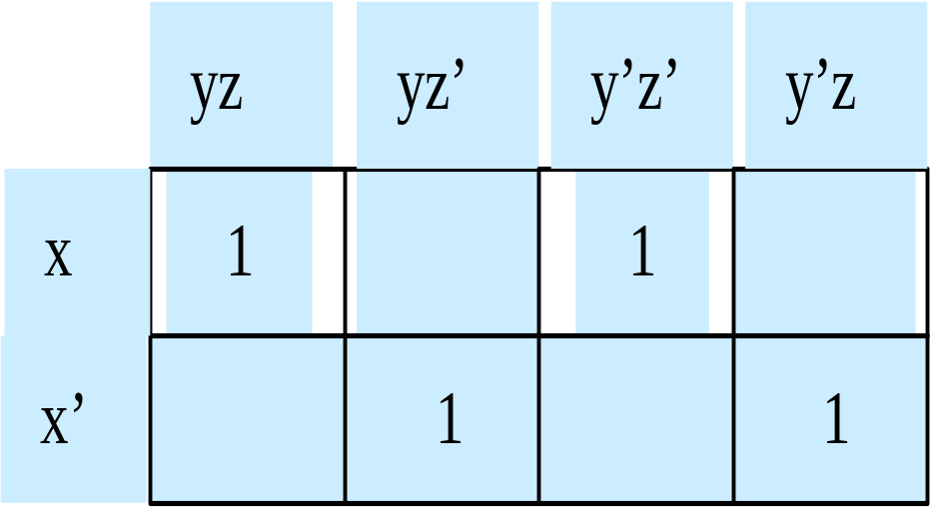
§7.5 Minimization of Circuits (2)
7.5.1 Karnaugh maps
(2) Representation of Boolean function
① Truth table
x y z | f(x,y,z)
0 0 0 | 0
0 0 1 | 1
0 1 0 | 1
0 1 1 | 0
1 0 0 | 1
1 0 1 | 0
1 1 0 | 0
1 1 1 | 1

Slide 67
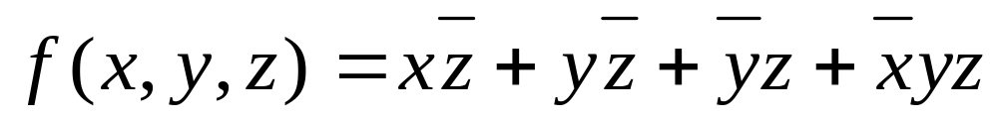
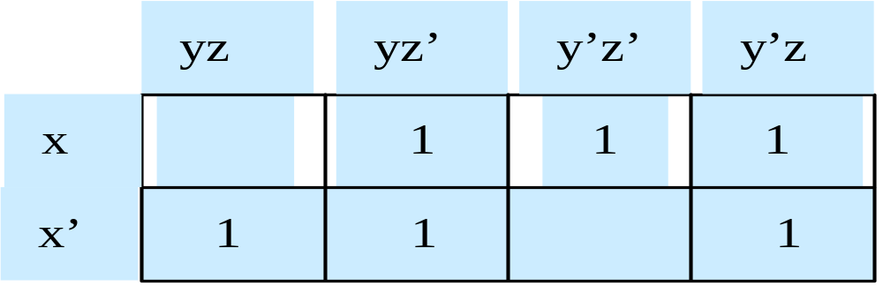
§7.5 Minimization of Circuits (3)
7.5.1 Karnaugh maps
(2) Representation of Boolean function
② sum-of-products expression
③ AND-OR expression

Slide 68
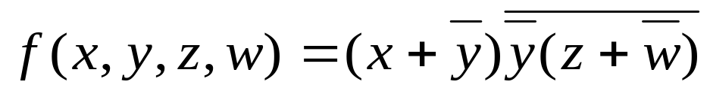
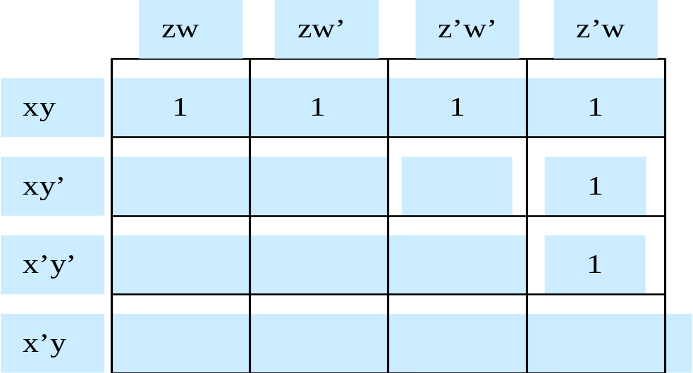
§7.5 Minimization of Circuits (4)
7.5.1 Karnaugh maps
(2) Representation of Boolean function
④ General expression

Slide 69
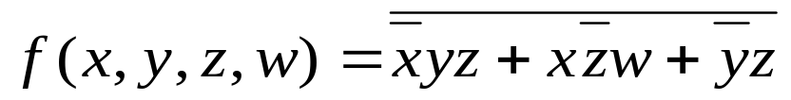
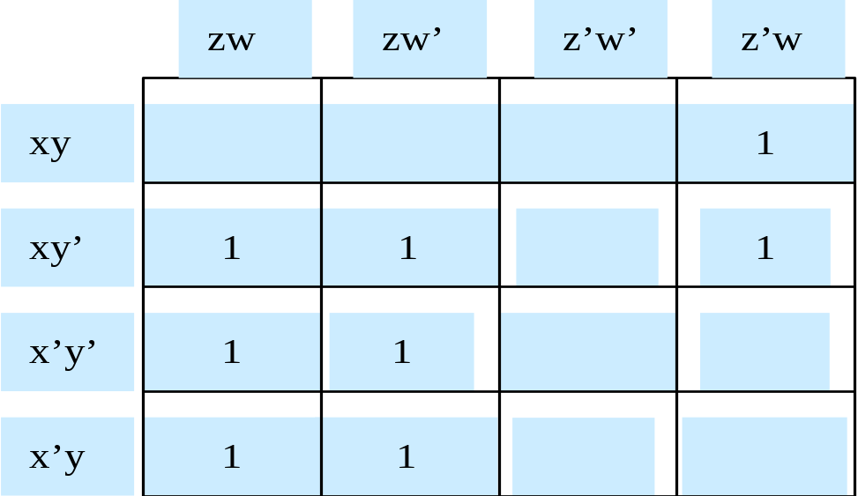
§7.5 Minimization of Circuits (5)
7.5.1 Karnaugh maps
(2) Representation of Boolean function
④ General expression
1
1
1
1
1
1
1
1

Slide 70
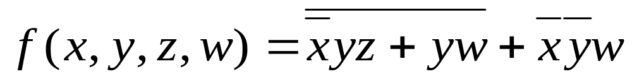
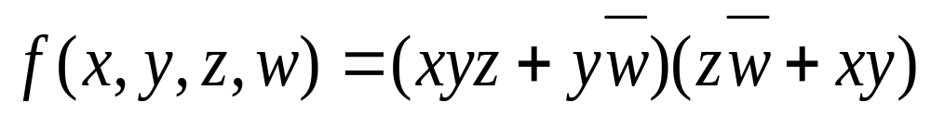
§7.5 Minimization of Circuits (6)
7.5.1 Karnaugh maps
(2) Representation of Boolean function
④ General expression

Slide 71
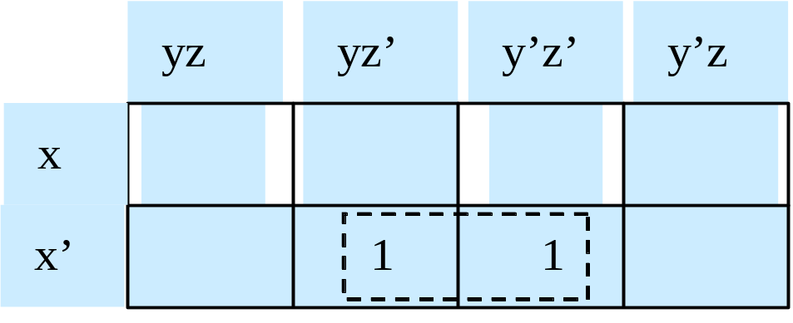
§7.5 Minimization of Circuits (7)
7.5.1 Karnaugh maps
(3) Simplification of Boolean functions using Karnaugh map
① The principle of simplification

Slide 72
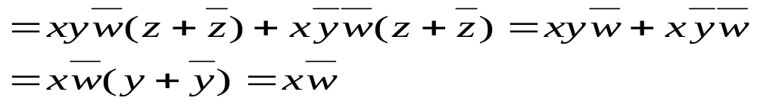
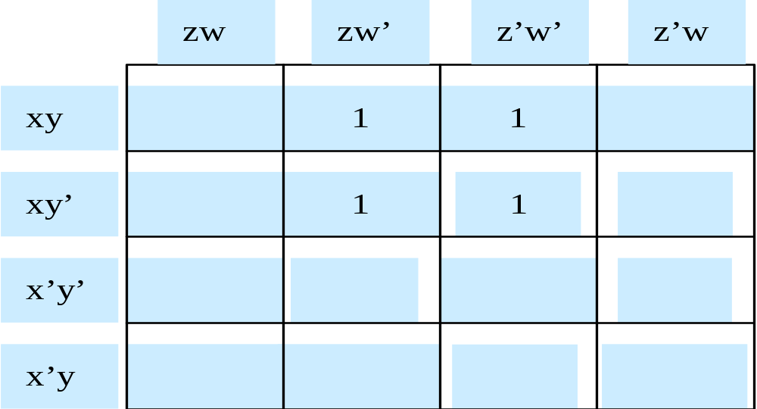
§7.5 Minimization of Circuits (8)
7.5.1 Karnaugh maps

Slide 73
§7.5 Minimization of Circuits (9)
7.5.1 Karnaugh maps
(3) Simplification of Boolean functions using Karnaugh map
② The steps of simplification
③ Illustrate
例：化简逻辑函数

Slide 74
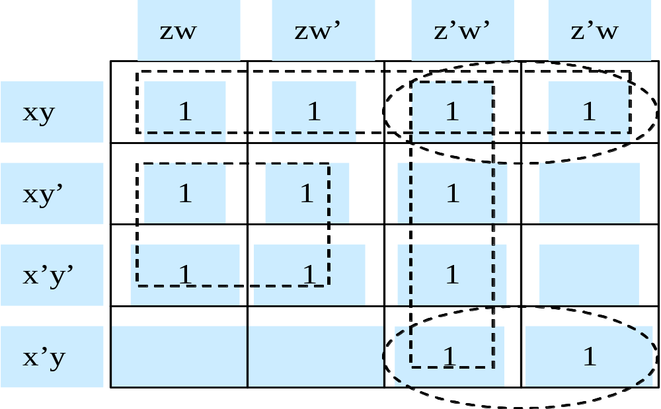
§7.5 Minimization of Circuits (10)

Slide 75
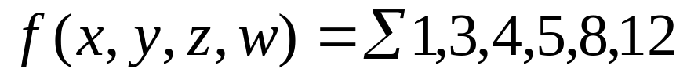
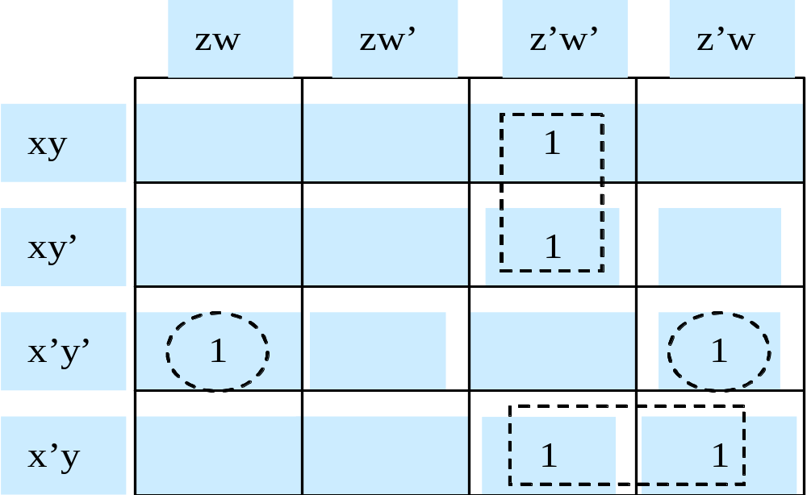
§7.5 Minimization of Circuits (11)
例：化简逻辑函数

Slide 76
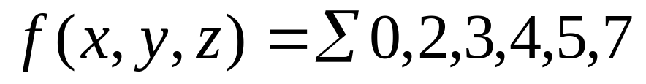
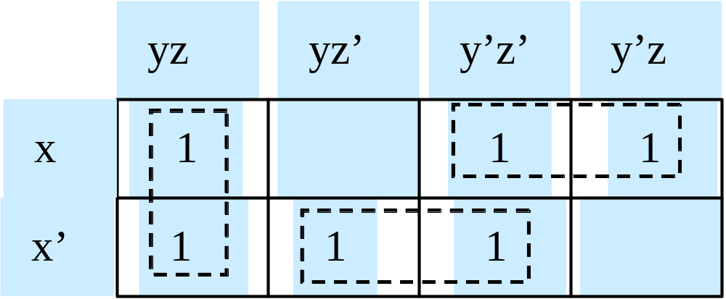
§7.5 Minimization of Circuits (12)
例：化简逻辑函数

Slide 77
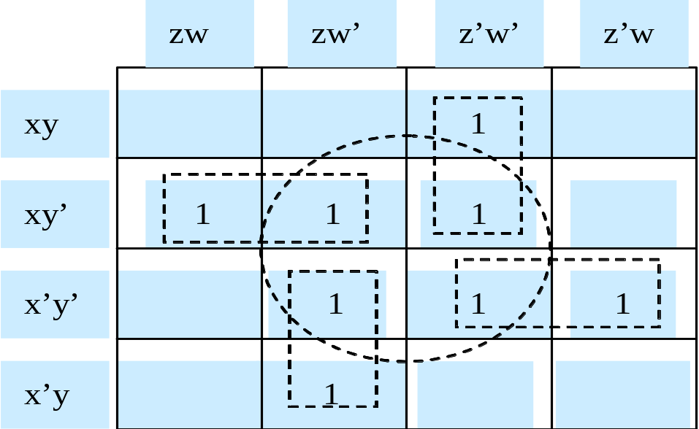
§7.5 Minimization of Circuits (13)
7.5.1 Karnaugh maps
(3) Simplification of Boolean functions using Karnaugh map
④ Notice

Slide 78
§7.5 Minimization of Circuits (14)
7.5.2 Don’t care conditions
(1) BCD (Binary Coded Decimal)
(2) Don’t care conditions

Slide 79
输入变量 x y z w | 输出变量 F |  | 输入变量 x y z w | 输出变量 F
0 0 0 0 | 0 |  | 1 0 0 0 | 1
0 0 0 1 | 0 |  | 1 0 0 1 | 1
0 0 1 0 | 0 |  | 1 0 1 0 | d
0 0 1 1 | 0 |  | 1 0 1 1 | d
0 1 0 0 | 0 |  | 1 1 0 0 | d
0 1 0 1 | 1 |  | 1 1 0 1 | d
0 1 1 0 | 1 |  | 1 1 1 0 | d
0 1 1 1 | 1 |  | 1 1 1 1 | d

Slide 80
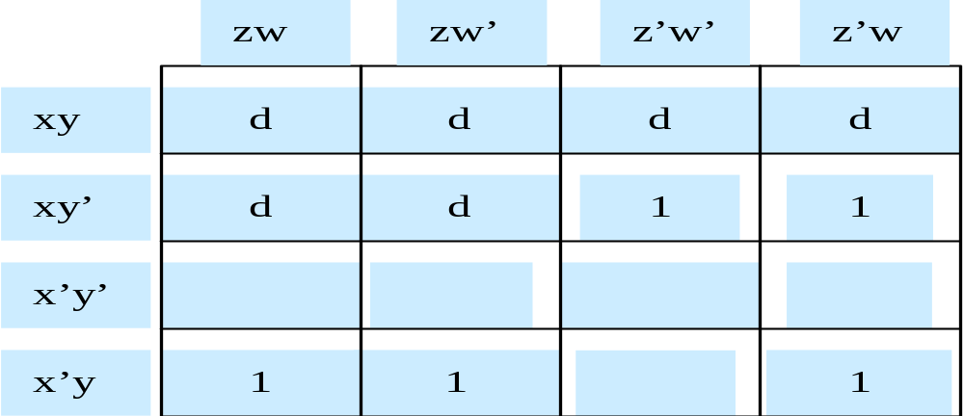
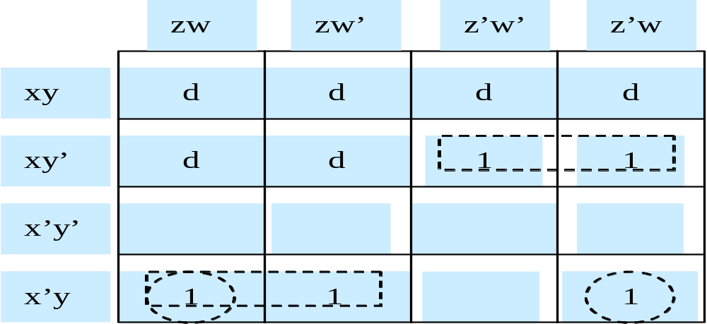

Slide 81
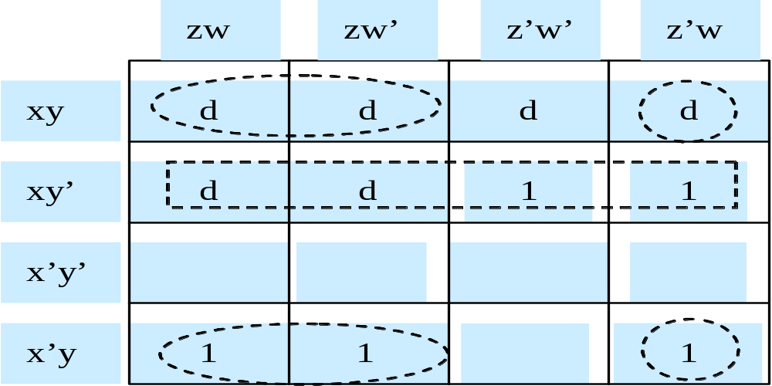
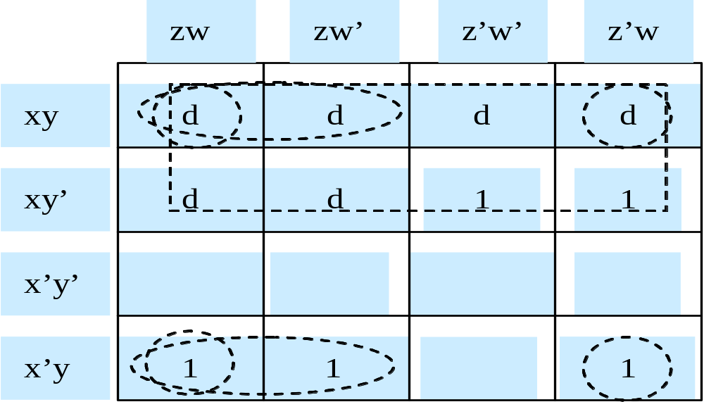

Slide 82
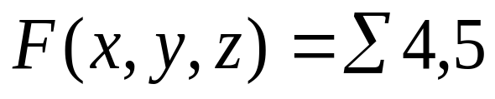


§7.5 Minimization of Circuits
7.5.1 Karnaugh maps
Exam 2:
and

