Slide 1
Discrete Mathematics
Shandong University Qilu Software College
Notes:
分类加法计数原理、分步乘法计数原理

Slide 2
Chapter 3
Counting

Slide 3
§3.1 The basics of counting (1)
3.1.1 Basic counting principles
（1）The product rule
Definition：
Suppose that a procedure can be broken down into a sequence of two tasks.If there are n₁ ways to do the first task and n₂ ways to do the second task after the first task has been done,then there are n₁×n₂ ways to do the procedure.

Slide 4
§3.1 The basics of counting (2)
…
…
n1:ways to do T₁
n2:ways to do T2
… …
…
…
…
n1*n2: ways to do the procedure

Slide 5
§3.1 The basics of counting (3)
3.1.1 Basic counting principles
（1）The product rule
An extended version of the product rule：
Suppose that a procedure is carried out by performing the tasks T₁,T₂,…,T_{m} in sequence.
If task T_{i} can be done in n_{i} ways after tasks T₁,T₂,…,and T_{i-1} have been done,then there are n₁×n₂×…×n_{m} ways to carry out the procedure.

Slide 6
§3.1 The basics of counting (4)
3.1.1 Basic counting principles
（2）The sum rule
Definition：
If a first task can be done in n₁ ways and a second task in n₂ ways,and if these tasks cannot be done at the same time, then there are n₁+n₂ ways to do one of these tasks.

Slide 7
§3.1 The basics of counting (5)
3.1.1 Basic counting principles
（2）The sum rule
An extended version of the sum rule：
Suppose that the tasks T₁,T₂,…,T_{m} can be done in n₁,n₂,…,n_{m} ways,respectively,and no two of this tasks can be done at the same time.Then the number of ways to do one of these tasks is n₁+n₂+…+n_{m} .

Slide 8
§3.1 The basics of counting (6)
3.1.2 More complex counting problems

Slide 9
Counting Internet Address IPv4
1
8
16
24
32
主机地址范围
A类地址
0
网络地址
主机地址（24位）
1.0.0.0到
（7位）
124.253.253.255
B类地址
10
网络地址（14位）
主机地址（16位）
128.0.0.0到
191.253.253.255
C类地址
110
网络地址（21位）
主机地址
192.0.0.0到
（8位）
223.253.253.255
D类地址
1110
多目的广播地址（28位）
224.0.0.0到
239.253.253.255
E类地址
11110
保留用于实验和将来使用
240.0.0.0到
244.253.253.255

Slide 10
§3.1 The basics of counting (6)
3.1.3 The inclusion-exclusion principle
Let A1 and A2 be sets;there are |A1| ways to select an element from A1 and |A2| ways to select an element from A2,the number of ways to select from A1 or A2 is the sum of the number of ways to select an element from A1 and the number of ways to select from A2,minus the ways to select an element that is in both A1 and A2.

Slide 11
§3.1 The basics of counting (6)
3.1.3 The inclusion-exclusion principle

Slide 12
§3.1 The basics of counting (6)
3.1.4 Tree diagrams

Slide 13
§3.2 The Pigeonhole principle (1)
3.2.1 Introduction
The pigeonhole principle(dirichlet drawer principle)：
If k+1 or more objects are placed into k boxes ,then there is at least one box containing two or more of the objects.
Notes:
The pigeonhole principle(dirichlet drawer principle)鸽巢原理（狄里克雷抽屉，狄利克雷）德国数学家。
对数论、数学分析和数学物理有突出贡献，是解析数论的创始人之一。

Slide 14
§3.2 The Pigeonhole principle (1)
3.2.1 Introduction
Corollary 1：
A function f from a set with k+1 or more to a set with k elements is not one-to-one.

Slide 15
§3.2 The Pigeonhole principle (2)
3.2.2 The generalized Pigeonhole principle
The generalized Pigeonhole principle(Corollary 2)：
If N objects are placed into K boxes , then there is at least one box containing at least ⎡N/K⎤ objects.

Slide 16
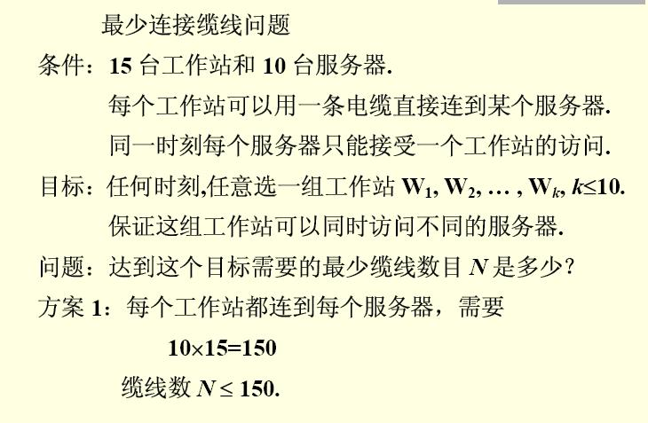
The generalized Pigeonhole principle

Slide 17
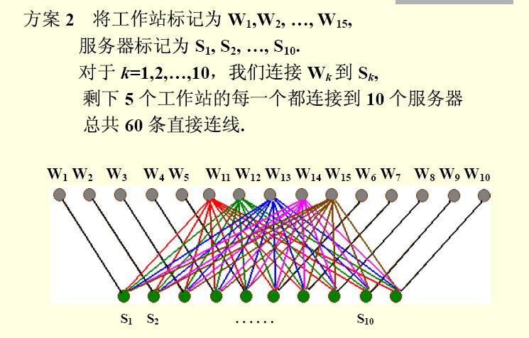
The generalized Pigeonhole principle

Slide 18
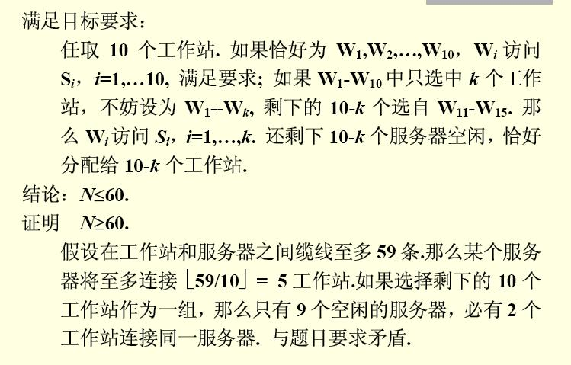
The generalized Pigeonhole principle

Slide 19
§3.2 The Pigeonhole principle (3)
3.2.3 Some elegant applications of
the pigeonhole principle
Theorem：
Every sequence of n²+1 distinct real numbers contains a subsequence of length n+1 that is either strictly increasing or strictly decreasing.

Slide 20
§3.2 The Pigeonhole principle
a₁,a₂,…a_{n2+1} 是n²+1个不同的实数
对于数列中的每一个项a_{i} 都关联一个有序对(i_{k,} d_{k})
即任意a_{k} ∈{a₁,a₂,…a_{n2+1} }
定义 函数f: a_{k} → (i_{k,} d_{k})
其中: i_{k}从a_{k}开始的最长递增子序列的长度
d_{k}从a_{k}开始的最长递减子序列的长度
(结论否定)假如没有长度为n+1的递增(减)序列
那么i_{k}和d_{k}都是小于等于n的正整数

Slide 21
§3.2 The Pigeonhole principle
由乘法法则知(i_{k,} d_{k}) 有n²种可能的有序对
又由鸽巢原理,n²+1种可能的有序对中必有两个相等
即存在a_{s}和a_{t}(a_{s} ≠ a_{t} s<t)使i_{s} =i_{t} 且d_{s} =d_{t}
如有a_{s}<a_{t}且i_{s} =i_{t}则把 a_{s}加到a_{t}开始的递增序列的前面,此时a_{t}开始的递增序列的长度为i_{t}+1(矛盾)
(同样分析a_{s}>a_{t})

Slide 22
§3.2 The Pigeonhole principle
例:假如6人中任意2人都认识,或任意2人都不认识.证明在这6人组中或者3人彼此认识,或者3人互不认识.
解:设A是6人中的其中一人.则其他5人与A认识的组成一组,与A不认识的组成一组
根据鸽巢原理其中一组中至少有3人
假如该3人组是与A认识的,如3人中有2人认识
则该2人与A组成3人认识组;如3人中没有2人认识,即3人彼此互不认识.

Slide 23
§3.2 The Pigeonhole principle
假如该3人组是与A不认识的,如3人中有2人不认识,则该2人与A组成3人不认识组;如3人中没有2人不认识,即3人彼此互相认识.

Slide 24
§3.2 The Pigeonhole principle (4)
3.2.3 Some elegant applications of
the pigeonhole principle
定义：假设p,q为正整数，p,q≧2 ,则存在最小正整数R(p,q),使得n ≧ R(p,q)时,或者有p人是彼此相识,或者有q人彼此不相识, 称R(p,q)为Ramsey数(拉姆齐数)。
Notes:
Ramsey(1903~1930)是英国数理逻辑学家,他把抽屉原理加以推广，

Slide 25
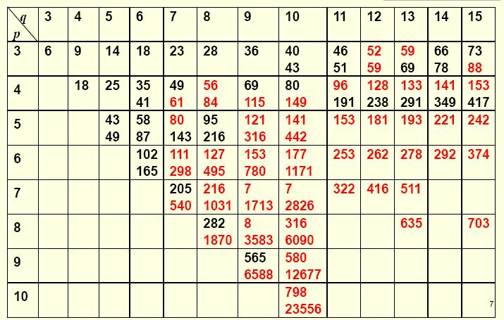
Ramsey Numbers
R (p , q) = R (q , p)

Slide 26
k6完全图,对他的边用红，黑两种颜色任意涂色，则必存在同色边的三角形。

Slide 27
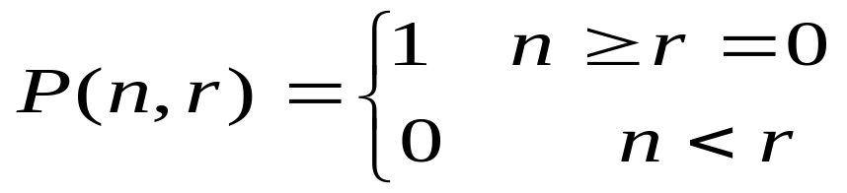
§3.3 Permutations and Combinations (1)
3.3.1 Permutations
（1）r-permutation
An ordered arrangement of r elements of a set is called an r-permutation.The number of r-permutations of a set with n elements is denoted by P(n,r).

Slide 28
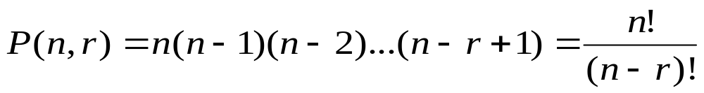
§3.3 Permutations and Combinations (2)
3.3.1 Permutations
（1）r-permutation
Theorem：
The number of r-permutations of a set with n distinct elements is
P(n,r) = n(n-1)(n-2)….(n-r+1).

Slide 29
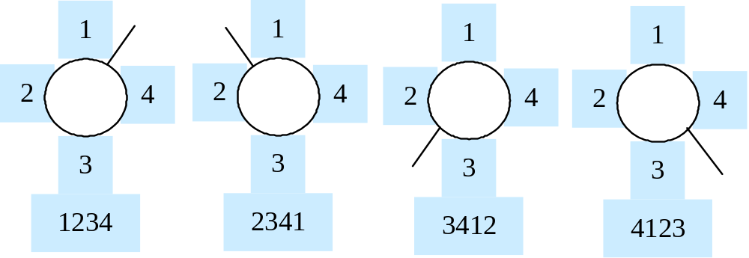
§3.3 Permutations and Combinations (3)
3.3.1 Permutations
（2）Circle-permutation

Slide 30
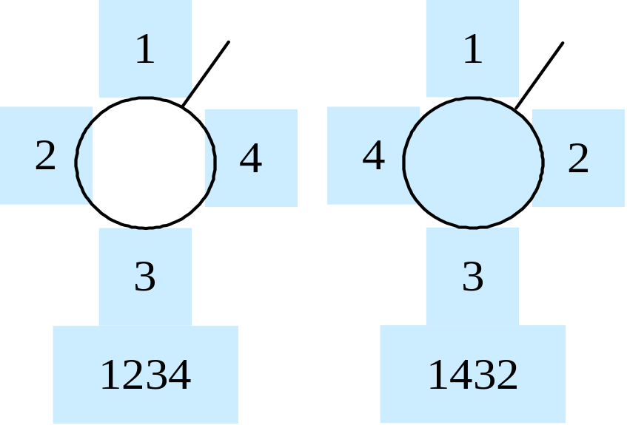
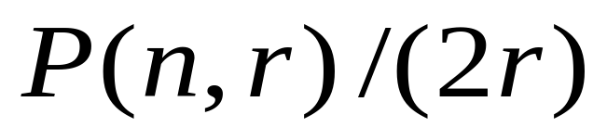
§3.3 Permutations and Combinations (4)
3.3.1 Permutations
（2）Circle-permutation

Slide 31
§3.3 Permutations and Combinations (5)
3.3.1 Permutations
（3）r-permutation with repetition
Theorem：
The number of r-permutations of a set of n distinct objects with repetition allowed is n^{r}.

Slide 32
§3.3 Permutations and Combinations (6)
3.3.2 Combinations
（1）r-combination
An r-combination of elements of a set is an unordered selection of r elements from the set.Thus, an r-combination is simply a subset of the set with r elements.
The number of r-combination of a set with n distinct elements is denoted by C(n,r).

Slide 33
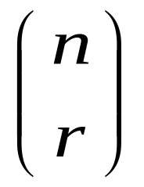
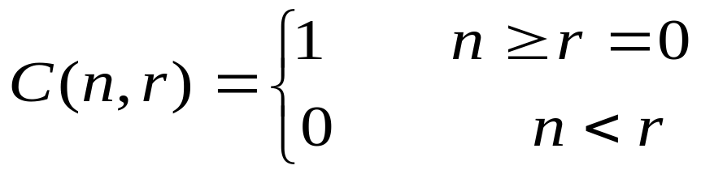
§3.3 Permutations and Combinations (7)
3.3.2 Combinations
（1）r-combination
Note that C(n,r) is also denoted by and is called a binomial coefficient.

Slide 34
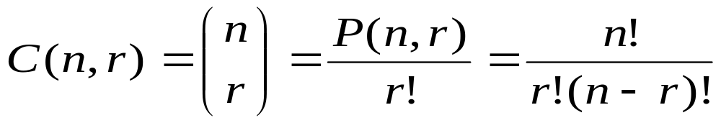
§3.3 Permutations and Combinations (8)
3.3.2 Combinations
（1）r-combination
Theorem：
The number of r-combinations of a set with n elements,where n is a nonnegative integer and r is an integer with 0 ≤ r ≤ n,equals

Slide 35
§3.3 Permutations and Combinations (9)
3.3.2 Combinations
（1）r-combination
Corollary：
Let n and r be nonnegative integers with r ≤ n .Then C(n,r) = C(n,n-r).

Slide 36
§3.3 Permutations and Combinations (10)
3.3.2 Combinations
（2）Combinations with repetition
Theorem：
There are C(n+r-1,r) r-combinations from a set with n elements when repetition of elements is allowed.

Slide 37
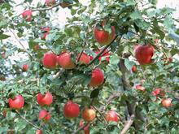
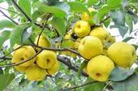
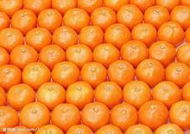

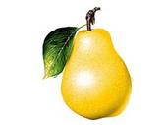

class A
class B
class C
class D
15=3+6+3+3 solutions

Slide 38
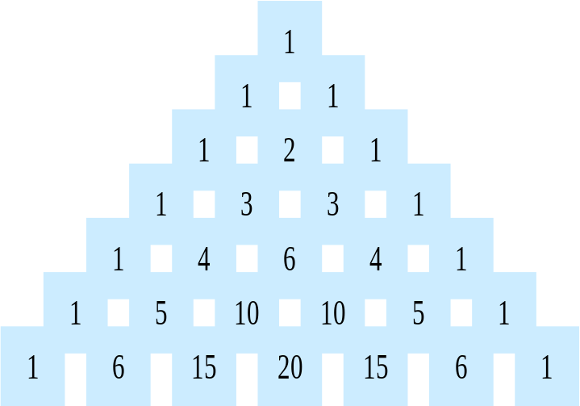
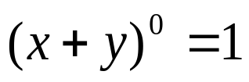

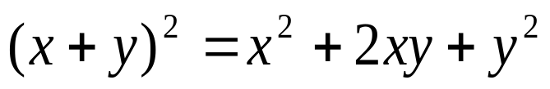
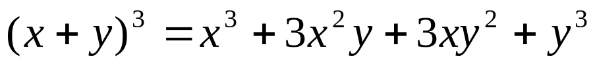
§3.4 Binomial coefficients (1)
3.4.1 The binomial theorem
Notes:
杨辉，中国南宋时期杰出的数学家和数学教育家。在13世纪中叶活动于苏杭一带，其著作甚多。
他著名的数学书共五种二十一卷。著有《详解九章算法》十二卷（1261年）、《日用算法》二卷（1262年）、《乘除通变本末》三卷（1274年）、《田亩比类乘除算法》二卷（1275年）、《续古摘奇算法》二卷（1275年）。
他在《续古摘奇算法》中介绍了各种形式的"纵横图"及有关的构造方法，同时"垛积术"是杨辉继沈括"隙积术"后，关于高阶等差级数的研究。杨辉在"纂类"中，将《九章算术》246个题目按解题方法由浅入深的顺序，重新分为乘除、分率、合率、互换、二衰分、叠积、盈不足、方程、勾股等九类。
17世纪的法国数学家帕斯卡PASCAL也提出来。

Slide 39
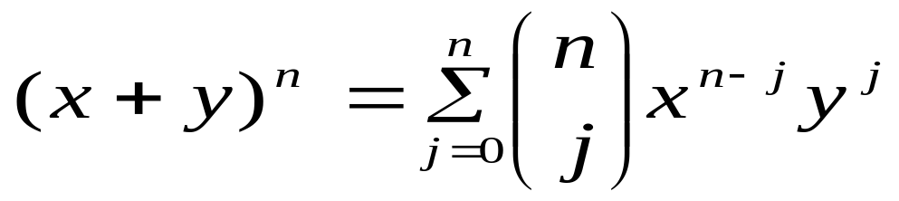
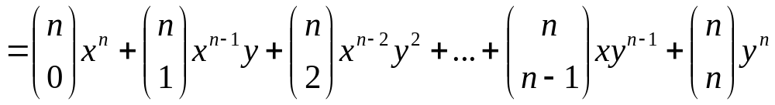
§3.4 Binomial coefficients (2)
3.4.1 The binomial theorem
The binomial theorem：Let x and y be variables,and let n be a nonnegative integer.Then

Slide 40
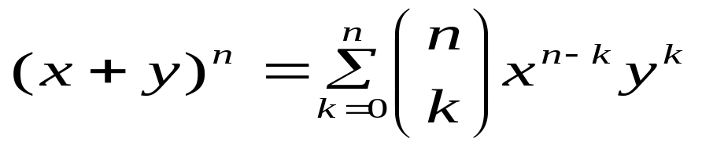
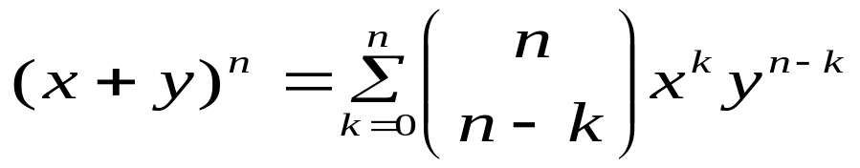
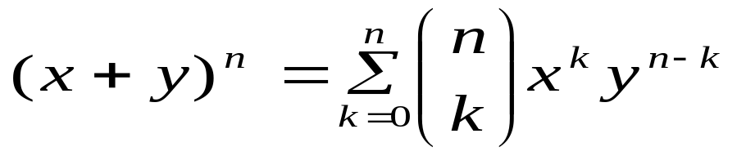
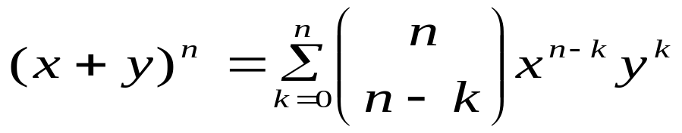
§3.4 Binomial coefficients (3)
3.4.1 The binomial theorem

Slide 41
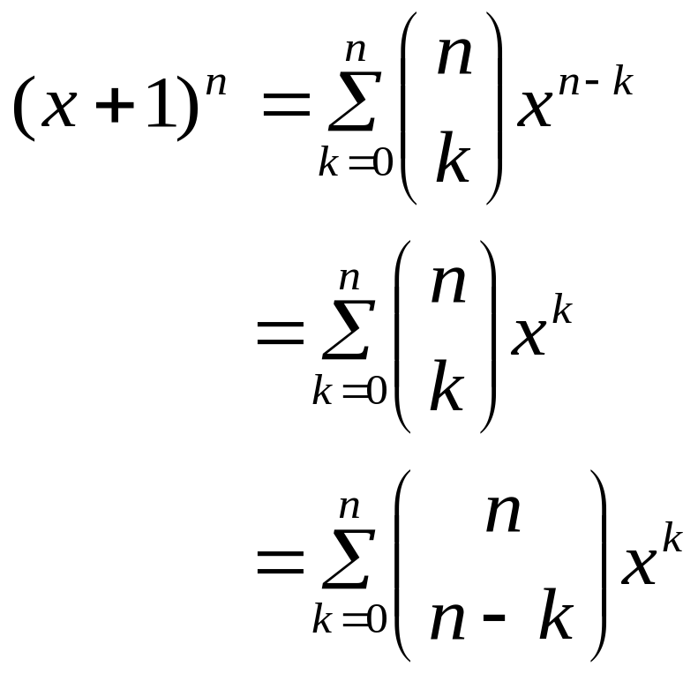
§3.4 Binomial coefficients (4)
3.4.1 The binomial theorem
if y=1 then

Slide 42
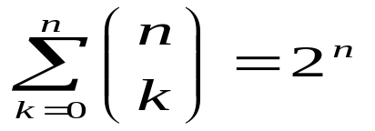
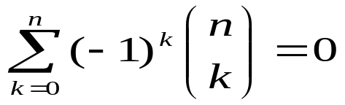
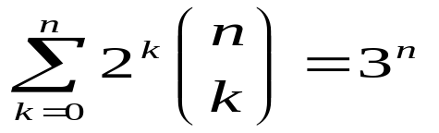
§3.4 Binomial coefficients (5)
3.4.1 The binomial theorem
Corollary 1：Let n be a nonnegative integer. Then
Corollary 2：Let n be a positive integer.Then
Corollary 3：Let n be a nonnegative integer. Then

Slide 43
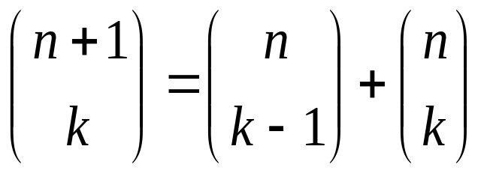
§3.4 Binomial coefficients (6)
3.4.2 Pascal’s identity and triangle
Pascal’s identity：Let n and k be positive integers with n ≥ k .Then

Slide 44
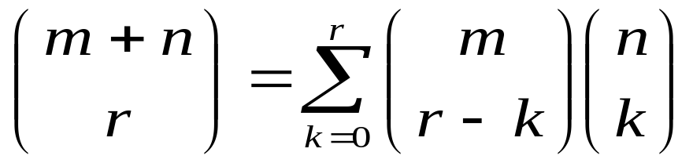
§3.4 Binomial coefficients (7)
3.4.3 Some other identities of the
binomial coefficients
Vandermonde’s identity：
Let m,n and r be nonnegative integers with r not exceeding either m or n,Then
Notes:
范德蒙得

Slide 45
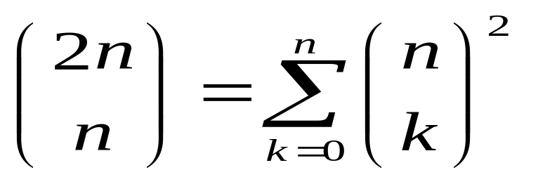
§3.4 Binomial coefficients (8)
3.4.3 Some other identities of the
binomial coefficients
Corollary 4：If n is a nonnegative integer,then

Slide 46
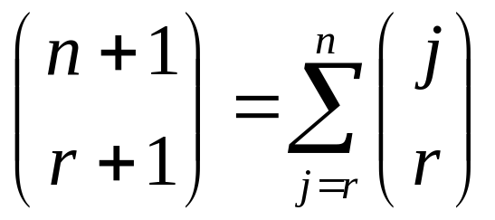
§3.4 Binomial coefficients (9)
3.4.3 Some other identities of the
binomial coefficients
Theorem：Let n and r be nonnegative integers with r ≤ n .Then

Slide 47
§3.5 Generalized permutation (1)
and combinations
3.3.1 Permutations with repetition
Theorem：
The number of r-permutations of a set of n distinct objects with repetition allowed is n^{r}.

Slide 48
§3.5 Generalized permutation (1)
and combinations
3.3.1 combinations with repetition
Theorem：
There are C(n+r-1,r) r-combinations from a set with n elements when repetition of elements is allowed.

Slide 49
§3.5 Generalized permutation (1)
and combinations
3.3.1 combinations with repetition
1 n个无区别的小球放入m个有区别的箱子里的方案数？
相当于从m类物体中允许重复的选取n个物体的方案数： C(m+n-1,n)、 C(m+n-1,m-1)
2 生活中的什么情况下可以使用该模型。选男女代表等
3 (x+y+z)⁴展开式有多少项？
C(3+4-1,4),C(3+4-1,3-1)
那(x+y+z)^{n} 展开式有多少项？
C(3+n-1,3-1)
4 x₁+x₂+x₃=11/n 其中x1≥0,x2≥0,x3≥0 正整数解的个数？

Slide 50
class A
三类水果每类先选取一个（第一步），剩余的 4-3个中做允许重复的选择（第二步）
1*C(4-3+3-1,4-3) 或者1*C(4-3+3-1,3-1)
m类物体允许重复的选取n个且每类必须至少选择一个
C(n-m+m-1,n-m)=C(n-1,n-m)=C(n-1,m-1)
class B
class C
class D
3 solutions

Slide 51
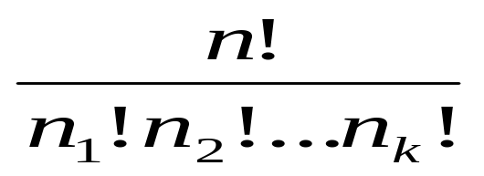
§3.5 Generalized permutation (1)
and combinations
3.3.2 Permutations with indistinguishable objects
Theorem：The number of different permutations of n objects,where there are n₁ indistinguishable objects of type 1, n₂ indistinguishable objects of type 2,…,n_{k} indistinguishable objects of type k,is
Notes:
Indistinguishable 不加区分的

Slide 52






...
任意排列
n 个
...
...
...
重复方案
n1个
n2个
n3个

Slide 53

§3.5 Generalized permutation (2)
and combinations
3.3.2 Distributing objects into boxes
Theorem：
The number of ways to distribute n distinguishable objects into k distinguishable boxes so that n_{i} objects are placed into box i (i=1,2,..,k),equals

Slide 54

§3.5 Generalized permutation (2)
and combinations
3.3.2 Distributing objects into boxes
n个球 | m个盒子 | 是否允许空盒 | 计数方案 | 备注
有区别 | 有区别 | 允许空盒 |  | 全排列
无区别 | 有区别 | 允许空盒 | C(m+n-1,n) | m个有区别的元素,取n个作允许重复的组合
无区别 | 有区别 | 不允许空盒 | C(n-1,m-1) | (1)选取m个球每盒一个 (2)n-m有区别的球放入m个有区别盒子中,允许某盒不放 C(n-m+m-1,n-m)=C(n-1,m-1)
无区别 | 无区别 | 允许空盒 |  | 一本书的6本复印件放入4个相同的箱子中
无区别 | 无区别 | 不允许空盒 |  | n-m个无区别物体允许为空的放入无区分m盒子

Slide 55
§3.5 Generalized permutation (2)
and combinations
3.3.2 Distributing objects into boxes
n个球 | m个盒子 | 是否允许空盒 | 计数方案 | 备注
有区别 | 有区别 | 不允许空盒 |  | 映上函数的个数
有区别 | 无区别 | 允许空盒 | (集合的划分) | 4人分配完全相同的3间办公室
有区别 | 无区别 | 不允许空盒 |  | Stirling数

Slide 56
§3.6 Generating permutations
and combinations
Overleap

Slide 57
Chapter 4
Advanced
counting
techniques

Slide 58
§4.1 Recurrence relations (1)
4.1.1 The concept of recurrence relations
Defination：
A recurrence relation for the sequence {a_{n}} is an equation that expresses a_{n} in terms of one or more of the previous terms of the sequence,namely,a₀,a₁,.., a_{n-1},for all integers n with n ≥ n₀,where n₀ is a nonnegative integer.A sequence is called a solution of a recurrence relation if its terms satisfy the recurrence relation.

Slide 59
§4.1 Recurrence relations (2)
4.1.2 Modeling with recurrence relations
Example 1：Compound Interest
Example 2：Fibonacci Numbers
Example 3：The Tower Hanoi
Example 4：Bit Strings
Example 5：Codeword Enumeration

Slide 60

Rabbits and Fibonacci Numbers
at least two months old | less than two months old | month | old pairs | young pairs | total pairs
 |  | 1 | 0 | 1 | 1
 |  | 2 | 0 | 1 | 1
 |  | 3 | 1 | 1 | 2
 |  | 4 | 1 | 2 | 3
 |  | 5 | 2 | 3 | 5
 |  | 6 | 3 | 5 | 8

Slide 61
The Tower Hanoi
(1, 1, 1)
A, B, C
(1,1,1) → (3,3,3)
(1,1,1) → (1,2,2)
(1,2,2) → (3,2,2)
(3,2,2) → (3,3,3)
(1,1,1) → (1,1,3)
(1,1,3) → (1,2,3)
(1,2,3) → (1,2,2)
(3,2,2) → (3,2,1)
(3,2,1) → (3,3,1)
(3,3,1) → (3,3,3)

Slide 62
§4.2 Solving Recurrence Relations (1)
4.2.1 Linear homogeneous recurrence
relation of degree k
Definition：
A linear homogeneous recurrence relation of degree k with constant coefficients is a recurrence relation of the form
a_{n} = c₁a_{n-1} + c₂a_{n-2} +…+ c_{k}a_{n-k}
where c₁,c₂,…,c_{k} are real numbers , and
c_{k} ≠ 0.

Slide 63
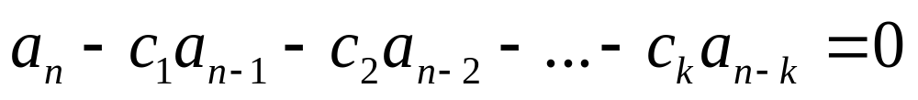
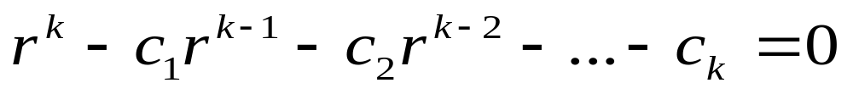
§4.2 Solving Recurrence Relations (2)
4.2.2 Solving linear homogeneous
recurrence relation with constant
coefficients
Linear homogeneous recurrence relation with constant coefficients :
Characteristic equation:

Slide 64
§4.2 Solving Recurrence Relations (3)
4.2.2 Solving linear homogeneous
recurrence relation with constant
coefficients
（1）distinct root
Theorem 1：Let c₁ and c₂ be real numbers.
Suppose that r²-c₁r-c₂=0 has two distinct roots r₁ and r_{2.} Then the sequence {a_{n}} is a solution of the recurrence relation a_{n}=c₁a_{n-1}+c₂a_{n-2} if and only if a_{n}=b₁r₁^{n}+b₂r₂^{n} for n=0,1,2, …,where b₁ and b₂ are constants.

Slide 65
（1）distinct root
Show that：r₁²-c₁r₁-c₂=0 , r₂²-c₁r₂-c₂=0
c₁a_{n-1}+c₂a_{n-2}
=c₁₍b₁r₁^{n-1}+b₂r₂^{n-1} )+c₂₍b₁r₁^{n-2}+b₂r₂^{n-2})
=b₁r₁^{n-2}(c₁ r₁+c₂) +b₂r₂^{n-2}(c₁ r₂+c₂)
= b₁r₁^{n-2}r₁² +b₂r₂^{n-2}r₂²
⁼ b₁r₁^{n}+b₂r₂^{n}
⁼a_{n}

Slide 66
（1）distinct root
Exam： a_{n=}a_{n-1}+2a_{n-2},a_{0=2,}a₁₌₇
r²-c₁r-c₂=0, r²-r-2=0
r₁=2, r₂=-1
a_{n=}b₁r₁^{n}+b₂r₂^{n} ₌b₁2^{n}+b₂(-1)^{n}
a₀₌₂ ₌ b₁2⁰+b₂(-1)⁰
a₁₌₇ ₌ b₁2¹+b₂(-1)¹
b_{1=3,} b₂₌₋₁
a_{n=}b₁2^{n}+b₂(-1)^{n}
⁼3*2^{n} + (-1)*(-1)^{n}

Slide 67
§4.2 Solving Recurrence Relations (4)
4.2.2 Solving linear homogeneous
recurrence relation with constant
coefficients
（1）distinct root
Theorem 2：Let c1,c2,…,ck be real numbers.
Suppose that the characteristic equation
r^{k}-c₁r^{k-1}-…-c_{k}=0 has k distinct roots r₁,r₂,…,r_{k}.Then a sequence {a_{n}} is a solution of the recurrence relation a_{n}=c₁a_{n-1}+c₂a_{n-2}+…+c_{k}a_{n-k} if and only if a_{n}=b₁r₁^{n}+b₂r₂^{n}+…+b_{k}r_{k}^{n}, for n=0,1,2,…, where b₁,b₂,…,b_{k} are constants.

Slide 68
§4.2 Solving Recurrence Relations (5)
4.2.2 Solving linear homogeneous
recurrence relation with constant
coefficients
（2） Multiple root
Theorem 3：Let c₁ and c₂ be real numbers wth c₂≠0. Suppose that r²-c₁r-c₂=0 has only one root r₀.A sequence {a_{n}} is a solution of the recurrence relation a_{n}=c₁a_{n-1}+c₂a_{n-2} if and only if a_{n}=b₁r₀^{n}+b₂nr₀^{n} for n=0,1,2,…, where b₁ and b₂ are constants.

Slide 69
（2） Multiple root
Exam： a_{n}=6a_{n-1}+9a_{n-2},a₀=1,a₁=6
r²-c₁r-c₂=0, r²-6r-9=0
r=3
a_{n}=b₁r₀^{n}+b₂nr₀^{n} =b₁3^{n}+b₂3*3^{n}
a₀=1 = b₁3⁰+b₂3*3⁰
a₁=6 = b₁3¹+b₂3*3¹
b₁=1, b₂=1
a_{n}=3^{n}+n*3^{n}

Slide 70
§4.2 Solving Recurrence Relations (6)
Theorem 4：Let c1,c2,…,ck be real numbers.
Suppose that the characteristic equation
r^{k}-c₁r^{k-1}-…-c_{k}=0 has t distinct roots r₁,r₂,…,r_{t} with multiplicities m₁,m₂,…,m_{t} , respectively ,so that
m_{i} ≥ 1 for i=1,2,…,t and m₁+m₂+…+m_{t} = k. Then a sequence {a_{n}} is a solution of the recurrence relation a_{n}=c₁a_{n-1}+c₂a_{n-2}+…+c_{k}a_{n-k} if and only if
a_{n} = (b_{1,0}+b_{1,1}n+…+b_{1,m1-1}n^{m1-1})r₁^{n}
+(b_{2,0}+b_{2,1}n+…+b_{2,m2-1}n^{m2-1})r₂^{n}
+…+(b_{t,0}+b_{t,1}n+…+b_{t,mt-1}n^{mt-1})r_{t}^{n}
for n=0,1,2,3,…, where b_{i,j} are constants for 1≤ i ≤ t and 0 ≤ j ≤ m_{i}-1.

Slide 71
§4.2 Solving Recurrence Relations (7)
4.2.3 Linear nonhomogeneous recurrence
relations with constant coefficients
A linear nonhomogeneous recurrence relation with constant coefficients
is a recurrence relation of the form
a_{n}=c₁a_{n-1}+c₂a_{n-2}+…+c_{k}a_{n-k}+F(n)
where c₁,c₂,…c_{k} are real numbers and F(n) is a function not identically zero depending only on n.
The recurrence relaton
a_{n}=c₁a_{n-1}+c₂a_{n-2}+…+c_{k}a_{n-k} , is called the associated homogeneous recurrence relation .

Slide 72
§4.2 Solving Recurrence Relations (8)
4.2.3 Linear nonhomogeneous recurrence
relations with constant coefficients
Theorem 1：
If {a_{n}^{(p)}} is a particular solution of the nonhomogeneous linear recurrence relation with constant coefficients
a_{n}=c₁a_{n-1}+c₂a_{n-2}+…+c_{k}a_{n-k}+F(n),
then every solution is of the form
{a_{n}^{(p)}+ a_{n}^{(h)}},where {a_{n}^{(h)}} is a solution of the associated homogeneous recurrence relation
a_{n}=c₁a_{n-1}+c₂a_{n-2}+…+c_{k}a_{n-k}.

Slide 73
§4.2 Solving Recurrence Relations (9)
Theorem 2：
Suppose that {a_{n}} satisfies the linear nonhomogeneous recurrence relation
a_{n}= c₁a_{n-1} + c₂a_{n-2} + …+ c_{k}a_{n-k} + F(n),
where c₁,c₂,…c_{k} are real numbers and
F(n)=(b_{t}n^{t}+b_{t-1}n^{t-1}+…+b₁n+b₀)s^{n},
where b₀,b₁,…,b_{t} and s are real numbers.
When s is not a root of the characteristic equation of the
associated linear homogeneous relation,there is a particular solution of the form
(p_{t}n^{t}+p_{t-1}n^{t-1}+…+p₁n+p₀)s^{n}.
When s is a root of this characteristic equation and its multiplicity is m,there is a particular solution of the form
n^{m}(p_{t}n^{t}+p_{t-1}n^{t-1}+…+p₁n+p₀)s^{n}.

Slide 74
§4.3 Divide-and-Conquer Algorithms and
Recurrence relations (1)
Overleap

Slide 75
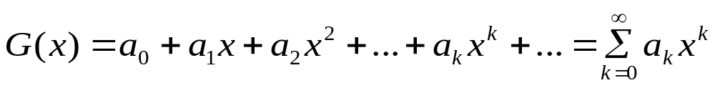
§4.4 Generating Functions (1)
4.4.1 The concept of generating functions
（1）Ordinary generating function
Definition：
The generating function for the sequence a₀,a₁,…,a_{k},…of real numbers is the infinite series

Slide 76
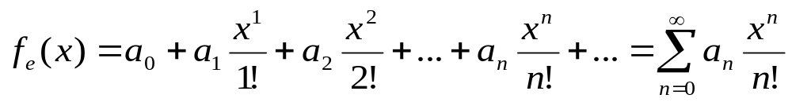
§4.4 Generating Functions (2)
4.4.1 The concept of generating functions
（2）Exponential generating function
Definition：
The exponential generating function for the sequence a₀,a₁,…,a_{k},…of real numbers is the infinite series

Slide 77
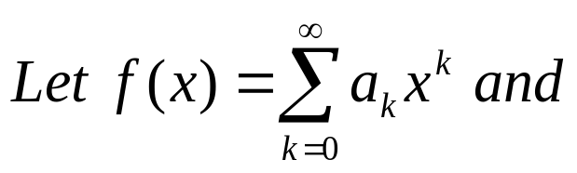
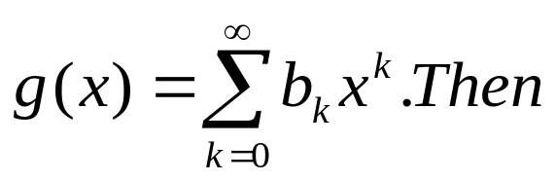
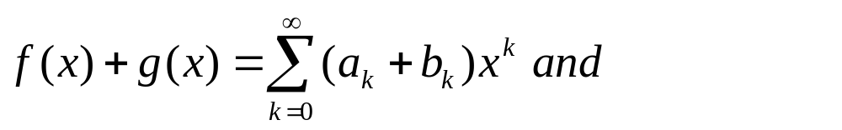
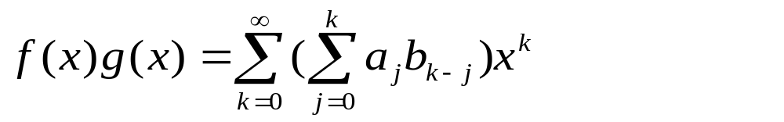
§4.4 Generating Functions (3)
4.4.2 Useful facts about power series
（1）The foundational operation of generating
function
Theorem 1：

Slide 78
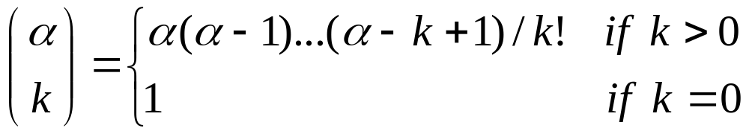
§4.4 Generating Functions (4)
4.4.2 Useful facts about power series
（2） The extended binomial theorem
Definition：
Let α be a real number and let k be a nonnegative integer.Then the extended binomial coefficient C(α,k) is defined by

Slide 79
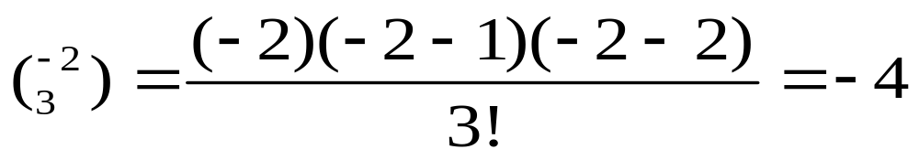
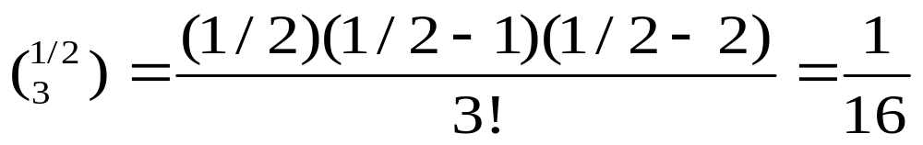
§4.4 Generating Functions (4)

Slide 80
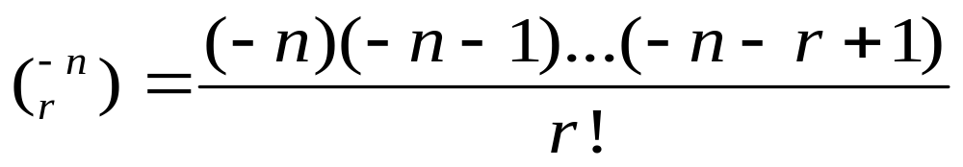
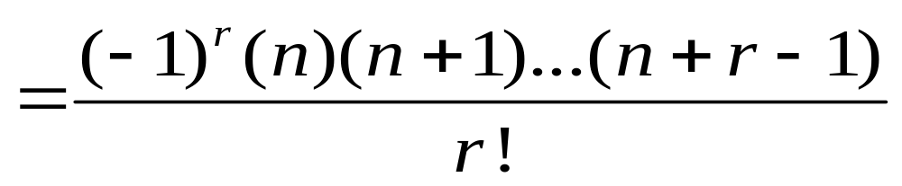
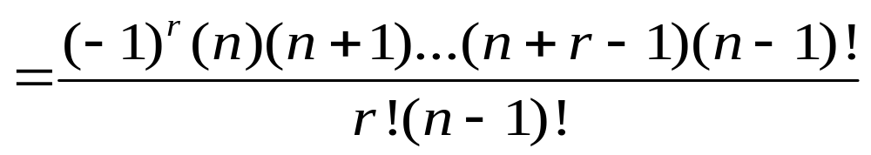
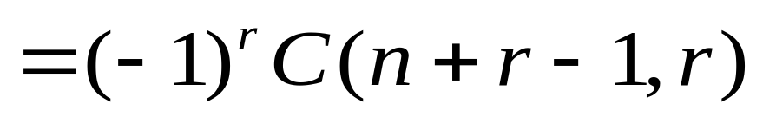
§4.4 Generating Functions (4)

Slide 81

§4.4 Generating Functions (5)
4.4.2 Useful facts about power series
（2） The extended binomial theorem
The extended binomial theorem：
Let x be a real number with |x| < 1 and let α be a real number.Then

Slide 82




§4.4 Generating Functions (6)
Find the generating functions for :
and

Slide 83
§4.4 Generating Functions (6)
Useful Generating functions
p219 TABLE 1

Slide 84


§4.4 Generating Functions (6)
4.4.3 Counting problems and generating
functions
show :

Slide 85
§4.4 Generating Functions (6)
Example1:find the number of solutions of
x₁+x₂+x₃=11
x1 ≥ 0; x2 ≥ 0; x3 ≥ 0
C(3+11-1,11)=78

Slide 86

§4.4 Generating Functions (6)
Example1:find the number of solutions of
x₁+x₂+x₃=11
x1 ≥ 1; x2 ≥ 2; x3 ≥ 3
C(3+11-6-1,11-6)=21

Slide 87

§4.4 Generating Functions (6)
Example1:find the number of solutions of
x₁+x₂+x₃=11
5≥x1 ≥2; 6≥ x2 ≥3; 7≥ x3 ≥4

Slide 88

§4.4 Generating Functions (6)
Example1:find the number of solutions of
x₁+2x₂+3x₃=11
x1 ≥0; x2 ≥0; x3 ≥0

Slide 89


§4.4 Generating Functions (6)
Example1:find the number of solutions of
Example1:find the number of solutions of
x₁+2x₂=15
x1 ≥0; x2 ≥0

Slide 90




§4.4 Generating Functions (6)
Example2:Using generating functions to find the number of solutions of r-combinations from a set with n elements when repetition of elements is allowed

Slide 91





§4.4 Generating Functions (6)
Example3:Using generating functions to find the number of ways to select r objects of n different kinds if we must select at least one object of each kind.

Slide 92
§4.4 Generating Functions (6)
Example4:Using generating functions to determine the number of ways to insert tokens worth ＄1, ＄2 and ＄5 into a vending machine to pay for an item that costs r dollars in two cases.

Slide 93
§4.4 Generating Functions (6)
4.4.4 Using generating functions to solve
recurrence relations
Example5:Using generating functions to solve the follow recurrence relations. CODEWORD problem
a_{n}=8a_{n-1}+10^{n-1}
a₀=1, a₁=9

Slide 94








§4.4 Generating Functions (6)
Solution1:
a_{n}=8a_{n-1}+10^{n-1}
a₀=1 ,a₁=9
a_{n}=8a_{n-1}
r-8=0 r=8

Slide 95



§4.4 Generating Functions (6)

Slide 96





§4.4 Generating Functions (6)
Solution2:

Slide 97

§4.4 Generating Functions (6)

Slide 98
§4.4 Generating Functions (6)
Solution3:
See p223-224

Slide 99
§4.4 Generating Functions (6)
4.4.5 Proving identities via generating
functions
SEE P224 example18

Slide 100




§4.5 Inclusion-exclusion (1)
The principle of inclusion-exclusion is useful in counting problems with the union or intersection of two finite sets .
[DeMorgan law] domain U，complement sets
,then

Slide 101






solution：(a)
if ,then
we see and
as
(1)

Slide 102


if
so
(2)
We conclude from（1）and（2）

Slide 103


DeMogan定理的推广：设
proving：证(a). N=2时定理已证。
设定理对n是正确的，即假定：

Slide 104


正确
即定理对n+1也是正确的。

Slide 105
最简单的计数问题是求有限集合A和B的并的元素数目。显然有
(1)
即具有性质A或B的元素的个数等于具

Slide 106

有性质A和B的元素个数。
U
B
A

Slide 107
证 若A∩B=φ，则 | A∪B |= |A| + |B|
| A |＝| A ∩( B∪B) |
＝| (A∩B)∪(A∩B)|
＝| A∩B | + | A∩B | ( 1 )
同理 | B | ＝| B∩A | + | B∩A | ( 2 )
| A∪B |＝|(A∩( B∪B))∪(B∩(A∪A))|
＝|(A∩B)∪(A∩B)∪(B∩A)∪(B∩A)|
＝| A∩B| + |A∩B | + | B∩A| ( 3 )

Slide 108
( 3 ) －( 1 ) －( 2 ) 得
| A∪B |－| A |－| B |
＝| A∩B| + |A∩B | + | B∩A|
－( | A∩B | + | A∩B | )
－( | B∩A | + | B∩A | )
＝－ | A∩B |
∴| A∪B |＝| A | + | B |－| A∩B |

Slide 109


theorem：
(2)

Slide 110


Slide 111




A
B
C

Slide 112
Exam: 一个学校只有三门课程：数学、物理、化学。已知修这三门课的学生分别有170、130、120人；同时修
数学、物理两门课的学生45人；同时修数学、化学的20人；同时修物理、化学的22人。同时修三门的3人。问这学
校共有多少学生？

Slide 113

令：M 为修数学的学生集合；
P 为修物理的学生集合；
C 为修化学的学生集合；

Slide 114

即学校学生数为336人。

Slide 115

同理可推出：
利用数学归纳法可得一般的定理：

Slide 116

The principle of inclusion-exclusion：
Let A₁,A₂,…,A_{n} be finite sets.Then
(4)

Slide 117
§4.6 Applications Inclusion-exclusion (1)
Let A_{i} be the subset containing the elements that have property Pi, the number of elements with all the properties P₁,P₂,P₃…P_{k} will be denoted by N(P₁P₂P₃…P_{k} )

Slide 118
§4.6 Applications Inclusion-exclusion (2)
If the number of elements with none of the properties P₁,P₂,P₃…P_{k} is denoted by N(P’₁P’₂P’₃…P’_{k} ) and the number of elements in set is denoted by N,then
From the inclusion-exclusion principle,we see that:

Slide 119

The Form of Applications Inclusion-exclusion

Slide 120

Another Form

Slide 121

Exam1:求从1到500的整数中能被3或5
除尽的数的个数。
solution:令A为从1到500的整数中被3除
尽的数的集合，B为被5除尽的数的集合

Slide 122

被3或5除尽的数的个数为

Slide 123

exam2: 求a,b,c,d,e,f六个字母的全排列
中不允许出现ace和df图象的排列数。
solution：设A为ace作为一个元素出现的
排列集，B为 df作为一个元素出现的
排列集， 为同时出现ace、df的
排列数。

Slide 124


根据容斥原理，不出现ace和df的排列数
为：
=6!- (5!+4!)+3!=582

Slide 125



Exam3: 求由a,b,c,d四个字母构成的n位符号串中，a,b,c,d至少出现一次的符号串数目。
solution：令A、B、C分别为n位符号串中不出现a，b，c符号的集合。
由于n位符号串中每一位都可取a，b，c，d四种符号中的一个，故不允许出现a的n位符号串的个数应是

Slide 126



a，b，c至少出现一次的n位符号串集
合即为

Slide 127



exam4。求不超过120的素数个数。
因 ，故不超过120的合数必然是2、3、5、7的倍数，而且不超过120的合数的因子不可能都超过11。
设 为不超过120的数 的倍数集，
=2，3，5，7。

Slide 128


Slide 129


Slide 130


Slide 131


Slide 132
注意：27并非就是不超过120的素数个数，因为这里排除了2，3，5，7四个数，又包含了1这个非素数。2，
3，5，7本身是素数。故所求的不超过
120的素数个数为：
27 -1 +4=30

Slide 133
Applications of inclusion-exclusion
Counting the number of primes---
The Sieve of Eratosthenes(伊拉脱森筛)
1 2 3 4 5 6 7 8 9 10
11 12 13 14 15 16 17 18 19 20
21 22 23 24 25 26 27 28 29 30
31 32 33 34 35 36
1 2 3 4 5 6 7 8 9 10
11 12 13 14 15 16 17 18 19 20
21 22 23 24 25 26 27 28 29 30
31 32 33 34 35 36
1 2 3 4 5 6 7 8 9 10
11 12 13 14 15 16 17 18 19 20
21 22 23 24 25 26 27 28 29 30
31 32 33 34 35 36
1 2 3 4 5 6 7 8 9 10
11 12 13 14 15 16 17 18 19 20
21 22 23 24 25 26 27 28 29 30
31 32 33 34 35 36
1 2 3 4 5 6 7 8 9 10
11 12 13 14 15 16 17 18 19 20
21 22 23 24 25 26 27 28 29 30
31 32 33 34 35 36

Slide 134
exam5。用26个英文字母作不允许重复的全排列，要求排除dog，god，gum，depth，thing字样的出现，求满足这些条件的排列数。
solution：所有排列中，令：

Slide 135


Slide 136




出现dog字样的排列，相当于把dog作
为一个单元参加排列，故
类似有：
由于god,dog不可能在一个排列中同
时出现，故：
类似：

Slide 137



由于gum,dog可以在dogum字样中同时
出现，故有：
类似有god和depth可以在godepth字样
中同时出现，故
god和thing可以在thingod字样中同时
出现，从而

Slide 138


Slide 139



由于god、depth、thing不可以同时出
现，故有：
其余多于3个集合的交集都为空集。

Slide 140

故满足要求的排列数为：

Slide 141
Applications of inclusion-exclusion
The number of onto functions
Example: How many onto functions are there from a set with six element to a set with three elements?
codomain B={b₁,b₂,b₃} ,let P₁,P₂,P₃ be the properties that b₁,b₂ and b₃ are not in the range of the function.
N(P’₁ P’₂ P’₃)=N- (N(P₁)+N( P₂)+N( P₃))
+ (N(P₁P₂)+N( P₃P₃)+N( P₂P₃))
- N(P₁P₂P₃)

Slide 142
Applications of inclusion-exclusion
The number of onto functions:
N=3⁶
N(P_{i}) is the number of functions that do not have b_{i} in their range.
N(P_{i}) =2⁶; N(P_{i}P_{j})=1⁶ ; N(P₁P₂P₃)=0
N(P₁’ P₂’ P₃’)=N- (N(P₁)+N( P₂)+N( P₃))
+ (N(P₁P₂)+N( P₃P₃)+N( P₂P₃))
- N(P₁P₂P₃)=3⁶- (2⁶+2⁶+2⁶)+(1⁶+1⁶+1⁶)-0= 3⁶- C(3,1)2⁶+C(3,2)1⁶-0=540

Slide 143
Applications of inclusion-exclusion
Theorem：
Let m and n be positive integers with m ≥ n.Then, there are
onto functions from a set with m elements to a set with n elements. (m n)
≥

Slide 144

Applications of inclusion-exclusion
exam:How many ways are there to assign five different jobs to four different employees if every employee is assigned at least one job?
Labeled objects to labeled boxes not empty

Slide 145
§4.6 Applications of inclusion-exclusion
Derangements 错排问题/错位排列
instance：
A derangement is a permutation of objects that leaves no object in its original position.
The Hatcheck Problem

Slide 146
Derangements
Consider: The Hatcheck Problem
Given
    An employee checks hats from n customers
    However, he forgets to tag them
    When customers check out their hats, they are given one at random
  Question
    What is the probability that no one will get their hat back?

Slide 147




Derangements
The hat-check problem can be modeled using derangements: permutations of objects such that no element is in its original position
- Example: 21453 is a derangement of 12345 but 21543 is not derangement
The number of derangements of a set with n elements is
Thus, the answer to the hatcheck problem is
Note that
Thus, the probability of the hatcheck problem converges

Slide 148

§4.6 Applications of inclusion-exclusion
Derangements 错排问题/错位排列
Theorem：
The number of derangements of a set with n elements is

Slide 149

n个元素依次给以标号1，2，…，n。
N个元素的全排列中，求每个元素都不
在自己原来位置上的排列数。
设 为数 在第 位上的全体排列，
=1，2，…，n。因数字 不能动，
因而有：

Slide 150


元素i不在自己原来位置上的排列数

Slide 151

m个元素在自己原来位置上的排列数.

Slide 152

每个元素都不在原来位置的排列数为

Slide 153

Exam1:数1，2，…，9的全排列中，求
偶数在原来位置上，其余都不在原来位
置的错排数目。
solu：实际上是1，3，5，7，9五个数
的错排问题，总数为：

Slide 154

Exam2: 在8个字母A,B,C,D,E,F,G,H的全
排列中,求使A,C,E,G四个字母不在原来
上的错排数目。
8个字母的全排列中，令
分别表示A,C,E,G在原来位置上的排列，则错排数为：

Slide 155


Slide 156
Exam3:求8个字母A,B,C,D,E,F,G,H的全排列中只有4个不在原来位置的排列
数。
solu：8个字母中只有4个不在原来位置
上，其余4个字母保持不动，相当于4个
元素的错排，其数目为

Slide 157

故8个字母的全排列中有4个不在原来位置上的排列数应为：C(8,4)·D₄ =C(8,4)·9=630

