Slide 1
Introduction
Chapter 1
  Uses of Computer Networks
  Network Hardware
  Network Software
  Reference Models
  Example Networks
  Network Standardization
  Metric Units
Revised: August 2011
CN5E by Tanenbaum & Wetherall, © Pearson Education-Prentice Hall and D. Wetherall, 2011

Slide 2
Uses of Computer Networks
Computer networks are collections of autonomous computers, e.g., the Internet
They have many uses:
  Business Applications »
  Home Applications »
  Mobile Users »
These uses raise:
  Social Issues »
This text covers networks for all of these uses
CN5E by Tanenbaum & Wetherall, © Pearson Education-Prentice Hall and D. Wetherall, 2011

Slide 3
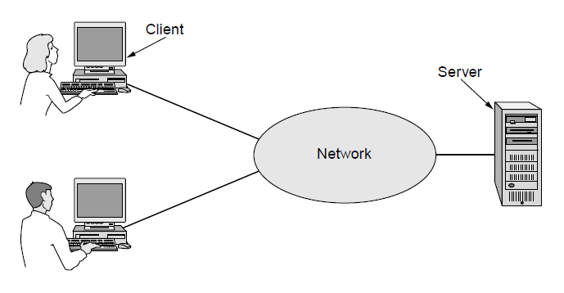
Business Applications
Companies use networks and computers for resource sharing with the client-server model:
Other popular uses are communication, e.g., email, VoIP, and e-commerce
request
response
CN5E by Tanenbaum & Wetherall, © Pearson Education-Prentice Hall and D. Wetherall, 2011

Slide 4
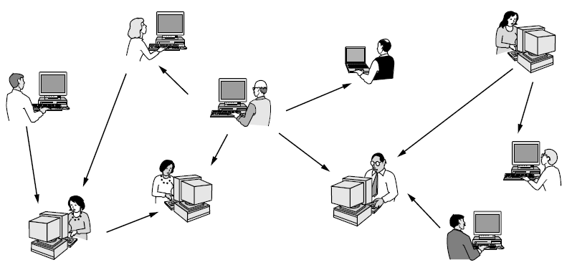
Home Applications
Homes contain many networked devices, e.g., computers, TVs, connected to the Internet by cable, DSL, wireless, etc.
Home users communicate, e.g., social networks, consume content, e.g., video, and transact, e.g., auctions
Some application use the peer-to-peer model in which there are no fixed clients and servers:
CN5E by Tanenbaum & Wetherall, © Pearson Education-Prentice Hall and D. Wetherall, 2011

Slide 5
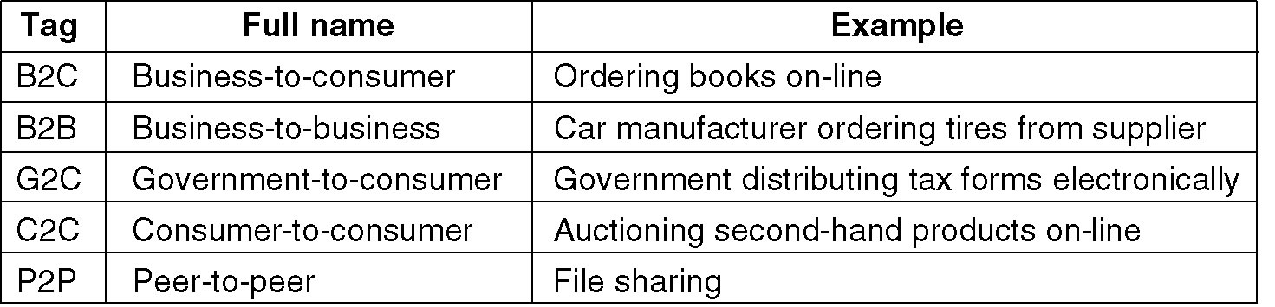
Home Network Applications (3)
Some forms of e-commerce.

Slide 6
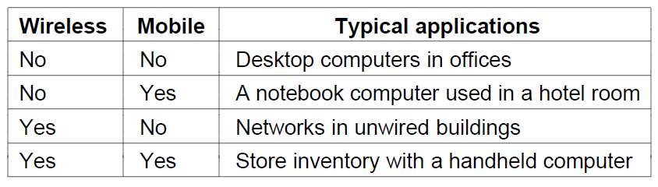
Mobile Users
Tablets, laptops, and smart phones are popular devices; WiFi hotspots and 3G cellular provide wireless connectivity.
Mobile users communicate, e.g., voice and texts, consume content, e.g., video and Web, and use sensors, e.g., GPS.
Wireless and mobile are related but different:
CN5E by Tanenbaum & Wetherall, © Pearson Education-Prentice Hall and D. Wetherall, 2011

Slide 7
Social Issues
  Network neutrality – no network restrictions
  Content ownership, e.g., DMCA takedowns
  Anonymity and censorship
  Privacy, e.g., Web tracking and profiling
  Theft, e.g., botnets and phishing
CN5E by Tanenbaum & Wetherall, © Pearson Education-Prentice Hall and D. Wetherall, 2011

Slide 8
Network Hardware
Networks can be classified by their scale:
Scale | Type
Vicinity | PAN (Personal Area Network) »
Building | LAN (Local Area Network) »
City | MAN (Metropolitan Area Network) »
Country | WAN (Wide Area Network) »
Planet | The Internet (network of all networks)
CN5E by Tanenbaum & Wetherall, © Pearson Education-Prentice Hall and D. Wetherall, 2011

Slide 9
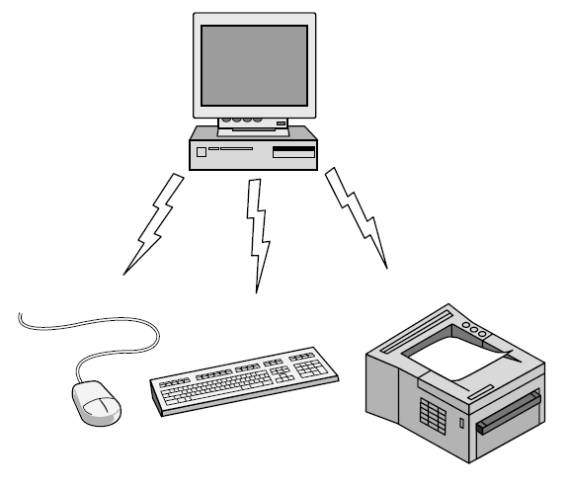
Personal Area Network
Connect devices over the range of a person
Example of a Bluetooth (wireless) PAN:
CN5E by Tanenbaum & Wetherall, © Pearson Education-Prentice Hall and D. Wetherall, 2011

Slide 10
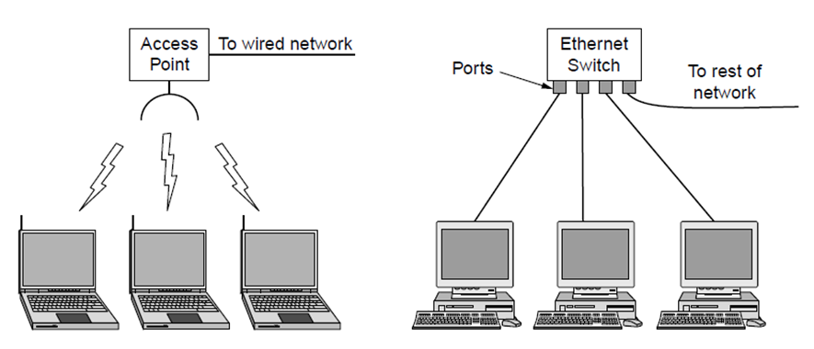
Local Area Networks
Connect devices in a home or office building
Called enterprise network in a company
Wireless LAN
with 802.11
Wired LAN with
switched Ethernet
CN5E by Tanenbaum & Wetherall, © Pearson Education-Prentice Hall and D. Wetherall, 2011

Slide 11
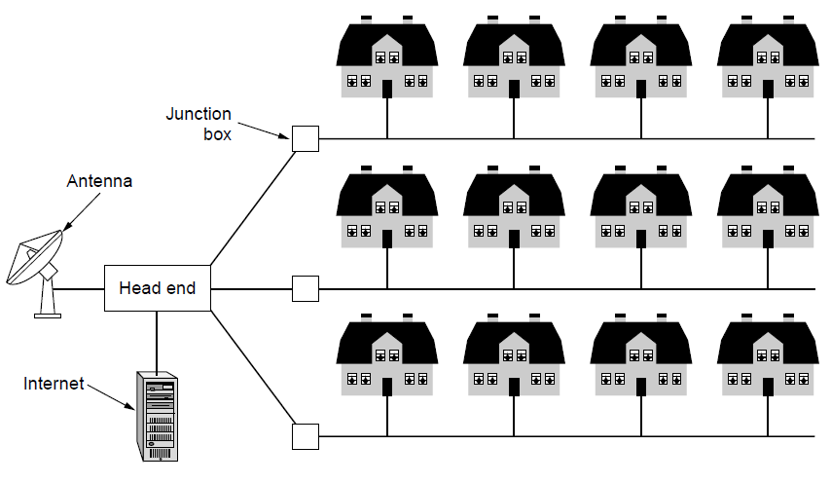
Metropolitan Area Networks
Connect devices over a metropolitan area
Example MAN based on cable TV:
CN5E by Tanenbaum & Wetherall, © Pearson Education-Prentice Hall and D. Wetherall, 2011

Slide 12
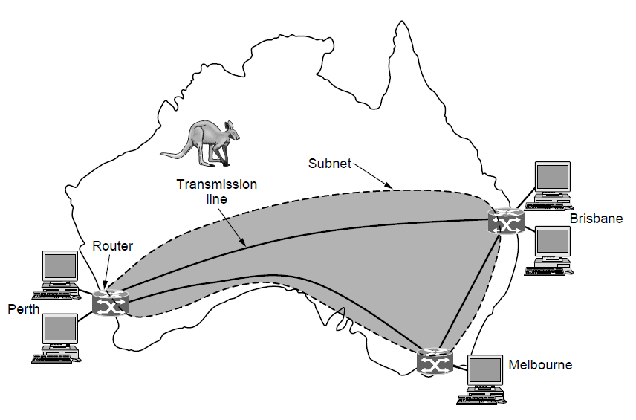
Wide Area Networks (1)
Connect devices over a country
Example WAN connecting three branch offices:
CN5E by Tanenbaum & Wetherall, © Pearson Education-Prentice Hall and D. Wetherall, 2011

Slide 13
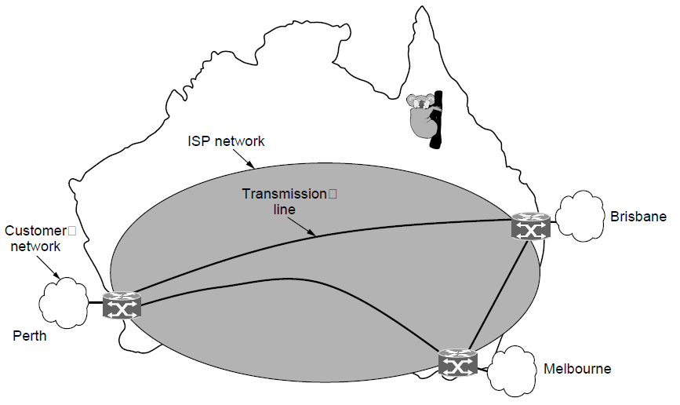
Wide Area Networks (2)
An ISP (Internet Service Provider) network is also a WAN.
Customers buy connectivity from the ISP to use it.
CN5E by Tanenbaum & Wetherall, © Pearson Education-Prentice Hall and D. Wetherall, 2011

Slide 14
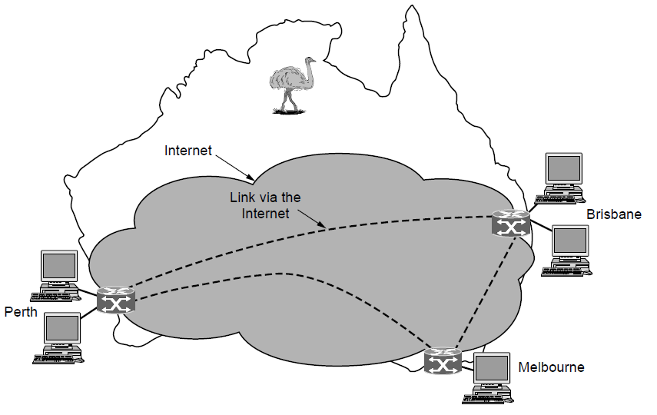
Wide Area Networks (3)
A VPN (Virtual Private Network) is a WAN built from virtual links that run on top of the Internet.
CN5E by Tanenbaum & Wetherall, © Pearson Education-Prentice Hall and D. Wetherall, 2011

Slide 15
Network Software
  Protocol layers »
  Design issues for the layers »
  Connection-oriented vs. connectionless service »
  Service primitives »
  Relationship of services to protocols »
CN5E by Tanenbaum & Wetherall, © Pearson Education-Prentice Hall and D. Wetherall, 2011

Slide 16
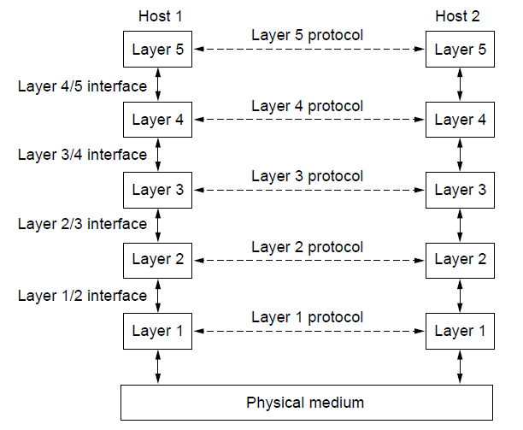
Protocol Layers (1)
Protocol layering is the main structuring method used to divide up network functionality.
Each protocol instance talks virtually to its peer
Each layer communicates only by using the one below
Lower layer services are accessed by an interface
At bottom, messages are carried by the medium
CN5E by Tanenbaum & Wetherall, © Pearson Education-Prentice Hall and D. Wetherall, 2011

Slide 17
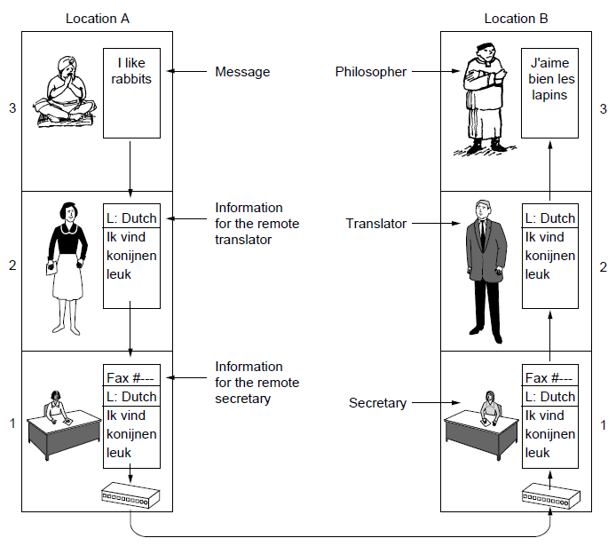
Protocol Layers (2)
Example: the philosopher-translator-secretary architecture
Each protocol at different layers serves a different purpose
CN5E by Tanenbaum & Wetherall, © Pearson Education-Prentice Hall and D. Wetherall, 2011

Slide 18
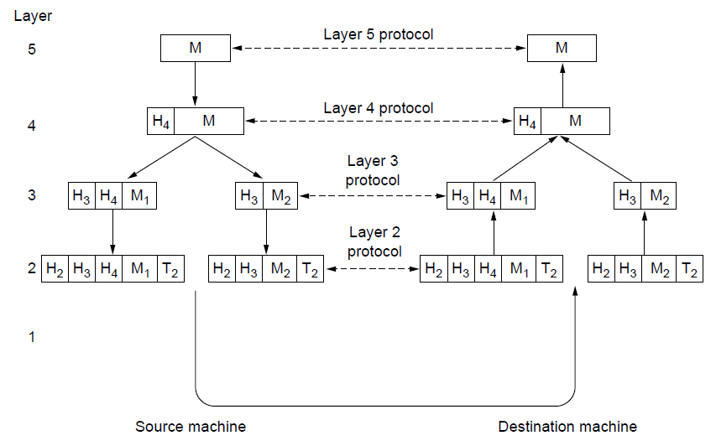
Protocol Layers (3)
Each lower layer adds its own header (with control inform-ation) to the message to transmit and removes it on receive
Layers may also split and join messages, etc.
CN5E by Tanenbaum & Wetherall, © Pearson Education-Prentice Hall and D. Wetherall, 2011

Slide 19
Design Issues for the Layers
Each layer solves a particular problem but must include mechanisms to address a set of recurring design issues
Issue | Example mechanisms at different layers
Reliability despite failures | Codes for error detection/correction (§3.2, 3.3) Routing around failures (§5.2)
Network growth and evolution | Addressing (§5.6) and naming (§7.1) Protocol layering (§1.3)
Allocation of resources like bandwidth | Multiple access (§4.2) Congestion control (§5.3, 6.3)
Security against various threats | Confidentiality of messages (§8.2, 8.6) Authentication of communicating parties (§8.7)
CN5E by Tanenbaum & Wetherall, © Pearson Education-Prentice Hall and D. Wetherall, 2011

Slide 20
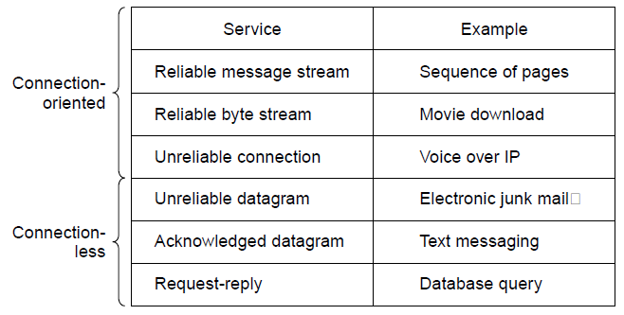
Connection-Oriented vs. Connectionless
Service provided by a layer may be kinds of either:
  Connection-oriented, must be set up for ongoing use (and torn down after use), e.g., phone call
  Connectionless, messages are handled separately, e.g., postal delivery
CN5E by Tanenbaum & Wetherall, © Pearson Education-Prentice Hall and D. Wetherall, 2011

Slide 21
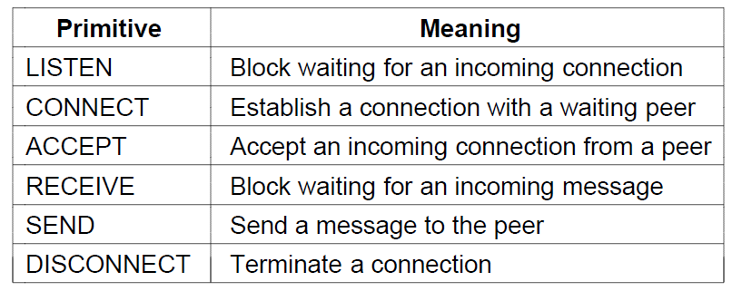
Service Primitives (1)
A service is provided to the layer above as primitives
Hypothetical example of service primitives that may provide a reliable byte stream (connection-oriented) service:
CN5E by Tanenbaum & Wetherall, © Pearson Education-Prentice Hall and D. Wetherall, 2011

Slide 22
Service Primitives (2)
Hypothetical example of how these primitives may be used for a client-server interaction
Client
Server
LISTEN (0)
CONNECT (1)
Connect request
ACCEPT
(2)
Accept response
RECEIVE
SEND
Request for data
(3)
RECEIVE
SEND (4)
Reply
DISCONNECT (5)
Disconnect
DISCONNECT (6)
Disconnect
CN5E by Tanenbaum & Wetherall, © Pearson Education-Prentice Hall and D. Wetherall, 2011

Slide 23
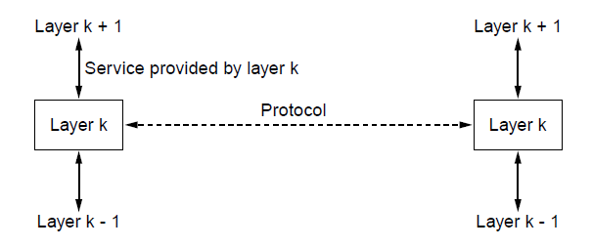
Relationship of Services to Protocols
Recap:
  A layer provides a service to the one above [vertical]
  A layer talks to its peer using a protocol [horizontal]
CN5E by Tanenbaum & Wetherall, © Pearson Education-Prentice Hall and D. Wetherall, 2011

Slide 24
Reference Models
Reference models describe the layers in a network architecture
  OSI reference model »
  TCP/IP reference model »
  Model used for this text »
  Critique of OSI and TCP/IP »
CN5E by Tanenbaum & Wetherall, © Pearson Education-Prentice Hall and D. Wetherall, 2011

Slide 25
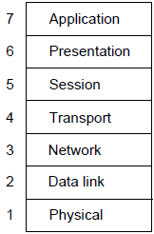
OSI Reference Model
A principled, international standard, seven layer model to connect different systems
– Provides functions needed by users
– Converts different representations
– Manages task dialogs
– Provides end-to-end delivery
– Sends packets over multiple links
– Sends frames of information
– Sends bits as signals
CN5E by Tanenbaum & Wetherall, © Pearson Education-Prentice Hall and D. Wetherall, 2011

Slide 26
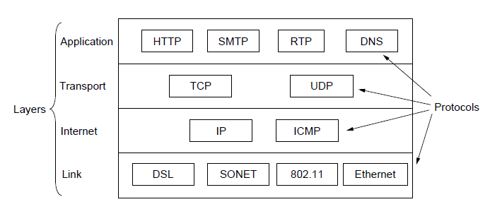
TCP/IP Reference Model
A four layer model derived from experimentation; omits some OSI layers and uses the IP as the network layer.
IP is the “narrow waist” of the Internet
Protocols are shown in their respective layers
CN5E by Tanenbaum & Wetherall, © Pearson Education-Prentice Hall and D. Wetherall, 2011

Slide 27
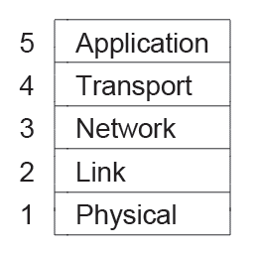
Model Used in this Book
It is based on the TCP/IP model but we call out the physical layer and look beyond Internet protocols.
CN5E by Tanenbaum & Wetherall, © Pearson Education-Prentice Hall and D. Wetherall, 2011

Slide 28
Critique of OSI & TCP/IP
OSI:
    Very influential model with clear concepts
    Models, protocols and adoption all bogged down by politics and complexity
TCP/IP:
    Very successful protocols that worked well and thrived
    Weak model derived after the fact from protocols
CN5E by Tanenbaum & Wetherall, © Pearson Education-Prentice Hall and D. Wetherall, 2011

Slide 29
Example Networks
  The Internet »
  3G mobile phone networks »
  Wireless LANs »
  RFID and sensor networks »
CN5E by Tanenbaum & Wetherall, © Pearson Education-Prentice Hall and D. Wetherall, 2011

Slide 30
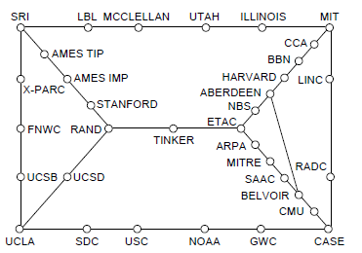
Internet (1)
Before the Internet was the ARPANET, a decentralized, packet-switched network based on Baran’s ideas.
Nodes are IMPs, or early routers, linked to hosts
56 kbps links
ARPANET topology in Sept 1972.
CN5E by Tanenbaum & Wetherall, © Pearson Education-Prentice Hall and D. Wetherall, 2011

Slide 31
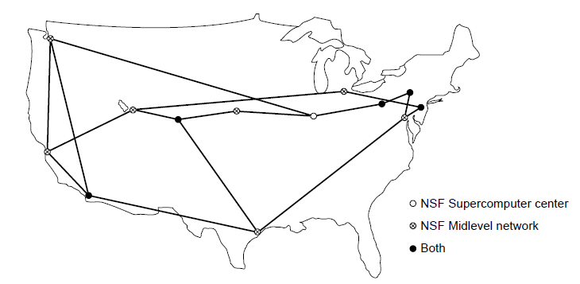
Internet (2)
The early Internet used NSFNET (1985-1995) as its backbone; universities connected to get on the Internet
T1 links (1.5 Mbps)
NSFNET topology in 1988
CN5E by Tanenbaum & Wetherall, © Pearson Education-Prentice Hall and D. Wetherall, 2011

Slide 32
Internet (3)
The modern Internet is more complex:
  ISP networks serve as the Internet backbone
  ISPs connect or peer to exchange traffic at IXPs
  Within each network routers switch packets
  Between networks, traffic exchange is set by business agreements
  Customers connect at the edge by many means
    Cable, DSL, Fiber-to-the-Home, 3G/4G wireless, dialup
  Data centers concentrate many servers (“the cloud”)
  Most traffic is content from data centers (esp. video)
  The architecture continues to evolve
CN5E by Tanenbaum & Wetherall, © Pearson Education-Prentice Hall and D. Wetherall, 2011

Slide 33
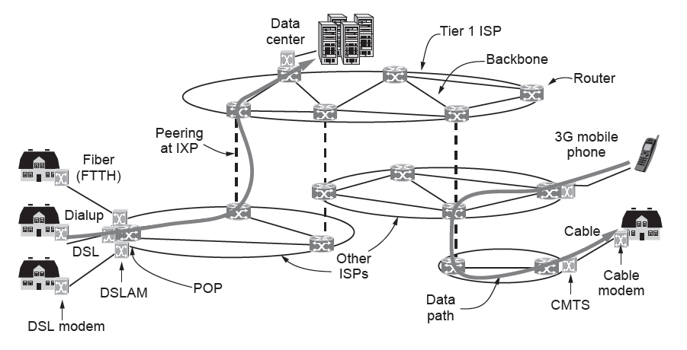
Internet (4)
Architecture of the Internet
CN5E by Tanenbaum & Wetherall, © Pearson Education-Prentice Hall and D. Wetherall, 2011

Slide 34
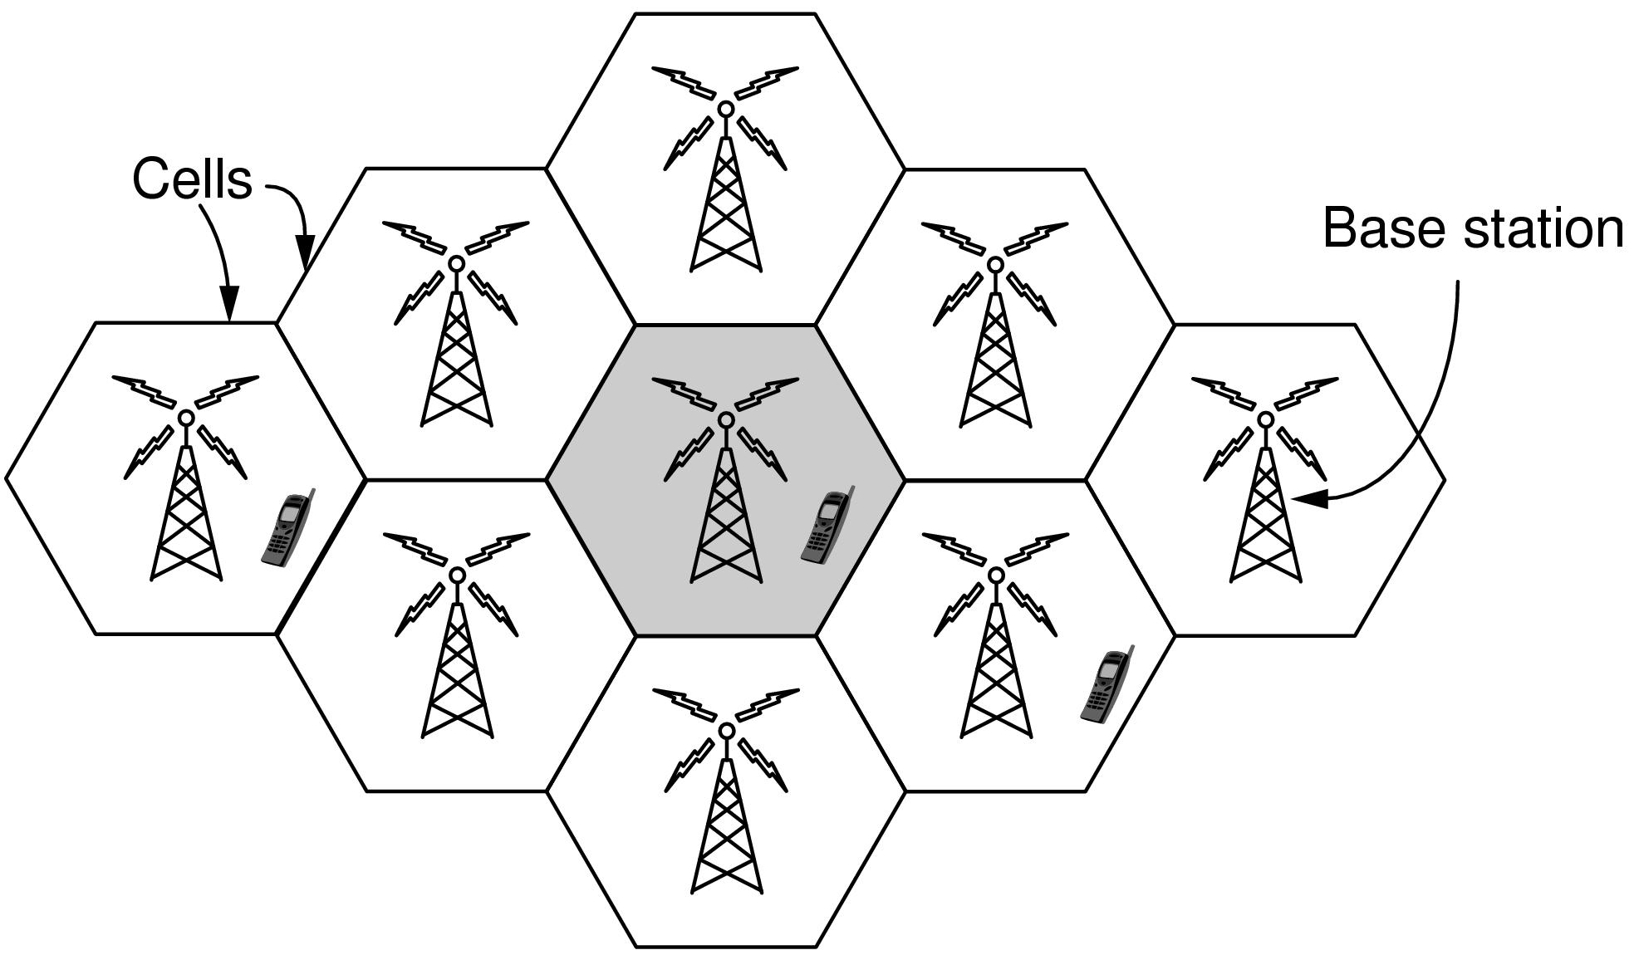
3G Mobile Phone Networks (1)
3G network is based on spatial cells; each cell provides wireless service to mobiles within it via a base station
CN5E by Tanenbaum & Wetherall, © Pearson Education-Prentice Hall and D. Wetherall, 2011

Slide 35
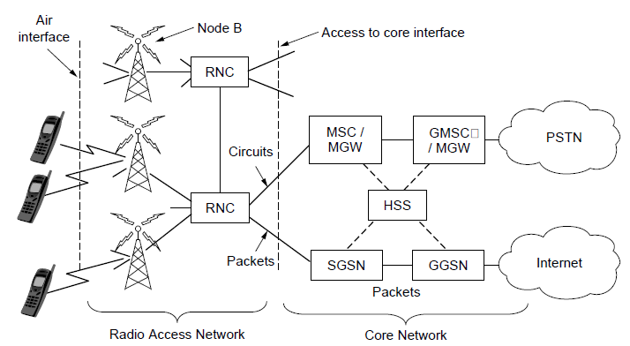
3G Mobile Phone Networks (2)
Base stations connect to the core network to find other mobiles and send data to the phone network and Internet
CN5E by Tanenbaum & Wetherall, © Pearson Education-Prentice Hall and D. Wetherall, 2011

Slide 36
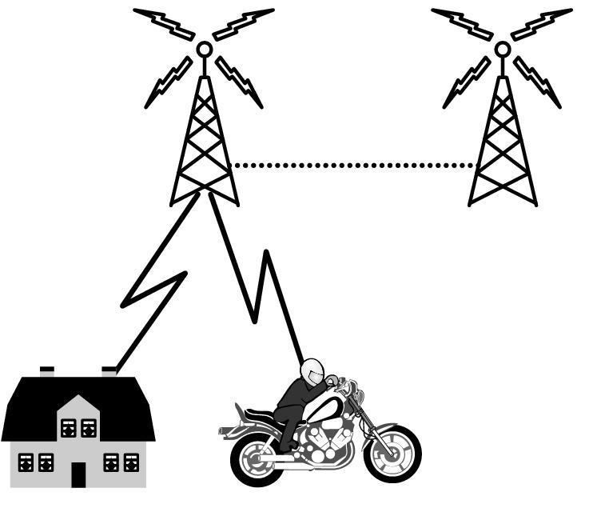
3G Mobile Phone Networks (3)
As mobiles move, base stations hand them off from one cell to the next, and the network tracks their location
Handover
CN5E by Tanenbaum & Wetherall, © Pearson Education-Prentice Hall and D. Wetherall, 2011

Slide 37
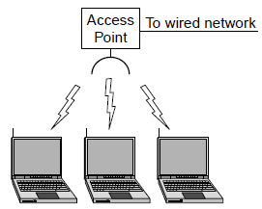
Wireless LANs (1)
In 802.11, clients communicate via an AP (Access Point) that is wired to the rest of the network.
CN5E by Tanenbaum & Wetherall, © Pearson Education-Prentice Hall and D. Wetherall, 2011

Slide 38
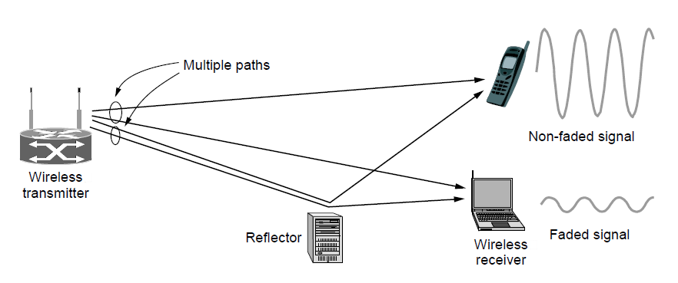
Wireless LANs (2)
Signals in the 2.4GHz ISM band vary in strength due to many effects, such as multipath fading due to reflections
    requires complex transmission schemes, e.g., OFDM
CN5E by Tanenbaum & Wetherall, © Pearson Education-Prentice Hall and D. Wetherall, 2011

Slide 39
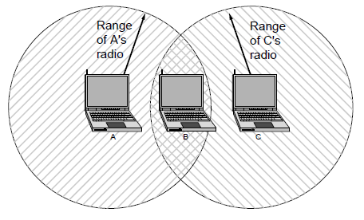
Wireless LANs (3)
Radio broadcasts interfere with each other, and radio ranges may incompletely overlap
    CSMA (Carrier Sense Multiple Access) designs are used
CN5E by Tanenbaum & Wetherall, © Pearson Education-Prentice Hall and D. Wetherall, 2011

Slide 40
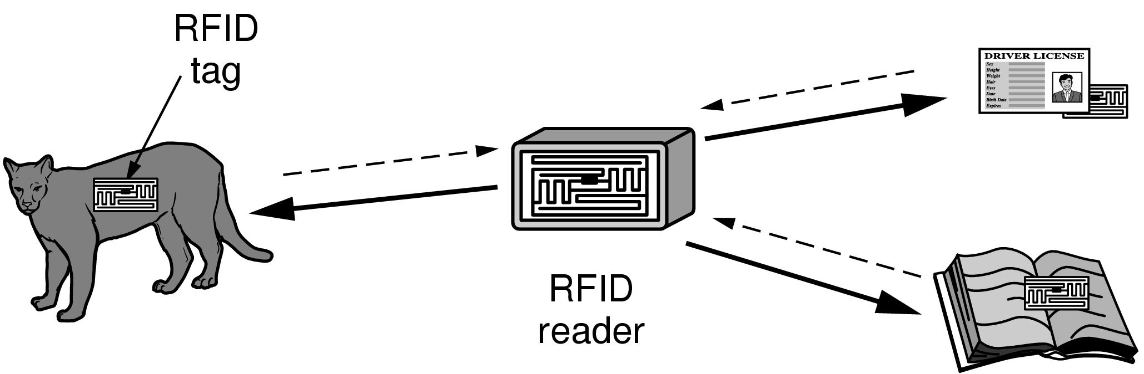
RFID and Sensor Networks (1)
Passive UHF RFID networks everyday objects:
    Tags (stickers with not even a battery) are placed on objects
    Readers send signals that the tags reflect to communicate
CN5E by Tanenbaum & Wetherall, © Pearson Education-Prentice Hall and D. Wetherall, 2011

Slide 41
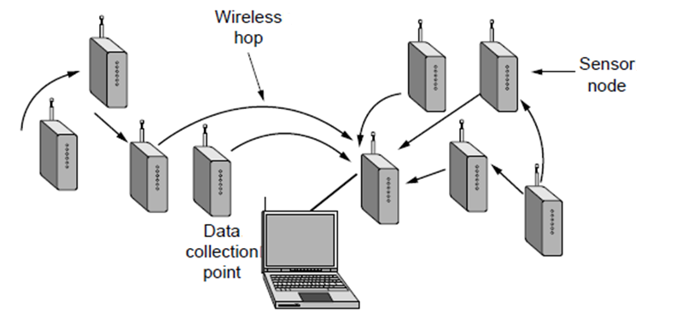
RFID and Sensor Networks (2)
Sensor networks spread small devices over an area:
    Devices send sensed data to collector via wireless hops
CN5E by Tanenbaum & Wetherall, © Pearson Education-Prentice Hall and D. Wetherall, 2011

Slide 42
Network Standardization
  Standards define what is needed for interoperability
  Some of the many standards bodies:
Body | Area | Examples
ITU | Telecommunications | G.992, ADSL H.264, MPEG4
IEEE | Communications | 802.3, Ethernet 802.11, WiFi
IETF | Internet | RFC 2616, HTTP/1.1 RFC 1034/1035, DNS
W3C | Web | HTML5 standard CSS standard
CN5E by Tanenbaum & Wetherall, © Pearson Education-Prentice Hall and D. Wetherall, 2011

Slide 43
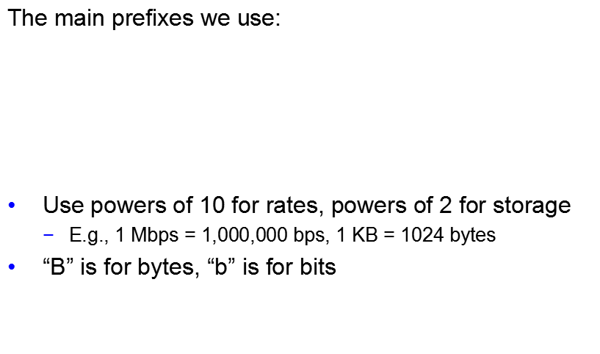
Metric Units
Prefix | Exp. | prefix | exp.
K(ilo) | 10³ | m(illi) | 10⁻³
M(ega) | 10⁶ | μ(micro) | 10⁻⁶
G(iga) | 10⁹ | n(ano) | 10⁻⁹
CN5E by Tanenbaum & Wetherall, © Pearson Education-Prentice Hall and D. Wetherall, 2011

Slide 44
End
Chapter 1
CN5E by Tanenbaum & Wetherall, © Pearson Education-Prentice Hall and D. Wetherall, 2011

