Slide 1
The Data Link Layer
Chapter 3
  Data Link Layer Design Issues
  Error Detection and Correction
  Elementary Data Link Protocols
  Sliding Window Protocols
  Example Data Link Protocols
Revised: August 2011
CN5E by Tanenbaum & Wetherall, © Pearson Education-Prentice Hall and D. Wetherall, 2011
Notes:
Gray units can be optionally omitted without causing later gaps

Slide 2
The Data Link Layer
Responsible for delivering frames of information over a single link
  Handles transmission errors and regulates the flow of data
Application
Transport
Network
Link
Physical
CN5E by Tanenbaum & Wetherall, © Pearson Education-Prentice Hall and D. Wetherall, 2011

Slide 3
Data Link Layer Design Issues
  Frames »
  Possible services »
  Framing methods »
  Error control »
  Flow control »
CN5E by Tanenbaum & Wetherall, © Pearson Education-Prentice Hall and D. Wetherall, 2011

Slide 4
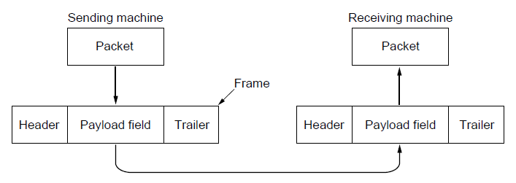
Frames
Link layer accepts packets from the network layer, and encapsulates them into frames that it sends using the physical layer; reception is the opposite process
Network
Link
Virtual data path
Physical
Actual data path
CN5E by Tanenbaum & Wetherall, © Pearson Education-Prentice Hall and D. Wetherall, 2011

Slide 5
Possible Services
Unacknowledged connectionless service
  Frame is sent with no connection / error recovery
  Ethernet is example
Acknowledged connectionless service
  Frame is sent with retransmissions if needed
  Example is 802.11
Acknowledged connection-oriented service
  Connection is set up; rare
CN5E by Tanenbaum & Wetherall, © Pearson Education-Prentice Hall and D. Wetherall, 2011

Slide 6
Framing Methods
  Byte count »
  Flag bytes with byte stuffing »
  Flag bits with bit stuffing »
  Physical layer coding violations
    Use non-data symbol to indicate frame
CN5E by Tanenbaum & Wetherall, © Pearson Education-Prentice Hall and D. Wetherall, 2011

Slide 7
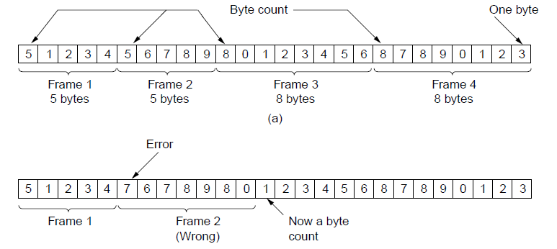
Framing – Byte count
Frame begins with a count of the number of bytes in it
  Simple, but difficult to resynchronize after an error
Expected
case
Error
case
CN5E by Tanenbaum & Wetherall, © Pearson Education-Prentice Hall and D. Wetherall, 2011

Slide 8
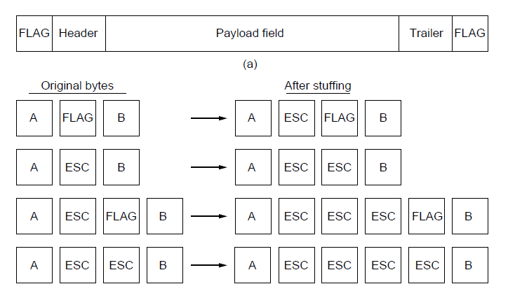
Framing – Byte stuffing
Special flag bytes delimit frames; occurrences of flags in the data must be stuffed (escaped)
  Longer, but easy to resynchronize after error
Frame
format
Need to escape extra ESCAPE bytes too!
Stuffing
examples
CN5E by Tanenbaum & Wetherall, © Pearson Education-Prentice Hall and D. Wetherall, 2011

Slide 9
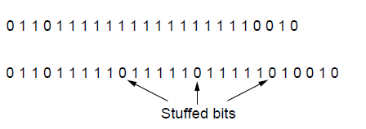
Framing – Bit stuffing
Stuffing done at the bit level:
  Frame flag has six consecutive 1s (not shown)
  On transmit, after five 1s in the data, a 0 is added
  On receive, a 0 after five 1s is deleted
Data bits
Transmitted bits
with stuffing
CN5E by Tanenbaum & Wetherall, © Pearson Education-Prentice Hall and D. Wetherall, 2011

Slide 10
Error Control
Error control repairs frames that are received in error
  Requires errors to be detected at the receiver
  Typically retransmit the unacknowledged frames
  Timer protects against lost acknowledgements
Detecting errors and retransmissions are next topics.
CN5E by Tanenbaum & Wetherall, © Pearson Education-Prentice Hall and D. Wetherall, 2011
Notes:
We’ll get to this later in the chapter (error detection/correction, and elementary data link protocols)

Slide 11
Flow Control
Prevents a fast sender from out-pacing a slow receiver
  Receiver gives feedback on the data it can accept
  Rare in the Link layer as NICs run at “wire speed”
    Receiver can take data as fast as it can be sent
Flow control is a topic in the Link and Transport layers.
CN5E by Tanenbaum & Wetherall, © Pearson Education-Prentice Hall and D. Wetherall, 2011
Notes:
We’ll get to this later in the chapter (sliding window protocol) but note that flow control is mostly the responsibility of the Transport layer in practice (e.g., TCP)

Slide 12
Error Detection and Correction
Error codes add structured redundancy to data so errors can be either detected, or corrected.
Error correction codes:
  Hamming codes »
  Binary convolutional codes »
  Reed-Solomon and Low-Density Parity Check codes
    Mathematically complex, widely used in real systems
Error detection codes:
  Parity »
  Checksums »
  Cyclic redundancy codes »
CN5E by Tanenbaum & Wetherall, © Pearson Education-Prentice Hall and D. Wetherall, 2011

Slide 13
Error Bounds – Hamming distance
Code turns data of n bits into codewords of n+k bits
Hamming distance is the minimum bit flips to turn one valid codeword into any other valid one.
  Example with 4 codewords of 10 bits (n=2, k=8):
    0000000000, 0000011111, 1111100000, and 1111111111
    Hamming distance is 5
Bounds for a code with distance:
  2d+1 – can correct d errors (e.g., 2 errors above)
  d+1 – can detect d errors (e.g., 4 errors above)
CN5E by Tanenbaum & Wetherall, © Pearson Education-Prentice Hall and D. Wetherall, 2011
Notes:
Why can a code with distance d+1 detect up to d errors? Because errors are detected by receiving invalid codewords (like 0101010101 for the example). If there are d+1 or more errors then one valid codeword may be turned into another valid codeword and there is no way to detect that an error has occurred.
Why can a code with distance 2d+1 detect up to d errors? Because errors are corrected by mapping a received invalid codeword to the nearest valid codeword, i.e., the one that can be reached with the fewest bit flips. If there are more than d bit flips, then the received codeword may be closer to another valid codeword than the codeword that was sent. For example, sending 0000000000 with 2 flips might give 1100000000 which is closest to 0000000000, correcting the error. But with 3 flips 1110000000 might be received, which is closest to 1111100000, which is still an error.

Slide 14
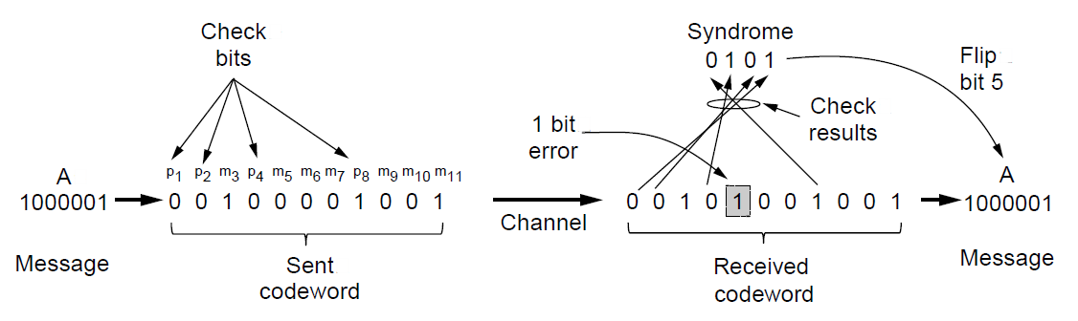
Error Correction – Hamming code
Hamming code gives a simple way to add check bits and correct up to a single bit error:
  Check bits are parity over subsets of the codeword
  Recomputing the parity sums (syndrome) gives the position of the error to flip, or 0 if there is no error
(11, 7) Hamming code adds 4 check bits and can correct 1 error
CN5E by Tanenbaum & Wetherall, © Pearson Education-Prentice Hall and D. Wetherall, 2011

Slide 15
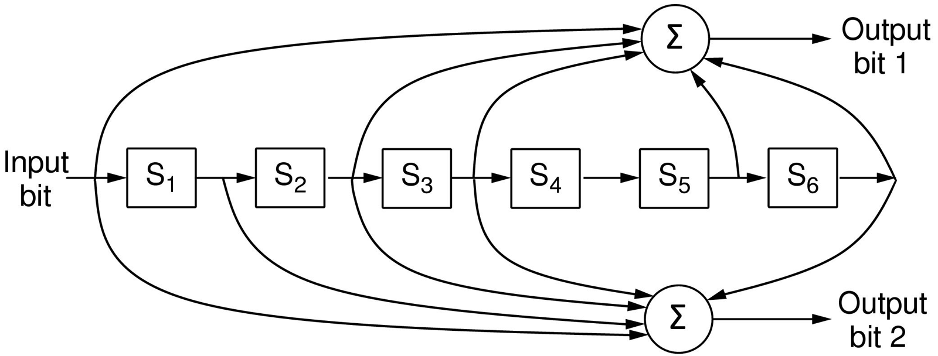
Error Correction – Convolutional codes
Operates on a stream of bits, keeping internal state
  Output stream is a function of all preceding input bits
  Bits are decoded with the Viterbi algorithm
… 1 1 1
…
0 1 1
1 0 1
Popular NASA binary convolutional code (rate = ½) used in 802.11
CN5E by Tanenbaum & Wetherall, © Pearson Education-Prentice Hall and D. Wetherall, 2011

Slide 16
Error Detection – Parity (1)
Parity bit is added as the modulo 2 sum of data bits
  Equivalent to XOR; this is even parity
  Ex: 1110000 → 11100001
  Detection checks if the sum is wrong (an error)
Simple way to detect an odd number of errors
  Ex: 1 error, 11100101; detected, sum is wrong
  Ex: 3 errors, 11011001; detected sum is wrong
  Ex: 2 errors, 11101101; not detected, sum is right!
  Error can also be in the parity bit itself
  Random errors are detected with probability ½
CN5E by Tanenbaum & Wetherall, © Pearson Education-Prentice Hall and D. Wetherall, 2011

Slide 17
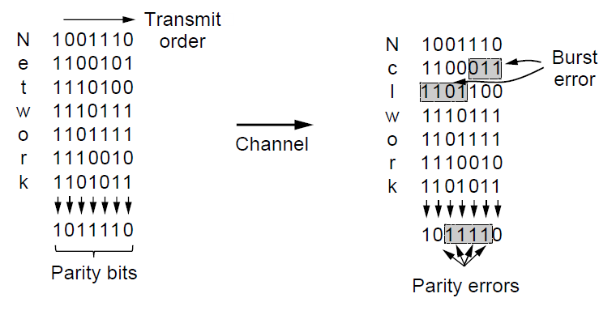
Error Detection – Parity (2)
Interleaving of N parity bits detects burst errors up to N
  Each parity sum is made over non-adjacent bits
  An even burst of up to N errors will not cause it to fail
CN5E by Tanenbaum & Wetherall, © Pearson Education-Prentice Hall and D. Wetherall, 2011

Slide 18
Error Detection – Checksums
Checksum treats data as N-bit words and adds N check bits that are the modulo 2^{N} sum of the words
  Ex: Internet 16-bit 1s complement checksum
Properties:
  Improved error detection over parity bits
  Detects bursts up to N errors
  Detects random errors with probability 1-2^{N}
  Vulnerable to systematic errors, e.g., added zeros
CN5E by Tanenbaum & Wetherall, © Pearson Education-Prentice Hall and D. Wetherall, 2011

Slide 19
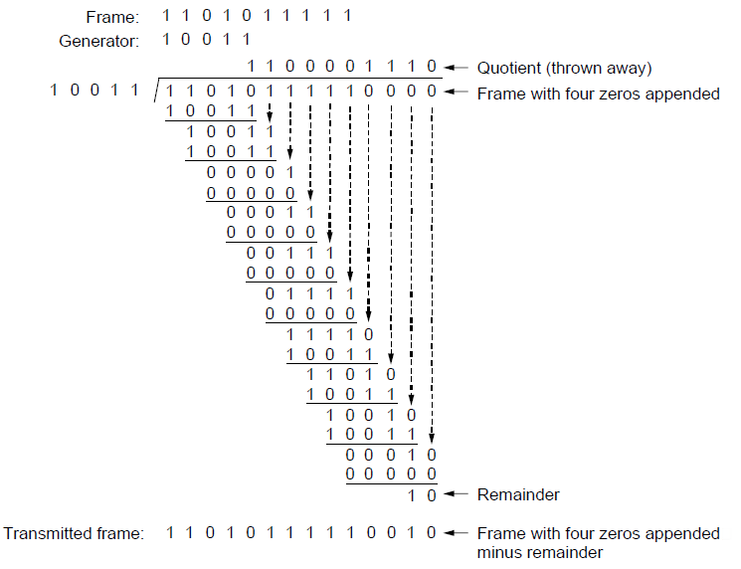
Error Detection – CRCs (1)
Adds bits so that transmitted frame viewed as a polynomial is evenly divisible by a generator polynomial
Start by adding 0s to frame and try dividing
Offset by any reminder to make it evenly divisible
CN5E by Tanenbaum & Wetherall, © Pearson Education-Prentice Hall and D. Wetherall, 2011

Slide 20
Error Detection – CRCs (2)
Based on standard polynomials:
  Ex: Ethernet 32-bit CRC is defined by:
  Computed with simple shift/XOR circuits
Stronger detection than checksums:
  E.g., can detect all double bit errors
  Not vulnerable to systematic errors
CN5E by Tanenbaum & Wetherall, © Pearson Education-Prentice Hall and D. Wetherall, 2011

Slide 21
Elementary Data Link Protocols
  Link layer environment »
  Utopian Simplex Protocol »
  Stop-and-Wait Protocol for Error-free channel »
  Stop-and-Wait Protocol for Noisy channel »
CN5E by Tanenbaum & Wetherall, © Pearson Education-Prentice Hall and D. Wetherall, 2011

Slide 22
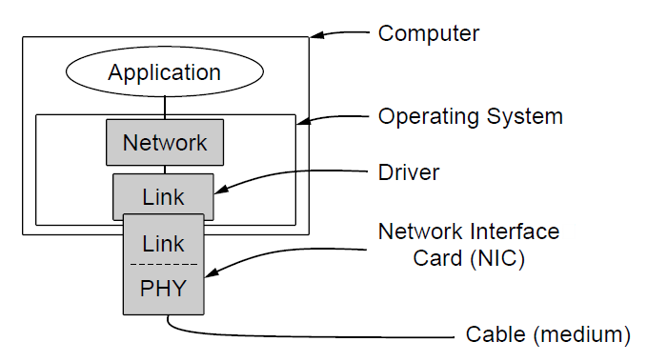
Link layer environment (1)
Commonly implemented as NICs and OS drivers; network layer (IP) is often OS software
CN5E by Tanenbaum & Wetherall, © Pearson Education-Prentice Hall and D. Wetherall, 2011

Slide 23
Link layer environment (2)
Link layer protocol implementations use library functions
  See code (protocol.h) for more details
Group | Library Function | Description
Network layer | from_network_layer(&packet) to_network_layer(&packet) enable_network_layer() disable_network_layer() | Take a packet from network layer to send Deliver a received packet to network layer Let network cause “ready” events Prevent network “ready” events
Physical layer | from_physical_layer(&frame) to_physical_layer(&frame) | Get an incoming frame from physical layer Pass an outgoing frame to physical layer
Events & timers | wait_for_event(&event) start_timer(seq_nr) stop_timer(seq_nr) start_ack_timer() stop_ack_timer() | Wait for a packet / frame / timer event Start a countdown timer running Stop a countdown timer from running Start the ACK countdown timer Stop the ACK countdown timer
CN5E by Tanenbaum & Wetherall, © Pearson Education-Prentice Hall and D. Wetherall, 2011

Slide 24
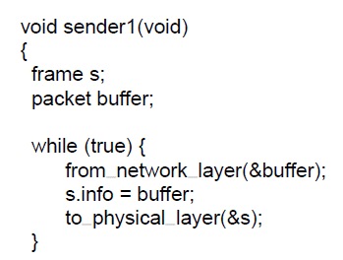
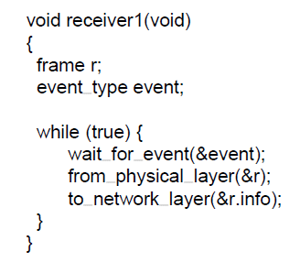
Utopian Simplex Protocol
An optimistic protocol (p1) to get us started
  Assumes no errors, and receiver as fast as sender
  Considers one-way data transfer
  That’s it, no error or flow control …
}
Sender loops blasting frames
Receiver loops eating frames
CN5E by Tanenbaum & Wetherall, © Pearson Education-Prentice Hall and D. Wetherall, 2011
Notes:
This is essentially what Ethernet does – just blast packets and receive as quickly as possible

Slide 25
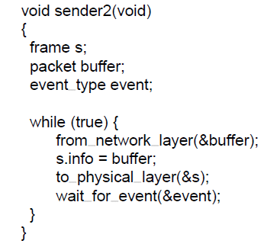
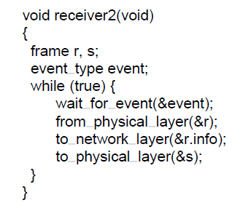
Stop-and-Wait – Error-free channel
Protocol (p2) ensures sender can’t outpace receiver:
  Receiver returns a dummy frame (ack) when ready
  Only one frame out at a time – called stop-and-wait
  We added flow control!
Sender waits to for ack after passing frame to physical layer
Receiver sends ack after passing frame to network layer
CN5E by Tanenbaum & Wetherall, © Pearson Education-Prentice Hall and D. Wetherall, 2011
Notes:
This is an intermediate protocol in which we’ve dealt with one issue (flow control) but not another (error control). It is instructive, but does not represent any real protocol (as it will deadlock if there are errors).

Slide 26
Stop-and-Wait – Noisy channel (1)
ARQ (Automatic Repeat reQuest) adds error control
  Receiver acks frames that are correctly delivered
  Sender sets timer and resends frame if no ack)
For correctness, frames and acks must be numbered
  Else receiver can’t tell retransmission (due to lost ack or early timer) from new frame
  For stop-and-wait, 2 numbers (1 bit) are sufficient
CN5E by Tanenbaum & Wetherall, © Pearson Education-Prentice Hall and D. Wetherall, 2011
Notes:
ARQ is also called PAR (Positive Acknowledgement with Retransmission)

Slide 27
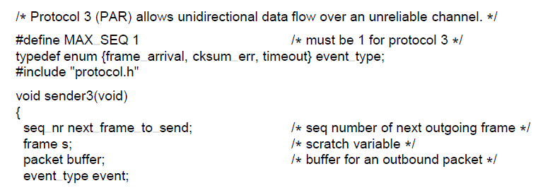
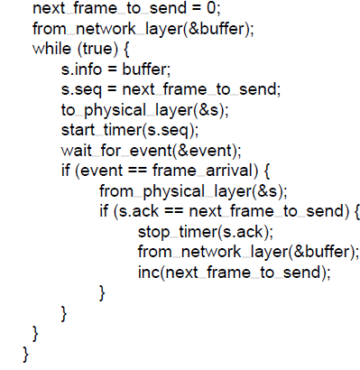
Stop-and-Wait – Noisy channel (2)
{
Sender loop (p3):
Send frame (or retransmission)
Set timer for retransmission
Wait for ack or timeout
If a good ack then set up for the next frame to send (else the old frame will be retransmitted)
CN5E by Tanenbaum & Wetherall, © Pearson Education-Prentice Hall and D. Wetherall, 2011
Notes:
This is essentially what 802.11 does – stop-and-wait to handle wireless errors. There are differences in the details: 802.11 uses a larger sequence number (12 bits) and gives up after a limited number of retransmissions (retries).

Slide 28
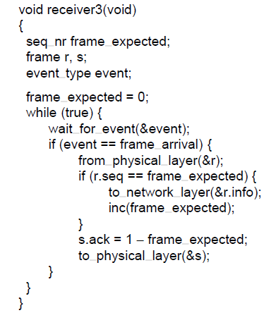
Stop-and-Wait – Noisy channel (3)
Receiver loop (p3):
Wait for a frame
If it’s new then take it and advance expected frame
Ack current frame
CN5E by Tanenbaum & Wetherall, © Pearson Education-Prentice Hall and D. Wetherall, 2011

Slide 29
Sliding Window Protocols
  Sliding Window concept »
  One-bit Sliding Window »
  Go-Back-N »
  Selective Repeat »
CN5E by Tanenbaum & Wetherall, © Pearson Education-Prentice Hall and D. Wetherall, 2011

Slide 30
Sliding Window concept (1)
Sender maintains window of frames it can send
  Needs to buffer them for possible retransmission
  Window advances with next acknowledgements
Receiver maintains window of frames it can receive
  Needs to keep buffer space for arrivals
  Window advances with in-order arrivals
CN5E by Tanenbaum & Wetherall, © Pearson Education-Prentice Hall and D. Wetherall, 2011

Slide 31
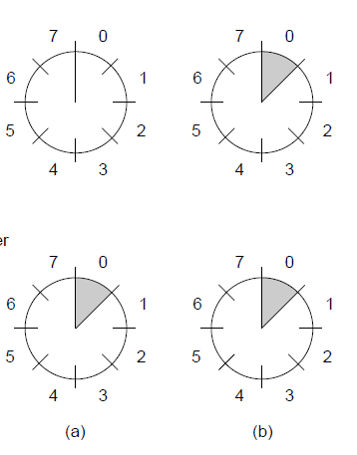
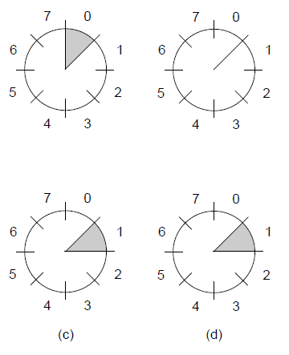
Sliding Window concept (2)
A sliding window advancing at the sender and receiver
  Ex: window size is 1, with a 3-bit sequence number.
Sender
Receiver
At the start
First frame is sent
First frame is received
Sender gets first ack
CN5E by Tanenbaum & Wetherall, © Pearson Education-Prentice Hall and D. Wetherall, 2011

Slide 32
Sliding Window concept (3)
Larger windows enable pipelining for efficient link use
  Stop-and-wait (w=1) is inefficient for long links
  Best window (w) depends on bandwidth-delay (BD)
  Want w ≥ 2BD+1 to ensure high link utilization
Pipelining leads to different choices for errors/buffering
  We will consider Go-Back-N and Selective Repeat
CN5E by Tanenbaum & Wetherall, © Pearson Education-Prentice Hall and D. Wetherall, 2011
Notes:
Pipelining means that there are multiple frames outstanding in the network at any instant.
For stop-and-wait, imagine a link from Seattle to Amsterdam that has a 500ms round-trip time. It doesn’t matter how fast the link is in bits/sec, stop-and-wait will only let it run at two packets per second.

Slide 33
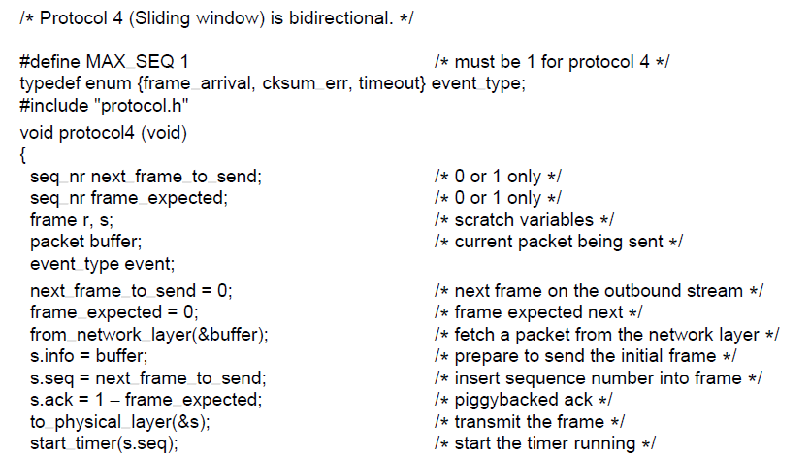
One-Bit Sliding Window (1)
Transfers data in both directions with stop-and-wait
  Piggybacks acks on reverse data frames for efficiency
  Handles transmission errors, flow control, early timers
{
Each node is sender and receiver (p4):
Prepare first frame
Launch it, and set timer
. . .
CN5E by Tanenbaum & Wetherall, © Pearson Education-Prentice Hall and D. Wetherall, 2011
Notes:
Shows a basic implementation of a sliding window for w=1 handling error/flow control for us to build on

Slide 34
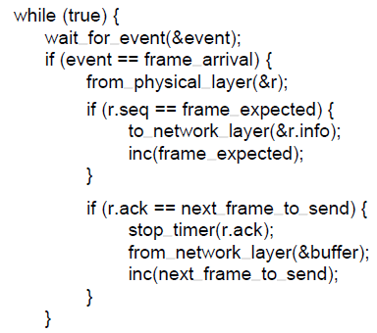
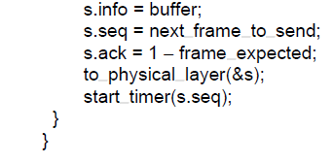
One-Bit Sliding Window (2)
. . .
Wait for frame or timeout
If a frame with new data then deliver it
If an ack for last send then prepare for next data frame
(Otherwise it was a timeout)
Send next data frame or retransmit old one; ack the last data we received
CN5E by Tanenbaum & Wetherall, © Pearson Education-Prentice Hall and D. Wetherall, 2011

Slide 35
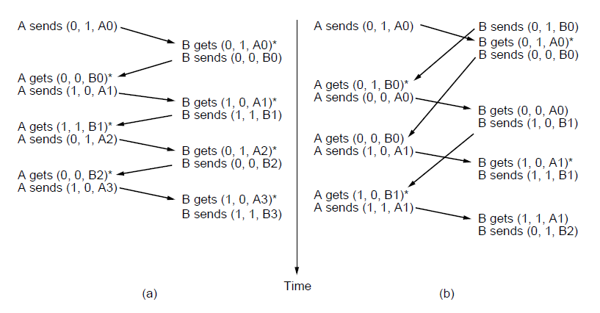
One-Bit Sliding Window (3)
Two scenarios show subtle interactions exist in p4:
    Simultaneous start [right] causes correct but slow operation compared to normal [left] due to duplicate transmissions.
Time
Notation is (seq, ack, frame number). Asterisk indicates frame accepted by network layer .
Normal case
Correct, but poor performance
CN5E by Tanenbaum & Wetherall, © Pearson Education-Prentice Hall and D. Wetherall, 2011

Slide 36
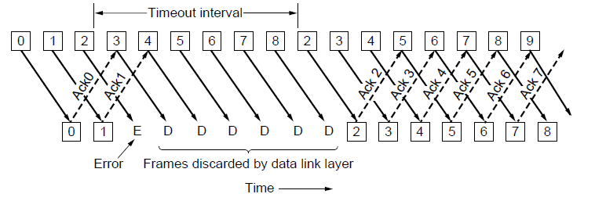
Go-Back-N (1)
Receiver only accepts/acks frames that arrive in order:
  Discards frames that follow a missing/errored frame
  Sender times out and resends all outstanding frames
CN5E by Tanenbaum & Wetherall, © Pearson Education-Prentice Hall and D. Wetherall, 2011

Slide 37
Go-Back-N (2)
Tradeoff made for Go-Back-N:
  Simple strategy for receiver; needs only 1 frame
  Wastes link bandwidth for errors with large windows; entire window is retransmitted
Implemented as p5 (see code in book)
CN5E by Tanenbaum & Wetherall, © Pearson Education-Prentice Hall and D. Wetherall, 2011

Slide 38
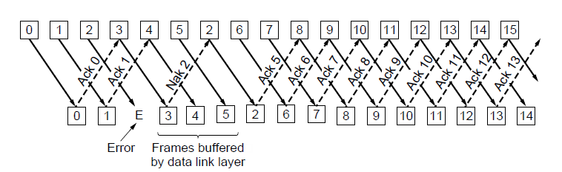
Selective Repeat (1)
Receiver accepts frames anywhere in receive window
  Cumulative ack indicates highest in-order frame
  NAK (negative ack) causes sender retransmission of a missing frame before a timeout resends window
CN5E by Tanenbaum & Wetherall, © Pearson Education-Prentice Hall and D. Wetherall, 2011

Slide 39
Selective Repeat (2)
Tradeoff made for Selective Repeat:
  More complex than Go-Back-N due to buffering at receiver and multiple timers at sender
  More efficient use of link bandwidth as only lost frames are resent (with low error rates)
Implemented as p6 (see code in book)
CN5E by Tanenbaum & Wetherall, © Pearson Education-Prentice Hall and D. Wetherall, 2011
Notes:
What happens if the NAK is lost, or if multiple data frames are lost per round-trip time? The retransmission timer goes off and transmission restarts from the acknowledgement point. To be more tolerant of these situations more acknowledgement information needs to be returned (more NAKs, a bit vector of the frames received beyond the cumulative ack, etc.)

Slide 40
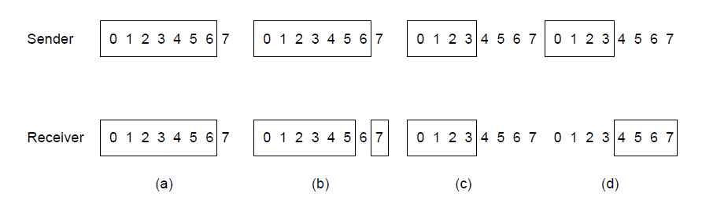
Selective Repeat (3)
For correctness, we require:
  Sequence numbers (s) at least twice the window (w)
Error case (s=8, w=7) – too few sequence numbers
Correct (s=8, w=4) – enough sequence numbers
Originals
Retransmits
Originals
Retransmits
New receive window overlaps old – retransmits ambiguous
New and old receive window don’t overlap – no ambiguity
CN5E by Tanenbaum & Wetherall, © Pearson Education-Prentice Hall and D. Wetherall, 2011

Slide 41
Example Data Link Protocols
  Packet over SONET »
  PPP (Point-to-Point Protocol) »
  ADSL (Asymmetric Digital Subscriber Loop) »
CN5E by Tanenbaum & Wetherall, © Pearson Education-Prentice Hall and D. Wetherall, 2011

Slide 42
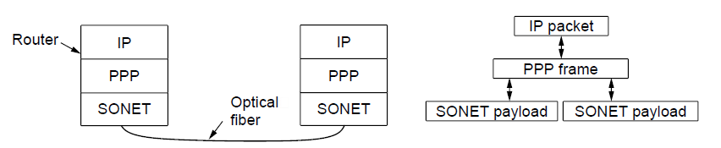
Packet over SONET
Packet over SONET is the method used to carry IP packets over SONET optical fiber links
  Uses PPP (Point-to-Point Protocol) for framing
Protocol stacks
PPP frames may be split over SONET payloads
CN5E by Tanenbaum & Wetherall, © Pearson Education-Prentice Hall and D. Wetherall, 2011

Slide 43
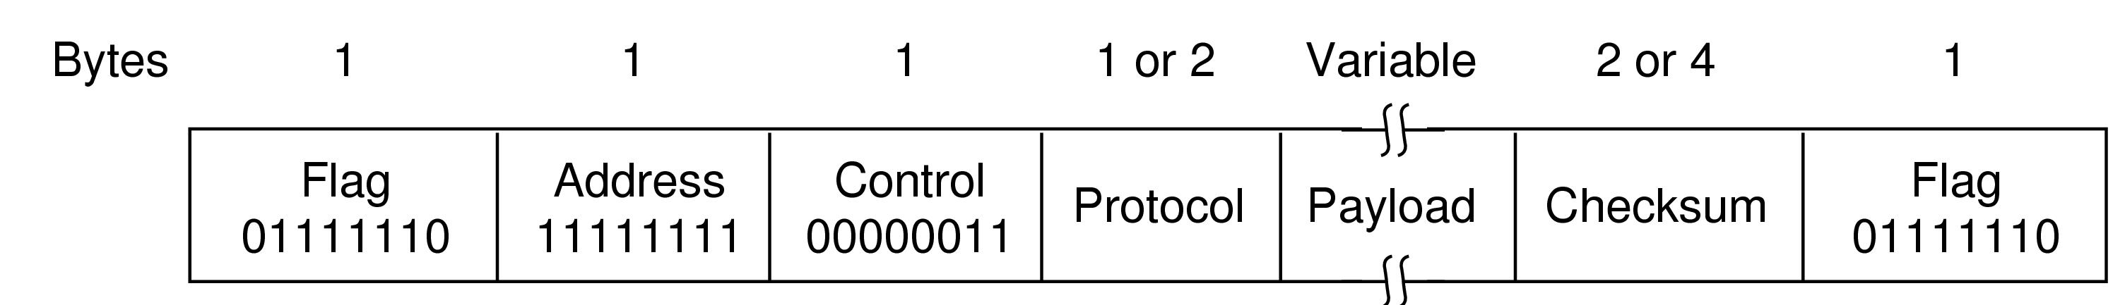
PPP (1)
PPP (Point-to-Point Protocol) is a general method for delivering packets across links
  Framing uses a flag (0x7E) and byte stuffing
  “Unnumbered mode” (connectionless unacknow-ledged service) is used to carry IP packets
  Errors are detected with a checksum
0x21 for IPv4
IP packet
CN5E by Tanenbaum & Wetherall, © Pearson Education-Prentice Hall and D. Wetherall, 2011

Slide 44
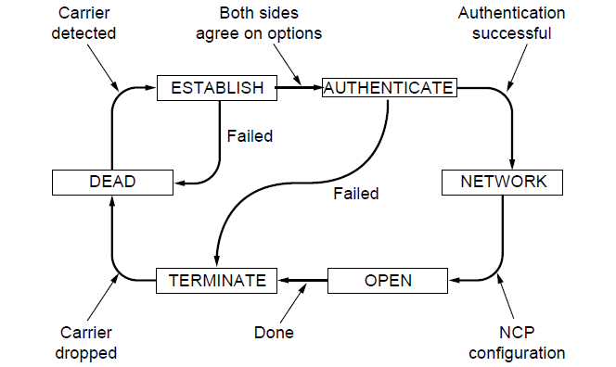
PPP (2)
A link control protocol brings the PPP link up/down
State machine for link control
CN5E by Tanenbaum & Wetherall, © Pearson Education-Prentice Hall and D. Wetherall, 2011

Slide 45
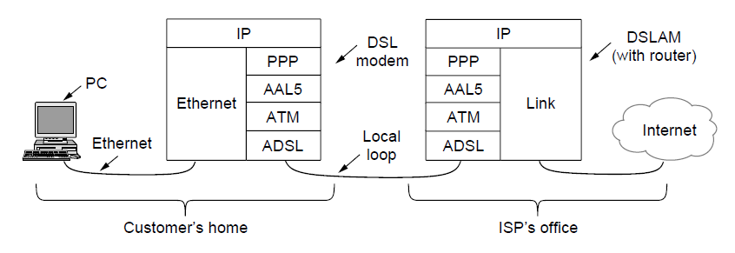
ADSL (1)
Widely used for broadband Internet over local loops
  ADSL runs from modem (customer) to DSLAM (ISP)
  IP packets are sent over PPP and AAL5/ATM (over)
CN5E by Tanenbaum & Wetherall, © Pearson Education-Prentice Hall and D. Wetherall, 2011

Slide 46
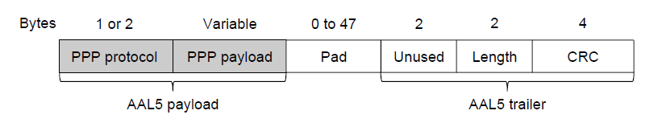
ADSL (2)
PPP data is sent in AAL5 frames over ATM cells:
  ATM is a link layer that uses short, fixed-size cells (53 bytes); each cell has a virtual circuit identifier
  AAL5 is a format to send packets over ATM
  PPP frame is converted to a AAL5 frame (PPPoA)
AAL5 frame is divided into 48 byte pieces, each of which goes into one ATM cell with 5 header bytes
CN5E by Tanenbaum & Wetherall, © Pearson Education-Prentice Hall and D. Wetherall, 2011
Notes:
Re ATM: ATM was a major technology in the 1990s that was hyped to win in the convergence of the Internet and telecommunications, but IP won instead. The short, fixed-size cells give flexibility (can mix voice and data without having the voice wait for a whole data packet). ATM is now used in niches such as ADSL and WAN links.

Slide 47
End
Chapter 3
CN5E by Tanenbaum & Wetherall, © Pearson Education-Prentice Hall and D. Wetherall, 2011

