Slide 1
Medium Access Control Sublayer
Chapter 4
  Channel Allocation Problem
  Multiple Access Protocols
  Ethernet
  Wireless LANs
  Broadband Wireless
  Bluetooth
  RFID
  Data Link Layer Switching
Revised: August 2011
CN5E by Tanenbaum & Wetherall, © Pearson Education-Prentice Hall and D. Wetherall, 2011
Notes:
Gray units can be optionally omitted without causing later gaps

Slide 2
The MAC Sublayer
Responsible for deciding who sends next on a multi-access link
  An important part of the link layer, especially for LANs
Application
Transport
Network
Link
Physical
MAC is in here!
CN5E by Tanenbaum & Wetherall, © Pearson Education-Prentice Hall and D. Wetherall, 2011

Slide 3
Channel Allocation Problem (1)
For fixed channel and traffic from N users
  Divide up bandwidth using FTM, TDM, CDMA, etc.
  This is a static allocation, e.g., FM radio
This static allocation performs poorly for bursty traffic
  Allocation to a user will sometimes go unused
CN5E by Tanenbaum & Wetherall, © Pearson Education-Prentice Hall and D. Wetherall, 2011

Slide 4
Channel Allocation Problem (2)
Dynamic allocation gives the channel to a user when they need it. Potentially N times as efficient for N users.
Schemes vary with assumptions:
Assumption | Implication
Independent traffic | Often not a good model, but permits analysis
Single channel | No external way to coordinate senders
Observable collisions | Needed for reliability; mechanisms vary
Continuous or slotted time | Slotting may improve performance
Carrier sense | Can improve performance if available
CN5E by Tanenbaum & Wetherall, © Pearson Education-Prentice Hall and D. Wetherall, 2011

Slide 5
Multiple Access Protocols
  ALOHA »
  CSMA (Carrier Sense Multiple Access) »
  Collision-free protocols »
  Limited-contention protocols »
  Wireless LAN protocols »
CN5E by Tanenbaum & Wetherall, © Pearson Education-Prentice Hall and D. Wetherall, 2011

Slide 6
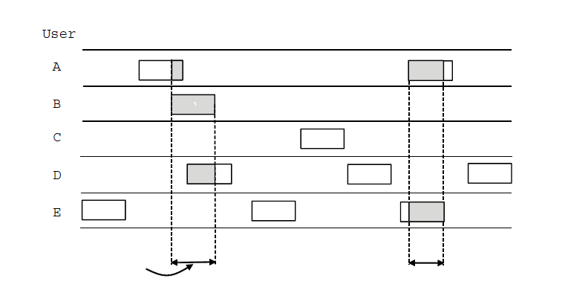
ALOHA (1)
In pure ALOHA, users transmit frames whenever they have data; users retry after a random time for collisions
  Efficient and low-delay under low load
`
User
A
B
C
D
E
Collision
Collision
Time
CN5E by Tanenbaum & Wetherall, © Pearson Education-Prentice Hall and D. Wetherall, 2011

Slide 7
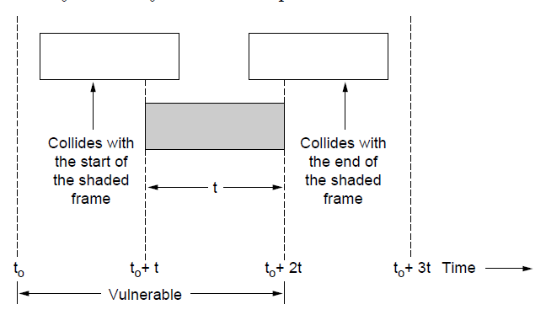
ALOHA (2)
Collisions happen when other users transmit during a vulnerable period that is twice the frame time
  Synchronizing senders to slots can reduce collisions
CN5E by Tanenbaum & Wetherall, © Pearson Education-Prentice Hall and D. Wetherall, 2011

Slide 8
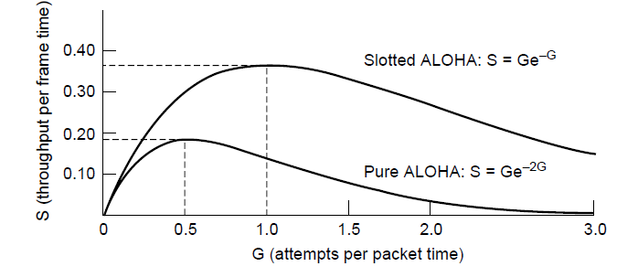
ALOHA (3)
Slotted ALOHA is twice as efficient as pure ALOHA
  Low load wastes slots, high loads causes collisions
  Efficiency up to 1/e (37%) for random traffic models
CN5E by Tanenbaum & Wetherall, © Pearson Education-Prentice Hall and D. Wetherall, 2011

Slide 9
CSMA (1)
CSMA improves on ALOHA by sensing the channel!
  User doesn’t send if it senses someone else
Variations on what to do if the channel is busy:
  1-persistent (greedy) sends as soon as idle
  Nonpersistent waits a random time then tries again
  p-persistent sends with probability p when idle
CN5E by Tanenbaum & Wetherall, © Pearson Education-Prentice Hall and D. Wetherall, 2011
Notes:
802.11 uses a refinement of p-persistent CSMA

Slide 10
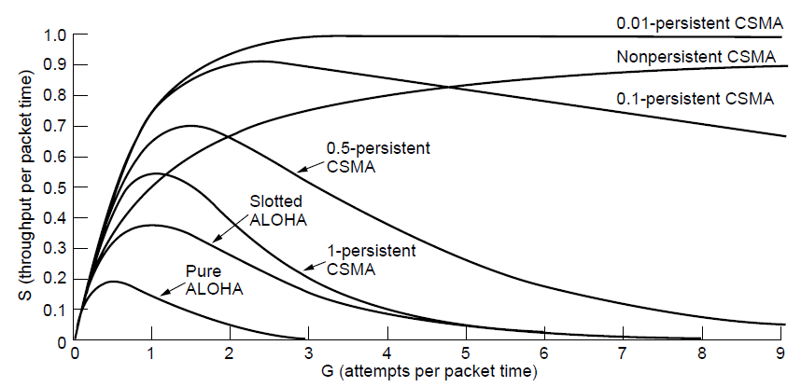
CSMA (2) – Persistence
CSMA outperforms ALOHA, and being less persistent is better under high load
CN5E by Tanenbaum & Wetherall, © Pearson Education-Prentice Hall and D. Wetherall, 2011

Slide 11
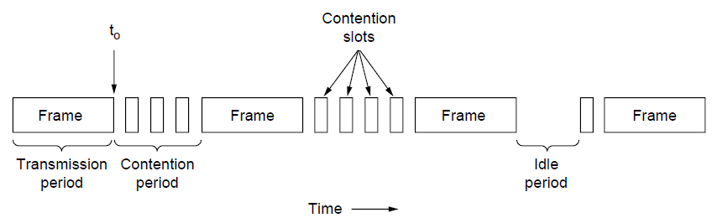
CSMA (3) – Collision Detection
CSMA/CD improvement is to detect/abort collisions
  Reduced contention times improve performance
Collision time is much shorter than frame time
CN5E by Tanenbaum & Wetherall, © Pearson Education-Prentice Hall and D. Wetherall, 2011

Slide 12
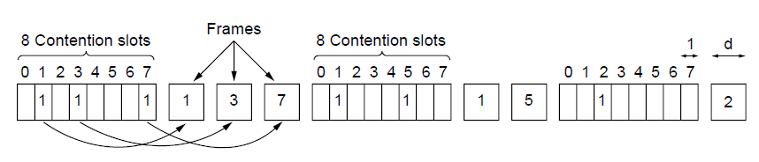
Collision-Free (1) – Bitmap
Collision-free protocols avoid collisions entirely
  Senders must know when it is their turn to send
The basic bit-map protocol:
  Sender set a bit in contention slot if they have data
  Senders send in turn; everyone knows who has data
CN5E by Tanenbaum & Wetherall, © Pearson Education-Prentice Hall and D. Wetherall, 2011

Slide 13
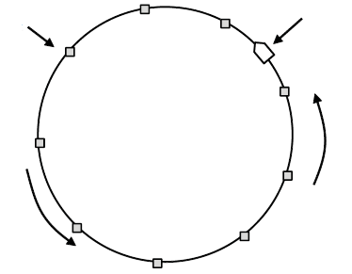
Collision-Free (2) – Token Ring
Token sent round ring defines the sending order
  Station with token may send a frame before passing
  Idea can be used without ring too, e.g., token bus
Token
Station
Direction of
transmission
CN5E by Tanenbaum & Wetherall, © Pearson Education-Prentice Hall and D. Wetherall, 2011

Slide 14
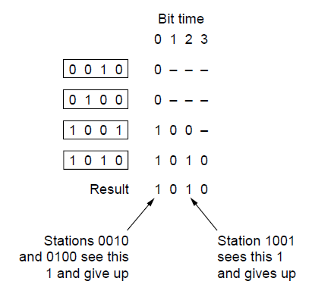
Collision-Free (3) – Countdown
Binary countdown improves on the bitmap protocol
  Stations send their address in contention slot (log N bits instead of N bits)
  Medium ORs bits; stations give up when they send a “0” but see a “1”
  Station that sees its full address is next to send
CN5E by Tanenbaum & Wetherall, © Pearson Education-Prentice Hall and D. Wetherall, 2011

Slide 15
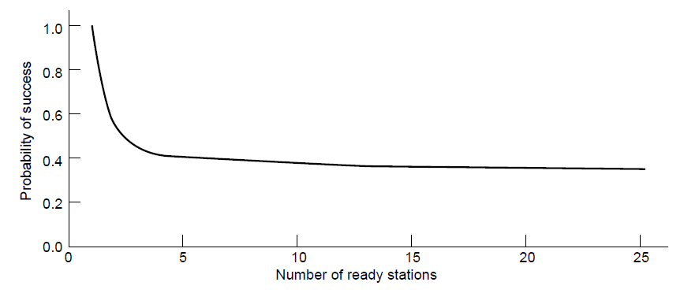
Limited-Contention Protocols (1)
Idea is to divide stations into groups within which only a very small number are likely to want to send
  Avoids wastage due to idle periods and collisions
Already too many contenders for a good chance of one winner
CN5E by Tanenbaum & Wetherall, © Pearson Education-Prentice Hall and D. Wetherall, 2011

Slide 16
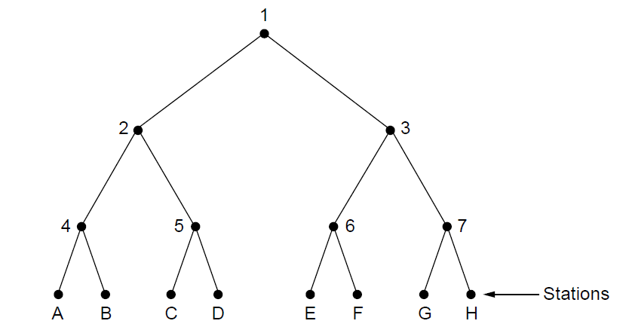
Limited Contention (2) –Adaptive Tree Walk
Tree divides stations into groups (nodes) to poll
  Depth first search under nodes with poll collisions
  Start search at lower levels if >1 station expected
Level 0
Level 1
Level 2
CN5E by Tanenbaum & Wetherall, © Pearson Education-Prentice Hall and D. Wetherall, 2011

Slide 17
Wireless LAN Protocols (1)
Wireless has complications compared to wired.
Nodes may have different coverage regions
  Leads to hidden and exposed terminals
Nodes can’t detect collisions, i.e., sense while sending
  Makes collisions expensive and to be avoided
CN5E by Tanenbaum & Wetherall, © Pearson Education-Prentice Hall and D. Wetherall, 2011

Slide 18
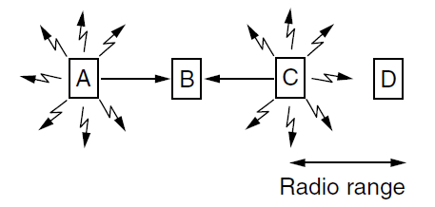
Wireless LANs (2) – Hidden terminals
Hidden terminals are senders that cannot sense each other but nonetheless collide at intended receiver
  Want to prevent; loss of efficiency
  A and C are hidden terminals when sending to B
CN5E by Tanenbaum & Wetherall, © Pearson Education-Prentice Hall and D. Wetherall, 2011

Slide 19
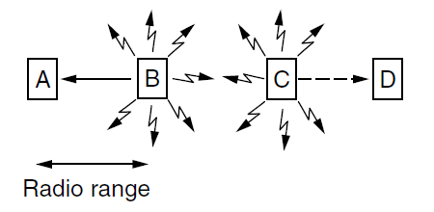
Wireless LANs (3) – Exposed terminals
Exposed terminals are senders who can sense each other but still transmit safely (to different receivers)
  Desirably concurrency; improves performance
  B → A and C → D are exposed terminals
CN5E by Tanenbaum & Wetherall, © Pearson Education-Prentice Hall and D. Wetherall, 2011

Slide 20
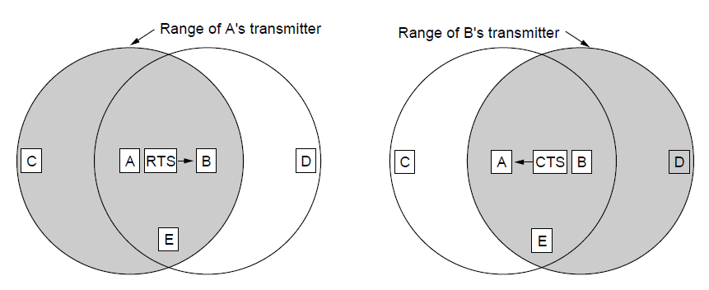
Wireless LANs (4) – MACA
MACA protocol grants access for A to send to B:
  A sends RTS to B [left]; B replies with CTS [right]
  A can send with exposed but no hidden terminals
  A sends RTS to B; C and E hear and defer for CTS
  B replies with CTS; D and E hear and defer for data
CN5E by Tanenbaum & Wetherall, © Pearson Education-Prentice Hall and D. Wetherall, 2011
Notes:
This protocol solves the issue of expensive collisions too, since the RTS/CTS are short packets – if there is a collision it will be brief, not as long as a data frame.

Slide 21
Ethernet
  Classic Ethernet »
  Switched/Fast Ethernet »
  Gigabit/10 Gigabit Ethernet »
CN5E by Tanenbaum & Wetherall, © Pearson Education-Prentice Hall and D. Wetherall, 2011

Slide 22
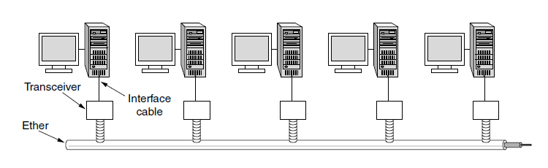
Classic Ethernet (1) – Physical Layer
One shared coaxial cable to which all hosts attached
  Up to 10 Mbps, with Manchester encoding
  Hosts ran the classic Ethernet protocol for access
CN5E by Tanenbaum & Wetherall, © Pearson Education-Prentice Hall and D. Wetherall, 2011

Slide 23
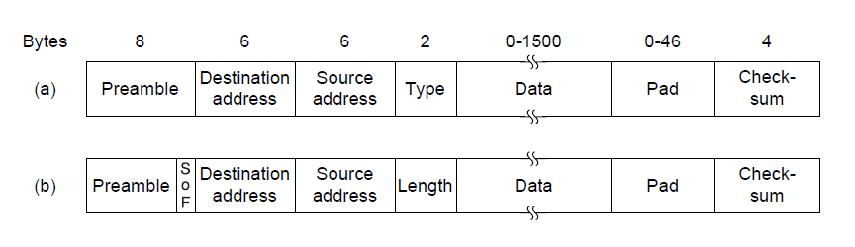
Classic Ethernet (2) – MAC
MAC protocol is 1-persistent CSMA/CD (earlier)
  Random delay (backoff) after collision is computed with BEB (Binary Exponential Backoff)
  Frame format is still used with modern Ethernet.
Ethernet
(DIX)
IEEE 802.3
CN5E by Tanenbaum & Wetherall, © Pearson Education-Prentice Hall and D. Wetherall, 2011

Slide 24
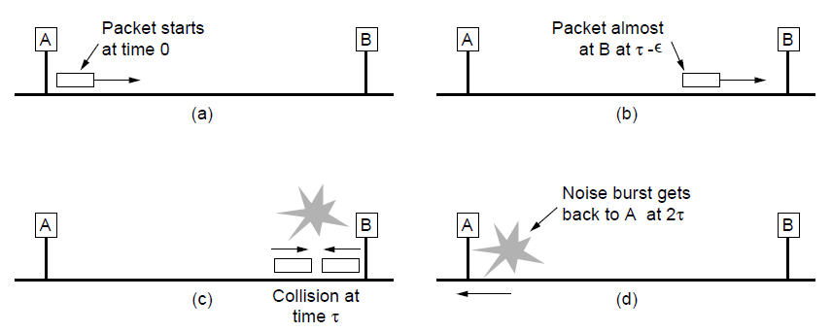
Classic Ethernet (3) – MAC
Collisions can occur and take as long as 2τ to detect
  τ is the time it takes to propagate over the Ethernet
  Leads to minimum packet size for reliable detection
CN5E by Tanenbaum & Wetherall, © Pearson Education-Prentice Hall and D. Wetherall, 2011

Slide 25
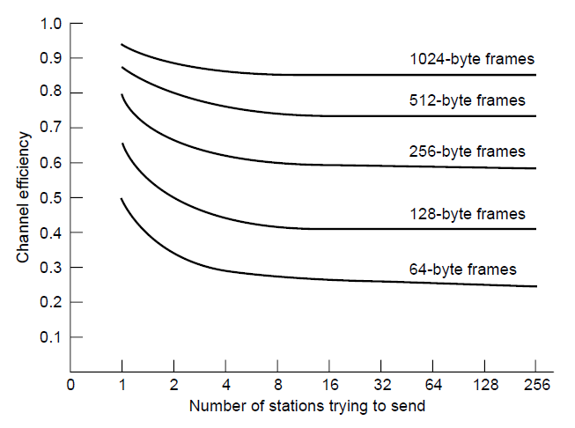
Classic Ethernet (4) – Performance
Efficient for large frames, even with many senders
  Degrades for small frames (and long LANs)
10 Mbps Ethernet,
64 byte min. frame
CN5E by Tanenbaum & Wetherall, © Pearson Education-Prentice Hall and D. Wetherall, 2011

Slide 26
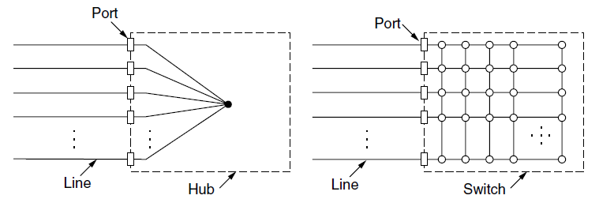
Switched/Fast Ethernet (1)
  Hubs wire all lines into a single CSMA/CD domain
  Switches isolate each port to a separate domain
    Much greater throughput for multiple ports
    No need for CSMA/CD with full-duplex lines
CN5E by Tanenbaum & Wetherall, © Pearson Education-Prentice Hall and D. Wetherall, 2011

Slide 27
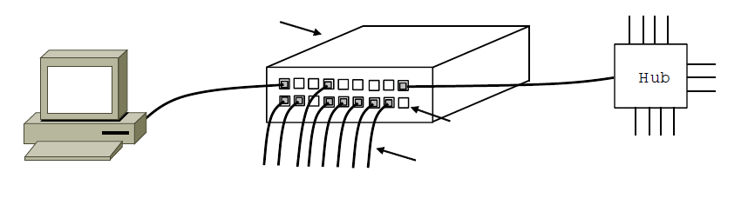
Switched/Fast Ethernet (2)
Switches can be wired to computers, hubs and switches
  Hubs concentrate traffic from computers
  More on how to switch frames the in 4.8
Switch
Hub
Switch ports
Twisted pair
CN5E by Tanenbaum & Wetherall, © Pearson Education-Prentice Hall and D. Wetherall, 2011

Slide 28
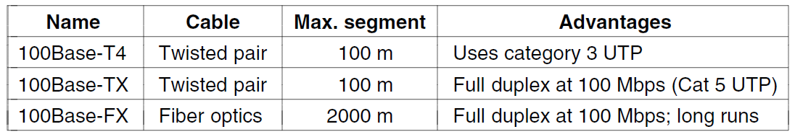
Switched/Fast Ethernet (3)
Fast Ethernet extended Ethernet from 10 to 100 Mbps
  Twisted pair (with Cat 5) dominated the market
CN5E by Tanenbaum & Wetherall, © Pearson Education-Prentice Hall and D. Wetherall, 2011

Slide 29
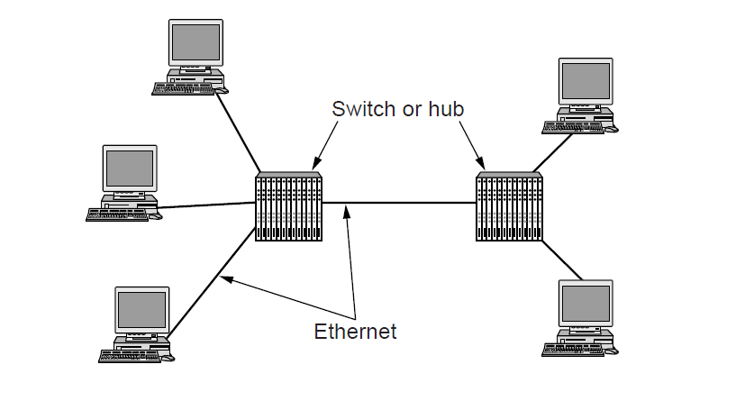
Gigabit / 10 Gigabit Ethernet (1)
Switched Gigabit Ethernet is now the garden variety
  With full-duplex lines between computers/switches
CN5E by Tanenbaum & Wetherall, © Pearson Education-Prentice Hall and D. Wetherall, 2011

Slide 30
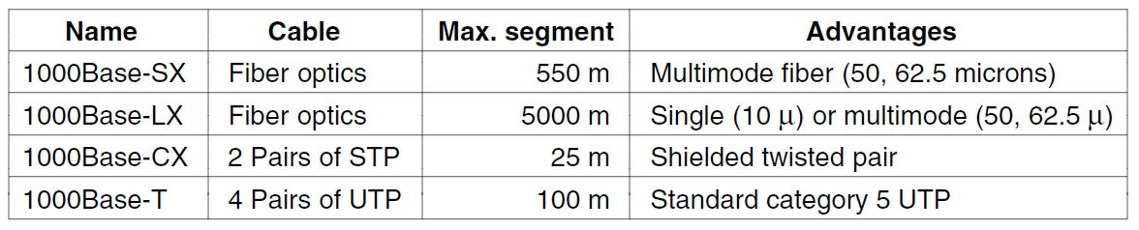
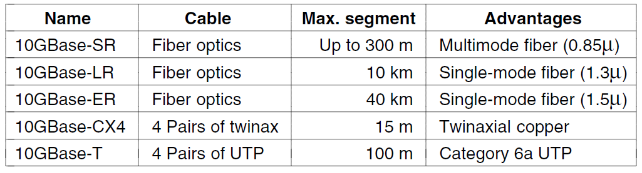
Gigabit / 10 Gigabit Ethernet (1)
  Gigabit Ethernet is commonly run over twisted pair
  10 Gigabit Ethernet is being deployed where needed
  40/100 Gigabit Ethernet is under development
CN5E by Tanenbaum & Wetherall, © Pearson Education-Prentice Hall and D. Wetherall, 2011

Slide 31
Wireless LANs
  802.11 architecture/protocol stack »
  802.11 physical layer »
  802.11 MAC »
  802.11 frames »
CN5E by Tanenbaum & Wetherall, © Pearson Education-Prentice Hall and D. Wetherall, 2011

Slide 32
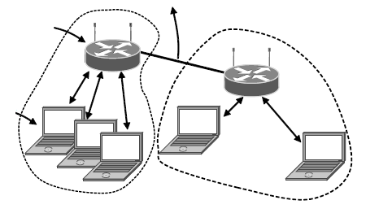
802.11 Architecture/Protocol Stack (1)
Wireless clients associate to a wired AP (Access Point)
  Called infrastructure mode; there is also ad-hoc mode with no AP, but that is rare.
To Network
Access
Point
Client
CN5E by Tanenbaum & Wetherall, © Pearson Education-Prentice Hall and D. Wetherall, 2011

Slide 33
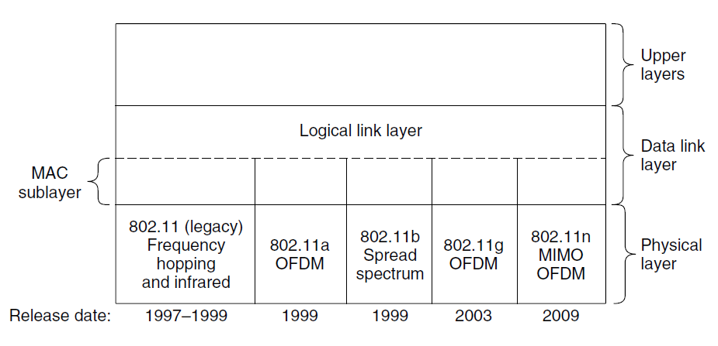
802.11 Architecture/Protocol Stack (2)
MAC is used across different physical layers
CN5E by Tanenbaum & Wetherall, © Pearson Education-Prentice Hall and D. Wetherall, 2011

Slide 34
802.11 physical layer
  NICs are compatible with multiple physical layers
    E.g., 802.11 a/b/g
Name | Technique | Max. Bit Rate
802.11b | Spread spectrum, 2.4 GHz | 11 Mbps
802.11g | OFDM, 2.4 GHz | 54 Mbps
802.11a | OFDM, 5 GHz | 54 Mbps
802.11n | OFDM with MIMO, 2.4/5 GHz | 600 Mbps
CN5E by Tanenbaum & Wetherall, © Pearson Education-Prentice Hall and D. Wetherall, 2011

Slide 35
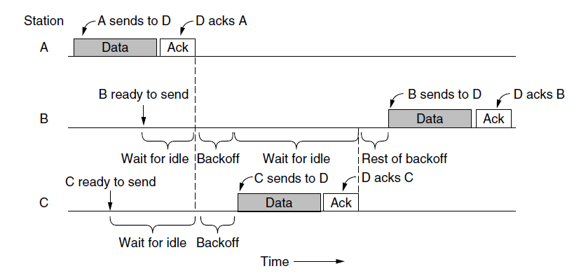
802.11 MAC (1)
  CSMA/CA inserts backoff slots to avoid collisions
  MAC uses ACKs/retransmissions for wireless errors
CN5E by Tanenbaum & Wetherall, © Pearson Education-Prentice Hall and D. Wetherall, 2011

Slide 36
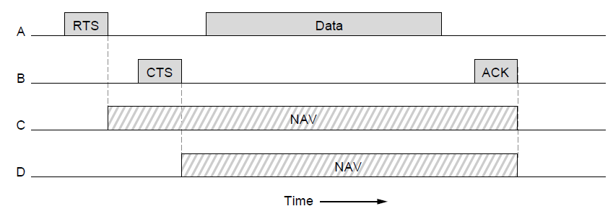
802.11 MAC (2)
Virtual channel sensing with the NAV and optional RTS/CTS (often not used) avoids hidden terminals
CN5E by Tanenbaum & Wetherall, © Pearson Education-Prentice Hall and D. Wetherall, 2011

Slide 37
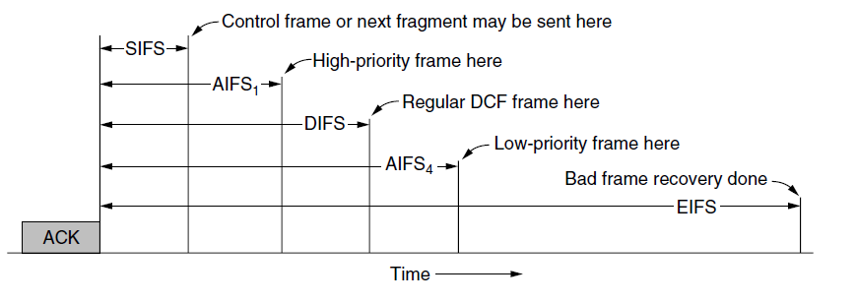
802.11 MAC (3)
  Different backoff slot times add quality of service
    Short intervals give preferred access, e.g., control, VoIP
  MAC has other mechanisms too, e.g., power save
CN5E by Tanenbaum & Wetherall, © Pearson Education-Prentice Hall and D. Wetherall, 2011

Slide 38
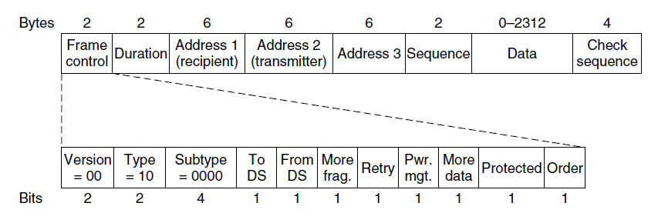
802.11 Frames
  Frames vary depending on their type (Frame control)
  Data frames have 3 addresses to pass via APs
CN5E by Tanenbaum & Wetherall, © Pearson Education-Prentice Hall and D. Wetherall, 2011

Slide 39
Broadband Wireless
  802.16 Architecture / Protocol Stack »
  802.16 Physical Layer »
  802.16 MAC »
  802.16 Frames »
CN5E by Tanenbaum & Wetherall, © Pearson Education-Prentice Hall and D. Wetherall, 2011

Slide 40
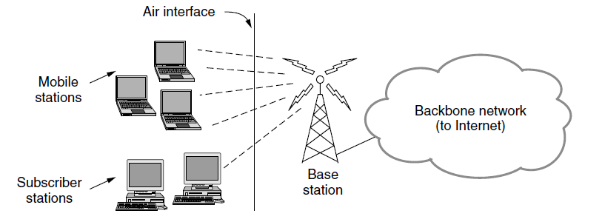
802.16 Architecture/Protocol Stack (1)
Wireless clients connect to a wired basestation (like 3G)
CN5E by Tanenbaum & Wetherall, © Pearson Education-Prentice Hall and D. Wetherall, 2011

Slide 41
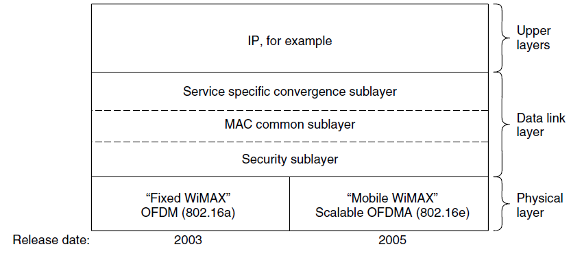
802.16 Architecture/Protocol Stack (2)
MAC is connection-oriented; IP is connectionless
  Convergence sublayer maps between the two
CN5E by Tanenbaum & Wetherall, © Pearson Education-Prentice Hall and D. Wetherall, 2011

Slide 42
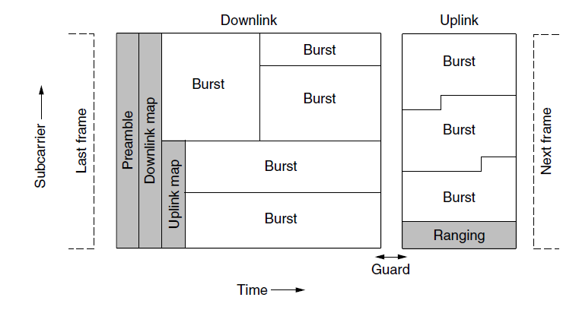
802.16 Physical Layer
Based on OFDM; base station gives mobiles bursts (subcarrier/time frame slots) for uplink and downlink
CN5E by Tanenbaum & Wetherall, © Pearson Education-Prentice Hall and D. Wetherall, 2011

Slide 43
802.16 MAC
Connection-oriented with base station in control
  Clients request the bandwidth they need
Different kinds of service can be requested:
  Constant bit rate, e.g., uncompressed voice
  Real-time variable bit rate, e.g., video, Web
  Non-real-time variable bit rate, e.g., file download
  Best-effort for everything else
CN5E by Tanenbaum & Wetherall, © Pearson Education-Prentice Hall and D. Wetherall, 2011

Slide 44
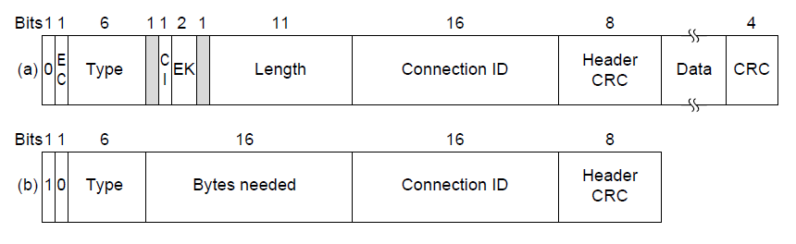
802.16 Frames
  Frames vary depending on their type
  Connection ID instead of source/dest addresses
(a)
(b)
(a) A generic frame. (b) A bandwidth request frame
CN5E by Tanenbaum & Wetherall, © Pearson Education-Prentice Hall and D. Wetherall, 2011

Slide 45
Bluetooth
  Bluetooth Architecture »
  Bluetooth Applications / Protocol »
  Bluetooth Radio / Link Layers »
  Bluetooth Frames »
CN5E by Tanenbaum & Wetherall, © Pearson Education-Prentice Hall and D. Wetherall, 2011

Slide 46
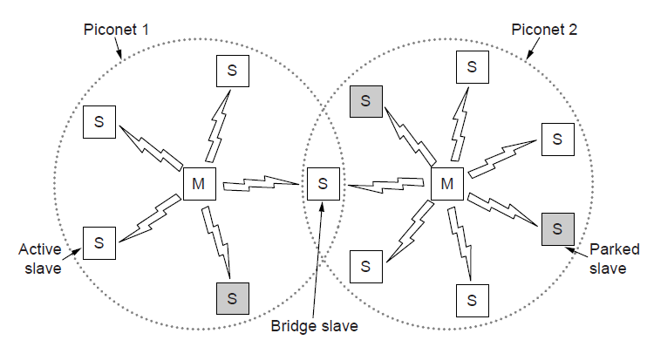
Bluetooth Architecture
Piconet master is connected to slave wireless devices
  Slaves may be asleep (parked) to save power
  Two piconets can be bridged into a scatternet
CN5E by Tanenbaum & Wetherall, © Pearson Education-Prentice Hall and D. Wetherall, 2011

Slide 47
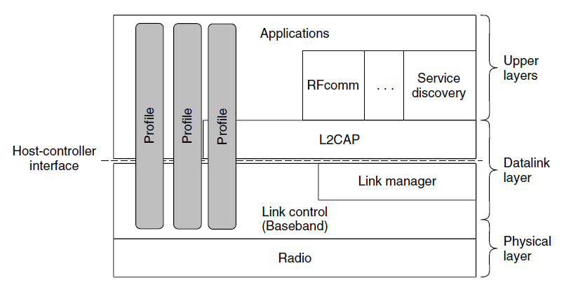
Bluetooth Applications / Protocol Stack
Profiles give the set of protocols for a given application
  25 profiles, including headset, intercom, streaming audio, remote control, personal area network, …
CN5E by Tanenbaum & Wetherall, © Pearson Education-Prentice Hall and D. Wetherall, 2011

Slide 48
Bluetooth Radio / Link Layers
Radio layer
  Uses adaptive frequency hopping in 2.4 GHz band
Link layer
  TDM with timeslots for master and slaves
  Synchronous CO for periodic slots in each direction
  Asynchronous CL for packet-switched data
  Links undergo pairing (user confirms passkey/PIN) to authorize them before use
CN5E by Tanenbaum & Wetherall, © Pearson Education-Prentice Hall and D. Wetherall, 2011

Slide 49
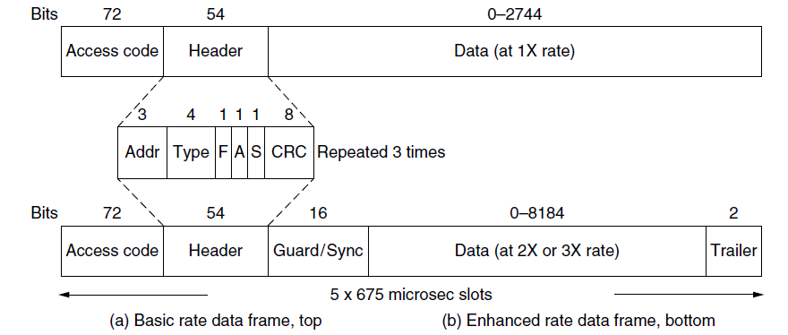
Bluetooth Frames
Time is slotted; enhanced data rates send faster but for the same time; addresses are only 3 bits for 8 devices
(a)
(b)
(a)
(b)
CN5E by Tanenbaum & Wetherall, © Pearson Education-Prentice Hall and D. Wetherall, 2011

Slide 50
RFID
  Gen 2 Architecture »
  Gen 2 Physical Layer »
  Gen 2 Tag Identification Layer »
  Gen 2 Frames »
CN5E by Tanenbaum & Wetherall, © Pearson Education-Prentice Hall and D. Wetherall, 2011

Slide 51
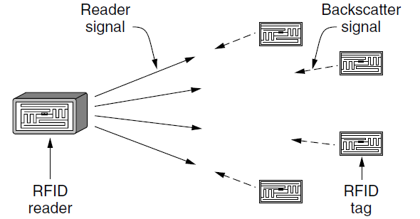
Gen 2 Architecture
Reader signal powers tags; tags reply with backscatter
CN5E by Tanenbaum & Wetherall, © Pearson Education-Prentice Hall and D. Wetherall, 2011

Slide 52
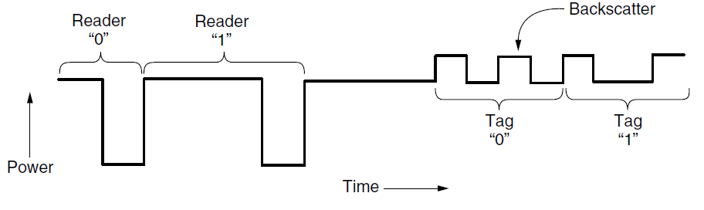
Gen 2 Physical Layer
  Reader uses duration of on period to send 0/1
  Tag backscatters reader signal in pulses to send 0/1
CN5E by Tanenbaum & Wetherall, © Pearson Education-Prentice Hall and D. Wetherall, 2011

Slide 53
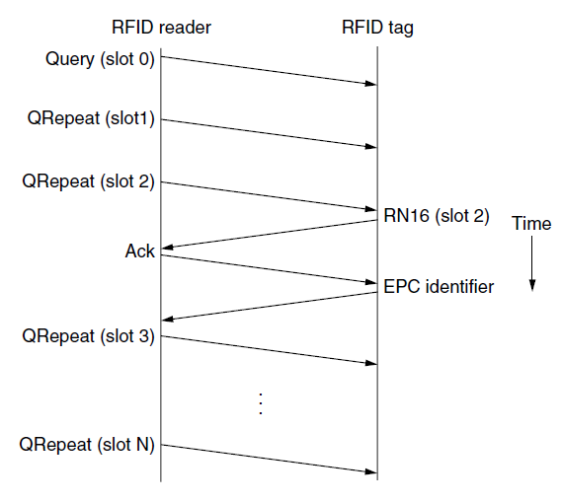
Gen 2 Tag Identification Layer
Reader sends query and sets slot structure
Tags reply (RN16) in a random slot; may collide
Reader asks one tag for its identifier (ACK)
Process continues until no tags are left
CN5E by Tanenbaum & Wetherall, © Pearson Education-Prentice Hall and D. Wetherall, 2011

Slide 54
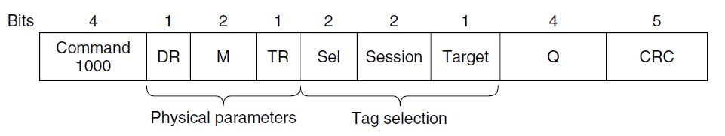
Gen 2 Frames
  Reader frames vary depending on type (Command)
    Query shown below, has parameters and error detection
  Tag responses are simply data
    Reader sets timing and knows the expected format
Query message
CN5E by Tanenbaum & Wetherall, © Pearson Education-Prentice Hall and D. Wetherall, 2011

Slide 55
Data Link Layer Switching
  Uses of Bridges »
  Learning Bridges »
  Spanning Tree »
  Repeaters, hubs, bridges, .., routers, gateways »
  Virtual LANs »
CN5E by Tanenbaum & Wetherall, © Pearson Education-Prentice Hall and D. Wetherall, 2011

Slide 56
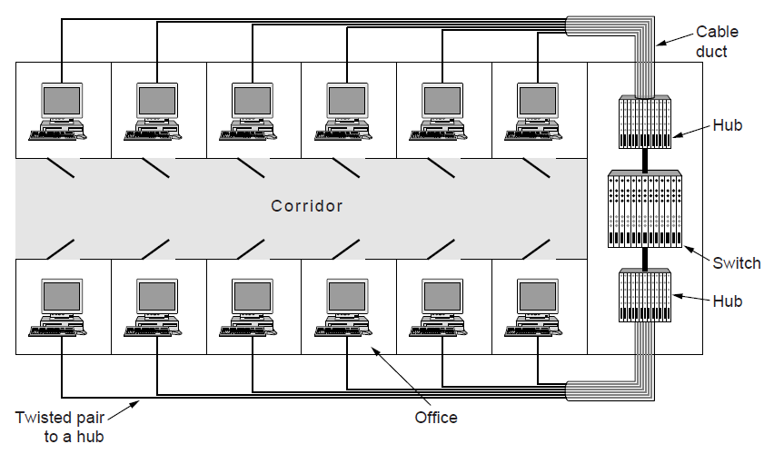
Uses of Bridges
Common setup is a building with centralized wiring
  Bridges (switches) are placed in or near wiring closets
CN5E by Tanenbaum & Wetherall, © Pearson Education-Prentice Hall and D. Wetherall, 2011

Slide 57
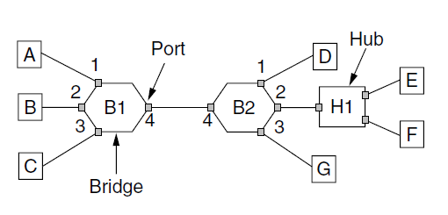
Learning Bridges (1)
A bridge operates as a switched LAN (not a hub)
  Computers, bridges, and hubs connect to its ports
CN5E by Tanenbaum & Wetherall, © Pearson Education-Prentice Hall and D. Wetherall, 2011

Slide 58
Learning Bridges (2)
Backward learning algorithm picks the output port:
  Associates source address on frame with input port
  Frame with destination address sent to learned port
  Unlearned destinations are sent to all other ports
Needs no configuration
  Forget unused addresses to allow changes
  Bandwidth efficient for two-way traffic
CN5E by Tanenbaum & Wetherall, © Pearson Education-Prentice Hall and D. Wetherall, 2011

Slide 59
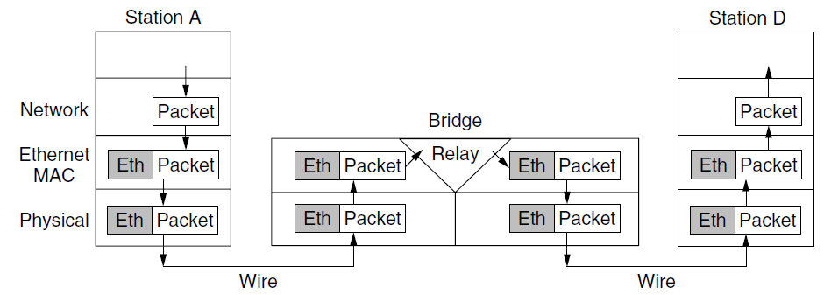
Learning Bridges (3)
Bridges extend the Link layer:
  Use but don’t remove Ethernet header/addresses
  Do not inspect Network header
CN5E by Tanenbaum & Wetherall, © Pearson Education-Prentice Hall and D. Wetherall, 2011

Slide 60
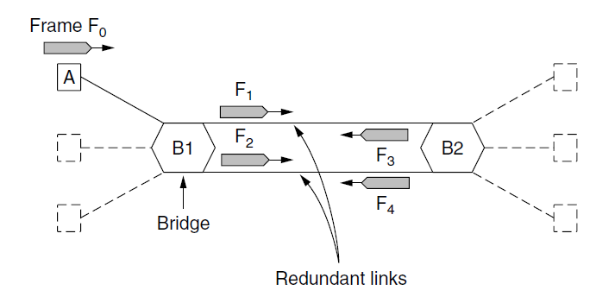
Spanning Tree (1) – Problem
Bridge topologies with loops and only backward learning will cause frames to circulate for ever
  Need spanning tree support to solve problem
CN5E by Tanenbaum & Wetherall, © Pearson Education-Prentice Hall and D. Wetherall, 2011

Slide 61
Spanning Tree (2) – Algorithm
  Subset of forwarding ports for data is use to avoid loops
  Selected with the spanning tree distributed algorithm by Perlman
I think that I shall never see
A graph more lovely than a tree.
A tree whose crucial property
Is loop-free connectivity.
A tree which must be sure to span.
So packets can reach every LAN.
First the Root must be selected
By ID it is elected.
Least cost paths from Root are traced
In the tree these paths are placed.
A mesh is made by folks like me
Then bridges find a spanning tree.
– Radia Perlman, 1985.
CN5E by Tanenbaum & Wetherall, © Pearson Education-Prentice Hall and D. Wetherall, 2011

Slide 62
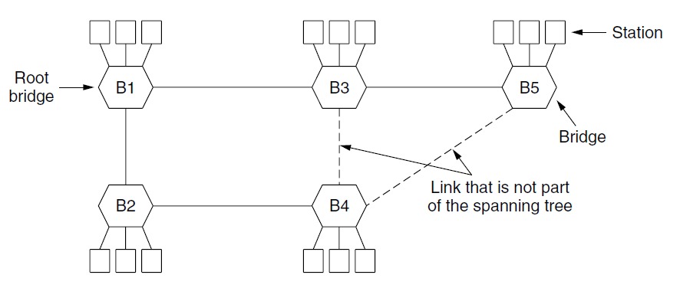
Spanning Tree (3) – Example
After the algorithm runs:
    B1 is the root, two dashed links are turned off
    B4 uses link to B2 (lower than B3 also at distance 1)
    B5 uses B3 (distance 1 versus B4 at distance 2)
CN5E by Tanenbaum & Wetherall, © Pearson Education-Prentice Hall and D. Wetherall, 2011

Slide 63
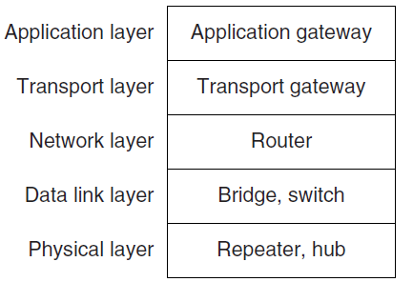
Repeaters, Hubs, Bridges, Switches, Routers, & Gateways
Devices are named according to the layer they process
  A bridge or LAN switch operates in the Link layer
CN5E by Tanenbaum & Wetherall, © Pearson Education-Prentice Hall and D. Wetherall, 2011

Slide 64
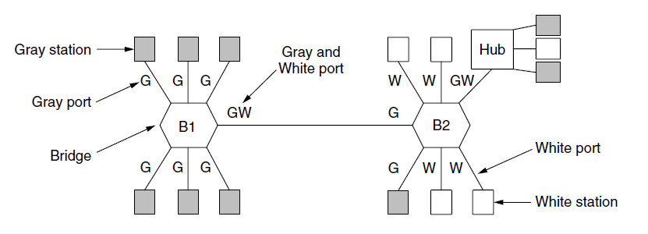
Virtual LANs (1)
VLANs (Virtual LANs) splits one physical LAN into multiple logical LANs to ease management tasks
  Ports are “colored” according to their VLAN
CN5E by Tanenbaum & Wetherall, © Pearson Education-Prentice Hall and D. Wetherall, 2011

Slide 65
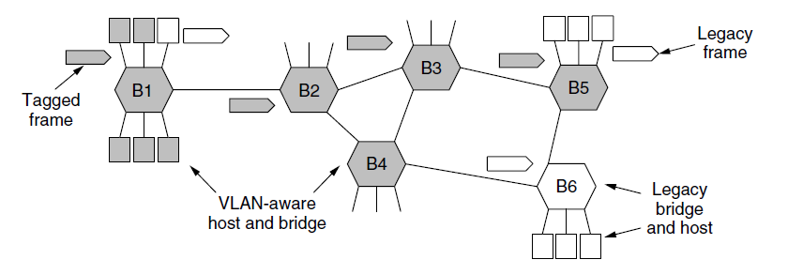
Virtual LANs (2) – IEEE 802.1Q
Bridges need to be aware of VLANs to support them
  In 802.1Q, frames are tagged with their “color”
  Legacy switches with no tags are supported
CN5E by Tanenbaum & Wetherall, © Pearson Education-Prentice Hall and D. Wetherall, 2011

Slide 66
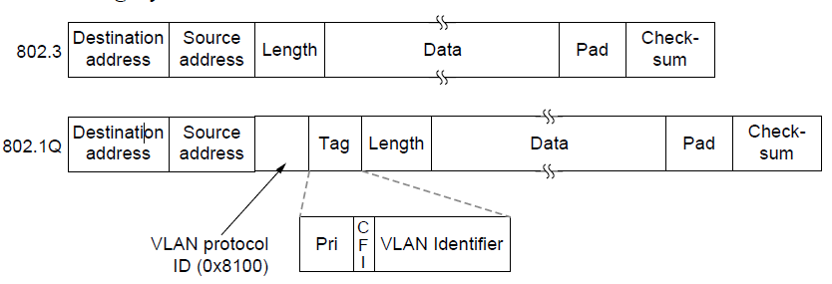
Virtual LANs (3) – IEEE 802.1Q
802.1Q frames carry a color tag (VLAN identifier)
  Length/Type value is 0x8100 for VLAN protocol
CN5E by Tanenbaum & Wetherall, © Pearson Education-Prentice Hall and D. Wetherall, 2011

Slide 67
End
Chapter 4
CN5E by Tanenbaum & Wetherall, © Pearson Education-Prentice Hall and D. Wetherall, 2011

