Slide 1
Network Layer
Chapter 5
  Design Issues
  Routing Algorithms
  Congestion Control
  Quality of Service
  Internetworking
  Network Layer of the Internet
Revised: August 2011
CN5E by Tanenbaum & Wetherall, © Pearson Education-Prentice Hall and D. Wetherall, 2011
Notes:
Gray units can be optionally omitted without causing later gaps

Slide 2
The Network Layer
Responsible for delivering packets between endpoints over multiple links
Application
Transport
Network
Link
Physical
CN5E by Tanenbaum & Wetherall, © Pearson Education-Prentice Hall and D. Wetherall, 2011

Slide 3
Design Issues
  Store-and-forward packet switching »
  Connectionless service – datagrams »
  Connection-oriented service – virtual circuits »
  Comparison of virtual-circuits and datagrams »
CN5E by Tanenbaum & Wetherall, © Pearson Education-Prentice Hall and D. Wetherall, 2011

Slide 4
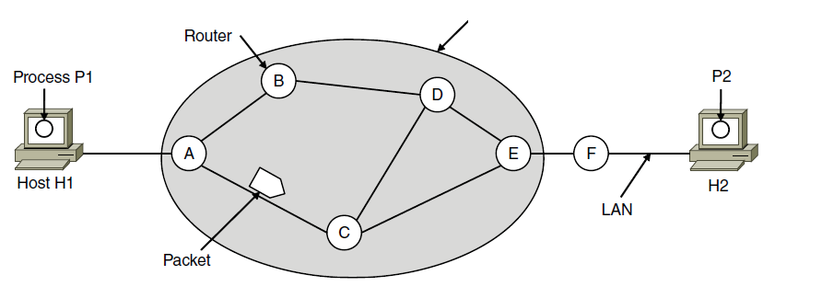
Store-and-Forward Packet Switching
Hosts send packets into the network; packets are forwarded by routers
ISP’s equipment
CN5E by Tanenbaum & Wetherall, © Pearson Education-Prentice Hall and D. Wetherall, 2011
Notes:
Routers treat packets as messages, receiving (storing) them and then forwarding them based on how the message is addressed.
For completeness, it is a process running on the host that sends the packet into the network and receives packets at the destination.

Slide 5
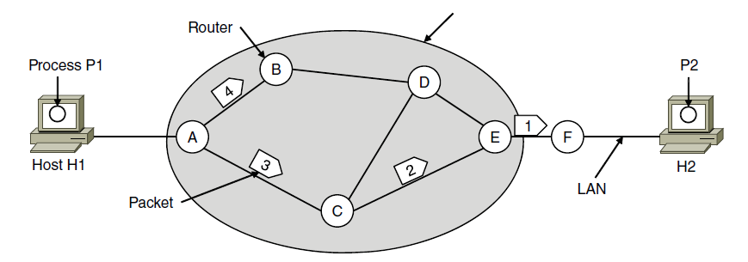
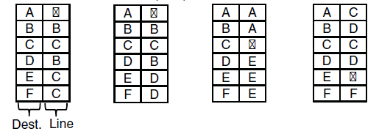

Connectionless Service – Datagrams
Packet is forwarded using destination address inside it
  Different packets may take different paths
ISP’s equipment
A’s table (initially) A’s table (later) C’s Table E’s Table
CN5E by Tanenbaum & Wetherall, © Pearson Education-Prentice Hall and D. Wetherall, 2011
Notes:
This model is like the postal service – each letter is sent through the network independently.
Datagram is a packet that contains an absolute destination address; routers need only look up the destination address in a table to find the outgoing line to send the packet on its way.

Slide 6
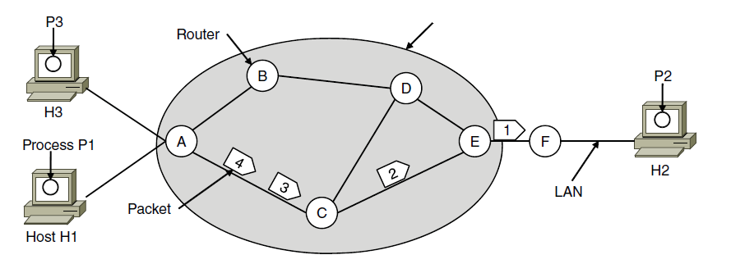



Connection-Oriented – Virtual Circuits
Packet is forwarded along a virtual circuit using tag inside it
  Virtual circuit (VC) is set up ahead of time
ISP’s equipment
A’s table C’s Table E’s Table
CN5E by Tanenbaum & Wetherall, © Pearson Education-Prentice Hall and D. Wetherall, 2011
Notes:
This model is like the telephone network.
Packets contain tags that are not full addresses; they only need to be unique at a given link and thus are re-written at each router from an incoming tag to an outgoing tag. The virtual circuit is set up with the tag mapping along the entire path. Then packets are sent along it. The packets will thus all follow the same path (and arrive in order).
“Virtual” refers to the fact that real/physical telephone circuits have both a path and a fixed bandwidth reservation of 64Kbps, whereas virtual circuits may have a variable bandwidth depending on how many VCs use a single link.

Slide 7
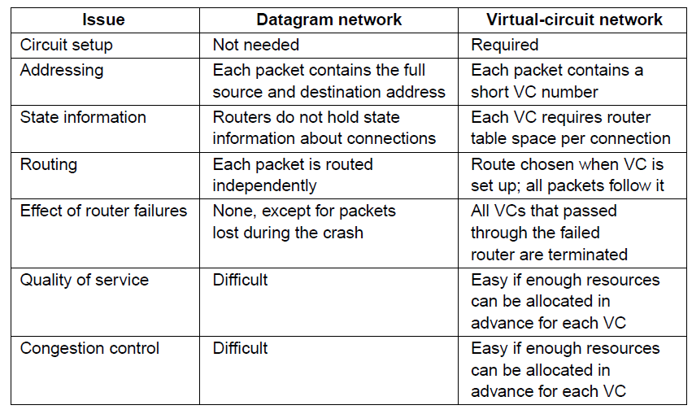
Comparison of Virtual-Circuits & Datagrams
CN5E by Tanenbaum & Wetherall, © Pearson Education-Prentice Hall and D. Wetherall, 2011

Slide 8
Routing Algorithms (1)
  Optimality principle »
  Shortest path algorithm »
  Flooding »
  Distance vector routing »
  Link state routing »
  Hierarchical routing »
  Broadcast routing »
  Multicast routing »
  Anycast routing »
  Routing for mobile hosts »
  Routing in ad hoc networks »
CN5E by Tanenbaum & Wetherall, © Pearson Education-Prentice Hall and D. Wetherall, 2011
Notes:
Grayed out topics are optional and can be omitted without loss of continuity

Slide 9
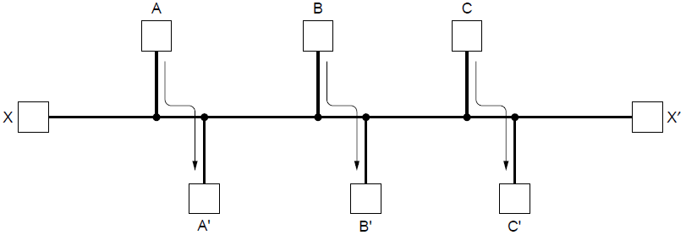
Routing Algorithms (2)
Routing is the process of discovering network paths
  Model the network as a graph of nodes and links
  Decide what to optimize (e.g., fairness vs efficiency)
  Update routes for changes in topology (e.g., failures)
Forwarding is the sending of packets along a path
CN5E by Tanenbaum & Wetherall, © Pearson Education-Prentice Hall and D. Wetherall, 2011
Notes:
Distinguish routing from forwarding.
We focus on adaptive routing schemes that update routes in response to failures. Some traffic-aware schemes also adapt to changes in traffic, but we do not consider them in the algorithms that follow.
For the graph, the traffic demands are A->A’, B->B’, C->C’ and X->X’. What would be fair? For each flow the get the same amount of bandwidth. If all network links have unit capacity then we would give each flow ½ a unit of capacity. The total network traffic is then 2 units. What would be efficient? If we gave the X->X’ flow no bandwidth then we could give each of the other three flows 1 unit. The total network traffic is then 3 units. So it is more efficient, but it is not fair. So we will have to decide what we want to optimize.

Slide 10
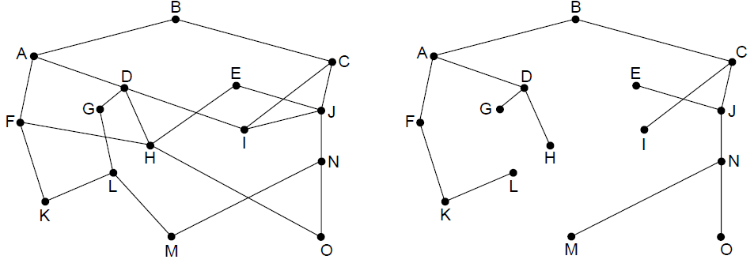
The Optimality Principle
Each portion of a best path is also a best path; the union of them to a router is a tree called the sink tree
  Best means fewest hops in the example
B
Network
Sink tree of best paths to router B
CN5E by Tanenbaum & Wetherall, © Pearson Education-Prentice Hall and D. Wetherall, 2011
Notes:
Proof by contradiction: if a portion of a best path is not a best path then there is something better. Substitute this better portion and you would have a better overall path, which cannot be the case if the overall path is a best path.
For sink trees, if there are multiple paths that are equally good, then one best path from one node to another is chosen at random. For example, H can be reached in 3 hops via H-D-A-B as shown, or by H-F-A-D (not shown). This is simple and useful as there is a single route from each router to each destination. If, instead, all equally best paths are kept then their union is a DAG (directed acyclic graph). This is a more general case that permits multiple paths from a router to a destination.

Slide 11
Shortest Path Algorithm (1)
Dijkstra’s algorithm computes a sink tree on the graph:
  Each link is assigned a non-negative weight/distance
  Shortest path is the one with lowest total weight
  Using weights of 1 gives paths with fewest hops
Algorithm:
  Start with sink, set distance at other nodes to infinity
  Relax distance to other nodes
  Pick the lowest distance node, add it to sink tree
  Repeat until all nodes are in the sink tree
CN5E by Tanenbaum & Wetherall, © Pearson Education-Prentice Hall and D. Wetherall, 2011
Notes:
The notion of weight generalizes distance to other cost metrics. Setting weights to be 1 gives paths with fewest hops. Setting weight to be distance gives paths that are shortest or lowest delay. Setting weight to be lower for higher capacity links favors higher capacity paths.

Slide 12
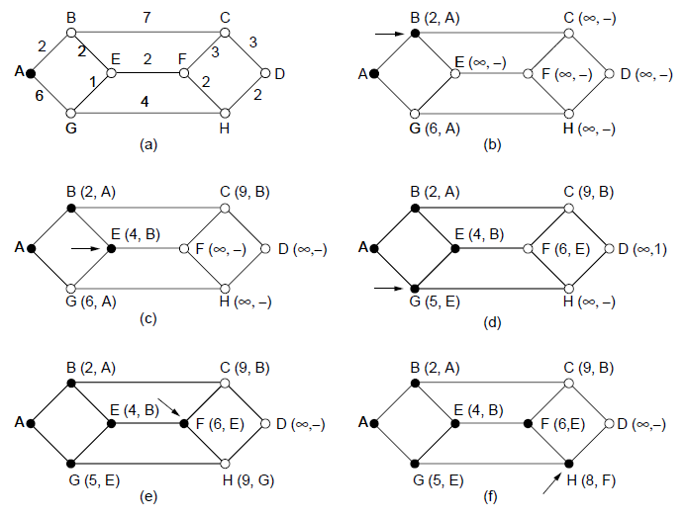
Shortest Path Algorithm (2)
A network and first five steps in computing the shortest paths from A to D. Pink arrows show the sink tree so far.
CN5E by Tanenbaum & Wetherall, © Pearson Education-Prentice Hall and D. Wetherall, 2011

Slide 13
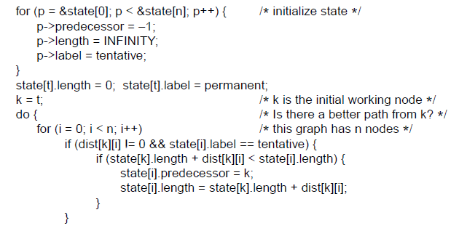
Shortest Path Algorithm (3)
. . .
Start with the sink, all other nodes are unreachable
Relaxation step. Lower distance to nodes linked to newest member of the sink tree
. . .
CN5E by Tanenbaum & Wetherall, © Pearson Education-Prentice Hall and D. Wetherall, 2011

Slide 14
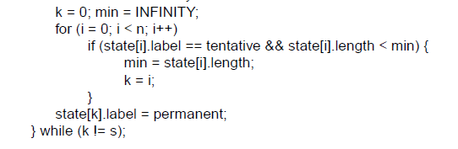
Shortest Path Algorithm (4)
. . .
Find the lowest distance, add it to the sink tree, and repeat until done
CN5E by Tanenbaum & Wetherall, © Pearson Education-Prentice Hall and D. Wetherall, 2011
Notes:
This code keeps going until it reaches a sought-after destination node; if it continued until there were no tentative nodes then it would have found the entire sink tree.
The predecessor links can be reversed to find the path from t -> s instead of from s -> t. This is because the link has the same cost in each direction so paths are symmetrical (or the same in each direction).

Slide 15
Flooding
A simple method to send a packet to all network nodes
Each node floods a new packet received on an incoming link by sending it out all of the other links
Nodes need to keep track of flooded packets to stop the flood; even using a hop limit can blow up exponentially
CN5E by Tanenbaum & Wetherall, © Pearson Education-Prentice Hall and D. Wetherall, 2011
Notes:
Note that flooding doesn’t actually find any routes that can be reused.

Slide 16
Distance Vector Routing (1)
Distance vector is a distributed routing algorithm
  Shortest path computation is split across nodes
Algorithm:
  Each node knows distance of links to its neighbors
  Each node advertises vector of lowest known distances to all neighbors
  Each node uses received vectors to update its own
  Repeat periodically
CN5E by Tanenbaum & Wetherall, © Pearson Education-Prentice Hall and D. Wetherall, 2011
Notes:
How long will it take to converge? The diameter of the network.

Slide 17
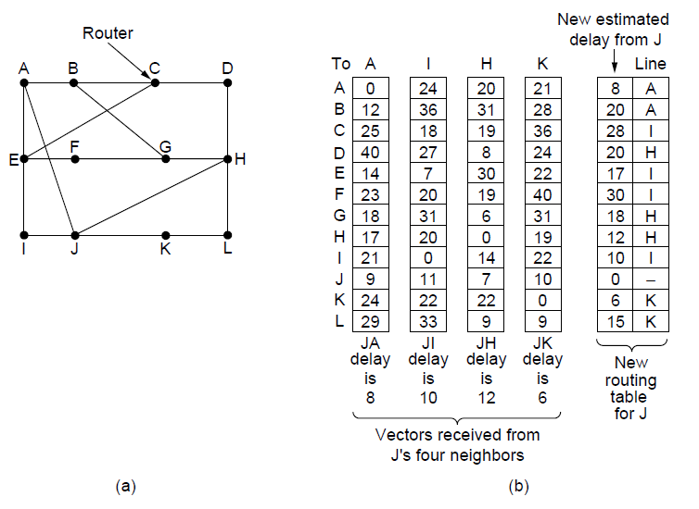
Distance Vector Routing (2)
Network
New vector for J
Vectors received at J from
Neighbors A, I, H and K
CN5E by Tanenbaum & Wetherall, © Pearson Education-Prentice Hall and D. Wetherall, 2011

Slide 18
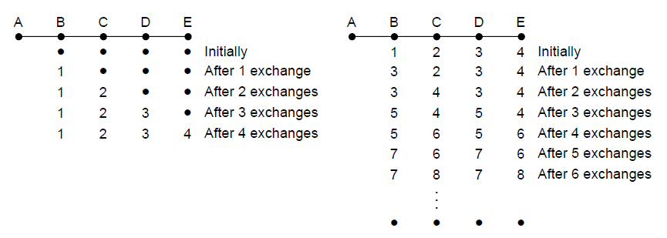
The Count-to-Infinity Problem
Failures can cause DV to “count to infinity” while seeking a path to an unreachable node
X
Good news of a path to A spreads quickly
Bad news of no path to A is learned slowly
CN5E by Tanenbaum & Wetherall, © Pearson Education-Prentice Hall and D. Wetherall, 2011

Slide 19
Link State Routing (1)
Link state is an alternative to distance vector
  More computation but simpler dynamics
  Widely used in the Internet (OSPF, ISIS)
Algorithm:
  Each node floods information about its neighbors in LSPs (Link State Packets); all nodes learn the full network graph
  Each node runs Dijkstra’s algorithm to compute the path to take for each destination
CN5E by Tanenbaum & Wetherall, © Pearson Education-Prentice Hall and D. Wetherall, 2011

Slide 20
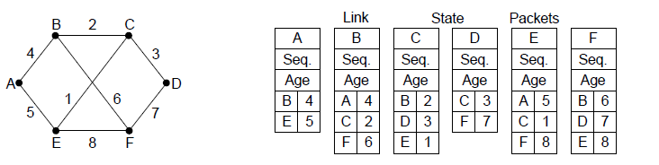
Link State Routing (2) – LSPs
LSP (Link State Packet) for a node lists neighbors and weights of links to reach them
Network
LSP for each node
CN5E by Tanenbaum & Wetherall, © Pearson Education-Prentice Hall and D. Wetherall, 2011

Slide 21
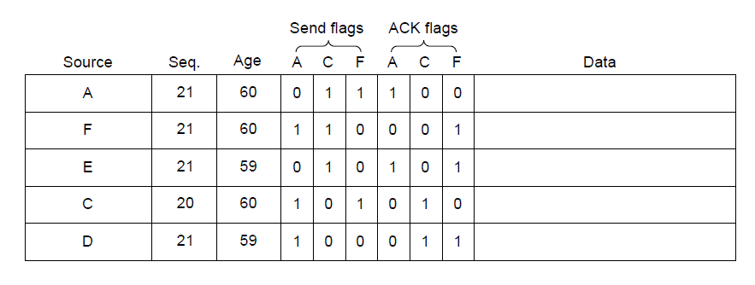
Link State Routing (3) – Reliable Flooding
Seq. number and age are used for reliable flooding
  New LSPs are acknowledged on the lines they are received and sent on all other lines
  Example shows the LSP database at router B
CN5E by Tanenbaum & Wetherall, © Pearson Education-Prentice Hall and D. Wetherall, 2011
Notes:
In the example, B has links to A, C and F in the network. It received LSPs from A, C, and F directly and so acknowledged A, C, and F respectively and sent that LSP on both other links. But B received E and D on two links, so it acknowledged both and sent only on the third link.

Slide 22
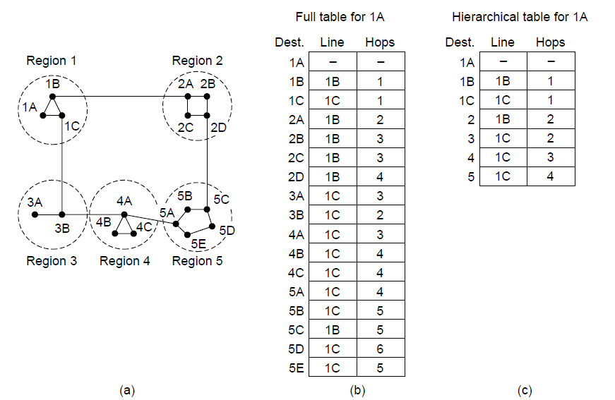
Hierarchical Routing
Hierarchical routing reduces the work of route computation but may result in slightly longer paths than flat routing
Best choice to reach nodes in 5 except for 5C
CN5E by Tanenbaum & Wetherall, © Pearson Education-Prentice Hall and D. Wetherall, 2011
Notes:
Hierarchical routing is what you think it is, e.g., to reach a given telephone first head towards the right country, then the right city in the country, then the phone in the city.
Each node keeps only one entry per region for other regions, plus an entry for all nodes in the local region.
The advantages are smaller routing tables, smaller routing computations to run at nodes, and fewer/smaller messages to send to describe the network.

Slide 23
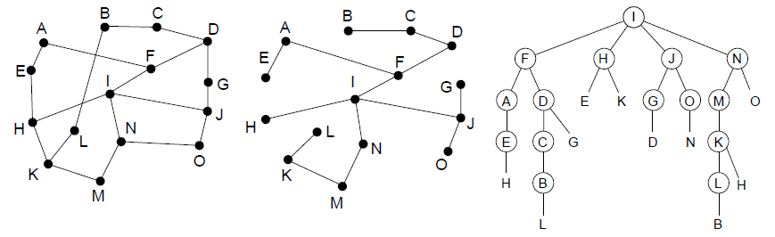
Broadcast Routing
Broadcast sends a packet to all nodes
  RPF (Reverse Path Forwarding): send broadcast received on the link to the source out all remaining links
  Alternatively, can build and use sink trees at all nodes
Network
Sink tree for I is efficient broadcast
RPF from I is larger than sink tree
CN5E by Tanenbaum & Wetherall, © Pearson Education-Prentice Hall and D. Wetherall, 2011
Notes:
Why use RPF? It requires only the regular (unicast) routing table at each node, such as built by distance vector, so it can be widely used. Sink trees are only available with a protocol that explicitly computes them such as link state. Note that broadcast with sink trees requires each node to compute all sink trees, since the broadcast is forwarded by looking up the sink tree for the source at each node, not a single broadcast tree for the network (as in the LAN spanning tree). However, using sink trees is more efficient since RPF over-sends. For example, D is reached from F (going down the sink tree), as well as from G (going out all remaining links).

Slide 24
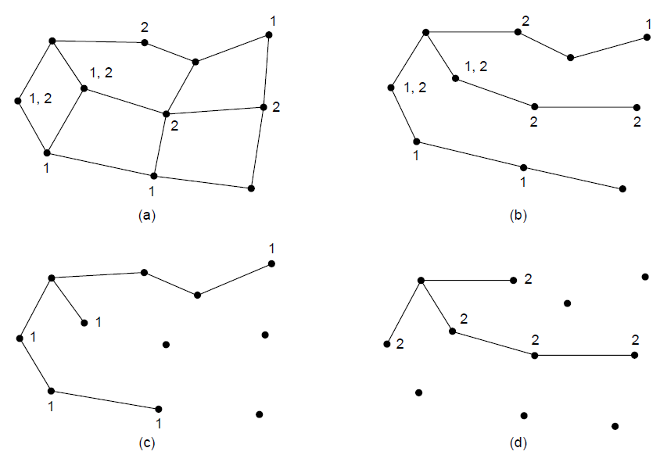
Multicast Routing (1) – Dense Case
Multicast sends to a subset of the nodes called a group
  Uses a different tree for each group and source
S
Network with groups 1 & 2
Spanning tree from source S
S
S
Multicast tree from S to group 1
Multicast tree from S to group 2
CN5E by Tanenbaum & Wetherall, © Pearson Education-Prentice Hall and D. Wetherall, 2011
Notes:
The example shows two of the multicast trees computed in the network. There are many more, the number of nodes times the number of groups. This is worth the effort when the group densely cover the network, i.e., most groups affect most nodes in the network so it makes sense for all nodes to build an efficient multicast tree.

Slide 25
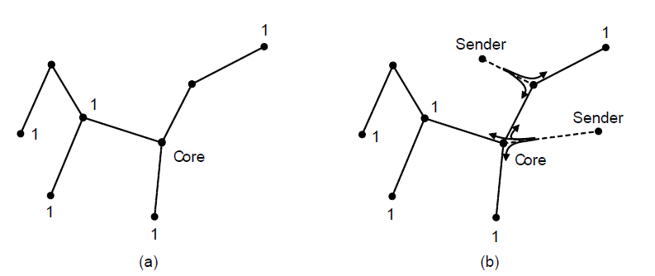
Multicast Routing (2) – Sparse Case
CBT (Core-Based Tree) uses a single tree to multicast
  Tree is the sink tree from core node to group members
  Multicast heads to the core until it reaches the CBT
p 1.
Sink tree from core to group 1
Multicast is send to the core then down when it reaches the sink tree
CN5E by Tanenbaum & Wetherall, © Pearson Education-Prentice Hall and D. Wetherall, 2011
Notes:
Tradeoff is that CBT is less efficient than computing the spanning tree for each source to reach each group, but it is less work to scale to large networks and many groups. Now, with CBT, nodes that are not on the group spanning tree do not need to compute it and can simply send to the core node using their regular routing tables. This is a good tradeoff when the groups sparsely cover the network, i.e., there are many groups that most nodes do not need to know about.

Slide 26
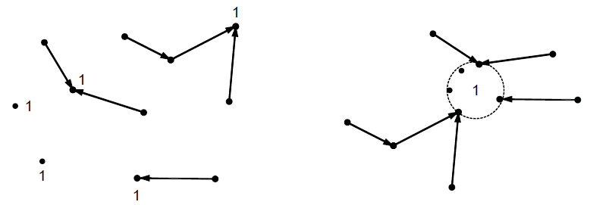
Anycast Routing
Anycast sends a packet to one (nearest) group member
  Falls out of regular routing with a node in many places
Anycast routes to group 1
Apparent topology of sink tree to “node” 1
CN5E by Tanenbaum & Wetherall, © Pearson Education-Prentice Hall and D. Wetherall, 2011
Notes:
We will see later that anycast is used in practice to reach the nearest root DNS server.

Slide 27
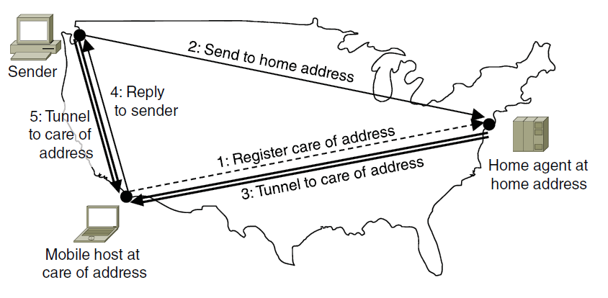
Routing for Mobile Hosts
Mobile hosts can be reached via a home agent
  Fixed home agent tunnels packets to reach the mobile host; reply can optimize path for subsequent packets
  No changes to routers or fixed hosts
CN5E by Tanenbaum & Wetherall, © Pearson Education-Prentice Hall and D. Wetherall, 2011
Notes:
The tradeoff that is being made here is that the routing system that computes spanning trees is not being changed at all, but routes to reach mobile hosts can be circuitous when the mobile is far from home.

Slide 28
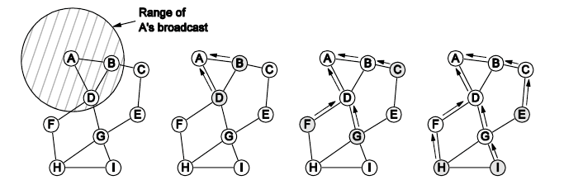
Routing in Ad Hoc Networks
The network topology changes as wireless nodes move
  Routes are often made on demand, e.g., AODV (below)
A’s starts to find route to I
A’s broadcast reaches B & D
B’s and D’s broadcast reach C, F & G
C’s, F’s and G’s broadcast reach H & I
CN5E by Tanenbaum & Wetherall, © Pearson Education-Prentice Hall and D. Wetherall, 2011

Slide 29
Congestion Control (1)
Handling congestion is the responsibility of the Network and Transport layers working together
    We look at the Network portion here
  Traffic-aware routing »
  Admission control »
  Traffic throttling »
  Load shedding »
CN5E by Tanenbaum & Wetherall, © Pearson Education-Prentice Hall and D. Wetherall, 2011

Slide 30
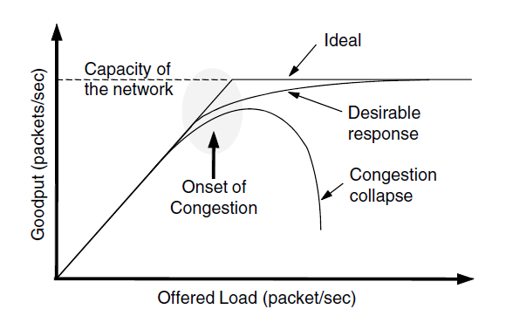
Congestion Control (2)
Congestion results when too much traffic is offered; performance degrades due to loss/retransmissions
  Goodput (=useful packets) trails offered load
CN5E by Tanenbaum & Wetherall, © Pearson Education-Prentice Hall and D. Wetherall, 2011
Notes:
As offered load increases, goodput should increase correspondingly until the capacity of the network is reached. Goodput will trail offered load because the load is bursty and queues will occasionally be too full and a packet will be discarded inside the network.
Congestion collapse can occur if the protocols are not carefully designed when nodes retransmit packets many times, believing that they have been lost, when copies of the packet are still in the network (in queues at routers) pending delivery. While throughput at a receiver may be high, goodput falls because multiple copies of the same packet are being received and after the first copy the bandwidth is wasted.
This really happened in the late 1980s as the Internet grew, and it lead to the design of modern TCP that includes congestion control mechanisms.

Slide 31
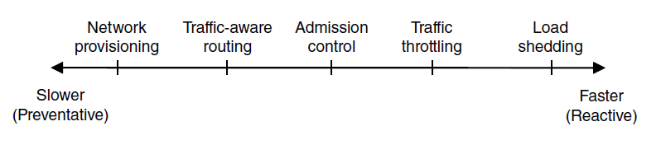
Congestion Control (3) – Approaches
Network must do its best with the offered load
  Different approaches at different timescales
  Nodes should also reduce offered load (Transport)
CN5E by Tanenbaum & Wetherall, © Pearson Education-Prentice Hall and D. Wetherall, 2011
Notes:
Provisioning is simply sizing the network to fit the offered load, i.e., don’t build it too small, or with little West-to-East capacity if there is much West-to-East traffic.

Slide 32
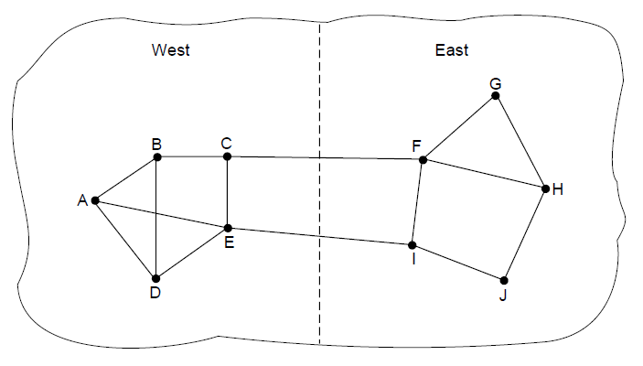
Traffic-Aware Routing
Choose routes depending on traffic, not just topology
  E.g., use EI for West-to-East traffic if CF is loaded
  But take care to avoid oscillations
CN5E by Tanenbaum & Wetherall, © Pearson Education-Prentice Hall and D. Wetherall, 2011
Notes:
Our previous routes only considered topology; this approach can get more traffic through the network.
If not careful, then routing can notice CF is busy and switch traffic over to use EI, only to later notice that EI is busy and switch traffic back to CF. There are various techniques to avoid this: 1) change routes only slowly, e.g., traffic engineering in which an external system sets weights and the routing system does not otherwise adapt; and 2) using multiple paths at once, e.g., both CF and EI.

Slide 33
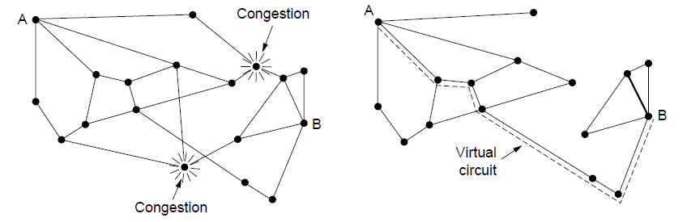
Admission Control
Admission control allows a new traffic load only if the network has sufficient capacity, e.g., with virtual circuits
  Can combine with looking for an uncongested route
Network with some congested nodes
Uncongested portion and route AB around congestion
CN5E by Tanenbaum & Wetherall, © Pearson Education-Prentice Hall and D. Wetherall, 2011

Slide 34
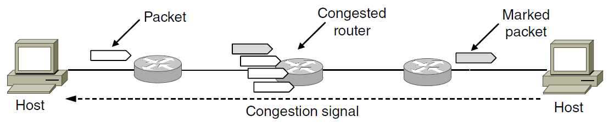
Traffic Throttling
Congested routers signal hosts to slow down traffic
  ECN (Explicit Congestion Notification) marks packets and receiver returns signal to sender
CN5E by Tanenbaum & Wetherall, © Pearson Education-Prentice Hall and D. Wetherall, 2011
Notes:
There are other designs, but this is the main one under deployment in the Internet. By marking existing packets using bits in the IP header, routers avoid sending additional packets at a time of congestion. Signal from receiver to sender is carried using a Transport protocol like TCP.

Slide 35
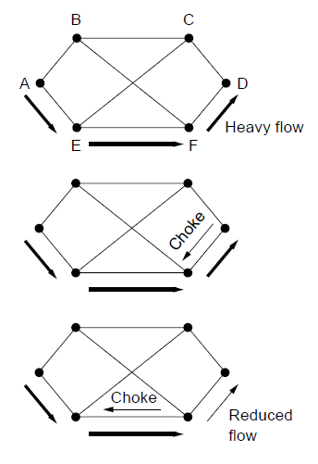
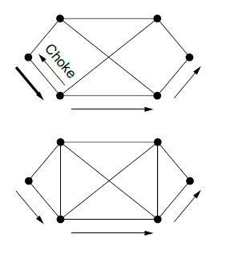
Load Shedding (1)
When all else fails, network will drop packets (shed load)
Can be done end-to-end or link-by-link
Link-by-link (right) produces rapid relief
1
4
2
5
3
CN5E by Tanenbaum & Wetherall, © Pearson Education-Prentice Hall and D. Wetherall, 2011

Slide 36
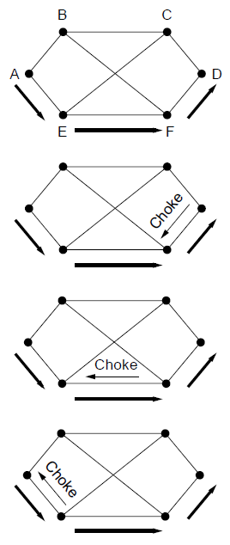
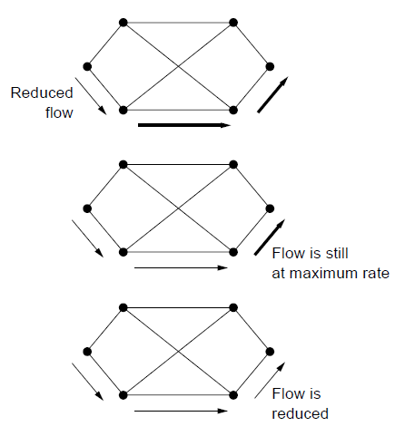
Load Shedding (2)
1
End-to-end (right) takes longer to have an effect, but can better target the cause of congestion
5
2
6
3
7
4
CN5E by Tanenbaum & Wetherall, © Pearson Education-Prentice Hall and D. Wetherall, 2011

Slide 37
Quality of Service
  Application requirements »
  Traffic shaping »
  Packet scheduling »
  Admission control »
  Integrated services »
  Differentiated services »
CN5E by Tanenbaum & Wetherall, © Pearson Education-Prentice Hall and D. Wetherall, 2011

Slide 38
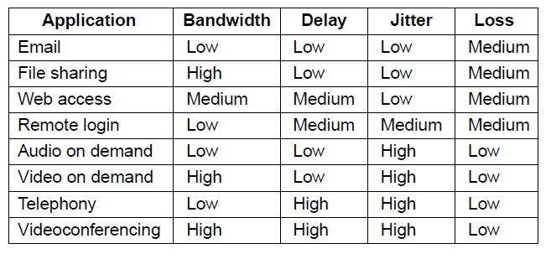
Application Requirements (1)
Different applications care about different properties
  We want all applications to get what they need
.
“High” means a demanding requirement, e.g., low delay
CN5E by Tanenbaum & Wetherall, © Pearson Education-Prentice Hall and D. Wetherall, 2011

Slide 39
Application Requirements (2)
Network provides service with different kinds of QoS (Quality of Service) to meet application requirements
Network Service | Application
Constant bit rate | Telephony
Real-time variable bit rate | Videoconferencing
Non-real-time variable bit rate | Streaming a movie
Available bit rate | File transfer
Example of QoS categories from ATM networks
CN5E by Tanenbaum & Wetherall, © Pearson Education-Prentice Hall and D. Wetherall, 2011
Notes:
Video conferencing is variable bit rate because video is normally compressed, so the bit rate varies over time. Telephony is typically carried at a lower, fixed rate.

Slide 40
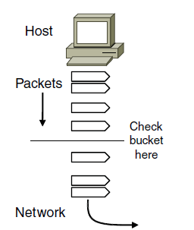
Traffic Shaping (1)
Traffic shaping regulates the average rate and burstiness of data entering the network
  Lets us make guarantees
Shape traffic here
CN5E by Tanenbaum & Wetherall, © Pearson Education-Prentice Hall and D. Wetherall, 2011

Slide 41
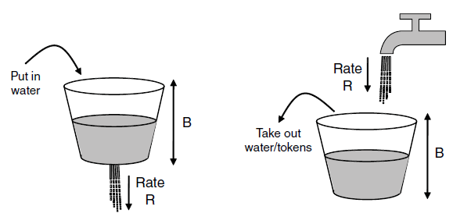
Traffic Shaping (2)
Token/Leaky bucket limits both the average rate (R) and short-term burst (B) of traffic
  For token, bucket size is B, water enters at rate R and is removed to send; opposite for leaky.
to send
to send
Leaky bucket
(need not full to send)
Token bucket
(need some water to send)
CN5E by Tanenbaum & Wetherall, © Pearson Education-Prentice Hall and D. Wetherall, 2011

Slide 42
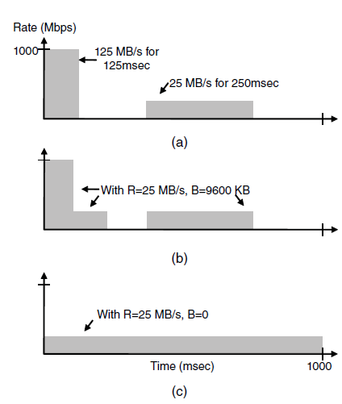
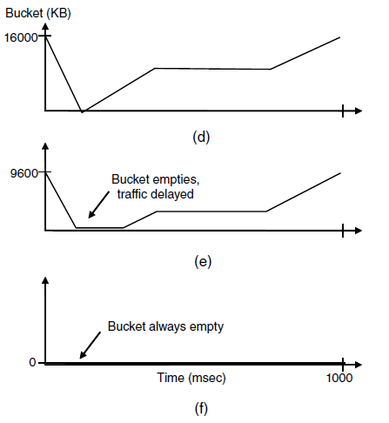
Traffic Shaping (3)
Host traffic
R=200 Mbps B=16000 KB
Shaped by R=200 Mbps B=9600 KB
Shaped by R=200 Mbps B=0 KB
Smaller bucket size delays traffic and reduces burstiness
CN5E by Tanenbaum & Wetherall, © Pearson Education-Prentice Hall and D. Wetherall, 2011
Notes:
For the host traffic the descriptor R=200 Mbps, B=16000KB is the smallest token bucket that can let the traffic pass unchanged. To compute this we work out R as the average rate over the time period, then given we find the smallest B such that the bucket size only just reaches zero at some point.

Slide 43
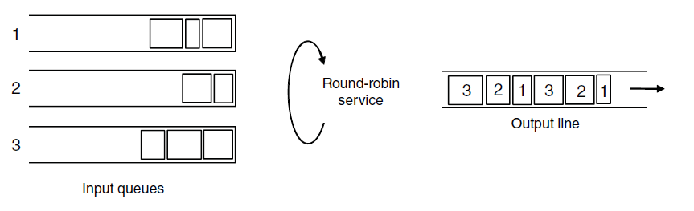
Packet Scheduling (1)
Packet scheduling divides router/link resources among traffic flows with alternatives to FIFO (First In First Out)
1
1
1
2
2
3
3
3
Example of round-robin queuing
CN5E by Tanenbaum & Wetherall, © Pearson Education-Prentice Hall and D. Wetherall, 2011

Slide 44
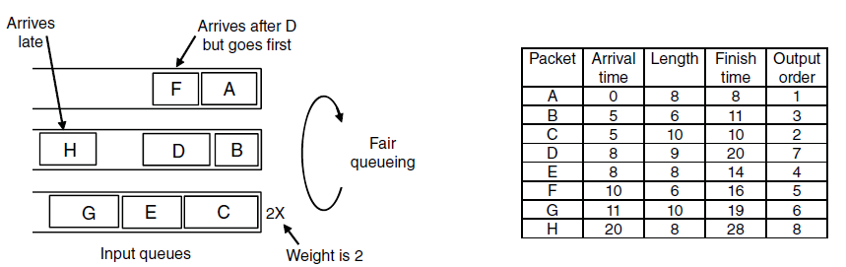
Packet Scheduling (2)
Fair Queueing approximates bit-level fairness with different packet sizes; weights change target levels
  Result is WFQ (Weighted Fair Queueing)
F_{i} = max(A_{i}, F_{i-1}) + L_{i}/W
Packets may be sent out of arrival order
Finish virtual times determine transmission order
CN5E by Tanenbaum & Wetherall, © Pearson Education-Prentice Hall and D. Wetherall, 2011
Notes:
Virtual times are measured in rounds, where a round lets each input queue send 1 bit for weight 1, or W bits for weight W. The time to send a packet of length L is thus L/W. The formula says that the finish virtual time for a packet is the larger of its arrival time plus the time to send it, or the finish time of the previous packet in the same queue plus the time to send it.

Slide 45
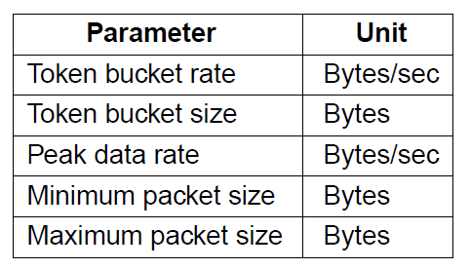
Admission Control (1)
Admission control takes a traffic flow specification and decides whether the network can carry it
  Sets up packet scheduling to meet QoS
Example flow specification
CN5E by Tanenbaum & Wetherall, © Pearson Education-Prentice Hall and D. Wetherall, 2011

Slide 46
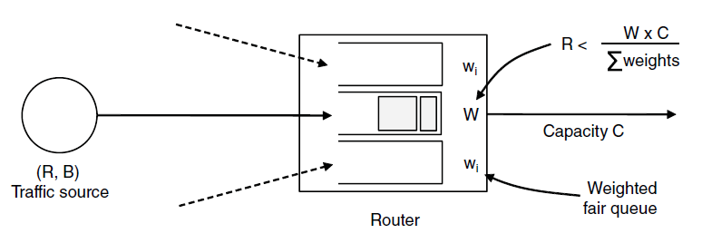
Admission Control (2)
Construction to guarantee bandwidth B and delay D:
  Shape traffic source to a (R, B) token bucket
  Run WFQ with weight W / all weights > R/capacity
  Holds for all traffic patterns, all topologies
CN5E by Tanenbaum & Wetherall, © Pearson Education-Prentice Hall and D. Wetherall, 2011
Notes:
Bandwidth is guaranteed at each router by setting a high enough weight on the flow; if this cannot be done then the flow must not be admitted.
Delay guarantees are more subtle and the bound is not given here. Essentially a burst of traffic can arrive at one router and be delayed but then it will not be delayed at other routers because it has already been shaped to be less bursty. So the total delay is something like the propagation delay plus B/R.

Slide 47
Integrated Services (1)
Design with QoS for each flow; handles multicast traffic.
Admission with RSVP (Resource reSerVation Protocol):
  Receiver sends a request back to the sender
  Each router along the way reserves resources
  Routers merge multiple requests for same flow
  Entire path is set up, or reservation not made
CN5E by Tanenbaum & Wetherall, © Pearson Education-Prentice Hall and D. Wetherall, 2011

Slide 48
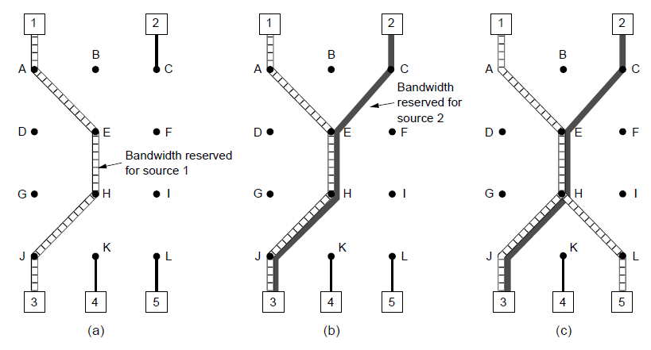
Integrated Services (2)
Merge
R3 reserves flow from S1
R3 reserves flow from S2
R5 reserves flow from S1; merged with R3 at H
CN5E by Tanenbaum & Wetherall, © Pearson Education-Prentice Hall and D. Wetherall, 2011

Slide 49
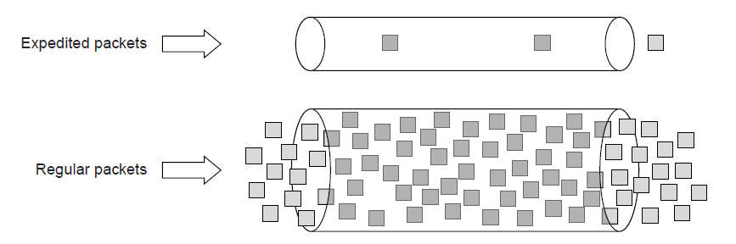
Differentiated Services (1)
Design with classes of QoS; customers buy what they want
  Expedited class is sent in preference to regular class
  Less expedited traffic but better quality for applications
CN5E by Tanenbaum & Wetherall, © Pearson Education-Prentice Hall and D. Wetherall, 2011

Slide 50
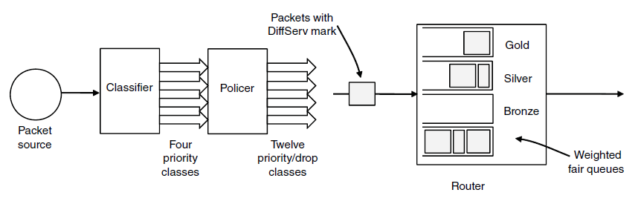
Differentiated Services (2)
Implementation of DiffServ:
  Customers mark desired class on packet
  ISP shapes traffic to ensure markings are paid for
  Routers use WFQ to give different service levels
CN5E by Tanenbaum & Wetherall, © Pearson Education-Prentice Hall and D. Wetherall, 2011

Slide 51
Internetworking
Internetworking joins multiple, different networks into a single larger network
  How networks differ »
  How networks can be connected »
  Tunneling »
  Internetwork routing »
  Packet fragmentation »
CN5E by Tanenbaum & Wetherall, © Pearson Education-Prentice Hall and D. Wetherall, 2011

Slide 52
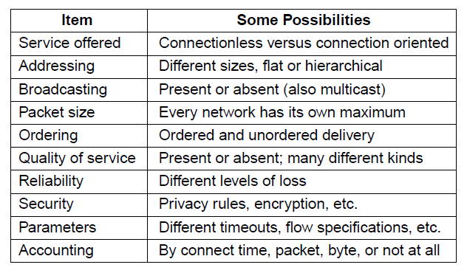
How Networks Differ
Differences can be large; complicates internetworking
CN5E by Tanenbaum & Wetherall, © Pearson Education-Prentice Hall and D. Wetherall, 2011

Slide 53
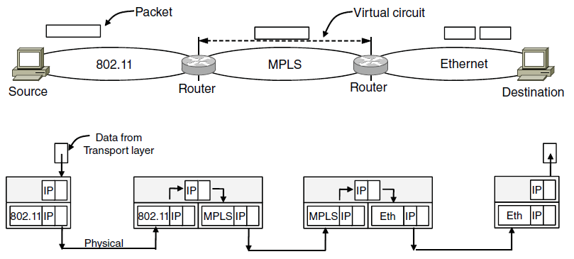
How Networks Can Be Connected
Internetworking based on a common network layer – IP
Packet mapped to a VC here
Common protocol (IP) carried all the way
CN5E by Tanenbaum & Wetherall, © Pearson Education-Prentice Hall and D. Wetherall, 2011
Notes:
The top half of the figure shows the difficulties – a packet sent as a datagram may suddenly have to be sent over a virtual circuit, which requires some way to map between the two.
The bottom half shows the solution – a common network layer protocol, IP, carries addresses and other information that identify the endpoints across networks.

Slide 54
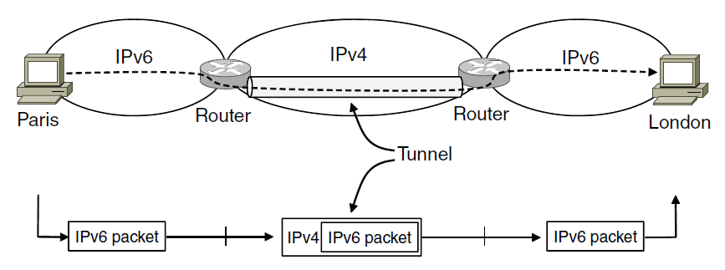
Tunneling (1)
Connects two networks through a middle one
  Packets are encapsulates over the middle
CN5E by Tanenbaum & Wetherall, © Pearson Education-Prentice Hall and D. Wetherall, 2011

Slide 55
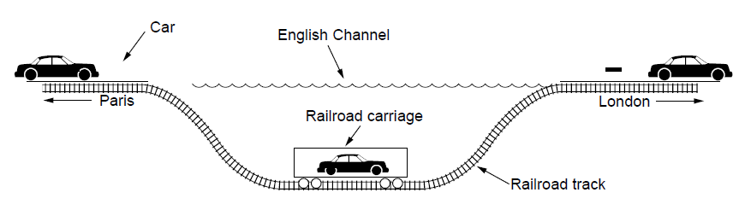
Tunneling (2)
Tunneling analogy:
  tunnel is a link; packet can only enter/exit at ends
CN5E by Tanenbaum & Wetherall, © Pearson Education-Prentice Hall and D. Wetherall, 2011

Slide 56
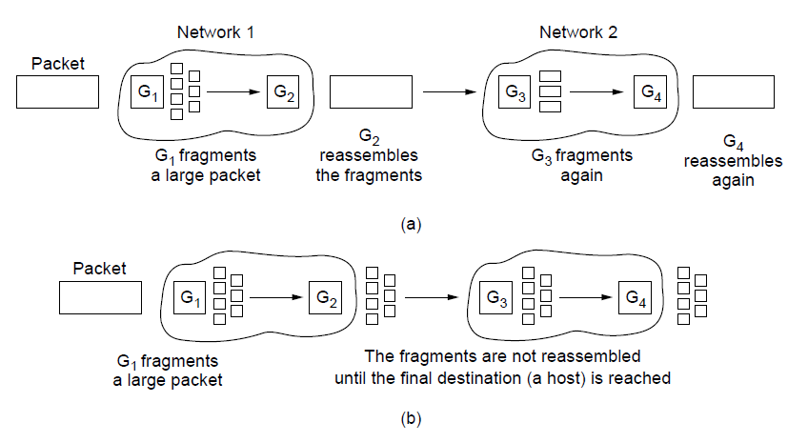
Packet Fragmentation (1)
Networks have different packet size limits for many reasons
  Large packets sent with fragmentation & reassembly
G₁ fragments
G₂ reassembles
G₃ fragments
G₄ reassembles
Transparent – packets fragmented / reassembled in each network
… destination will reassemble
G₁ fragments
Non-transparent – fragments are reassembled at destination
CN5E by Tanenbaum & Wetherall, © Pearson Education-Prentice Hall and D. Wetherall, 2011

Slide 57
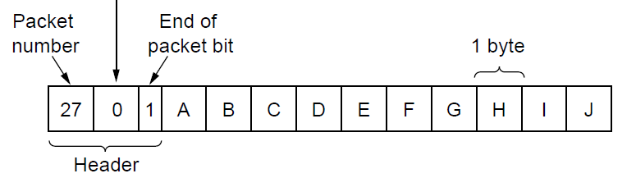
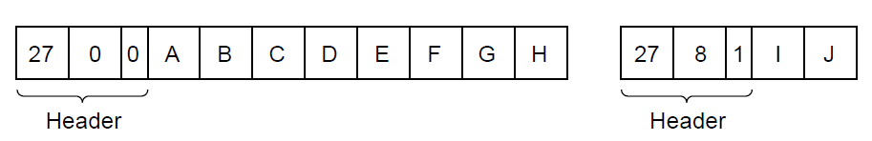
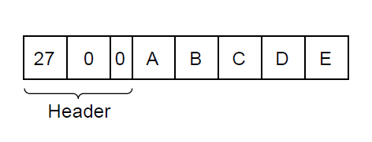


Packet Fragmentation (2)
Example of IP-style fragmentation:
Packet
number
Start
offset
End
bit
Original packet:
(10 data bytes)
Fragmented:
(to 8 data bytes)
Re-fragmented:
(to 5 bytes)
CN5E by Tanenbaum & Wetherall, © Pearson Education-Prentice Hall and D. Wetherall, 2011

Slide 58

Packet Fragmentation (3)
Path MTU Discovery avoids network fragmentation
  Routers return MTU (Max. Transmission Unit) to source and discard large packets
Try 1200
Try 900
CN5E by Tanenbaum & Wetherall, © Pearson Education-Prentice Hall and D. Wetherall, 2011

Slide 59
Network Layer in the Internet (1)
  IP Version 4 »
  IP Addresses »
  IP Version 6 »
  Internet Control Protocols »
  Label Switching and MPLS »
  OSPF—An Interior Gateway Routing Protocol »
  BGP—The Exterior Gateway Routing Protocol »
  Internet Multicasting »
  Mobile IP »
CN5E by Tanenbaum & Wetherall, © Pearson Education-Prentice Hall and D. Wetherall, 2011

Slide 60
Network Layer in the Internet (2)
IP has been shaped by guiding principles:
    Make sure it works
    Keep it simple
    Make clear choices
    Exploit modularity
    Expect heterogeneity
    Avoid static options and parameters
    Look for good design (not perfect)
    Strict sending, tolerant receiving
    Think about scalability
    Consider performance and cost
CN5E by Tanenbaum & Wetherall, © Pearson Education-Prentice Hall and D. Wetherall, 2011
Notes:
Very much an open working design that has favored simplicity and practical engineering considerations rather than design by committee.

Slide 61

Network Layer in the Internet (3)
Internet is an interconnected collection of many networks that is held together by the IP protocol
CN5E by Tanenbaum & Wetherall, © Pearson Education-Prentice Hall and D. Wetherall, 2011

Slide 62

IP Version 4 Protocol (1)
IPv4 (Internet Protocol) header is carried on all packets and has fields for the key parts of the protocol:
CN5E by Tanenbaum & Wetherall, © Pearson Education-Prentice Hall and D. Wetherall, 2011

Slide 63

IP Addresses (1) – Prefixes
Addresses are allocated in blocks called prefixes
  Prefix is determined by the network portion
  Has 2^{L} addresses aligned on 2^{L} boundary
  Written address/length, e.g., 18.0.31.0/24
CN5E by Tanenbaum & Wetherall, © Pearson Education-Prentice Hall and D. Wetherall, 2011

Slide 64

IP Addresses (2) – Subnets
Subnetting splits up IP prefix to help with management
  Looks like a single prefix outside the network
ISP gives network
a single prefix
Network divides it into subnets internally
CN5E by Tanenbaum & Wetherall, © Pearson Education-Prentice Hall and D. Wetherall, 2011
Notes:
Check the size of the different subnets:
Prefix has 2^16=32K addresses, CS subnet is largest, 2^15=16K addresses, EE subnet has 2^14=8K addresses, Art has 2^13=4K addresses.
There are 4K addresses left over. What is the prefix? It is found by writing the address ranges out to see that 128.208.64.0/19 is left.
Can the prefix lengths just be changed between EE/CS/Art? No, then blocks of size 2^N would not always be aligned on a 2^N boundary.

Slide 65

IP Addresses (3) – Aggregation
Aggregation joins multiple IP prefixes into a single larger prefix to reduce routing table size
ISP advertises
a single prefix
ISP customers have different prefixes
CN5E by Tanenbaum & Wetherall, © Pearson Education-Prentice Hall and D. Wetherall, 2011
Notes:
Same mechanism as subnets, just a different motivation (of reducing the size of routing tables instead of making it easier to use the block of addresses you have).

Slide 66

IP Addresses (4) – Longest Matching Prefix
Packets are forwarded to the entry with the longest matching prefix or smallest address block
  Complicates forwarding but adds flexibility
Except for this part!
Main prefix goes this way
CN5E by Tanenbaum & Wetherall, © Pearson Education-Prentice Hall and D. Wetherall, 2011
Notes:
At New York, the LMP rule makes it easy to add an exception to go elsewhere to reach part of a prefix. Without it, we would have had to split the prefix up into its components and give a route for each component.

Slide 67

IP Addresses (5) – Classful Addresing
Old addresses came in blocks of fixed size (A, B, C)
  Carries size as part of address, but lacks flexibility
  Called classful (vs. classless) addressing
CN5E by Tanenbaum & Wetherall, © Pearson Education-Prentice Hall and D. Wetherall, 2011
Notes:
This is just history. Prefixes are variable size, which is much more flexible and suits different kinds of usage, but now the prefix length needs to be carried separately by the routing protocols because it is not part of the address.

Slide 68

IP Addresses (6) – NAT
NAT (Network Address Translation) box maps one external IP address to many internal IP addresses
  Uses TCP/UDP port to tell connections apart
  Violates layering; very common in homes, etc.
CN5E by Tanenbaum & Wetherall, © Pearson Education-Prentice Hall and D. Wetherall, 2011
Notes:
So Internet traffic sent to/from port 1111 might really be going to a computer A in the home while traffic sent to/from port 2222 to the same IP address might be going to a computer B.
The mapping in the NAT box is set up when a connection is established. A side-effect is that connections can only be made from inside the house to the Internet – you can’t run a server in your home without special configuration. This is a consequence of violating layering.

Slide 69
IP Version 6 (1)
Major upgrade in the 1990s due to impending address exhaustion, with various other goals:
    Support billions of hosts
    Reduce routing table size
    Simplify protocol
    Better security
    Attention to type of service
    Aid multicasting
    Roaming host without changing address
    Allow future protocol evolution
    Permit coexistence of old, new protocols, …
Deployment has been slow & painful, but may pick up pace now that addresses are all but exhausted
CN5E by Tanenbaum & Wetherall, © Pearson Education-Prentice Hall and D. Wetherall, 2011

Slide 70

IP Version 6 (2 )
IPv6 protocol header has much longer addresses (128 vs. 32 bits) and is simpler (by using extension headers)
CN5E by Tanenbaum & Wetherall, © Pearson Education-Prentice Hall and D. Wetherall, 2011

Slide 71

IP Version 6 (3)
IPv6 extension headers handles other functionality
CN5E by Tanenbaum & Wetherall, © Pearson Education-Prentice Hall and D. Wetherall, 2011

Slide 72
Internet Control Protocols (1)
IP works with the help of several control protocols:
  ICMP is a companion to IP that returns error info
    Required, and used in many ways, e.g., for traceroute
  ARP finds Ethernet address of a local IP address
    Glue that is needed to send any IP packets
    Host queries an address and the owner replies
  DHCP assigns a local IP address to a host
    Gets host started by automatically configuring it
    Host sends request to server, which grants a lease
CN5E by Tanenbaum & Wetherall, © Pearson Education-Prentice Hall and D. Wetherall, 2011

Slide 73

Internet Control Protocols (2)
Main ICMP (Internet Control Message Protocol) types:
CN5E by Tanenbaum & Wetherall, © Pearson Education-Prentice Hall and D. Wetherall, 2011

Slide 74

Internet Control Protocols (3)
ARP (Address Resolution Protocol) lets nodes find target Ethernet addresses [pink] from their IP addresses
CN5E by Tanenbaum & Wetherall, © Pearson Education-Prentice Hall and D. Wetherall, 2011

Slide 75

Label Switching and MPLS (1)
MPLS (Multi-Protocol Label Switching) sends packets along established paths; ISPs can use for QoS
  Path indicated with label below the IP layer
CN5E by Tanenbaum & Wetherall, © Pearson Education-Prentice Hall and D. Wetherall, 2011

Slide 76

Label Switching and MPLS (2)
Label added based on IP address on entering an MPLS network (e.g., ISP) and removed when leaving it
  Forwarding only uses label inside MPLS network
CN5E by Tanenbaum & Wetherall, © Pearson Education-Prentice Hall and D. Wetherall, 2011

Slide 77


OSPF— Interior Routing Protocol (1)
OSPF computes routes for a single network (e.g., ISP)
  Models network as a graph of weighted edges
Network:
Graph:
3
Broadcast LAN modeled as a well-connected node
CN5E by Tanenbaum & Wetherall, © Pearson Education-Prentice Hall and D. Wetherall, 2011
Notes:
The broadcast LAN connecting routers (LAN 3) could be modeled as a mesh since it connects each of R3, R4 and R5 to all of the others. Instead, it is modeled as a node (LAN 3) to which the other nodes connect.

Slide 78

OSPF— Interior Routing Protocol (2)
OSPF divides one large network (Autonomous System) into areas connected to a backbone area
  Helps to scale; summaries go over area borders
CN5E by Tanenbaum & Wetherall, © Pearson Education-Prentice Hall and D. Wetherall, 2011

Slide 79

OSPF— Interior Routing Protocol (3)
OSPF (Open Shortest Path First) is link-state routing:
  Uses messages below to reliably flood topology
  Then runs Dijkstra to compute routes
CN5E by Tanenbaum & Wetherall, © Pearson Education-Prentice Hall and D. Wetherall, 2011

Slide 80
BGP— Exterior Routing Protocol (1)
BGP (Border Gateway Protocol) computes routes across interconnected, autonomous networks
  Key role is to respect networks’ policy constraints
Example policy constraints:
    No commercial traffic for educational network
    Never put Iraq on route starting at Pentagon
    Choose cheaper network
    Choose better performing network
    Don’t go from Apple to Google to Apple
CN5E by Tanenbaum & Wetherall, © Pearson Education-Prentice Hall and D. Wetherall, 2011
Notes:
Since different networks have different practices and goals we can’t reduce the preferred routes to a single weight number attached to links.

Slide 81

BGP— Exterior Routing Protocol (2)
Common policy distinction is transit vs. peering:
  Transit carries traffic for pay; peers for mutual benefit
  AS1 carries AS2↔AS4 (Transit) but not AS3 (Peer)
CN5E by Tanenbaum & Wetherall, © Pearson Education-Prentice Hall and D. Wetherall, 2011

Slide 82

BGP— Exterior Routing Protocol (3)
BGP propagates messages along policy-compliant routes
  Message has prefix, AS path (to detect loops) and next-hop IP (to send over the local network)
CN5E by Tanenbaum & Wetherall, © Pearson Education-Prentice Hall and D. Wetherall, 2011

Slide 83
Internet Multicasting
Groups have a reserved IP address range (class D)
  Membership in a group handled by IGMP (Internet Group Management Protocol) that runs at routers
Routes computed by protocols such as PIM:
  Dense mode uses RPF with pruning
  Sparse mode uses core-based trees
IP multicasting is not widely used except within a single network, e.g., datacenter, cable TV network.
CN5E by Tanenbaum & Wetherall, © Pearson Education-Prentice Hall and D. Wetherall, 2011

Slide 84
Mobile IP
Mobile hosts can be reached at fixed IP via a home agent
  Home agent tunnels packets to reach the mobile host; reply can optimize path for subsequent packets
  No changes to routers or fixed hosts
CN5E by Tanenbaum & Wetherall, © Pearson Education-Prentice Hall and D. Wetherall, 2011
Notes:
This is a repeat of earlier “routing for mobile hosts” which was modeled on the mobile IP protocol

Slide 85
End
Chapter 5
CN5E by Tanenbaum & Wetherall, © Pearson Education-Prentice Hall and D. Wetherall, 2011

