Slide 1
Transport Layer
Chapter 6
  Transport Service
  Elements of Transport Protocols
  Congestion Control
  Internet Protocols – UDP
  Internet Protocols – TCP
  Performance Issues
  Delay-Tolerant Networking
Revised: August 2011
CN5E by Tanenbaum & Wetherall, © Pearson Education-Prentice Hall and D. Wetherall, 2011
Notes:
Gray units can be optionally omitted without causing later gaps

Slide 2
The Transport Layer
Responsible for delivering data across networks with the desired reliability or quality
Application
Transport
Network
Link
Physical
CN5E by Tanenbaum & Wetherall, © Pearson Education-Prentice Hall and D. Wetherall, 2011

Slide 3
Transport Service
  Services Provided to the Upper Layer »
  Transport Service Primitives »
  Berkeley Sockets »
  Socket Example: Internet File Server »
CN5E by Tanenbaum & Wetherall, © Pearson Education-Prentice Hall and D. Wetherall, 2011

Slide 4
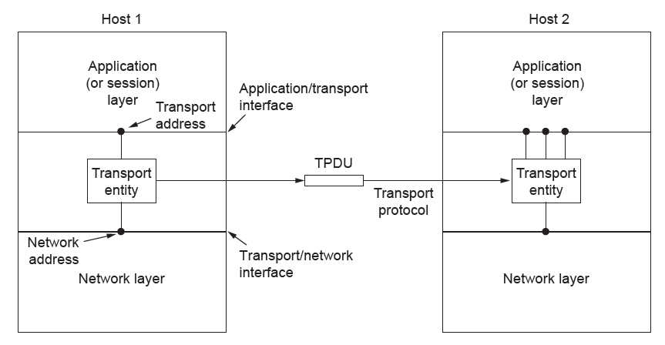
Services Provided to the Upper Layers (1)
Transport layer adds reliability to the network layer
  Offers connectionless (e.g., UDP) and connection-oriented (e.g, TCP) service to applications
CN5E by Tanenbaum & Wetherall, © Pearson Education-Prentice Hall and D. Wetherall, 2011

Slide 5
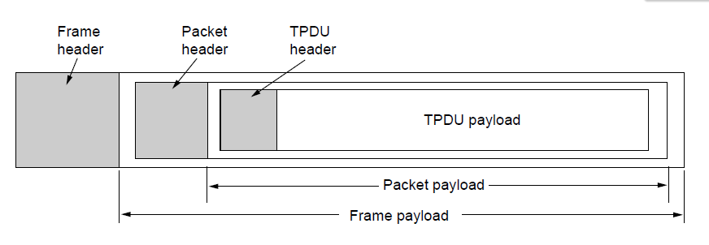
Services Provided to the Upper Layers (2)
Transport layer sends segments in packets (in frames)
Segment
Segment
CN5E by Tanenbaum & Wetherall, © Pearson Education-Prentice Hall and D. Wetherall, 2011

Slide 6
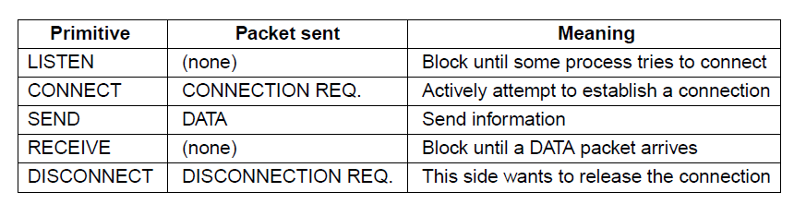
Transport Service Primitives (1)
Primitives that applications might call to transport data for a simple connection-oriented service:
  Client calls CONNECT, SEND, RECEIVE, DISCONNECT
  Server calls LISTEN, RECEIVE, SEND, DISCONNECT
Segment
CN5E by Tanenbaum & Wetherall, © Pearson Education-Prentice Hall and D. Wetherall, 2011

Slide 7
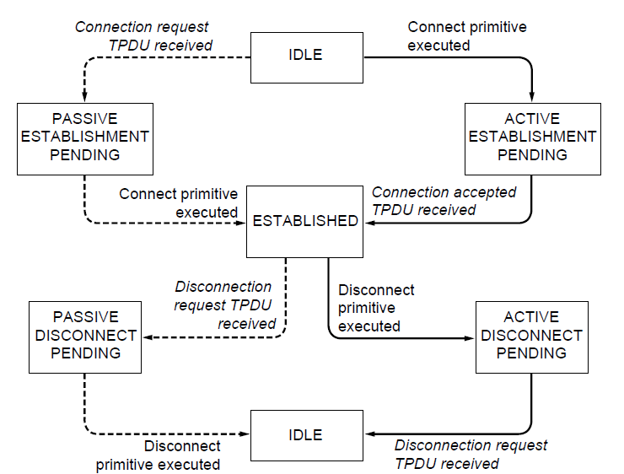
Transport Service Primitives (2)
State diagram for a simple connection-oriented service
Solid lines (right) show client state sequence
Dashed lines (left) show server state sequence
Transitions in italics are due to segment arrivals.
CN5E by Tanenbaum & Wetherall, © Pearson Education-Prentice Hall and D. Wetherall, 2011

Slide 8
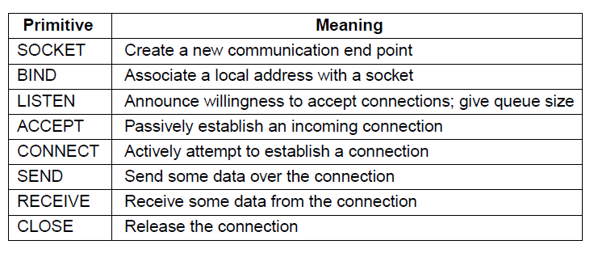
Berkeley Sockets
Very widely used primitives started with TCP on UNIX
  Notion of “sockets” as transport endpoints
  Like simple set plus SOCKET, BIND, and ACCEPT
CN5E by Tanenbaum & Wetherall, © Pearson Education-Prentice Hall and D. Wetherall, 2011

Slide 9
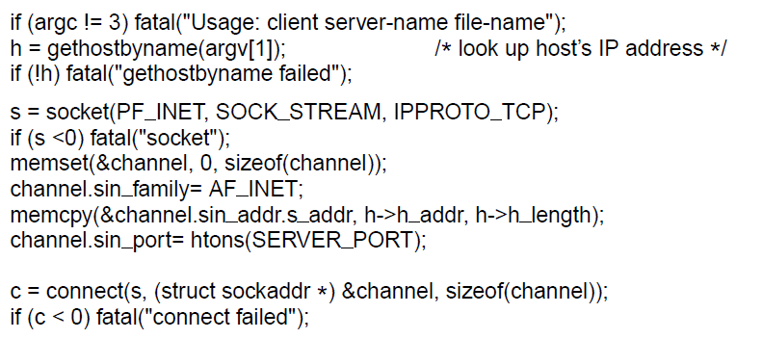
Socket Example – Internet File Server (1)
Client code
. . .
Get server’s IP address
Make a socket
Try to connect
. . .
CN5E by Tanenbaum & Wetherall, © Pearson Education-Prentice Hall and D. Wetherall, 2011

Slide 10
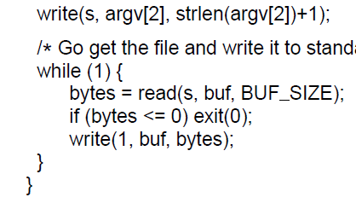
Socket Example – Internet File Server (2)
Client code (cont.)
. . .
Write data (equivalent to send)
Loop reading (equivalent to receive) until no more data; exit implicitly calls close
CN5E by Tanenbaum & Wetherall, © Pearson Education-Prentice Hall and D. Wetherall, 2011

Slide 11
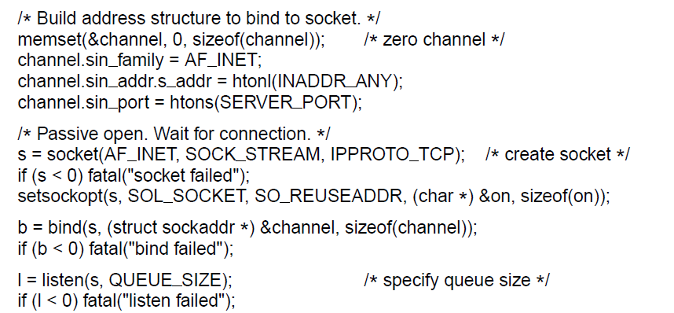
Socket Example – Internet File Server (3)
Server code
. . .
Make a socket
Assign address
Prepare for incoming connections
. . .
CN5E by Tanenbaum & Wetherall, © Pearson Education-Prentice Hall and D. Wetherall, 2011

Slide 12
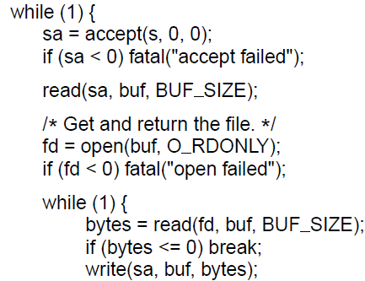
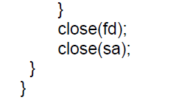
Socket Example – Internet File Server (4)
Server code
. . .
Block waiting for the next connection
Read (receive) request and treat as file name
Write (send) all file data
Done, so close this connection
CN5E by Tanenbaum & Wetherall, © Pearson Education-Prentice Hall and D. Wetherall, 2011

Slide 13
Elements of Transport Protocols
  Addressing »
  Connection establishment »
  Connection release »
  Error control and flow control »
  Multiplexing »
  Crash recovery »
CN5E by Tanenbaum & Wetherall, © Pearson Education-Prentice Hall and D. Wetherall, 2011

Slide 14
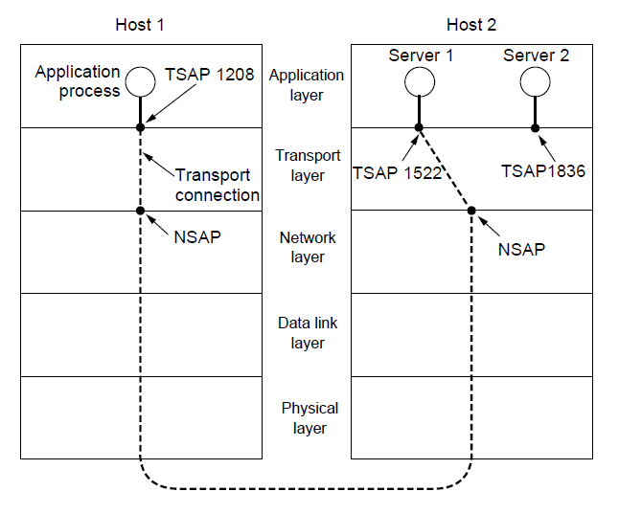
Addressing
Transport layer adds TSAPs
Multiple clients and servers can run on a host with a single network (IP) address
TSAPs are ports for TCP/UDP
CN5E by Tanenbaum & Wetherall, © Pearson Education-Prentice Hall and D. Wetherall, 2011

Slide 15
Connection Establishment (1)
Key problem is to ensure reliability even though packets may be lost, corrupted, delayed, and duplicated
  Don’t treat an old or duplicate packet as new
  (Use ARQ and checksums for loss/corruption)
Approach:
  Don’t reuse sequence numbers within twice the MSL (Maximum Segment Lifetime) of 2T=240 secs
  Three-way handshake for establishing connection
CN5E by Tanenbaum & Wetherall, © Pearson Education-Prentice Hall and D. Wetherall, 2011
Notes:
The MSL of 2 minutes is just an engineering bound that is conservative (and probably too high these days). Twice the MSL is used to ensure that neither a packet nor an acknowledgment for the packet can still be in the network.

Slide 16
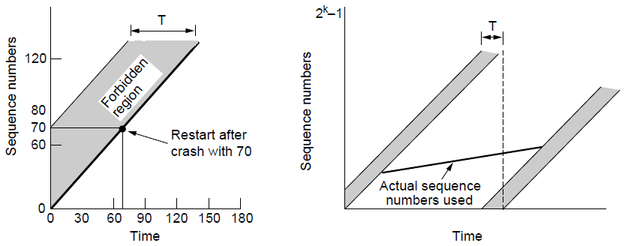
Connection Establishment (2)
Use a sequence number space large enough that it will not wrap, even when sending at full rate
  Clock (high bits) advances & keeps state over crash
Need seq. number not to wrap within T seconds
Need seq. number not to climb too slowly for too long
CN5E by Tanenbaum & Wetherall, © Pearson Education-Prentice Hall and D. Wetherall, 2011
Notes:
In TCP, the sequence number used for detecting duplicates is treated as the combination of a timestamp and 32 bit sequence number. It won’t wrap within 2MSL = 4 minutes (satisfying the left side) and will rise fast enough (avoiding the problem on the right hand side)

Slide 17
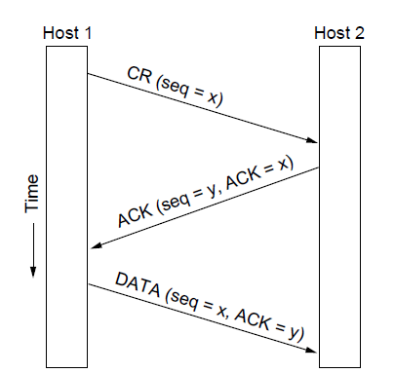
Connection Establishment (3)
Three-way handshake used for initial packet
  Since no state from previous connection
  Both hosts contribute fresh seq. numbers
  CR = Connect Request
CN5E by Tanenbaum & Wetherall, © Pearson Education-Prentice Hall and D. Wetherall, 2011
Notes:
For the initial packet we can’t tell if it is a duplicate by looking to see if the sequence number has already been received without remembering state across connections, and we don’t want to do that. The 3-way handshake is used instead. Having both hosts contribute fresh sequence numbers (x and y) is key.

Slide 18
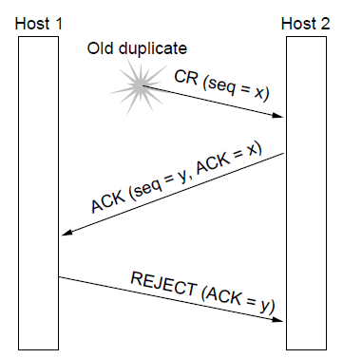
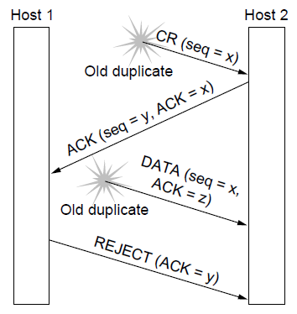
Connection Establishment (4)
Three-way handshake protects against odd cases:
Duplicate CR. Spurious ACK does not connect
Duplicate CR and DATA. Same plus DATA will be rejected (wrong ACK).
a)
X
b)
X
X
CN5E by Tanenbaum & Wetherall, © Pearson Education-Prentice Hall and D. Wetherall, 2011

Slide 19
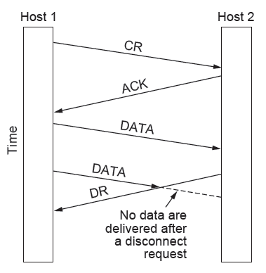
Connection Release (1)
Key problem is to ensure reliability while releasing
Asymmetric release (when one side breaks connection) is abrupt and may lose data
X
CN5E by Tanenbaum & Wetherall, © Pearson Education-Prentice Hall and D. Wetherall, 2011

Slide 20
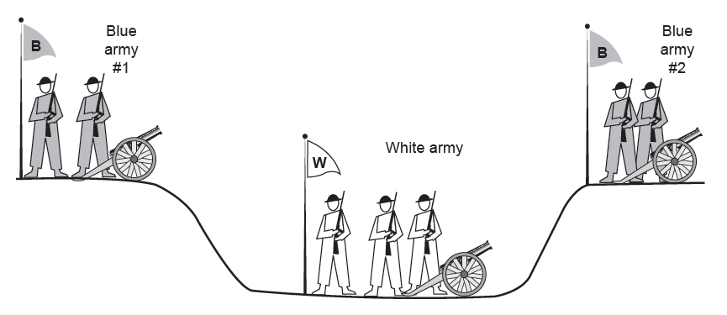
Connection Release (2)
Symmetric release (both sides agree to release) can’t be handled solely by the transport layer
  Two-army problem shows pitfall of agreement
Attack?
Attack?
CN5E by Tanenbaum & Wetherall, © Pearson Education-Prentice Hall and D. Wetherall, 2011

Slide 21
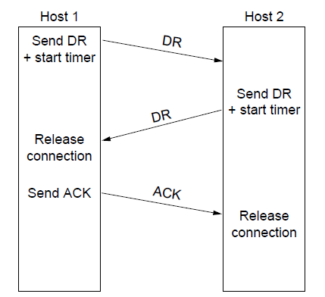
Connection Release (3)
Normal release sequence, initiated by transport user on Host 1
  DR=Disconnect Request
  Both DRs are ACKed by the other side
CN5E by Tanenbaum & Wetherall, © Pearson Education-Prentice Hall and D. Wetherall, 2011

Slide 22
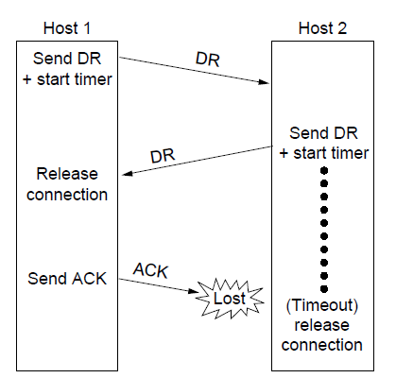
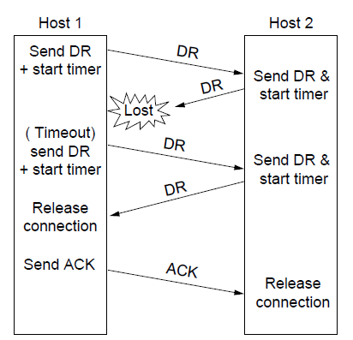
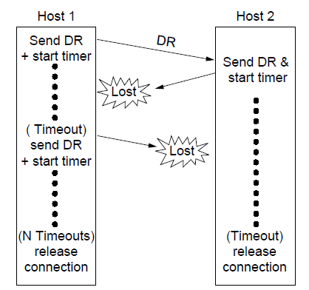
Connection Release (4)
Error cases are handled with timer and retransmission
Final ACK lost, Host 2 times out
Lost DR causes retransmissions
Extreme: Many lost DRs cause both hosts to timeout
CN5E by Tanenbaum & Wetherall, © Pearson Education-Prentice Hall and D. Wetherall, 2011

Slide 23
Error Control and Flow Control (1)
Foundation for error control is a sliding window (from Link layer) with checksums and retransmissions
Flow control manages buffering at sender/receiver
  Issue is that data goes to/from the network and applications at different times
  Window tells sender available buffering at receiver
  Makes a variable-size sliding window
CN5E by Tanenbaum & Wetherall, © Pearson Education-Prentice Hall and D. Wetherall, 2011

Slide 24
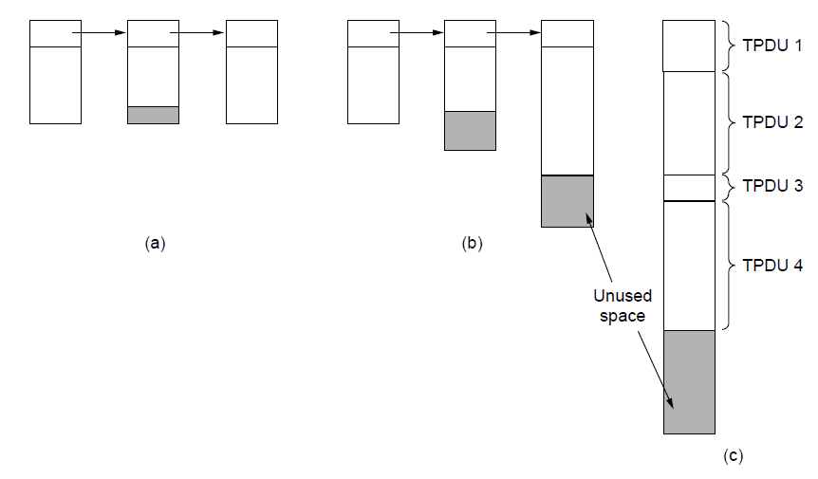
Error Control and Flow Control (2)
Different buffer strategies trade efficiency / complexity
a) Chained fixed-size buffers
b) Chained variable-size buffers
c) One large circular buffer
CN5E by Tanenbaum & Wetherall, © Pearson Education-Prentice Hall and D. Wetherall, 2011

Slide 25
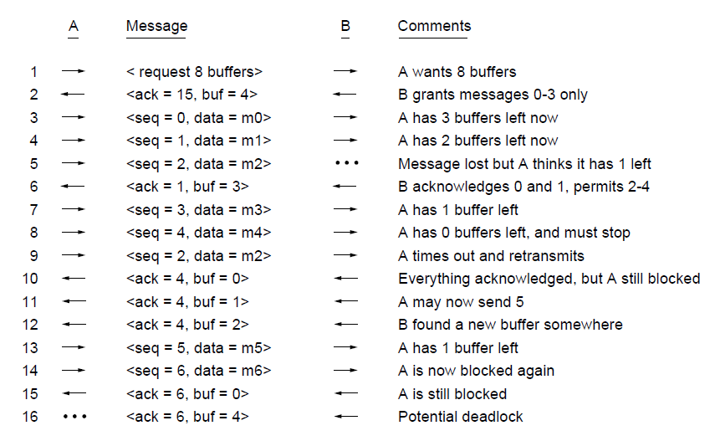
Error Control and Flow Control (3)
Flow control example: A’s data is limited by B’s buffer
B’s Buffer
0
1
2
3
0
1
2
3
0
1
2
3
0
1
2
3
1
2
3
4
1
2
3
4
1
2
3
4
1
2
3
4
1
2
3
4
2
3
4
5
3
4
5
6
3
4
5
6
3
4
5
6
3
4
5
6
7
8
9
10
CN5E by Tanenbaum & Wetherall, © Pearson Education-Prentice Hall and D. Wetherall, 2011
Notes:
Example: B has a fixed buffer of 4 segments. A gets to send up to message ack+buf. Messages go into B’s buffer. Pink shows occupied buffer space. At unrelated times B’s application reads data from B’s buffer and frees up space for more data to arrive.
Q: when does B’s application receive data from the buffer? Between times 5&6, 10&11, 11&12, and 15&16.
Q: why is there a potential deadlock at the end? Because A is waiting for an indication of new buffer space (via an ACK) and B is waiting for new data. This problem is avoided by having a timer at either sender or receiver. (TCP uses a sender window probe, a periodic probe that stimulates the receiver when the sender has data to send and thinks the window is full.)

Slide 26
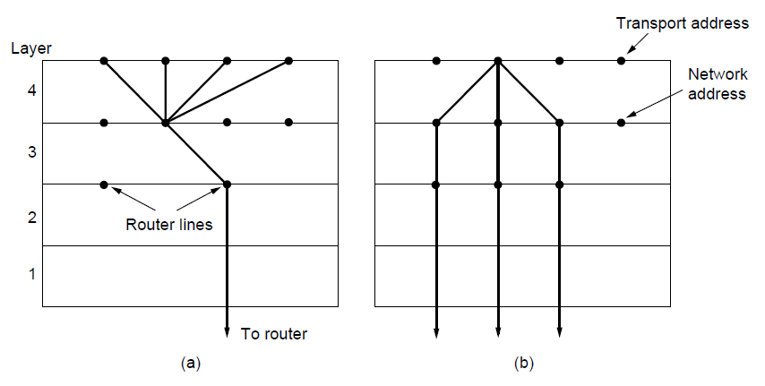
Multiplexing
Kinds of transport / network sharing that can occur:
  Multiplexing: connections share a network address
  Inverse multiplexing: addresses share a connection
Multiplexing
Inverse Multiplexing
CN5E by Tanenbaum & Wetherall, © Pearson Education-Prentice Hall and D. Wetherall, 2011

Slide 27
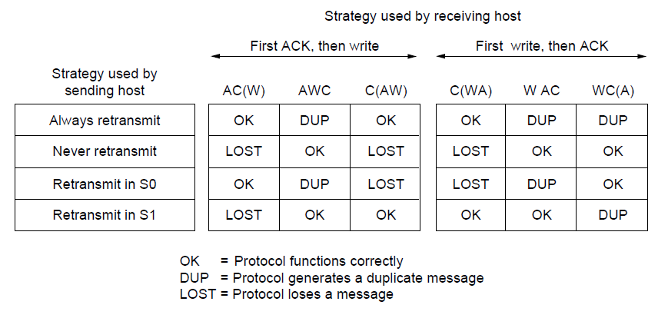
Crash Recovery
Application needs to help recovering from a crash
  Transport can fail since A(ck) / W(rite) not atomic
CN5E by Tanenbaum & Wetherall, © Pearson Education-Prentice Hall and D. Wetherall, 2011

Slide 28
Congestion Control
Two layers are responsible for congestion control:
    Transport layer, controls the offered load [here]
    Network layer, experiences congestion [previous]
  Desirable bandwidth allocation »
  Regulating the sending rate »
  Wireless issues »
CN5E by Tanenbaum & Wetherall, © Pearson Education-Prentice Hall and D. Wetherall, 2011

Slide 29
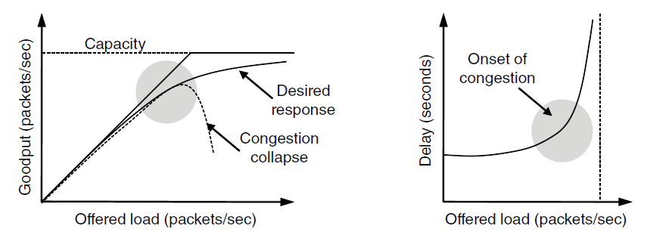
Desirable Bandwidth Allocation (1)
Efficient use of bandwidth gives high goodput, low delay
Goodput rises more slowly than load when congestion sets in
Delay begins to rise sharply when congestion sets in
CN5E by Tanenbaum & Wetherall, © Pearson Education-Prentice Hall and D. Wetherall, 2011
Notes:
Goodput is useful throughput (minus retransmissions).
The power metric is load/delay. It will rise with load until delay starts to climb rapidly. This is one way to find the knee in the curve that is a good operating point.

Slide 30
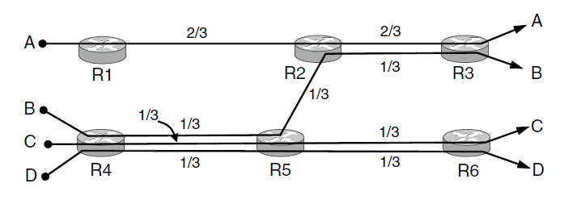
Desirable Bandwidth Allocation (2)
Fair use gives bandwidth to all flows (no starvation)
  Max-min fairness gives equal shares of bottleneck
Bottleneck link
CN5E by Tanenbaum & Wetherall, © Pearson Education-Prentice Hall and D. Wetherall, 2011
Notes:
Note that fairness is more complicated than giving all flows the same bandwidth, e.g., 1/3 units. B, C, and D share a bottleneck so they each get 1/3 of it. But A does not have this bottleneck so giving it 1/3 units only wastes some bandwidth -- it can have 2/3 units without slowing anyone else down. This is max-min fair, which maximizes the minimum bandwidth flows get, then lets flows go ahead when they are able to use excess bandwidth.

Slide 31
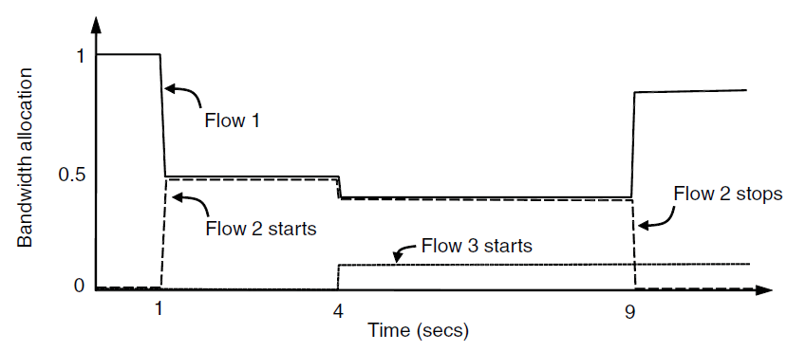
Desirable Bandwidth Allocation (3)
We want bandwidth levels to converge quickly when traffic patterns change
Flow 1 slows quickly when Flow 2 starts
Flow 1 speeds up quickly when Flow 2 stops
CN5E by Tanenbaum & Wetherall, © Pearson Education-Prentice Hall and D. Wetherall, 2011

Slide 32
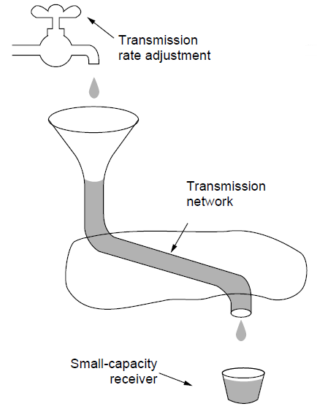
Regulating the Sending Rate (1)
Sender may need to slow down for different reasons:
  Flow control, when the receiver is not fast enough [right]
  Congestion, when the network is not fast enough [over]
A fast network feeding a low-capacity receiver → flow control is needed
CN5E by Tanenbaum & Wetherall, © Pearson Education-Prentice Hall and D. Wetherall, 2011

Slide 33
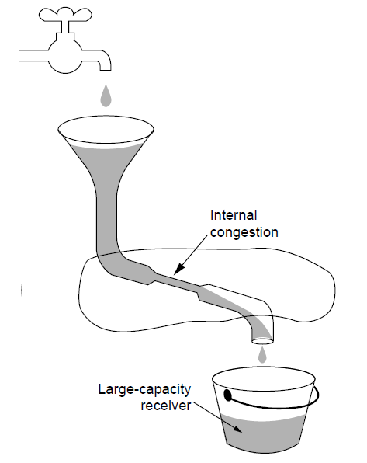
Regulating the Sending Rate (2)
Our focus is dealing with this problem – congestion
A slow network feeding a high-capacity receiver → congestion control is needed
CN5E by Tanenbaum & Wetherall, © Pearson Education-Prentice Hall and D. Wetherall, 2011

Slide 34
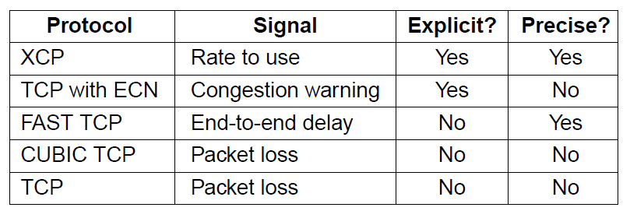
Regulating the Sending Rate (3)
Different congestion signals the network may use to tell the transport endpoint to slow down (or speed up)
CN5E by Tanenbaum & Wetherall, © Pearson Education-Prentice Hall and D. Wetherall, 2011

Slide 35
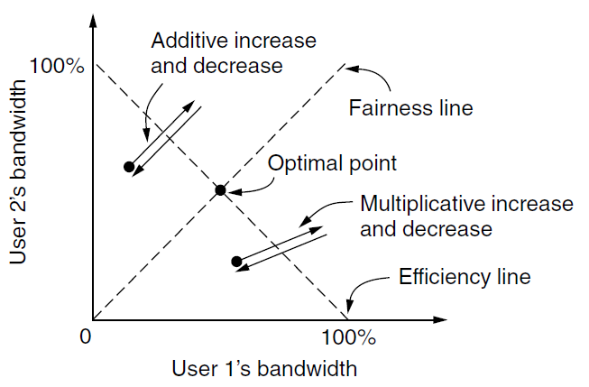
Regulating the Sending Rate (3)
If two flows increase/decrease their bandwidth in the same way when the network signals free/busy they will not converge to a fair allocation
+ /– constant
+/– percentage
CN5E by Tanenbaum & Wetherall, © Pearson Education-Prentice Hall and D. Wetherall, 2011
Notes:
The game shows two competing flows. The network is efficient when the sum of the flows is 1 unit, shown by the efficiency line. The network is fair when both flows have the same bandwidth, shown by the fairness line (y=x). Each flow increases or decreases their bandwidth periodically depending on whether the network is uncongested or congested. Additive policies change the bandwidth by a constant amount, like 1 Mbps. Additive changes for both users will thus follow a 45 degree line. Multiplicative policies change the bandwidth by a fractional amount, like 10%. Multiplicative changes for both users will thus go along a line towards or away from the origin. With AIAD or MIMD the flows oscillate over the efficiency line but do not become more fair.

Slide 36
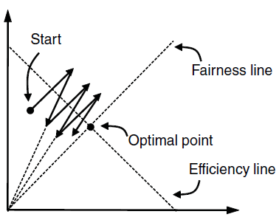
Regulating the Sending Rate (4)
The AIMD (Additive Increase Multiplicative Decrease) control law does converge to a fair and efficient point!
  TCP uses AIMD for this reason
User 2’s bandwidth
User 1’s bandwidth
CN5E by Tanenbaum & Wetherall, © Pearson Education-Prentice Hall and D. Wetherall, 2011
Notes:
Amazing! Exercise: pick any point for user 1 and user 2’s bandwidth and simulate AIMD. It will move towards the optimal point

Slide 37
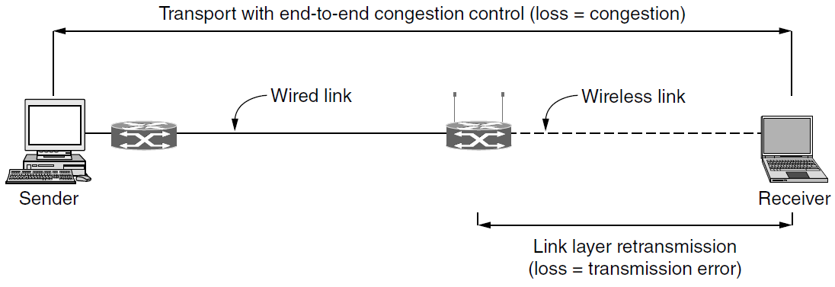
Wireless Issues
Wireless links lose packets due to transmission errors
  Do not want to confuse this loss with congestion
  Or connection will run slowly over wireless links!
Strategy:
  Wireless links use ARQ, which masks errors
CN5E by Tanenbaum & Wetherall, © Pearson Education-Prentice Hall and D. Wetherall, 2011

Slide 38
Internet Protocols – UDP
  Introduction to UDP »
  Remote Procedure Call »
  Real-Time Transport »
CN5E by Tanenbaum & Wetherall, © Pearson Education-Prentice Hall and D. Wetherall, 2011

Slide 39
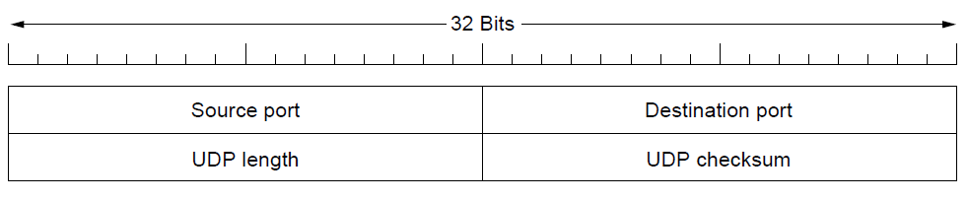
Introduction to UDP (1)
UDP (User Datagram Protocol) is a shim over IP
  Header has ports (TSAPs), length and checksum.
CN5E by Tanenbaum & Wetherall, © Pearson Education-Prentice Hall and D. Wetherall, 2011
Notes:
Not much additional functionality over IP!

Slide 40
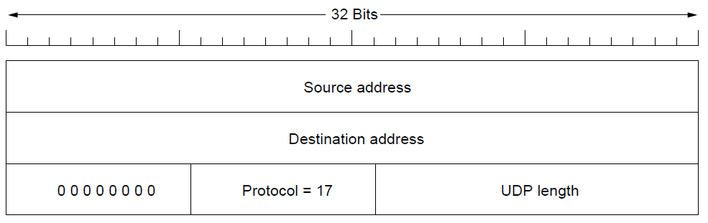
Introduction to UDP (2)
Checksum covers UDP segment and IP pseudoheader
  Fields that change in the network are zeroed out
  Provides an end-to-end delivery check
CN5E by Tanenbaum & Wetherall, © Pearson Education-Prentice Hall and D. Wetherall, 2011
Notes:
If IP pseudoheader wasn’t covered then nothing would check that the host addresses were correct.

Slide 41
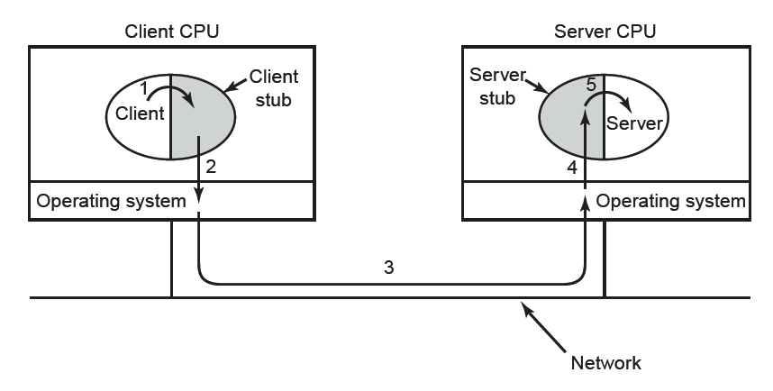
RPC (Remote Procedure Call)
RPC connects applications over the network with the familiar abstraction of procedure calls
  Stubs package parameters/results into a message
  UDP with retransmissions is a low-latency transport
CN5E by Tanenbaum & Wetherall, © Pearson Education-Prentice Hall and D. Wetherall, 2011

Slide 42
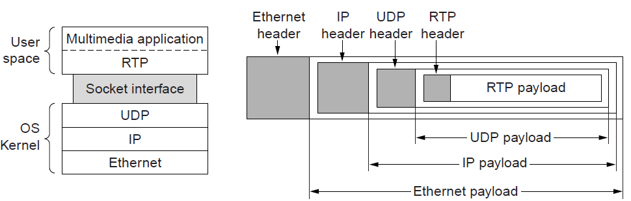
Real-Time Transport (1)
RTP (Real-time Transport Protocol) provides support for sending real-time media over UDP
  Often implemented as part of the application
CN5E by Tanenbaum & Wetherall, © Pearson Education-Prentice Hall and D. Wetherall, 2011

Slide 43
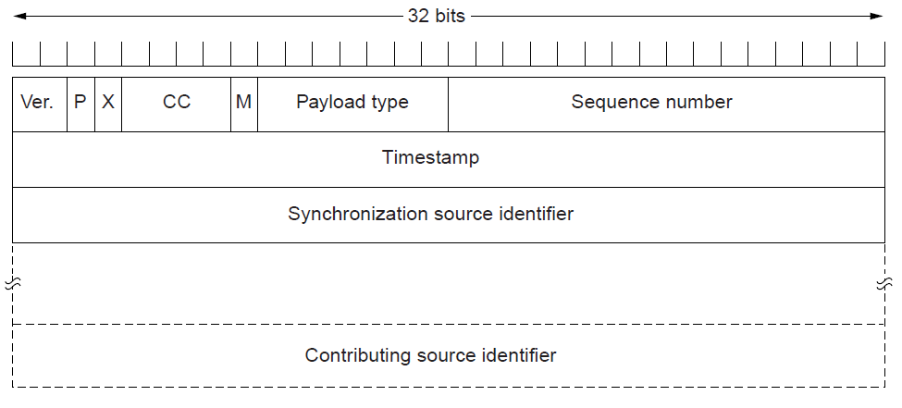
Real-Time Transport (2)
RTP header contains fields to describe the type of media and synchronize it across multiple streams
  RTCP sister protocol helps with management tasks
CN5E by Tanenbaum & Wetherall, © Pearson Education-Prentice Hall and D. Wetherall, 2011

Slide 44
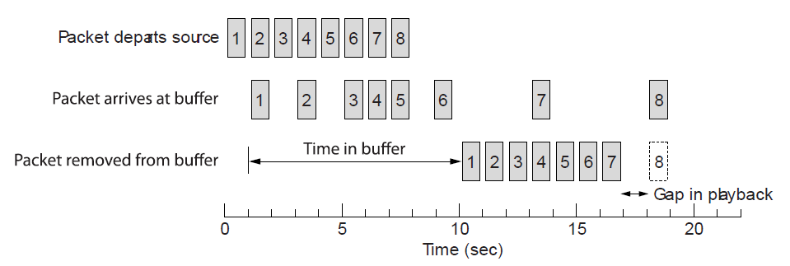
Real-Time Transport (3)
Buffer at receiver is used to delay packets and absorb jitter so that streaming media is played out smoothly
Packet 8’s network delay is too large for buffer to help
Constant rate
Variable rate
Constant rate
CN5E by Tanenbaum & Wetherall, © Pearson Education-Prentice Hall and D. Wetherall, 2011

Slide 45
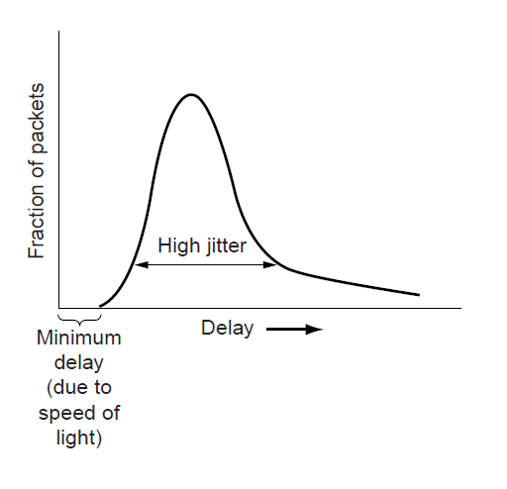
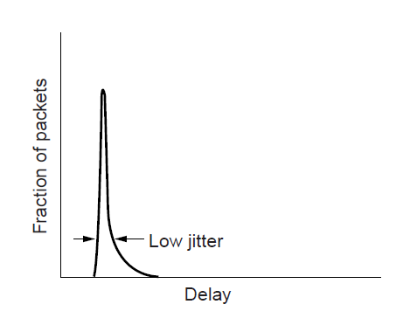
Real-Time Transport (3)
High jitter, or more variation in delay, requires a larger playout buffer to avoid playout misses
  Propagation delay does not affect buffer size
Buffer
Misses
CN5E by Tanenbaum & Wetherall, © Pearson Education-Prentice Hall and D. Wetherall, 2011

Slide 46
Internet Protocols – TCP
  The TCP service model »
  The TCP segment header »
  TCP connection establishment »
  TCP connection state modeling »
  TCP sliding window »
  TCP timer management »
  TCP congestion control »
CN5E by Tanenbaum & Wetherall, © Pearson Education-Prentice Hall and D. Wetherall, 2011

Slide 47
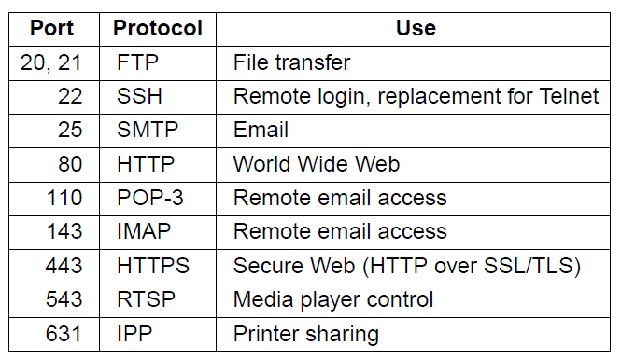
The TCP Service Model (1)
TCP provides applications with a reliable byte stream between processes; it is the workhorse of the Internet
  Popular servers run on well-known ports
CN5E by Tanenbaum & Wetherall, © Pearson Education-Prentice Hall and D. Wetherall, 2011

Slide 48
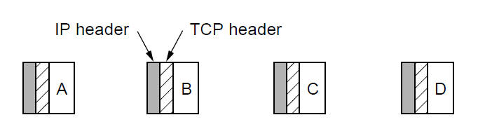
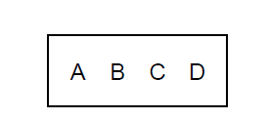
The TCP Service Model (2)
Applications using TCP see only the byte stream [right] and not the segments [left] sent as separate IP packets
Four segments, each with 512 bytes of data and carried in an IP packet
2048 bytes of data delivered to application in a single READ call
CN5E by Tanenbaum & Wetherall, © Pearson Education-Prentice Hall and D. Wetherall, 2011

Slide 49
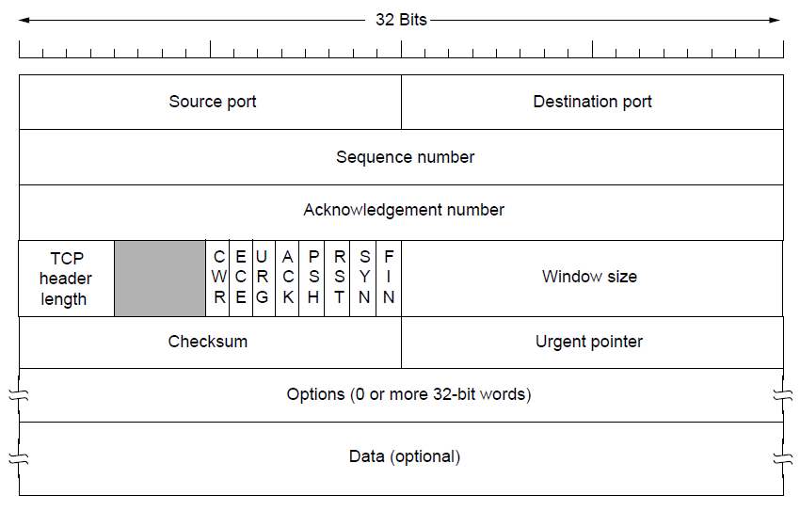
The TCP Segment Header
TCP header includes addressing (ports), sliding window (seq. / ack. number), flow control (window), error control (checksum) and more.
CN5E by Tanenbaum & Wetherall, © Pearson Education-Prentice Hall and D. Wetherall, 2011
Notes:
The flags say what kind of segment it is, e.g., SYN for a connection establishment (synchronize) segment. The ack. number is a cumulative acknowledgement that means all data up to that number has been received. After the fixed part can come options.

Slide 50
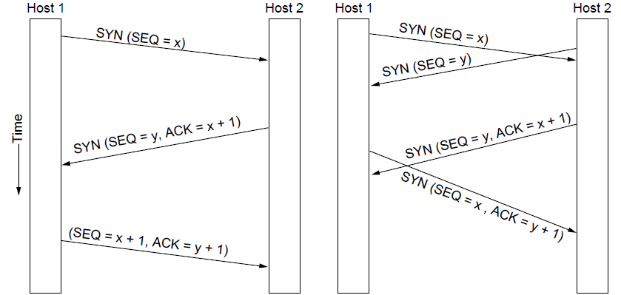
TCP Connection Establishment
TCP sets up connections with the three-way handshake
  Release is symmetric, also as described before
Normal case
Simultaneous connect
CN5E by Tanenbaum & Wetherall, © Pearson Education-Prentice Hall and D. Wetherall, 2011
Notes:
One slight difference from before: the receiver echoes ACK+1 rather than simply ACK to show that it received and understood the connection request.
Terminology: connection request is a SYN, for synchronize, disconnect request is a FIN for finish.

Slide 51
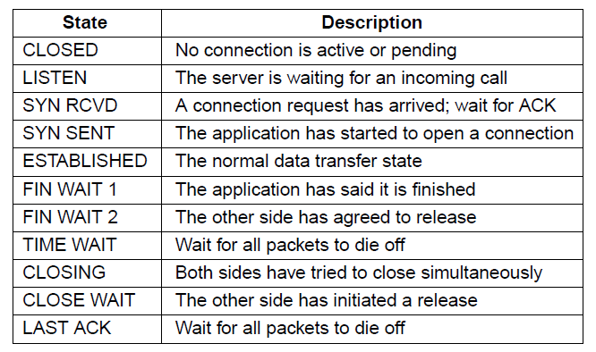
TCP Connection State Modeling (1)
The TCP connection finite state machine has more states than our simple example from earlier.
CN5E by Tanenbaum & Wetherall, © Pearson Education-Prentice Hall and D. Wetherall, 2011

Slide 52
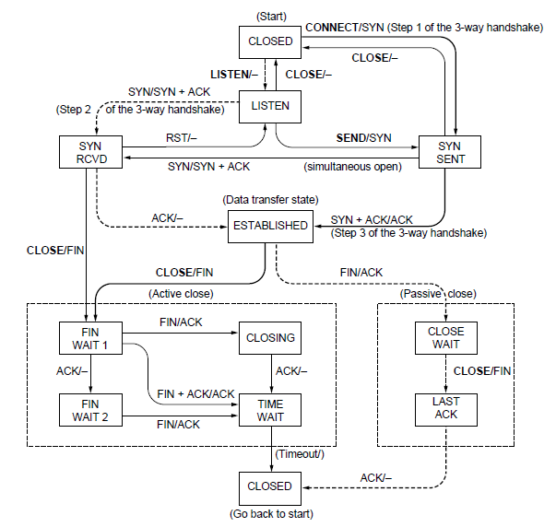
TCP Connection State Modeling (2)
Solid line is the normal path for a client.
Dashed line is the normal path for a server.
Light lines are unusual events.
Transitions are labeled by the cause and action, separated by a slash.
CN5E by Tanenbaum & Wetherall, © Pearson Education-Prentice Hall and D. Wetherall, 2011
Notes:
Exercise: using two instances of this, follow the path of a normal connection from a three-way handshake (both sides should move from closed to established using socket calls and packet exchanges) to teardown (both sides should move to closed at bottom). Ignore packet loss as it is not covered here. Then try a simultaneous open, etc.

Slide 53
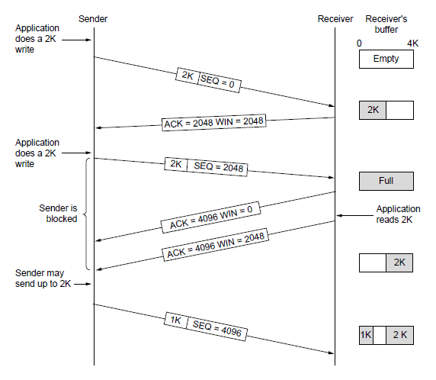
TCP Sliding Window (1)
TCP adds flow control to the sliding window as before
  ACK + WIN is the sender’s limit
CN5E by Tanenbaum & Wetherall, © Pearson Education-Prentice Hall and D. Wetherall, 2011
Notes:
To see why the figure is correct about where the data lies in the buffer note that it is a circular buffer. Data is put in from left to right then starts at the left edge again (bottom). Similarly, data is read out left to right (second from bottom).

Slide 54

TCP Sliding Window (2)
Need to add special cases to avoid unwanted behavior
  E.g., silly window syndrome [below]
Receiver application reads single bytes, so sender always sends one byte segments
CN5E by Tanenbaum & Wetherall, © Pearson Education-Prentice Hall and D. Wetherall, 2011
Notes:
These sort of things problems crop up in practice as being part of the mechanisms we have described so far. They usually call for modified sliding window / flow control rules in special cases. Solution for silly window syndrome is that receiver should not send window updates for tiny buffer openings like “one byte available”. It should wait until a whole segment can be buffered to avoid this.

Slide 55

TCP Timer Management
TCP estimates retransmit timer from segment RTTs
  Tracks both average and variance (for Internet case)
  Timeout is set to average plus 4 x variance
LAN case – small, regular RTT
Internet case – large, varied RTT
CN5E by Tanenbaum & Wetherall, © Pearson Education-Prentice Hall and D. Wetherall, 2011
Notes:
RTT is round-trip time, a measure of delay that can be easily computed at one end without synchronized clocks.
Average is computed with an EWMA, exponentially weighted moving average that is very simple: new value = alpha x old value + (1-alpha) x sample. Alpha is 7/8, say.
Similarly for estimating the variance. TCP actually computes the deviation from the mean with another EWMA.

Slide 56
TCP Congestion Control (1)
TCP uses AIMD with loss signal to control congestion
  Implemented as a congestion window (cwnd) for the number of segments that may be in the network
  Uses several mechanisms that work together
Name | Mechanism | Purpose
ACK clock | Congestion window (cwnd) | Smooth out packet bursts
Slow-start | Double cwnd each RTT | Rapidly increase send rate to reach roughly the right level
Additive Increase | Increase cwnd by 1 packet each RTT | Slowly increase send rate to probe at about the right level
Fast retransmit / recovery | Resend lost packet after 3 duplicate ACKs; send new packet for each new ACK | Recover from a lost packet without stopping ACK clock
CN5E by Tanenbaum & Wetherall, © Pearson Education-Prentice Hall and D. Wetherall, 2011

Slide 57

TCP Congestion Control (2)
Congestion window controls the sending rate
  Rate is cwnd / RTT; window can stop sender quickly
  ACK clock (regular receipt of ACKs) paces traffic and smoothes out sender bursts
ACKs pace new segments into the network and smooth bursts
CN5E by Tanenbaum & Wetherall, © Pearson Education-Prentice Hall and D. Wetherall, 2011

Slide 58

TCP Congestion Control (3)
Slow start grows congestion window exponentially
  Doubles every RTT while keeping ACK clock going
Increment cwnd for each new ACK
CN5E by Tanenbaum & Wetherall, © Pearson Education-Prentice Hall and D. Wetherall, 2011
Notes:
It’s only slow compared to jumping to a large window immediately, which was how it used to work when slow-start was invented.

Slide 59

TCP Congestion Control (4)
Additive increase grows cwnd slowly
  Adds 1 every RTT
  Keeps ACK clock
ACK
CN5E by Tanenbaum & Wetherall, © Pearson Education-Prentice Hall and D. Wetherall, 2011

Slide 60

TCP Congestion Control (5)
Slow start followed by additive increase (TCP Tahoe)
  Threshold is half of previous loss cwnd
Loss causes timeout; ACK clock has stopped so slow-start again
CN5E by Tanenbaum & Wetherall, © Pearson Education-Prentice Hall and D. Wetherall, 2011
Notes:
Slow-start switches to additive increase at the slow-start threshold, which is set to be half the cwnd at the previous data loss. (First loss that finds this threshold is not shown.)
With both slow-start and additive increase the connection spends much of its time with a reasonable cwnd. But we have to start over after loss because by the time it is detected the ACK clock has stopped.

Slide 61

TCP Congestion Control (6)
With fast recovery, we get the classic sawtooth (TCP Reno)
  Retransmit lost packet after 3 duplicate ACKs
  New packet for each dup. ACK until loss is repaired
The ACK clock doesn’t stop, so no need to slow-start
CN5E by Tanenbaum & Wetherall, © Pearson Education-Prentice Hall and D. Wetherall, 2011
Notes:
With fast recovery, the packet loss is detected with three duplicate ACKs, the lost packet (next to be ACKed) is retransmitted (fast retransmit), the cwnd is halved, and then a new packet is sent for each acknowledgment that is received. Eventually the ack will jump forward when the retransmission fills the hole, and at that point we synchronize.

Slide 62

TCP Congestion Control (7)
SACK (Selective ACKs) extend ACKs with a vector to describe received segments and hence losses
  Allows for more accurate retransmissions / recovery
No way for us to know that 2 and 5 were lost with only ACKs
CN5E by Tanenbaum & Wetherall, © Pearson Education-Prentice Hall and D. Wetherall, 2011

Slide 63
Performance Issues
Many strategies for getting good performance have been learned over time
  Performance problems »
  Measuring network performance »
  Host design for fast networks »
  Fast segment processing »
  Header compression »
  Protocols for “long fat” networks »
CN5E by Tanenbaum & Wetherall, © Pearson Education-Prentice Hall and D. Wetherall, 2011

Slide 64
Performance Problems
Unexpected loads often interact with protocols to cause performance problems
  Need to find the situations and improve the protocols
Examples:
  Broadcast storm: one broadcast triggers another
  Synchronization: a building of computers all contact the DHCP server together after a power failure
  Tiny packets: some situations can cause TCP to send many small packets instead of few large ones
CN5E by Tanenbaum & Wetherall, © Pearson Education-Prentice Hall and D. Wetherall, 2011

Slide 65
Measuring Network Performance
Measurement is the key to understanding performance – but has its own pitfalls.
Example pitfalls:
  Caching: fetching Web pages will give surprisingly fast results if they are unexpectedly cached
  Timing: clocks may over/underestimate fast events
  Interference: there may be competing workloads
CN5E by Tanenbaum & Wetherall, © Pearson Education-Prentice Hall and D. Wetherall, 2011

Slide 66
Host Design for Fast Networks
Poor host software can greatly slow down networks.
Rules of thumb for fast host software:
  Host speed more important than network speed
  Reduce packet count to reduce overhead
  Minimize data touching
  Minimize context switches
  Avoiding congestion is better than recovering from it
  Avoid timeouts
CN5E by Tanenbaum & Wetherall, © Pearson Education-Prentice Hall and D. Wetherall, 2011

Slide 67

Fast Segment Processing (1)
Speed up the common case with a fast path [pink]
  Handles packets with expected header; OK for others to run slowly
Segment
segment
CN5E by Tanenbaum & Wetherall, © Pearson Education-Prentice Hall and D. Wetherall, 2011

Slide 68

Fast Segment Processing (2)
Header fields are often the same from one packet to the next for a flow; copy/check them to speed up processing
TCP header fields that stay the same for a one-way flow (shaded)
IP header fields that are often the same for a one-way flow (shaded)
CN5E by Tanenbaum & Wetherall, © Pearson Education-Prentice Hall and D. Wetherall, 2011

Slide 69
Header Compression
Overhead can be very large for small packets
  40 bytes of header for RTP/UDP/IP VoIP packet
  Problematic for slow links, especially wireless
Header compression mitigates this problem
  Runs between Link and Network layer
  Omits fields that don’t change or change predictably
    40 byte TCP/IP header → 3 bytes of information
  Gives simple high-layer headers and efficient links
CN5E by Tanenbaum & Wetherall, © Pearson Education-Prentice Hall and D. Wetherall, 2011

Slide 70

Protocols for “Long Fat” Networks (1)
Networks with high bandwidth (“Fat”) and high delay (“Long”) can store much information inside the network
  Requires protocols with ample buffering and few RTTs, rather than reducing the bits on the wire
Starting to send 1 Mbit
San Diego → Boston
20ms after start
40ms after start
CN5E by Tanenbaum & Wetherall, © Pearson Education-Prentice Hall and D. Wetherall, 2011

Slide 71

Protocols for “Long Fat” Networks (2)
You can buy more bandwidth but not lower delay
  Need to shift ends (e.g., into cloud) to lower further
Propagation delay
Minimum time to send and ACK a 1-Mbit file over a 4000-km line
CN5E by Tanenbaum & Wetherall, © Pearson Education-Prentice Hall and D. Wetherall, 2011

Slide 72
Delay Tolerant Networking
DTNs (Delay Tolerant Networks) store messages inside the network until they can be delivered
  DTN Architecture »
  Bundle Protocol »
CN5E by Tanenbaum & Wetherall, © Pearson Education-Prentice Hall and D. Wetherall, 2011

Slide 73

DTN Architecture (1)
Messages called bundles are stored at DTN nodes while waiting for an intermittent link to become a contact
  Bundles might wait hours, not milliseconds in routers
  May be no working end-to-end path at any time
CN5E by Tanenbaum & Wetherall, © Pearson Education-Prentice Hall and D. Wetherall, 2011

Slide 74

DTN Architecture (2)
Example DTN connecting a satellite to a collection point
CN5E by Tanenbaum & Wetherall, © Pearson Education-Prentice Hall and D. Wetherall, 2011
Notes:
What is the advantage of using a DTN here versus a traditional wireless network? There may be no working path sometimes (satellite has no contact, ground station backhaul broken) or the path might not exist for long enough to send a but satellite software would still like to “send images” without worrying about these issues even if the network stores them. Storing bundles at ground stations also decouples the satellite link from the ground backhaul. If the wireless is faster then images may be stored in the ground station.

Slide 75

Bundle Protocol (1)
The Bundle protocol uses TCP or other transports and provides a DTN service to applications
CN5E by Tanenbaum & Wetherall, © Pearson Education-Prentice Hall and D. Wetherall, 2011
Notes:
Why the convergence layer? We want to define just one Bundle protocol to run over TCP or other transport layers (SCTP, etc.). The transport protocols are not going to have exactly the same interfaces, so they will not fit exactly with the bundle protocol. Convergence layers are the glue that join the interfaces together.

Slide 76

Bundle Protocol (2)
Features of the bundle message format:
    Dest./source add high-level addresses (not port/IP)
    Custody transfer shifts delivery responsibility
    Dictionary provides compression for efficiency
CN5E by Tanenbaum & Wetherall, © Pearson Education-Prentice Hall and D. Wetherall, 2011

Slide 77
End
Chapter 6
CN5E by Tanenbaum & Wetherall, © Pearson Education-Prentice Hall and D. Wetherall, 2011

