Slide 1
2017 GDP ANALYSIS of 177 countries using data analytics tools
By Hanwen, Bhav and Sana

Slide 2
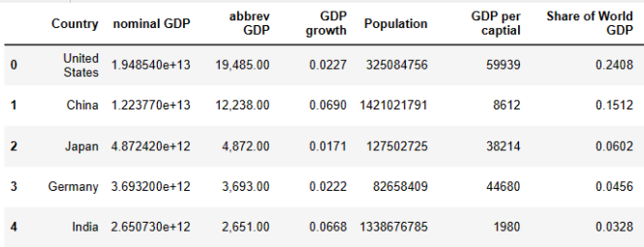
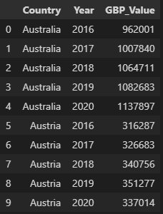
Data collection & cleaning
www.Eric_Grose.com (😆)
Nasdaq

Slide 3
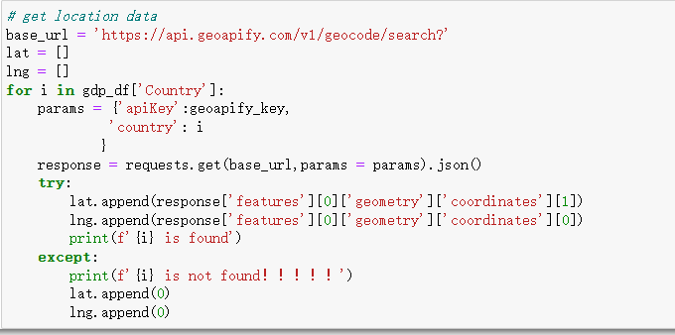

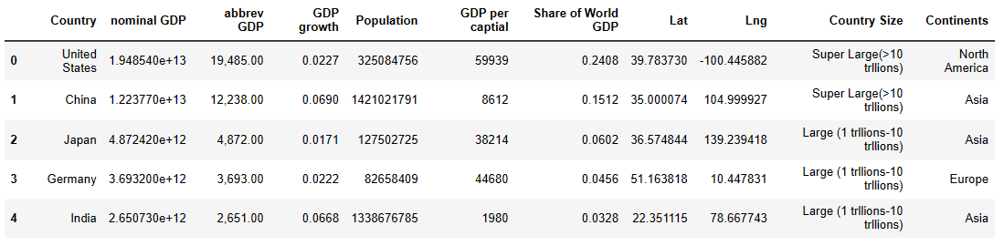
Location Data from APIs

Slide 4
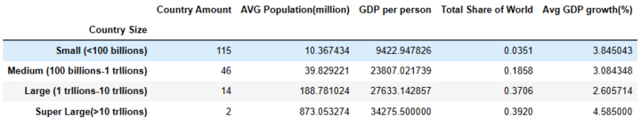
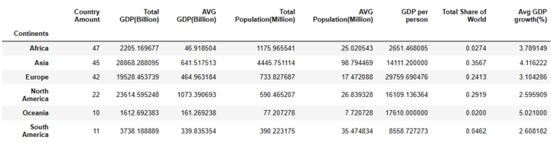
Groupby Summary
After groupby on country size, America and China take almost 40 percent from world and other 14 countries take 37 percent of the world, which means 14 countries take 78% GDP and other 161 countries only got 22% GDP.
After groupby on continents, Oceania's GDP grows fastest and North America, Asia and Europe take most part of World GDP. However, the Average GDP in Africa is lowest. Europe countries got highest GDP per Person which means Europe countries are most developed countries.

Slide 5
QUESTION
HOW THESE COUNTRIES GOING ON IN 2016 TO 2020

Slide 6
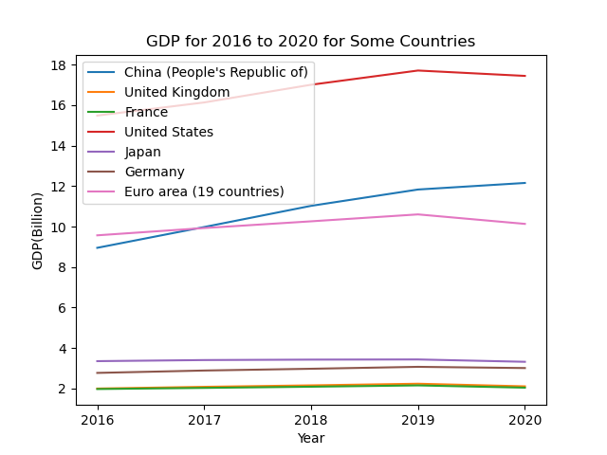
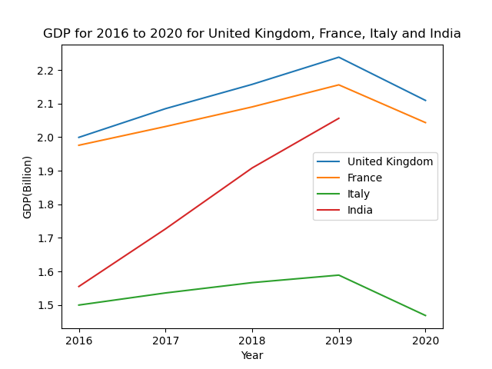
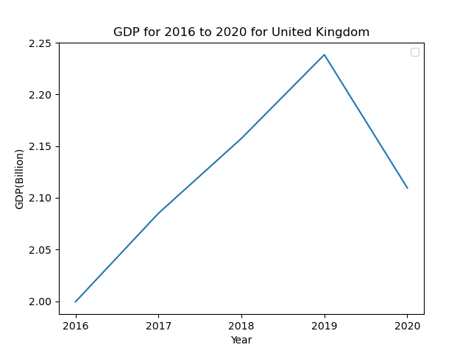
GDP Data for 2016 to 2020
USA is top one country. China and Europe are on the same level.
UK and France are same. The slope shows India grows up really fast. However, the first covid year happened.
Breakdown to UK, the growth is stable in first four year. However, the first covid year affect a lot to UK.

Slide 7
QUESTION
HOW THE GDP WORLD MAP LOOK LIKE?

Slide 8
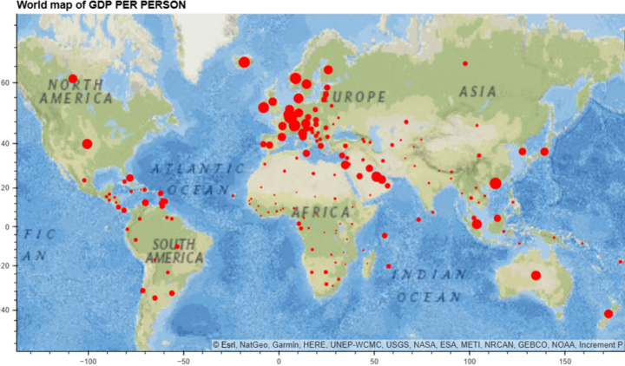
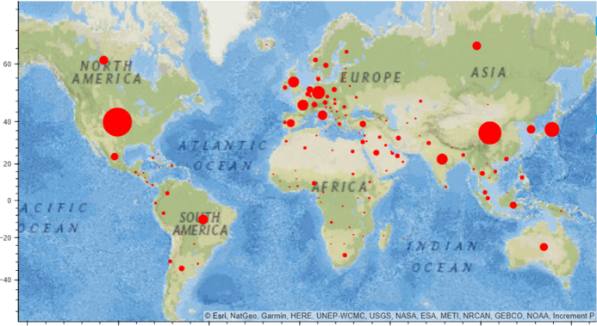
World Map
World Map for GDP Per Person World Map for Total Nominal GDP
Point size is based on GDP per Person, which means point size directly shows the development of the country. The map shows most Europe countries are well developed.
Point size is based on total GDP, which means point size shows the development of the country. The map shows USA and China are two biggest part of world GDP.

Slide 9
QUESTION
IS THERE ANY RELATIONSHIP BETWEEN POPULATION AND TOTAL GDP OF THESE COUNTRIES?

Slide 10
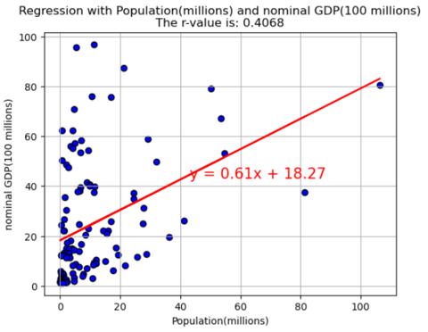
Linear Regressions
R_Value is 0.4068
For small countries(which total GDP is smaller than 100 billions), if population grows up 1 millions, the total GDP will increase around 61 millions dollar.

Slide 11
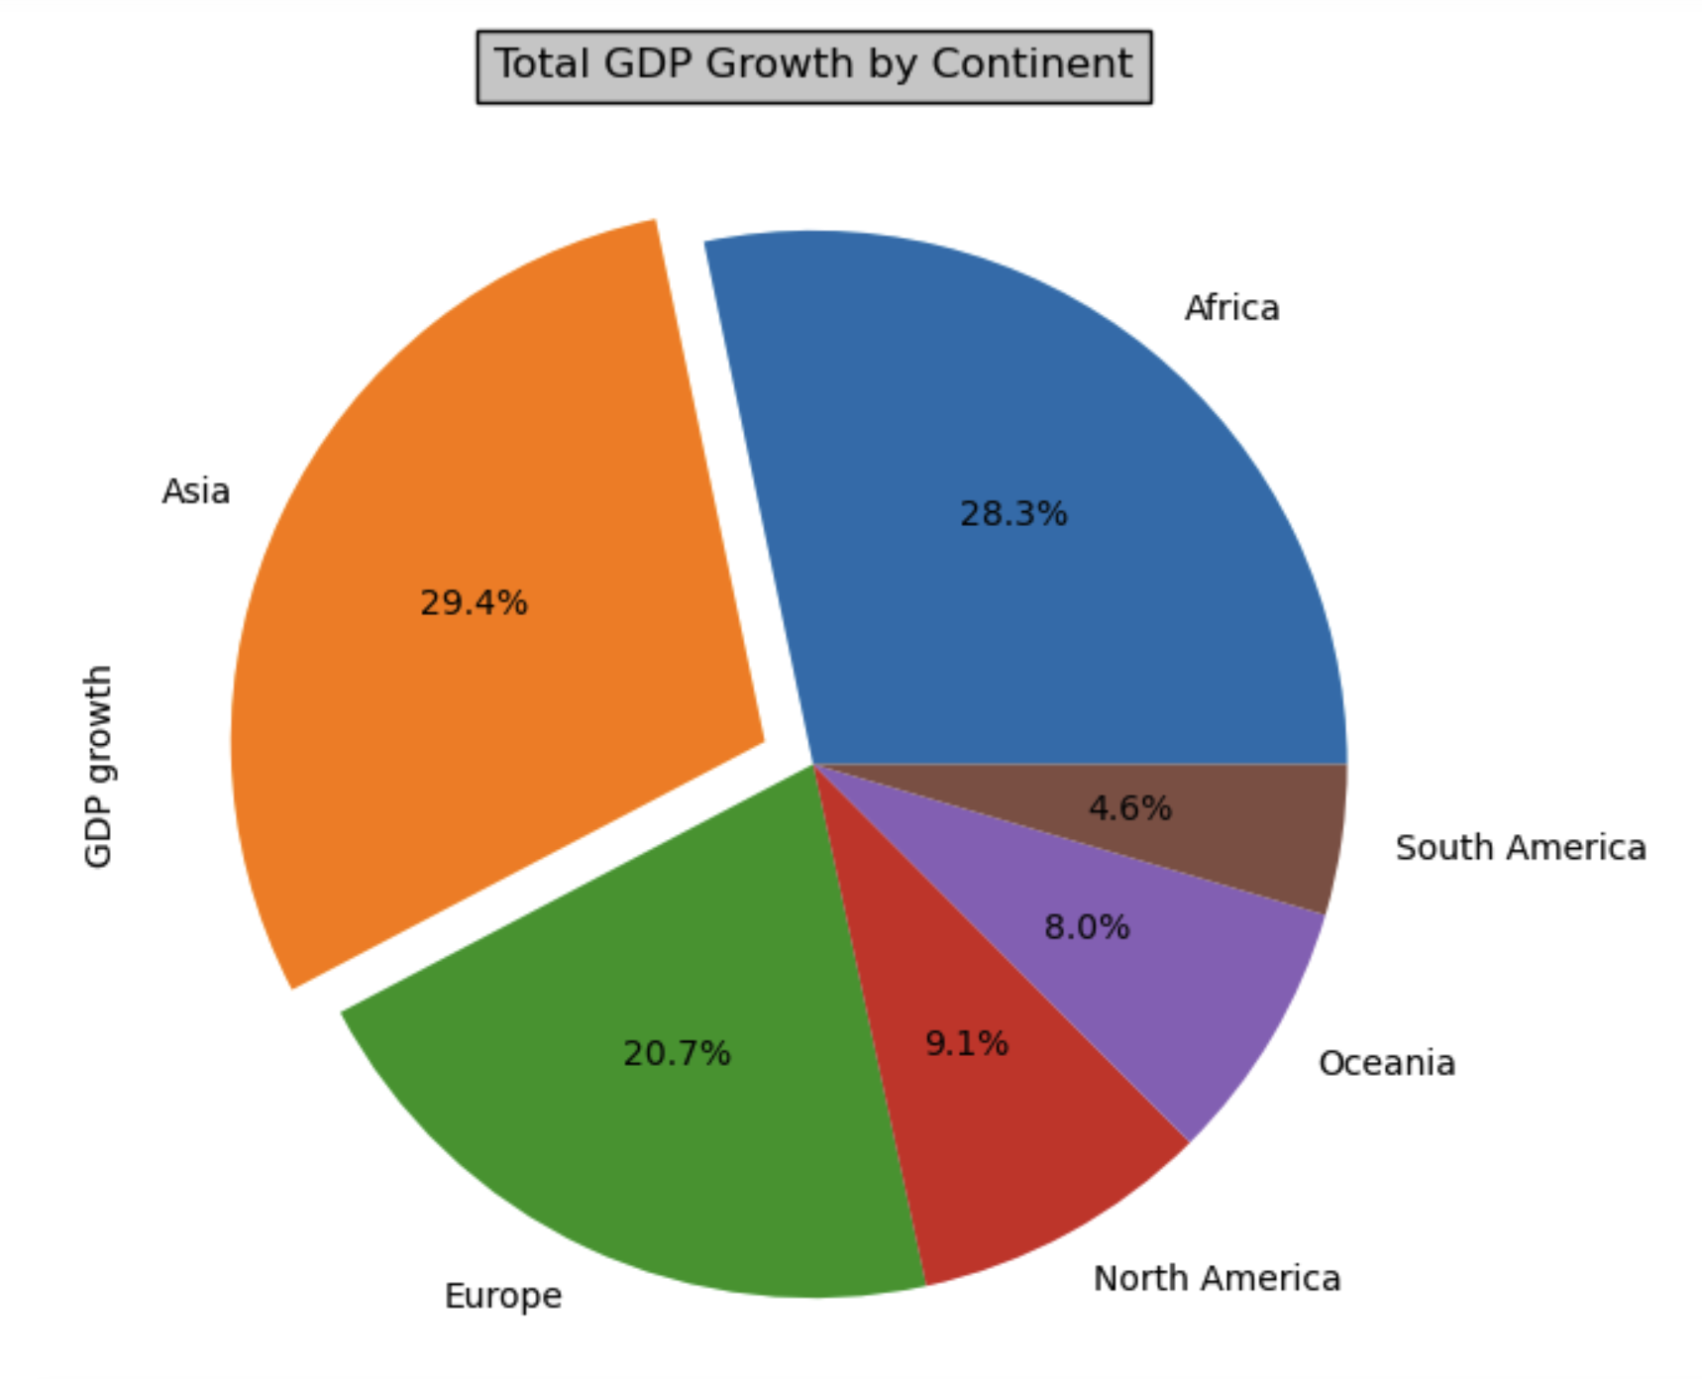
GDP Growth by continents
The estimated GDP growth rates by continent in 2017 reflect some general trends and patterns in the global economy. Here are some key points:
Asia :Highest estimated GDP growth rate at 6.4%. Reflects continued economic growth and development in countries such as China, India, and Japan
Africa: Moderate estimated GDP growth rate at 3.2%. Reflects gradual economic growth and development, despite challenges such as poverty and political instability
Europe:Slow estimated GDP growth rate at 2.4%. Reflects ongoing economic challenges such as high debt, low productivity, and slow population growth
North Americas: Moderate estimated GDP growth rate at 2.2%. Reflects relatively stable economic conditions in the United States and Canada
Oceania: Moderate estimated GDP growth rate at 2.7%. Reflects relatively stable economic conditions in Australia and New Zealand
South America: Very low estimated GDP growth rate at 0.9%. Reflects economic challenges such as political instability, high inflation, and low foreign investment.

Slide 12
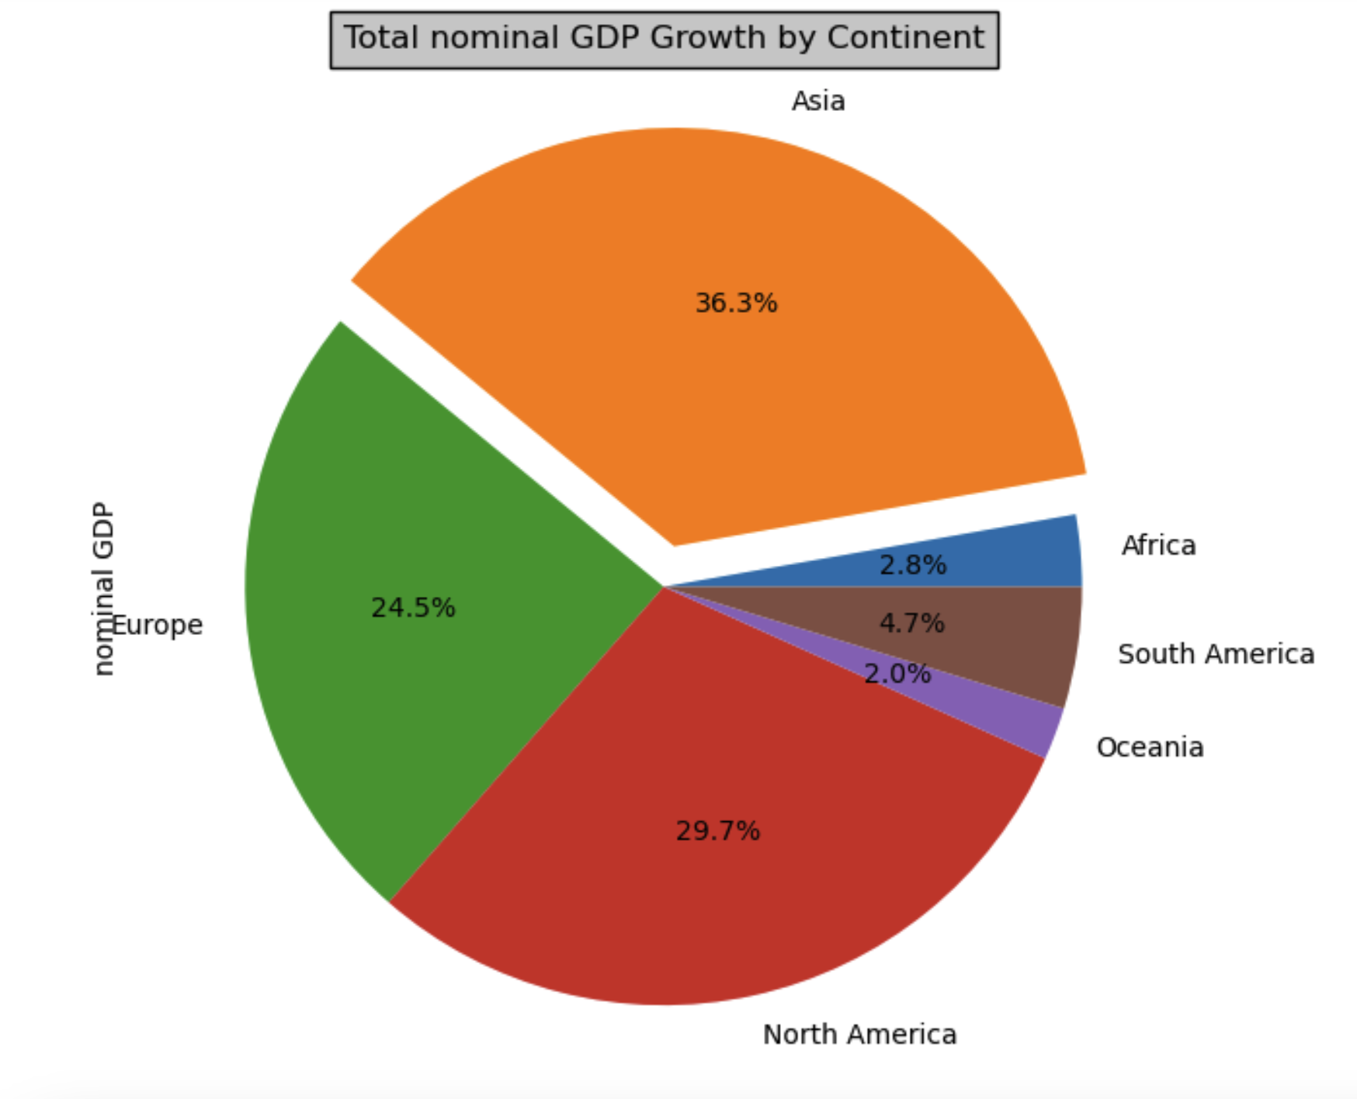
Nominal GDP ranking by continents
Nominal GDP measures the economic output of a country or region without adjusting for inflation, so it may not reflect differences in the cost of living or the purchasing power of consumers but gives an overall idea of country's total economic output (goods and services) as valued at current market prices.
Asia had the largest nominal GDP of $31.9 trillion, with China being the second-largest economy in the world.
North America had a nominal GDP of $21.6 trillion, with the United States being the largest economy in the region.
Europe had a nominal GDP of $21.1 trillion, with the European Union being a significant contributor to the economic output of the region.
South America had a nominal GDP of $3.1 trillion, with Brazil being the largest economy in the region.
Oceania had a nominal GDP of $1.4 trillion, with Australia being the largest economy in the region.
Africa had a nominal GDP of $2.4 trillion, with Nigeria being the largest economy in Africa.

Slide 13
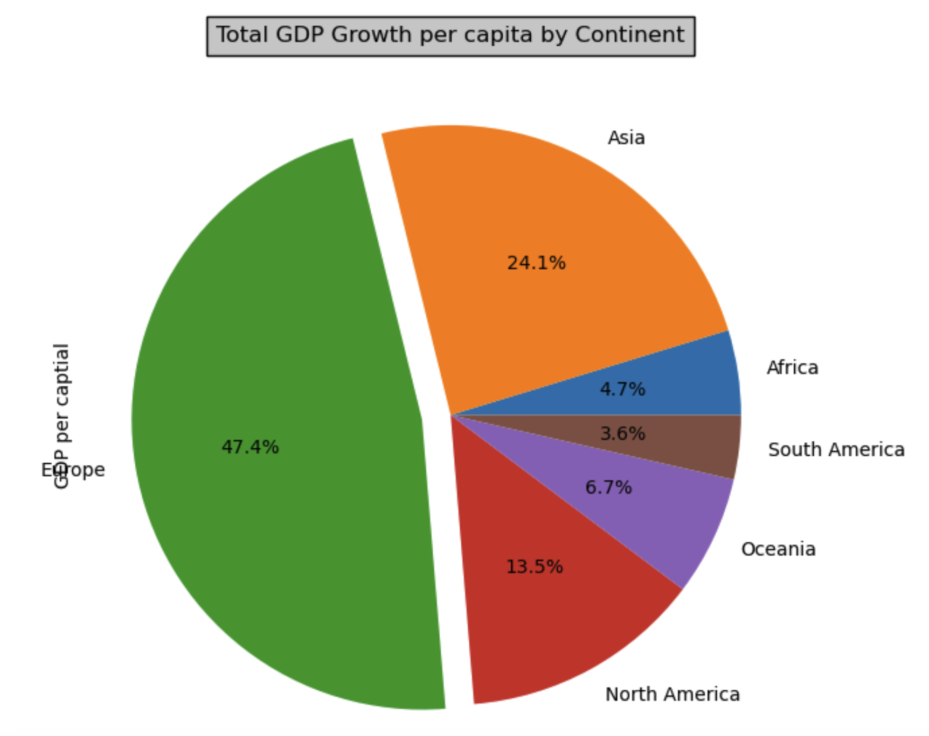
GDP per capita by continents
Analyzing the data it emerged out that GDP per capita in different continents are dominated by the European region which covered almost 48% as compared to the global GDP per capita.
This trend can be summarised due to numerous reasons such as: developed infrastructure, highly educated workforce, political stability, diversified economy, and strong social welfare systems.
While on the other hand South America and Africa have lower GDP per capita due to a combination of factors including economic dependence, political instability, weak infrastructure, income inequality, and lack of diversification.

Slide 14
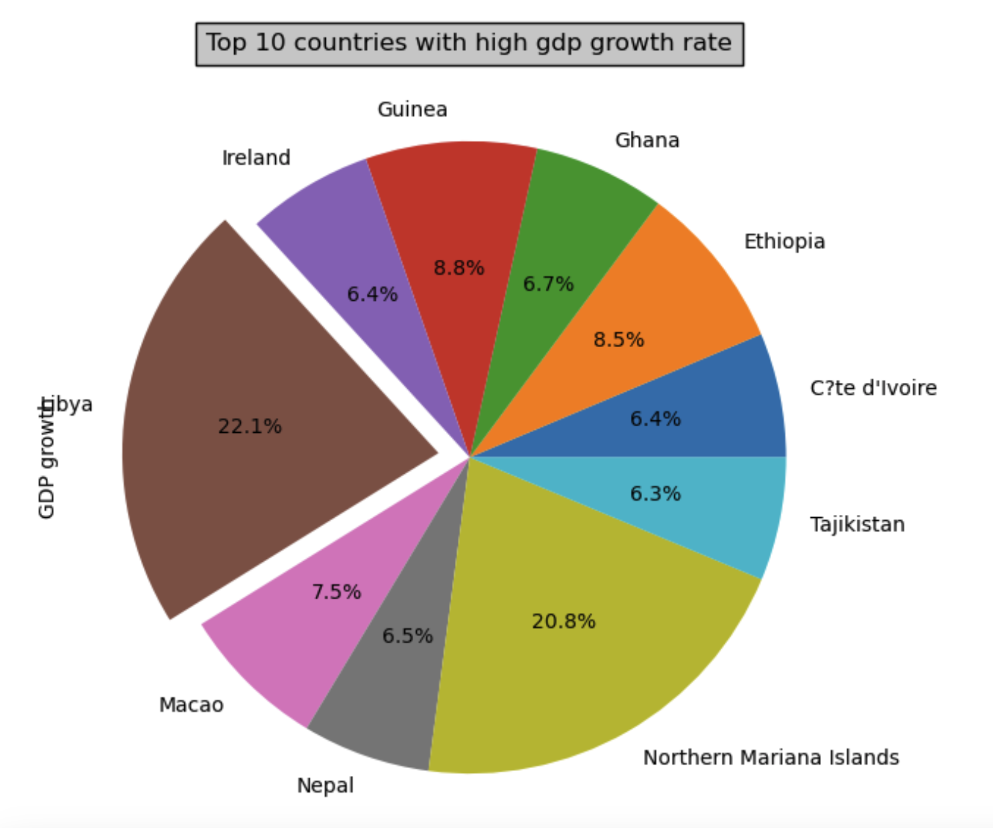
GDP growth index by countries
High GDP growth is another measure that highlighted the country’s with the significant improvement in their local economy.
After years of conflict and low oil prices, Libya's real GDP growth rate rebounded to an estimated 22.1% in 2017. The growth was driven by a sharp increase in oil production and exports, which account for the majority of the country's GDP followed by Northern Mariana Islands and African countries.

Slide 15
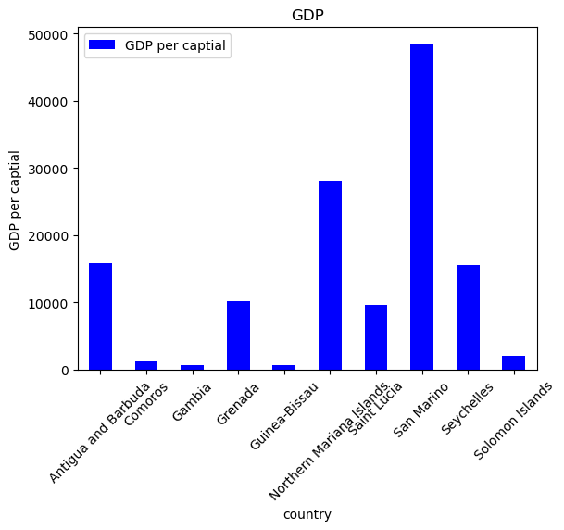
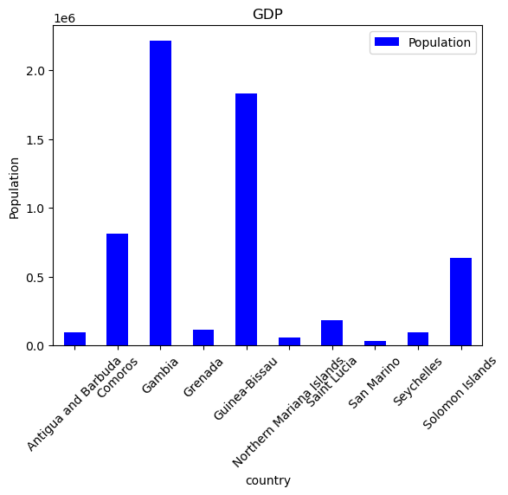
Bar charts- Top ten poorest countries in terms of GDP per Capita and Population.
T

Slide 16
Analysis of top ten poorest Countries
The correlation is very clear.After Analysis the both graphs Correlation between GDP per capita and the Population of the country are very clearly inversely proportional to each other.Higher the Population lower GDP per capita and it is more prominent with poor countries.Since, their overall GDP is already low and more population hits it more when it comes to individual share of GDP per person.

Slide 17
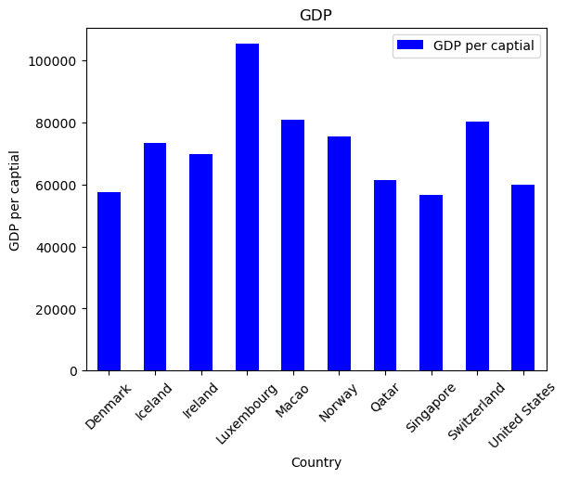
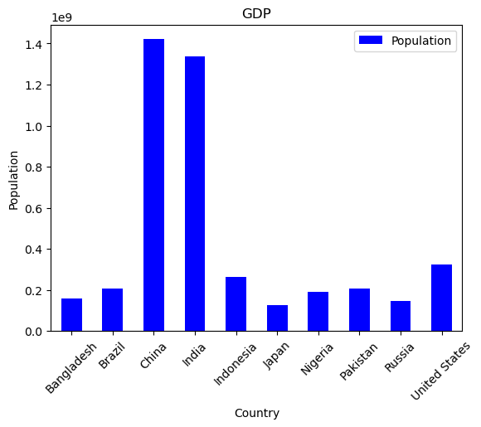
Top Ten Richest countries in terms of GDP per capital
And Population

Slide 18
Analysis of top ten poorest Countries
Although GDP of the country like India and china are high.Since their population is so huge resulting in lower GDP per capita .Therefore it does not form the part of top 10 GDP per capita.

Slide 19
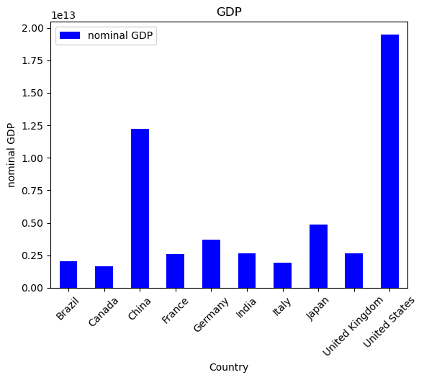
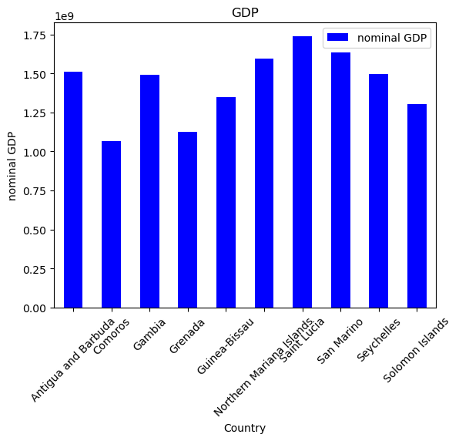
Top ten poorest countries in terms of NominalGDP vs. Top ten Richest countries.

Slide 20


