Slide 1
Problem Analysis

Slide 2
Objectives:
By the end of this session, the student will be able to:
Explain the purpose of the IPO Chart

Slide 3
PDT - Define the Problem
PDT - Define the Problem
  From the previous session, the first step in developing a Program was described as:
Must have a clear understanding of the problem
There is no room for assumptions
There is no difference between solving the wrong problem correctly and solving the right problem incorrectly
To help with analysis, the problem should be broken into:
  Inputs
  Outputs
  Processes
IPO Charts are a tool used

Slide 4








IPO Charts
IPO Charts
  If we have an understanding of what the input will be, and what the output will be, we will have a better chance of determining what needs to be done to transform input into output.

Slide 5

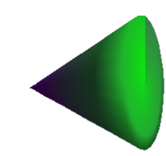
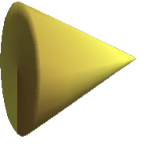
IPO Charts, continued
IPO Charts, continued
  The software that we write is best thought of as a 'Black Box'. There will be data feeding into it, and information flowing out of it.
  We can list tasks that must take place in the 'Black Box' in order to facilitate the transformation of input to output.

Slide 6
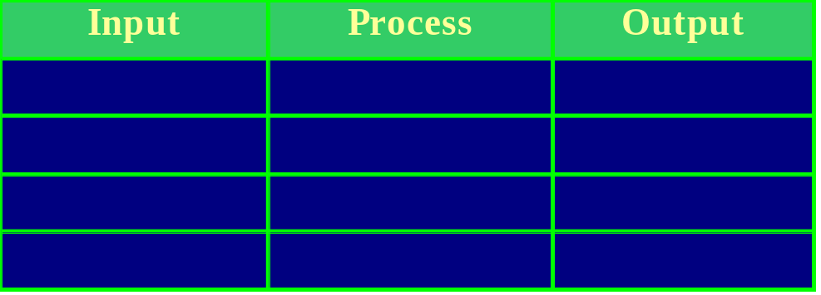
IPO Charts, continued
IPO Charts, continued
  Step 2 of the Program Development Cycle referred to a tool called an IPO Chart. It is also known as a Defining Diagram. IPO is an acronym for Input Process Output. It is a technique to break a problem down into one of these three categories using a chart such as:

Slide 7
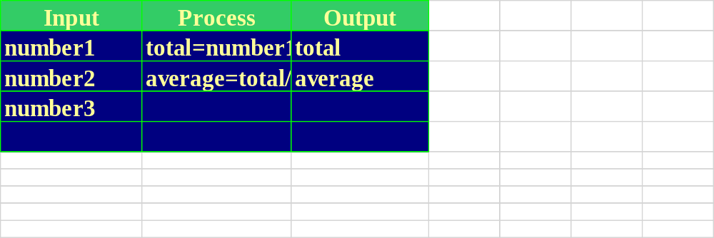
IPO Charts, continued
IPO Charts, continued
  Example:
  Develop a program to accept three numbers, add them together, then print their total and average.
  What would an IPO Chart look like?

Slide 8
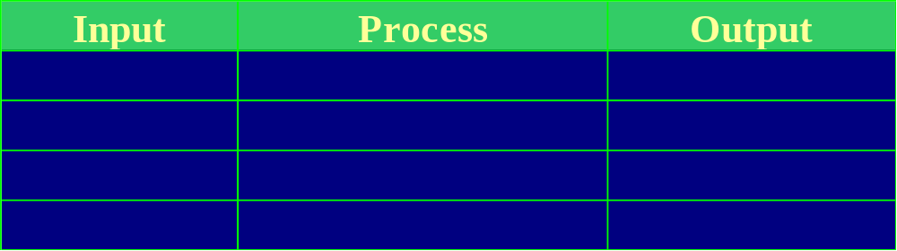

Slide 9
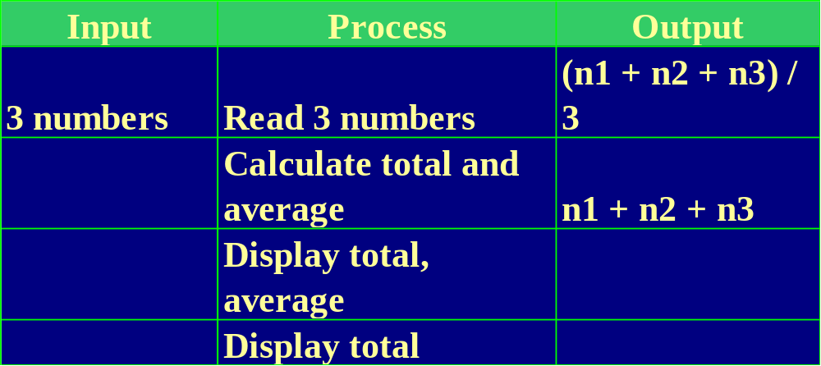
IPO Charts, continued
IPO Charts, continued
  Why is the following chart wrong?

Slide 10
IPO Charts, continued
IPO Charts, continued
  Example:
  Develop a program that displays the area and perimeter of a triangle when only two sides are given. The two sides will be 'a' and 'b' from the diagram below.
  c² = a² + b²
  area = 0.5 x (a x b)‏
  What would an IPO Chart look like?
c
a
b

Slide 11
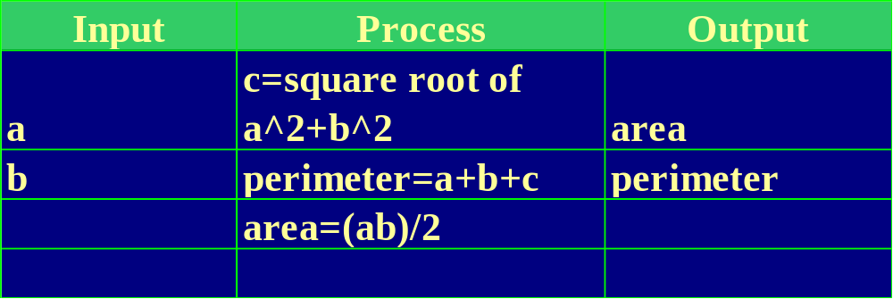

Slide 12

Read the problems on the following slides and create IPO charts for each. Read each one carefully to make sure you understand what needs to be solved. Then identify the information you will need to solve it and what information needs to be displayed. Finally determine the calculations and decisions required to take your inputs and convert them to the required outputs.

Slide 13
Problem #1
Juanita is planning a trip to visit the Grand Canyon. Since she lives in Seattle, Washington, she is concerned about the cost of gas needed to make the trip. Traveling on the highway, Juanita’s car gets 18 miles per gallon (MPG). Assuming that the average cost of gas is in dollars per gallon (DPG), calculate how much money it will cost for her to travel to the Grand Canyon. Using the equation below, you can calculate the cost of travel by distance divided by MPG times CPG:
cost = distance ÷ MPG×DPG

Slide 14
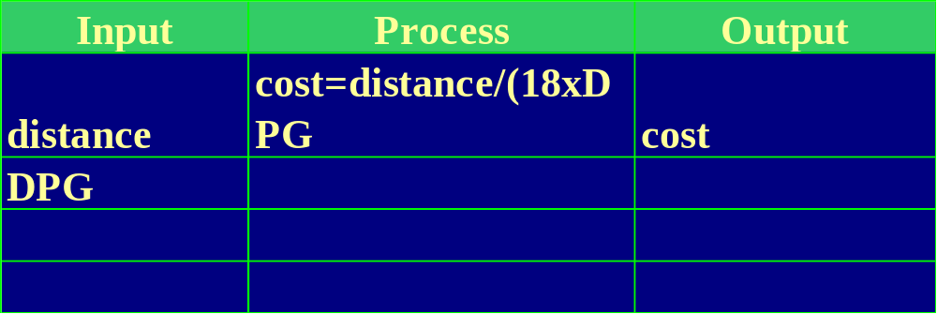

Slide 15
Problem #2
  In order to determine the maximum range available to an aircraft flying a specific direction, the fuel on board becomes the limiting factor. While flying the assigned heading, the aircraft may experience a headwind or a tailwind. Headwinds will be indicated by negative numbers, tailwinds by positive numbers.
  The cruise performance chart for the aircraft provides the airspeed and rate of fuel consumption for various altitudes and power settings. The pilot is responsible for selecting the altitude & power setting from the performance chart. Based on the values selected by the pilot from the cruise performance chart, calculate and display the actual speed of the aircraft over the ground and the maximum range of the aircraft. For maximum range, the aircraft is permitted to expend all but 15% of the starting fuel capacity.
  Ground speed = Cruise airspeed + wind
  Time aloft = (0.85 * fuel) / rate of consumption
  Maximum range = Ground Speed * Time aloft

Slide 16
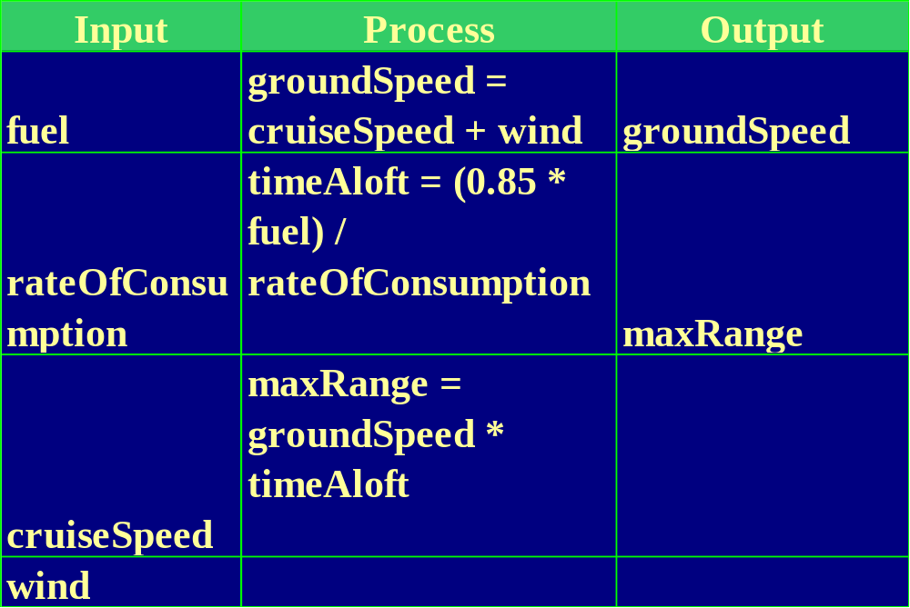

Slide 17
Problem #3
  Calculate the gross pay and net pay for an employee. Display each deduction, total deduction, gross pay and net pay for the employee.
  Overtime is calculated at 1.5 times the normal rate for hours worked in excess of 44 hours/week.
  Long term benefits are charged at $2.00 per every full $100.00 of gross weekly earnings to a maximum payment of $100.00 per week.
  Unemployment insurance is 1.3% of gross pay to a maximum of $11.40 per week.
  Canada Pension Plan is 1.6% of gross pay on all earnings below $700 per week.
  Federal tax is calculated at 17% on the first $20,000 earned annually, 23% on the next $20,000 earned annually and 29% on the remainder.
  Provincial tax which is calculated with the Federal tax is 49% of Federal tax collected.

Slide 18
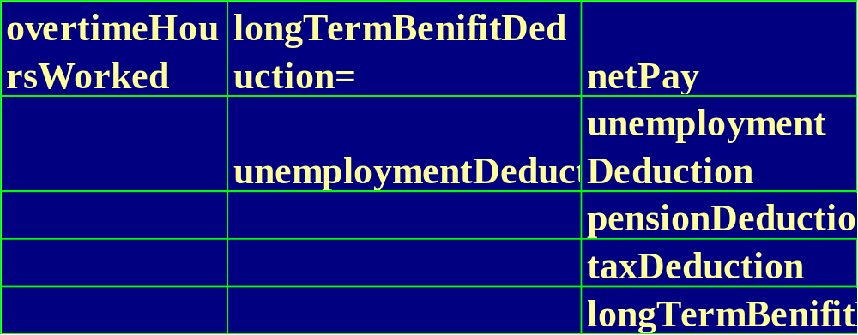

Slide 19
Problem #4
  Create a four-function calculator. The program will prompt the user to enter three values. The first value entered is a value that tells the program what operation to perform, the second and third values are the values to be used in the calculation. The possible values that determine the operation to be performed are: 'A' for Add, 'S' for subtract, 'M' for multiply, 'D' for divide, and 'Q' to quit the program. After reading the input values, the program will perform the required operation, and display the output in the form:
  x operation y = result
  Where x and y are the two numbers entered, operation is a full description of the operation performed to make a proper sentence (i.e. 'plus', 'minus', 'multiplied by' and 'divided by'), and result is the result of the calculation.

Slide 20
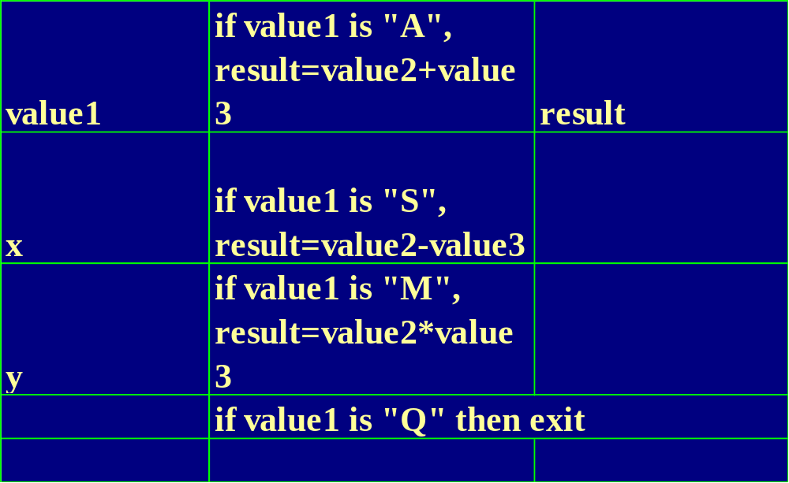

Slide 21
Problem #5
  The members of the Board of a small university are considering voting for a pay increase for their 25 faculty members. They are considering a pay increase of 8%, but before doing so they want to know how much this pay increase will cost. Design a program which will prompt for and accept the current salary for each of the faculty members, and then calculate and display their individual pay increases. At the end of the program, you are to print the total faculty payroll before and after the pay increase, and the total pay increase involved.

Slide 22
