Slide 1
File Paths
*referenced from http://www.coffeecup.com/help/articles/absolute-vs-relative-pathslinks/
And http://docs.oracle.com/javase/tutorial/essential/io/path.html

Slide 2
What Is a Path?
A file system stores and organizes files on some form of media, generally one or more hard drives, in such a way that they can be easily retrieved. Most file systems in use today store the files in a {tree}(or {hierarchal}) structure. At the top of the tree is one (or more) {root} nodes. Under the root node, there are {files} and {directories}(folders in Microsoft Windows). Each directory can contain files and subdirectories, which in turn can contain files and subdirectories, and so on, potentially to an almost limitless depth.

Slide 3
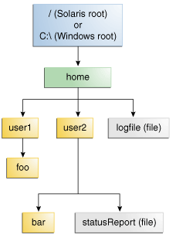
What Is a Path?
The following figure shows a sample directory tree containing a {single} root node. Microsoft Windows supports multiple root nodes. Each root node maps to a volume, such as {C:\ or D:\} . The Solaris OS supports a single root node, which is denoted by the {} character,

Slide 4
A file is identified by its path through the file system, beginning from the root node. For example, the statusReport file in the previous figure is described by the following notation in the Solaris OS:
{/home/user2/statusReport}
In Microsoft Windows, statusReport is described by the following notation:
{C:\/home/user2/statusReport}

Slide 5
The character used to separate the directory names (also called the {delimiter}) is specific to the file system: The Solaris OS and Unix systems (most web servers use Unix) uses the {forward slash/}, and Microsoft Windows uses the {backwards slash\}.

Slide 6
Relative or Absolute?
A path is either relative or absolute. An absolute path always contains the {root} element and the complete directory list required to locate the file. For example,/home/user2/statusReport is an {absolute} path. All of the information needed to locate the file is contained in the path string.

Slide 7
A relative path needs to be combined with another path in order to access a file. For example, user1/foo is a {relative} path. Without more information, a program cannot reliably locate the user1/foo directory in the file system.
Relative paths use {../} to move up the directory tree

Slide 8
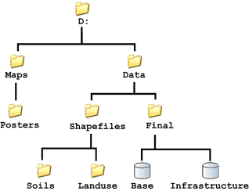
Exercises
Use the following directory tree to answer the questions in this section:

Slide 9
What is the root?
The first one D:
What is the absolute path to Base?
D:/Data/Final/Base
What is the absolute path to Infrastructure?
D:/Data/Final/Infrastructure
What information is needed prior to constructing a relative path to these two files?
The file tree or locations of files
Assume a file in Posters needs to reference Base. What would be its relative path?
../../Data/Final/Base
Assume the file is now in Base. What is the relative path to Infrastructure?
Infrastructure

Slide 10
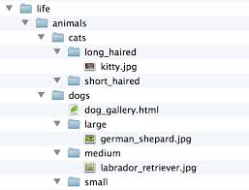
Use the following image of a directory tree to answer the questions on the following slides:

Slide 11
What is the root?
life
What is the absolute path to german_shepard.jpg?
Life/Animals/dogs/larger/german_shepard.jpg
dog_gallery.html needs to reference kitty.jpg. Write down the absolute and relative paths that could be used?
Life/Animals/Cats/long_haired/kitty.jpg
../Cats/long_haired/kitty.jpg
Why should we never use absolute paths?
Because it wont work properly
dog_gallery.html needs to reference labrador_retriever.jpg. Write down the absolute and relative paths.
Life/Animals/dogs/medium/Labrador_retriever.jpg
Medium/Labrador_retriever.jpg

Slide 12
IMPORTANT
Save this pptx to your Lesson 2 folder under Unit 1
When you have been taught how to create links you will be responsible for creating a link to this pptx and uploading it your class website
Don’t forget…your website can be marked at the end of each unit (unless otherwise stated) for completeness, design and functionality
A total of 15 APP marks will be assigned each time

