Slide 1

Primitive Data, Variables, Expressions and Arithmetic Operators

Slide 2
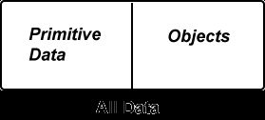
Primitive Data Types
byte | short | int | long | float | double | char | boolean
Objects
All data in Java falls into one of two categories: primitive data and objects.
Primitive data value uses a small, fixed number of bytes.
There are only eight primitive data types.
A programmer can not create new primitive data types.
An object is a big block of data. An object may use many bytes of memory.
An object usually consists of many internal pieces.
The data type of an object is called its class.
Many classes are already defined in Java.
A programmer can invent new classes to meet the particular needs of a program.

Slide 3
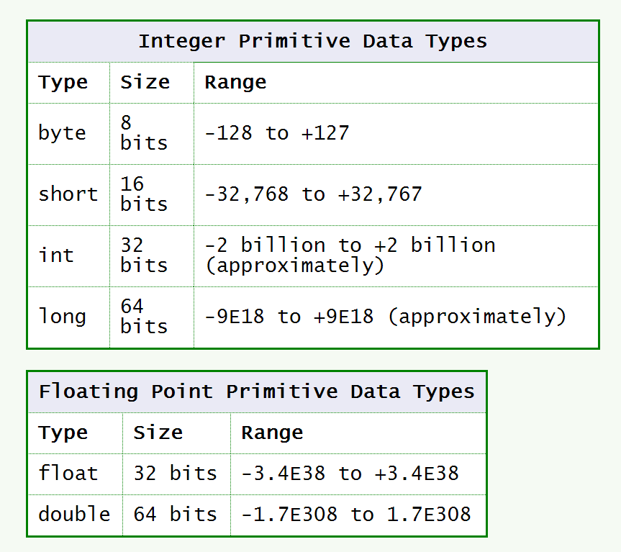
Data Type Values

Slide 4
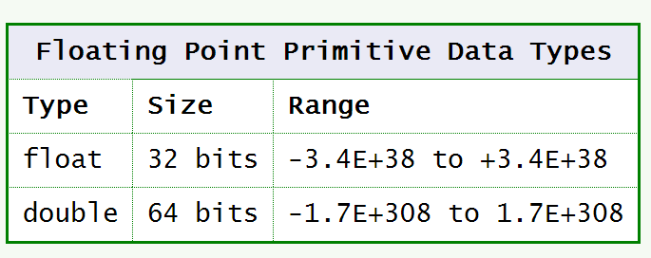
Floating Point Types

Slide 5
The char Primitive Data Type
Primitive type char represents a SINGLE character. It does not include any font information. When you want to deal with more than one character at a time (almost always), you need to use objects that have been built out of char data.

Slide 6
Character Literals
A character literal is a single character with an apostrophe on each side:
'm' 'y' 'A'
A control character is represented with a special sequence of characters:
'\n' '\t'

Slide 7
Be Careful
Warning: The following is not a character literal:
"Hello" This is a String, which is not primitive data. It is, in fact, an object. Strings are surrounded by double quote marks ", not by apostrophes.

Slide 8
Primitive Data Type boolean
Another of the primitive data types is the type boolean. It is used to represent a single true/false value.

Slide 9
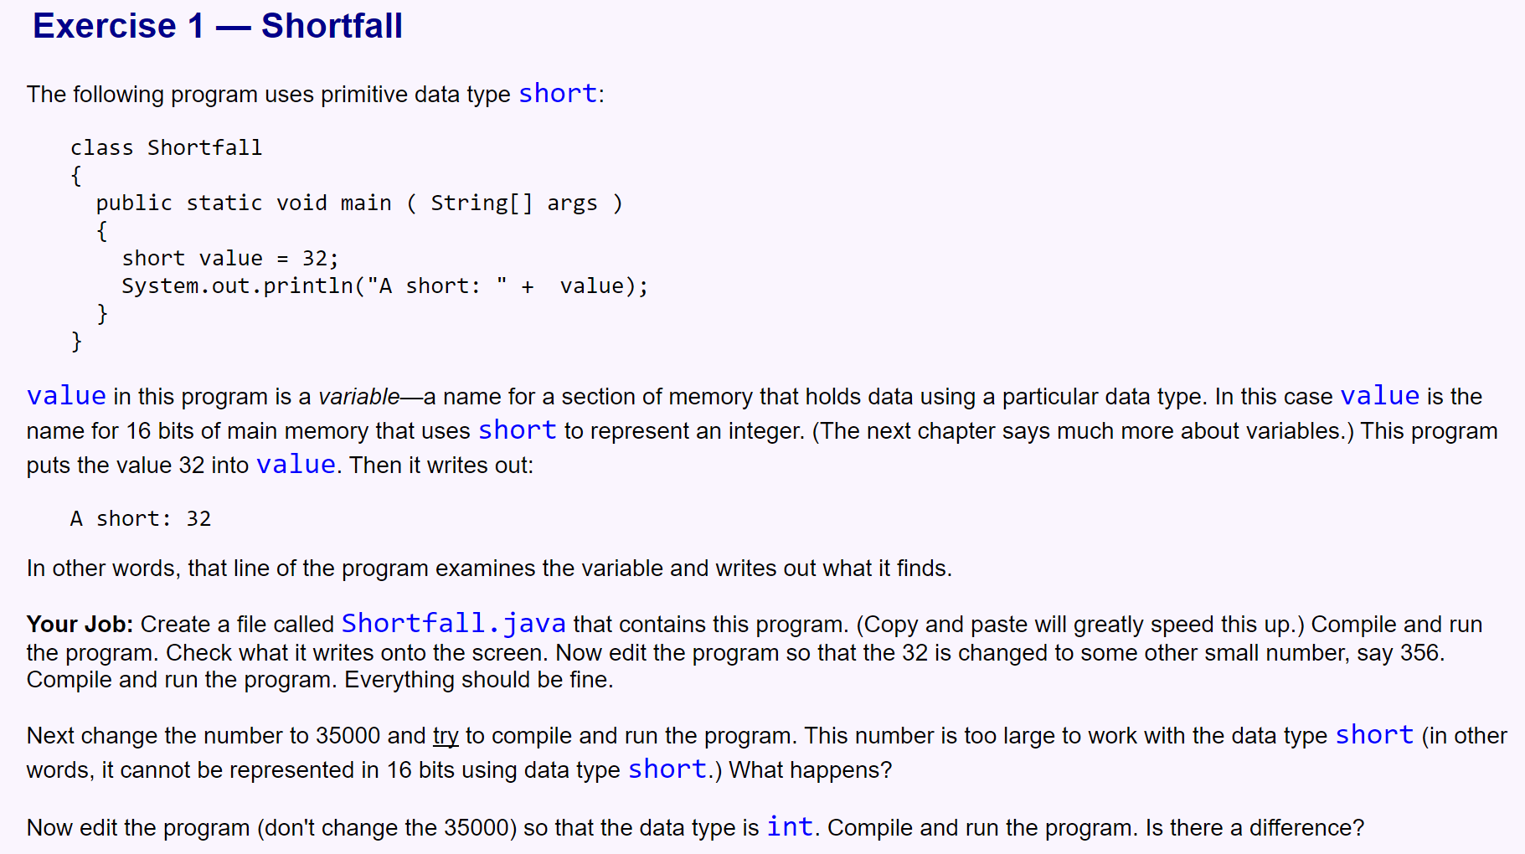
Exercises Create a project named “prjDataInJava2” and add the following classes to it.

Slide 10
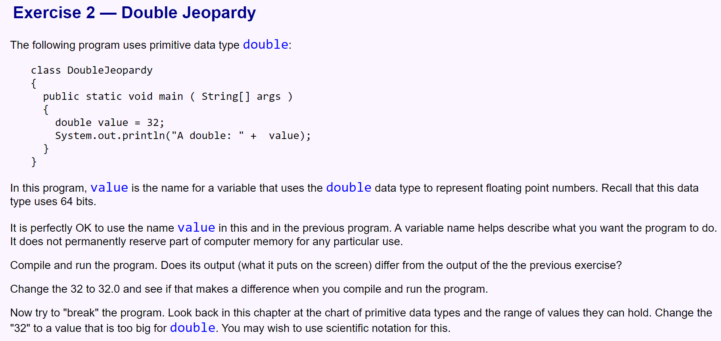

Slide 11
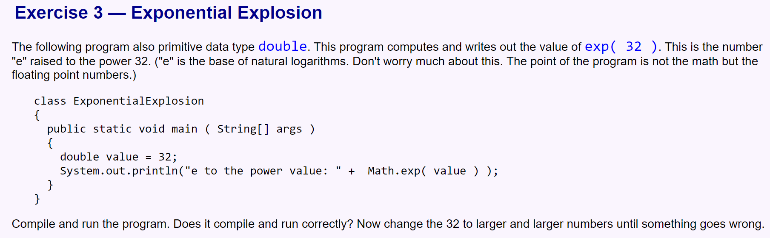

Slide 12
