Slide 1
Decisions
The If Statement
The Single Brach If Statement
Boolean Expressions

Slide 2
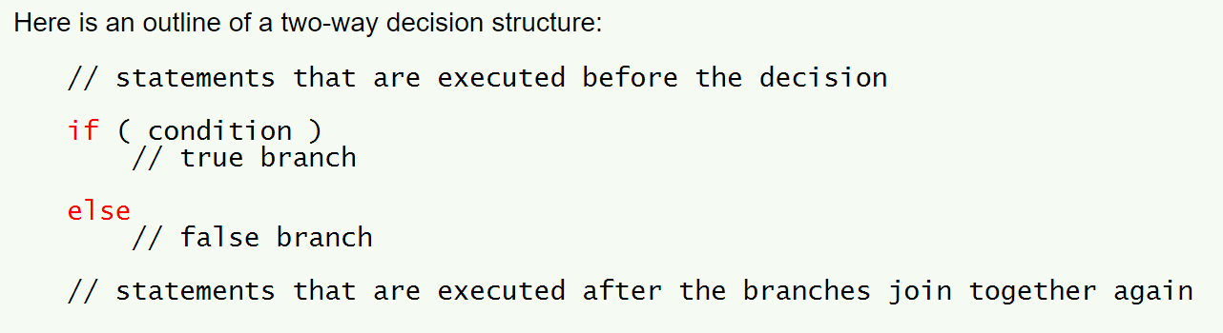
Outline of a Two-way Decision

Slide 3
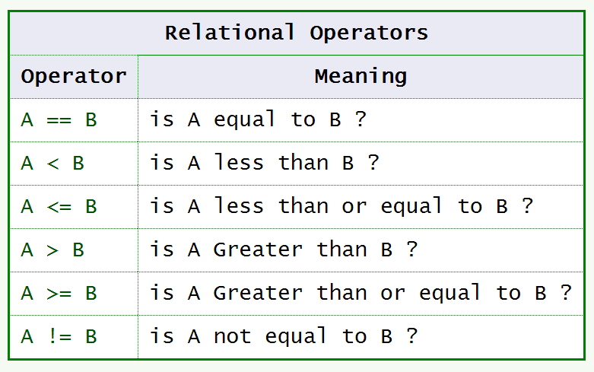
Boolean Expressions

Slide 4
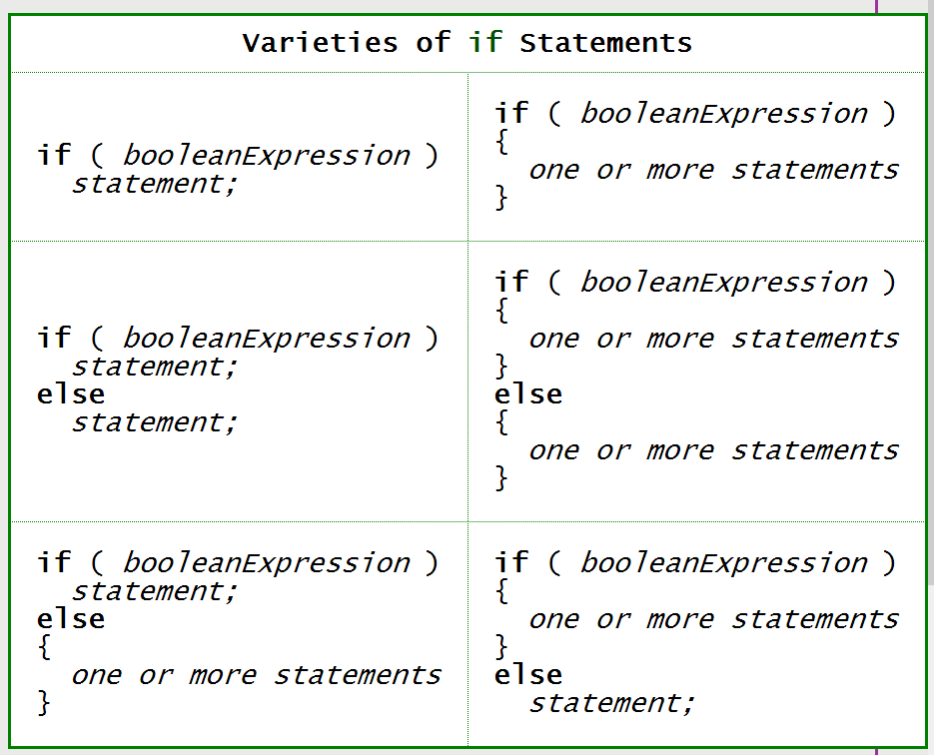
Varieties of if Statements

Slide 5
Logical Operators
&& AND
|| OR
! NOT

Slide 6
Precedence of NOT
The NOT operator has ____ precedence, so it is done before arithmetic and relational operators unless you use parentheses.

Slide 7
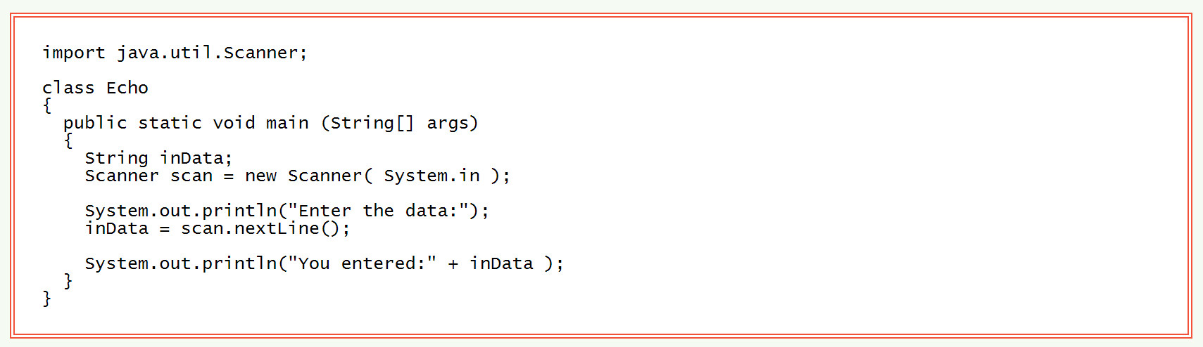
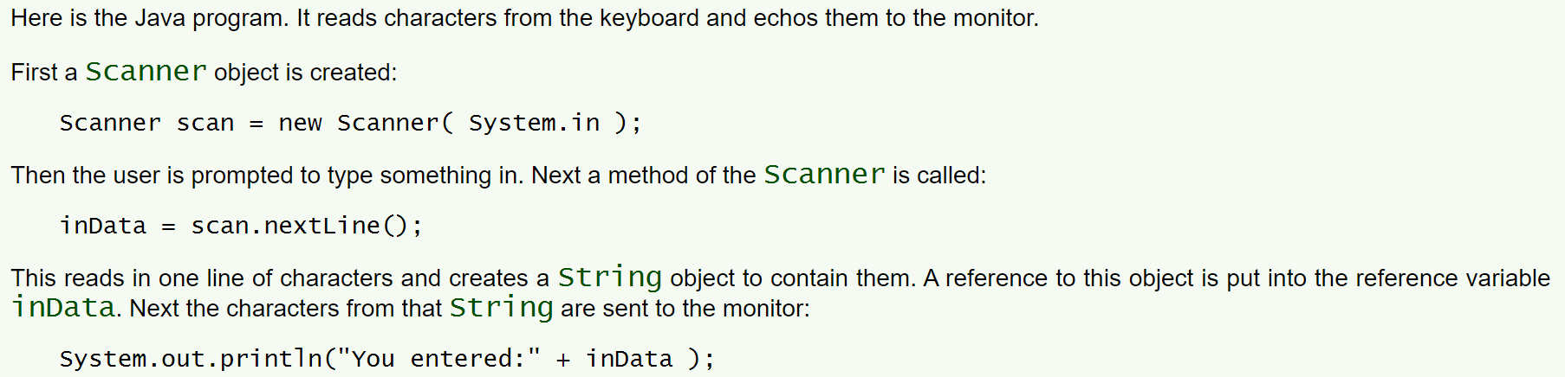
Console IO
Scanner is available in this package and it must be imported
Use a function in the Scanner object to read a line from the console window
Here we create a new Scanner object and assign it to a variable
The line import java.util.Scanner; says to use the Scanner class from the package java.util.

Slide 8
Scanner.nextLine()
nextLine() is a function that will read the line entered into a console
The line is defined by pressing the Enter key
The line a string even if you entered a number
Use the class ____________function parse out the integer from the string or the ____________ to parse out a double or the ____________ to parse out a float

Slide 9
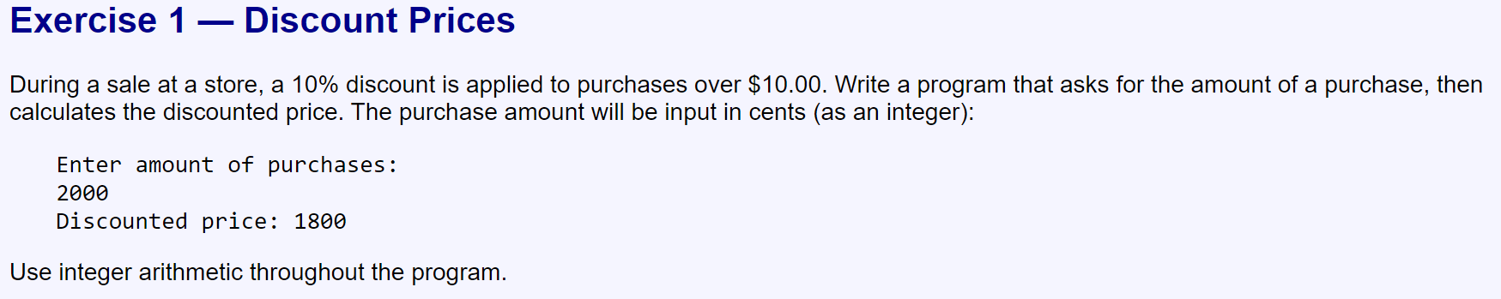
Exercises Create a project called “prjJavaDecisions” and create any 2 classes from each part
Part 1

Slide 10
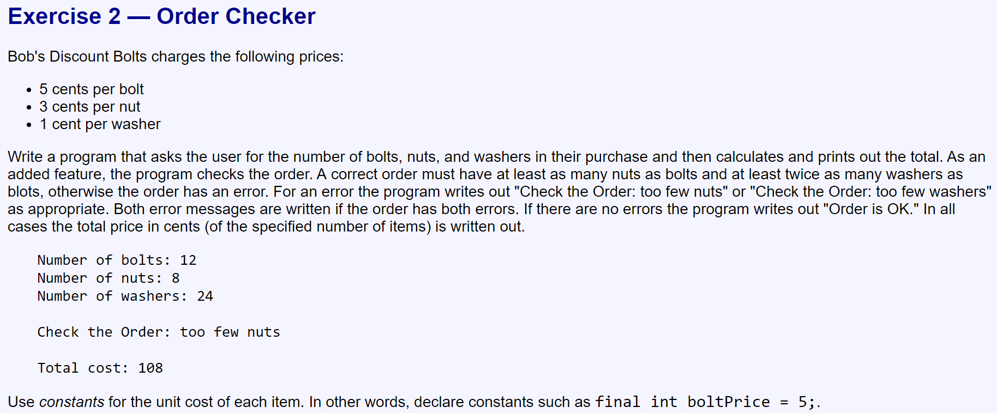

Slide 11
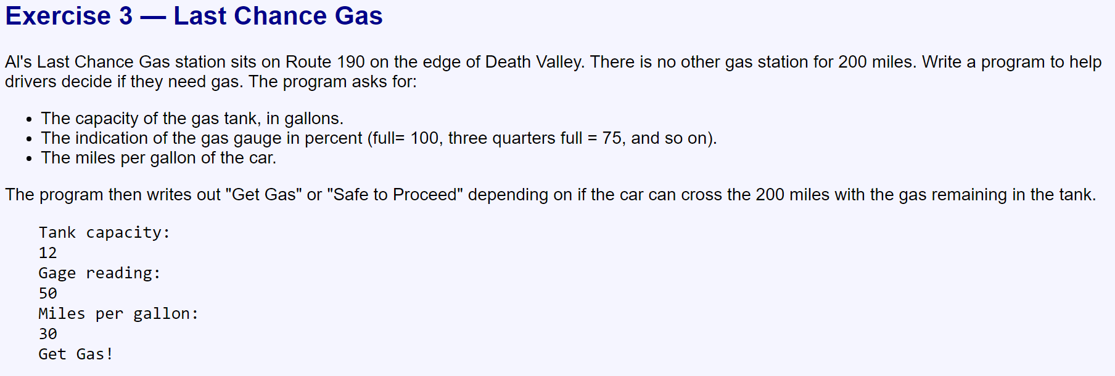

Slide 13
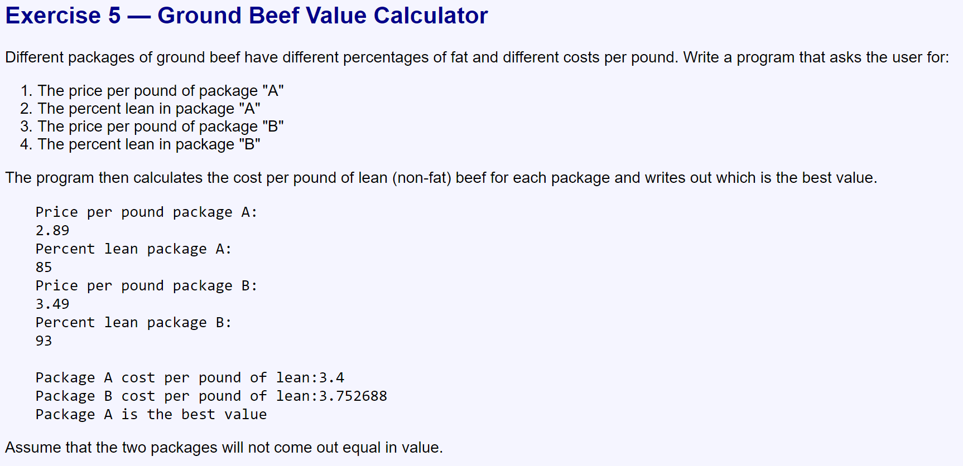

Slide 14
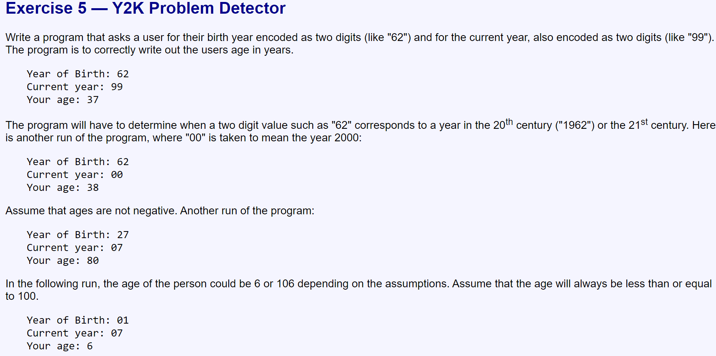

Slide 15
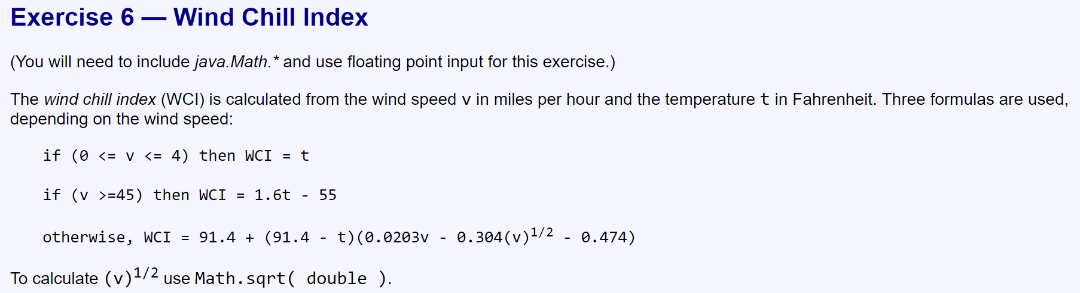

Slide 16
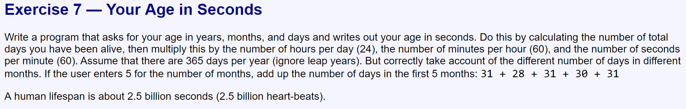

Slide 17
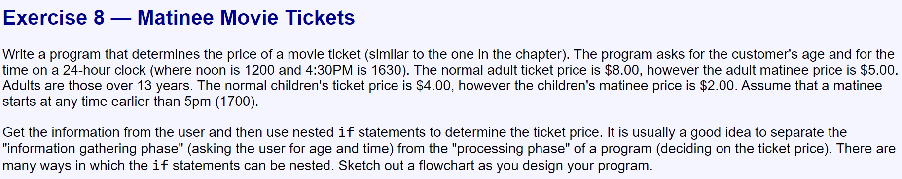

Slide 18
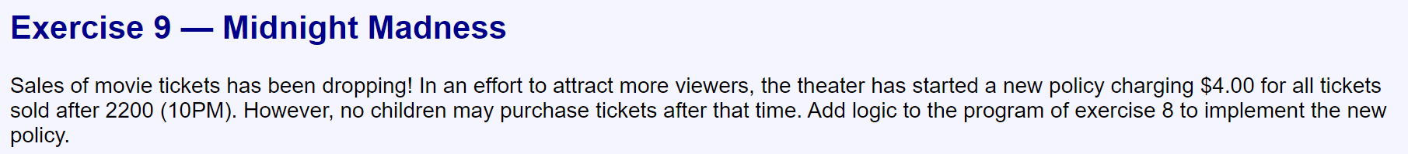

Slide 19
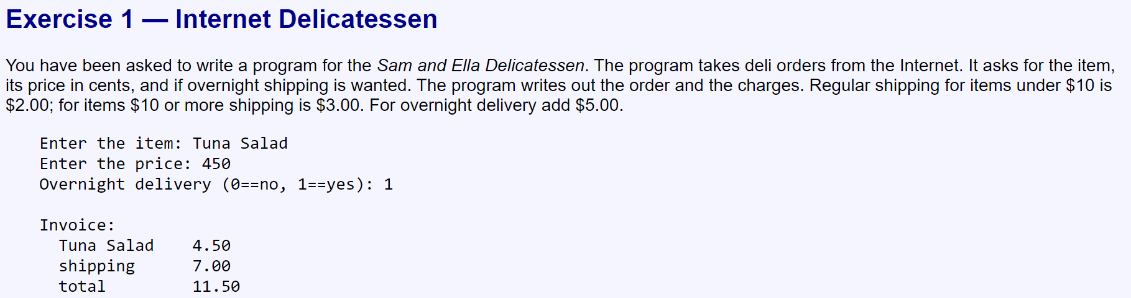
Part 2

Slide 20
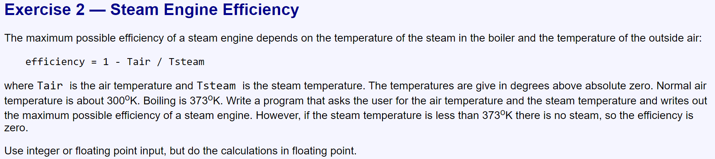

Slide 21
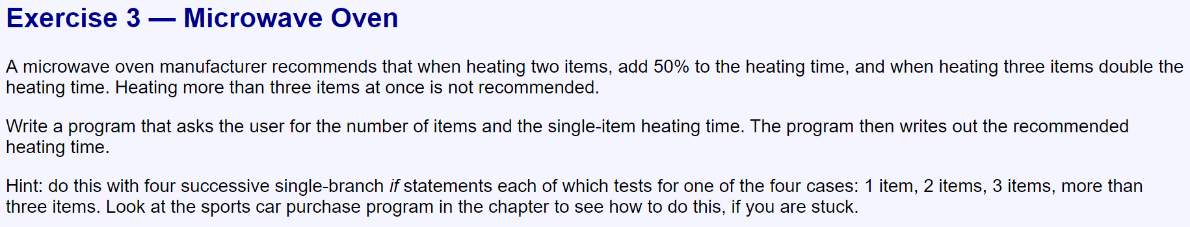

Slide 22
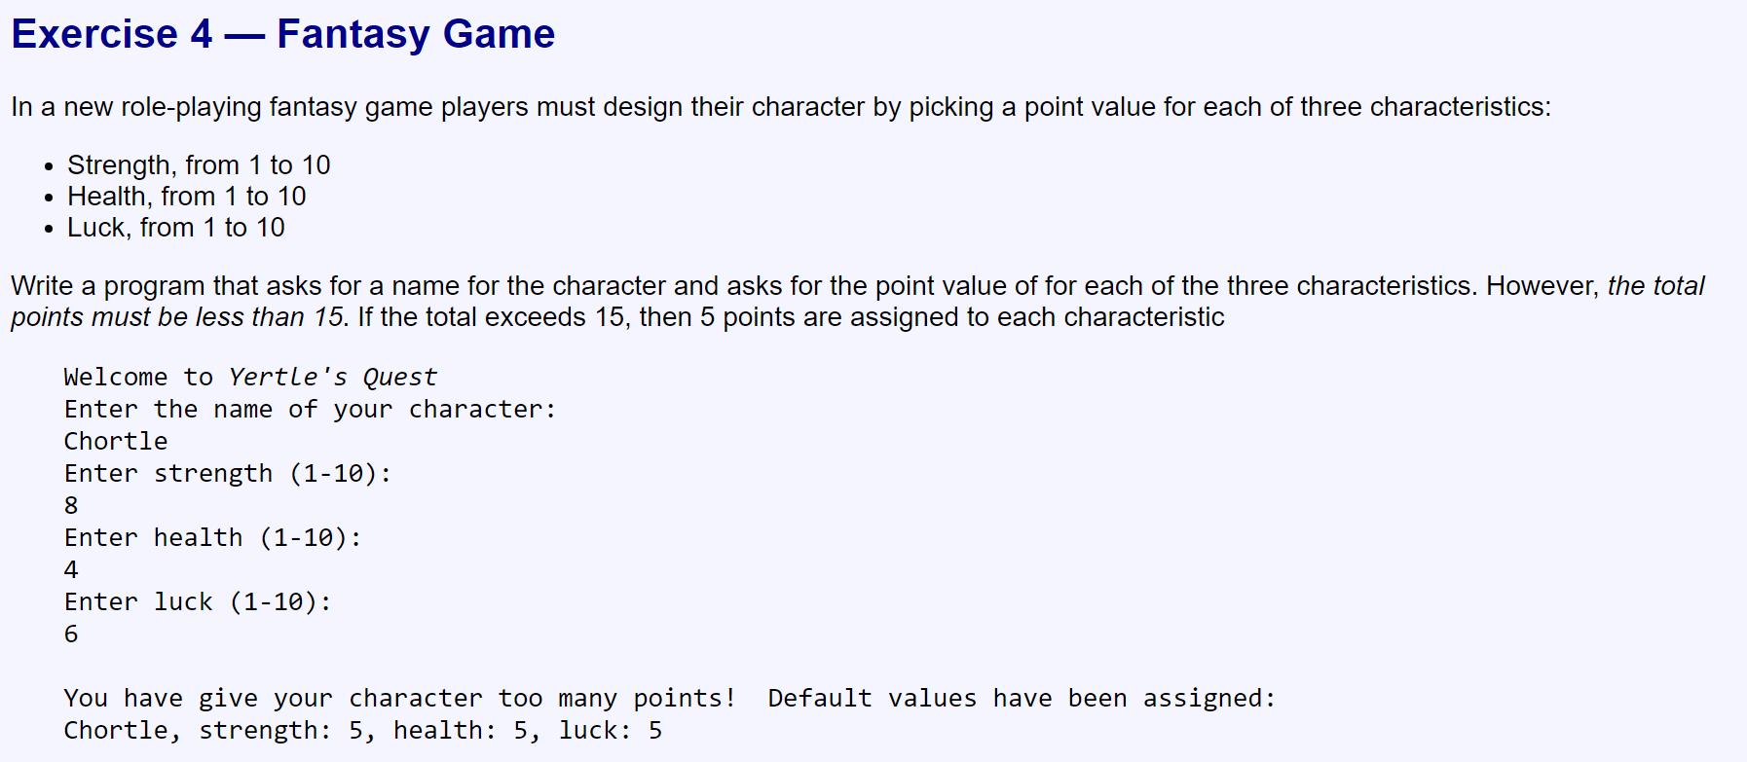

Slide 23
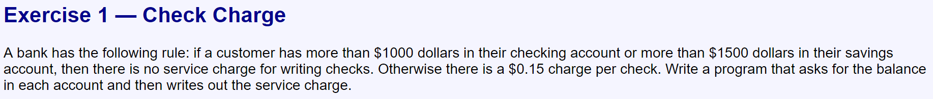
Part 3

Slide 24
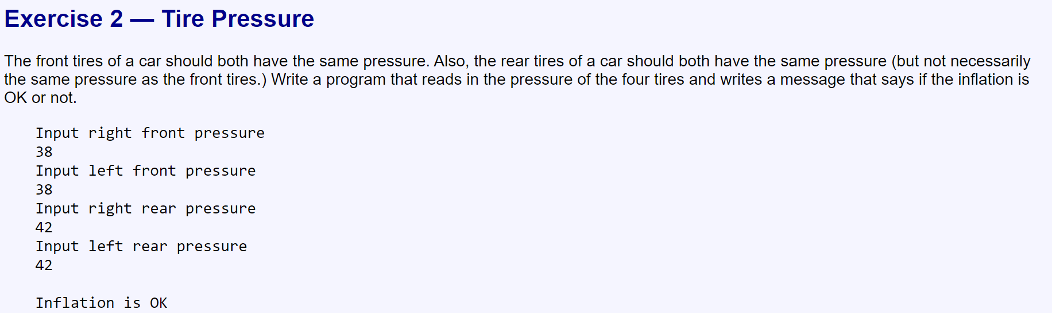

Slide 25
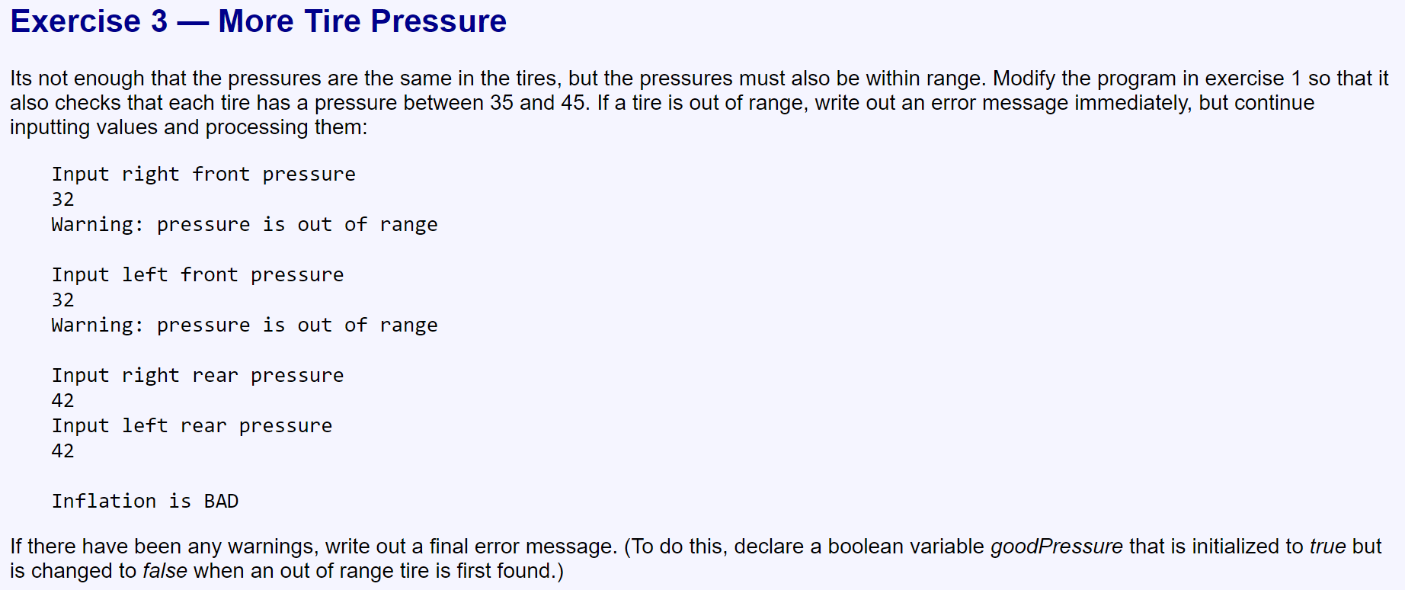

Slide 26
