Slide 1

Intro to Java

Slide 2
Simple Java Program
Here is an example Java program. It is about as small as a Java program can be. When it runs, it writes Hello World! on the computer monitor.
class Hello {
public static void main ( String[] args ) { System.out.println("Hello World!");
}
}

Slide 3
Java Source File
This program can be created using a text editor such as the Notepad editor that comes with Windows. The program will be in a text file on the hard disk, named Hello.java.
A source program is a text file that contains a program (such as above) written in a programming language. Since it contains ordinary text (stored as bytes) it can not be directly executed (run) by the computer system. As a text file, you can print it, display it on the monitor, or alter it with a text editor.

Slide 4
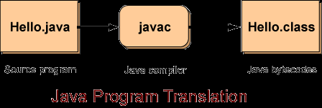
Bytecodes
To run a Java program the source file is first translated into a file of bytecodes.
A Java bytecode is a machine instruction for a Java processor. A file of bytecodes is a machine language program for a Java processor.

Slide 5
Java Program Translation
The source program Hello.java is examined by a program called javac running on your computer. The javac program is a compiler (a translator) that translates the source program into a bytecode or class file called Hello.class.
Important Idea: The bytecode file will contain exactly the same bytecodes no matter what computer the javac compiler runs on.

Slide 6
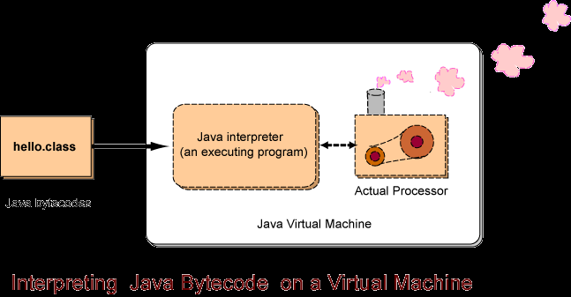
Java Virtual Machine

Slide 7
The Java Virtual Processor
People do not have hardware Java processor chips. They have ordinary PCs and Macintoshes.
Now for the clever part: the Java processor can be implemented as software! It is implemented as a program that reads the bytecodes and performs the operations they specify. This is another type of interpreter. Some interpreters run source code written in a high level language like Basic; others (like the Java interpreter) run bytecodes.
The "Java interpreter" in the picture is an executable program that is running on an ordinary computer system, such as a desktop Intel system. Each type of computer system has its own Java interpreter that can run on that system. The "Actual Processor" is the actual hardware processor chip of that computer system.
When a Java program is translated into bytecodes, the bytecodes are the same no matter what computer system is used.
A Java source program (such as Hello.java) can be written and compiled on one computer (say a Windows computer) to produce bytecode (say Hello.class). Now that bytecode can run on any computer that has a Java interpreter.

Slide 8
Using an IDE
Although we can create a java program simply by using the JDK (java development kit) which comes with the java compiler and java interpreter), it is much easier to use an IDE, like intelliJIDEA.
Your teacher should provide you with a copy of intelliJIDEA or at least point you to a location where you can download it.

Slide 9
intelliJIDEA
intelliJIDEA is an IDE for programmers using a variety of languages.
There are many different versions and optional features.
To avoid having to install all the extras, try and get your teacher’s copy which will come preconfigured with all the necessary tools.

Slide 10
A Java Project in intelliJIDEA
We’ll start off by making simple single class java applications.
To do this start intelliJIDEA(llok for idea64 in the bin folder of the application’s installation folder).
Make sure you can see the Project Explorer (Select View→Tool Windows→Project)…this displays all your projects and their folders and files
Next, click File→New→Project

Slide 11
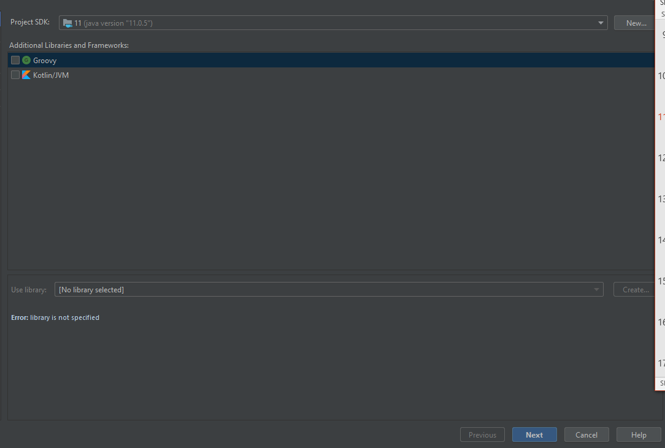
New Java Project Dialog Box

Slide 12
New Java Project
Don’t select anything other than Java as the project type(top left pane)
Note the Project SDK
SDK stands for solutions developer kit
It usually refers to a folder that has the javac compiler, java interpreter and all other associated files
Click Next and then select the Create from Project Template checkbox option
Next comes the screen where we will have to enter a project name and a project location

Slide 13
Project Name and Location
Call the project “prjMyFirstJavaProject
Set the location and paste the project name at the end of the location
The IDE will create this folder for you
Click Finish

Slide 14
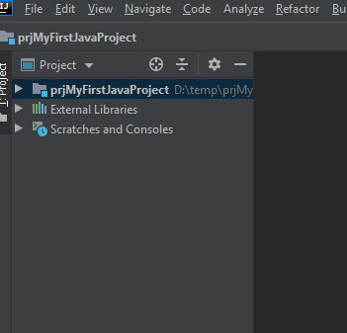
Your Project
Project shows up here…click it to open up the project and see its contents

Slide 15
The Project Workspace
You’ll notice that project is made up of a src folder as well as other folders and files
The src folder will contain your source files and default package folder.
The other folder contains all the java related library files you need to create a java program.
Only concern yourself with src and the package folder.
Right click package folder, then select New→Class.

Slide 16
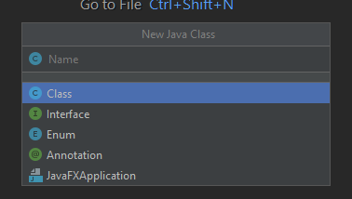
The New Java Class Dialog Box
Provide a name for your class
All java programs are made up classes
Every program must have at least one
Call this class sample
Hit Enter
Note the source file appears in the src folder
Make sure the source file is selected and note the default code

Slide 17
Settings
All java programs start off by running a main method.
This method is found in a class.
Classes are containers for methods (functions) and variables.
Your project only need one of these functions, unless of course you want to start off a program from another class in the same project.
Let’s give this class the name sample.
Add the main method (as illustrated in the next slide)

Slide 18
Code Analysis
package com.company;
public class sample {
public static void main(String[] args) {
}
}

Slide 19
Run Configuration
Next we will need to tell our IDE where our main method is
To do this click on Run→Run or right click the class and select Run ‘sample.main()’
Depending on what you selected you may then use the dialog box and its options to indicate which class to run (remember the class must have a main method)

Slide 20
Code Analysis
The class name “sample” matches the file name exactly.
The source file ends in .java
Finally the most important part at this time is the main method. This is where we start our program. It’s the function that gets called by the jre when we run our program.

Slide 21
Hello World!
Let’s write our Hello World! Program.
Add the following to your code’s main function (sometimes called method):
System.out.println("Hello World!");
Note the output window and the results of your program!!

Slide 22
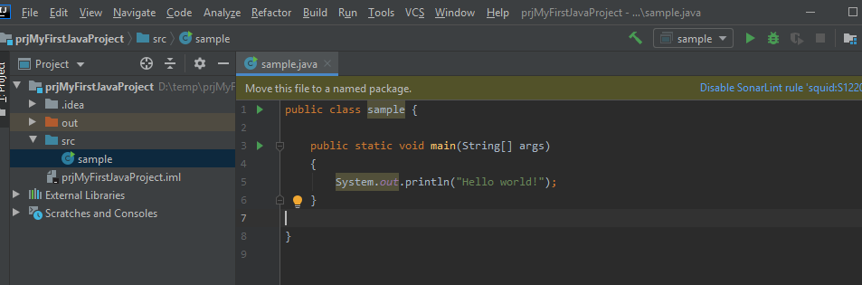
Run Your Program
On your toolbar there should be an icon that looks like a green arrow.
Press it to run your code.

Slide 23
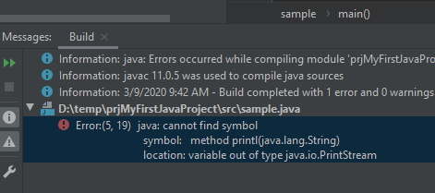
Output
Your output will display in the Console window located at the bottom of the IDE
Any problems will display in the same area
Force a syntax error and re-run your program
Note the errors

Slide 24
Syntax and Logic Errors
Don’t forget that Syntax errors will prevent your program from compiling while Logic errors (or bugs) will compile but not perform their intended actions.

Slide 25
Comments
A comment is a note written to a human reader of a program. A comment starts with the two characters // (slash slash). Those characters and everything that follows them on that one line are ignored by the java compiler.
Often you want to write a comment that spans several lines, as above.
With this style of comment, everything between the two characters /* and the two characters */ are ignored by the compiler.

Slide 26
Exercises
Practice using your IDE and running your programs by creating the following classes (on the following slides), each with their own main method. Create the Emily class in a separate project. Create the HelloPlanets in the Emily project (you’ll have to reconfigure the Run settings to start from the HelloPlanets class or right click from the class itself and look for the proper Run options). Make sure to select the class you want to run prior to clicking the Run button on the toolbar. Also don’t forget to name the files to match the class names.

Slide 27
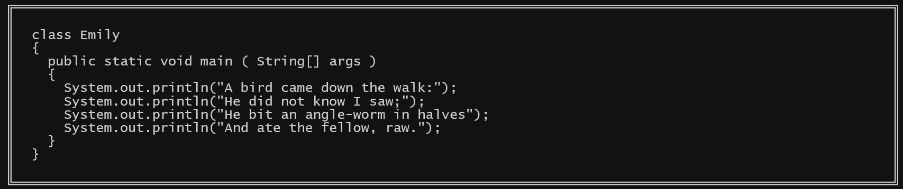

Slide 28
