Slide 1
File IO

Slide 2
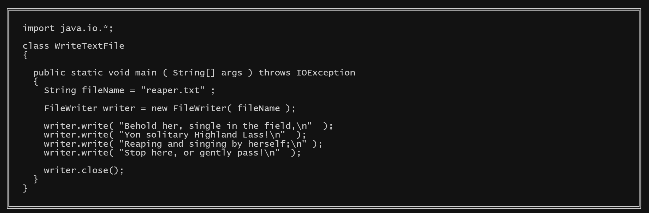
FileWriter
Class FileWriter is used for output of character data to a disk file.
Use the object’s write function to write to the file
It’s constructor requires the path to the file to write to
Create the FileWriter object
Close the file when done

Slide 3
Closing a File
Use the close() method when a program is done with a file.
If you don't, the program might stop running before the operating system has finished writing data to the file.
The data written to the file might be lost!

Slide 4
FileWriter Constructors
Here are two (out of several) FileWriter constructors:
FileWriter(____________)
FileWriter(String fileName, ____________)
The first constructor's argument fileName is the name of a disk file that will be created in the current subdirectory.
If there is already a file with that name, it will be replaced.
The second form of the constructor has an argument, append.
If append is true, the constructor will open an existing file for writing without destroying its contents.
If the file does not exist, it will be created.

Slide 5
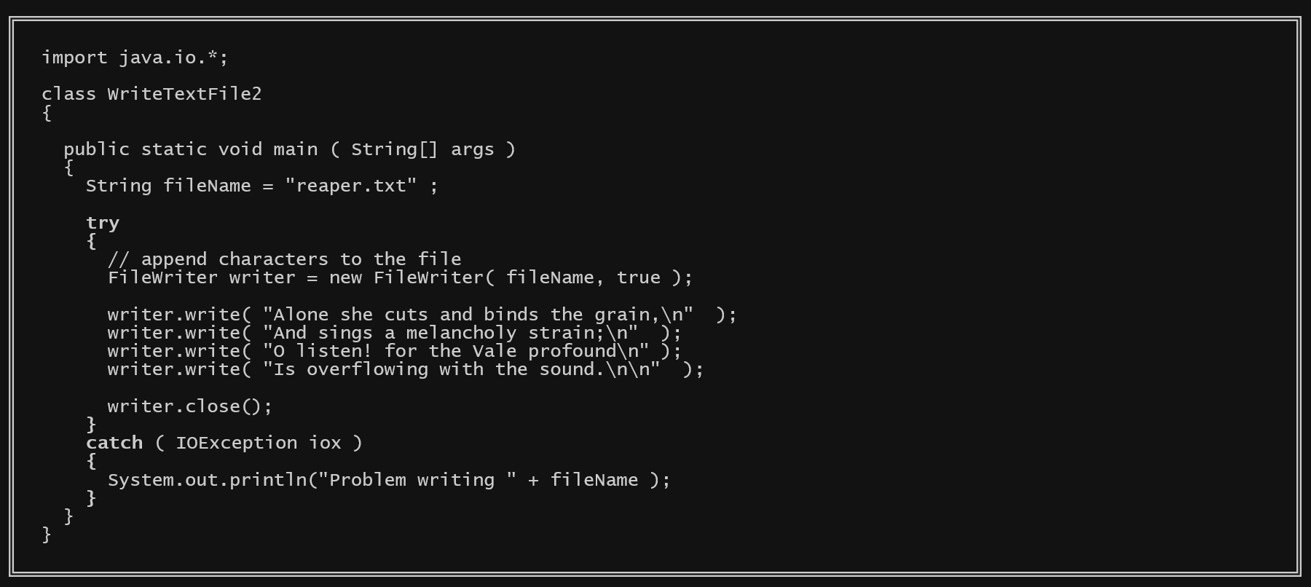
IOExceptions
Most I/O methods throw an ____________ when an error is encountered. A method that uses one of these I/O methods must either (1) include ____________ in its header, or (2) perform its I/O in a ____________ block and then catch IOExceptions.

Slide 6
The write() Method
With FileWriter use the write() method to write characters to the file.
There are several write() methods with different parameters.
To output numerical results as characters use string ____________:
int answer; . . . stream.write( "The answer is: " _ answer)

Slide 7
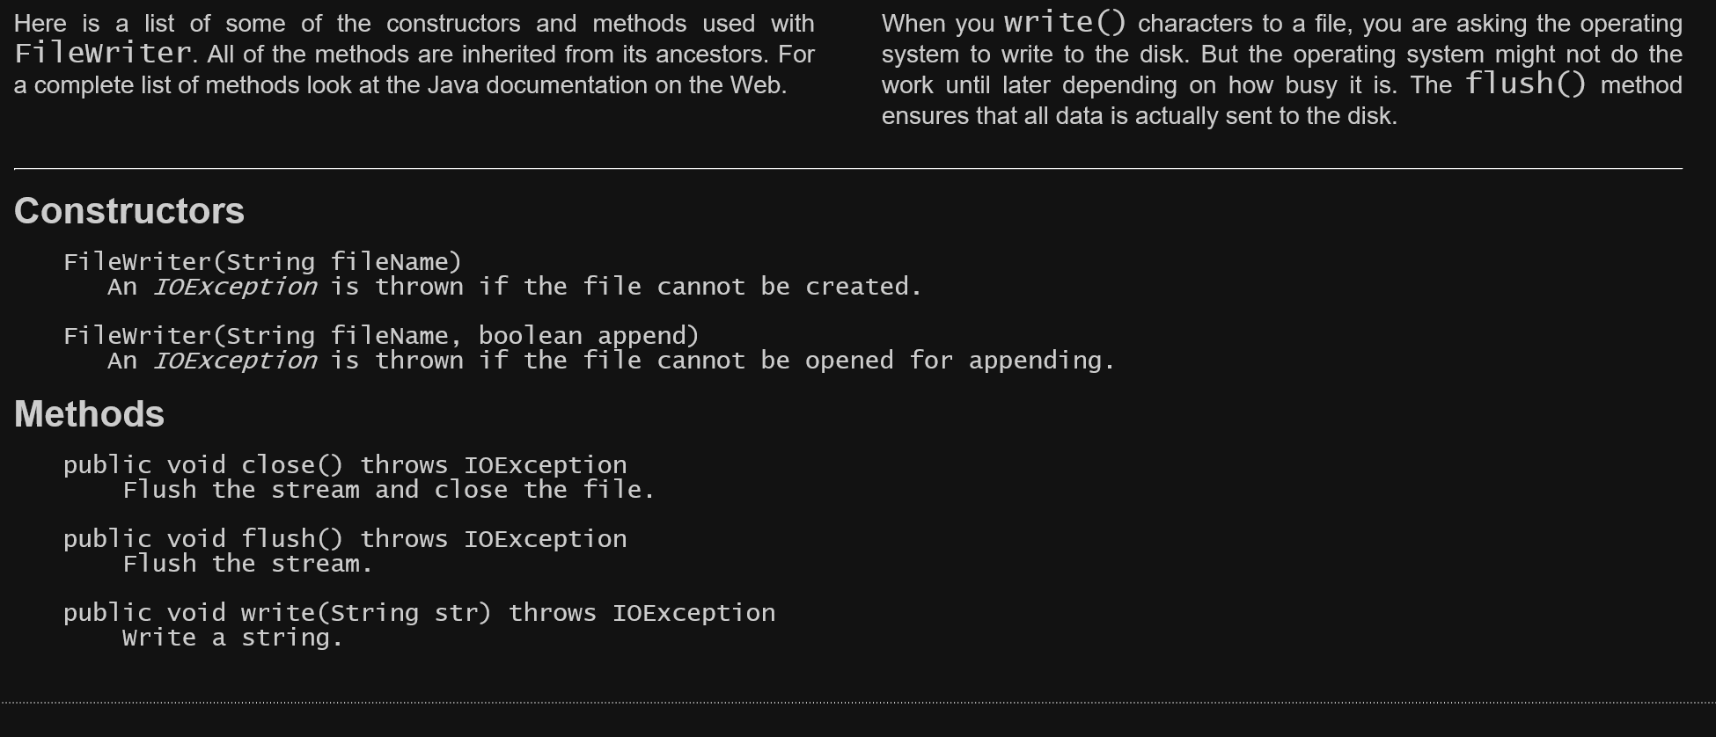
Summary of Class FileWriter

Slide 8
The BufferedWriter Stream
Disk input and output is more efficient when a buffer is used. For our small example programs it doesn't matter much. However, programs that do extensive I/O should use buffers.
Use BufferedWriter to do this with a character output stream.
BufferedWriter(____________) Construct a buffered character-output stream
Since a FileWriter is a Writer it is the correct type for the parameter.
Here is how this might be done:
BufferedWriter out = new BufferedWriter(____________);

Slide 9
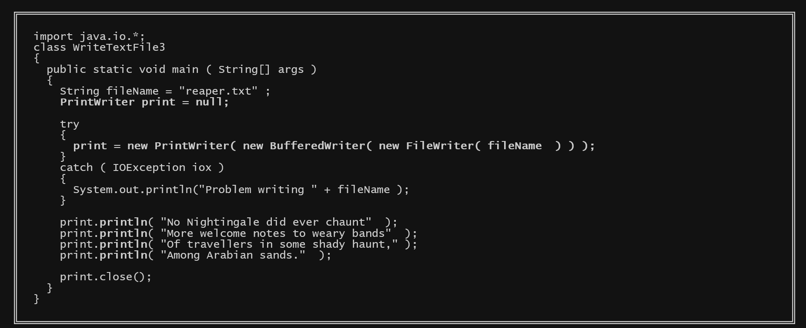
Updated Example

Slide 10
Reading from Text Files
____________ is used for input of character data from a disk file.
The input file can be an ordinary ASCII, one byte per character text file.
A Reader stream automatically translates the characters from the disk file format into the internal char format.
The characters in the input file might be from other alphabets supported by the UTF format, in which case there will be up to four bytes per character.
In this case, also, characters from the file are translated into char format.
As with output, it is good practice to use a buffer to improve efficiency.
Use ____________ for this.

Slide 11
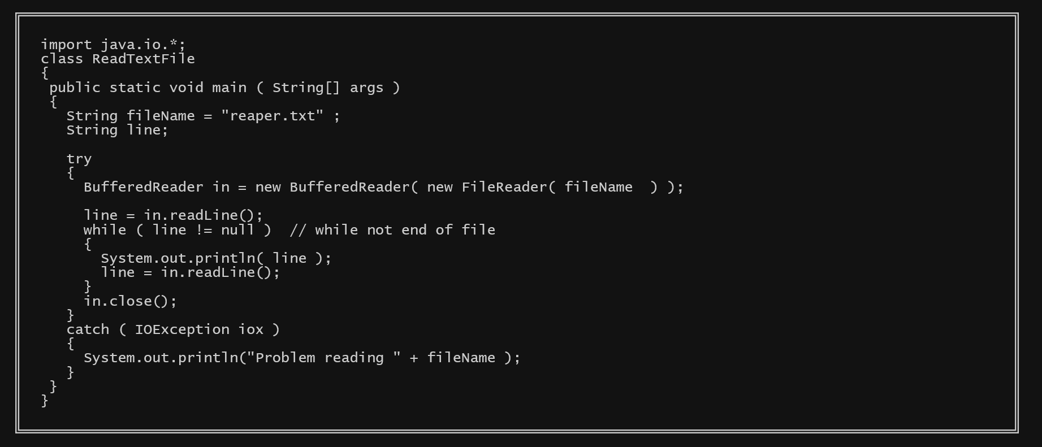
Example Program

Slide 12
Constructors
The constructor for BufferedReader looks like this:
BufferedReader( Reader in )
The constructor for FileReader looks like this:
FileReader( String fileName ) throws FileNotFoundException
The methods from BufferedReader which interest us are:
void ____________ () throws IOException // close the stream
int ____________ () throws IOException // read a single character into an int
String ____________ () throws IOException // read one line of characters into a String.

Slide 13
Closing Input Files
Closing an input file is less important than closing an output file.
When end-of-file is detected there is no more data.
(There is no need to flush an input file).
But close input files anyway.
Doing so lets the operating system manage resources more effectively.
Of course, to write to a file after reading it in, the file must first be closed and then opened for output (with a FileWriter stream).

Slide 14
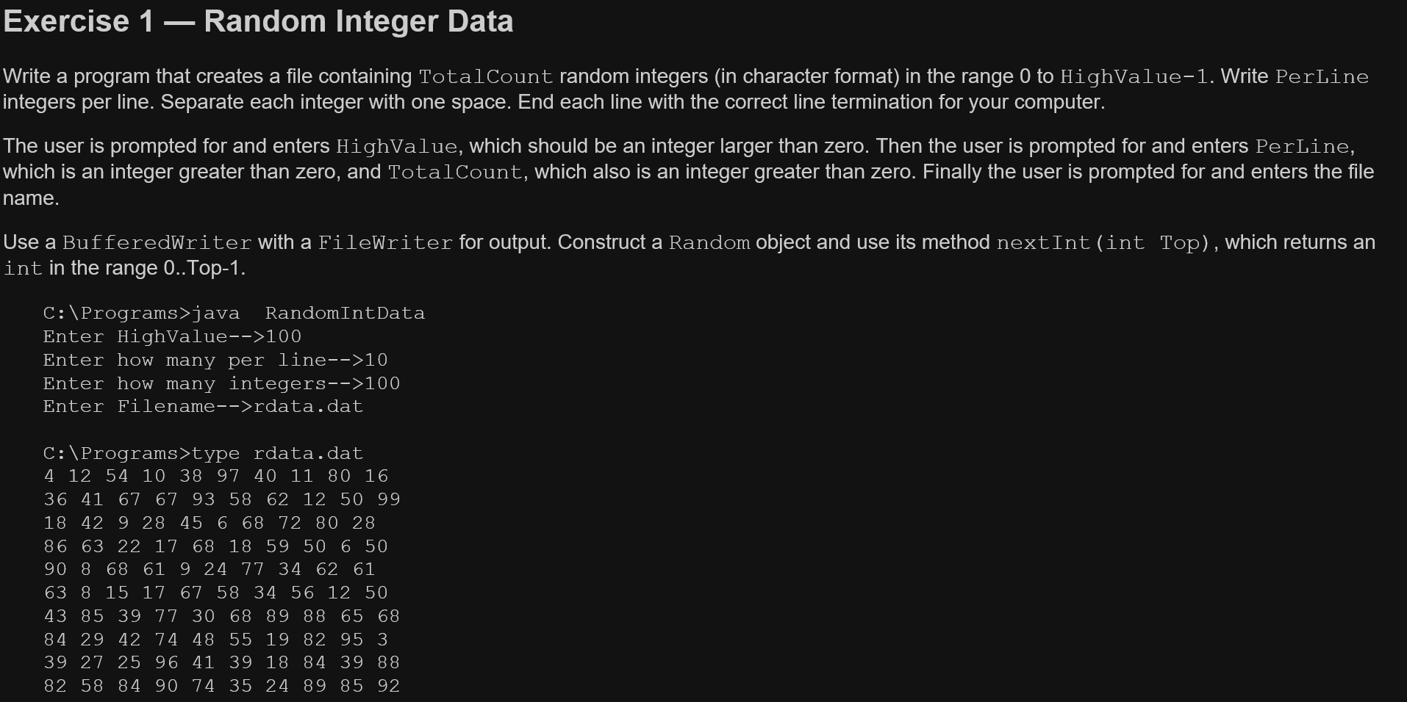
Exercises Complete all exercises. Part 1

Slide 15
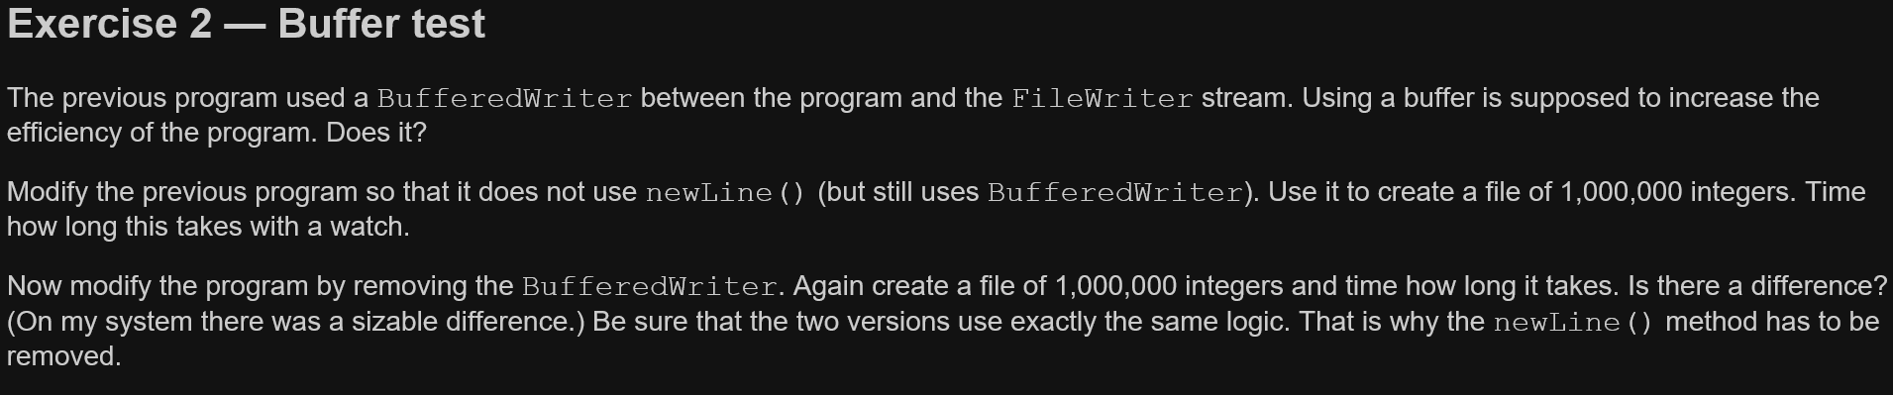

Slide 16
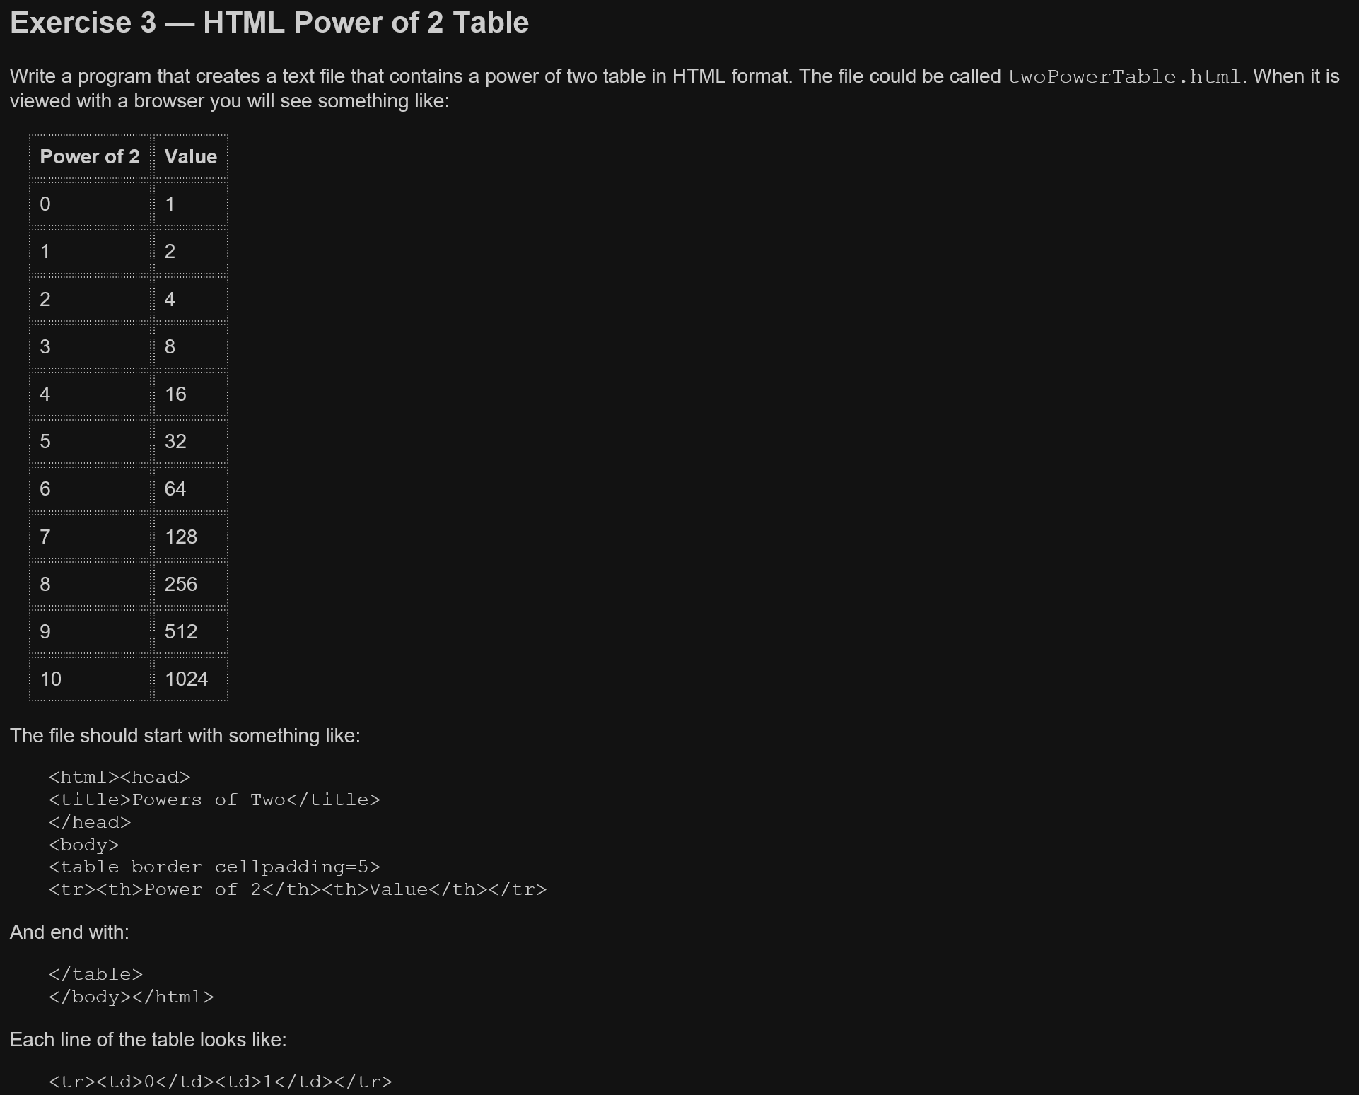

Slide 17
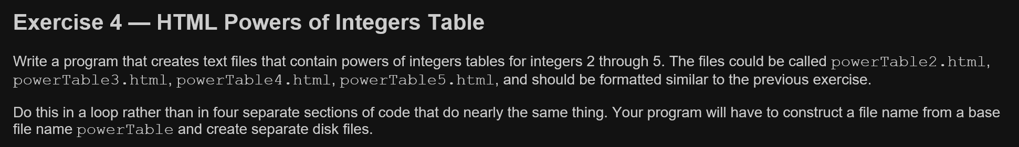

Slide 18
Part 2
Create a program that will make a copy of any simple text file provided the paths of the input and output files.

