Slide 1
More Arrays
Methods that Change Arrays
Arrays of Objects and Linear Search
Two Dimensional Arrays

Slide 2
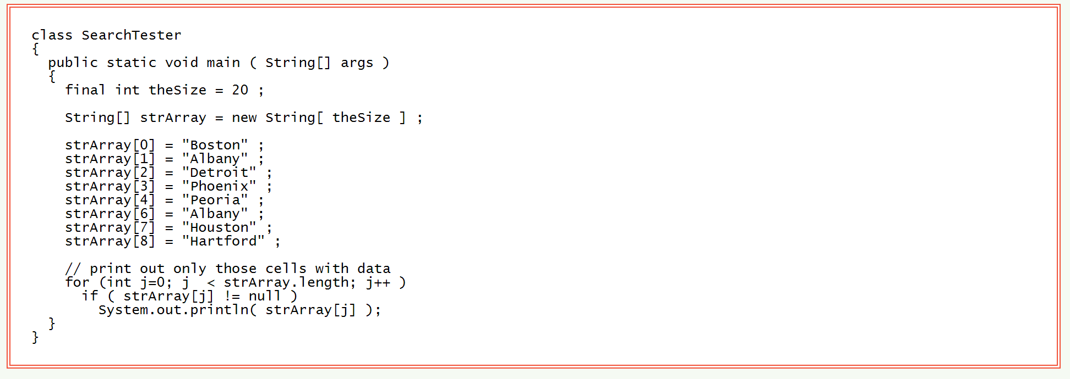
Searching a List
What is happening in this program?

Slide 3
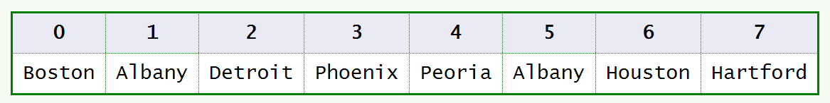
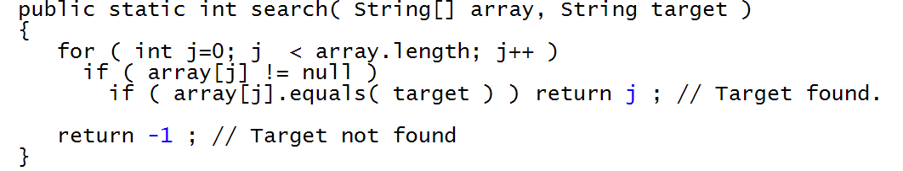
Linear Search
This is a method or function called search
This function returns an int
What possible values does this function return?

Slide 4
Two-Dimensional Arrays
Often data comes naturally in a two dimensional form.
Web browser screens are two dimensional, as are spreadsheets, printed pages, and images.
For many of these situations you need a two-dimensional array.
This is a collection of cells laid out in a 2D grid, like graph paper. Each cell can hold a value (as with a 1D array).
However, now ____ indexes are needed to specify a cell.
If you have ever used a spreadsheet then you have used a 2D grid for holding and manipulating data.

Slide 5
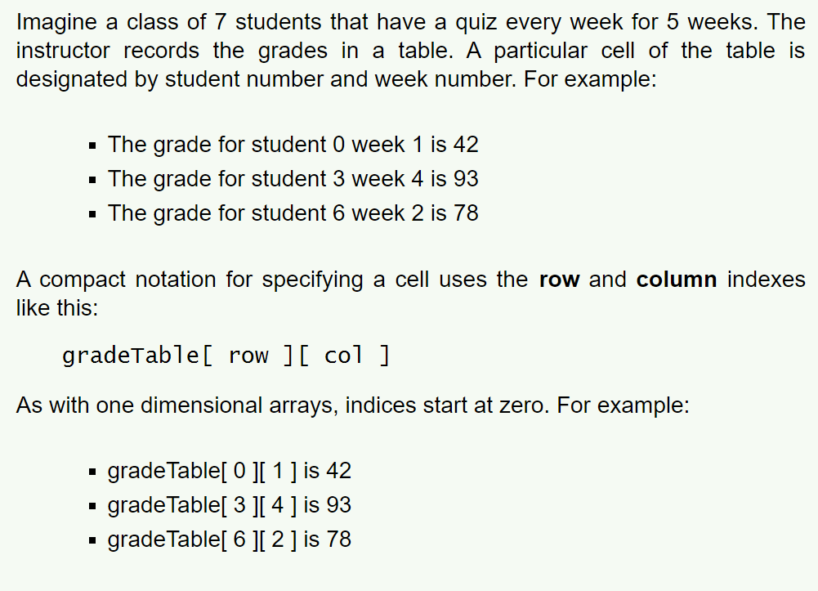
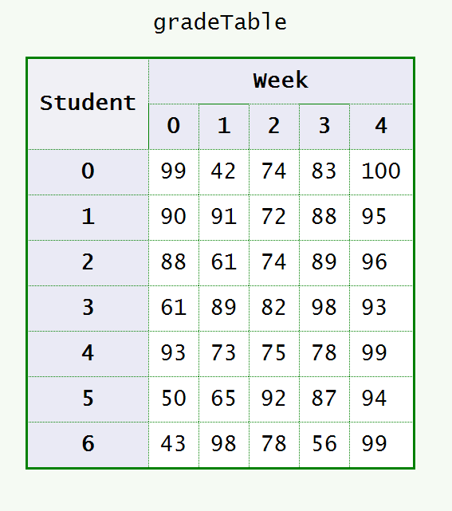
Table of Student Grades

Slide 6
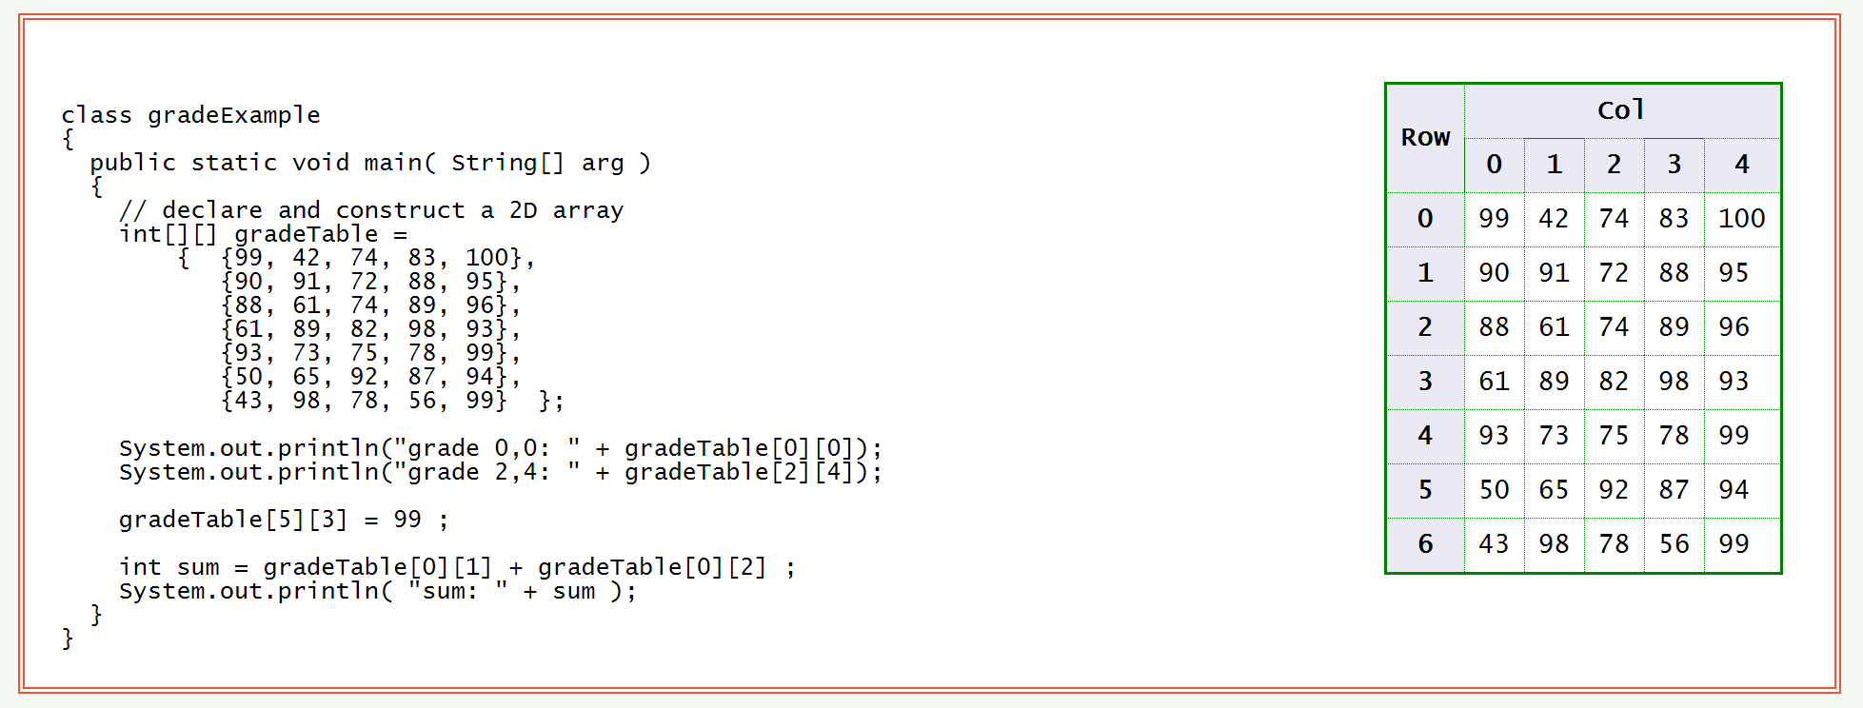
2D Array of int

Slide 7
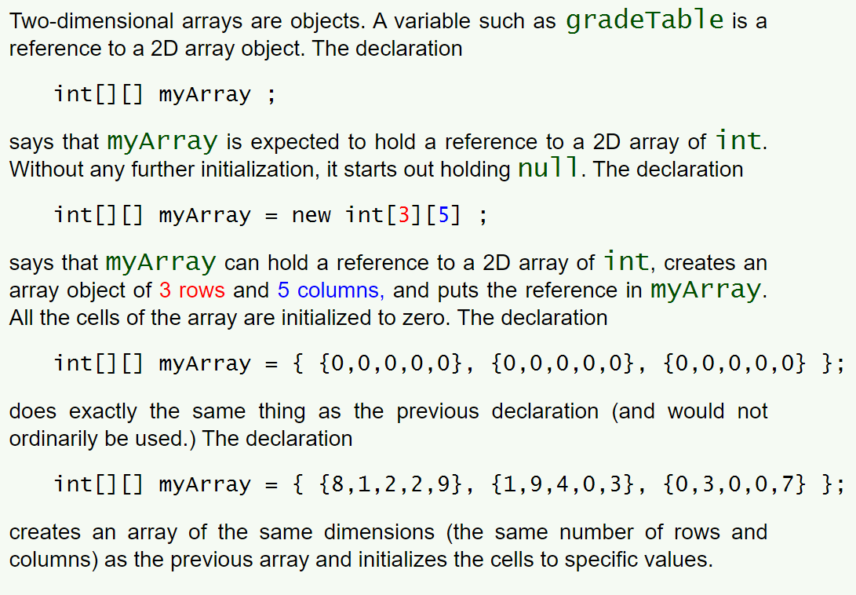
2D Array Declaration

Slide 8
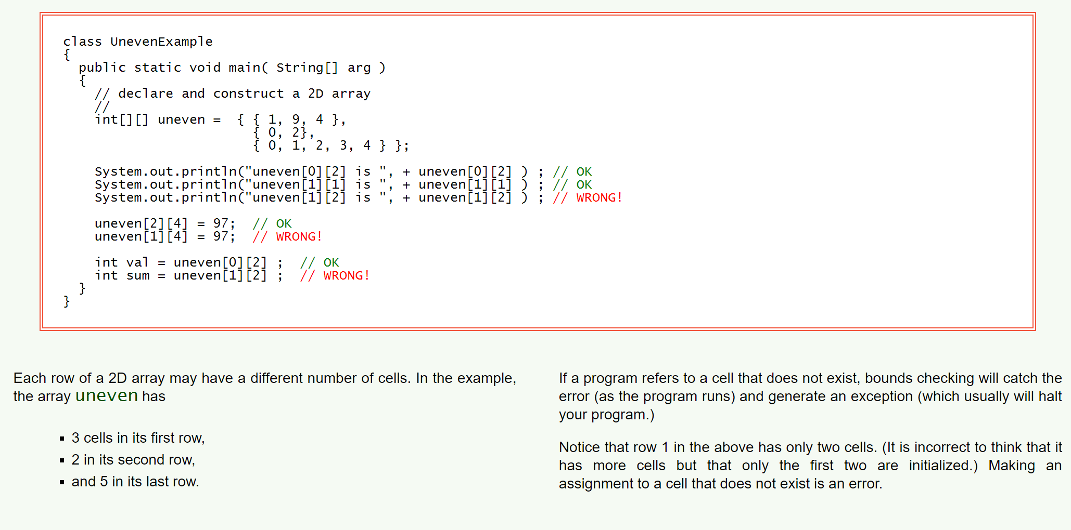
Different Numbers of Cells per Row

Slide 9
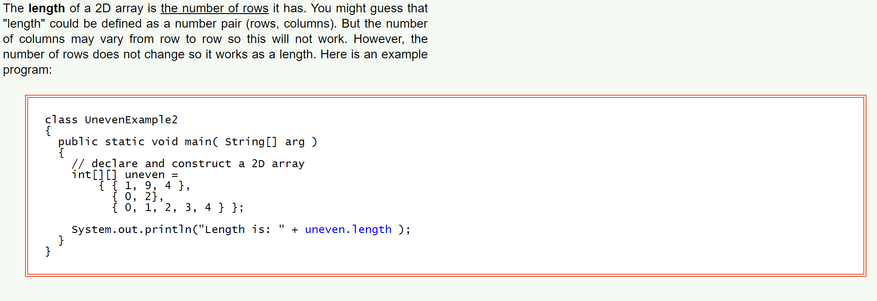
Length of a 2D Array

Slide 10
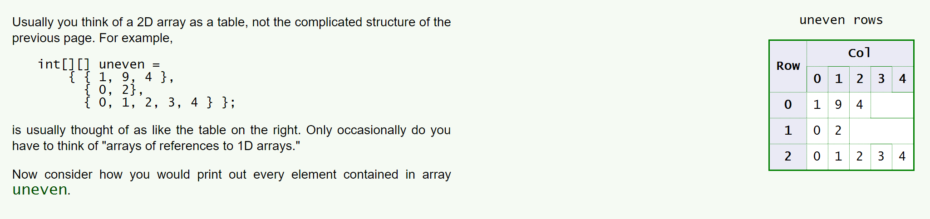
Usual View of a 2D Array

Slide 11
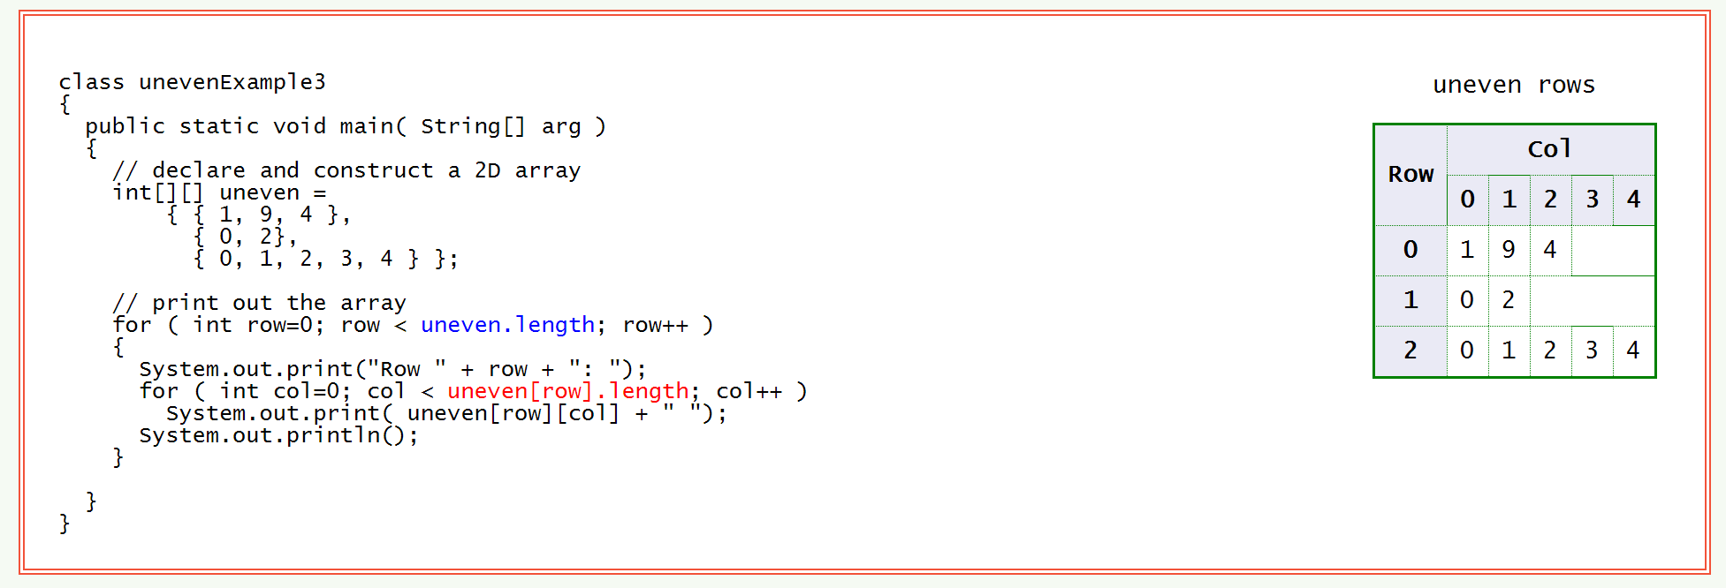
Printing a 2D Array

Slide 12
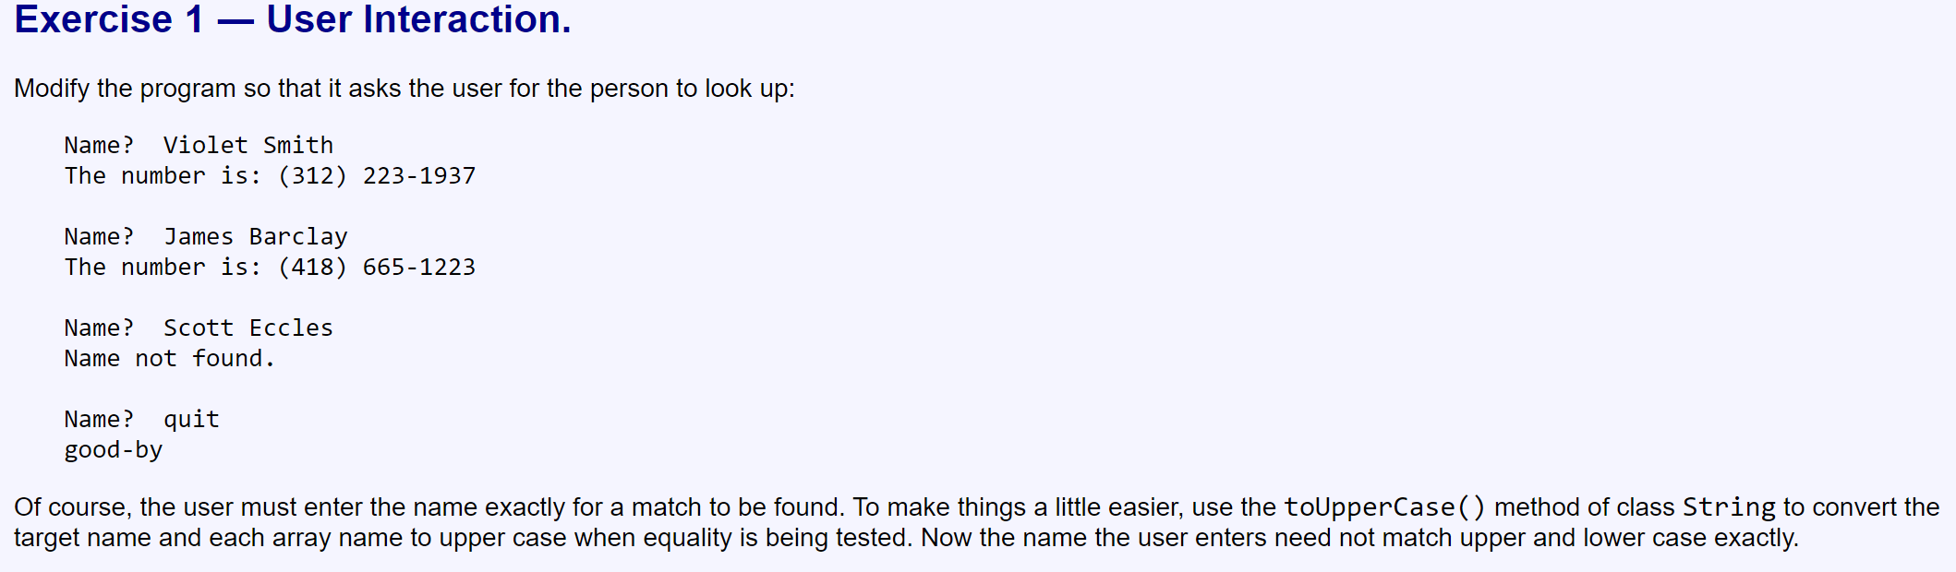
Exercises Complete at least 2 exercises from each part.
Daniel Roach,1-436-137-2362
Willoughby Smith,(312) 992-8761
Talon Farmer,1-843-489-9309
Vance Simon,1-426-866-1047
Sylvester Dodson,1-945-981-1412
Violet Smith,(418) 665 1937
Oleg Ayala,1-571-519-6372
Dante Maxwell,1-377-351-2986
James Barclay,(416) 665-1223
Lyle Gross,1-182-510-7338
Store the above data into a 2D array to help solve the following exercise.

Slide 13
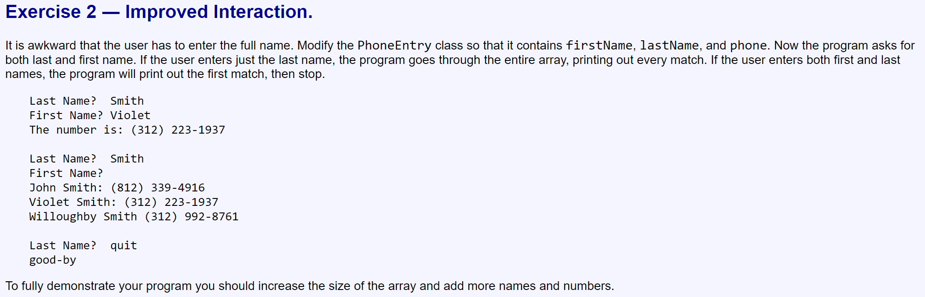

Slide 14
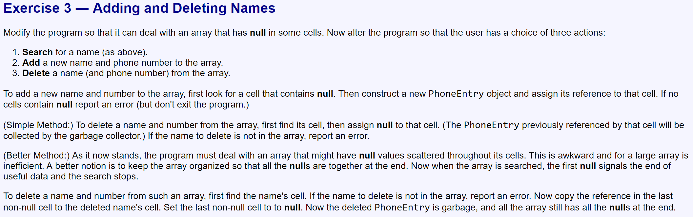

Slide 15
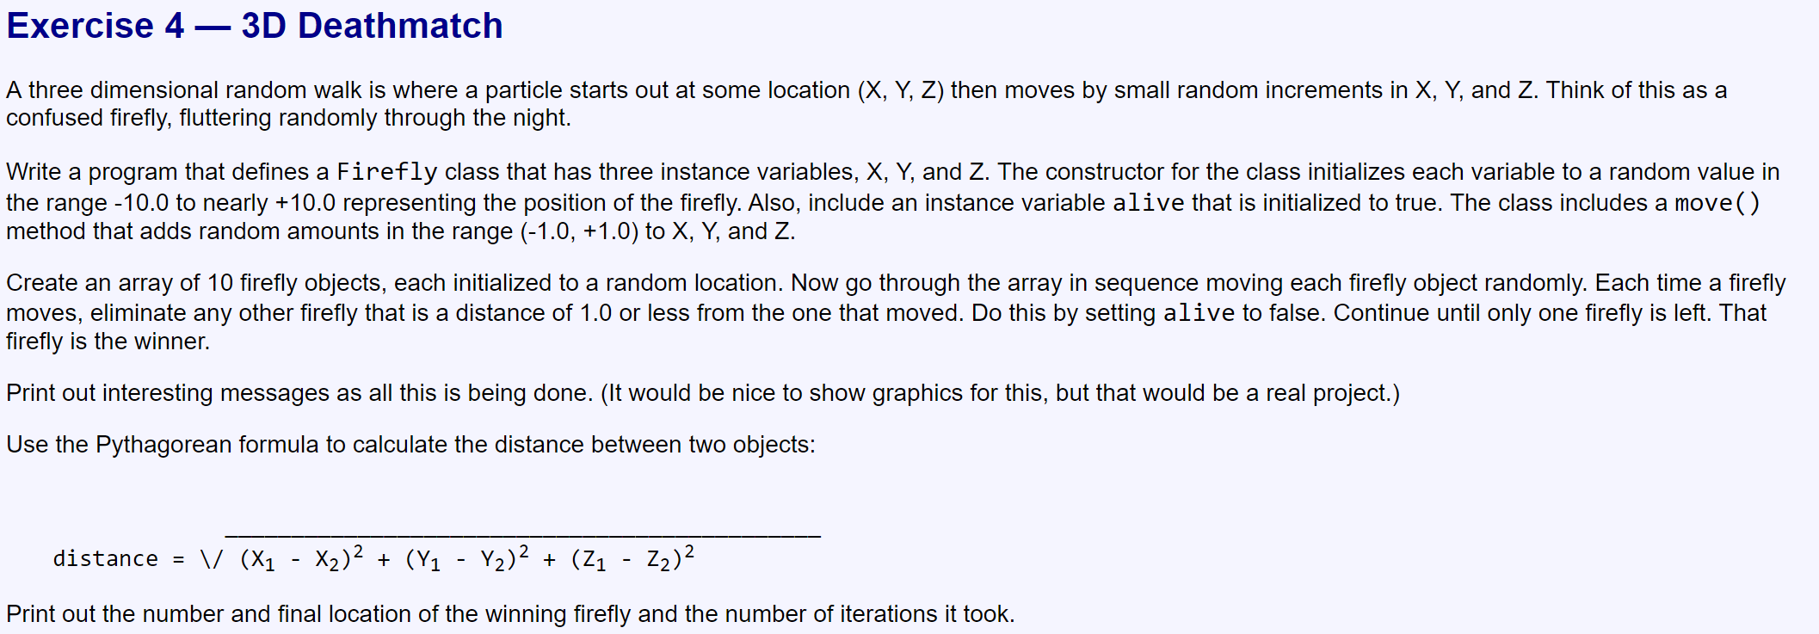

Slide 16
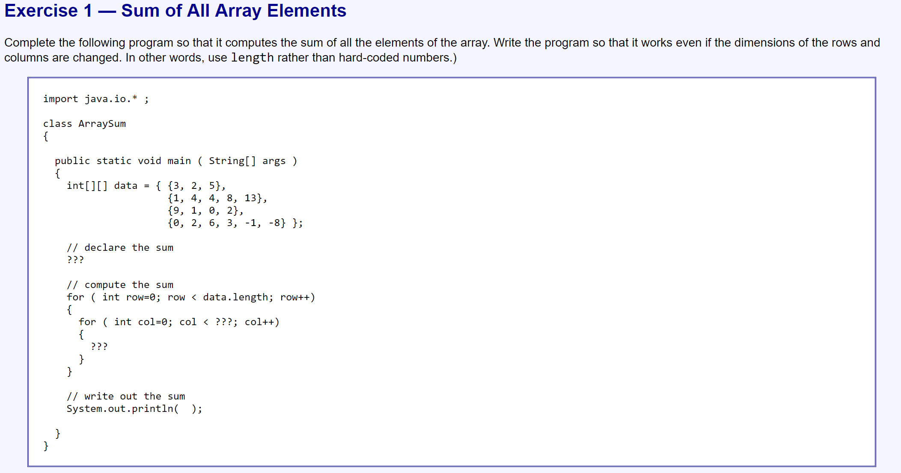
Part 2

Slide 17
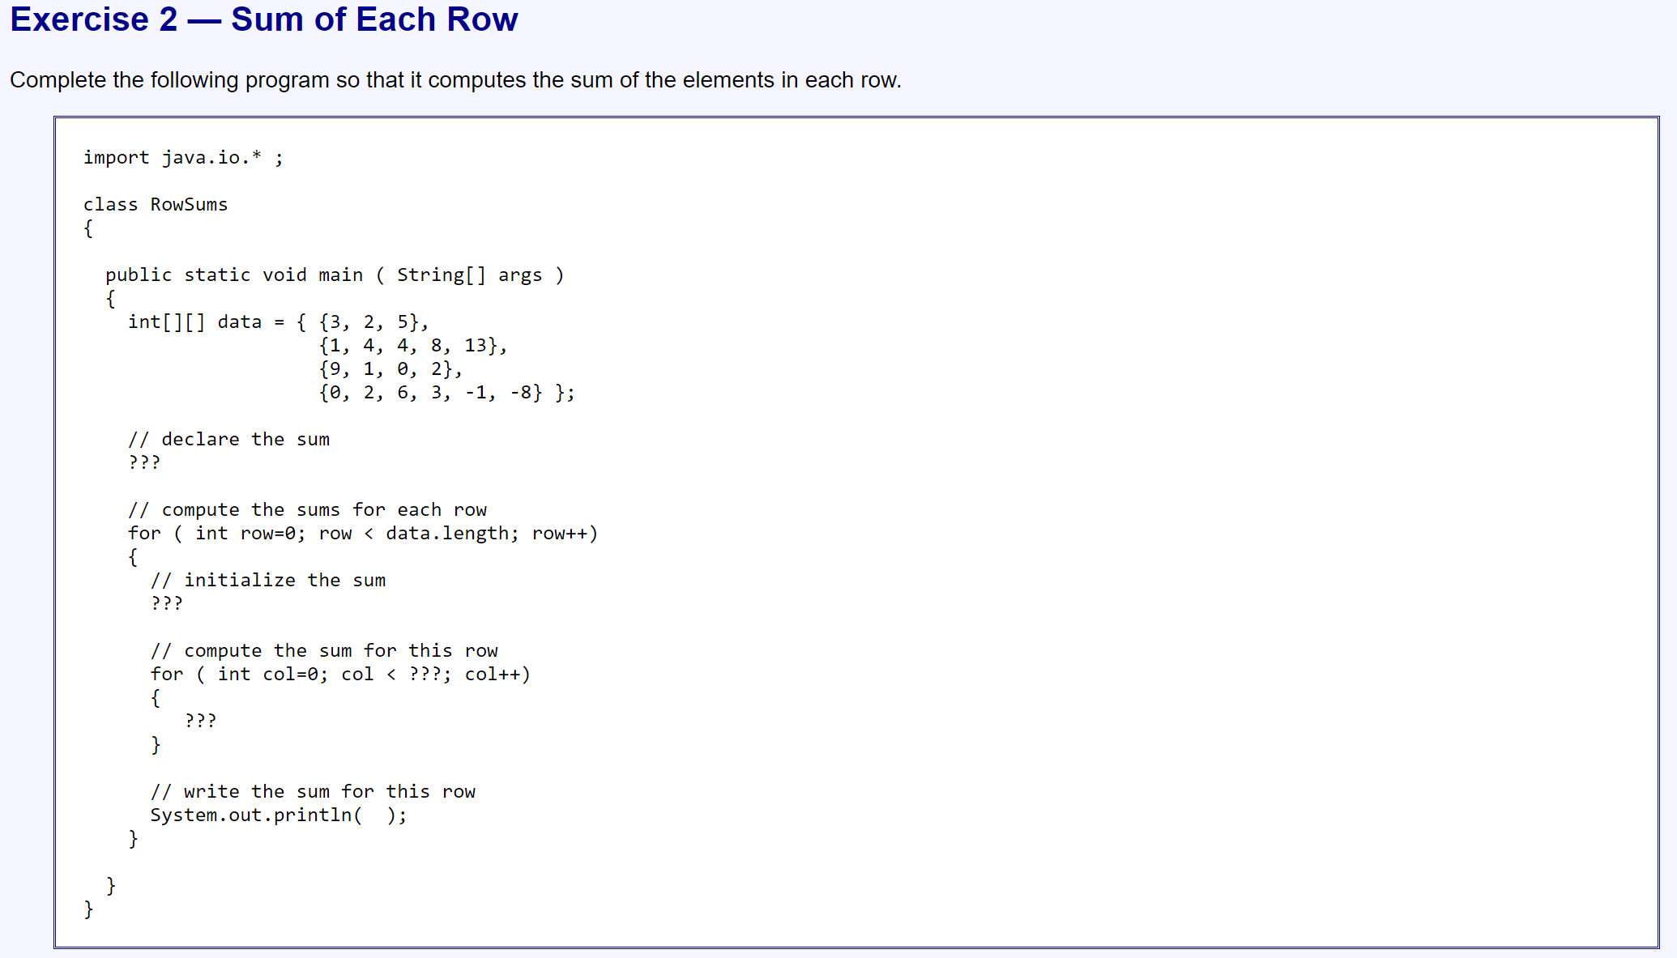

Slide 18
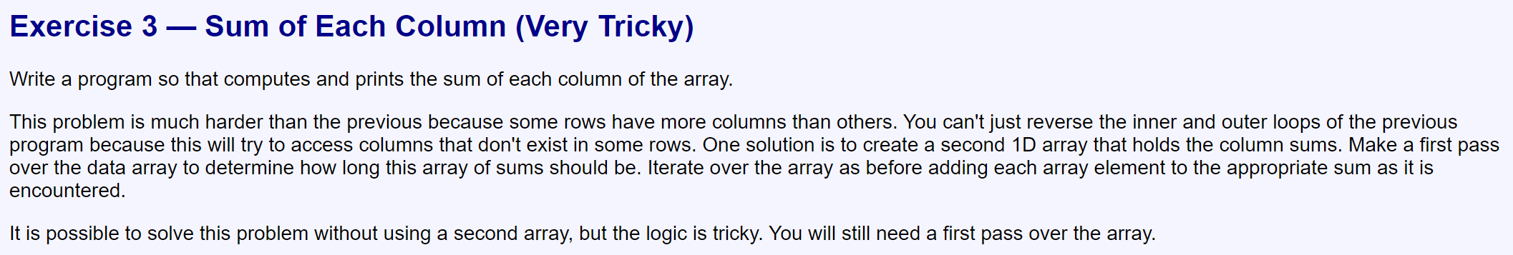

Slide 19
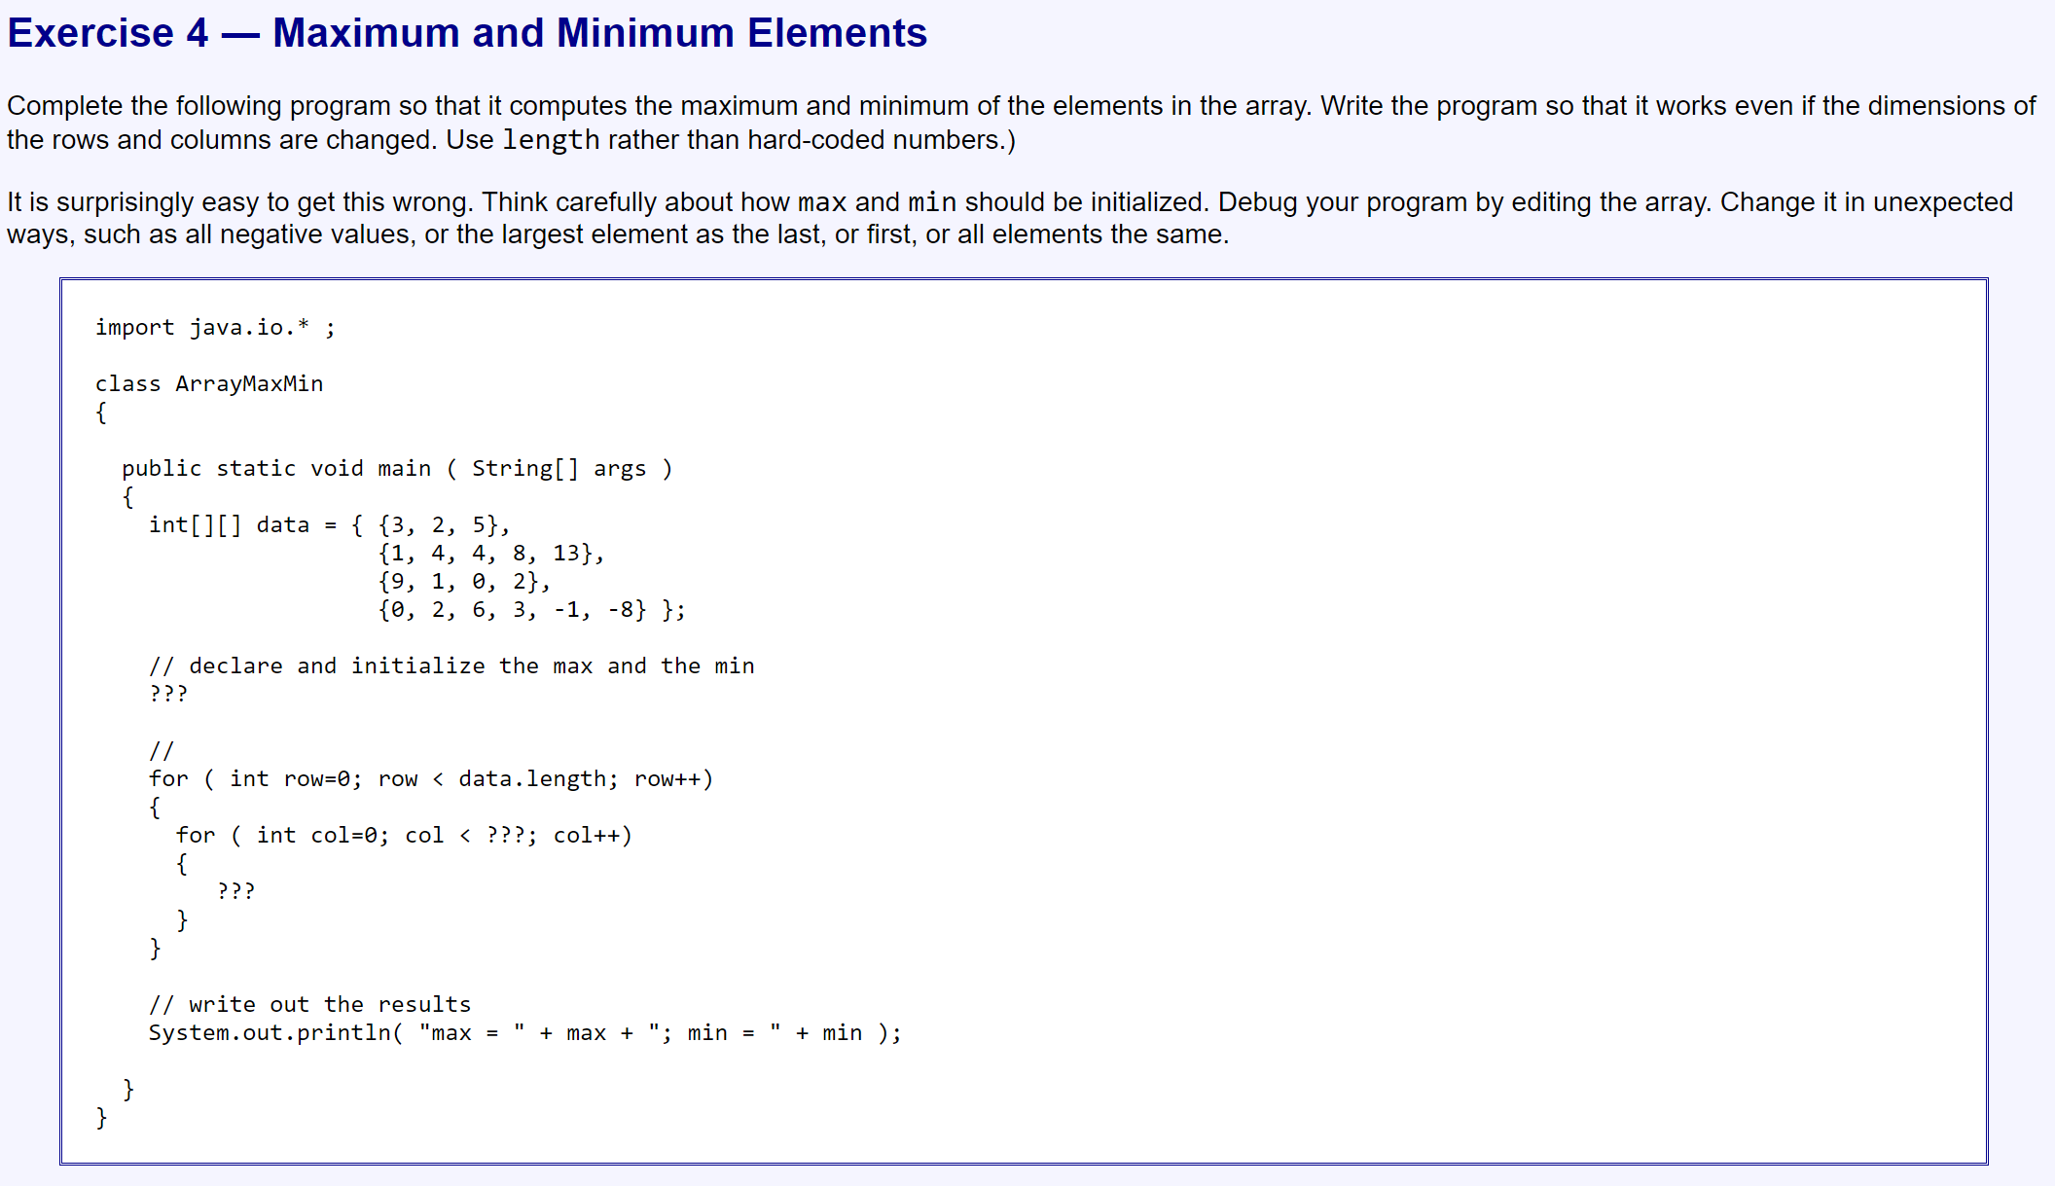

Slide 20
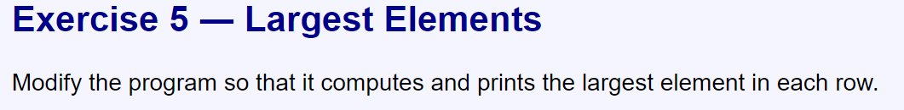

Slide 21
