Slide 1
Californians on the Move
Presented by
Team 7
Notes:
Introductions: Sara

Slide 2
Team 7
Jenifer Hwang: Population, Migration and Poverty
Daniel Kim: Unemployment, Demographics (i.e., race)
Natalia Karimova: Rent and Housing
Hossein Esteaneh: Transportation /Traffic Congestion
Sara McLean: Household Income, Gini Co-efficient
Notes:
Introductions: Sara

Slide 3
Project Description and Scope
More Californians are leaving the state than migrating into the state. Following these data points, we set out to prove this statement:
increased poverty levels
increased population
Transportation/traffic congestion (time to/from work)
unemployment rates
reduced incomes (per capita income levels)
higher income inequality
higher housing costs
higher taxes
Population Scope Baseline: California
Population Competitive View: Colorado, Florida, Idaho, Oregon, Texas
5 states chosen based on migration data and supporting articles of top states Californians moving to
Time Frame: 5 year time frame 2013-2018
Notes:
Sara

Slide 4
Research Q & A
What are the top reasons people are leaving California?
Does unemployment affect population movement out of California?
Do rent and housing price increases affect population movement?
Do transportation/traffic congestion times (travel to/from work) affect population movement?
Does income level affect population movement?
What are the demographics (specifically race) of the population movement?
Notes:
Sara

Slide 5
Data Set and Supporting Findings
api.census.gov/
Transportation; Population; Incomes; Housing Costs; Taxation; Populations
Supporting findings
https://www.economy.com/united-states/net-migration
https://www.nytimes.com/2020/01/09/upshot/american-population-slowdown.html
https://www.prb.org/usdata/indicator/migration/map/state/2010/
https://www.census.gov/library/stories/2019/04/moves-from-south-west-dominate-recent-migration-flows.html
https://www.ocregister.com/2019/10/31/190122-more-people-left-california-last-year-vs-arrived-a-38-jump/
https://showmehome.com/unpacking-californias-migration-trends/
https://www.ppic.org/press-release/whos-movin-out-of-california/
https://www.latimes.com/california/story/2019-12-21/california-population-continues-to-decline-with-state-emigration-a-major-factor
https://next10.org/sites/default/files/California-Migration-Final2.pdf
Notes:
Sara

Slide 6
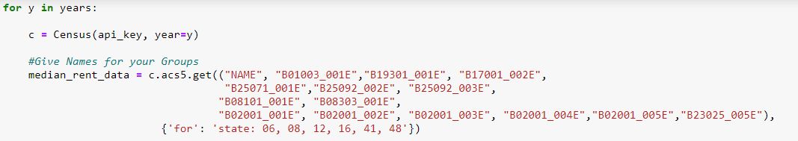
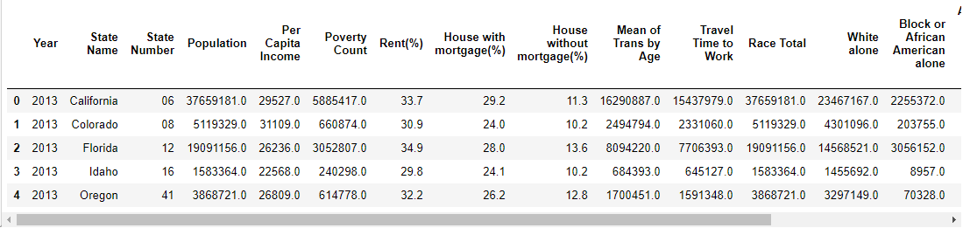
Data Exploration
Data Clean Up Process
Data Source:
Census API Collection.
American Community Survey 5-Year Data (ACS5)
2013 – 2018 years
Notes:
Natalia Karimova

Slide 7
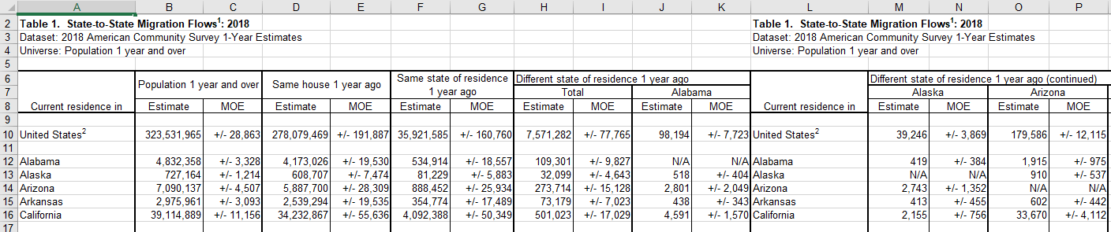
Data Exploration
Additional (not api) data from Census:
State-to-state migration (Tables) -
https://www.census.gov/data/tables/time-series/demo/geographic-mobility/state-to-state-migration.html
Process:
VBA script was generated to collect necessary data for all states (2013-2018).
Obtained CSV file was merged with the main DataFrame by State and Year.
Notes:
Natalia

Slide 8
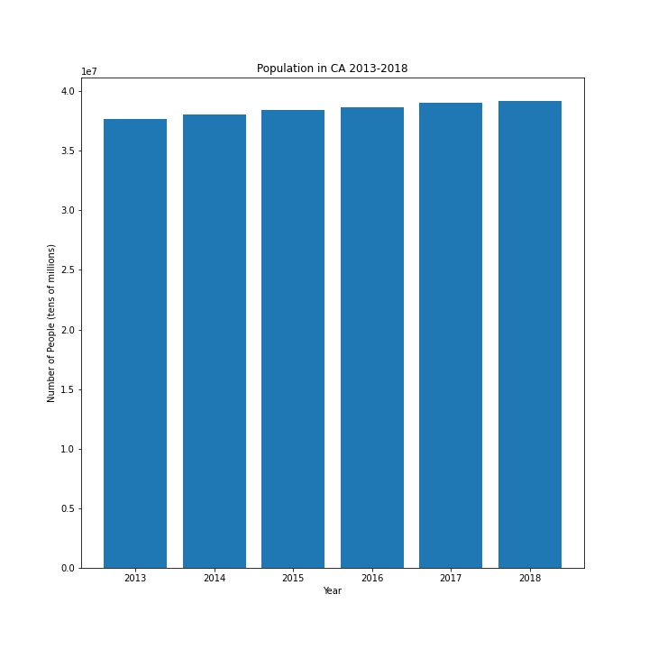
Population and Migration Findings
Over the years, population has been increasing.
Notes:
Jenifer

Slide 9
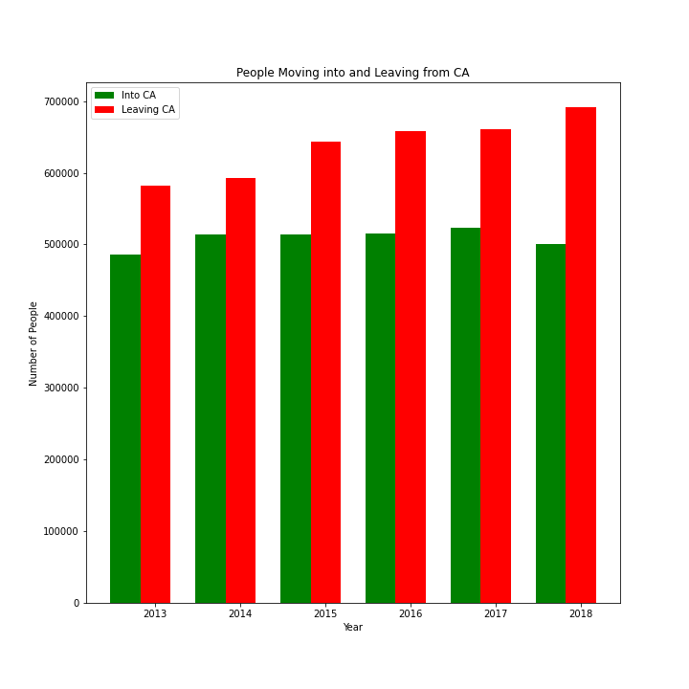
Population and Migration Findings
Even though, population in the overall state has been increasing, more people over the years have been moving out of CA.
Notes:
Jenifer

Slide 10
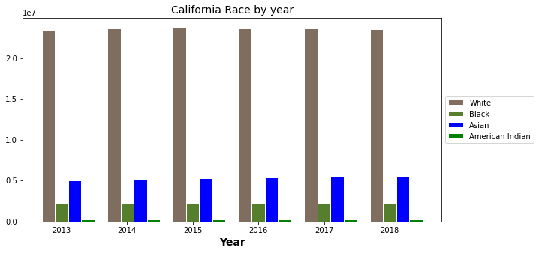
Population and Demographics
Conclusions
Notes:
Daniel

Slide 11
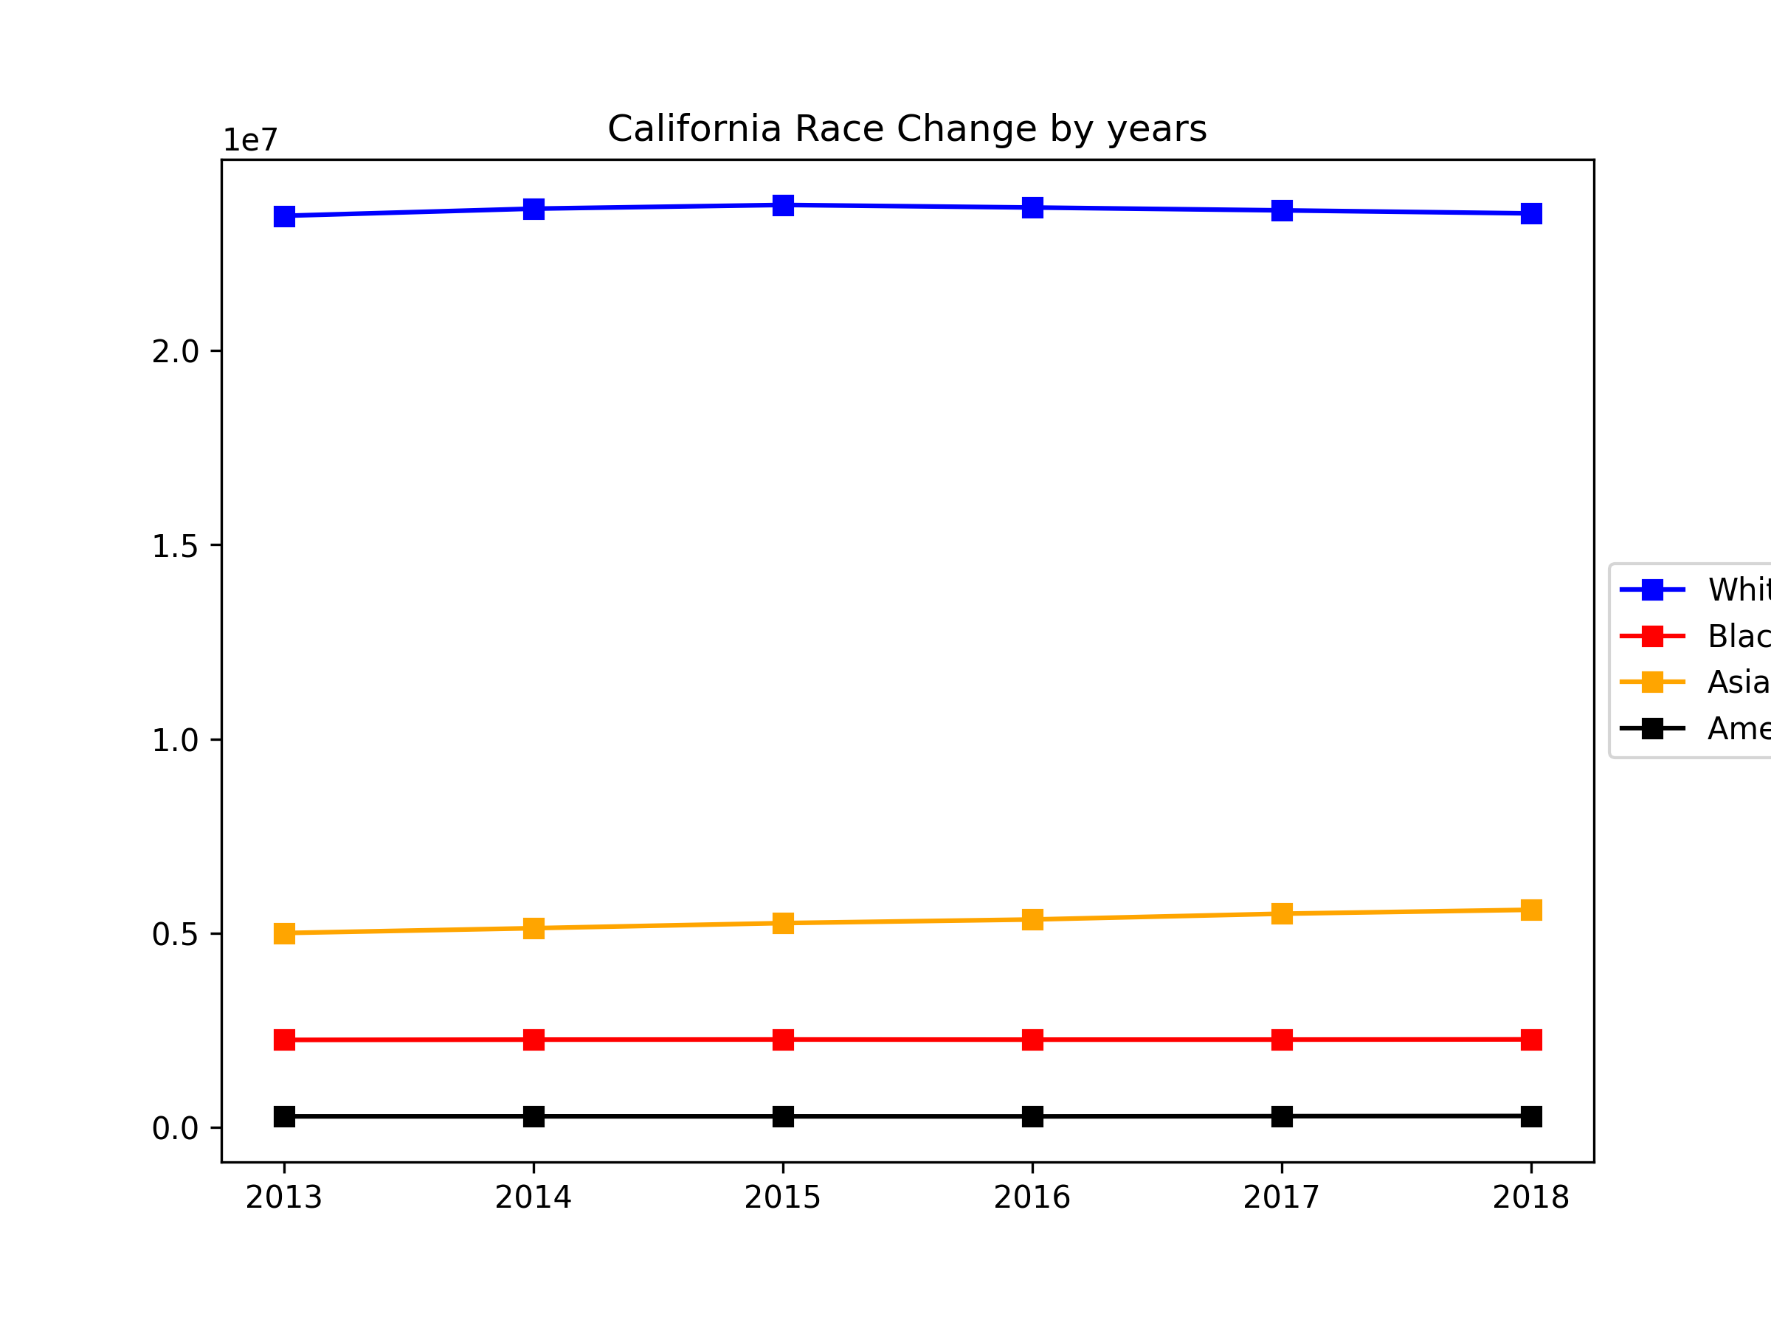
Population and Demographics
Conclusions
Notes:
Daniel

Slide 12
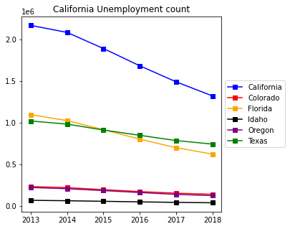
Population and Unemployment Findings
Conclusions?
Notes:
Daniel

Slide 13
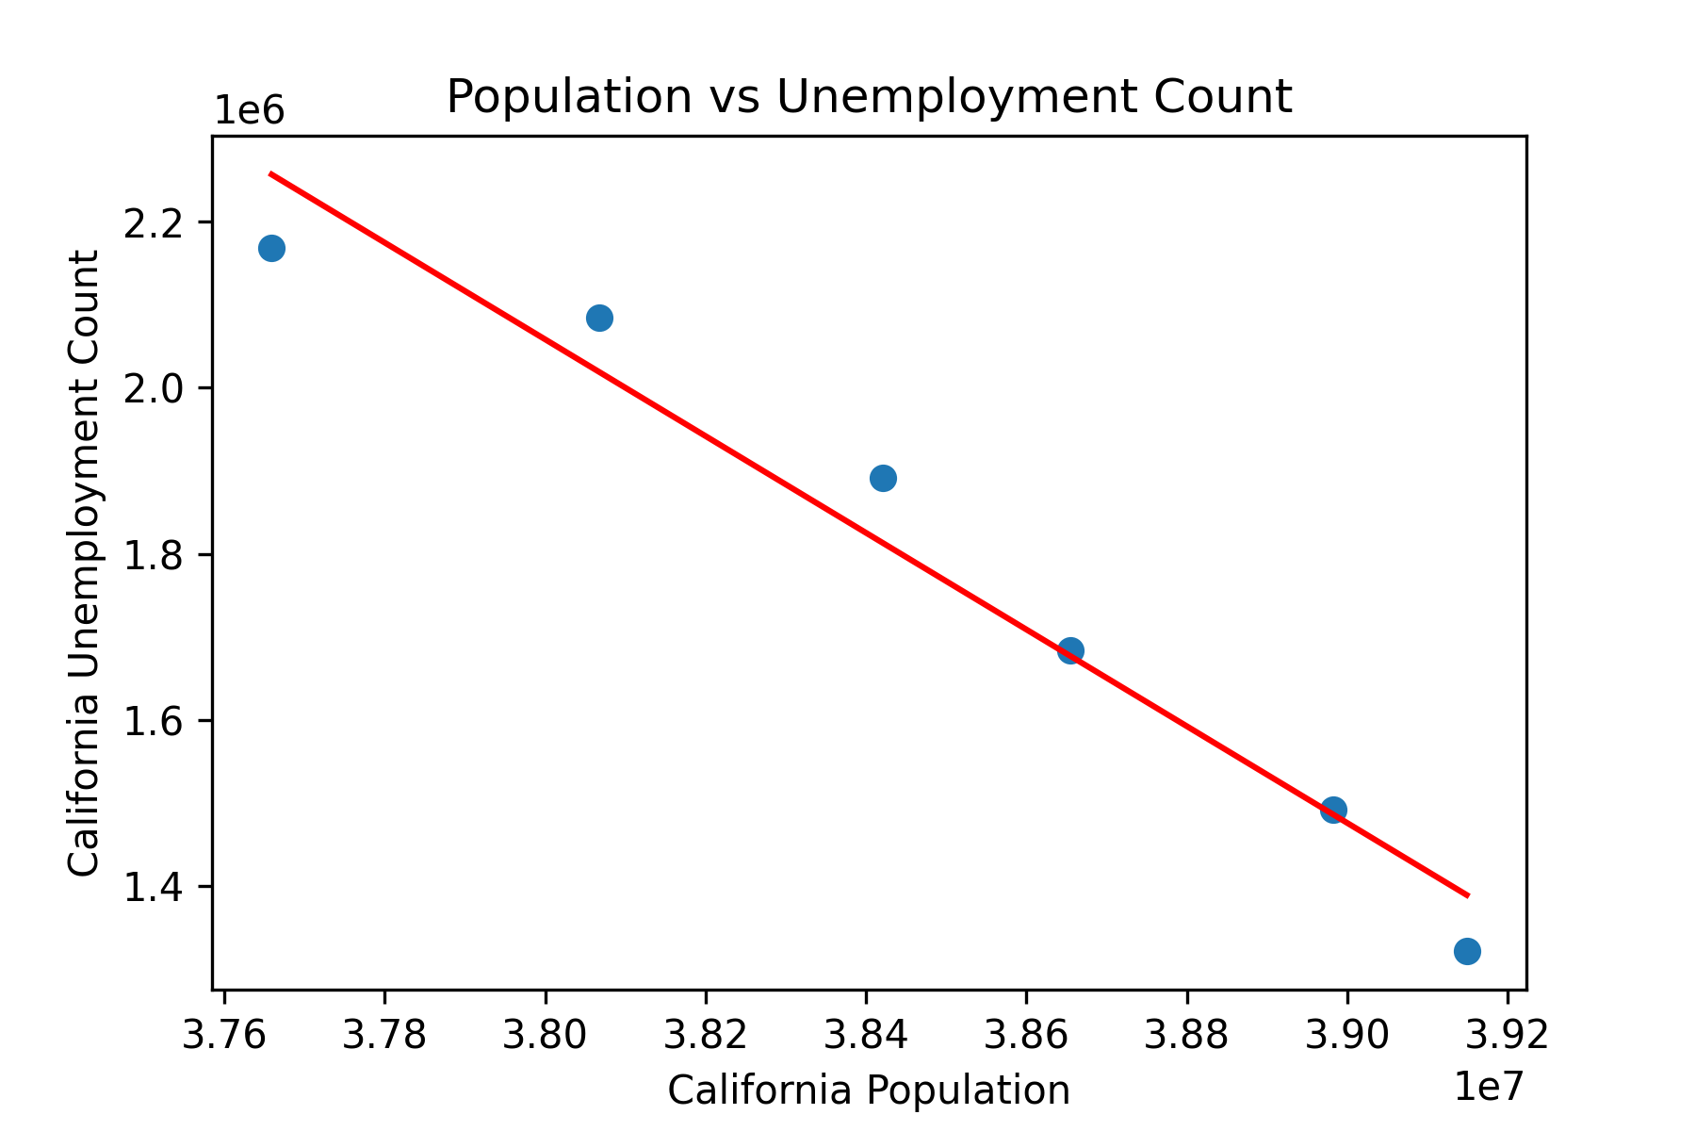
Population and Unemployment Findings
Conclusions
Notes:
Daniel

Slide 14
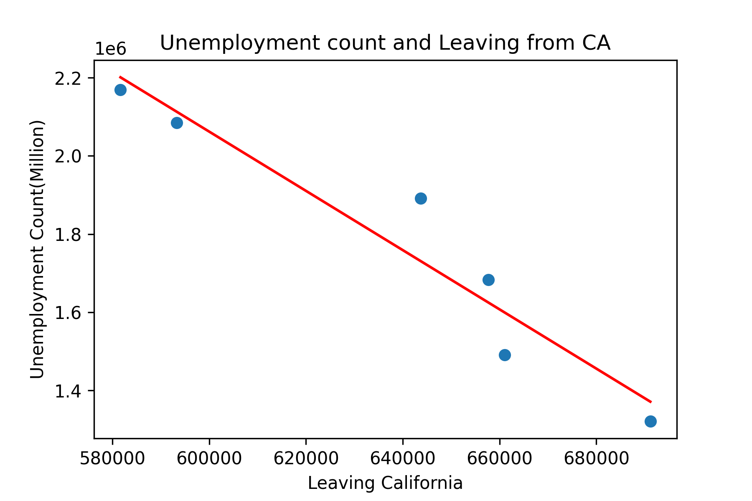
Population and Unemployment Findings
Conclusions?
Notes:
Daniel

Slide 15
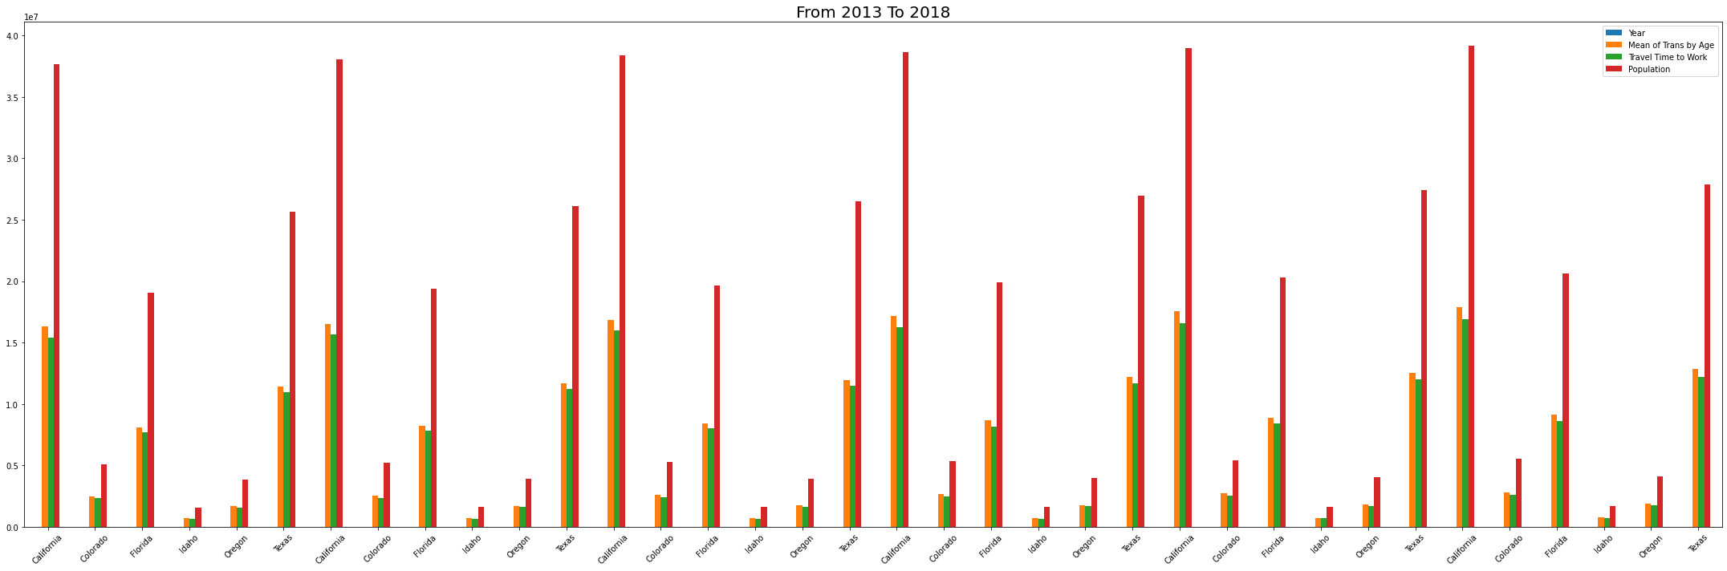
Transportation/ Traffic Congestion (travel time to & from work)
Conclusions?
Notes:
Hossein

Slide 16
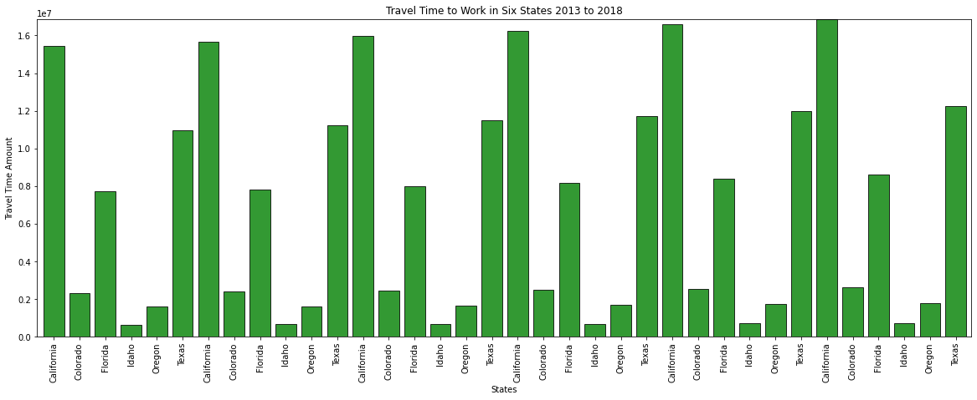
Transportation/ Traffic Congestion (travel time to & from work)
Conclusions?
Notes:
Hossein

Slide 17
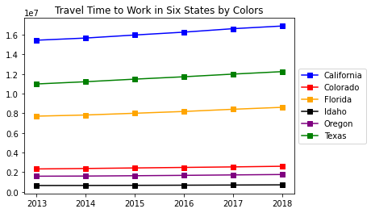
Transportation/ Traffic Congestion (travel time to & from work)
Conclusions?
Notes:
Hossein

Slide 18
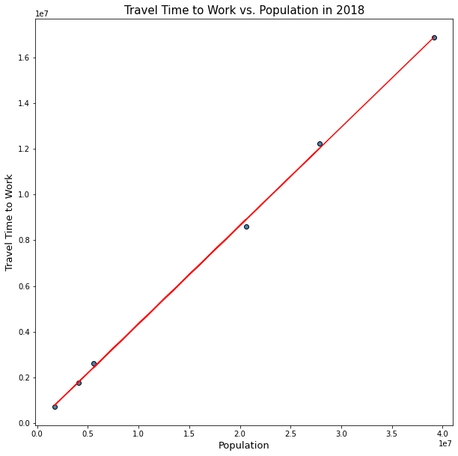
Transportation/ Traffic Congestion (travel time to & from work)
Conclusions?
Notes:
Hossein

Slide 19
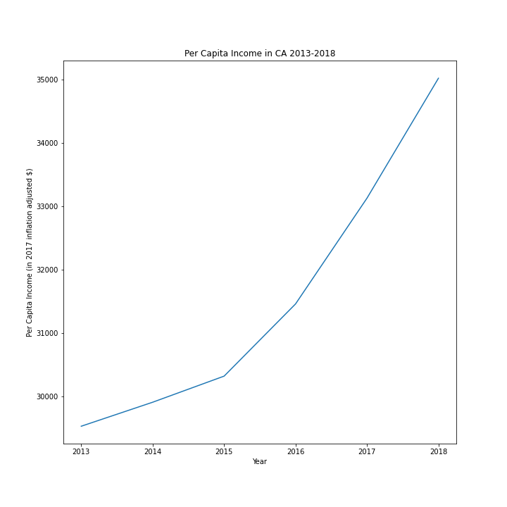
Population and Per Capita Income
Per Capita Income is used to evaluate the standard of living and quality of life. It is calculated by Income divided by Population.
Even though the Per Capita Income is increasing it does not necessarily mean that the standard of living is increasing as well.
The Per Capita Income does not take into account inflation changes over the years. The Census calculated these numbers using the 2017 inflation adjusted numbers.
Notes:
Jenifer

Slide 20
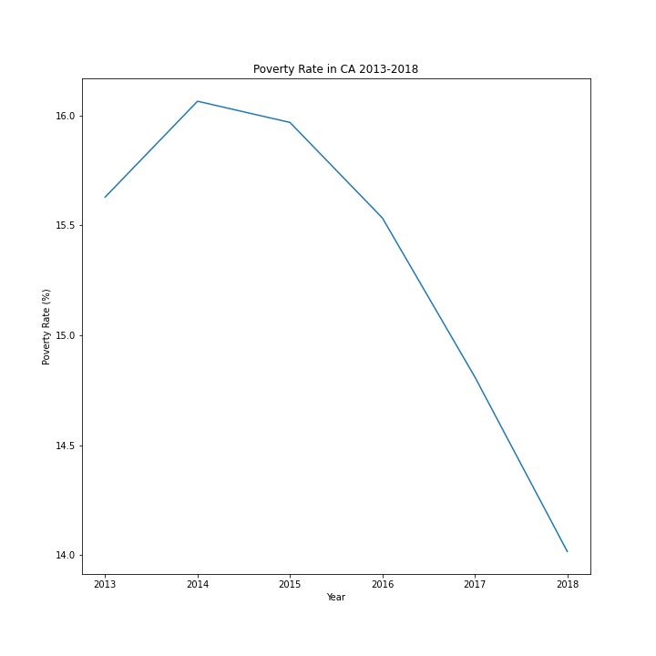
Poverty Rate Findings
Poverty Rate has been decreasing over the years but it could be indicator of change in inflation.
Notes:
Jenifer

Slide 21
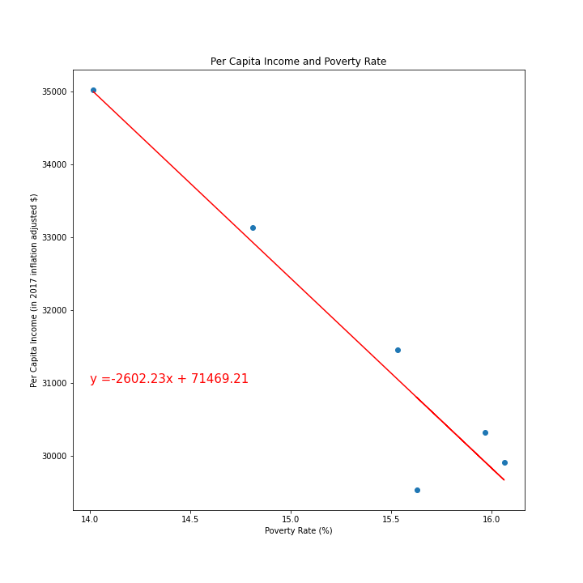
Per Capita Poverty Findings
Per Capita Income and Poverty Rate are negatively strongly correlated and significant.
This is shown from the r-squared value which is .91 and the p-value that is less than .05.
r-squared = 0.91
p-value = 0.003
Notes:
Jenifer

Slide 22
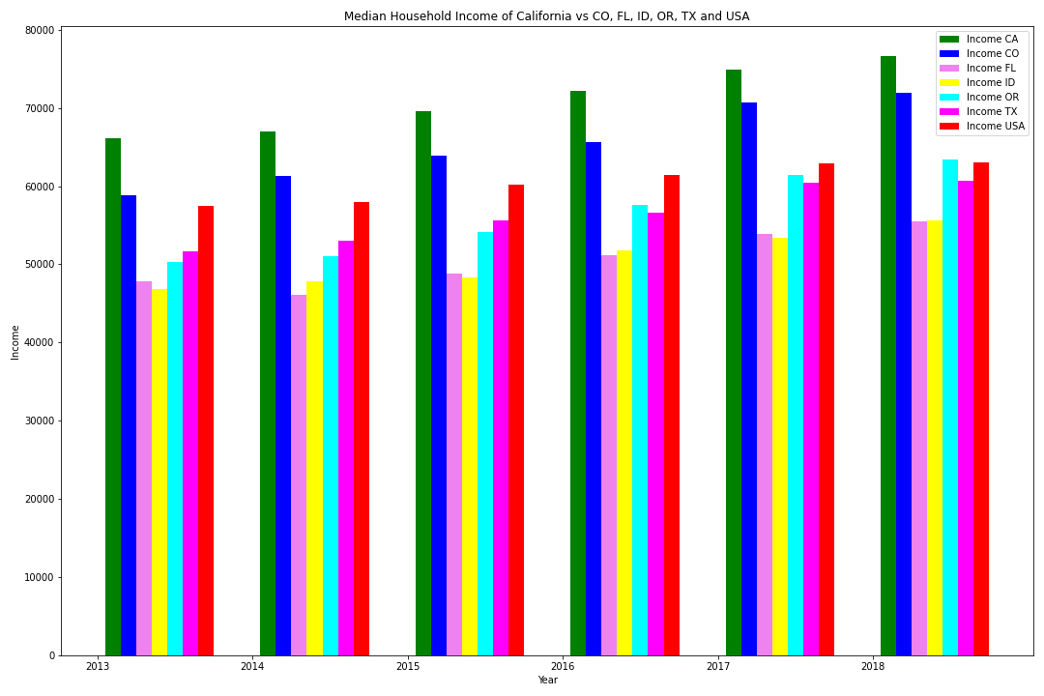
Median Household Income
Median household income from US Census highlights that California leads in income among the 5 competing states and US average
California shows higher incomes compared to USA average and 5 competing states over 5 year data span
Notes:
Sara

Slide 23
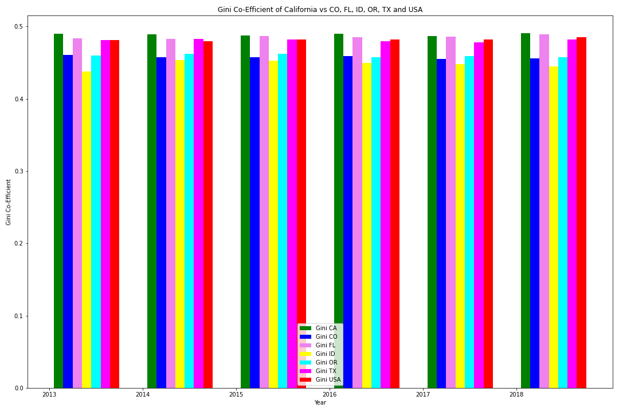
Household Income and ACS Gini co-efficient
ACS Gini co-efficient: measure of income inequality calculated by US Census
0: closer to zero (0) represents perfect equality
1: closer to one(1) represents perfect inequality
California show higher income inequality than 5 competing states and USA average
While California shows higher incomes over 5 competing states, there is higher income inequality among the population compared to 5 competing states and USA average
Notes:
Sara

Slide 24
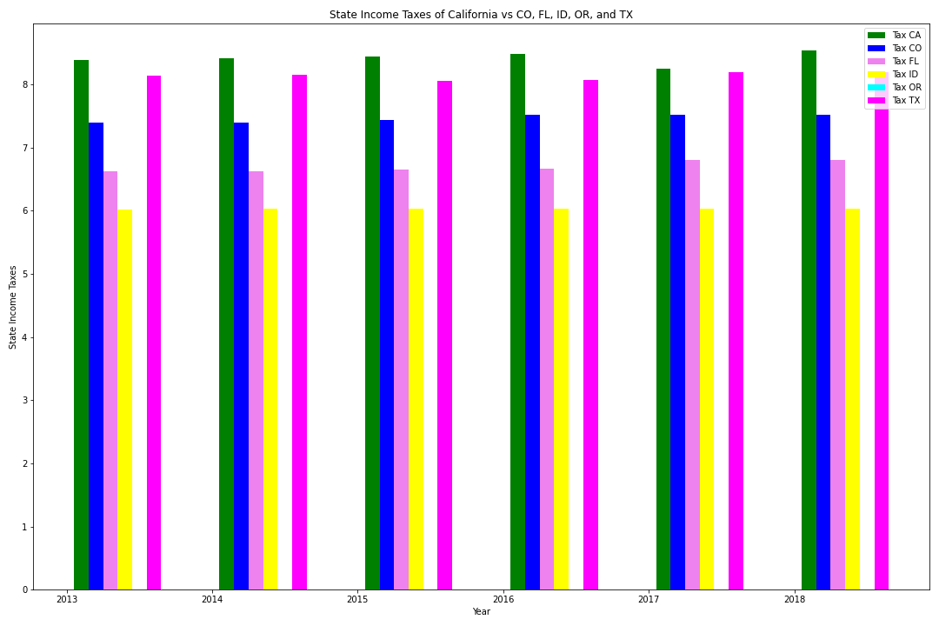
Household Income and State Tax Data
State Tax Data: represents % state tax households pay within CA and 5 competing states
California pays higher state taxes than 5 competing states
While California has higher incomes, more goes to taxes than other states
Notes:
Sara

Slide 25
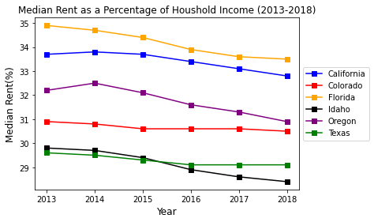
Population, Rent & Housing Findings
Conclusions:
Both California and Florida have higher rent.
The cheapest state to rent is Idaho.
%
Rent
Household Income
Notes:
Natalia

Slide 26
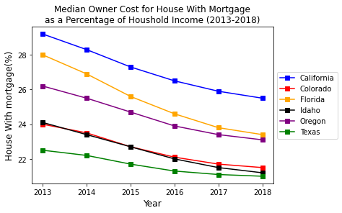
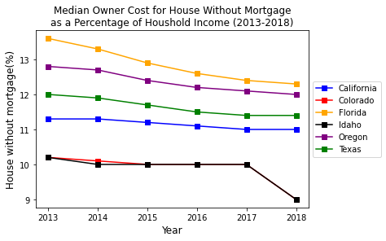
Population, Mortgage & Housing Findings
Conclusions:
California is the most expensive state to buy a house with mortgage.
Situation changes significantly if we consider the House without Mortgage.
The most attractive states to have property is Idaho and Colorado.
Notes:
Natalia

Slide 27
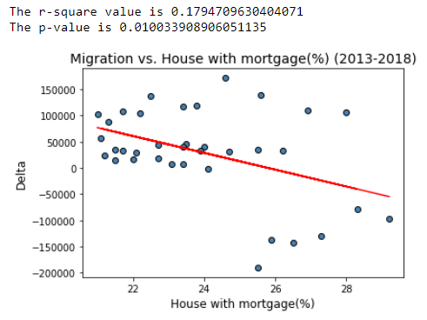
Correlation: Migration and Housing with Mortgage
Conclusions:
We found a weak correlation between moving from CA due to a housing prices.
Notes:
Natalia

Slide 28
Summary of Findings and Conclusions
1. General Conclusions and What Findings Mean
The information gathered from the US Census confirms our hypothesis that money inequality, expensive housing and traffic congestion are a few of many factors that are leading Californians to leave the state.
Implications: These are not the only factors beyond those covered in the US Census that are reasons why people may be leaving.
2. Difficulties
We faced difficulties in using some of the US Census API data as it wouldn’t always lead where we needed for information. Many hours were needed to locate some of the necessary data used for the project.
3. Additional Questions
We would include more states and more years if we had more time. We would also look to add more variables into the data set including immigration data into California, birth rates, climate change including fire disasters, education expenses, other deciding factors for leaving California.
Notes:
Sara

