Slide 1
Californians on the Move
Presented by
Team 7
Notes:
Introductions: Sara

Slide 2
Team 7
Jenifer Hwang: Population, Migration and Poverty
Daniel Kim: Unemployment, Demographics (i.e., race)
Natalia Karimova: Rent and Housing
Hossein Esteaneh: Transportation /Traffic Congestion
Sara McLean: Household Income, Gini Co-efficient
Notes:
Introductions: Sara

Slide 3
Project Description and Scope
More Californians are leaving the state than migrating into the state. Following these data points, we set out to prove this statement:
increased poverty levels
increased population
Transportation/traffic congestion (time to/from work)
unemployment rates
reduced incomes (per capita income levels)
higher income inequality
higher housing costs
higher taxes
Population Scope Baseline: California
Population Competitive View: Colorado, Florida, Idaho, Oregon, Texas
5 states chosen based on migration data and supporting articles of top states Californians moving to
Time Frame: 5 year time frame 2013-2018
Notes:
Sara

Slide 4
Research Q & A
What are the top reasons people are leaving California?
Does unemployment affect population movement out of California?
Do rent and housing price increases affect population movement?
Do transportation/traffic congestion times (travel to/from work) affect population movement?
Does income level affect population movement?
What are the demographics (specifically race) of the population movement?
Notes:
Sara

Slide 5
Data Set and Supporting Findings
api.census.gov/
Transportation; Population; Incomes; Housing Costs; Taxation; Populations
Supporting findings
https://www.economy.com/united-states/net-migration
https://www.nytimes.com/2020/01/09/upshot/american-population-slowdown.html
https://www.prb.org/usdata/indicator/migration/map/state/2010/
https://www.census.gov/library/stories/2019/04/moves-from-south-west-dominate-recent-migration-flows.html
https://www.ocregister.com/2019/10/31/190122-more-people-left-california-last-year-vs-arrived-a-38-jump/
https://showmehome.com/unpacking-californias-migration-trends/
https://www.ppic.org/press-release/whos-movin-out-of-california/
https://www.latimes.com/california/story/2019-12-21/california-population-continues-to-decline-with-state-emigration-a-major-factor
https://next10.org/sites/default/files/California-Migration-Final2.pdf
Notes:
Sara

Slide 6
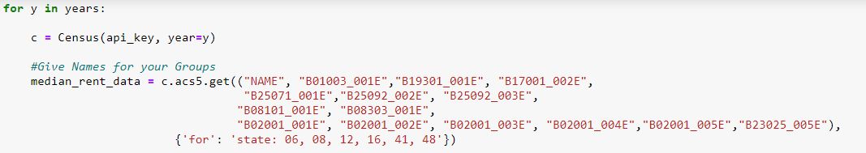
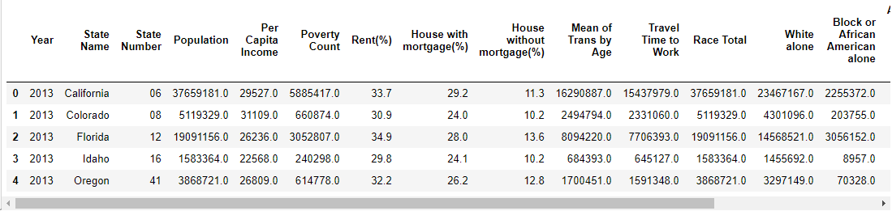
Data Exploration
Data Clean Up Process
Data Source:
Census API Collection.
American Community Survey 5-Year Data (ACS5)
2013 – 2018 years
Notes:
Natalia Karimova

Slide 7
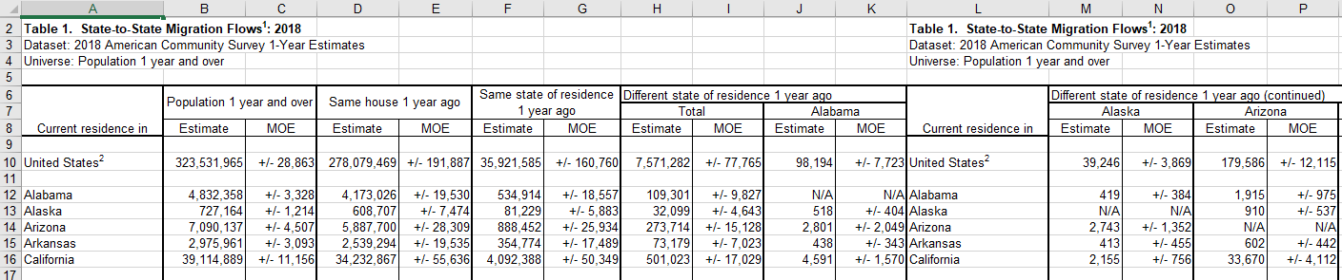
Data Exploration
Additional (not api) data from Census:
State-to-state migration (Tables) -
https://www.census.gov/data/tables/time-series/demo/geographic-mobility/state-to-state-migration.html
Process:
VBA script was generated to collect necessary data for all states (2013-2018).
Obtained CSV file was merged with the main DataFrame by State and Year.
Notes:
Natalia

Slide 8
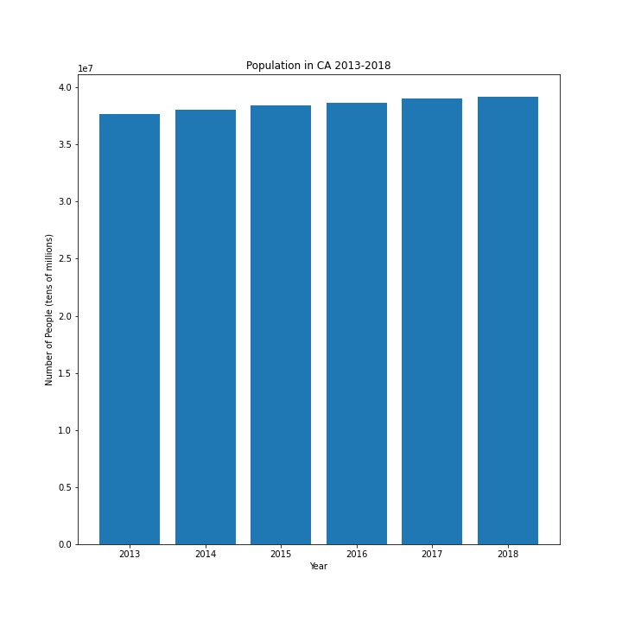
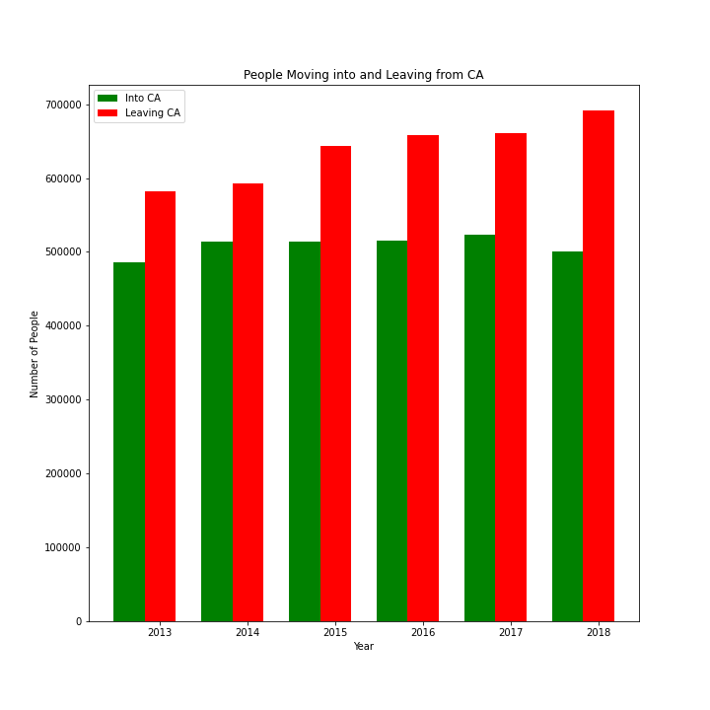
Population and Migration Findings
Over the years, population has been increasing.
Even though, population in the overall state has been increasing, more people over the years have been moving out of CA.
Notes:
Jenifer

Slide 9
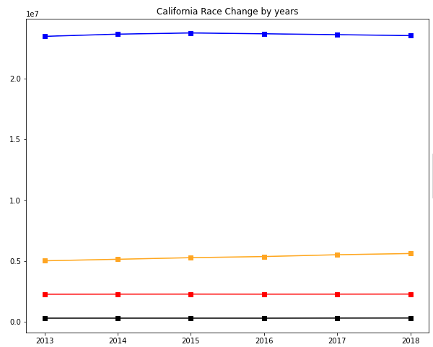
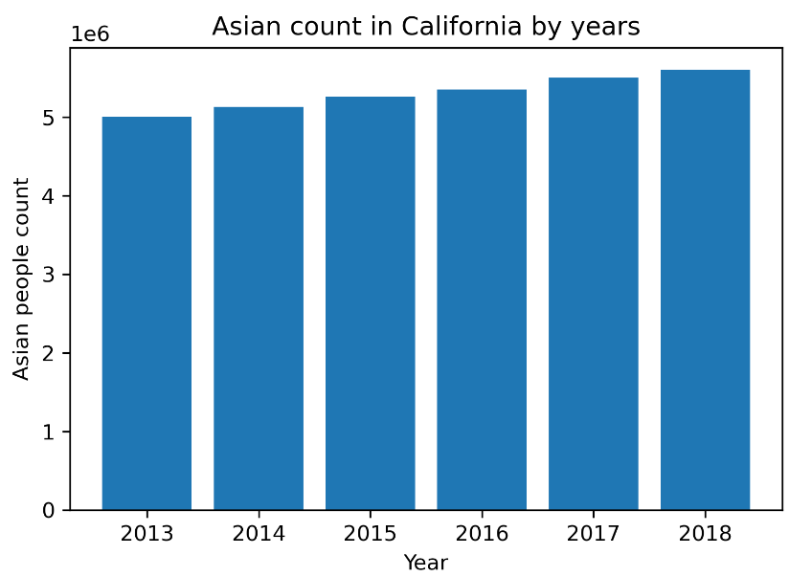

Population and Demographics
From 2013 to 2018 there are no significant change on demographics. Only Asian population is moderately increased compare to other races.
We found that growth of Asian population seems the reason of growing California’s population.

Slide 10
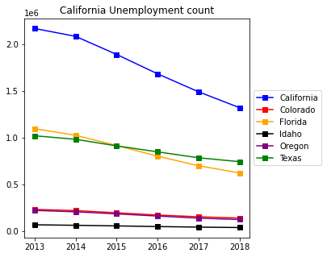
Population and Unemployment Findings
California unemployment count is decreasing by years.
Based on census data, California’s unemployment count declines more than other states.

Slide 11
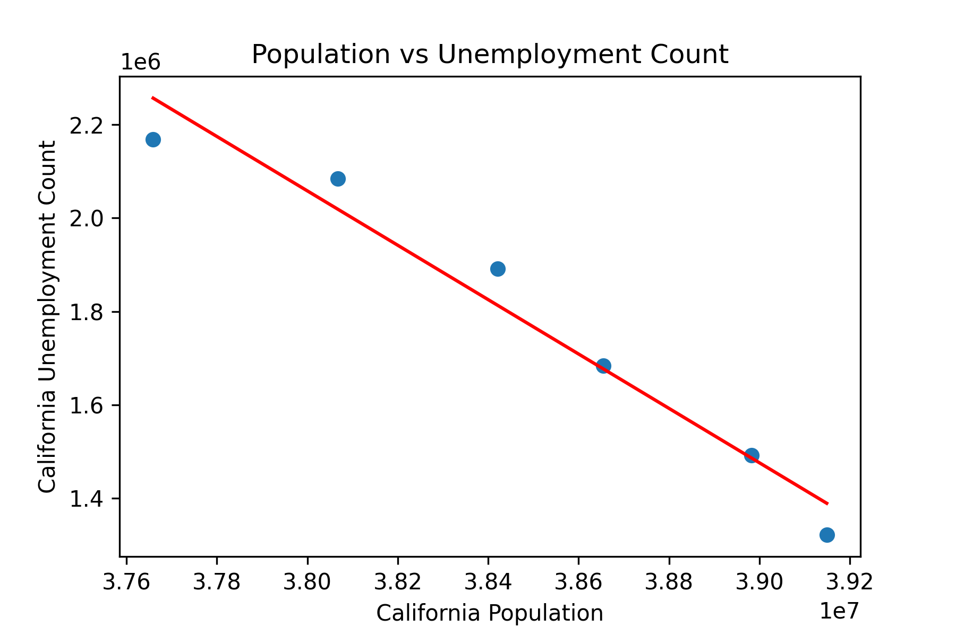
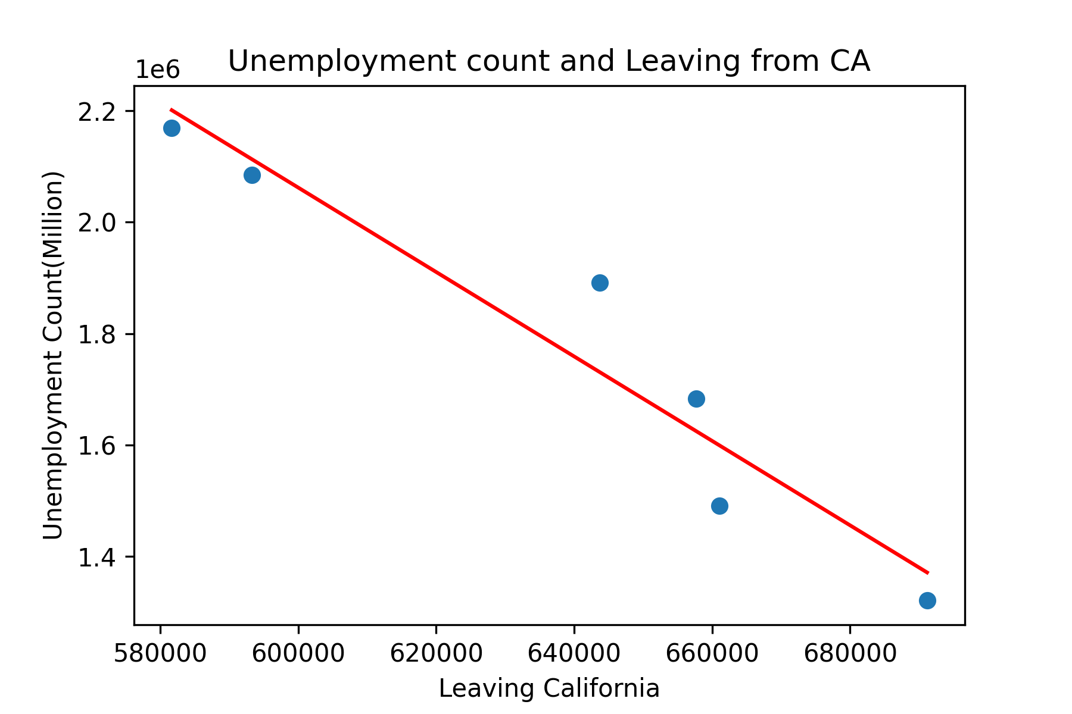
Population and Unemployment Findings
California population is growing
Count of leaving California is growing
Unemployment count is decreasing
We found that population and unemployment count indicate a negative correlation.
Therefore, we conclude that unemployment is not the reason of people leaving California.

Slide 12
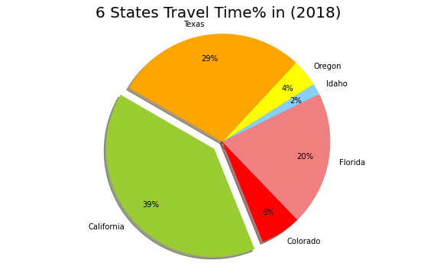
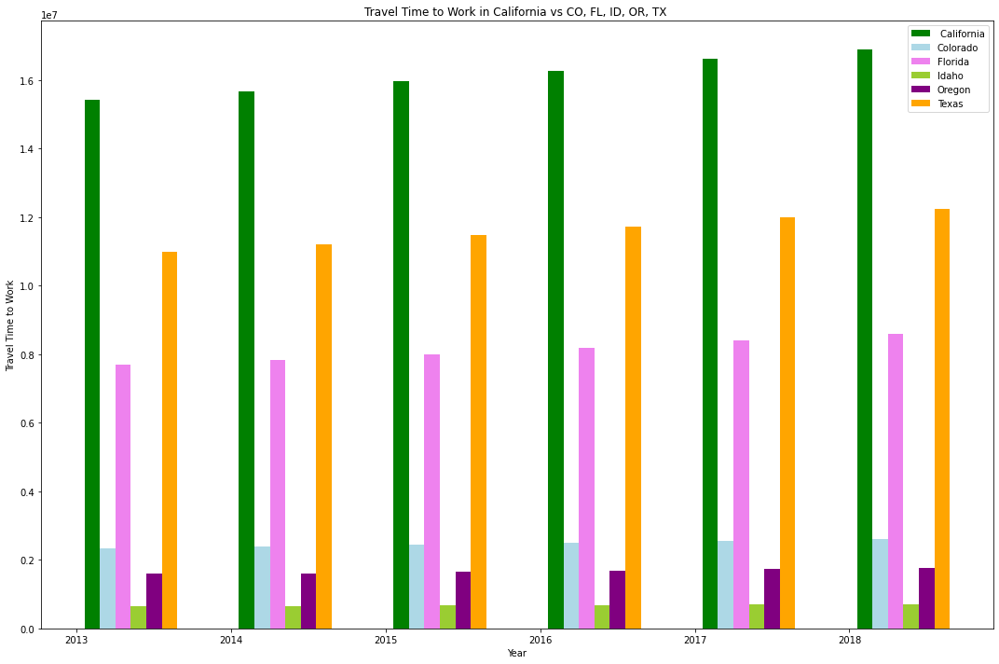
Transportation/Traffic Congestion (travel time to & from work)
Travel time to work could be one of the reason people are leaving California compare with other five states. In these graphs we can see that people spend more time to travel to work instead of being with their family. Texas and Florida have more travel time to work after California, and Idaho is the lowest. In this pie graph we could see people in California spend the most travel time to work and Idaho with the lowest .
Notes:
Hossein

Slide 13
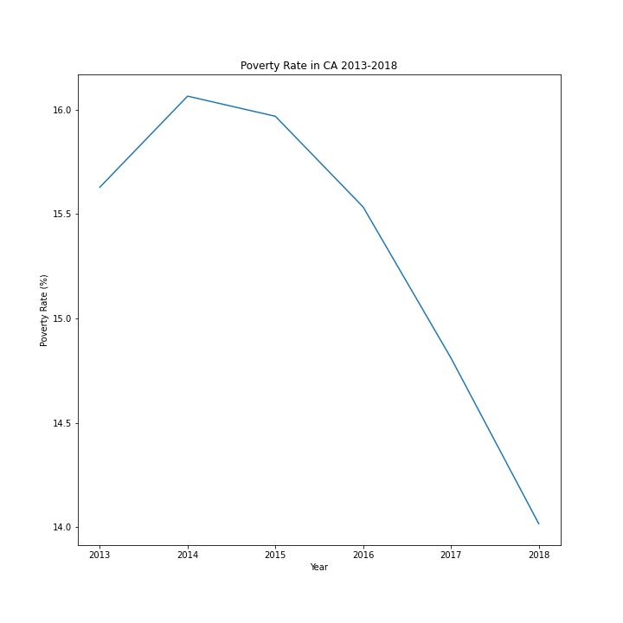
Poverty Rate Findings
Poverty Rate has been decreasing over the years but it could be indicator of change in inflation.
Notes:
Jenifer

Slide 14
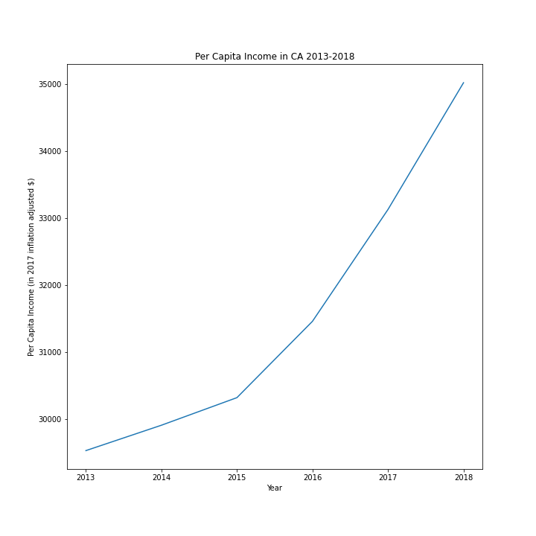
Per Capita Income
Per Capita Income is used to evaluate the standard of living and quality of life. It is calculated by Income divided by Population.
Even though the Per Capita Income is increasing it does not necessarily mean that the standard of living is increasing as well.
The Per Capita Income does not take into account inflation changes over the years. The Census calculated these numbers using the 2017 inflation adjusted numbers.
Notes:
Jenifer

Slide 15
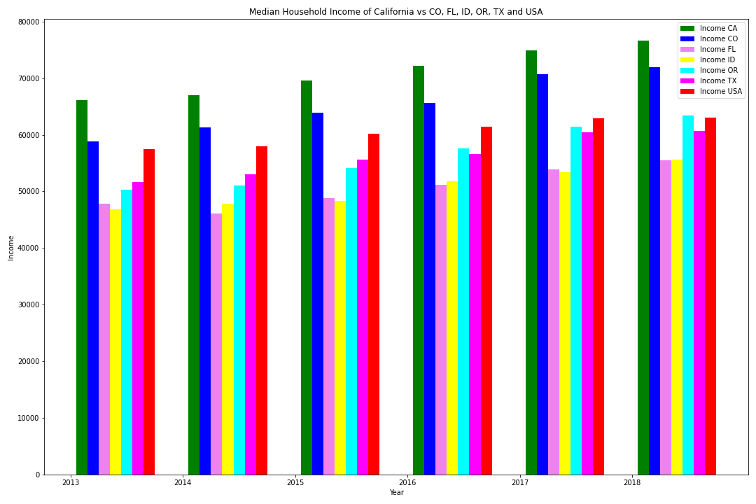
Median Household Income
Median household income from US Census highlights that California leads in income among the 5 competing states and US average
California shows higher incomes compared to USA average and 5 competing states over 5 year data span
Notes:
Sara

Slide 16
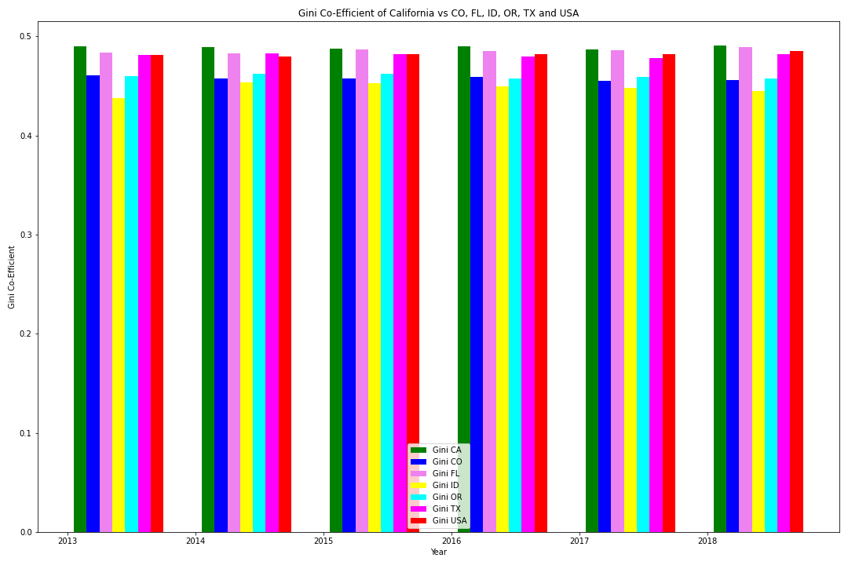
Household Income and ACS Gini co-efficient
ACS Gini co-efficient: measure of income inequality calculated by US Census
0: closer to zero (0) represents perfect equality
1: closer to one(1) represents perfect inequality
California show higher income inequality than 5 competing states and USA average
While California shows higher incomes over 5 competing states, there is higher income inequality among the population compared to 5 competing states and USA average
Notes:
Sara

Slide 17
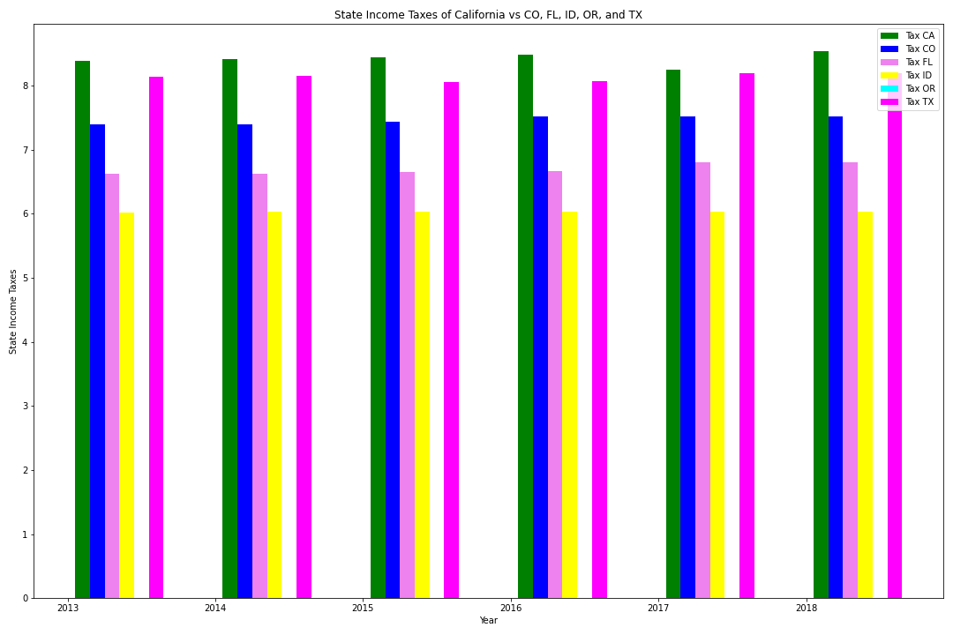
Household Income and State Tax Data
State Tax Data: represents % state tax households pay within CA and 5 competing states
California pays higher state taxes than 5 competing states
While California has higher incomes, more goes to taxes than other states
Notes:
Sara

Slide 18
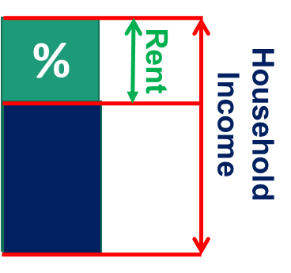
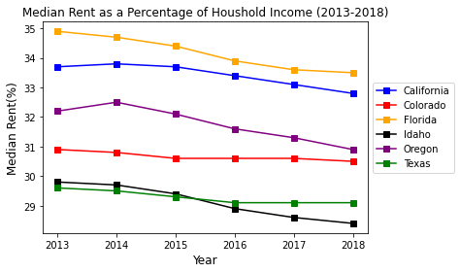
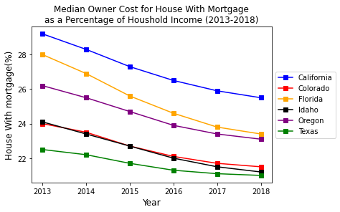
Migration vs Rent & Housing Findings
Both California and Florida have higher rent.
California is the most expensive state to buy a house with mortgage.
The most attractive states to have property is ID, TX and CO.
We found a weak positive correlation between migration from CA due to a housing prices (r-value = 0.45).
So, there are another reasons why people prefer to move out from CA.

Slide 19
Summary of Findings and Conclusions
1. General Conclusions and What Findings Mean
The information gathered from the US Census confirms our hypothesis that money inequality, expensive housing and traffic congestion are a few of many factors that are leading Californians to leave the state.
Implications: These are not the only factors beyond those covered in the US Census that are reasons why people may be leaving.
2. Difficulties
We faced difficulties in using some of the US Census API data as it wouldn’t always lead where we needed for information. Many hours were needed to locate some of the necessary data used for the project.
3. Additional Questions
We would include more states and more years if we had more time. We would also look to add more variables into the data set including immigration data into California, birth rates, climate change including fire disasters, education expenses, other deciding factors for leaving California.
Notes:
Sara

