Slide 1

Peruvian Football News Generator Using Generative Models
{
NLP | Dr. Wester Zela
Purizaga Ñaupas, Jesús Humberto
}
...

Slide 2
01
Peruvian Football News Generator
{
..
}
..

Slide 3
News Generator
The news generator works as follows: you give the headline and the generator creates the news article.
Headline:
Body
Example:
Universitario ganó la final de la Liga 1 Betson:
Hace unos días se jugó la final de la Liga 1 Betson entre Alianza Lima y Universitario siendo el resultado del partido 0-2 para los cremas.

Slide 4


Web scraping
{
..
}
..

Slide 5
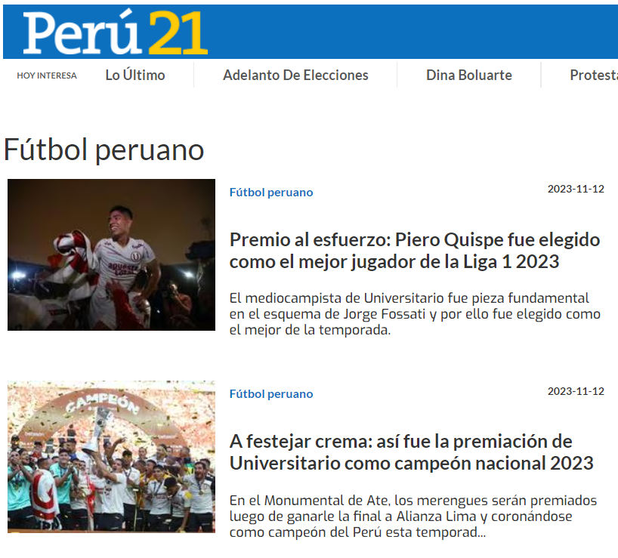
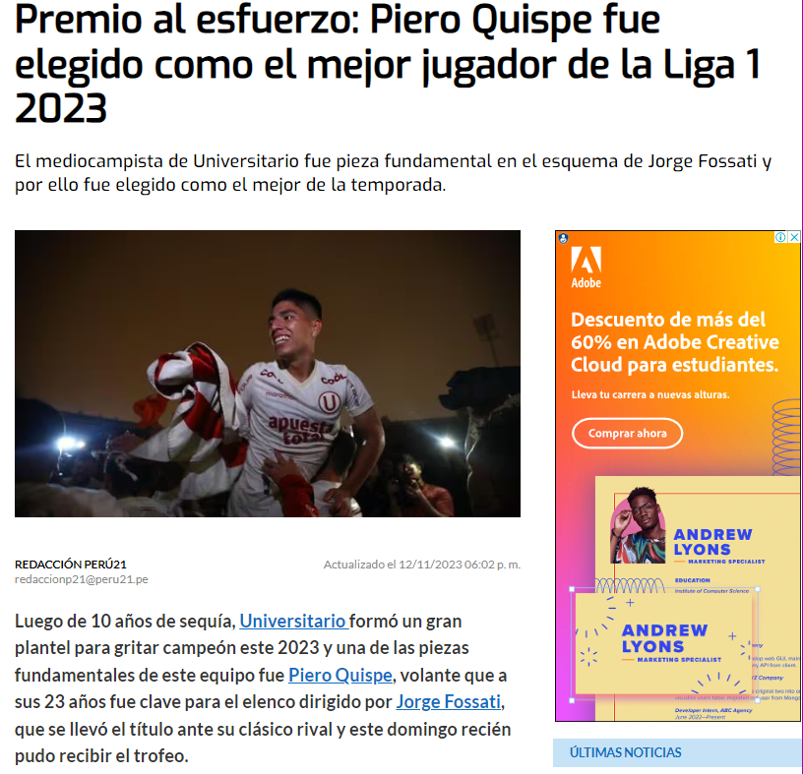
Web scraping (Peru21)
{
Peruvian Football News from 01/01/23 to 12/11/23
Extract
Headline
Subheading
Body
}
*

Slide 6

02
Models (GRU, GPT2 & Alpaca)
{
..
}
..

Slide 7
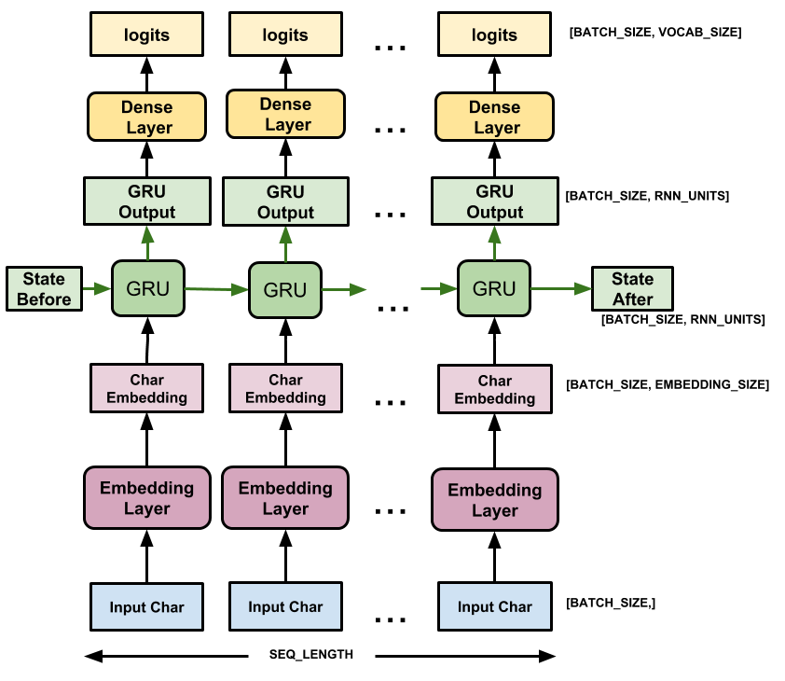
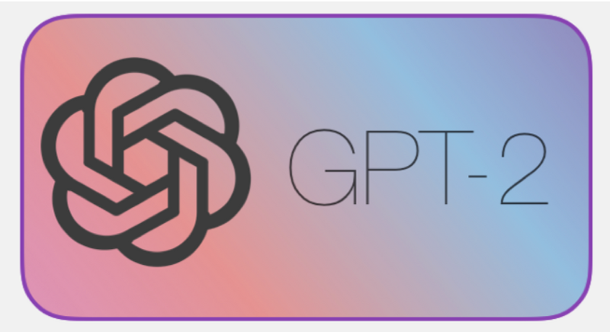

Text Generative Models
{
GRU (Gated Recurrent Unit)
A type of Recurrent Neural Network (RNN)
Pre-trained Models (Fine tuning)
}
GPT-2 Spanish
Alpaca 7B

Slide 8
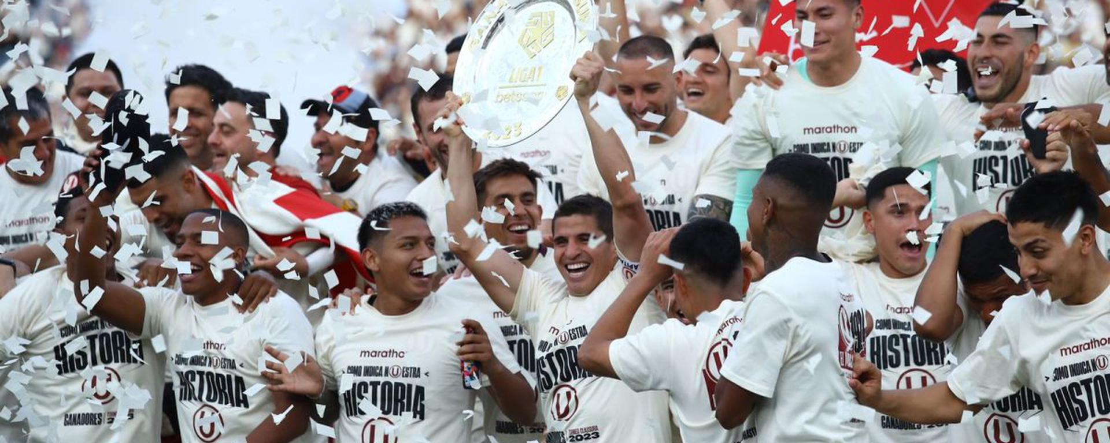
Thanks!
}
*

