Slide 1
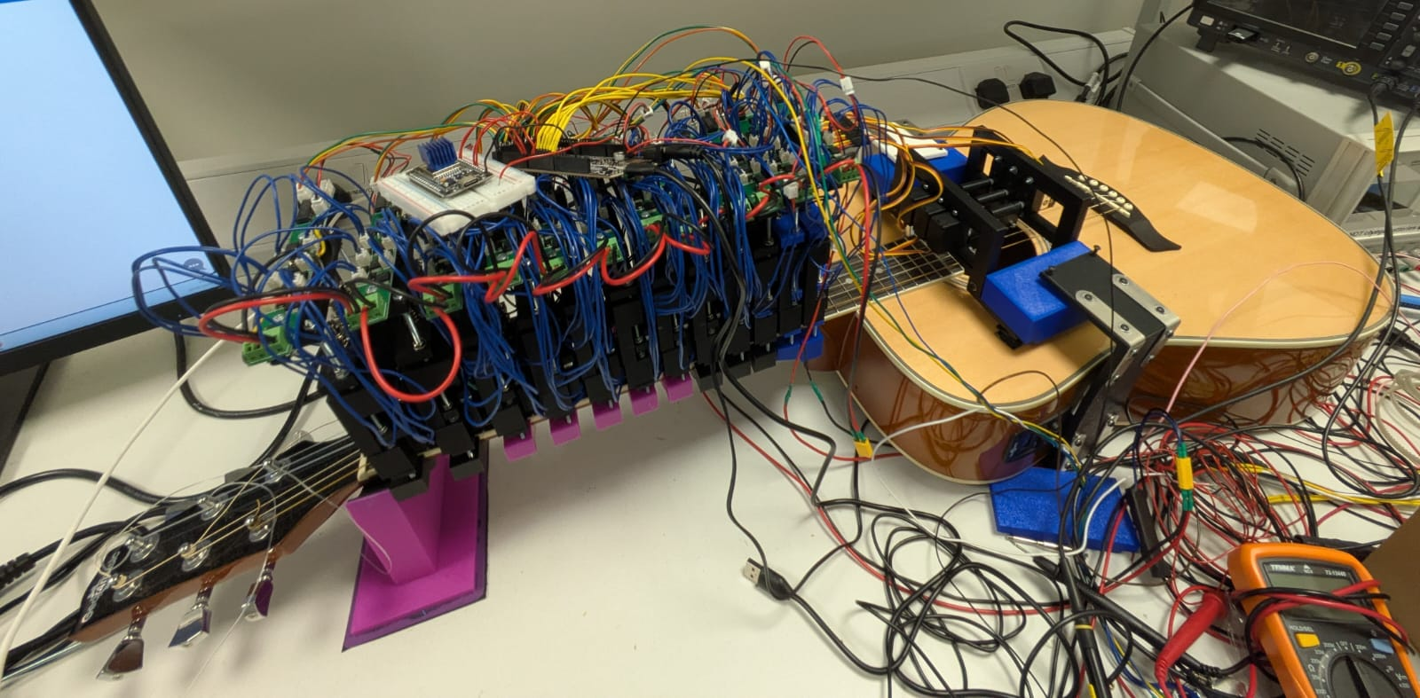
gAItar
A robotically actuated acoustic guitar with generative AI

Slide 2
Video Demonstration
https://youtu.be/pzkTf3Y7SAQ

Slide 3
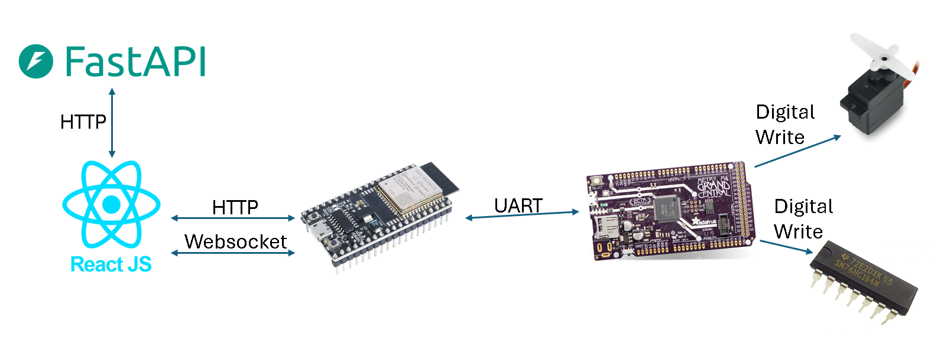
System Overview

Slide 4
Backend endpoints
POST /upload-midi-binary
POST /upload-midi (legacy)
POST /generate-midi/
Post /convert-audio-to-midi/

Slide 5
/upload-midi-binary overview
Endpoint: POST /upload-midi-binary
Receives: A user-uploaded MIDI file and its song metadata.
Translates: Converts MIDI notes into a playable sequence of guitar events (string, fret, time).
Optimizes: Serializes these events into a custom, highly compact binary format designed for the microcontroller's limited memory.
Delivers: Returns the binary data to the frontend for transfer to the ESP32.

Slide 6
MIDI to Guitar
Metadata extraction
Note to guitar mapping
Melodic track isolation
Merging and time normalisation
Event encoding
JSON formatting
Extract global timing info
Remove percussion (MIDI track 9) and empty tracks
Combine melodic tracks, convert time to absolute ms
Greedy algorithm to map not to string, fret pair, lowest note first
Encode each note on and off event: Timing, string number, fret number
Sort events chronologically and wrap into JSON structure

Slide 7
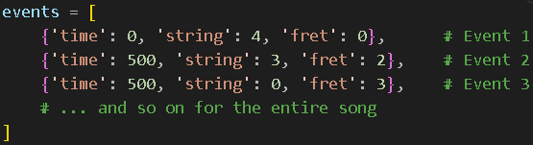
Playback instruction format
JSON event format
30x reduction in file sizes
Binary encoding
Byte 0 | Byte 1 | Byte 2 | Byte 3 | Byte 4
Time ms (unsigned long) |  |  |  | Guitar Mapping
Byte 4
Bit 7 | Bit 6 | Bit 5 | Bit 4 | Bit 3 | Bit 2 | Bit 1 | Bit 0
0 | 1 | 1 | 0 | 0 | 0 | 1 | 0
String = [7:5] |  |  | Fret = [4:0]

Slide 8
/generate-midi/ overview
User input
JSON payload from React.js frontend
Model inference
Text2midi T5 transformer model
Token generation
Text based musical tokens
Decode to midi
Miditok library used to turn tokens into midi file
Output
MIDI file returned to frontend
Text2midi neural network usage

Slide 9
/audio-to-midi/ overview
User Input
Upload
Output
Clip recorded as wav file from frontend
Wav file is uploaded to /audio-to-midi/ endpoint
Automated Musical Transcription (AMT)
Basic Pitch Neural network by Spotify research MIDI output
Send MIDI file to frontend for user decision

Slide 10
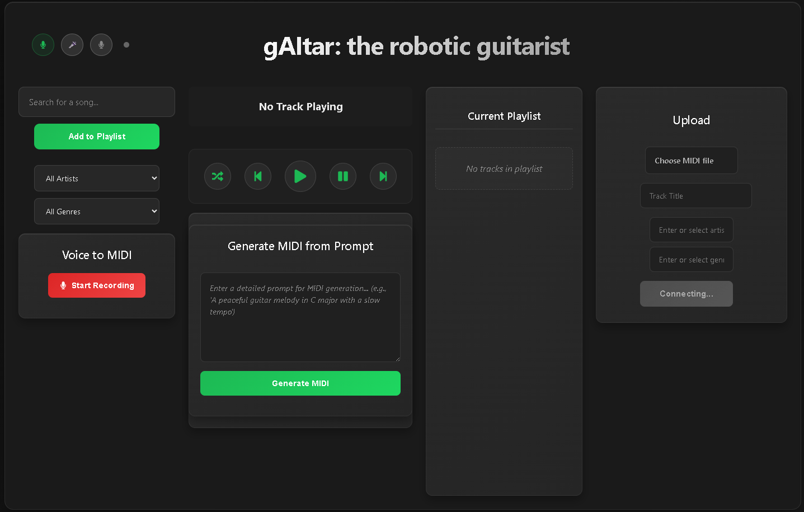
Frontend overview (React.js)
Controls.js
Playback controls
Search.js
Search and filter for songs
Playlist.js
Manages song queue
Upload.js
Form for upload, posts to backend, websocket for progress
GenMIDI.js
Generate MIDI from text prompt, posts text to backend
VoiceToMIDI.js
User microphone input, sends recording to backend for MIDI transcription
VoiceControl.js
Uses browser Speech Recognition API to respond to commands
PLaybackInfo.js
Websocket for live playback info

Slide 11
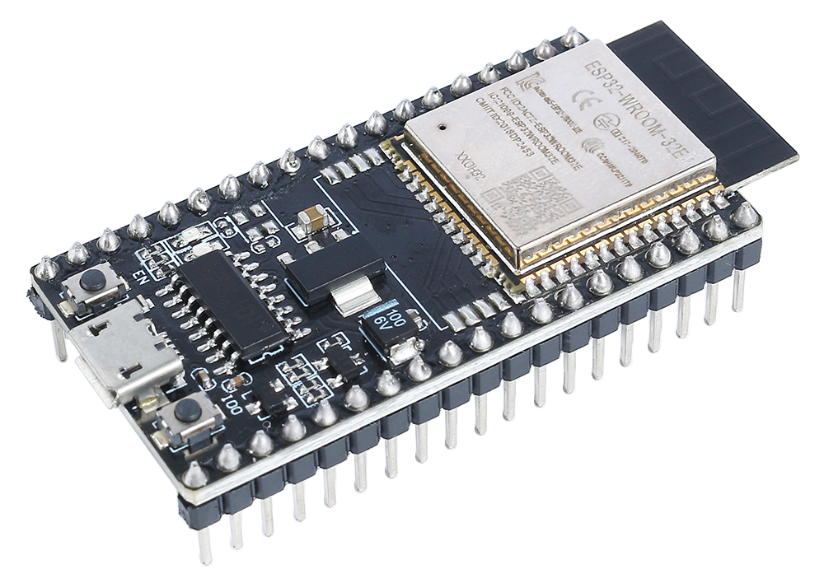
ESP32 Wi-Fi Co-processor
Web Server – (Play, Pause, Skip, Upload, List)
Wi-Fi Connection – (Local network)
UART bridge – (forwards control commands and files over UART)
Real-Time status – (handles information from UART and sends to frontend via Websocket)

Slide 12
Adafruit Grand Central Hardware Controller
Respond to UART commands from ESP32
Store binary IR files on microSD card
Parse IR files to control actuators
Send status updates over UART to ESP32
RTOS tasks: file receiver, instruction receiver, playback

Slide 13
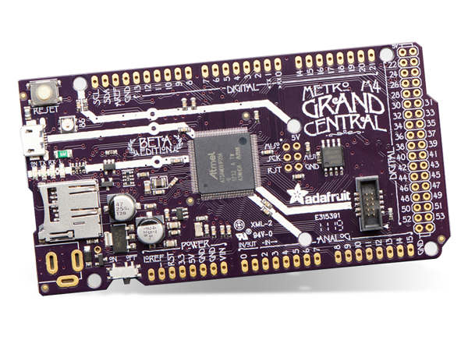
Adafruit Grand Central
70 GPIOs – tons of I/O for motors, sensors, and controls
22 PWM outputs – precise motor/actuator control
microSD Card Slot – expandable file storage
8 SERCOMs – flexible I2C/SPI/UART communication
120 MHz Cortex-M4 + FPU/DSP – fast, real-time processing
1MB Flash / 256KB RAM – enough for complex logic and buffering

Slide 14
Command structure
Play
[PLAY]:{“title”: “Entertainer”, “artist”: “Joplin”, “genre”: “Ragtime”}
Pause
“Pause” current song is paused with offsets calculated and stored for playing the same song
List
“List” traverses microSD card and lists all files and sends over UART

Slide 15
File upload
MIDI file uploaded by user
MIDI file sent to backend for translation to binary
File sent to Grand Central via UART
File deleted from ESP32 SPIFFS
Binary file returned to frontend and sent to ESP32
File saved to ESP32 SPIFFS
File saved to microSD card
Status updates sent to ESP32 via UART

Slide 16
UART file upload TX state machine
IDLE
OPEN_FILE
SEND_HEADER
WAIT_HEADER_ACK
SEND_CHUNK
Wait for final POST chunk from frontend (entire file saved to SPIFFS)
Open SPIFFS file, get size and clear UART buffer
Send START:<path>:SIZE:<size>
Start ACK timer
Wait for ACK:START:SIZE:<size>
Read chunk from SPIFFS file
Send CHUNK:<id>:SIZE:<size>
Send chunk data
WAIT_CHUNK_ACK
Wait for ACK:CHUNK:<id>
CLEANUP
Close and Delete SPIFFS file
ACK valid
Invalid ACK retry
Invalid ACK recvd retry
ACK valid

Slide 17
UART file upload RX state machine
PARSE_HEADER
OPEN_FILE
PARSE_CHUNK_HEADER
READ_CHUNK
Wait for START:<path>:<size>
Create directories
Open file for writing
Send “ACK:START:SIZE:<filesize>
Wait for CHUNK:<id>:<size>
Accumulate chunk data bytes
Check chunk id correctness
When data bytes is the size of the expected chunk write to file
DONE
Send “ACK:CHUNK:<chunk id>”
Valid header
All chunks received
More chunks needed

Slide 18
Status updates
Playback status
Instruction UART
Upload status
Calculated on ESP32 side from state machine
ESP32 monitors UART and sends via Websocket
STATUS:{“currentTime”:<ms>,”totalTime”:<ms>}
Sent to UI via Websocket

Slide 19
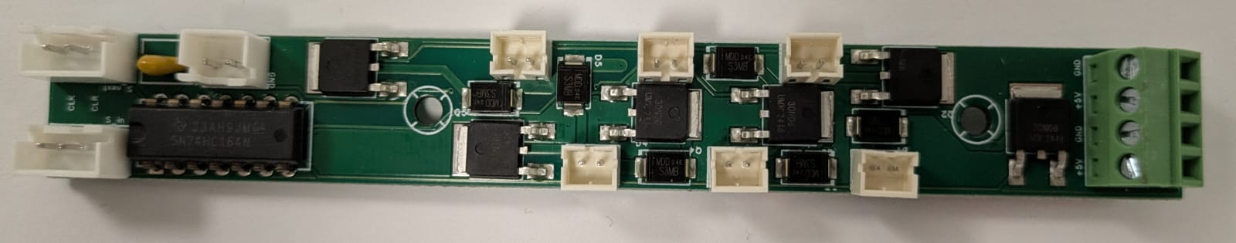
Actuation hardware
6 Servos (1 per string)
72 linear solenoids (discrete, up to 12th fret)
12 PCBs with shift registers and MOSFET drivers for solenoids (fret wise)

Slide 20
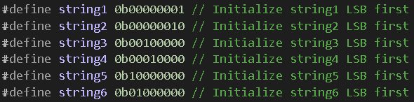
Actuation control logic
Servos toggle, damping position
Binary file unpacked event by event
event[7:5] is string, event[4:0] fret (5’d31 is string off event)
Each string mapped to a bit in fretStates byte
Eg to press B(2), D(4) and A(5) string on the 3rd fret:
fretStates[2] = 0x02|0x10|0x80 = 8’b10010010 = 0x92

Slide 21
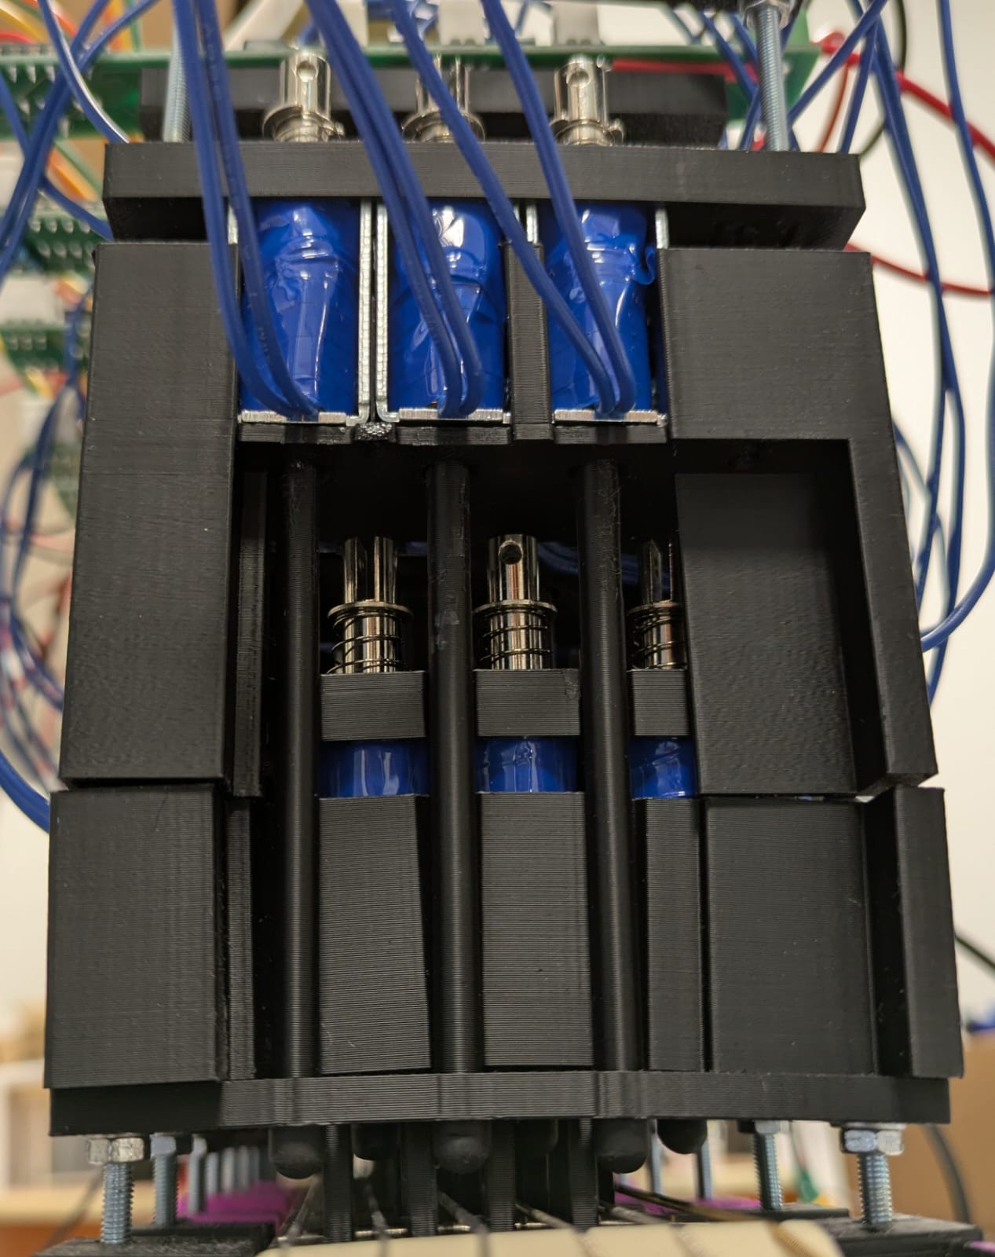
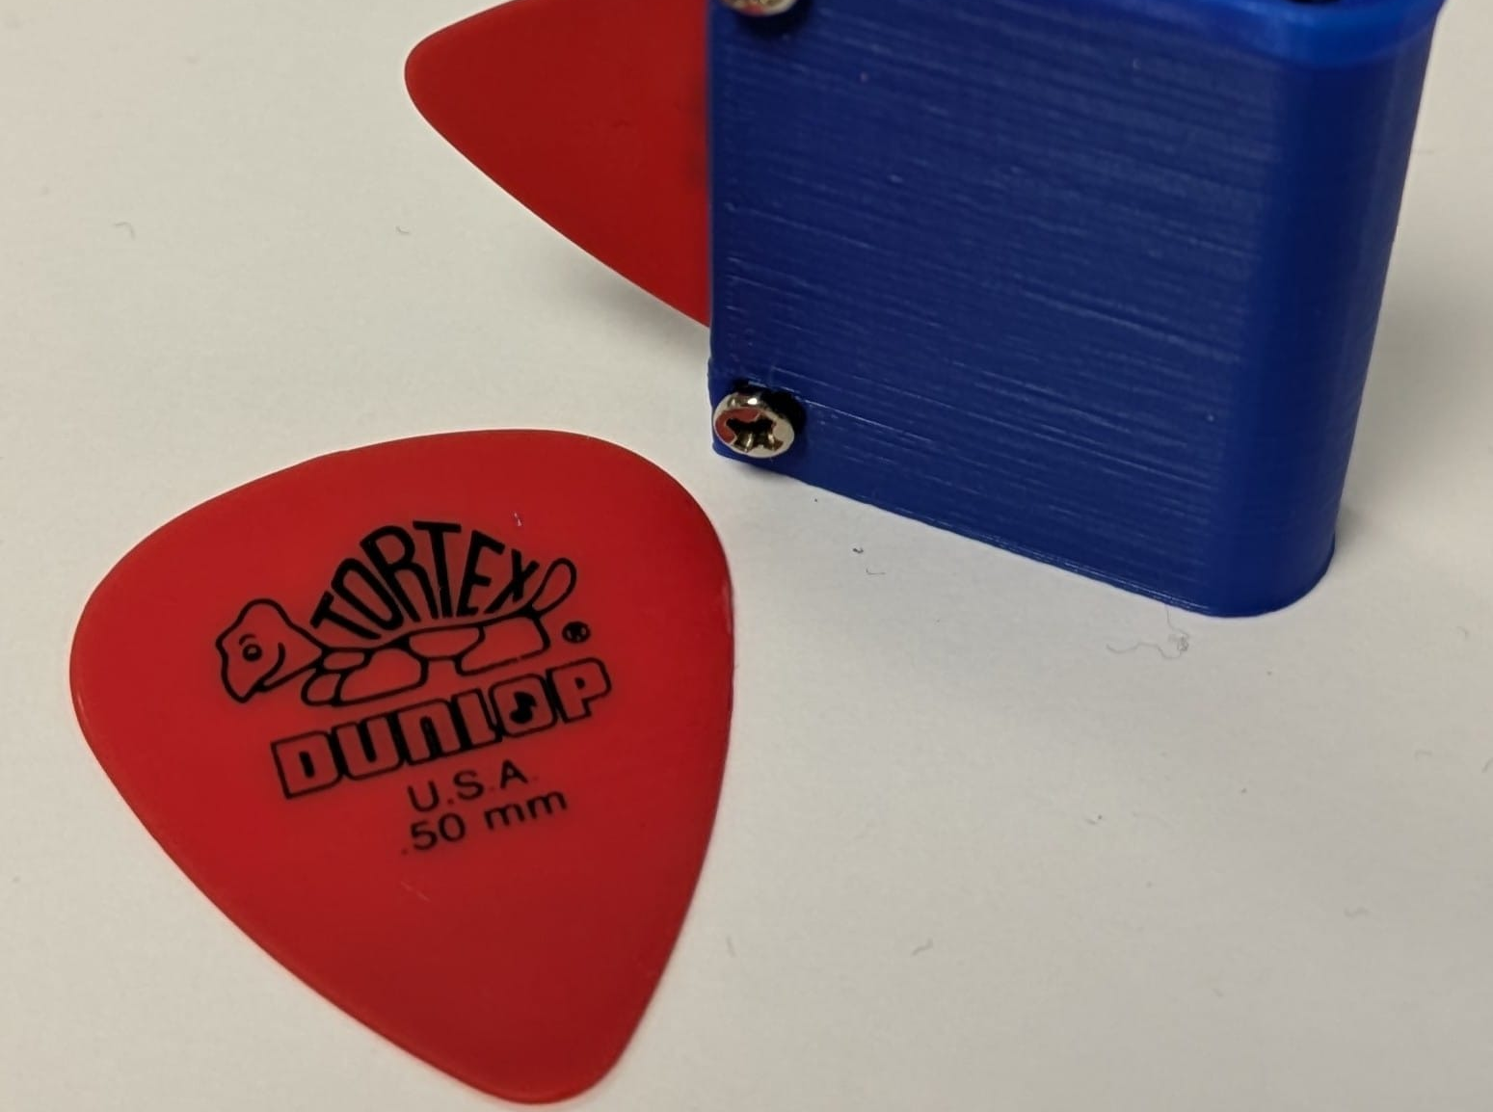
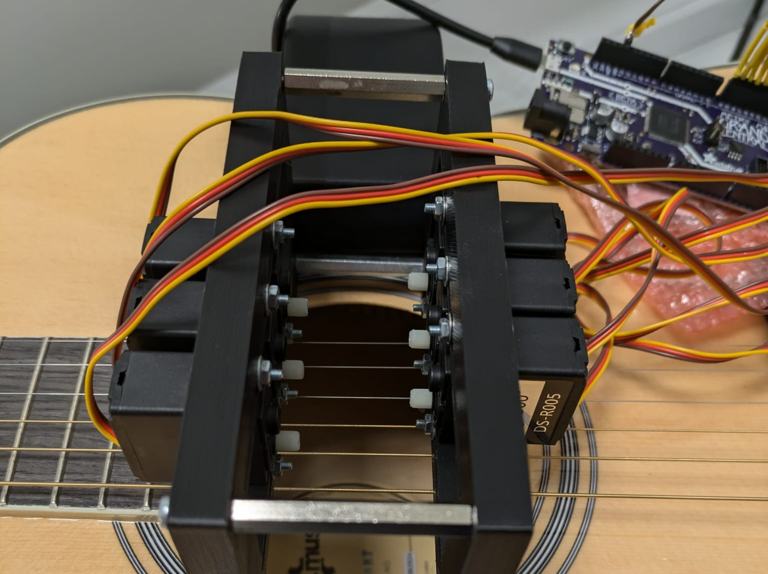
Physical Design
LH actuators
Linear solenoids
Fret wise clamping system
Biomimetic end effector
RH actuators
2Kg Servos
Clamp + bridge system
Plectrum holders

Slide 22
Testing and Evaluation methods
Test plans (qualitative and quantitative where applicable)
Survey (primarily college students)
Comparison to existing examples

Slide 23
Test Results
Areas for improvement
Actuation noise was 78.4dB, target of 50dB
Plucking/strumming frequency was 3Hz, target 5Hz
Search voice command did not work reliably
No error message on unrecognized command
GUI didn’t adapt well to different screen sizes

Slide 24
Survey Results
System Usability
89% found GUI easy to use
Performance ratings
Voice Features: 53% rated good/excellent
92% rated system as responsive
4.23/5 average usability score
86% found system reliable
80% satisfied with MIDI file handling
Audio Quality: 3.7/5 average
Hardware Performance: 59% rated good/excellent
Music Generation: 68% rated good/excellent
Demonstration suitability
83% found system inspiring
82% believed it would capture audience interest
96% said it demonstrates engineering concepts well
8.3/10 average score as open-day demonstrator
80% likely to explore electronics further after seeing it

Slide 25
Conclusion
Project Success
Key Achievement
Core Impact
Met initial requirements
Survey validated system as effective for intended purpose
A fully integrated, end to end system
System demonstrates interdisciplinary nature and knowledge learnt from EIE

Slide 26
Future Work
Right Hand mechanism
Left Hand noise
AI & AMT
Musical Dynamics
Integrate faster actuators to enable tremolo effect >5Hz
Extra DOF for RH mechanism
Include MIDI velocity in encoding
Redesign LH mechanism targeting quiet actuation
Improve GenAI component
Explore more advanced models
Data Format Optimisation (DONE)
Replace JSON format with compact custom format

Slide 27
Thanks for listening Any questions?
jet21@ic.ac.uk

