Slide 1
Semester Project: Domain Discovery,
Recommendation & Graph Intelligence
Week 10: Recommendation Engine
Group 6 — Big Data Course — UPC
Iam Alvarez Orellana • Jeffrey Diaz Villanueva Paula Mancilla Cienfuegos • Fernando Paredes Espinoza

Slide 2
Project Pipeline
4-layer architecture from raw data to recommendations
W3 DATA
W5 FEATURES
W7 CLUSTERS
W10 RECS
steam_v1.parquet 480 k interactions Star schema on AppID
X_numeric (87k×26) X_categorical (87k×5k) X_text TF-IDF (87k×5k)
Tags-only binary matrix K-Means K=6 (SVD+L2) 6 semantic segments
Popularity baseline Content + MF + Hybrid HR@10 evaluation
→
→
→
Group 6 | Big Data | UPC

Slide 3
Dataset
Steam Games & Reviews — Kaggle CC0
80,000+
87,806
Steam games in full catalog
Games in feature matrices
480,025
69,943
Interaction records (V1 subset, 500 games)
Tagged games (used for clustering)
426,601
99.8 %
Unique users
Interaction matrix sparsity
Star schema: AppID joins Games catalog ↔ Reviews interactions
Group 6 | Big Data | UPC

Slide 4
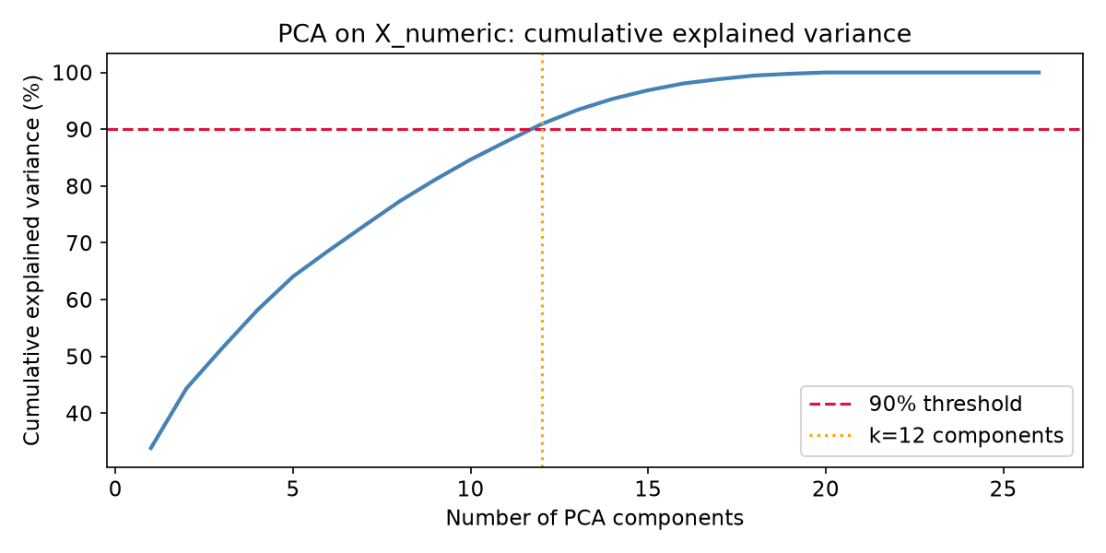
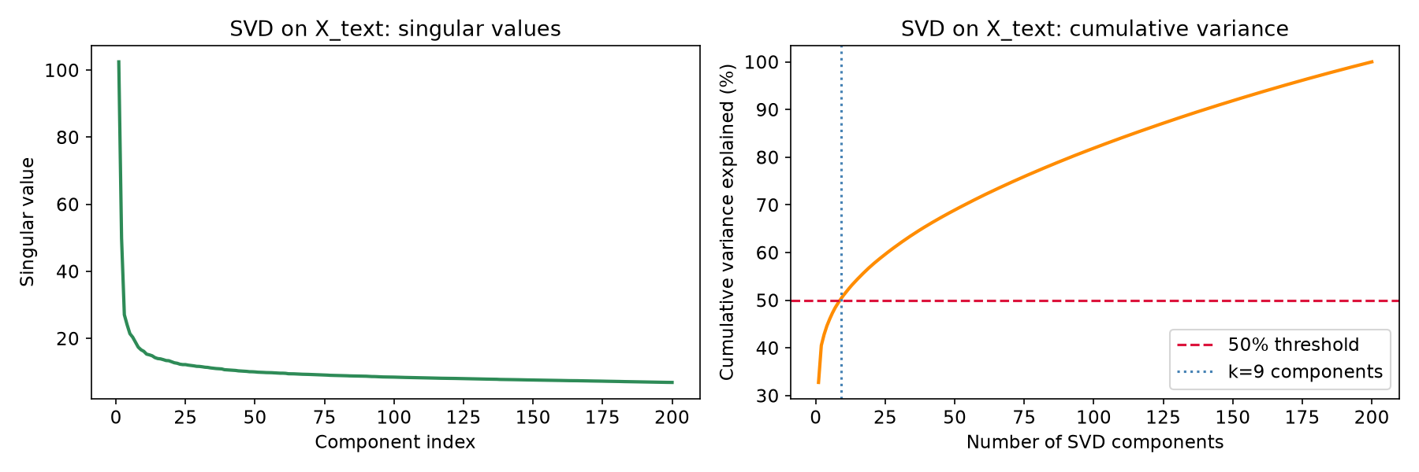
Feature Engineering (W5) — Dimensionality Reduction
PCA on X_numeric and TruncatedSVD on X_text
PCA: k=12 components capture ≥90% of numeric variance. 12D used for Lloyd’s verification in W7.
SVD on X_text: slow singular value decay (broad vocabulary). k=201 for 50% variance. k=50 used in clustering (tag matrix).
Group 6 | Big Data | UPC

Slide 5
Clustering — Class 7 Methodology
How lecture concepts drove implementation decisions
Lloyd’s Algorithm Verification
Representation Ablation
K Selection (Elbow + Silhouette)
Class 7 defines K-means as iterative assignment + centroid update. We manually ran one iteration per seed to confirm J_after ≤ J_before (5/5 seeds).
Class 7: distance metric depends on representation. We tested 3 variants: Raw sparse → sil=0.026 SVD 50D → sil=0.064 SVD+L2 → sil=0.077 ✓
Class 7: no universal K. We swept K∈{4,6,8,10}. K=6 chosen: balanced cluster sizes (min 4,773) vs K=8/10 (min 958 games).
Group 6 | Big Data | UPC

Slide 6
K=6 Cluster Profiles
Top tags by lift = P(tag|cluster) / P(tag)
C0 Creative Tools
C1 Action
C2 Narrative
Size: 4,773 (6.8%) video production 14.6× audio production 14.6× photo editing 14.6×
Size: 15,353 (22%) combat 3.2× action-adventure 3.1× side scroller 3.1×
Size: 13,576 (19.4%) text-based 4.0× story rich 3.1× great soundtrack 2.9×
C3 Strategy/Puzzle
C4 Local Multiplayer
C5 Casual/HO
Size: 14,060 (20.1%) card game 3.8× logic 3.7× building 3.3×
Size: 12,112 (17.3%) local co-op 5.8× 4 player local 5.8× split screen 5.7×
Size: 10,069 (14.4%) hidden object 6.5× point & click 5.5×
Silhouette = 0.077 | Inertia = 29,175 | ARI stability mean = 0.49
Group 6 | Big Data | UPC

Slide 7
Recommendation Engine — Architecture (Week 10)
4 systems evaluated on the same 484-game universe
1. Popularity Baseline
2. Content-Based Baseline
3. Matrix Factorization (SGD)
4. Hybrid Recommender
Rank by aggregate 'recommendations' count. Same list for every user. No personalization.
TF-IDF on name+tags +description (3k terms). SVD → 50D. User vector = centroid of train games. Cosine similarity ranking.
Binary interaction matrix R ∈ {0,1}^{users × games}. Latent factors P, Q. Objective: min MSE + L2 reg. k ∈ {10, 20, 50} swept.
α × content_score + (1-α) × MF_score Both min-max normalized. α ∈ {0.1,0.3,0.5,0.7,0.9} Best: α = 0.3
AppID is the common key across catalog, interaction parquet, and cluster labels — hybrid combination is exact by construction.
Group 6 | Big Data | UPC

Slide 8
Matrix Factorization — SGD
Objective function and update rules
Objective:
min_{P,Q} Σ_{(u,i)∈Ω} (R_ui - p_uᵀ q_i)² + λ ( ‖P‖² + ‖Q‖² )
SGD updates per observed pair (u, i):
p_u ← p_u + η ( e_ui · q_i − λ · p_u ) where e_ui = R_ui − p_uᵀ q_i
q_i ← q_i + η ( e_ui · p_u − λ · q_i )
Hyperparameters:
Learning rate η
0.03
Standard for implicit binary data
Regularization λ
0.01
Prevents overfitting (99.8% sparse matrix)
Epochs
30
Convergence confirmed by loss curve
Latent dim k
{10, 20, 50}
Swept; best k=10 on 484-game universe
Initialization
N(0, 0.01)
Small values break symmetry
Group 6 | Big Data | UPC

Slide 9
Evaluation Protocol
Hit-Rate@K on held-out positive interactions
Build interaction matrix
Candidate pool
1
4
Sparse binary R (users × games). voted_up=True → 1. Duplicates removed.
All games the user has NOT interacted with in training.
Qualify users
Compute HR@K
2
5
Keep users with ≥ 2 positive interactions (need ≥1 train + 1 hold-out).
Fraction of users whose held-out game appears in top-K. Primary metric: HR@10.
Train/test split
Leakage prevention
3
6
Hold out 1 random positive per user (random_state=42). Rest = training.
Training items masked to −∞ before ranking. Hold-out never used in training.
12,389 qualifying users | 484-game universe | 426,601 total users
Group 6 | Big Data | UPC

Slide 10
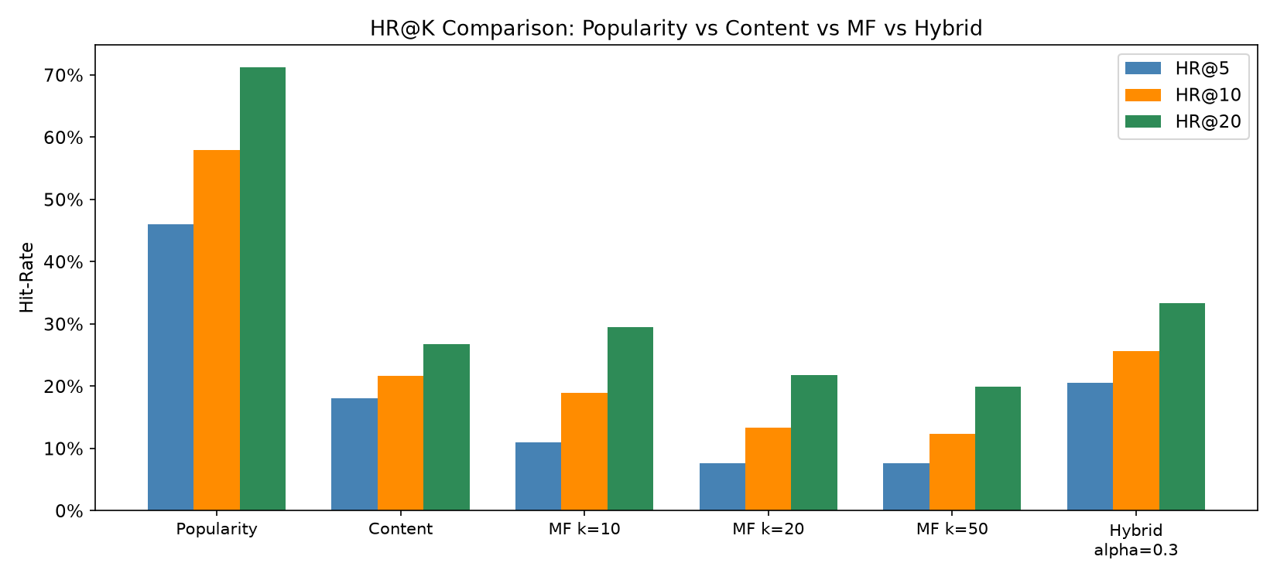
Results — HR@K Comparison
All 4 systems evaluated at K ∈ {5, 10, 20}
System
HR@5
HR@10
HR@20
Popularity
0.4597
0.5796
0.7124
Content-based
0.1806
0.2170
0.2669
MF k=10
0.1103
0.1888
0.2949
MF k=20
0.0764
0.1333
0.2183
MF k=50
0.0756
0.1235
0.1998
Hybrid α=0.3 ★
0.2057
0.2569
0.3330
Group 6 | Big Data | UPC

Slide 11
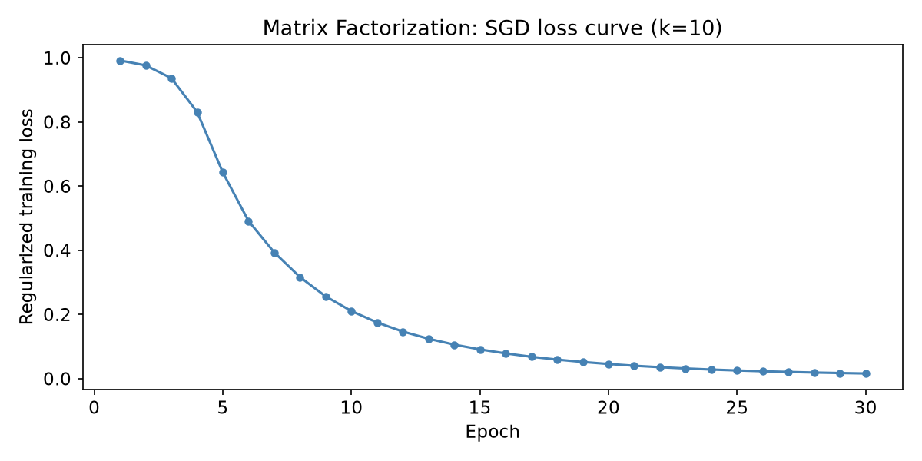
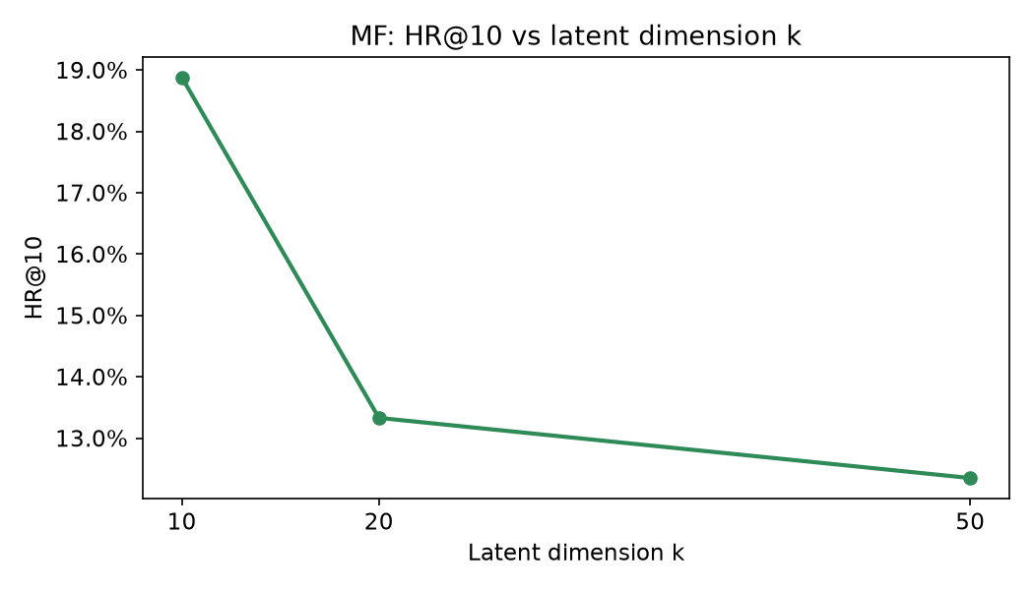
MF Training & K-Sweep Analysis
Convergence and latent dimension selection
Loss decreases monotonically over 30 epochs (k=10). Convergence confirmed — regularized MSE drops from 0.98 to 0.016.
k=10 beats k=20 and k=50 on HR@10. Smaller latent space generalizes better on the sparse 484-game universe. Higher k overfits the scarce interaction signal.
Group 6 | Big Data | UPC

Slide 12
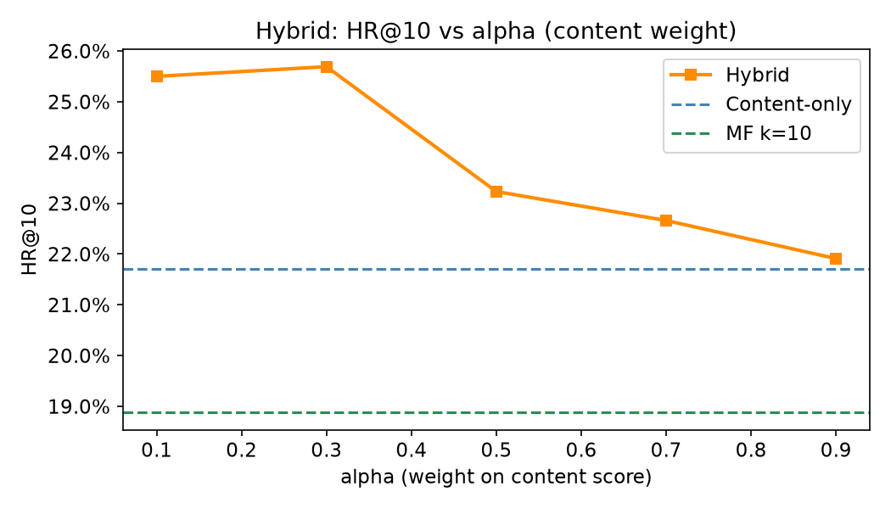
Hybrid System — Alpha Sweep
Balancing content signal vs collaborative filtering
s_hybrid(u,g) =
α × s_content(u,g)
+ (1-α) × s_MF(u,g)
• α = 0.3 is optimal → HR@10 = 0.2569
• 30% content + 70% MF
• Beats content-only (0.217) by +18%
• Beats MF-only (0.189) by +36%
• Both signals needed — neither dominates
Group 6 | Big Data | UPC

Slide 13
Key Findings & Conclusions
Class 7 methodology validated
Lloyd’s descent confirmed on 5/5 seeds. SVD+L2 representation improved silhouette from 0.026 (raw) to 0.077. K=6 chosen via balanced elbow + cluster size analysis.
Recommendation engine delivers
Hybrid α=0.3 achieves HR@10=0.2569 — best among personalized systems. Content-based alone (0.217) and MF alone (0.189) are each sub-optimal. Combining both signals matters.
Popularity ceiling is high
Popularity HR@10=0.58 is dominant because the evaluation universe is small (484 games). Full-catalog evaluation would likely reverse this result as user tastes diverge from average.
Group 6 | Big Data | UPC

Slide 14
Reproducible Pipeline
All results generated from 5 commands
Step 1 — Ingestion
python src/ingest.py
steam_v1.parquet → data/processed/
Step 2 — Feature Engineering
python src/feature_engineering.py
X_numeric, X_categorical, X_text → artifacts/
Step 3 — Clustering
python src/clustering_week7.py
cluster_labels_k6.npy → artifacts/clustering/
Step 4 — Recommendation
python src/recommendation.py
rec_metrics.json → artifacts/recommendation/
Step 5 — Figures & Reports
python src/generate_figures.py
PNG figures → reports/Week5/ and reports/Week10/
random_state=42 throughout — all results fully deterministic
Group 6 | Big Data | UPC

