Slide 1
AI-Powered Smart Service Marketplace with Intelligent Discovery and Dynamic Pricing Models
R26-IT-090

Slide 2

The Real-World Problem
A massive communication and technology gap exists between non-technical homeowners and local blue-collar workers. Existing apps require formal English/technical keywords, creating a "Keyword Barrier."
Who Is Affected
Homeowners :
Workers :
Societal Impact:
Suffer from delays due to the lack of technical terminology and difficulty finding the right repairers.
Although demand was very good, there was difficulty in connecting with homeowners and finding new work.
The local gig economy remains highly informal, unregulated, and inefficient.

Slide 3

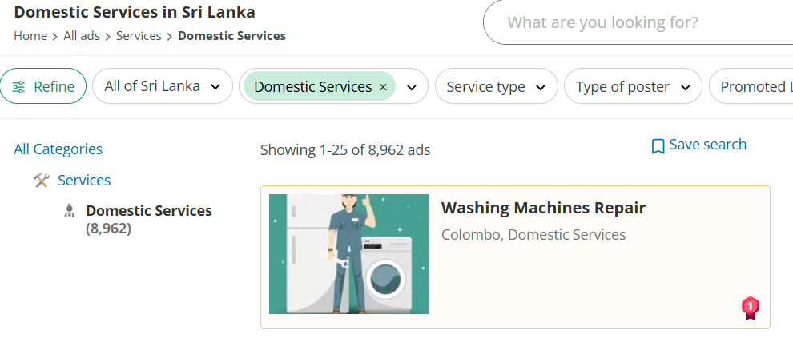
Current Platforms - Sri Lanka
Ikmal.lk is a Sri Lankan based site. But the Homeowners need the knowledge in English to search the relevant worker type and need to manually filter the worker through the platform.

Slide 4


Current Platforms
TaskRabbit is an Europe and USA based gig platform. They provide a wide range of worker categories. But the homeowner needs to know the name of the worker needed to complete the task.

Slide 5
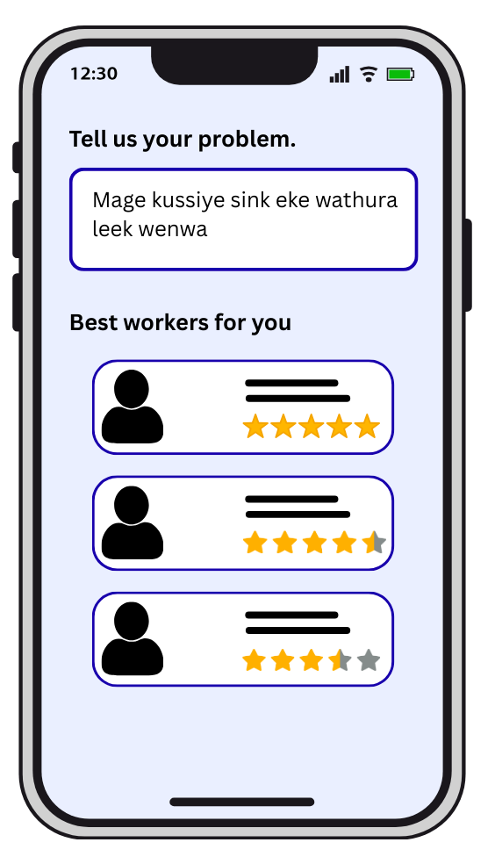
Our Solution: AI-Powered Smart Service Marketplace
Solution Overview:
A mobile-first platform that replaces manual searching with an intelligent, end-to-end AI pipeline.
Key Benefits for Homeowners:
Frictionless Search:
No technical jargon required; users simply speak or type naturally in Singlish .
Verified Trust:
The system, recommends the best workers nearby.
Transparent Costs:
A 3-stage dynamic pricing guide prevents overcharging and arguments.

Slide 6
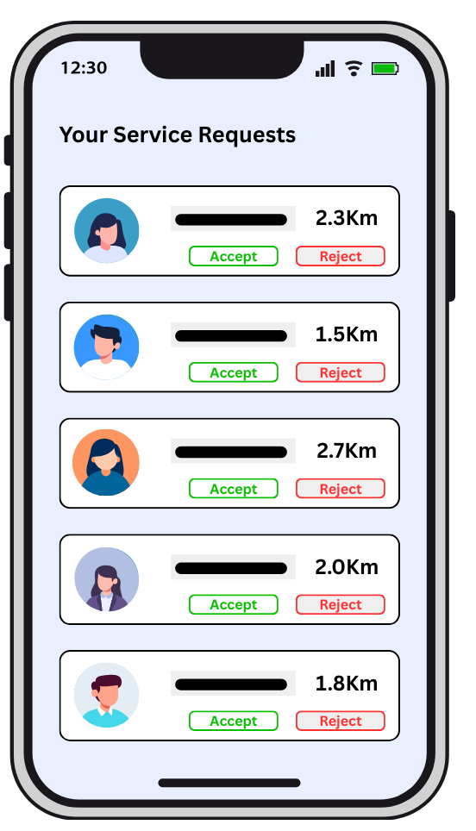
Our Solution: AI-Powered Smart Service Marketplace
Solution Overview:
A mobile-first platform that replaces manual searching with an intelligent, end-to-end AI pipeline.
Key Benefits for Workers:
Targeted Job Pipeline:
Workers receive perfectly matched jobs based on their exact skills and real-time location.
Zero Marketing Cost:
Eliminates the need for freelancers to pay for digital ads or rely on word-of-mouth.
Fair Compensation:
The multi-stage fare estimation protects their income by specifically calculating transport and inspection fees before the repair begins.

Slide 7

IT22551320 | BANDARA W A M S
Intelligent Service Discovery and Intent Recognition System
IT22551320 | Bandara W A M S | R26-IT-090

Slide 8
Intelligent Service Discovery and Intent Recognition System
The Problem Definition:
Many homeowners fail to find the right worker to solve their problem because they don't know the relevant "keywords.“
Many people in Sri Lanka lack the ability to write meaningful English sentences.
Contribution to the Overall Solution:
This component acts as the "Intelligent Gateway." It translates the user's unstructured symptom description directly into the structured database query required by the rest of the microservices pipeline .
IT22551320 | Bandara W A M S | R26-IT-090

Slide 9
Intelligent Service Discovery and Intent Recognition System
The Novelty
The first domain-specific Sinhala and English code-mixed (Singlish) NLP classifier for the Sri Lankan domestic service sector, without relying on heavy, expensive global LLMs
Research Objectives
Main: Develop a bilingual NLP microservice to accurately classify unstructured maintenance queries.
Sub-objectives: Synthesize a domain-specific Singlish dataset, engineer custom text-preprocessing filters, and optimize a Support Vector Machine (SVM) classifier.
IT22551320 | Bandara W A M S | R26-IT-090

Slide 10
Intelligent Service Discovery and Intent Recognition System
Domain Knowledge & Validation
Knowledge Domain:
Natural Language Processing (NLP) & Statistical Machine Learning.
Specific Technologies Utilized:
Fast Text Sub-word Vectorization: Chosen specifically to handle Out-Of-Vocabulary (OOV) phonetic spelling errors in Singlish.
Support Vector Machines (SVM): Optimized for sparse, high-dimensional text arrays with lower computational overhead than deep learning.
Validation & Evaluation:
Primary Metric: F1 - Score (to ensure accurate evaluation across imbalanced worker categories)
Data Availability & Ethics:
Synthesized custom Singlish dataset via crowdsourcing. Strict PII (Personally Identifiable Information) scrubbing prior to training ensures data privacy.
IT22551320 | Bandara W A M S | R26-IT-090

Slide 11
Intelligent Service Discovery and Intent Recognition System
Implementation Details & Dependencies:
Many homeowners fail to find the right worker to solve their problem because they don't know the relevant "keywords.“
Many people in Sri Lanka lack the ability to write meaningful English sentences.
Contribution to the Overall Solution:
This component acts as the "Intelligent Gateway." It translates the user's unstructured symptom description directly into the structured database query required by the rest of the microservices pipeline .
IT22551320 | Bandara W A M S | R26-IT-090

Slide 12
Intelligent Service Discovery and Intent Recognition System
System Overview:
Operates as an independent, stateless RESTful microservice.
Input: Raw conversational text strings via HTTP POST requests.
Process: Executes text preprocessing, FastText vectorization, and SVM intent classification.
Output: Returns a structured JSON payload identifying the Main Category (e.g., Plumber) and Subcategory (e.g., PipeRepair).
Dependencies & Common Components:
Specific Dependencies: Python 3.x, FastAPI (server framework), Scikit-Learn (machine learning execution), and NLP libraries (e.g., NLTK/Spacy).
Common System Components:
Node.js API Gateway: Acts as the central orchestrator routing requests to this component.
MongoDB: The central database where the structured service request is ultimately stored for the Recommendation Engine to use.
IT22551320 | Bandara W A M S | R26-IT-090

Slide 13

IT22283658 | SHIWANTHIKA M.M
Intelligent Worker Recommendation Engine
IT22283658 | Shiwanthika M M | R26-IT-090

Slide 14
Intelligent Worker Recommendation Engine
The Problem Definition:
Users quickly find the most suitable worker.
They may spend a lot of time calling different people, checking reviews, or asking friends.
Sometimes they choose workers who are far away, unavailable, or do not have the correct skills.
Contribution to the Overall Solution:
The Intelligent Worker Recommendation Engine contributes by analyzing user requests, predicting worker suitability, and ranking them using real-time factors, enabling fast, accurate, and reliable household service recommendations.
IT22283658 | Shiwanthika M M | R26-IT-090

Slide 15
Intelligent Worker Recommendation Engine
The Novelty
First, a machine learning model such as Random Forest can predict how suitable a worker is based on past data. Then a multi-criteria scoring model ranks workers using real-time factors like distance, availability, and ratings.
Research Objectives
Main: To develop an intelligent worker recommendation engine that helps users find the most suitable household service workers efficiently.
Sub-objectives: Collect and manage worker profile data such as skills, experience, ratings, and availability, Analyze user service requests and identify the required service type.
IT22283658 | Shiwanthika M M | R26-IT-090

Slide 16
Intelligent Worker Recommendation Engine
Domain Knowledge & Validation
Domain Knowledge: Understanding the household service field and identifying key factors such as worker skills, experience, ratings, distance, and availability.
Validation: Testing the system to ensure worker recommendations are accurate, reliable, and useful for users.
Research Methodology
The household service domain guides the methodology by identifying key features like skills, experience, ratings, availability, and distance for accurate worker recommendations.
IT22283658 | Shiwanthika M M | R26-IT-090

Slide 17
Intelligent Worker Recommendation Engine
What specific Latest Technology/Technologies in that Domain are utilized to develop the proposed solution
Machine Learning (Random Forest), real-time data processing, and hybrid recommendation systems are used to predict and rank suitable workers.
How to Validate and Evaluate the Proposed Solution
The system is tested using sample data and user requests, measuring accuracy, relevance, and user feedback.
Data Availability, Security and Ethical Clearance
Worker data is collected from verified sources while ensuring data privacy, security, and ethical use of user and worker information.
IT22283658 | Shiwanthika M M | R26-IT-090

Slide 18
Intelligent Worker Recommendation Engine
Implementation Details
System Overview of the Individual Component
The engine depends on the worker database, user interface, ML library (Random Forest), scoring module, and backend framework for processing and integration.
Dependencies and common components
Worker Database, User Interface, Machine Learning Library, Scoring Module, Backend Framework
IT22283658 | Shiwanthika M M | R26-IT-090

Slide 19

IT22643704 | Wijebandara W.N.S.K
Intelligent Service Discovery and Intent Recognition System

Slide 20
Intelligent Service Discovery and Intent Recognition System
Problem:
Service platforms mainly evaluate workers using star ratings
Star ratings alone cannot fully represent customer experience
Many platforms allow unverified reviews, leading to unreliable feedback
Workers may have multiple skills, but platforms often show one overall rating
Proposed Solution:
A module that analyzes verified customer reviews
Uses sentiment analysis + star ratings
Generates category-based credibility scores for workers
IT22643704 | Wijebandara W.N.S.K | R26-IT-090

Slide 21
Intelligent Service Discovery and Intent Recognition System
Research Problem:
Existing reputation systems rely mainly on numerical ratings
Text reviews are often ignored in credibility evaluation
Most sentiment models are trained on standard English datasets
In Sri Lanka, users frequently write reviews using Singlish
Example: “Plumber eka awilla pipe eka hariyata fix kala. Good service.”
Research Gap:
Lack of sentiment analysis models adapted for Singlish customer reviews
Lack of integrated credibility models combining ratings and sentiment
Lack of category-based worker evaluation
IT22643704 | Wijebandara W.N.S.K | R26-IT-090

Slide 22
Intelligent Service Discovery and Intent Recognition System
Main Objective
Develop an AI-based credibility evaluation module that analyzes verified customer reviews using sentiment analysis and star ratings.
Specific Objectives:
Enable verified review submission after completed transactions
Analyze review text using sentiment analysis
Calculate sentiment scores from review data
Normalize star rating scores
Generate category-based credibility scores for workers
IT22643704 | Wijebandara W.N.S.K | R26-IT-090

Slide 23
Intelligent Service Discovery and Intent Recognition System
Technologies Used:
Natural Language Processing (NLP)
Machine Learning Sentiment Analysis
Python / Scikit-learn
Text preprocessing techniques
Processing Steps:
Customer submits text review + star rating
Review text undergoes NLP preprocessing
Sentiment model classifies review as positive or negative
System calculates sentiment score
Star rating is normalized
Credibility score is calculated using a weighted model
Formula:
Credibility Score =w1 × Sentiment Score + w2 × Normalized Star Rating
IT22643704 | Wijebandara W.N.S.K | R26-IT-090

Slide 24
Intelligent Service Discovery and Intent Recognition System
Dataset:
Customer review dataset including Singlish reviews
Example sources:
- Collected review samples
- Public review datasets
- Simulated service marketplace reviews
Validation:
Model performance evaluated using:
- Accuracy
- Precision
- Recall
- F1-Score
Security & Ethics:
Reviews allowed only after verified service transactions
No personal data stored in the dataset
Data used only for research and system evaluation
IT22643704 | Wijebandara W.N.S.K | R26-IT-090

Slide 25
Intelligent Service Discovery and Intent Recognition System
System Overview
Inputs:
Processing:
Output:
Verified review text
Star rating
Job category
NLP preprocessing
Sentiment classification
Score calculation
Category-based credibility score for each worker
Example Worker Profile:
Plumbing Credibility Score → 0.92
Electrical Credibility Score → 0.55
IT22643704 | Wijebandara W.N.S.K | R26-IT-090

Slide 26
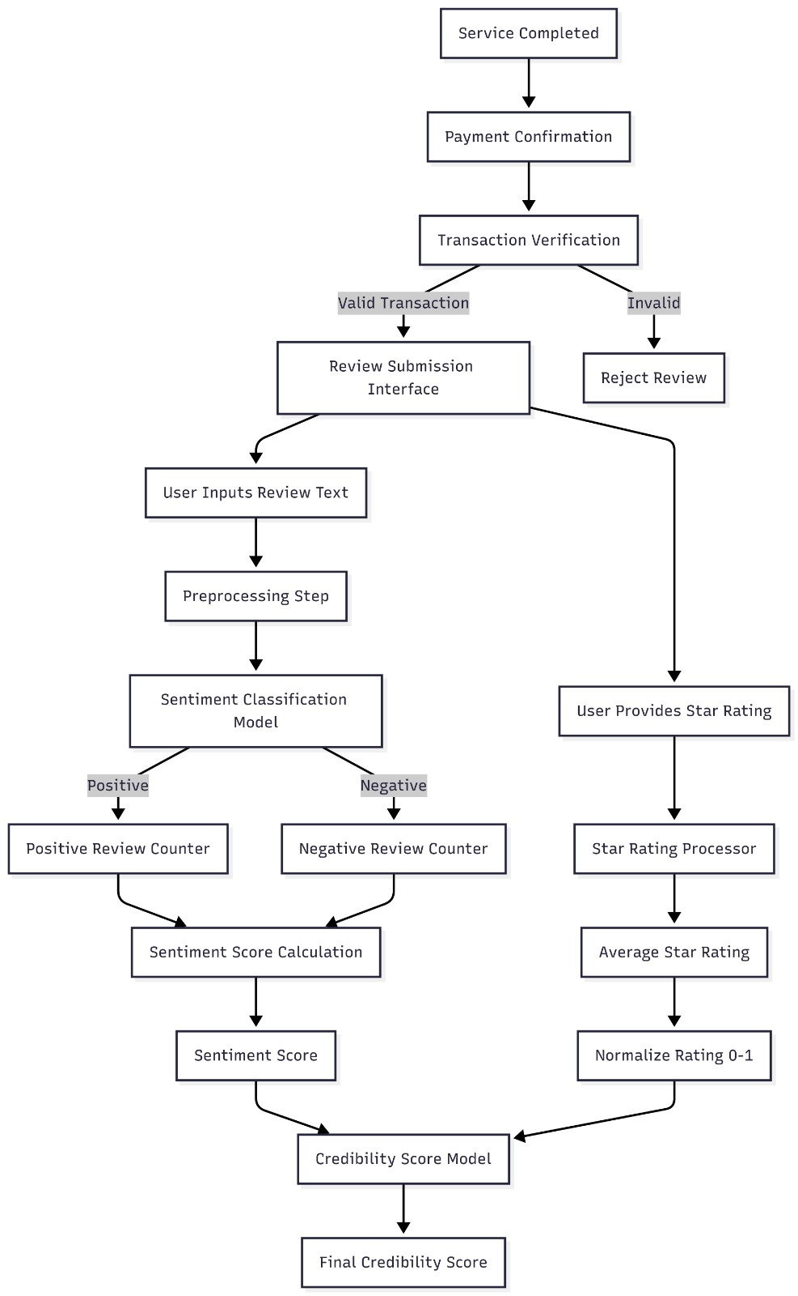
Intelligent Service Discovery and Intent Recognition System
Dependencies and the Component diagram
NLP libraries (NLTK / SpaCy)
Machine learning libraries (Scikit-learn)
Database for review storage
IT22643704 | Wijebandara W.N.S.K | R26-IT-090

Slide 27

IT22137982|A.J.T.M. Kumara
Intelligent Dynamic Fare Estimation System

Slide 28
Intelligent Dynamic Fare Estimation System
Problem Definition:
Arbitrary pricing leading to customer dissatisfaction and lack of transparency.
Contribution to Overall Solution:
Standardizes pricing to build trust between homeowners and technicians.
Novelty:
3-Stage Pricing Logic- Unlike existing apps that use a single fixed fee, this component separates costs into Transport (GPS-based), Inspection (Fixed), and Repair (ML-predicted).
IT22137982 | Kumara A.J.T.M| R26-IT-090

Slide 29
Intelligent Dynamic Fare Estimation System
Knowledge Domain: Supervised Machine Learning (Regression Analysis) and Geospatial Data Processing
Technologies Utilized:
  Python (Scikit-learn): For training the Multiple Linear Regression model.
  Node.js & Express: For real-time calculation orchestration.
React Native: Cross-platform mobile UI for price breakdown visualization
Data Availability & Ethics:
  Data Source: Primary data via localized market surveys in Sri Lanka.
Security: SSL/TLS encryption for all pricing API requests
IT22137982 | Kumara A.J.T.M| R26-IT-090

Slide 30
Intelligent Dynamic Fare Estimation System
Performance Metrics:
  Mean Absolute Error (MAE): To measure prediction accuracy against actual invoices.
  Root Mean Square Error (RMSE): To penalize large prediction outliers.
Validation Method:
  UAT (User Acceptance Testing): Surveys with 20 technicians to ensure the 3-stage logic covers their operational costs (fuel + time).
System Accuracy Goal: Maintain a 90% accuracy rate compared to the final invoiced amount.
IT22137982 | Kumara A.J.T.M| R26-IT-090

Slide 31
Intelligent Dynamic Fare Estimation System
System Architecture (Individual Focus):
  Input Layer: Job type, Complexity level (1-5), GPS Coordinates.
  Processing Layer: Distance Matrix calculation (Google Maps API).
    ML Regression execution (Python Flask/FastAPI).
Output Layer: Transparent 3-Stage breakdown displayed on the React Native App
Dependencies:
  Requires the User Management Module for technician location data.
  Requires the Job Posting Module for specific task complexity parameters.
IT22137982 | Kumara A.J.T.M| R26-IT-090

Slide 32
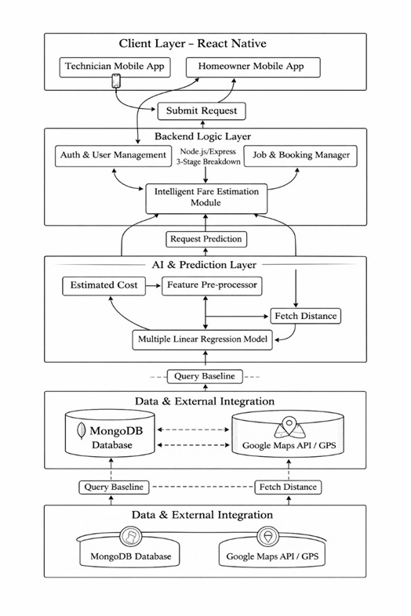
Intelligent Dynamic Fare Estimation System
Component Diagram
IT22137982 | Kumara A.J.T.M| R26-IT-090

Slide 33
AI-Powered Smart Service Marketplace with Intelligent Discovery and Dynamic Pricing Models
Commercialization: Market & Value Proposition
Target Market:
Initially targeting the urban and suburban informal household maintenance sector in the Western Province.
Customer Profiles:
Homeowners: Busy, middle-income professionals who lack hardware terminology and seek reliable help.
Workers: Skilled independent freelancers lacking the capital for digital marketing.
Value Proposition:
Frictionless, language-agnostic service discovery. We provide guaranteed trust and transparent pricing for users, and a zero-marketing-cost job pipeline for workers.
Intellectual Property (IP):
Copyrighted machine learning algorithms (Recommendation & Pricing models)
Trademarked brand identity.

Slide 34
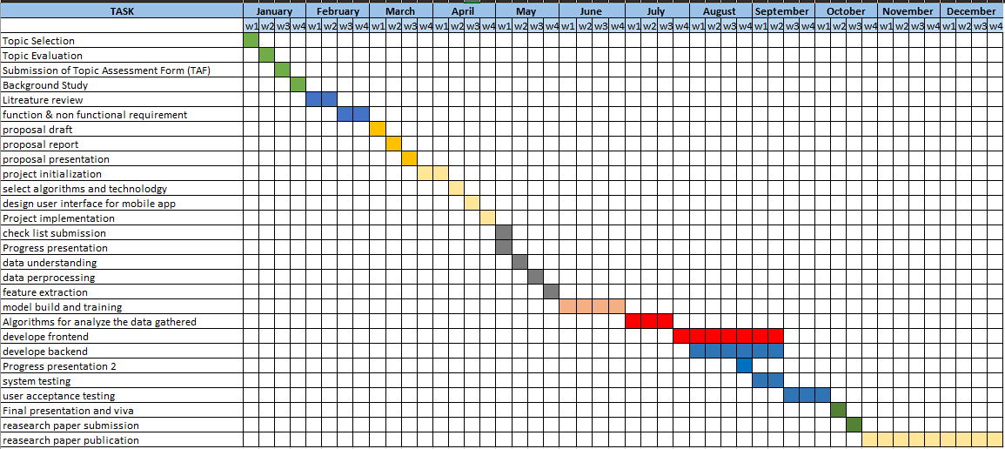
AI-Powered Smart Service Marketplace with Intelligent Discovery and Dynamic Pricing Models
Gantt Chart

Slide 35
AI-Powered Smart Service Marketplace with Intelligent Discovery and Dynamic Pricing Models
Work breakdown structure
Member 1: Bandara W.A.M.S. (NLP & Intent Recognition)
Collect and preprocess a dataset of Singlish/English service queries.
Develop Intent Recognition algorithms to classify user problems.
Implement Entity Extraction logic to identify specific hardware/issues.
Deploy the NLP pipeline as an independent microservice.
Member 2: Shiwanthika M.M. (Worker Recommendation Engine)
Define weighted scoring metrics (Skill match, Distance, Education, Availability).
Develop the Hybrid Recommendation Algorithm.
Integrate real-time location data for dynamic matching.
Deploy the recommendation logic as an independent microservice.

Slide 36
AI-Powered Smart Service Marketplace with Intelligent Discovery and Dynamic Pricing Models
Work breakdown structure
Member 3: Wijebandara W.N.S.K. (Review Credibility & Spam Filtering)
Collect training datasets of genuine and spam customer reviews.
Train a Sentiment Analysis model (e.g., Naive Bayes) to classify feedback.
Implement the automated "Trust Score" calculation algorithm.
Deploy the review auditing system as an independent microservice.
Member 4: Kumara A.J.T.M. (Dynamic Fare Estimation System)
Conduct market research to establish baseline labor and transport rates.
Develop a Regression Model to predict repair costs based on job complexity.
Implement the 3-Stage Pricing Logic (Transport fee, Inspection fee, Repair estimate).
Deploy the pricing prediction system as an independent microservice.

Slide 37

The End

