Slide 1
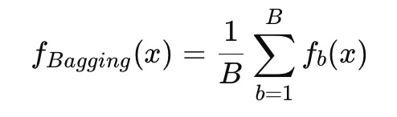

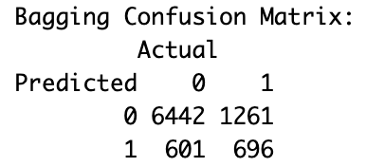
Model#5—Bagging
Full Prediction
Train Error: 18.37%
Test Error: 9.52381e-05
Confusion Matrix:
Prediction Error
Class 0: 5.78%
Class 1: 36.28%
Partial Prediction
Train Error: 1.65%
Test Error: 20.69%
Confusion Matrix:
Prediction Error
Class 0: 8.53%
Class 1: 35.56%

Slide 2
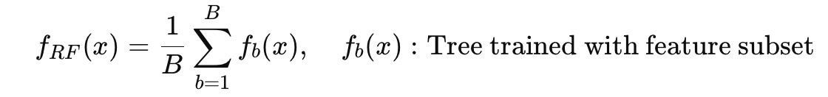
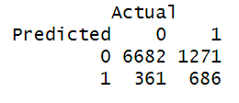
Model#6—Random Forest
Full Prediction
Train Error: 11.10%
Test Error:18.83%
Confusion Matrix:
Prediction Error
Class 0: 5.13%
Class 1: 35.03%
Partial Prediction
Train Error: 1.65%
Test Error: 20.69%
Confusion Matrix:
Prediction Error
Class 0: 8.53%
Class 1: 35.56%

Slide 3


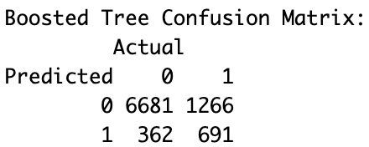
Model#7—Boosted Trees
Full Prediction
Train Error: 16.17%
Test Error:17.95%
Confusion Matrix:
Prediction Error
Class 0: 5.43%
Class 1: 36%
Partial Prediction
Train Error: 16.17%
Test Error: 18.09%
Confusion Matrix:
Prediction Error
Class 0: 5.14%
Class 1: 35.31%

