Slide 1

Assist
Help is on the way!
Notes:
To change the image on this slide, select the picture and delete it. Then click the Pictures icon in the placeholder to insert your own image.

Slide 2
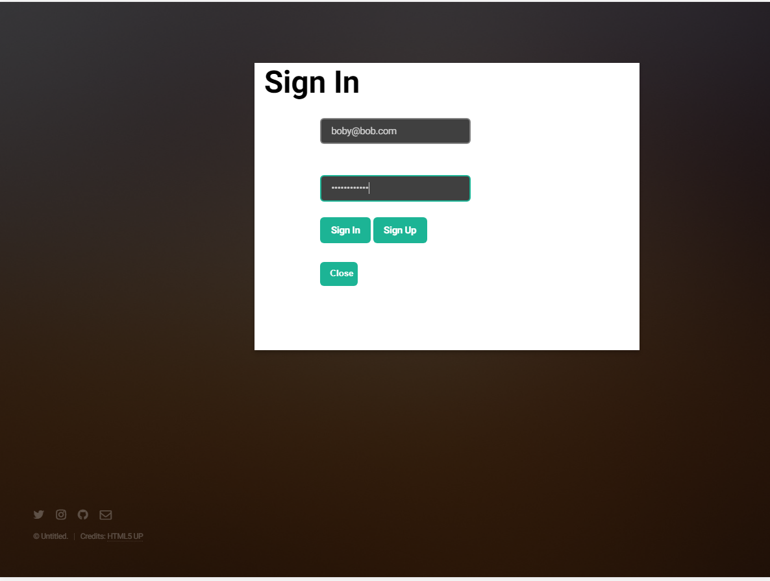

Slide 3
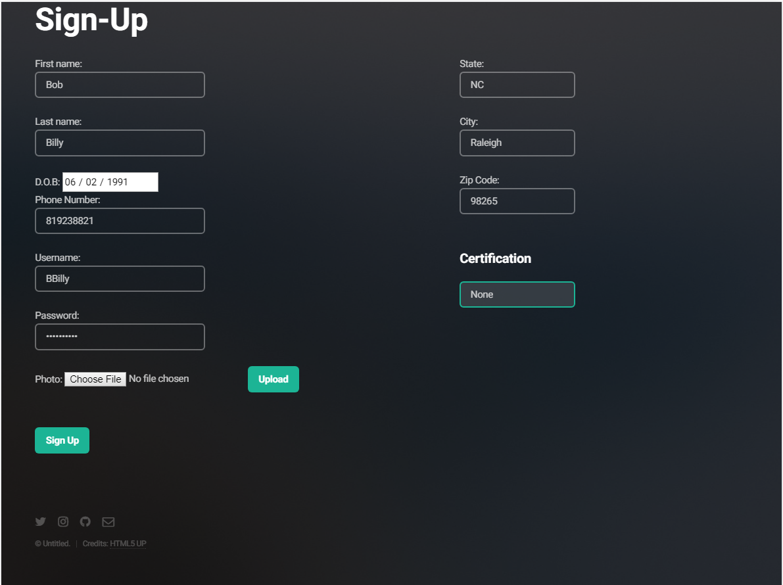

Slide 4
Service process
Phase 1
Potential client is in need!
Phase 2
Client broadcasts their need.
Phase 3
Nearest active Assist associate responds
Phase 4
Client accepts associate’s response
Phase 5
Associate arrives and assists client

Slide 5
