Slide 1

Assist
Help is on the way!
Notes:
To change the image on this slide, select the picture and delete it. Then click the Pictures icon in the placeholder to insert your own image.

Slide 2
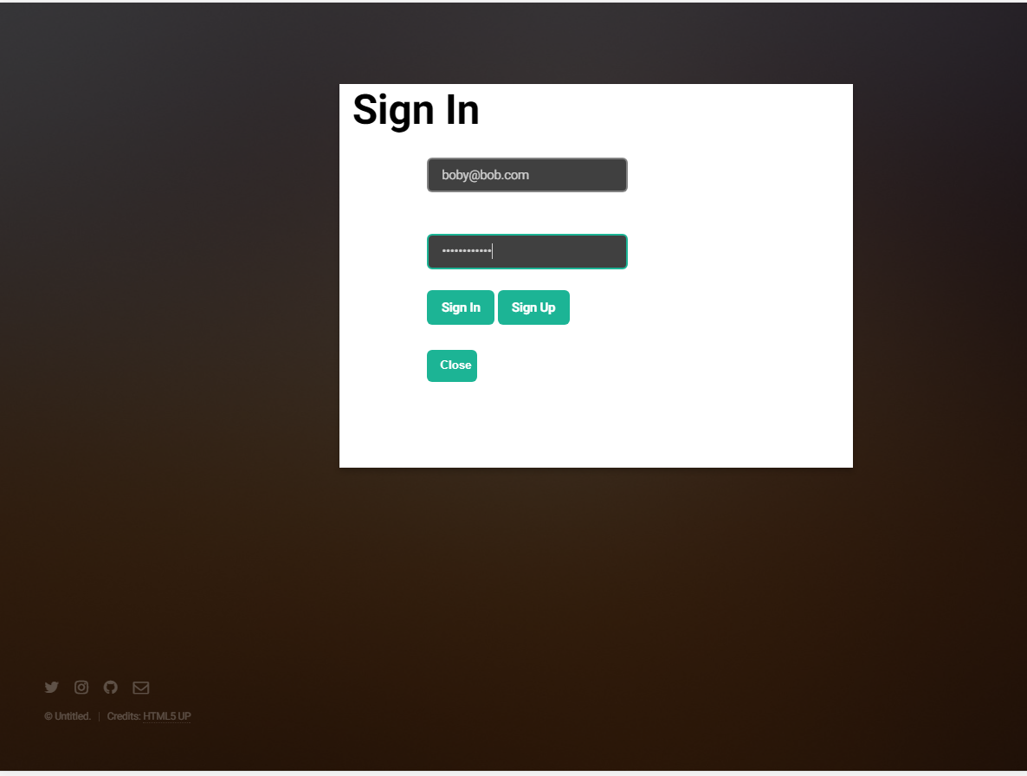

Slide 3
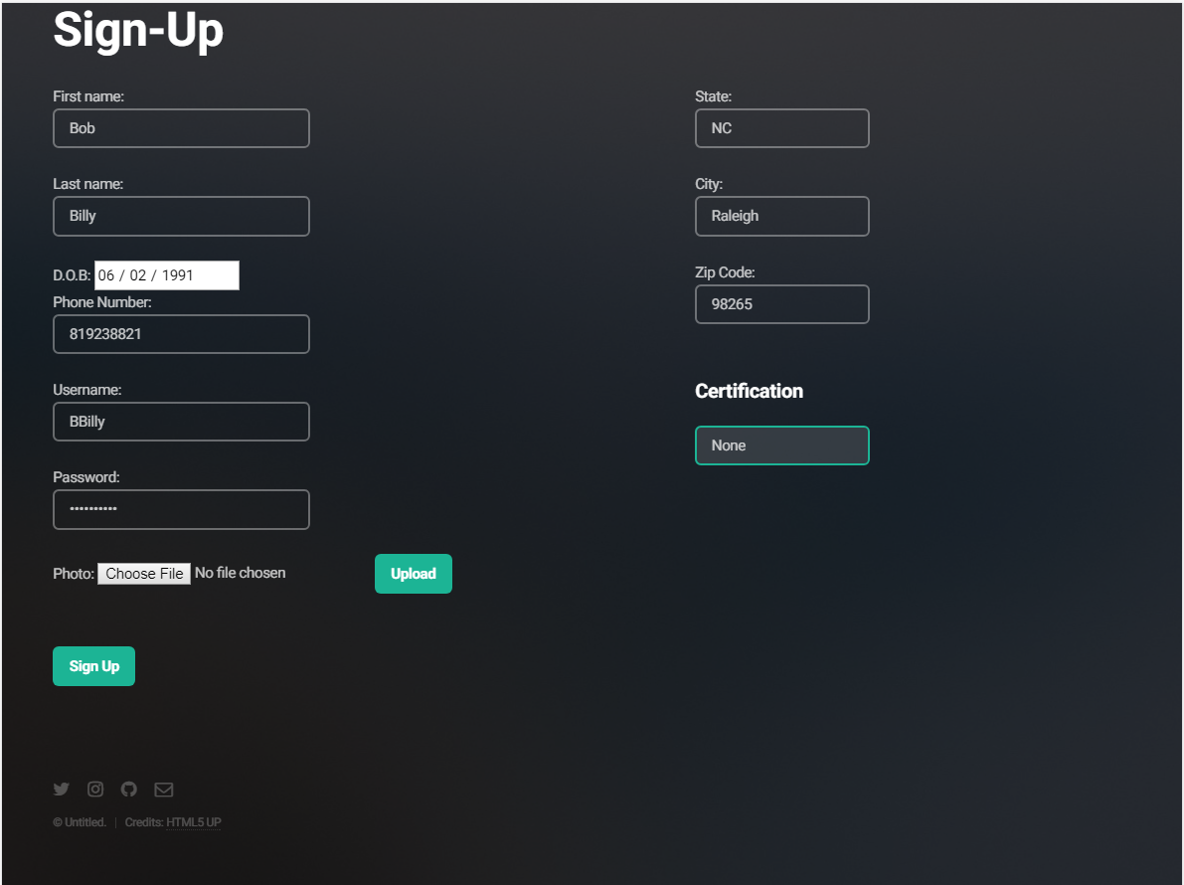

Slide 4
Service process
Phase 1
Potential distressed client is in need!
Phase 2
Distressed client broadcasts their need.
Phase 3
Nearest active Assist hero responds
Phase 4
Client receives notification of hero’s response
Phase 5
Hero arrives and assists distressed client

Slide 5
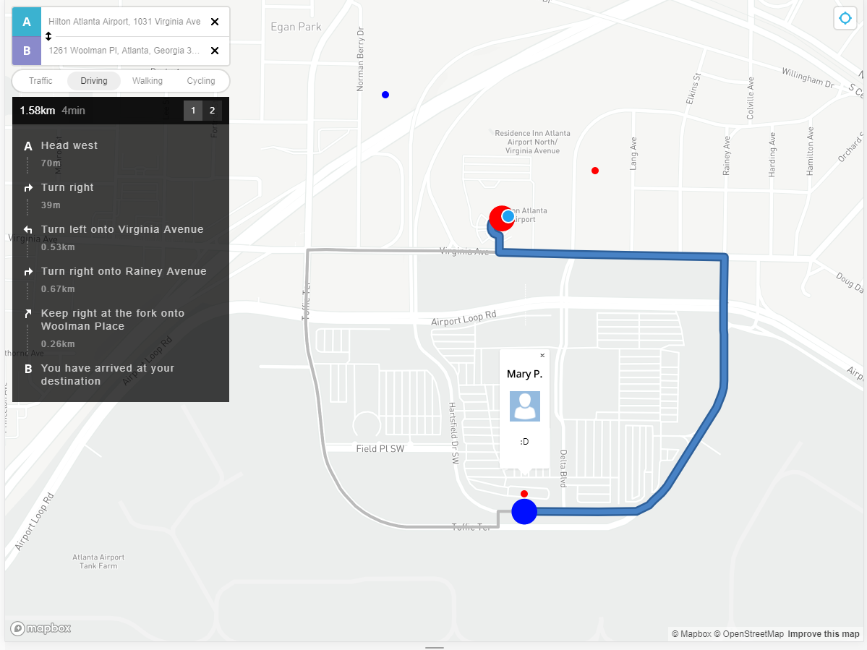

Slide 6
