Slide 1
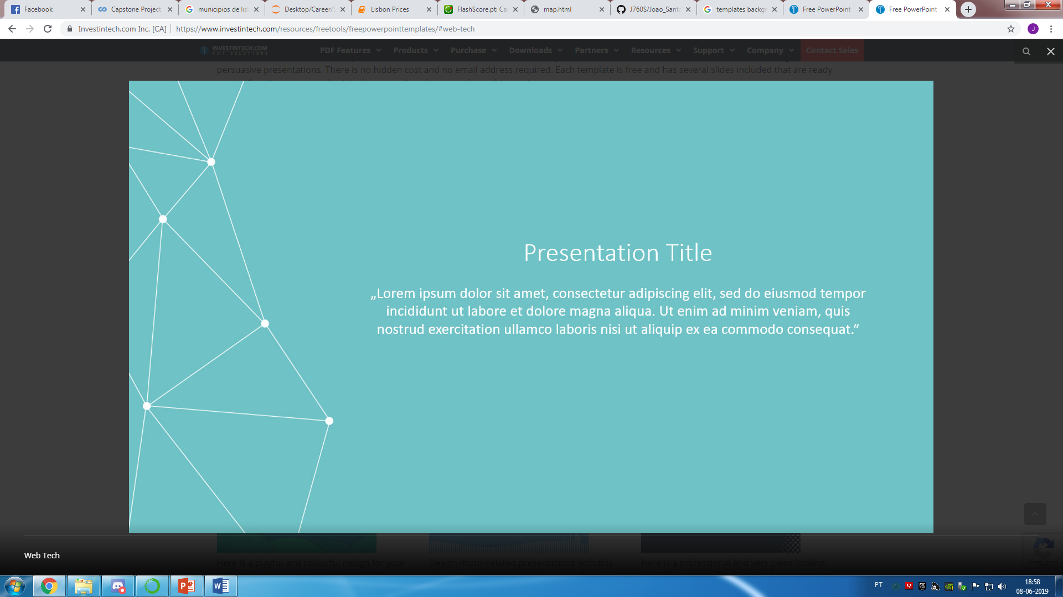

Housing Prices in Lisbon
Applied Data Science Capstone
João André Agostinho dos Santos

Slide 2
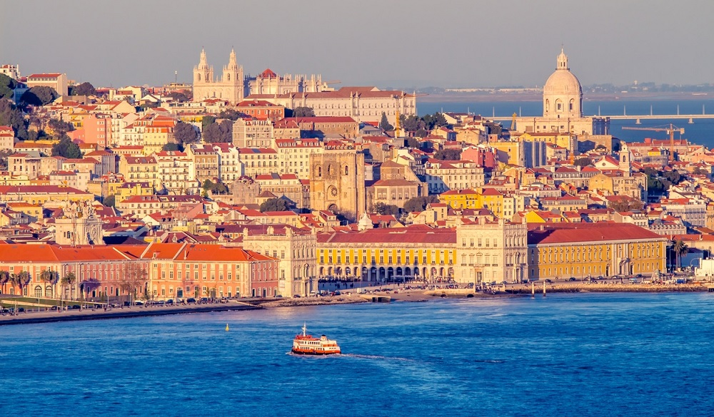
Introduction
Lisbon is the stunning capital city of Portugal and is one of the most charismatic and vibrant cities of Europe;
Data shows over 4,5 Million tourists visit Lisbon, per year, being Lisbon one of the most desired places to visit;

Slide 3

Data Description
Sources: Second-level Administrative Divisions of Portugal from Spatial Data Repository of NYU and Price per square meter in Portugal municipals (Jornal de Negócios);
From the first one, the .json file has coordinates of the all city of Portugal. I cleaned the data and reduced it to city of Lisbon where I used it to create choropleth map of the prices per square meter in the district of Lisbon. The second is a dataset that contained the price per square meter in all municipals in Portugal.

Slide 4


Methodology

Slide 5
Procedure
1º Geo-Location of the Municipals of Lisbon;
2º Foursquare API to get the most common venues in each region;
3º K-Means Algorithm
4º Folium Library – Choropleth Map

Slide 6
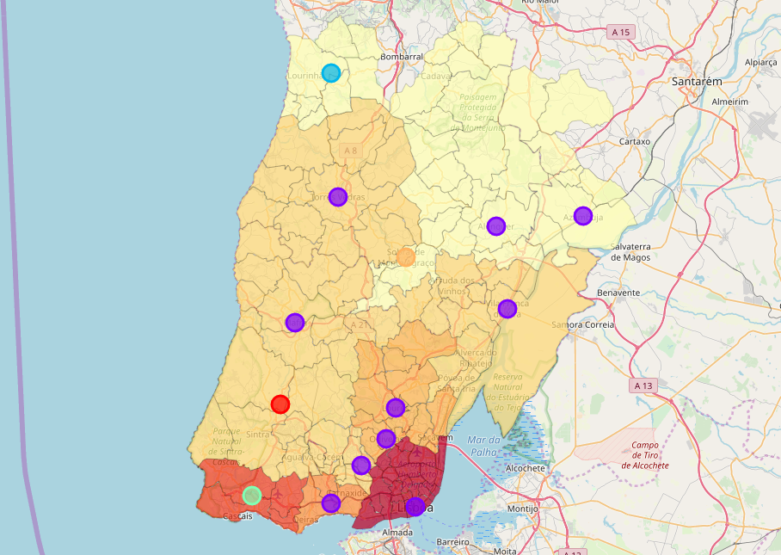
Outcome
Cluster | Description | Color
1 | Café and Bar Venues | Purple
2 | Restaurant & Sport Venues | Red
3 | Store Venues | Blue
4 | Local Restaurants Venues | Orange
5 | Golf & Social Venues | Green
Areas such as, Cascais, Oeiras, Great Lisbon, Loures are the areas that have the highest values in terms of price per square meter that correspond with a value higher than 1.228€.
In contrast, we have Cadaval, Lourinhã, Alenquer and Azambuja with the lowest values of our study with values below 831€.

Slide 7
Results & Conclusions
if a customer aims to live near Great Lisbon, paying the least for square meter, this study would indicate Amadora as the best choice
When opening a store, if the objective is purely having contact with customers, the best choices will be: Great Lisbon and Cascais, due to the agglomerate of people, but also due to being characterized by being a social sphere. On the other hand, if the objective of the store is merely, to have a physical location of the startup, for example, then a lower cost per square meter, would be the best choice, meaning, Lourinhã, Cadaval, Alenquer and Azambuja being the best spots to do so.

