Slide 1
Introductory Analysis and Visualization in R
Week 3: Visualization with ggplot2
June 26, 2020
Jennine Dawicki McKenna
Senior Research Investigator, Black Lab

Slide 2
Overview
Brief review
ggplot2
Writing your own functions
Flow control: conditionals
Try it out: Create your own plots using your own data or a data set supplied by R.
Notes:
A few comments on organizing projects first
To discover more R datasets type: data()

Slide 3
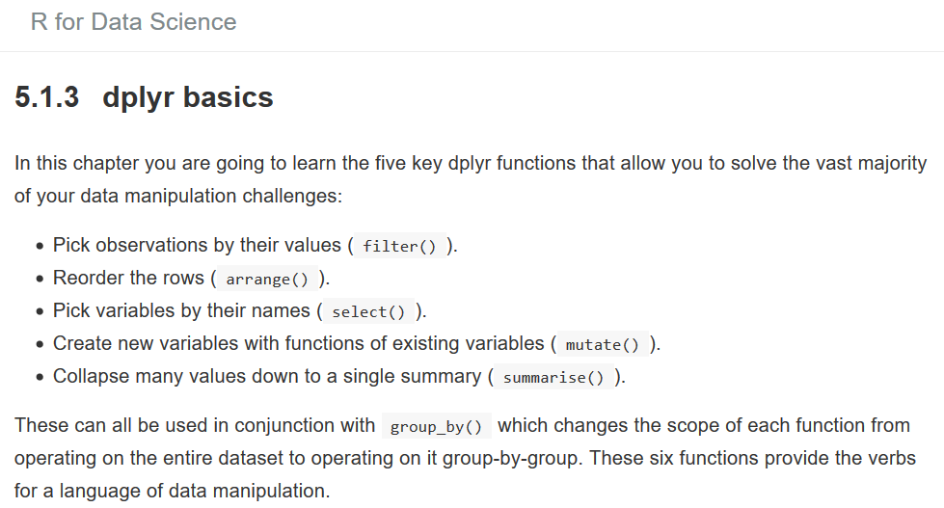
Review
Consider project organization up front (directory structure, R project).
Import datasets using readr: GUI can reveal code for reproducibility.
dplyr “verbs” provide a consistent framework for operating on data frames.
Output of one function can be “piped” as input into the next.
Tidy data makes working with data easier.
https://r4ds.had.co.nz/transform.html#dplyr-basics

Slide 4
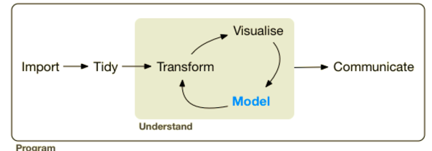
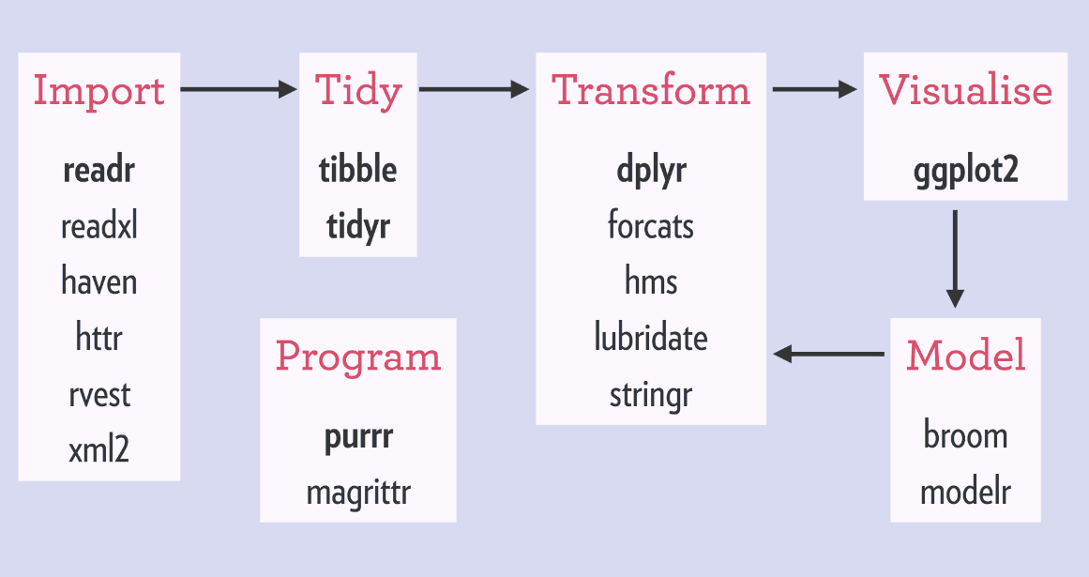
Review: Philosophy of the tidyverse
coherent – designed to work together
consistency – apply what you already know
coverage – support throughout analysis workflow
parsimony – minimum set of functions
https://rviews.rstudio.com/2017/06/08/what-is-the-tidyverse/
Notes:
Ggplot2 is one of the core packages in the tidyverse and embraces the principles here

Slide 5
More grammar analogies: “ggplot2- a layered grammar of graphics”
Any graph can be expressed from the same set of components: a data set, a coordinate system, and a set of geoms – the visual representation of data points
Advantages:
Learn one system.
A graphs consists of one or more layers. Layers are independent. Change one without changing all.
Allows for an unlimited number of combinations.
https://r4ds.had.co.nz/data-visualisation.html
http://vita.had.co.nz/papers/layered-grammar.pdf
http://swcarpentry.github.io/r-novice-gapminder/08-plot-ggplot2/index.html
Notes:
This is all very conceptual. Let’s make that concept more concrete.

Slide 6
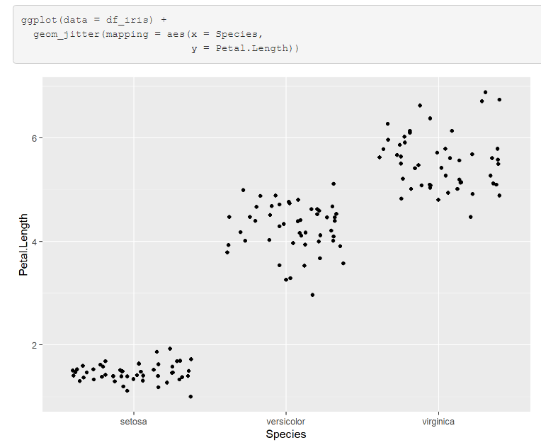
A concrete example: scatterplot
1. call to ggplot()
2. define aesthetic mappings
3. add layers with <GEOM_FUNCTION>
https://ggplot2.tidyverse.org/reference/geom_point.html
https://ggplot2.tidyverse.org/reference/geom_jitter.html
Notes:
The first argument to ggplot() is a data frame, as we saw with the dplyr functions.
Additionally, we need to define a mapping from a variable in the data frame to an “aesthetic”, a visual property of the data (e.g. size, shape, color, even position).
We also need to specify a “geom_function”, some way to visually display the data (e.g. point, line, bar).

Slide 7
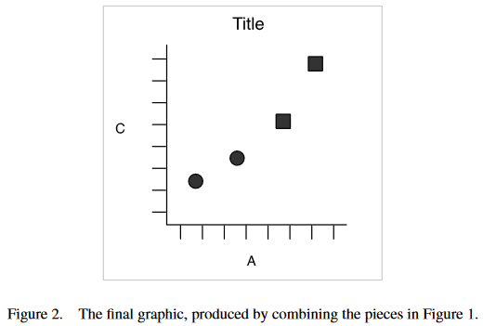
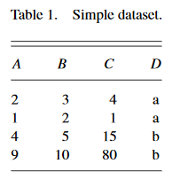
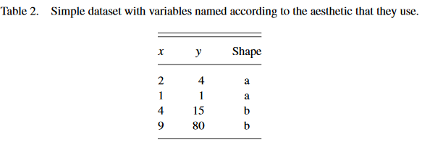
What do we mean by “mapping to an aesthetic”? Example: scatterplot of A vs. C
map x-position to A, y-position to C, shape to D
http://vita.had.co.nz/papers/layered-grammar.pdf
Notes:
associate a variable, here A, with some visual property, x-position
It might be a little strange at first to think about position as an aesthetic.

Slide 8
ggplot2-example.Rmd walkthrough
For more on R Markdown see:
https://r4ds.had.co.nz/r-markdown.html

Slide 9
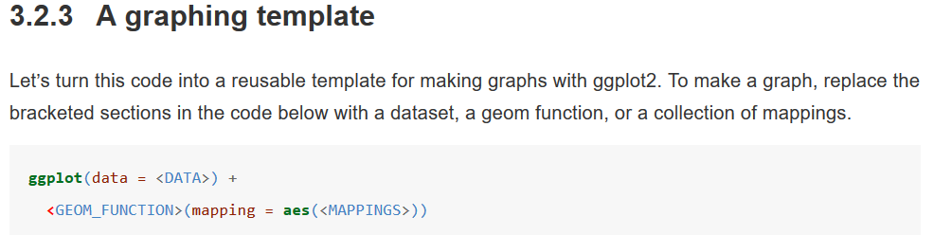
3 steps to creating graphics with ggplot2
1. call to ggplot()
2. define aesthetic mappings
3. add layers with <GEOM_FUNCTION>
https://r4ds.had.co.nz/data-visualisation.html#a-graphing-template
https://methodenlehre.github.io/SGSCLM-R-course/graphics-with-ggplot2.html

Slide 10
Choosing a geom function
How many variables are you working with?
Are the variables continuous or discrete?
https://ggplot2.tidyverse.org/
https://ggplot2.tidyverse.org/reference/

Slide 11
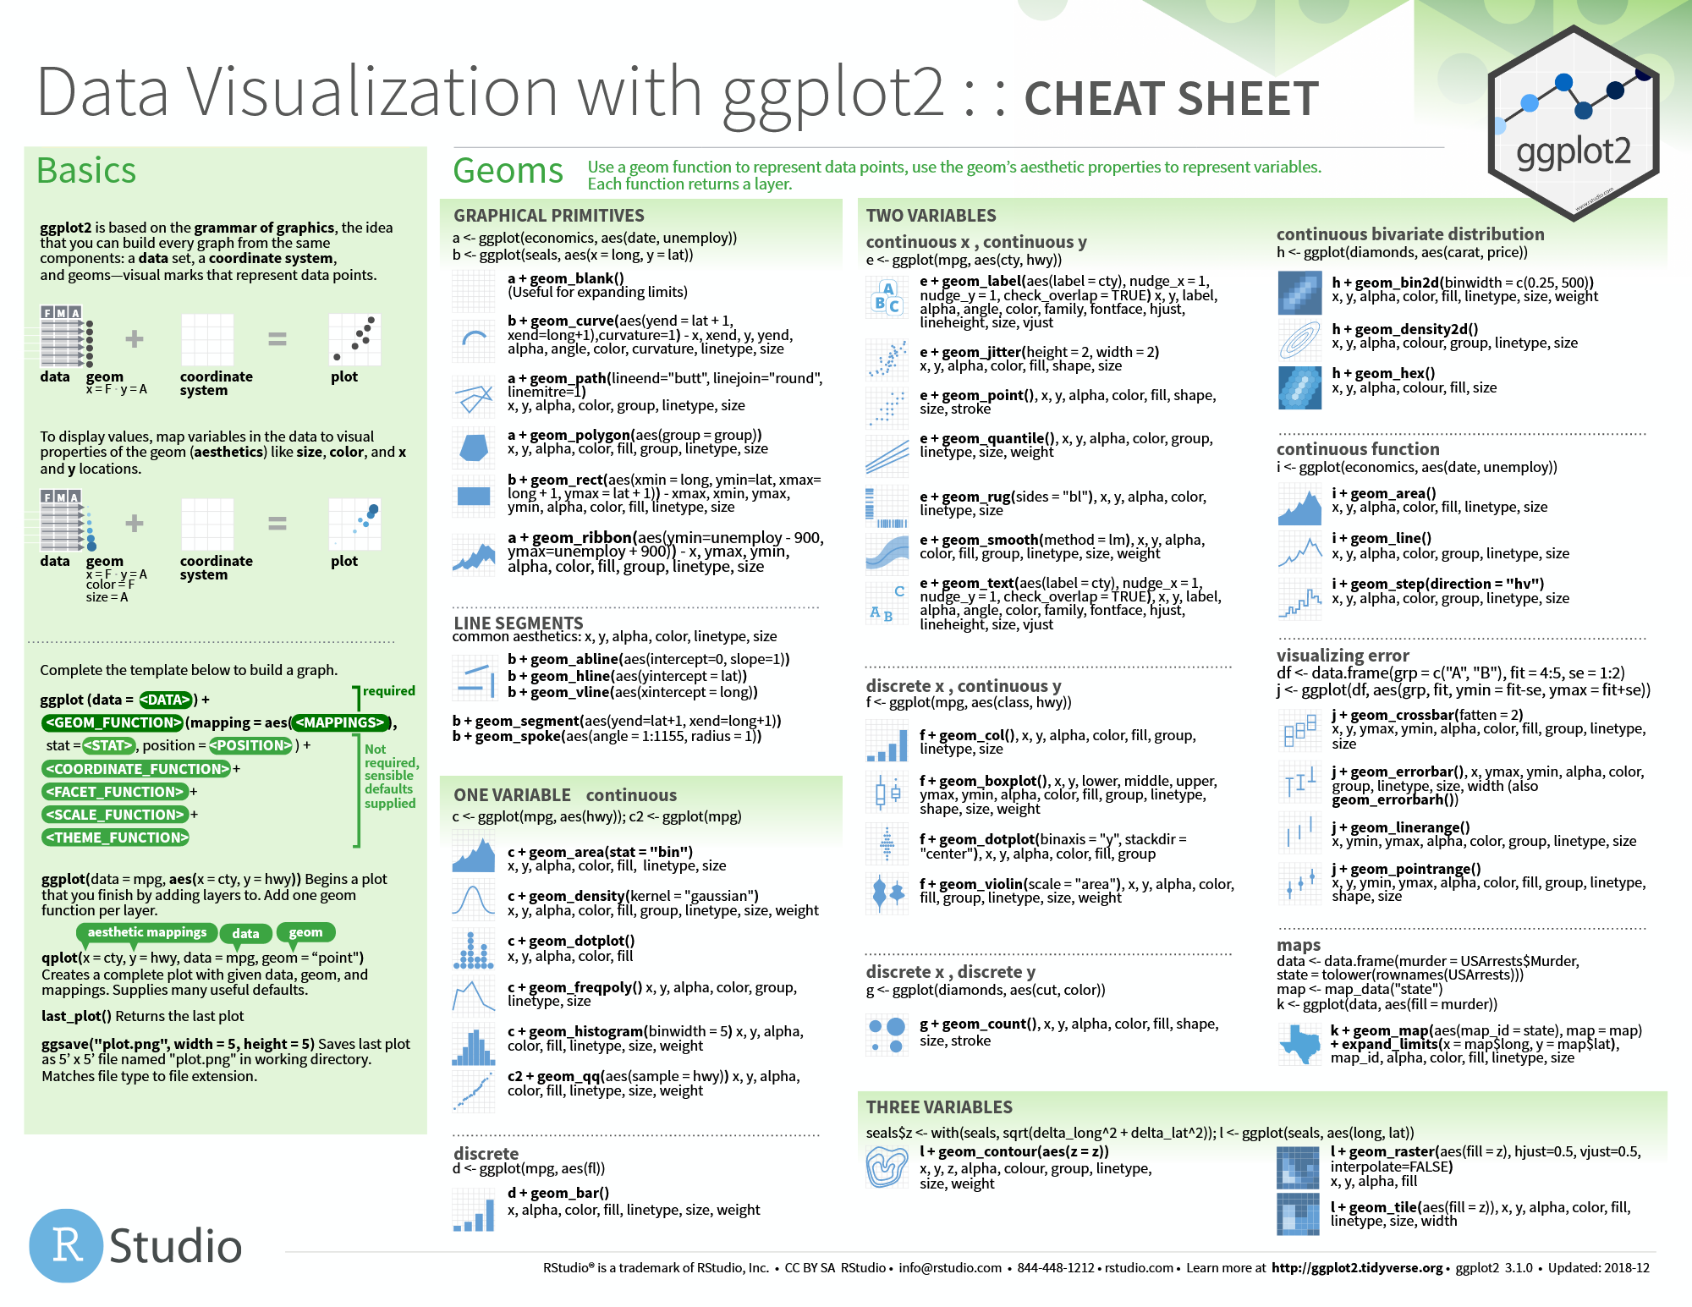
https://github.com/rstudio/cheatsheets/blob/master/data-visualization-2.1.pdf

Slide 12
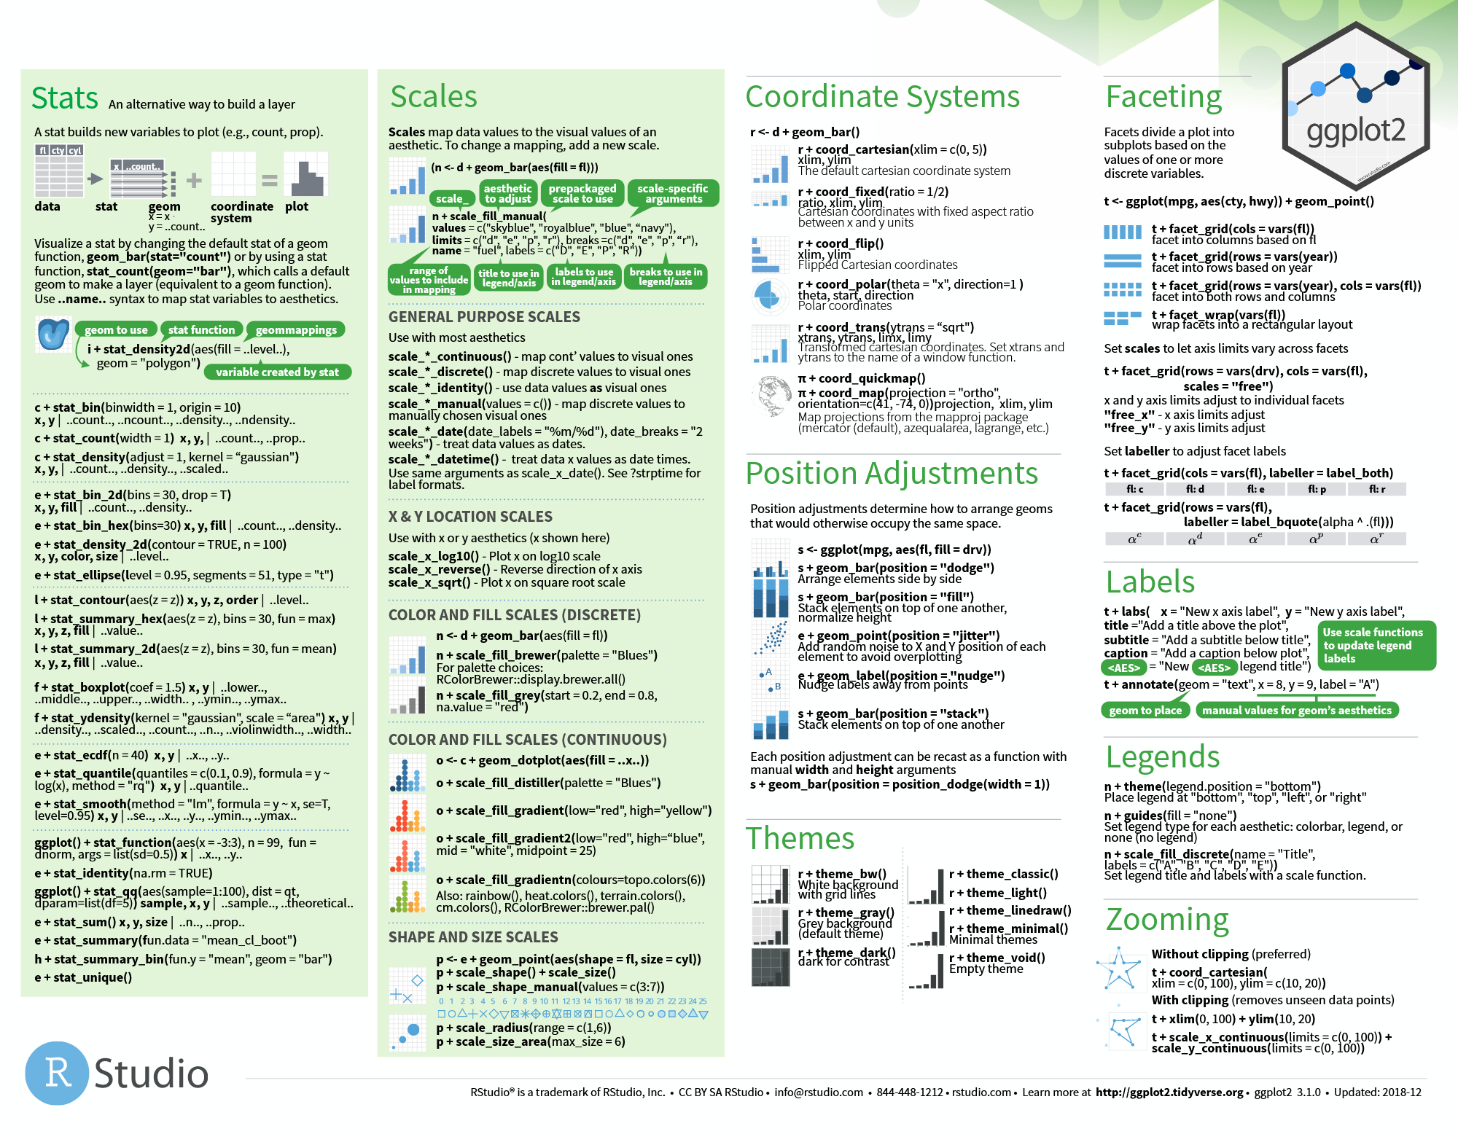

Slide 13
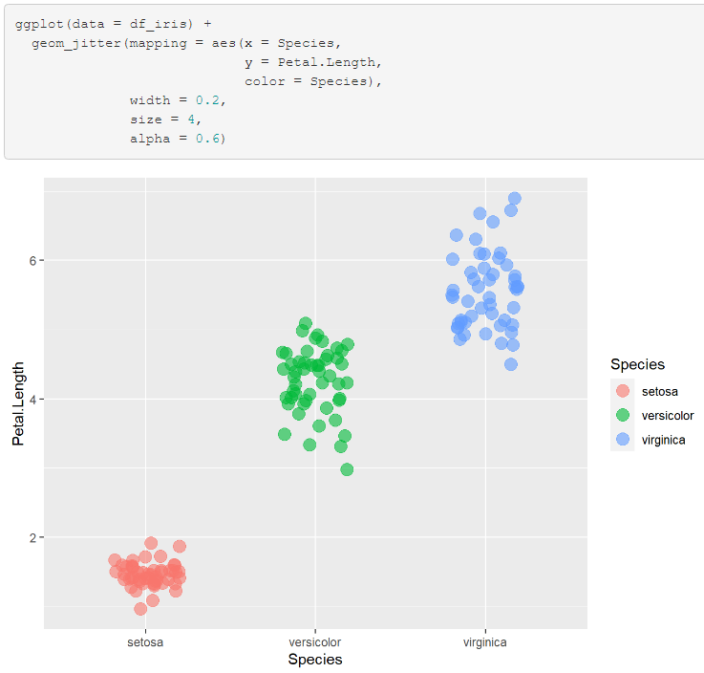
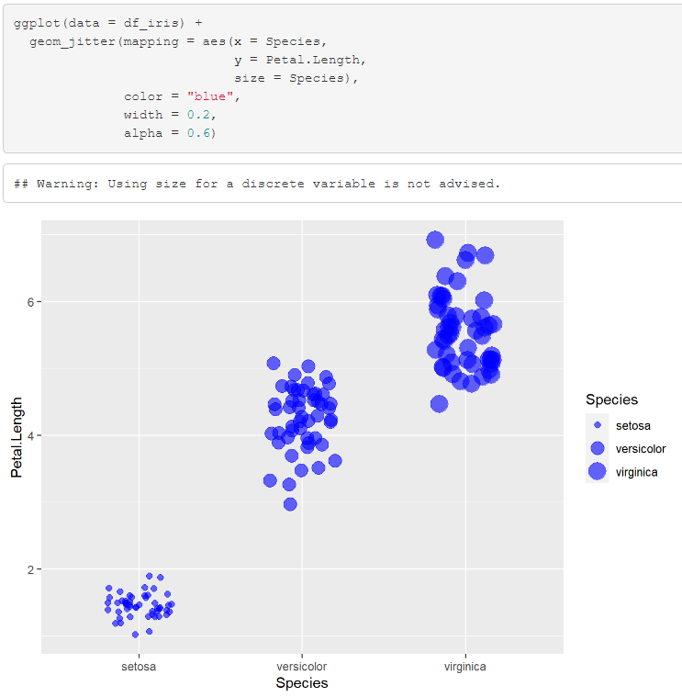
Defining aesthetics inside vs. outside aes()

Slide 14
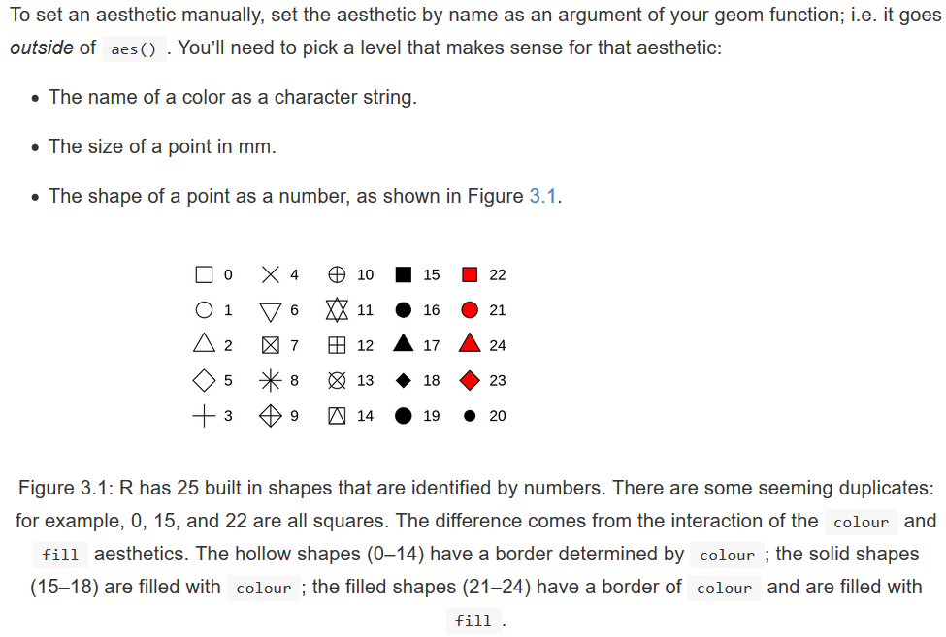
More aesthetics
https://r4ds.had.co.nz/data-visualisation.html#aesthetic-mappings

Slide 15
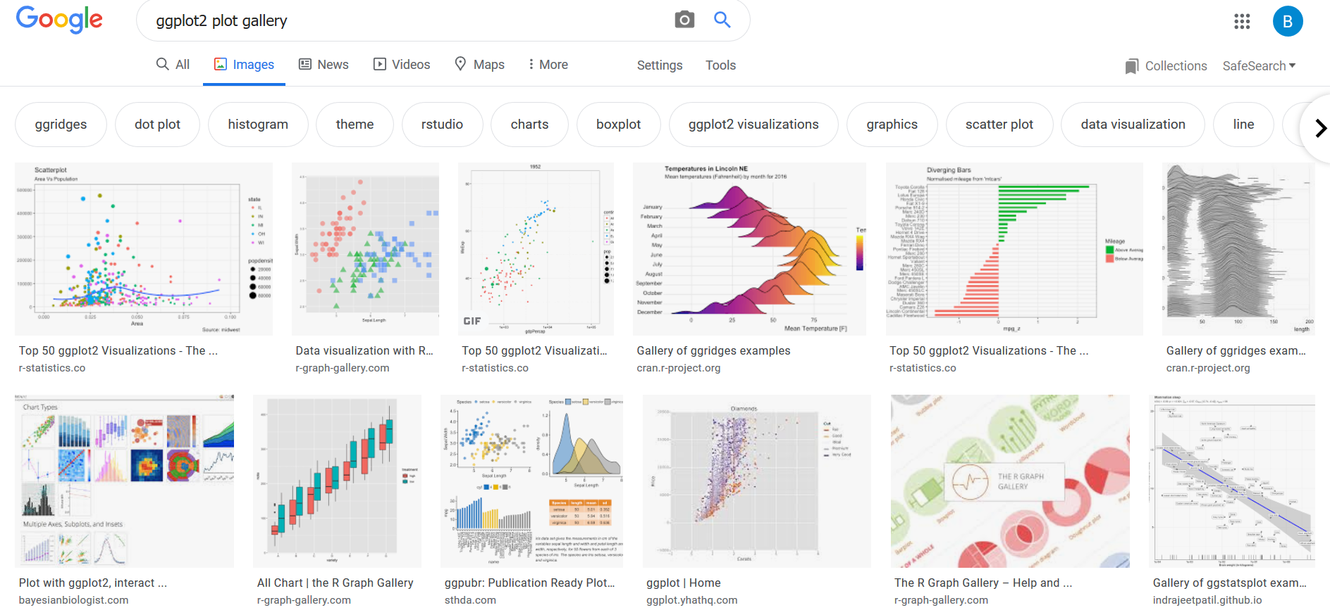
Check out what other people have done!
http://r-statistics.co/Top50-Ggplot2-Visualizations-MasterList-R-Code.html
https://www.r-graph-gallery.com/

Slide 16
I’ve just touched on the very basics
Check out
Labels and annotations
Color palettes and themes
Stats
Faceting
Coordinate systems
https://r4ds.had.co.nz/data-visualisation.html
https://r4ds.had.co.nz/graphics-for-communication.html

Slide 17
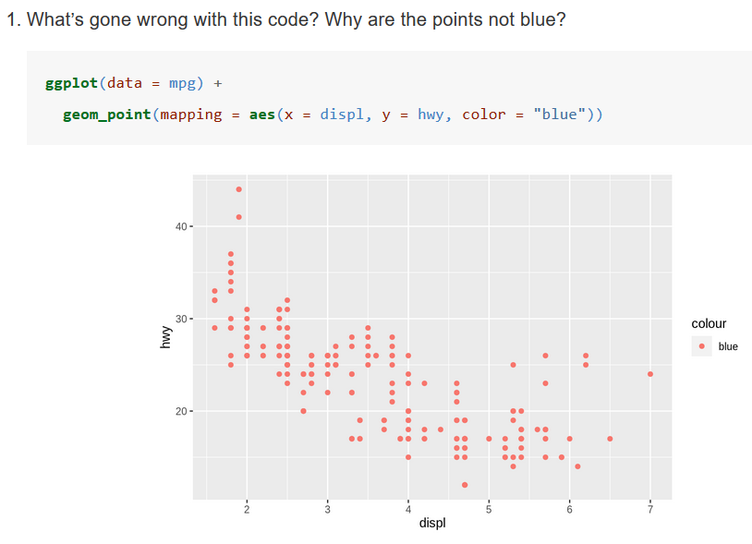
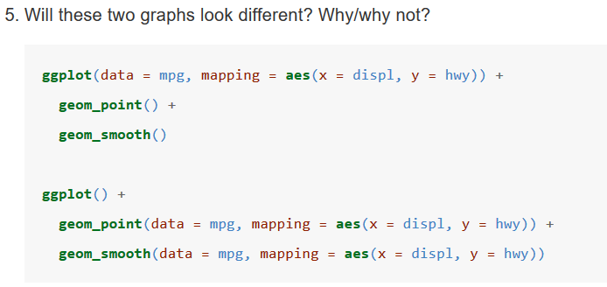
Exercises
https://r4ds.had.co.nz/data-visualisation.html

Slide 18
Writing your own functions
When to write a function?
General rule: avoid copying and pasting more than twice
Advantages of a function over copy-and-paste:
Easier to understand – you can give your function an informative name.
Less maintenance – update code in a single place.
Reduce mistakes associated with copying and pasting.
https://r4ds.had.co.nz/functions.html

Slide 19
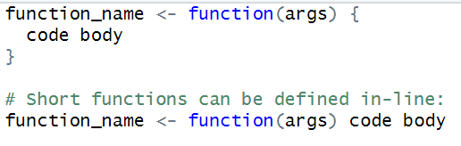
3 (+1) key steps to creating a new function
Choose an appropriate name for the function.
List arguments to the function inside function().
Place code you have developed in the function body.
(Testing: check function with different inputs.)

Slide 20
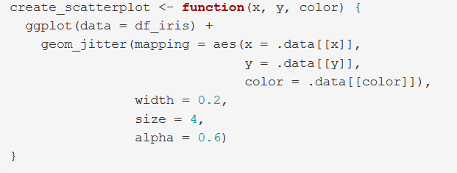
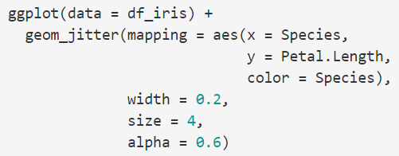
Example function
function name
arguments
code
It’s usually easiest to get code working on a sample input first.
Implement the function.
Notes:
Here, we use the .data "pronoun" to access (using double brackets, [[]]) the relevant column name, as specified by a character vector (e.g. x = "Species").

Slide 21
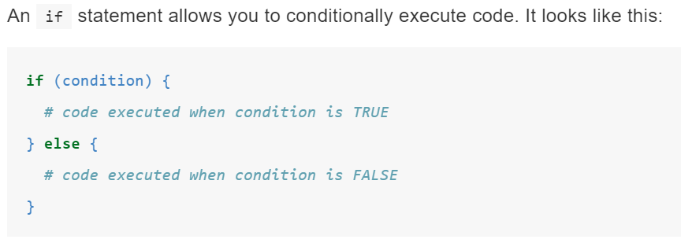
Conditional execution
The condition must evaluate to either TRUE or FALSE.
Use || (or) and && (and) to combine multiple logical expressions.
https://r4ds.had.co.nz/functions.html#conditional-execution

Slide 22
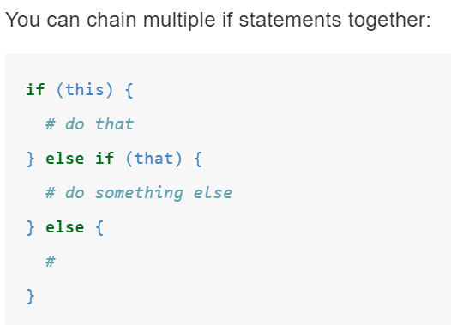
You can also chain multiple conditions
Also check out switch() function as an alternative to a long series of chained if statements.
https://r4ds.had.co.nz/functions.html#multiple-conditions

Slide 23
Next week
Iteration
Strings
Other potential topics – modeling, regular expressions, version control, more detail on a previous topic?

