Slide 1
Guide to setting up R and RStudio
June 4, 2020

Slide 2
Overview
Install R
Install RStudio
Install “tidyverse” package
Load “tidyverse”
R resources

Slide 3
1. Install R (Tess Cherlin)
You’ll need to install both R and RStudio for this workshop.
I found the following guide to be helpful. Rather than reproduce it here, see:
https://github.com/rladies/meetup-presentations_philadelphia/blob/master/2020_06/R%20Studio%20Download%20Tutorial%202020.pdf
I’ve included screenshots for installation in Windows 10.

Slide 4
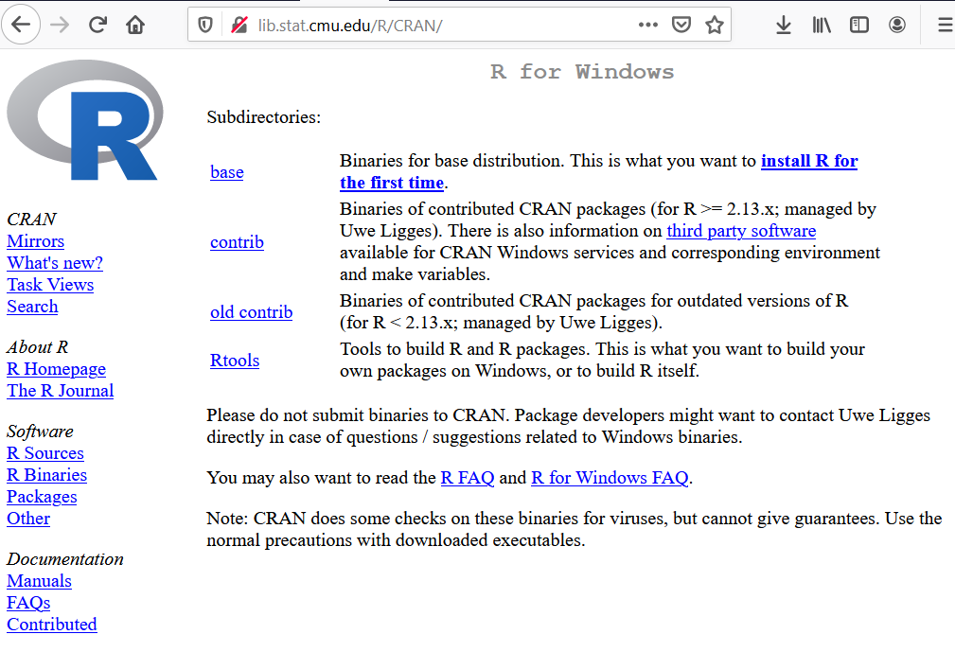
Screenshots for first-time R installation on Windows 10

Slide 5
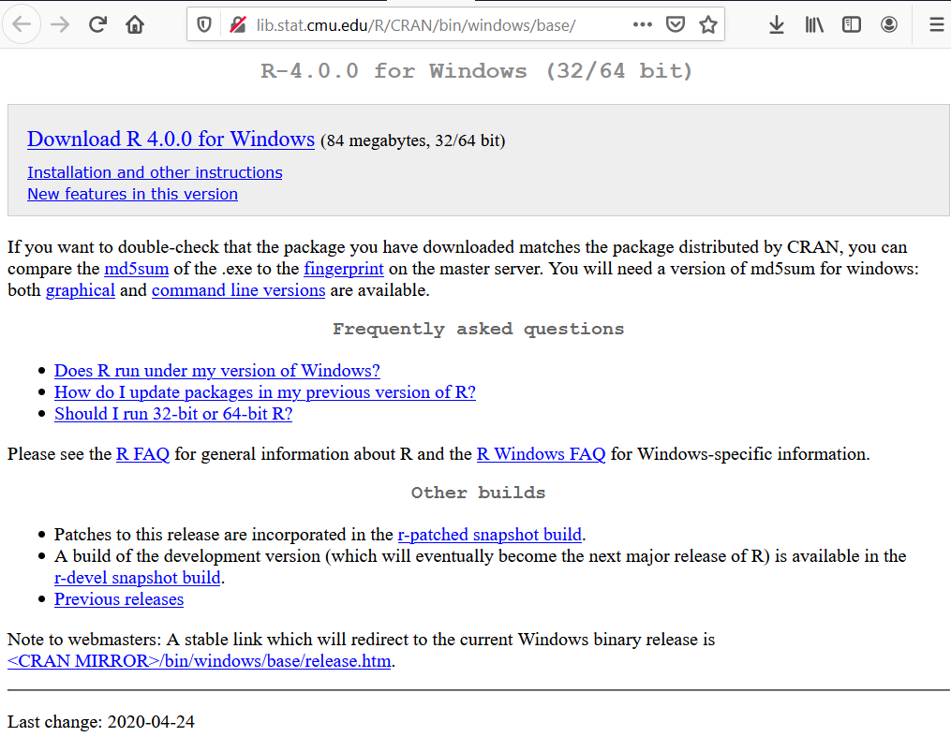
It’s best, although optional, to check md5sum to avoid malware

Slide 6
Windows: Download and install md5sum utility
https://support.microsoft.com/en-us/help/889768/how-to-compute-the-md5-or-sha-1-cryptographic-hash-values-for-a-file
https://support.microsoft.com/en-us/help/841290/availability-and-description-of-the-file-checksum-integrity-verifier-u

Slide 7
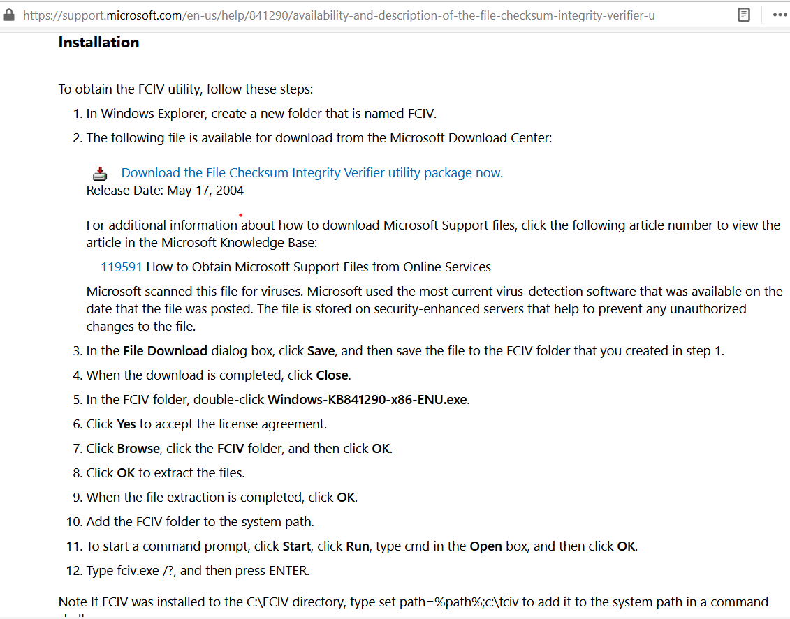
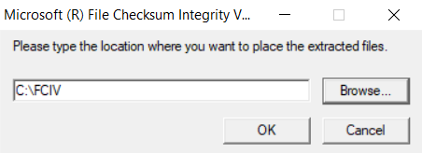

Slide 8
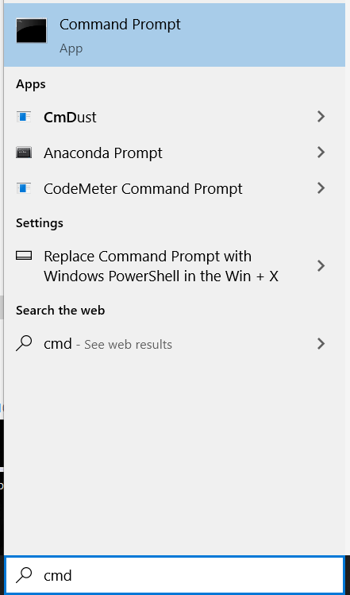
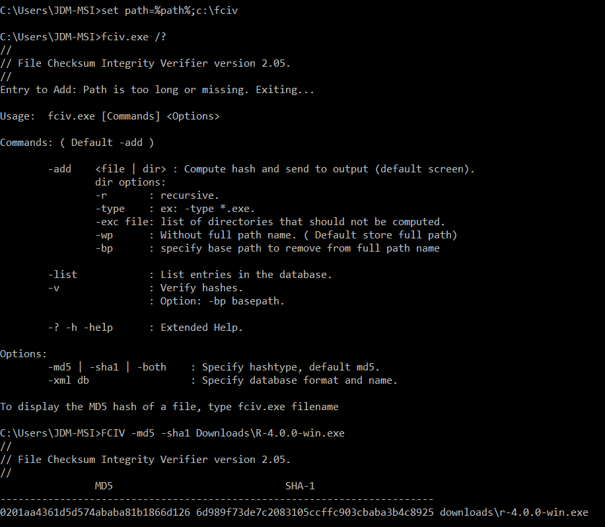
Add FCIV folder to system path

Slide 9

And check md5sum of R download file against “fingerprint” from the download page
My R exe is located in my Download folder

Slide 10
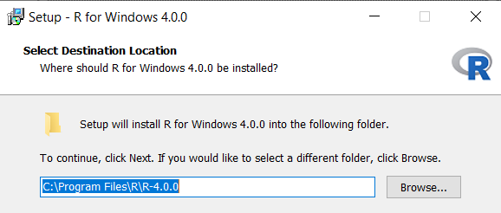
Double-click to install the R exe, default installation options are fine

Slide 11
2. Install RStudio
Continue with Steps 6-9 in tutorial.
See the link below for finding your way around RStudio:
http://swcarpentry.github.io/r-novice-gapminder/01-rstudio-intro/index.html

Slide 12
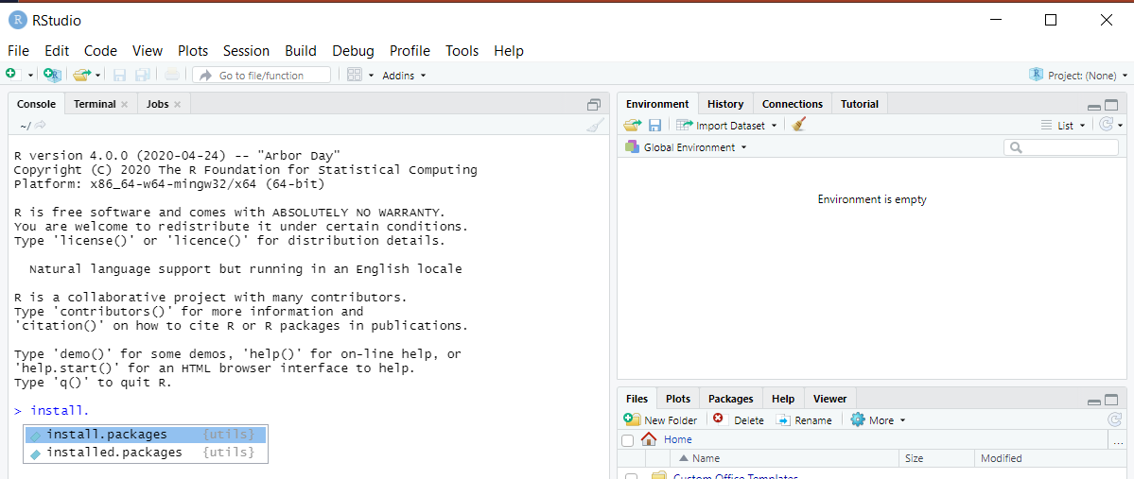
3. Open RStudio and install “tidyverse”
You can begin typing and then use the <TAB> key to suggest auto-completion. Here I’ve typed “install.” and then hit the <TAB> key.

Slide 13
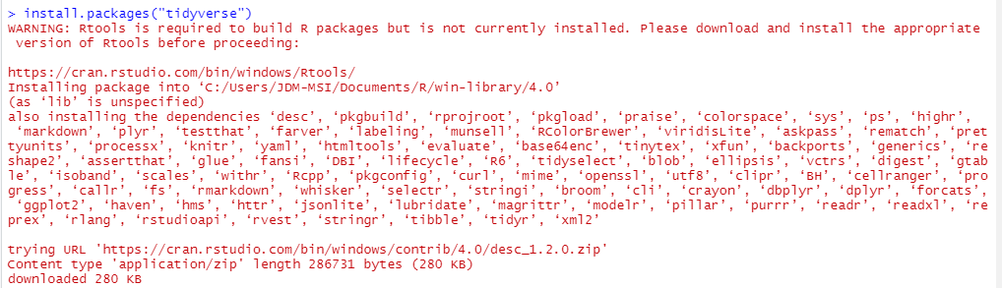
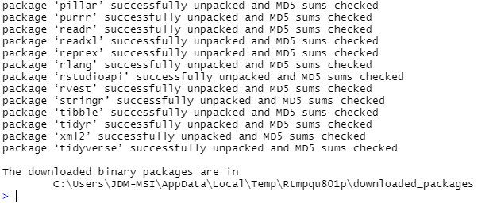
Cont.
…
Look for successful completion of the package and its dependencies.

Slide 14
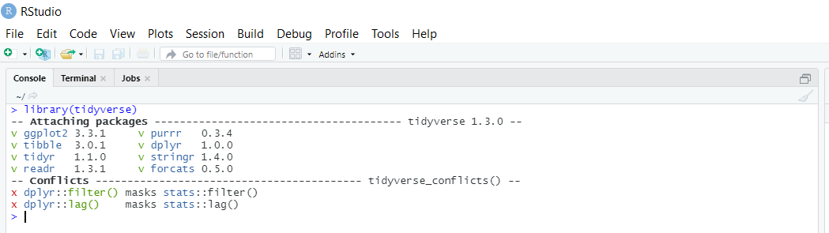
4. Installation only needs to be completed once, but packages need to be loaded each session
Use the library() command to load previously installed packages.

Slide 15
R resources
https://www.r-project.org/
https://rstudio.com/
https://r4ds.had.co.nz/
A great resource for data analysis and visualization in R.
https://software-carpentry.org/lessons/
Offers tutorials in many languages, including R.
https://www.meetup.com/rladies-philly
A Philly-based Meetup that supports gender diversity in the R community

