Slide 1
Introductory Analysis and Visualization in R
Week 1: Getting started
June 12, 2020
Jennine Dawicki McKenna
Senior Research Investigator, Black Lab

Slide 2
Overview
Approach
Concrete example of analysis workflow
Basics: Getting started in R
Variable assignment
Types of vectors
Subsetting
Operators (Arithmetic, Logical, Comparison)
Function calls
Knowing how to get help
Walkthrough introductory R script
Data structures in R: focus on data frames

Slide 3
I’m trying out a new approach: work through a concrete example
Take a concrete, tab-delimited data set generated in the lab
Walk through analysis step-by-step
Interact with the data visually (plotting)
Introduce coding concepts in relation to the example
Focus on reproducibility
… But I want to touch on some basics this week before diving in.
Notes:
Definitely won’t be comprehensive and will necessarily leave a lot out- even some basics. The idea is that if you can convince yourself it’s useful to you and have a few resources to get started, then you can pick these things up. And there are local R communities in Philly ready to help.

Slide 4
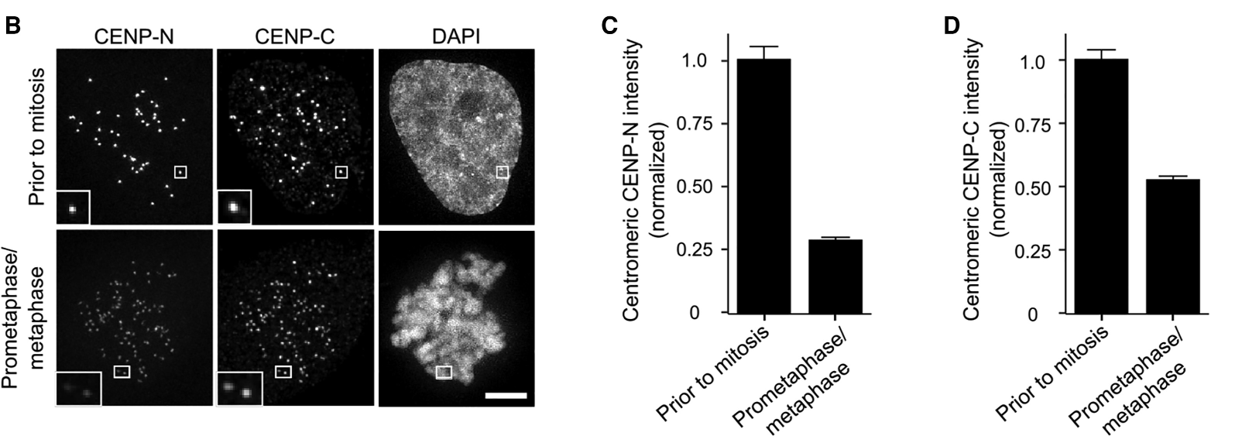
The example: centromere protein intensity
Allu et al., Curr Biol 2019
nowout
wout20min
Notes:
The particular data set will be centromere protein intensity values, but the concepts introduced will work for many tab-delimited data sets frequently generated in science labs.

Slide 5
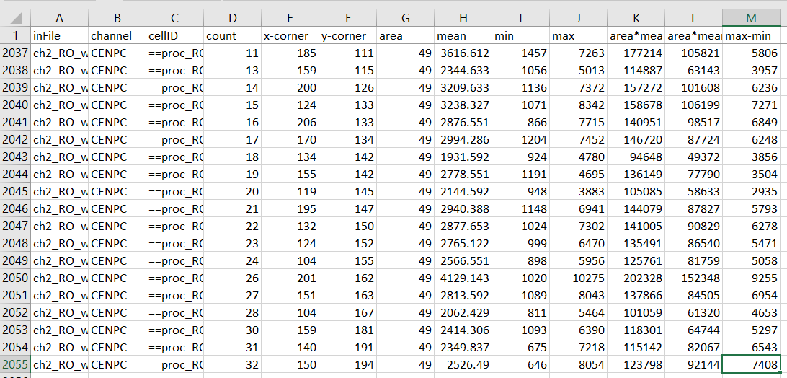
The raw data: Tab-delimited text file with header
13 columns, header line, 2054 rows of data.
Each row holds statistics associated with a single centromere (cellID, count), for a single centromere protein (channel).
The statistic we’re interested in here is a background-subtracted intensity.

Slide 6
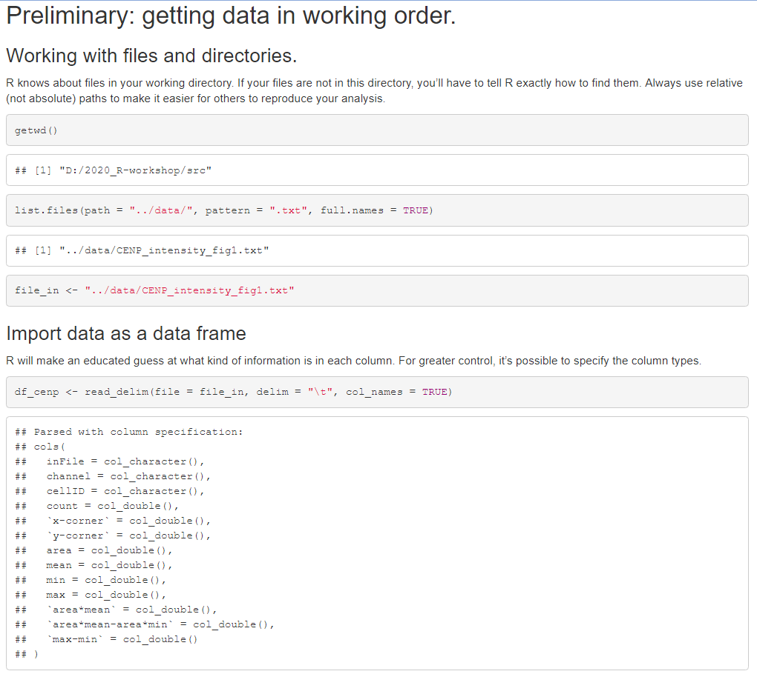
Overview of analysis: Get data into R

Slide 7
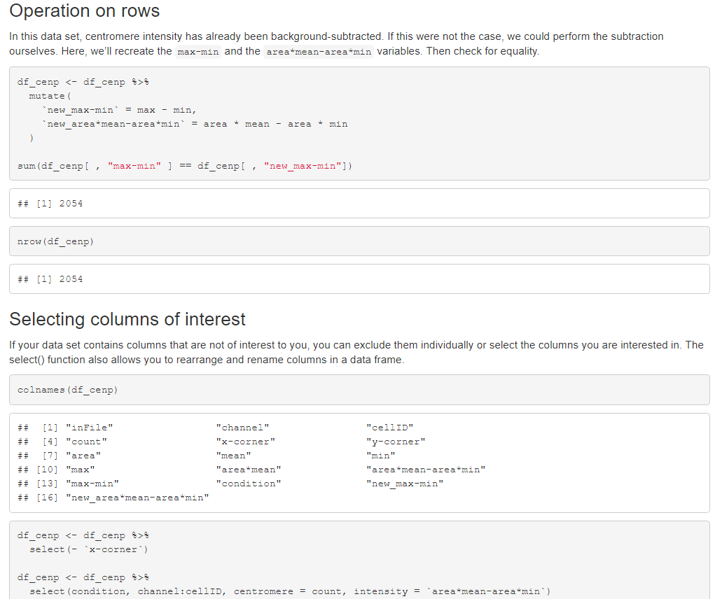
Overview of analysis: Pre-processing

Slide 8
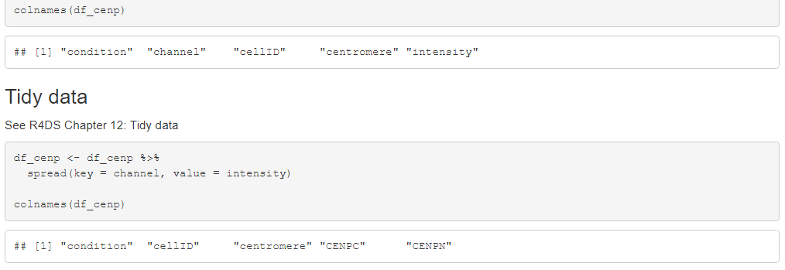
Overview of analysis: “Tidying” data

Slide 9
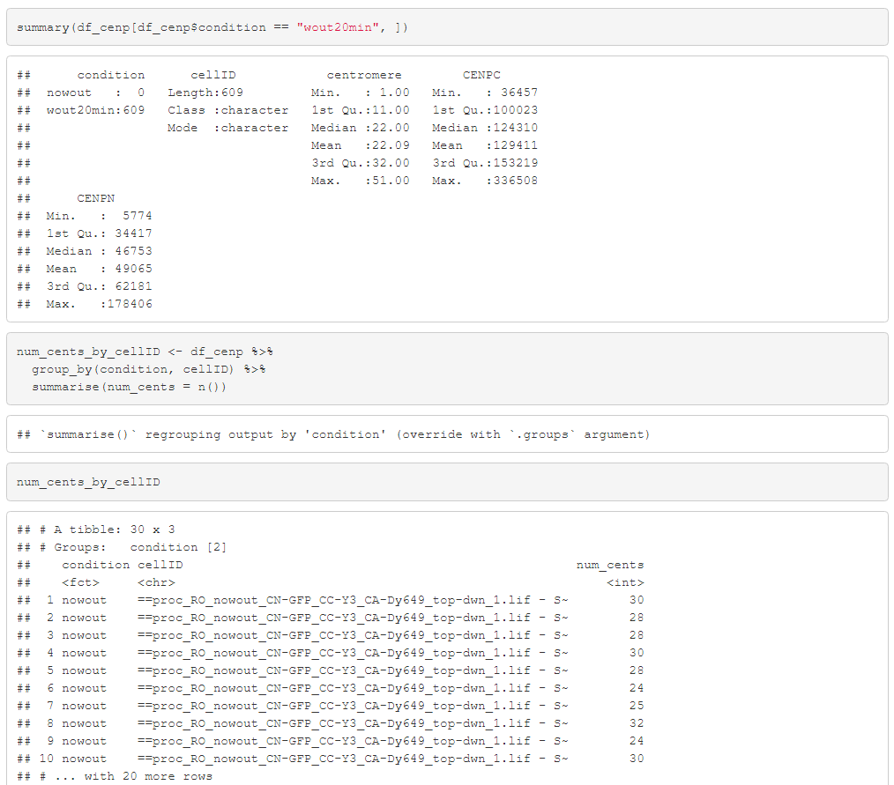
Overview of analysis: Exploratory data analysis

Slide 10
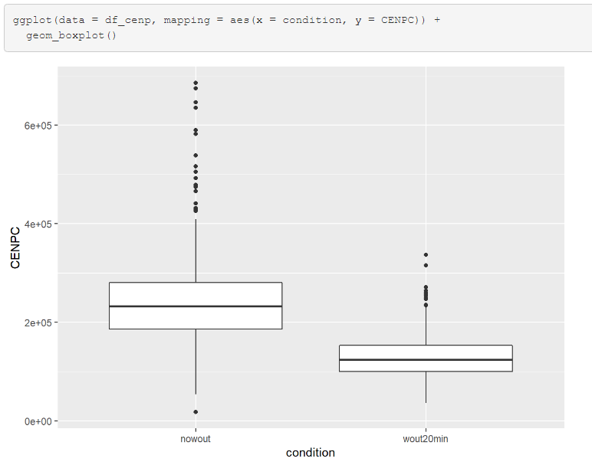
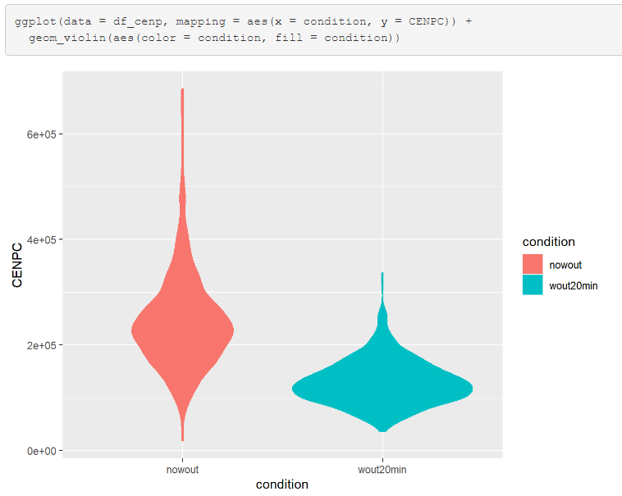
Overview of analysis: Visualizing data

Slide 11
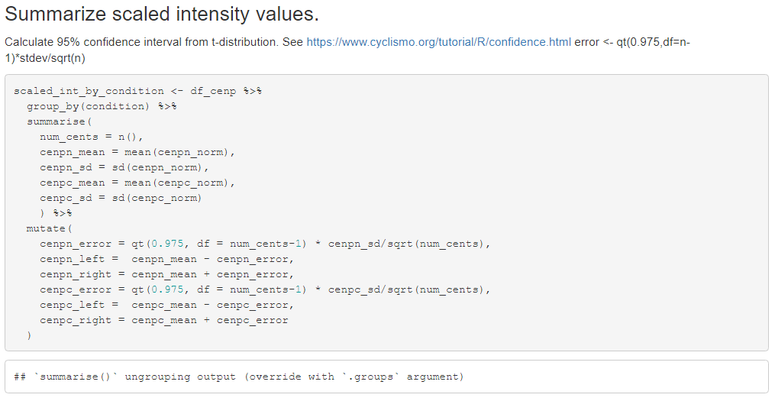
Overview of analysis: Summarizing data

Slide 12
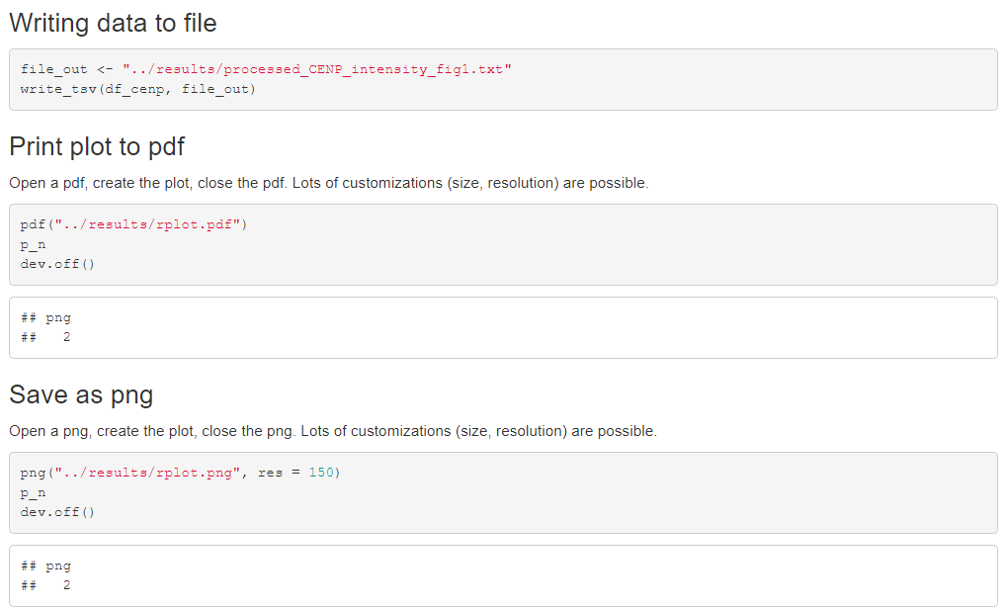
Overview of analysis: Writing data to file

Slide 13
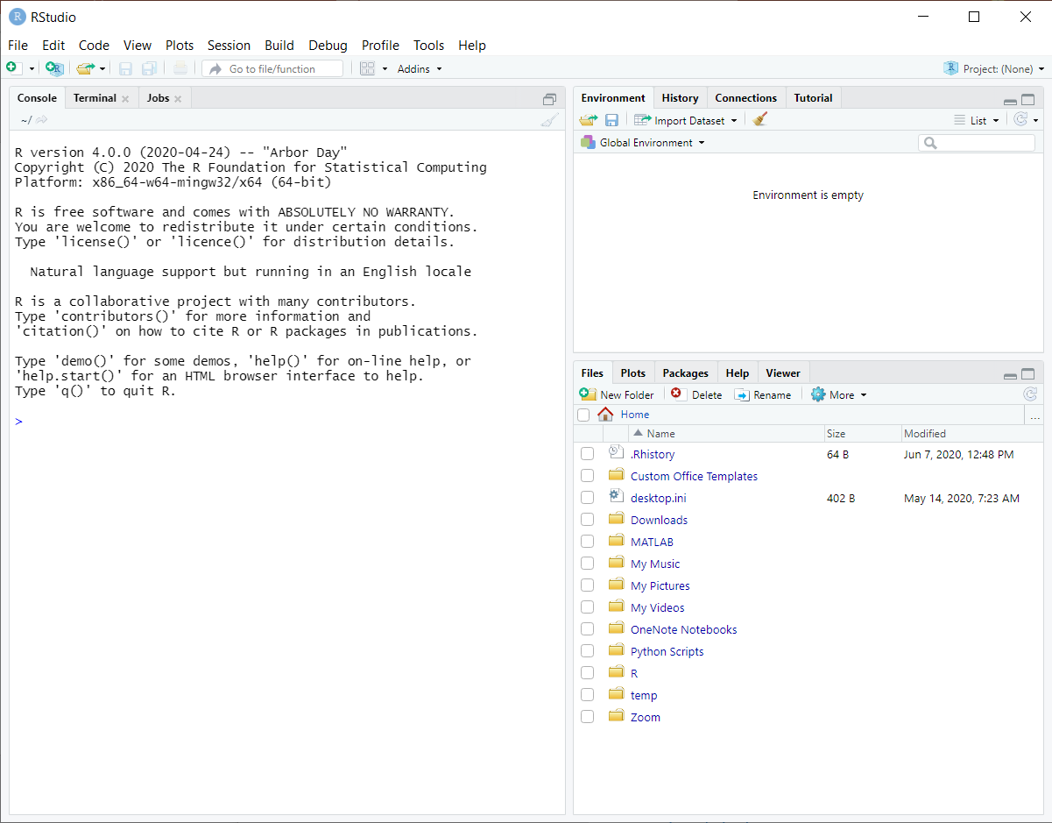
RStudio provides an interactive development environment (IDE)
Environment allows you to view your objects in your workspace
History
Type expressions directly into the Console
Files provides directory access
Plots

Slide 14
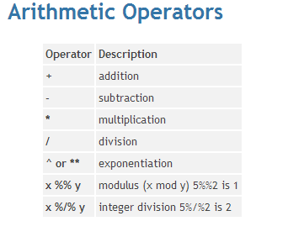
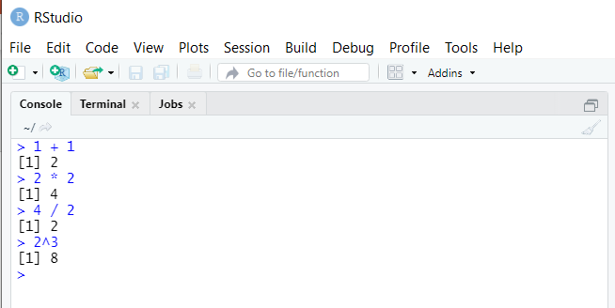
R can be used as a calculator
https://it.chass.ncsu.edu/tutorials/r-project/section2.php
Work along with the examples.
Notes:
Type directly into the console.

Slide 15
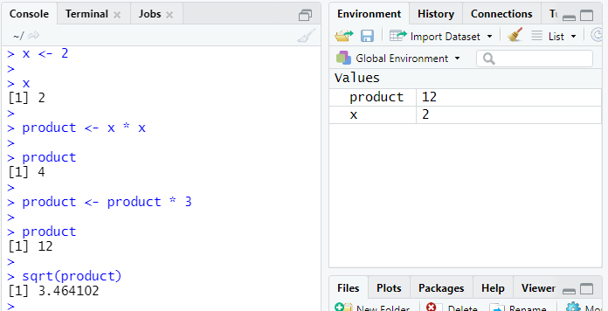
Store value using an assignment statement
Left-hand side
Variable name
x <- 2
Right-hand side
Value
< -
Assignment operator in R
Variable name on the left
Assignment does not print a value
Stored variable can be returned and used
Variable appears in Environment tab
Variables can be reassigned
Right side of assignment is fully evaluated before assignment
Notes:
It is possible to reverse the directionality of assignment, but avoid doing this yourself. Also, the “’=“ for assignment is discouraged.

Slide 16
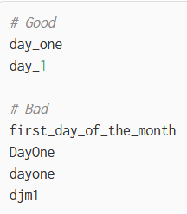
Variable naming
Rules for variable naming
Variable name must start with a letter- never a number.
You can use a combination of:
Letters
Digits
Period (.)
Underscore (_)
May not:
Contain spaces
Be a “reserved” word
Not rules, but these will make your life easier
Variable names should be concise and meaningful
R convention is to use an underscore to separate words within a name
Avoid using names of existing functions and variables
See http://adv-r.had.co.nz/Style.html
Notes:
There are additional nuances in naming that I don’t include here, such as variables can also start with a period.

Slide 17
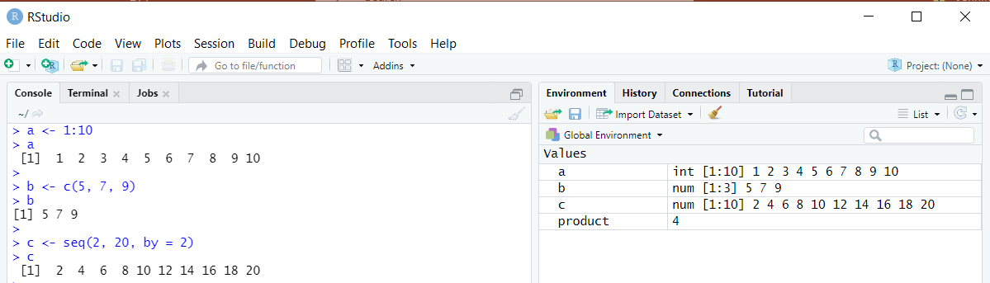
R is vectorized
R is vectorized: everything is a vector, e.g. “6” is a vector of length 1
A vector is a sequence of data elements of the same basic type.
Create vectors:
Use the colon (:) operator for consecutive numbers.
c() function creates a vector, in which all elements are the same type.
seq() function allows you to specify step size (or vector length).
Notes:
Up to now, we’ve been working with single digits. It’s good to be aware that R is built upon the concept of vectors.
For more on vectorization see
https://www.noamross.net/archives/2014-04-16-vectorization-in-r-why/

Slide 18
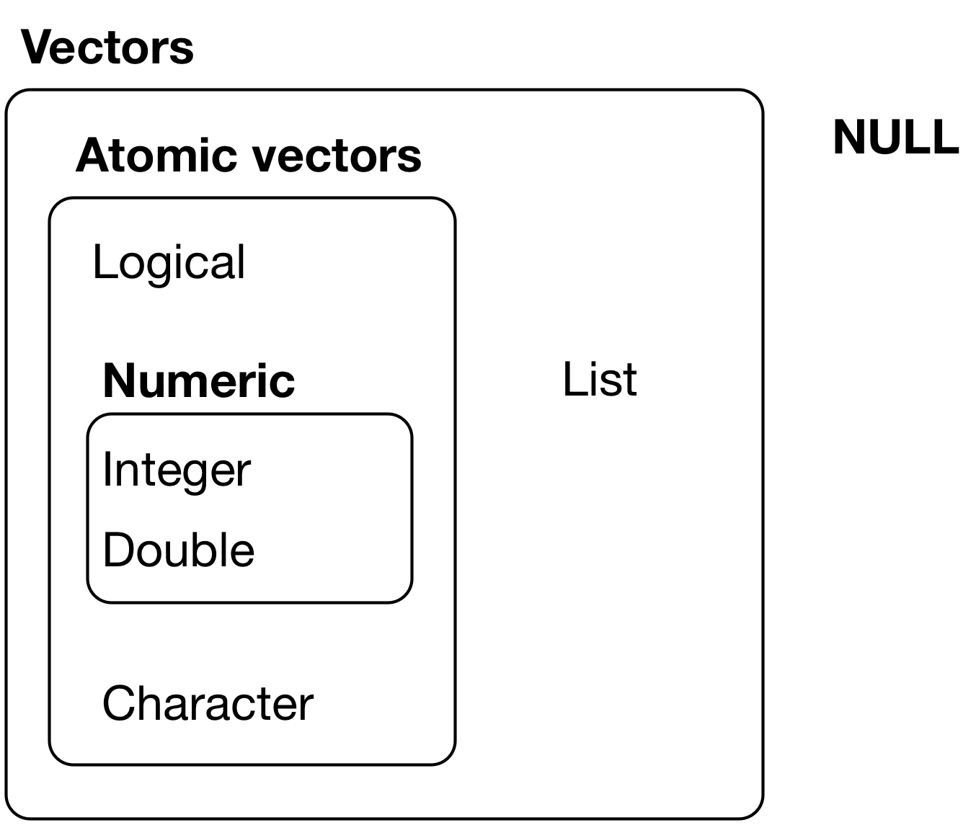
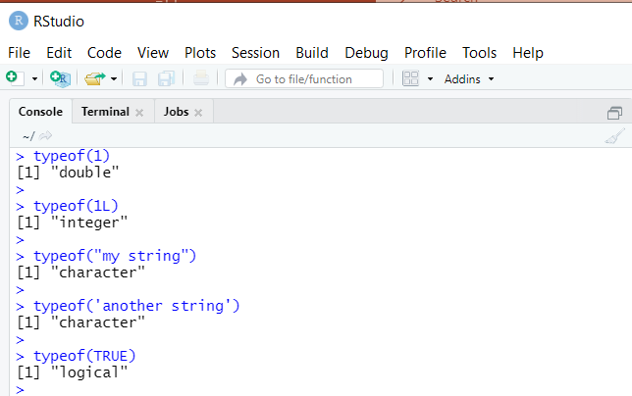
Types of vectors in R
Figure 20.1: The hierarchy of R’s vector types
https://r4ds.had.co.nz/vectors.html
Atomic vectors are homogenous
vs. lists, which can contain other lists
Notes:
R is vectorized. We’ll get more into this later.
Raw vectors store fixed-length sequences of bytes.

Slide 19
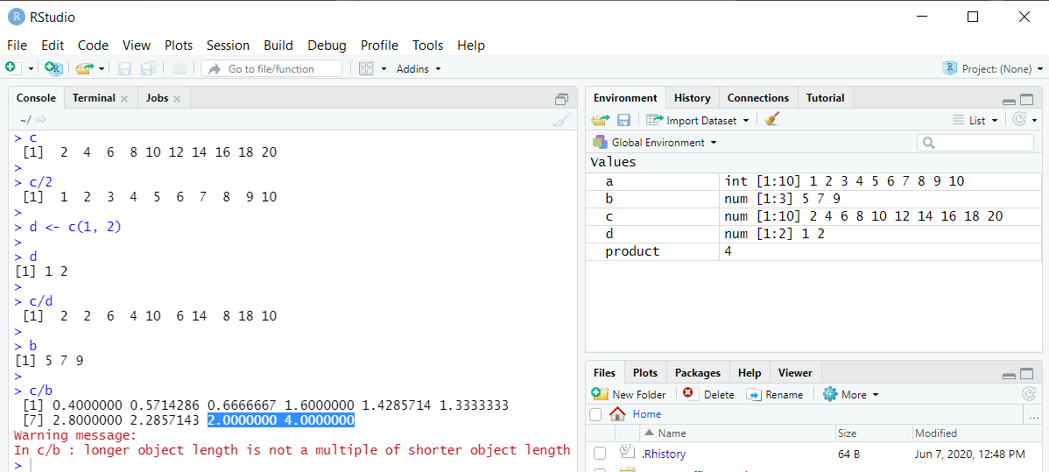
Operations on vectors- be aware of “recycling”
Notes:
Vector of length 10
Divide by vector of length 1? Divides each element of first vector by single element in second vector. Doesn’t work in all languages.
Divide by vector of length 2, vector gets “recycled” five times

Slide 20
Back to example
character vector indicating path to txt file
file_in variable is used in function call
Why bother creating a variable?
Here, maybe doesn’t matter so much, but we might want to process other files the same way. Creating a variable gives us the flexibility to do so and separates out the process of identifying the file from what action we’re performing using the file name.

Slide 21
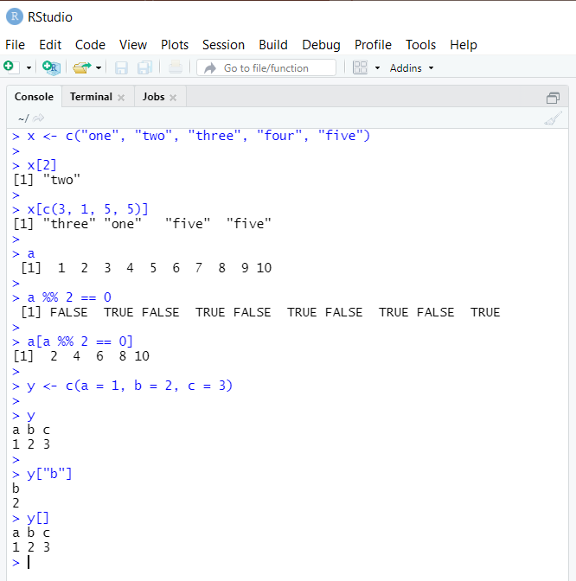
Subsetting vectors
There are four ways to access elements of a vector:
Using integers
Positive integers keeps the elements at those positions
Negative integers drops the elements
Logical indexing
Indexing by element name
Indexing by nothing, y[]
Returns entire vector
More useful in a matrix
[1, ] selects first row, all columns
[ ,-1 ] selects all rows, all columns except the first

Slide 22
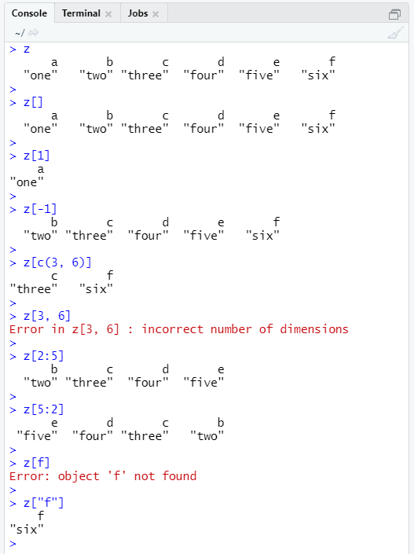
Try it out: What will this print?
“slicing”

Slide 23
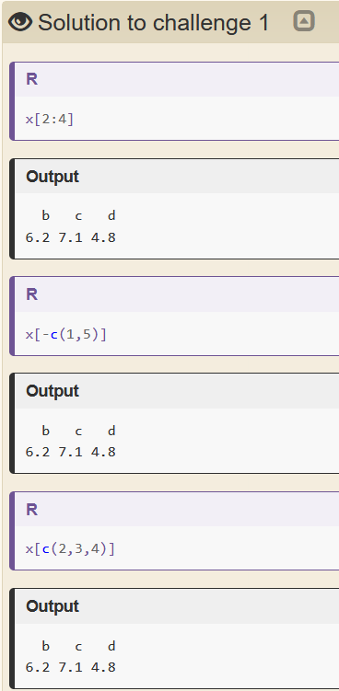
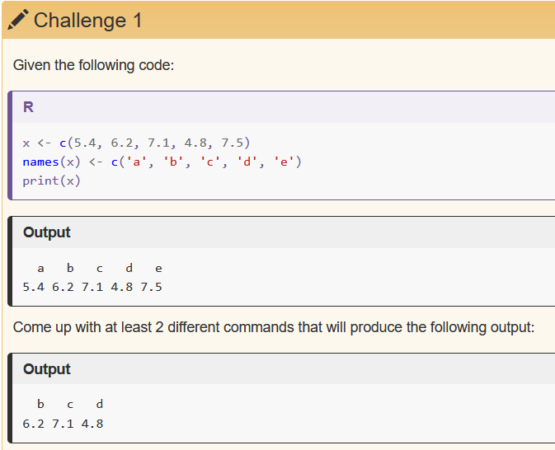
Try it out: Produce the output
http://swcarpentry.github.io/r-novice-gapminder/06-data-subsetting/index.html

Slide 24
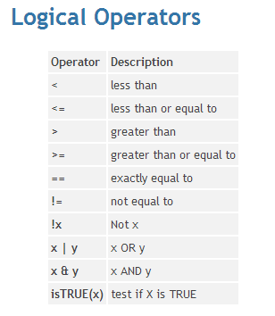
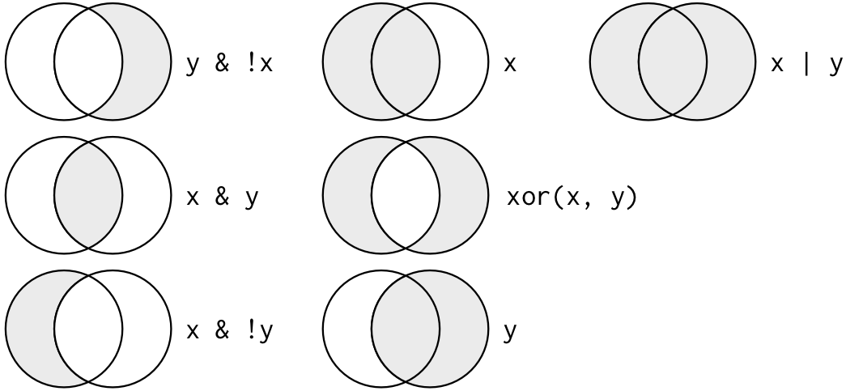
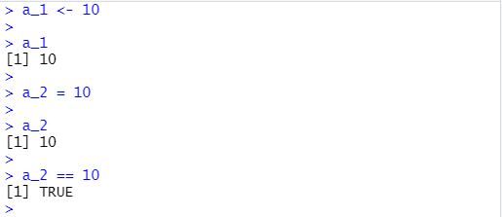
Logical operators and indexing are very useful
Watch:
“=“ and “==“ are not equivalent
https://methodenlehre.github.io/SGSCLM-R-course/the-r-language.html
https://it.chass.ncsu.edu/tutorials/r-project/section2.php

Slide 25
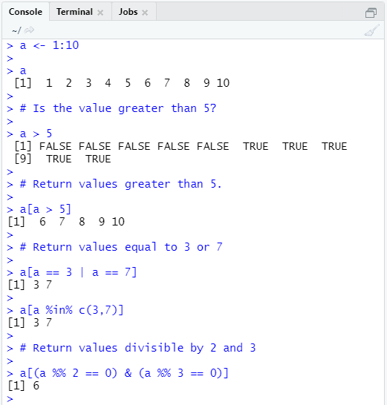
Try it out: Logical operators and indexing
Type:
help("%in%")

Slide 26
Back to example
Here, I’m using a function called summary() to summarize the data, but I only want the data associated with the “wout20min” condition.
Don’t worry about the details yet- I haven’t introduced data frames, but you might recognize the square brackets [] as subsetting.

Slide 27

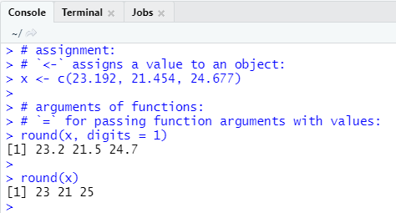
Function calls
A function allows you to perform some task without having to rewrite the code to do it.
The functions we’ve seen accept arguments and return a value.
Arguments with no default value are required.
Later we’ll talk about how and why to create our own functions.
https://methodenlehre.github.io/SGSCLM-R-course/the-r-language.html#function-calls
Notes:
You’ve already seen some functions already- sqrt(), c(), seq(), summary()

Slide 28
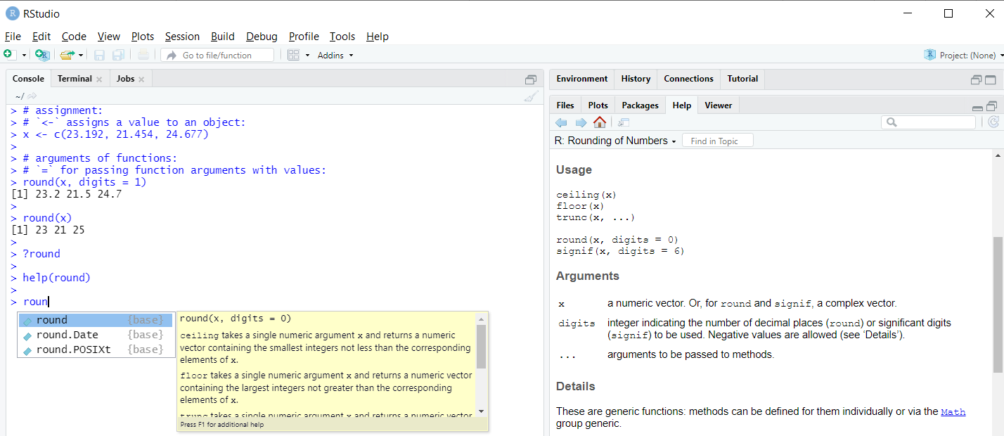
Getting help

Slide 29
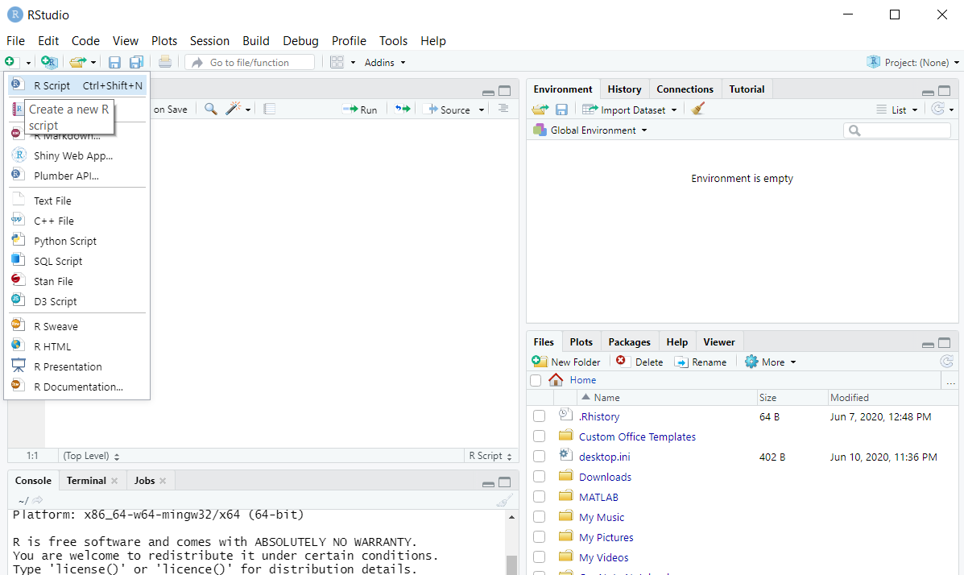
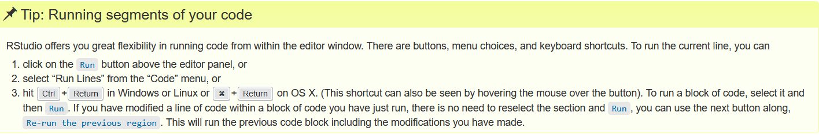
RStudio Editor panel
Code Editor allows you to save and edit your code.
http://swcarpentry.github.io/r-novice-gapminder/01-rstudio-intro/index.html
Notes:
Let’s create a new R script now.

Slide 30
Work through introductory R script

Slide 31
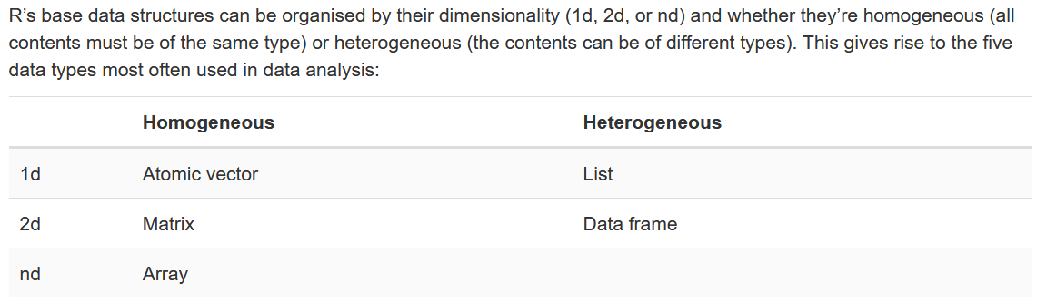
Data structures in R
http://adv-r.had.co.nz/Data-structures.html
Notes:
We’ve already seen atomic vectors for homogenous data types.
For the remainder of the workshop, I’ll focus on data frames that allow us to work with heterogenous data.

Slide 32
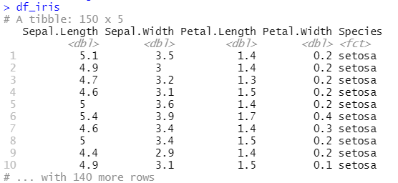
The “tibble” data frame
Each column has a name and type.
Each row contains one set of values from each column.
Use the $ operator to extract a column.
Useful functions for understanding data frame structure: str(), colnames(), nrow(), ncol(), dim()
summary()
For more information, type:
vignette("tibble")
Notes:
In particular, we’ll be using a specific data frame called a “tibble”. Compared with older data.frame:
It never changes an input’s type.
It never adjusts the names of variables.
It evaluates its arguments lazily and sequentially. And more

Slide 33
Next week
Directories and files: reading in/writing out
Is there a tab-delimited or csv file you’d like to work with?
Using “verbs” to manipulate data frames
Piping
Creating visualizations in ggplot2

