Slide 1

Caching
OPTIMIZING PERFORMANCE
Sergei, Jungwoo

Slide 2
Part 1
Core Concepts & Foundations of Caching

Slide 3
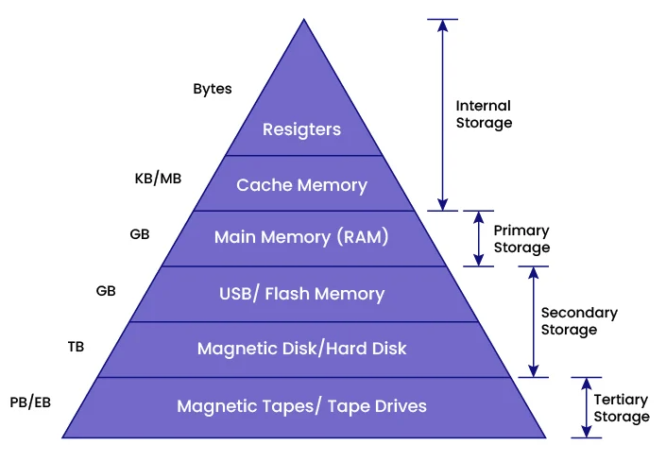

Understanding the Hierarchy
The Cost of Distance
L1/L2 Cache: Hardware level, sub-nanosecond access.
Main Memory (RAM): Primary application workspace (~100ns).
File System/Disk: Persistent storage, high latency (ms).
Network/DB: The ultimate bottleneck in modern apps.

Slide 4






The Economics of Speed
Latency Reduction
Throughput
Consistency Risk
Eliminating round-trips to slow data sources for near-instant responses.
Allowing systems to handle 10x higher load by serving from memory.
The primary trade-off: Dealing with stale data and invalidation logic.

Slide 5
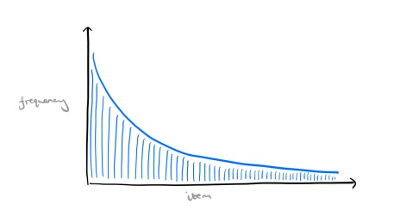
The Long Tail Rule
Most traffic volume comes from a small set of "Head" items. Caching is designed to capture this niche to maximize performance.
Frequency
80/20 Pareto Principle: 80% of requests hit 20% of the dataset.
Efficiency: Caching the "Head" reduces origin server load by orders of magnitude.
Item
Notes:
https://blog.acolyer.org/2018/10/26/robinhood-tail-latency-aware-caching-dynamic-reallocation-from-cache-rich-to-cache-poor/

Slide 6
Part 2
Application-Level Java Caching

Slide 7
Local vs. Distributed Caching
Local cache (Caffeine, Ehcache)
Distributed cache (Redis, Hazelcast)
Ultra-fast RAM access.
Shared across all server nodes.
Within the same JVM.
Persistence and large datasets.
No network latency.
Consistency across instances.
Rule of thumb: Start with a local cache. Add Redis only when you have multiple nodes or need persistence

Slide 8



Eviction Strategy Framework
LRU
LFU
W-TinyLFU
Least Recently Used: evicts data not accessed for the longest time.
Least Frequently Used: evicts data with the fewest accesses.
Caffeine’s Default: combines recency (LRU) and frequency (LFU) for near-optimal hits.

Slide 9
DEMO 1:

Slide 10

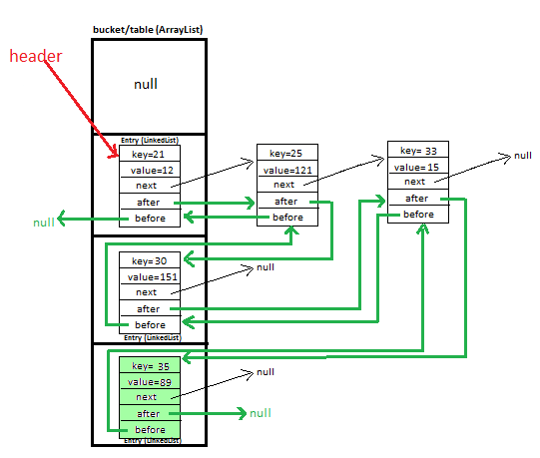

Manual LRU with LinkedHashMap

Slide 12
Limitations of Manual LRU
✅ Good for learning, small caches (up to thousands of entries)
❌ Not thread‑safe – will break in concurrent applications
❌ No time‑based expiration (TTL)
❌ No statistics (hit rate, eviction count)
❌ No protection against cache stampede (many threads loading same missing key)
❌ Manual memory management

Slide 13
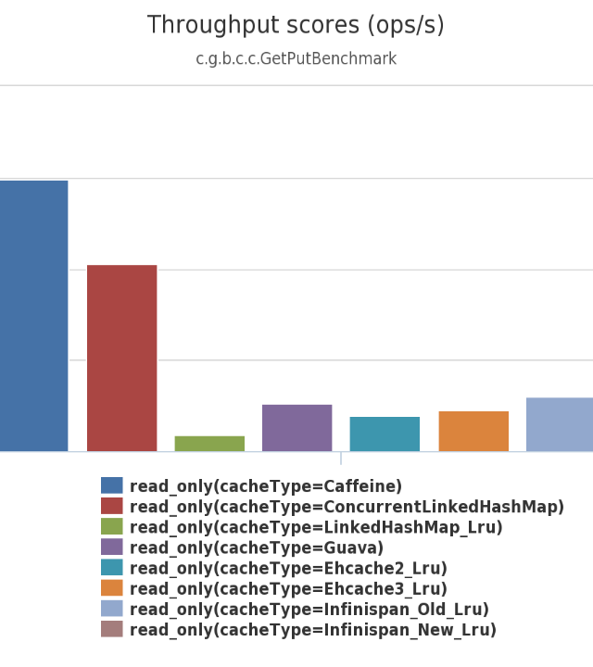
Production Standard: Caffeine
Caffeine is the go-to in-memory cache for high-scale Java systems (Spring Boot, Netflix, Uber).
Key features:
Thread‑safe (lock‑free reads)
W‑TinyLFU eviction (higher hit rate than LRU/LFU)
Time‑based expiration (expireAfterWrite, expireAfterAccess)
Statistics (recordStats())
Atomic get(key, loader) – prevents stampede
Benchmark: Caffeine is significantly faster than ConcurrentHashMap‑based caches for read‑heavy workloads.

Slide 14



The Cache Stampede Crisis
100x
Thread 1
Thread 2
Thread 3
…
Thread 100
Problem
Result
A popular cache entry expires (or is missing). Hundreds of concurrent threads all miss at the same time.
All 100 threads hit the database / slow origin → overload, degraded performance, even cascading failure.

Slide 15
Solution: Atomic Get-or-Load
Caffeine’s cache.get(k, k -> loadFromDB(k)) is atomic
How it works:
Thread A checks cache → miss → starts loading (computes value)
Threads B, C, D … also call get for same missing key
Caffeine makes them wait for Thread A’s result
After Thread A stores the value, all waiting threads receive it instantly
Result: Only one database call – not 100
No manual locking: Caffeine handles it internally

Slide 16
DEMO 2:

Slide 17


Caffeine vs Redis
Speed | Microseconds (no network) | Milliseconds
Data Sharing | Single JVM only | Across all servers
Persistence | None (in‑memory) | Yes (RDB/AOF)
Consistency | Strong (within one node) | Eventual / configurable
Use Case | High‑throughput local cache | Shared session store, rate limiting, cross‑node coordination

Slide 18
Summary: Choosing the Right Caching Strategy
REQUIREMENT | STRATEGY
Learning / tiny internal cache | LinkedHashMap with LRU (manual)
Production local cache (single JVM, high concurrency | Caffeine
Need disk persistence | Ehcache
Share cache across multiple servers | Redis (or Hazelcast)
Spring Boot convenience | @Cacheable + Caffeine backend

Slide 19
Questions?
Thank you for your attention.

Slide 20





Image Sources
https://miro.medium.com/v2/resize:fit:1400/1*_tZhIBbU3uMguaNyH9kBtg.png
Source: medium.com
https://miro.medium.com/1*9V4i7s4ZxFHMxylZdd6KQg.png
Source: medium.com
https://miro.medium.com/v2/resize:fit:600/1*zyaAeuPt40T2NTcJYZ4JvA.png
Source: medium.com
https://miro.medium.com/v2/resize:fit:1400/1*-ecZ7cQQ8qsPTkr0s1cbVA.png
Source: miladezzat.medium.com
https://lh3.googleusercontent.com/3XvW7TdxE6c5CNBYvfhOm4968exmDoDpgSR-FiG5uDvBM5bcxJ7aObCe6BUXH9OganwLZlt8XU5h3m9Lfj3Q_hddROmUgk9ko1FxVYcqbSJplAHewZCcg5fUAIPxozyJaJWx1Io
Source: www.javamadesoeasy.com
https://raw.githubusercontent.com/ben-manes/caffeine/master/wiki/throughput/read.png
Source: github.com

